Slide 1
Ethernet 802.3 LANs
Chapter 5
Panko and Panko
Business Data Networks and Security
Copyright © 2015 Pearson Education, Inc.

Slide 2
Ethernet Begins
Introduction
Physical Layer Standards
Data Link Layer Standards
Advanced Switch Operation
Ethernet Security

Slide 3
Bob Metcalfe
Working on his PhD at MIT
Hit a snag, but the Xerox Palo Alto Research Center still hired him
First visited the University of Hawaii’s ALOHANET packet radio project
Developed a way to make it more efficient
Applied it to a cabled network, called it Ethernet as a joke
Eventually commercialized it

Slide 4
Ethernet Begins
Introduction
Physical Layer Standards
Data Link Layer Standards
Advanced Switch Operation
Ethernet Security

Slide 5
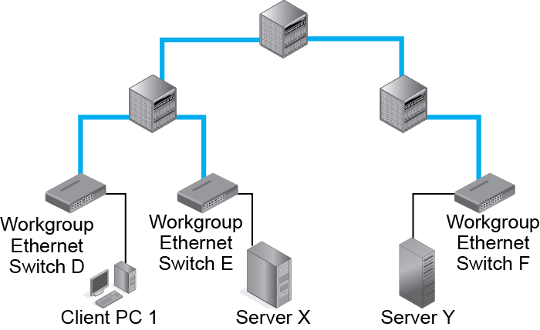
5.1 Simple Switched Ethernet Network
Workgroup Switches Connect
Hosts to the Network

Slide 6
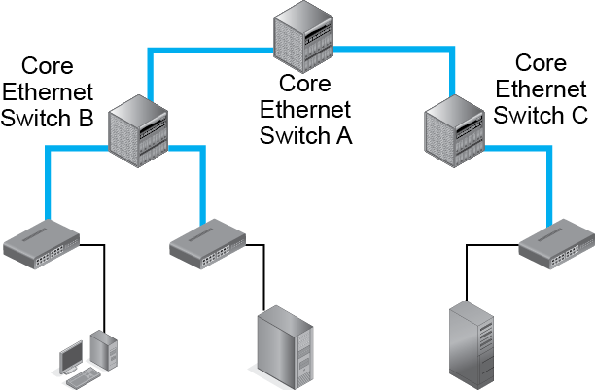
5.1 Simple Switched Ethernet Network
Core Switches Connect Switches to Other Switches

Slide 7
5.2 Ethernet Workgroup Switch with 48 Ports
Hosts Normally Connect to Workgroup Switches Through UTP Copper Wiring

Slide 8
5.2 Ethernet Workgroup Switch with 48 Ports
Switches Often Connect to Other Switches Through Optical Fiber

Slide 9
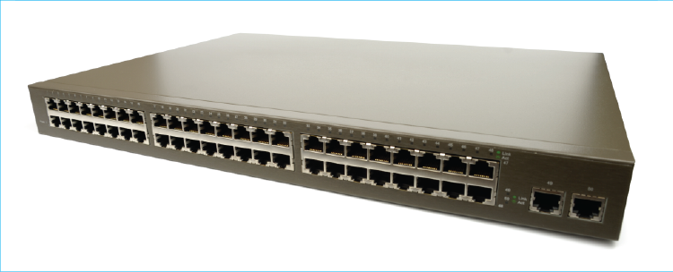
5.2 Ethernet Workgroup Switch with 48 Ports
19 inches
48 cm

Slide 10
Ethernet Begins
Introduction
Physical Layer Standards
Data Link Layer Standards
Advanced Switch Operation
Ethernet Security

Slide 11
5.3 UTP versus Optical Fiber
Characteristic | Unshielded Twisted Pair | Optical Fiber
Medium | Copper wire | Glass
Signal | Electrical | Light
Maximum Distance in LANs | Usually 100 m | For LANs, usually 200 to 500 m
Speed | Similar | Similar
Cost | Lower | Higher

Slide 12
5.4 IEEE LAN/MAN Standards Committee
IEEE Standards Association
  802 LAN/MAN Standards Committee
    802.1 Working Group
    Standards used by multiple working groups
    Security Standards
    802.3 Working Group
    Ethernet standards
    802.11 Working Group
    Wi-Fi wireless LAN standards

Slide 13
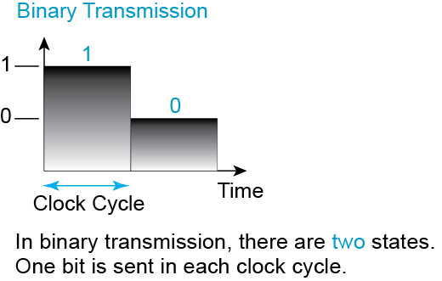
5.6 Binary and Digital Signaling

Slide 14
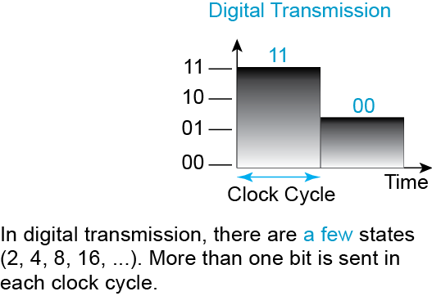
5.6 Binary and Digital Signaling

Slide 15
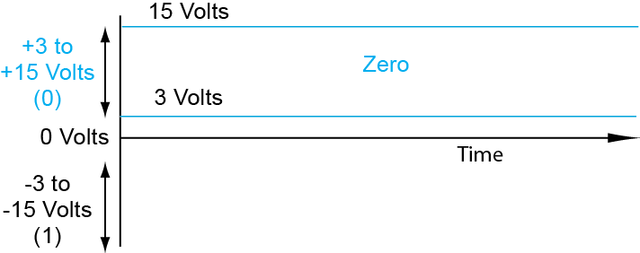
5.7 Error Resistance in Binary and Digital Signaling

Slide 16
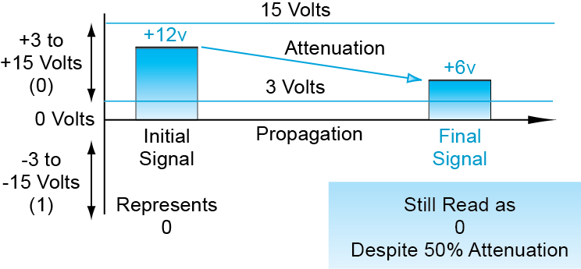
5.7 Error Resistance in Binary and Digital Signaling

Slide 17
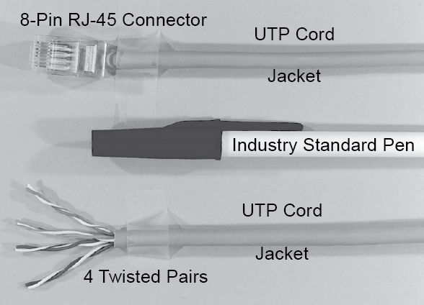
5.8 Four-Pair Unshielded Twisted Pair Copper Wiring

Slide 18
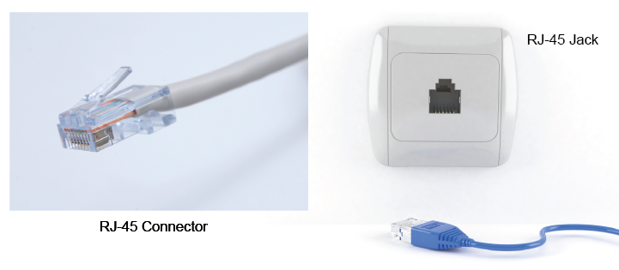
5.9 RJ-45 (Ethernet) Connector and Jack
RJ-45 Jack
RJ-45 Connector

Slide 19
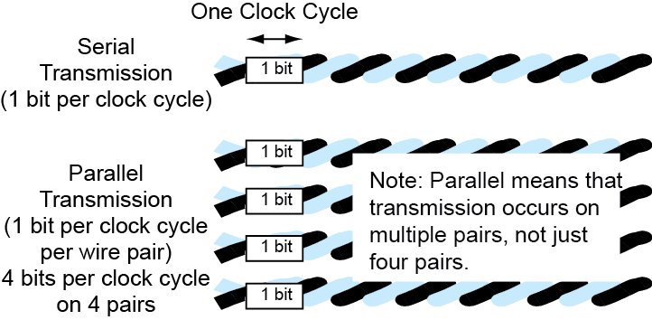
5.10 Serial versus Parallel Transmission
NOT just 4 pairs!

Slide 20
5.11 UTP Quality Category, Transmission Speed, and Maximum Distance
Ethernet Signaling Standard | Transmission Speed | UTP Quality Category | Maximum Cord Length
100BASE-TX | 100 Mbps | Category 5e, 6, or higher | 100 meters
1000BASE-T | 1 Gbps | Category 5e, 6, or higher | 100 meters
10GBASE-T | 10 Gbps | Category 6 | 55 meters
10GBASE-T | 10 Gbps | Category 6A | 100 meters
Category is a measure of UTP QUALITY

Slide 21
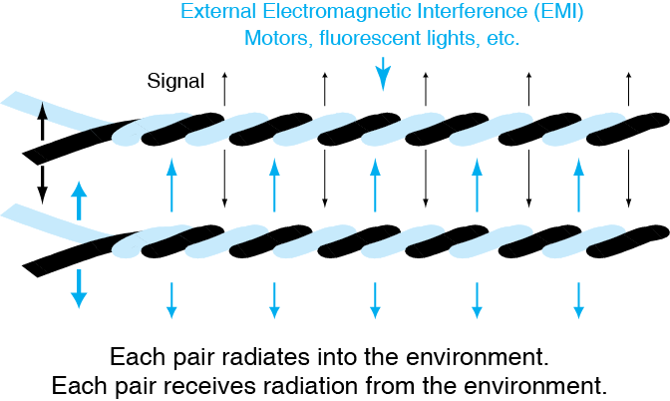
5.12 Terminal Crosstalk Interference

Slide 22
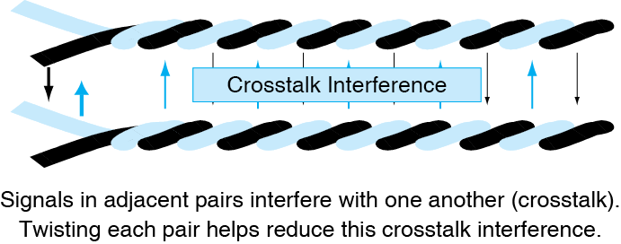
5.12 Terminal Crosstalk Interference

Slide 23
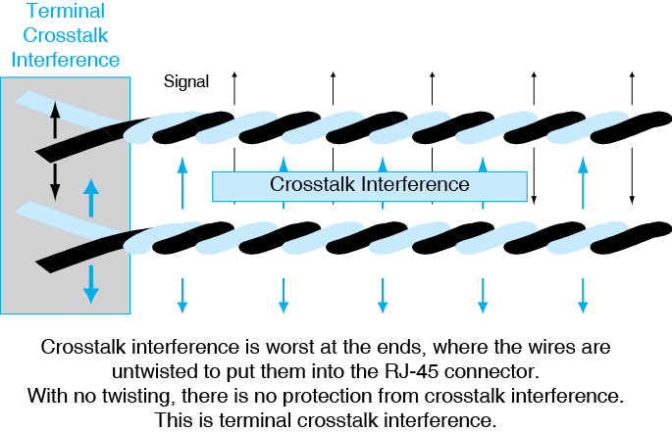
5.12 Terminal Crosstalk Interference

Slide 24
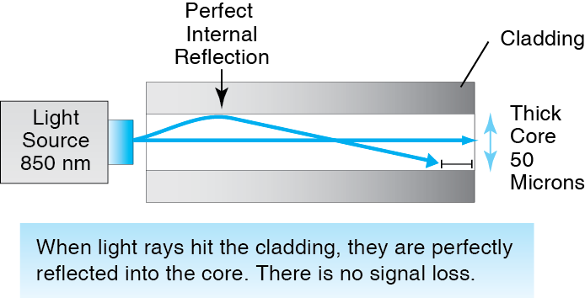
5.13 Optical Fiber Transmission

Slide 25
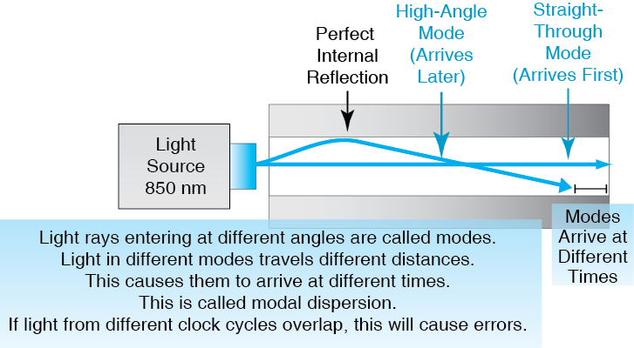
5.13 Optical Fiber Transmission

Slide 26
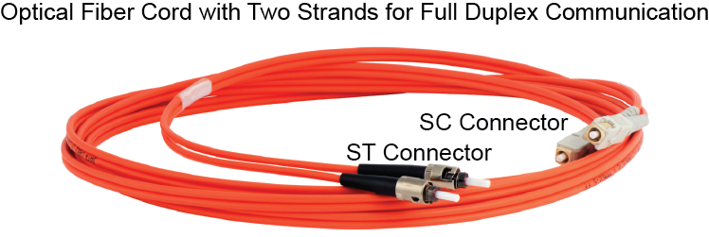
5.14 Optical Fiber Cord

Slide 27
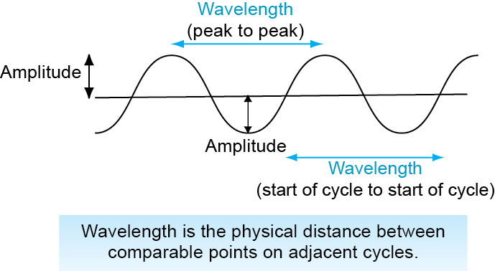
5.15 Light Amplitude and Wavelength

Slide 28
5.16 Optical Fiber Quality Designations and Transmission Distance
ISO 11801 Standard | Minimum Modal Bandwidth (MHz*km) at 850 nm | Maximum Distance at 1 Gbps, 850 nm light (1000BASE-SX) | Maximum Distance at 10 Gbp, 850 nm light (10GBASE-SR) | Maximum Distance at 100 Gbps, 850 nm light
OM3 | 2,000 | 550 m | 300 m | 100 m
OM4 | 4,700 | 1,000 m | 440 m | 150 m
OM stands for Optical Multimode; a standard for multimode fiber.

Slide 29
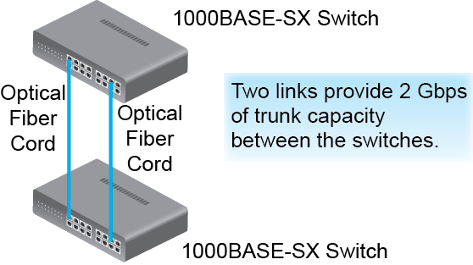
5.17 Link Aggregation (Bonding)

Slide 30
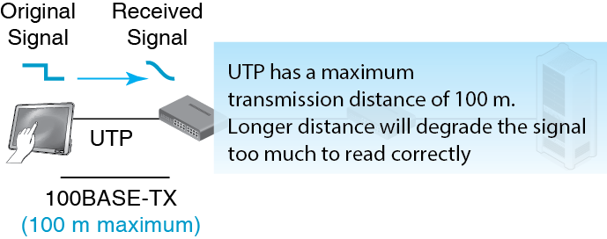
5.18 Ethernet Physical Link Maximums and Unlimited Data Link Distances

Slide 31
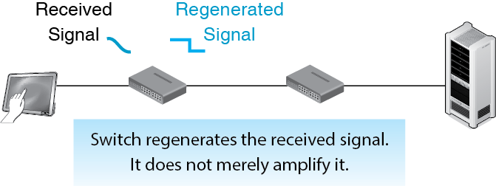
5.18 Ethernet Physical Link Maximums and Unlimited Data Link Distances

Slide 32
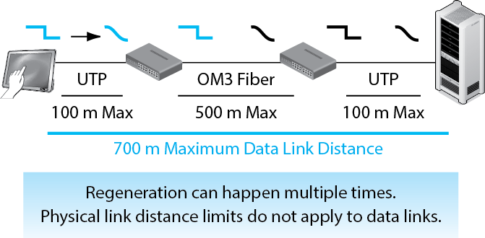
5.18 Ethernet Physical Link Maximums and Unlimited Data Link Distances

Slide 33
Ethernet Begins
Introduction
Physical Layer Standards
Data Link Layer Standards
Advanced Switch Operation
Ethernet Security

Slide 34
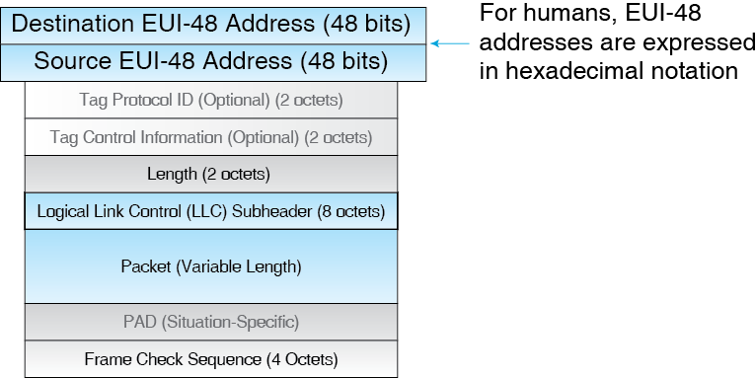
5.19 Ethernet 802.3 Frame

Slide 35
5.20 Hexadecimal Notation
4 Bits | Decimal (Base 10) | Hexadecimal (Base 16)
0000 | 0 | 0 hex
0001 | 1 | 1 hex
0010 | 2 | 2 hex
0011 | 3 | 3 hex
0100 | 4 | 4 hex
0101 | 5 | 5 hex
0110 | 6 | 6 hex
0111 | 7 | 7 hex
What is 0101 in hex?
What is 0000 in hex?

Slide 36
5.20 Hexadecimal Notation
4 Bits* | Decimal (Base 10) | Hexadecimal (Base 16)
1000 | 8 | 8 hex
1001 | 9 | 9 hex
1010 | 10 | A hex
1011 | 11 | B hex
1100 | 12 | C hex
1101 | 13 | D hex
1110 | 14 | E hex
1111 | 15 | F hex
What is 1001 in hex?
What is 1111 in hex?

Slide 37
5.20 Hexadecimal Notation
Converting a 48-bit MAC address to hex
  Write down the 48-bit address in 12 four-bit nibbles.
  Represent each nibble as a hex symbol.
  Pair the hex symbols and put a dash between the 6 pairs.
  Try these four nibbles: 0000111101011010

Slide 38
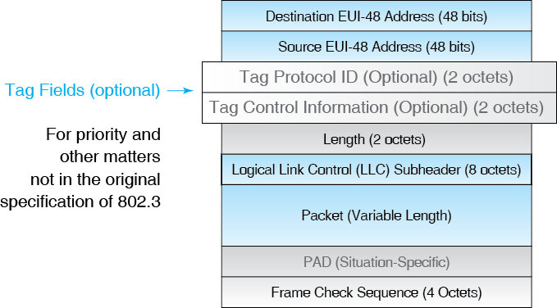
5.19 Ethernet 802.3 Frame

Slide 39
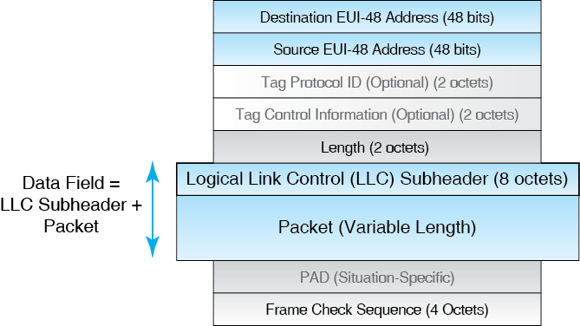
5.19 Ethernet 802.3 Frame

Slide 40
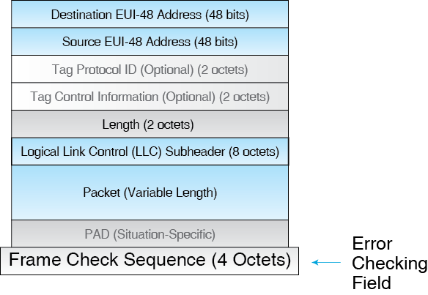
5.19 Ethernet 802.3 Frame

Slide 41
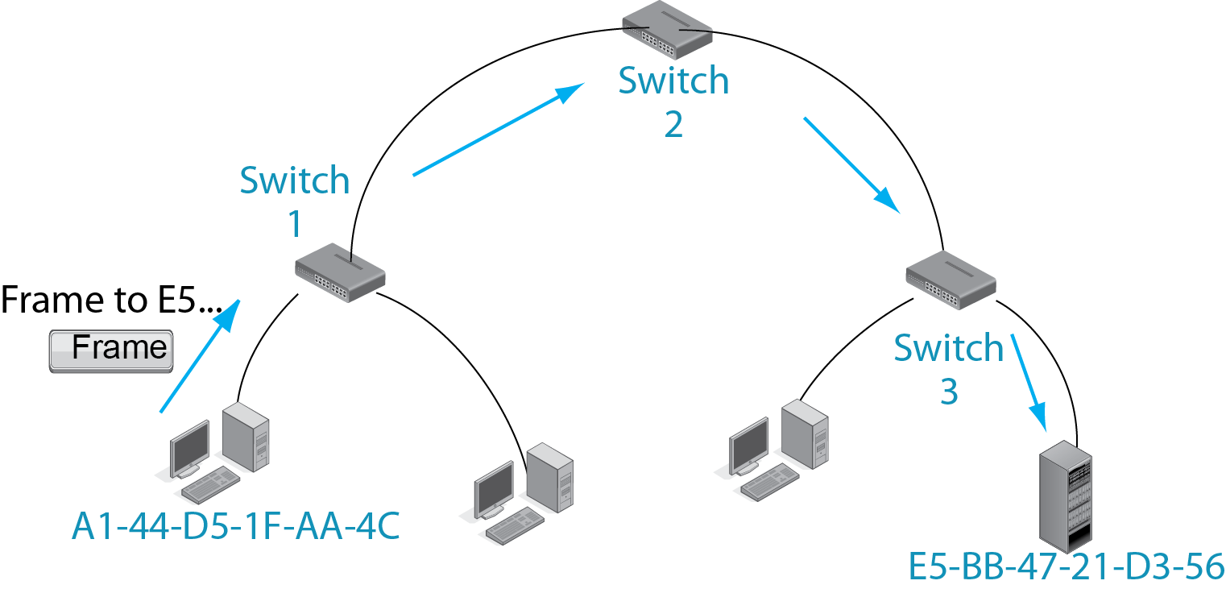
5.21 Multi-Switch Ethernet Operation
A packet from A1… to E5… must pass through Switches 1, 2, and 3.

Slide 42
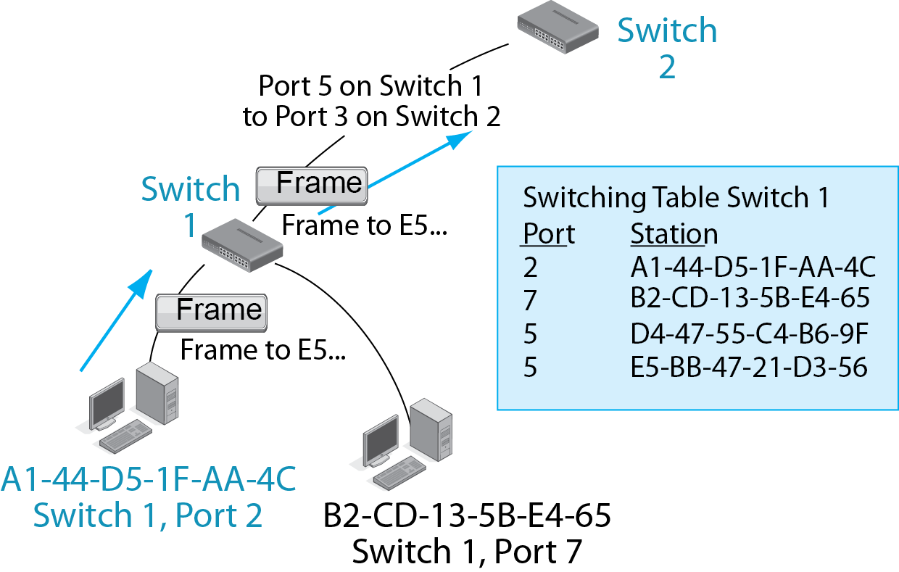
5.21 Multi-Switch Ethernet Operation
Switch 1 sees that it should send the frame to E5 out Port 5.

Slide 43
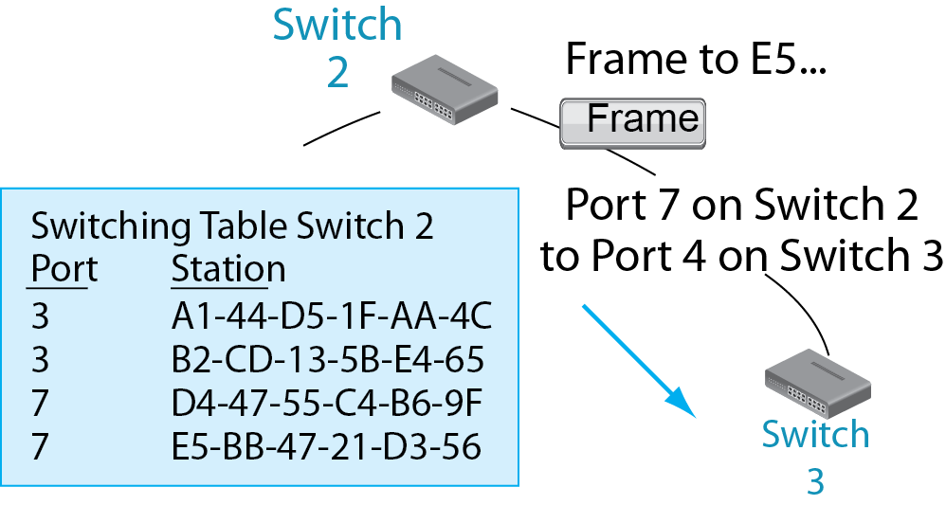
5.21 Multi-Switch Ethernet Operation
Switch 2 sees that it should send the frame to E5 out Port 7.

Slide 44
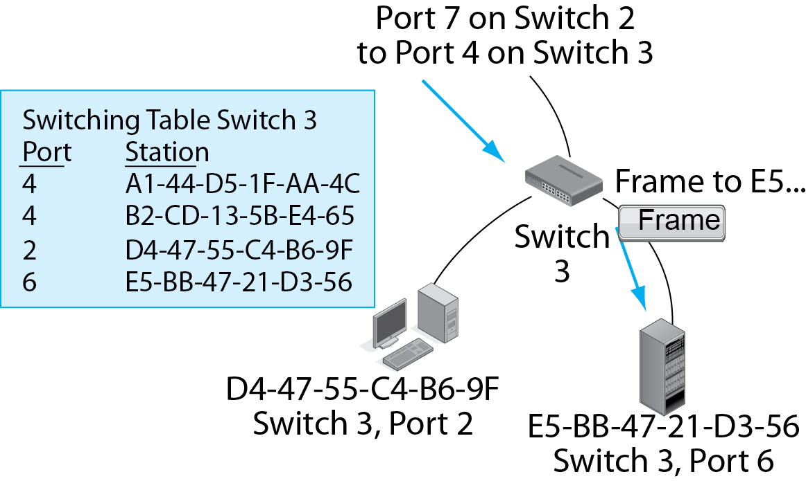
5.21 Multi-Switch Ethernet Operation
Switch 3 sees that it should send the frame to E5 out Port 6.

Slide 45
Ethernet Begins
Introduction
Physical Layer Standards
Data Link Layer Standards
Advanced Switch Operation
Ethernet Security

Slide 46
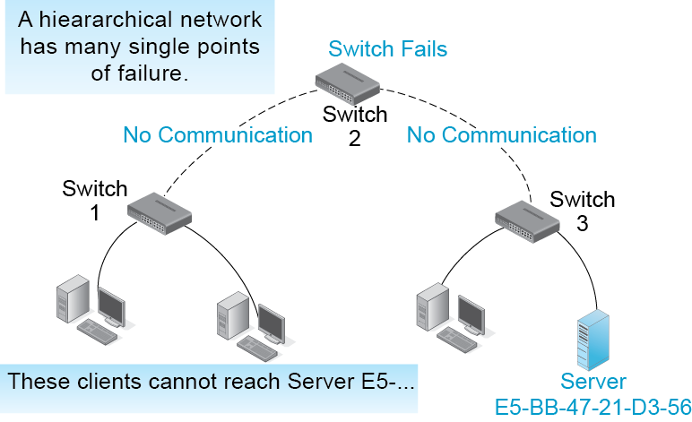
5.22 Single Point of Failure

Slide 47
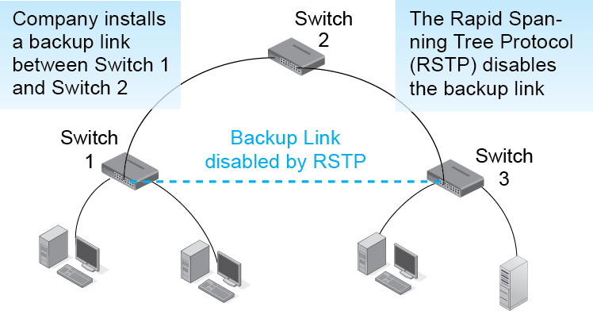
5.23 Backup Link and the Rapid Spanning Tree Protocol
Loops are not allowed in Ethernet.
A strict hierarchy is required.

Slide 48
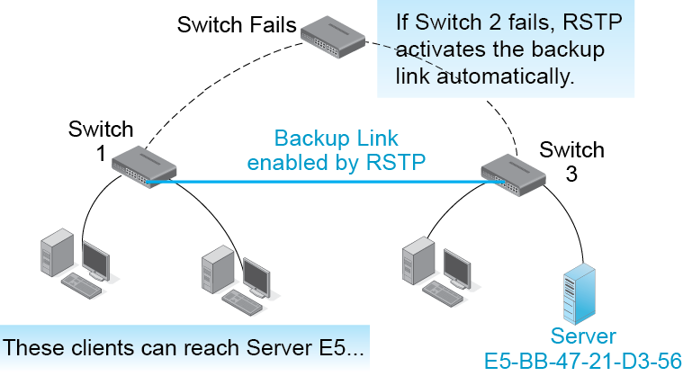
5.23 Backup Link and the Rapid Spanning Tree Protocol

Slide 49
5.24 Advanced Ethernet Capabilities
Priority
  Ethernet switches can provide up to eight priority levels
Manageability
  Manageable switches can be managed by SNMP
  Although manageable switches cost much more than non-manageable switches, this is more than made up for by lower management costs
  Software-defined networking may bring a revolution in switch management

Slide 50
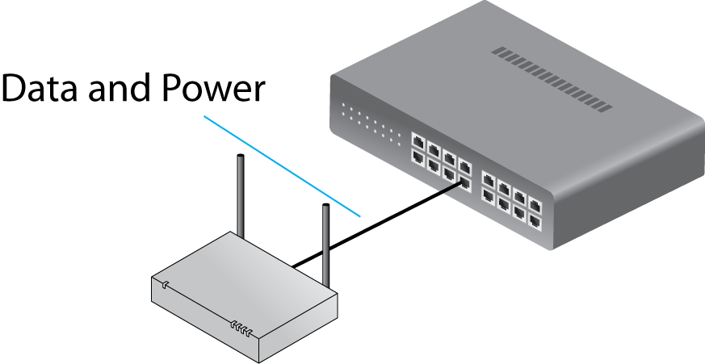
5.24 Advanced Ethernet Capabilities
Power over Ethernet (POE)
  Switches can supply power to devices via UTP.
  (Wired telephone systems and USB ports already do this.)
  Less expensive than
  supplying power
  separately.

Slide 51
5.24 Advanced Ethernet Capabilities
Power Over Ethernet (POE) Plus
  USB ports provide both data transmission and power to hosts
  Switches implementing POE Plus can provide up to 25 watts of power over UTP to hosts
  This is sufficient for voice over IP phones, surveillance cameras, and most access points
  This saves money because there is no need to install power lines to these devices
  Not sufficient for desktop or laptop PCs

Slide 52
Ethernet Begins
Introduction
Physical Layer Standards
Data Link Layer Standards
Advanced Switch Operation
Ethernet Security

Slide 53
5.25 802.1X Port-Based Access Control on an Ethernet Switch
The Problem
  Anyone can enter the building and plug their computer into a switch or into a wall RJ-45 port, which connects to a switch.
  This usually gives the attacker access to the network without going through a firewall.

Slide 54
5.25 802.1X Port-Based Access Control on an Ethernet Switch
Solution: access control at switch ports.
  802.1X Port Based Access Control can do this.
  Created by the 802.1 WG, not the 802.3 WG.
  802.1 WG creates general standards, such as security standards.

Slide 55
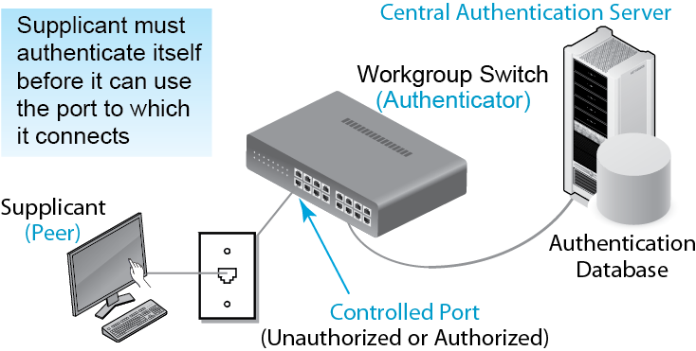
5.25 802.1X Port-Based Access Control on an Ethernet Switch

Slide 56
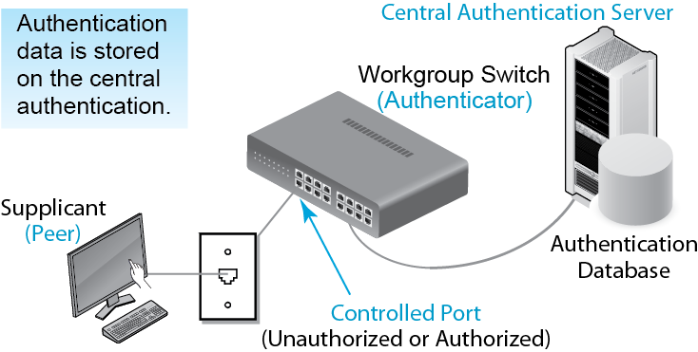
5.25 802.1X Port-Based Access Control on an Ethernet Switch

Slide 57
5.25 802.1X Port-Based Access Control on an Ethernet Switch
Advantages of a Central Authentication Server
  Consistency: Attacker cannot find a misconfigured switch.
  Rapid changes: When someone leaves, is hired, or needs credential changes.
  Switch cost: Authentication server does heavy work.
  Reduced management cost: Only one authentication database to maintain.

Slide 58
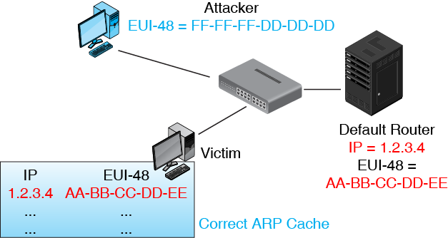
5.26 Man in the Middle Attack in an Ethernet LAN Using ARP Poisoning
ARP Cache tells a host where to send a frame to reach a
particular IP address

Slide 59
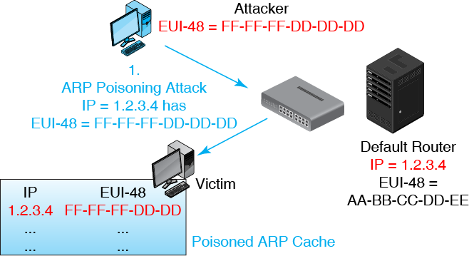
5.26 Man in the Middle Attack in an Ethernet LAN Using ARP Poisoning

Slide 60
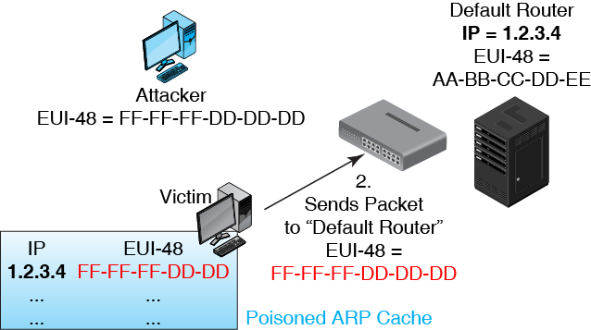
5.26 Man in the Middle Attack in an Ethernet LAN Using ARP Poisoning

Slide 61
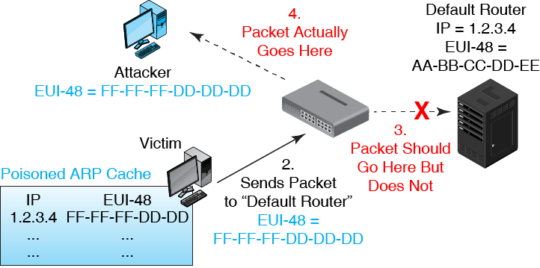
5.26 Man in the Middle Attack in an Ethernet LAN Using ARP Poisoning

