Slide 1
Wireless LANs I
Chapter 6
Panko and Panko
Business Data Networks and Security
Copyright © 2015 Pearson Education, Inc.

Slide 2
Introduction
Radio Signal Propagation
Radio Bands and Bandwidth
Spread Spectrum Transmission
802.11 WLAN Operation
802.11 Transmission Standards
Wireless Mesh Networking

Slide 3
6.1 802.11/Wi-Fi WLAN Technology
Ethernet 802.3 LANs
  Require standards at Layer 1 (physical) and Layer 2 (data link)
  Therefore, use OSI standards
  The 802.3 Working Group of the IEEE 802 Committee creates standards

Slide 4
6.1 802.11/Wi-Fi WLAN Technology
Wireless LANs
  Operate at Layers 1 and 2
  OSI dominates at Layers 1 and 2
  Therefore, they are OSI standards

Slide 5
6.1 802.11/Wi-Fi WLAN Technology
802.11 Wireless LAN Technology
  The dominant WLAN technology today
  Standardized by the 802.11 Working Group of the IEEE 802 Committee

Slide 6

6.1 802.11/Wi-Fi WLAN Technology
Wi-Fi Alliance
  Industry association of 802.11 equipment manufacturers
    802.11 standards have many options
    Wi-Fi Alliance selects subsets of standards as profiles
    Does interoperability testing on these profiles
    Only products that pass can display the Wi-Fi logo

Slide 7

6.1 802.11/Wi-Fi WLAN Technology
Wi-Fi Alliance
  However, sometimes develops new standards
    Two have been security nightmares
    WPA
    WPS

Slide 8
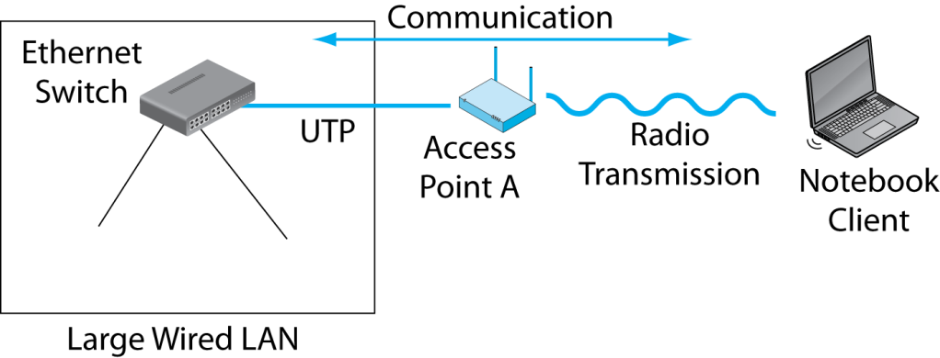
6.2 Hybrid Switched/Wireless 802.11 Network
The wireless access point connects the
wireless client to the wired Ethernet LAN.

Slide 9
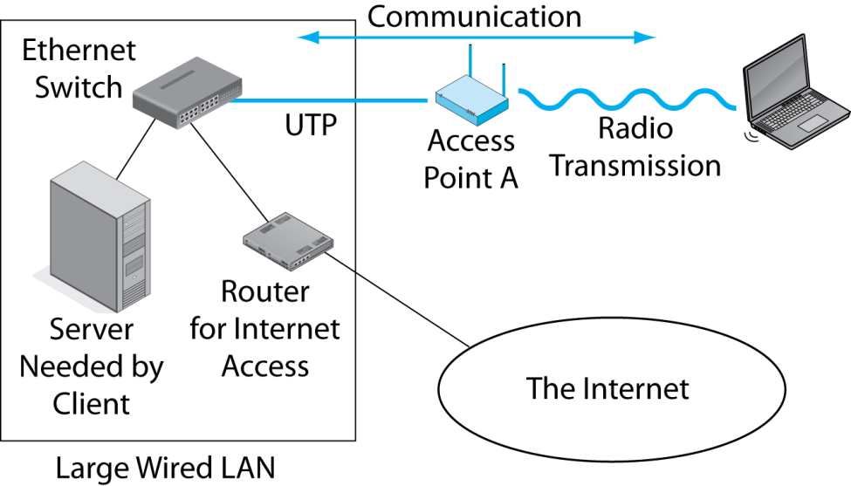
6.2 Hybrid Switched/Wireless 802.11 Network
The LAN connection is needed to give clients access to servers and Internet access routers on the wired LAN.

Slide 10
Introduction
Radio Signal Propagation
Radio Bands and Bandwidth
Spread Spectrum Transmission
802.11 WLAN Operation
802.11 Transmission Standards
Wireless Mesh Networking

Slide 11
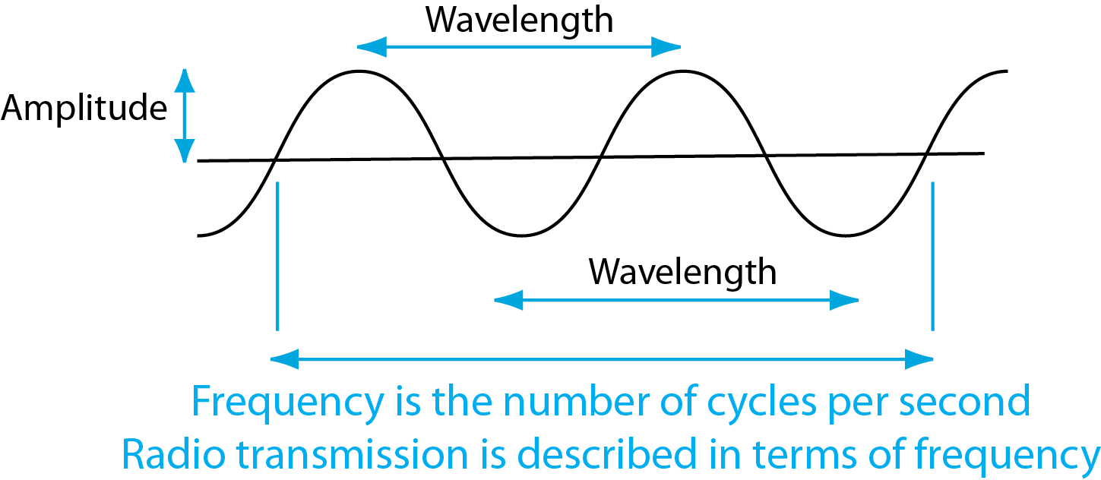
6.3 Electromagnetic Wave
Optical fiber transmission is measured in terms of wavelength.
Typical data LAN frequencies are 500 MHz to 10 GHz

Slide 12
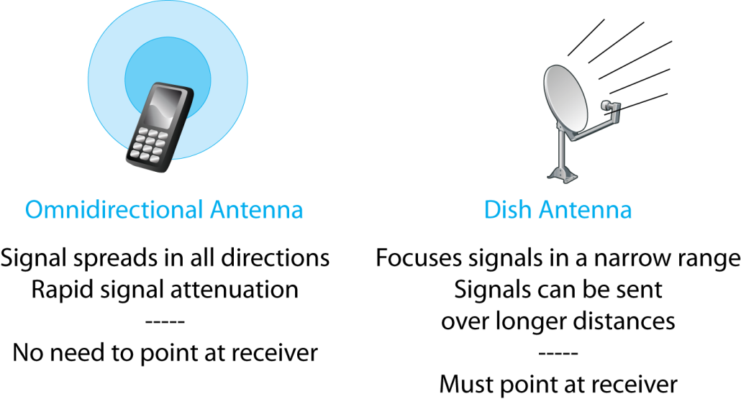
6.4 Omnidirectional and Dish Antennas

Slide 13
6.4 Omnidirectional and Dish Antennas
Questions:
What type of antenna do mobile phones use?
Why?

Slide 14
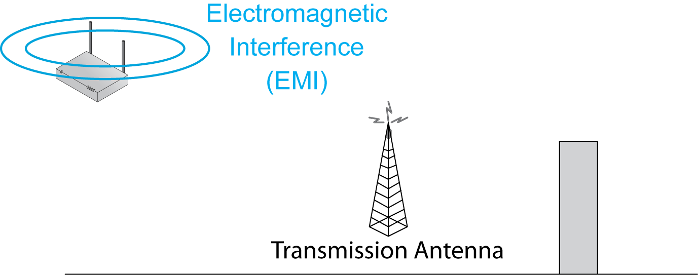
6.5: Wireless Propagation Problems
2.
Electromagnetic
Interference (EMI) is unwanted power at the same frequency from other devices.
1.
Wireless transmission has many propagation problems.

Slide 15
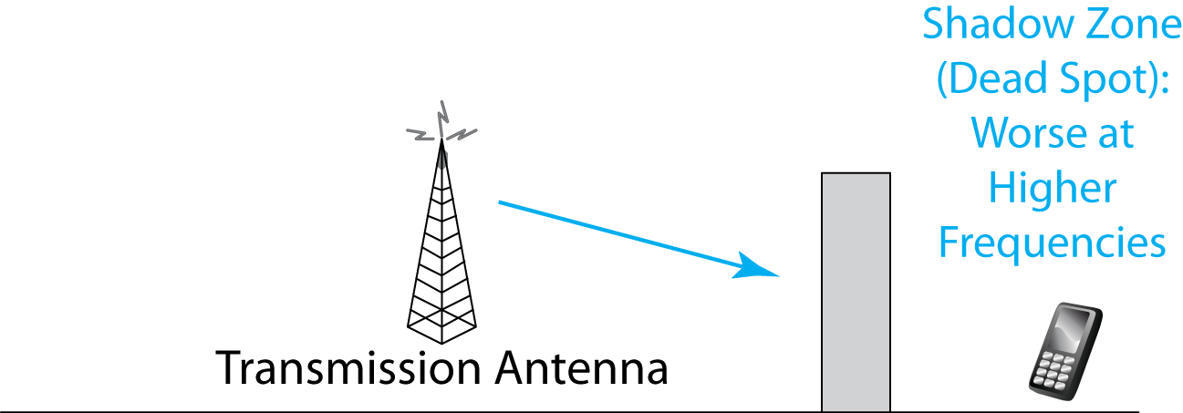
6.5: Wireless Propagation Problems
Shadow zones are places the signal cannot penetrate because of obstacles in its path.
Shadow zones, also called dead spots,
grow worse as frequency increases.

Slide 16

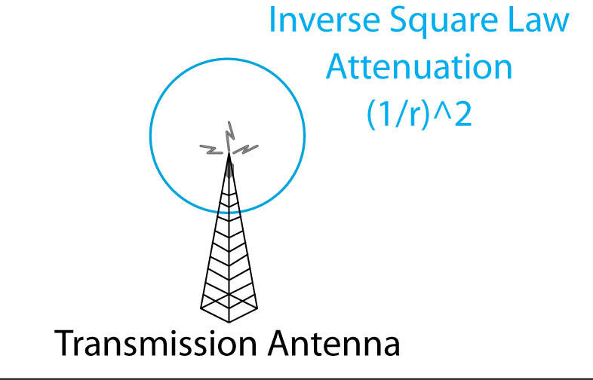
6.5: Wireless Propagation Problems
The signal strength spreads out as the surface of a sphere.
This means that its strength falls as (1/r²), where r is the radius.
If you double the distance, you only get ¼ the signal strength

Slide 17
6.6: Inverse Square Law Attenuation
Radio signals spread out in a sphere.
  S = signal power, r = range (distance) or radius
  If the signal power at 10 meters is 9 milliwatts (mW), how strong is it at 30 meters?
S₂ = S₁ * (r₁/r₂)²
S₂ = 9 mW * (10/30)²
S₂ = 9 mW * (1/3)²
S₂ = 9 mW * (1/9)
S₂ = 1 mW

Slide 18
6.6: Inverse Square Law Attenuation
Your turn.
  If the signal strength at 5 meters is 48 mW, how strong is it at 20 meters?

Slide 19
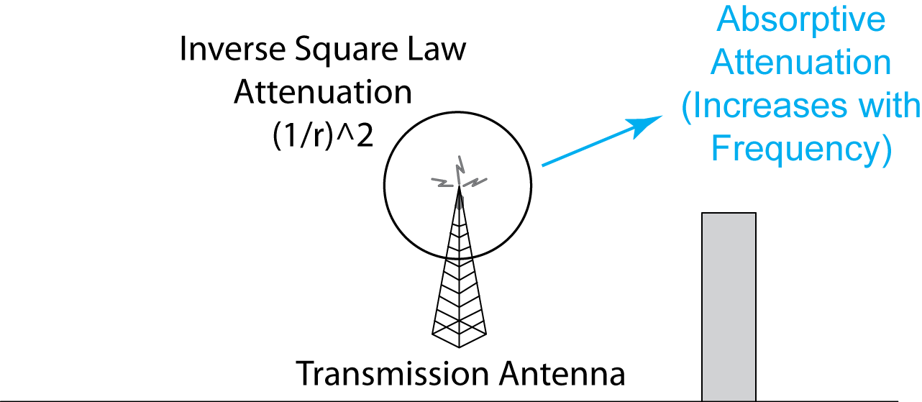
6.5: Wireless Propagation Problems
Signal is absorbed by the air and water.
Note that there are two types of attenuation: Inverse square law and absorptive attenuation.
Note that this is different than shadow zones.

Slide 20
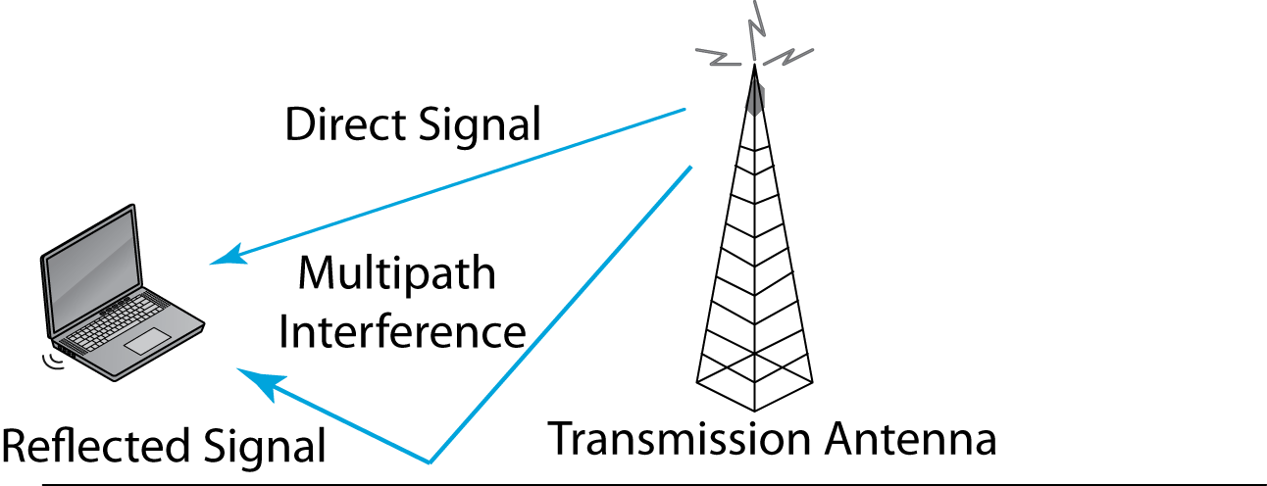
6.5: Wireless Propagation Problems
Direct and reflected signals may interfere.
Most serious propagation problem at WLAN frequencies.

Slide 21
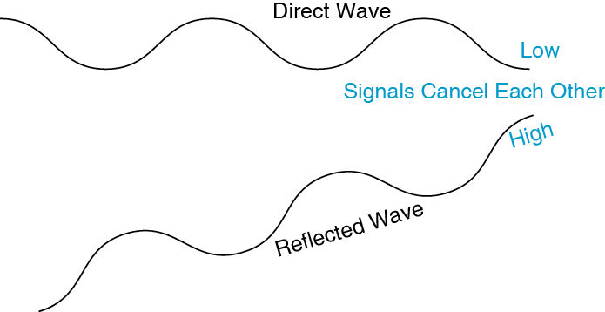
6.7: Multipath Interference
If the two waves are out of phase, they will negate each other, giving no signal.

Slide 22
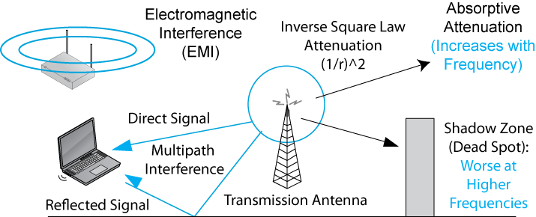
6.5: Wireless Propagation Problems
Recap
Two forms of attenuation
Two grow worse at higher frequencies

Slide 23
Introduction
Radio Signal Propagation
Radio Bands and Bandwidth
Spread Spectrum Transmission
802.11 WLAN Operation
802.11 Transmission Standards
Wireless Mesh Networking

Slide 24
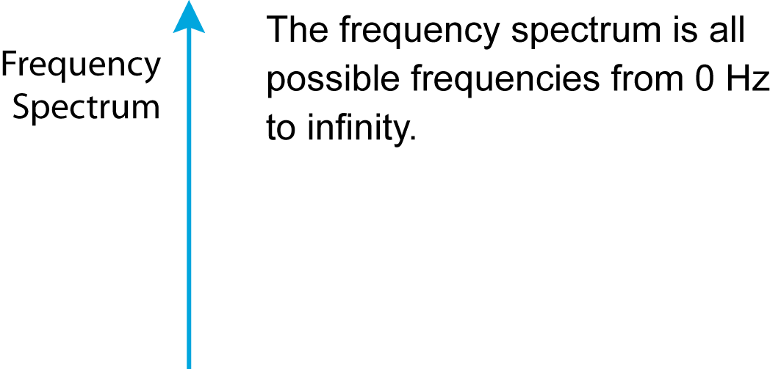
6.8 Frequency Spectrum, Service Band, Channels
0 Hz

Slide 25
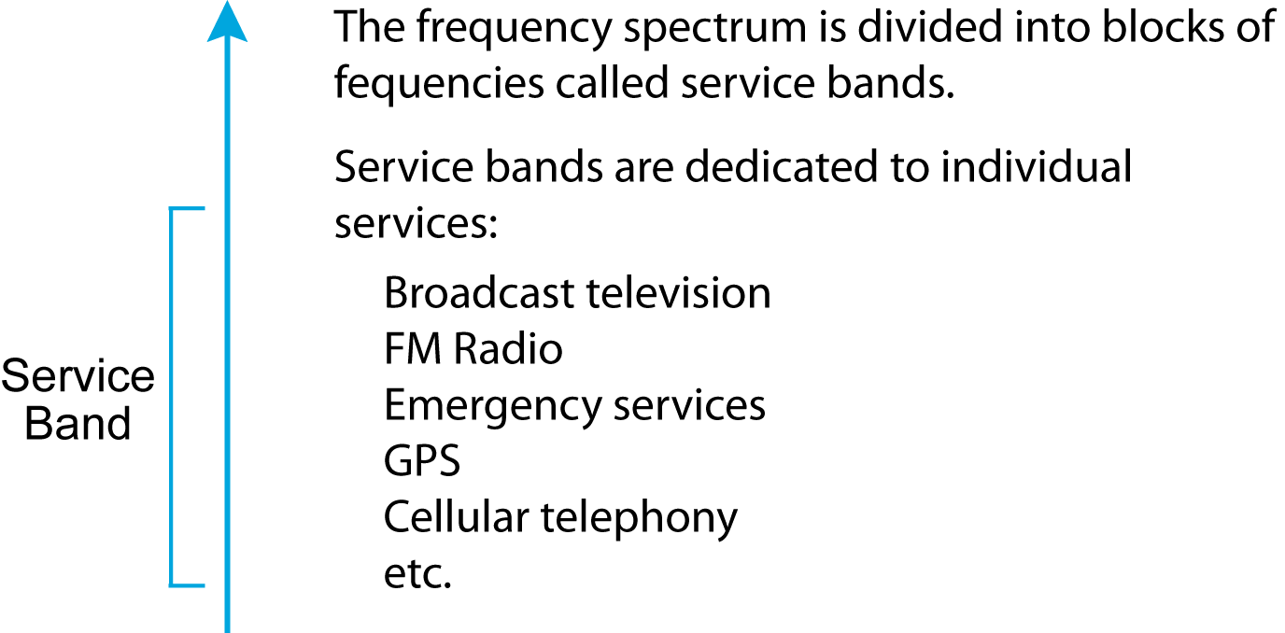
6.8 Frequency Spectrum, Service Band, Channels

Slide 26
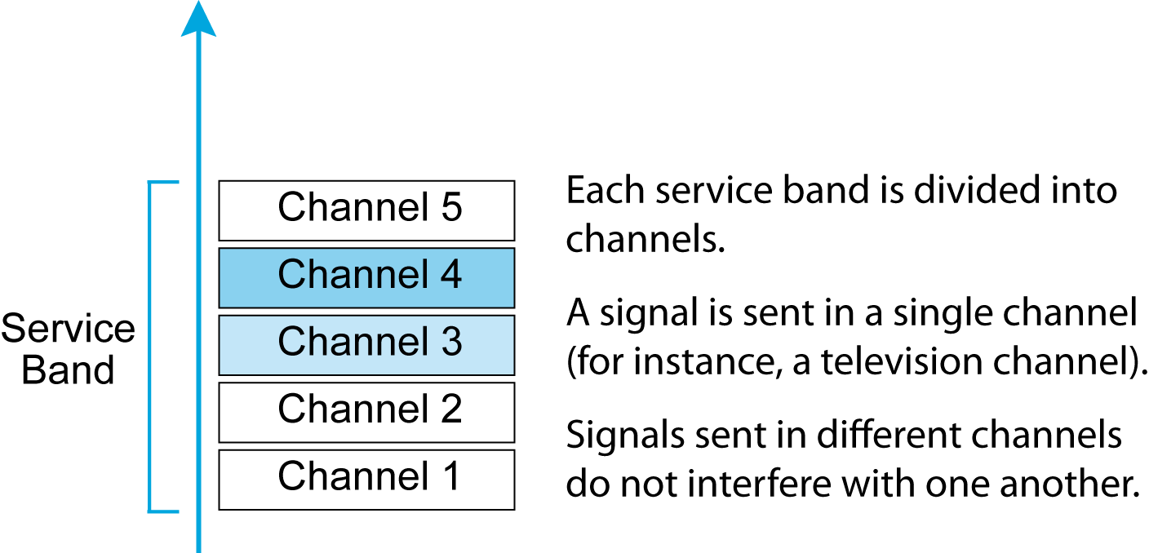
6.8 Frequency Spectrum, Service Band, Channels

Slide 27
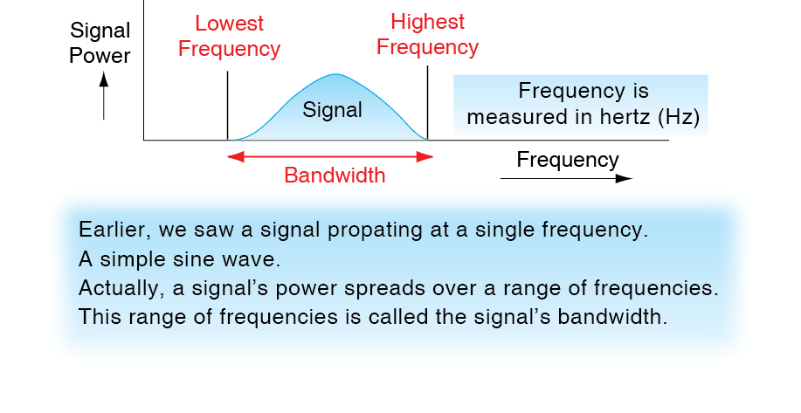
6.9 Signal Bandwidth

Slide 28
6.10: Channel Bandwidth and Transmission Speed
Channel Bandwidth
  Channel bandwidth is the highest frequency in a channel minus the lowest frequency.
  An 88.0 MHz to 88.2 MHz channel has a bandwidth of 0.2 MHz (200 kHz).
  Higher-speed signals need wider channel bandwidths.

Slide 29
6.10 Channel Bandwidth and Transmission Speed
Transmission Speed and Channel Bandwidth
  There is a direct relationship between required transmission speed and required channel bandwidth
  Doubling bandwidth doubles the possible transmission speed
  Multiplying bandwidth by N makes possible N times the transmission speed

Slide 30
6.10 Channel Bandwidth and Transmission Speed
Broadband Channels
  Broadband means wide radio channel bandwidth and therefore high speed
  Popularly, fast systems are called “broadband” even if they are not radio systems

Slide 31
6.11 2.4 GHz and 5 GHz Service Band
The 2.4 GHz Service Band
  2.4 GHz to 2.485 GHz
  Propagation characteristics are good
  For 20 MHz 802.11 channels, only three nonoverlapping channels are possible
  Channels 1, 6, and 11

Slide 32
6.11 2.4 GHz and 5 GHz Service Band
The 2.4 GHz Service Band
  Co-channel interference between nearby access points transmitting in the same channel degrades performance
  Except in very small networks, difficult or impossible to put nearby access points on different channels (Figure 6-12)

Slide 33
6.11 2.4 GHz and 5 GHz Service Band
The 5 GHz Service Band
  More bandwidth, so between 11 and 24 non-overlapping 20 MHz channels
  Makes it easy to have nearby access points operate on non-overlapping channels
  Increasing channel bandwidth in newer standards reduces the number of possible channels

Slide 34
6.11 2.4 GHz and 5 GHz Service Band
What is the main advantage of 2.4 GHz operation?
What is the main advantage of 5 GHz operation?

Slide 35
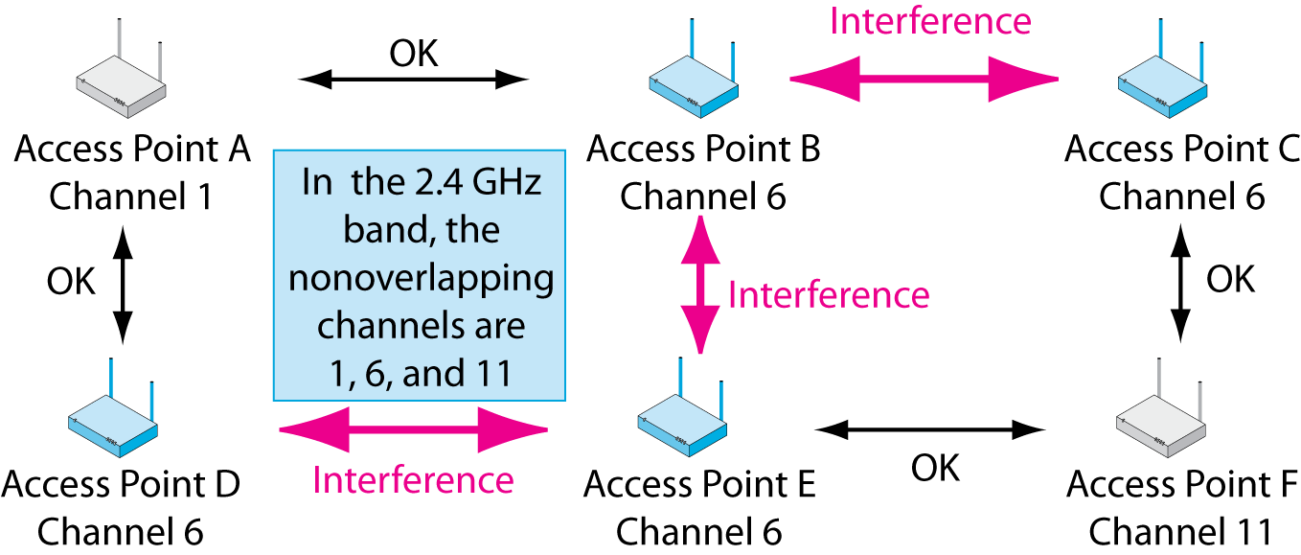
6.12 Co-Channel Interference, 2.4 GHz Band
The 2.4 GHz Unlicensed Band
  Difficult or impossible to put nearby access points on different channels

Slide 36
6.12 Co-Channel Interference, 2.4 GHz Band

Slide 37
6.13 Licensed & Unlicensed Service Bands
Licensed Radio Bands
  If two nearby radio hosts transmit in the same channel, their signals will interfere
  Most radio bands are licensed bands, in which hosts need a license to transmit: FM radio, etc.
  The government limits licenses to control interference
  In cellular telephone bands, only the central antennas are licensed, not the mobile phones

Slide 38
6.13 Licensed & Unlicensed Service Bands
Unlicensed Radio Bands
  A few service bands are set aside as unlicensed bands
  Hosts in these service bands do not need to be licensed to be turned on or moved
  Anybody can operate anywhere

Slide 39
6.13 Licensed & Unlicensed Service Bands
Unlicensed Radio Bands
  802.11 Wi-Fi operates in unlicensed radio bands
  This allows access points and hosts to be moved freely

Slide 40
6.13 Licensed & Unlicensed Service Bands
Unlicensed Radio Bands
  However, there is no legal recourse against interference from other nearby users
  Your only recourse is to negotiate
  At the same time, you may not cause unreasonable interference by transmitting at illegally high power

Slide 41
Introduction
Radio Signal Propagation
Radio Bands and Bandwidth
Spread Spectrum Transmission
802.11 WLAN Operation
802.11 Transmission Standards
Wireless Mesh Networking

Slide 42
Spread Spectrum Transmission
Spread Spectrum Transmission
  You are required by law to use spread spectrum transmission in the 2.4 and 5 GHz bands.
  Spread spectrum transmission reduces propagation problems.
    Especially multipath interference
  Spread spectrum transmission is NOT used for security in WLANs.

Slide 43
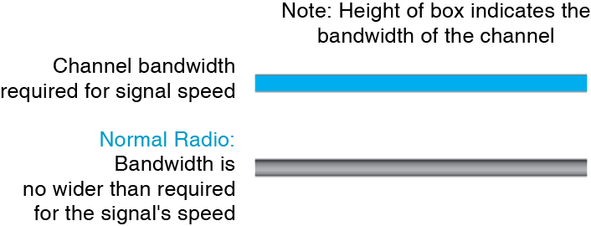
6.14: Normal vs Spread Spectrum Transmission
Why do you not want to make radio channel bandwidth greater than the signal requires?

Slide 44

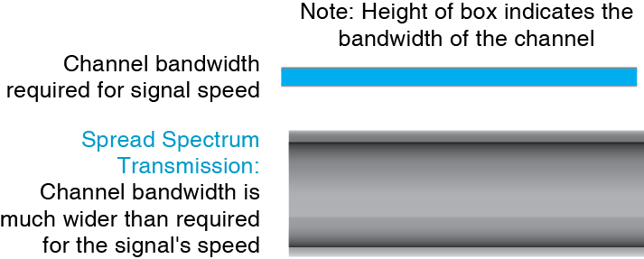
6.14: Normal vs Spread Spectrum Transmission
Wasteful of bandwidth but necessary
to avoid propagation problems.

Slide 45
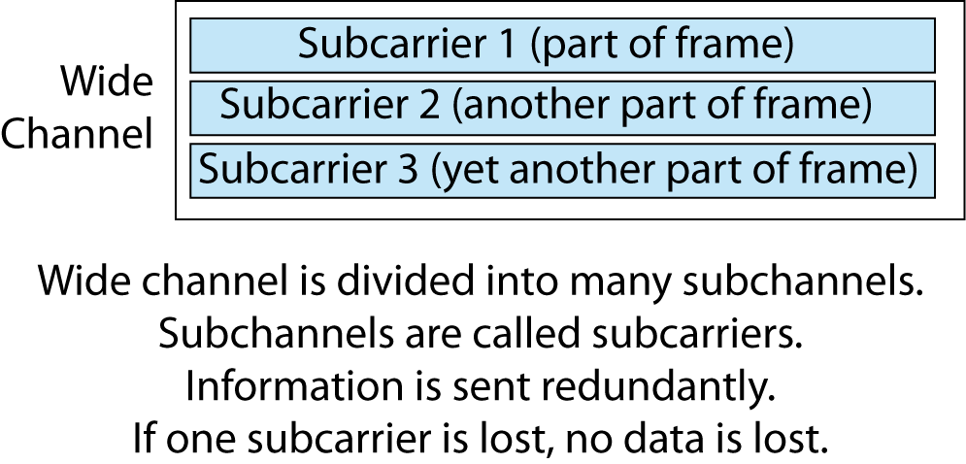
6.15: Orthogonal Frequency Division Multiplexing

Slide 46
Introduction
Radio Signal Propagation
Radio Bands and Bandwidth
Spread Spectrum Transmission
802.11 WLAN Operation
802.11 Transmission Standards
Wireless Mesh Networking

Slide 47
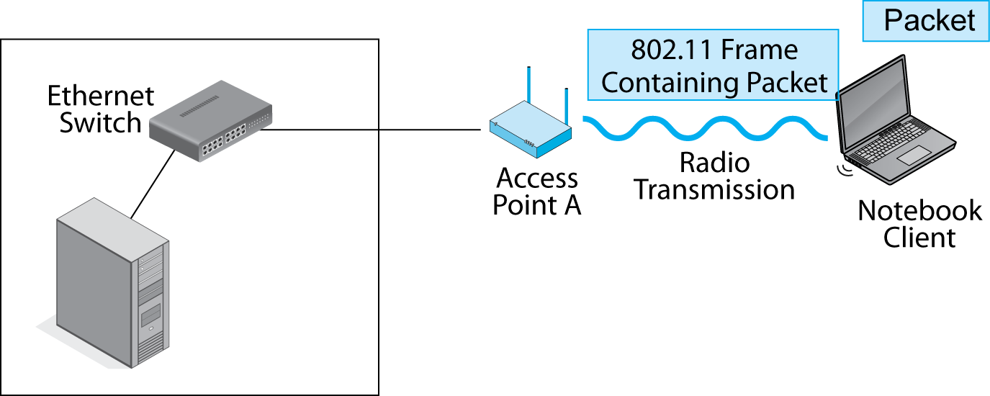
6.16 Typical 802.11 Wi-Fi Operation
Sender puts a packet for the destination
host into an 802.11 frame, then sends the
frame wirelessly to the access point.

Slide 48
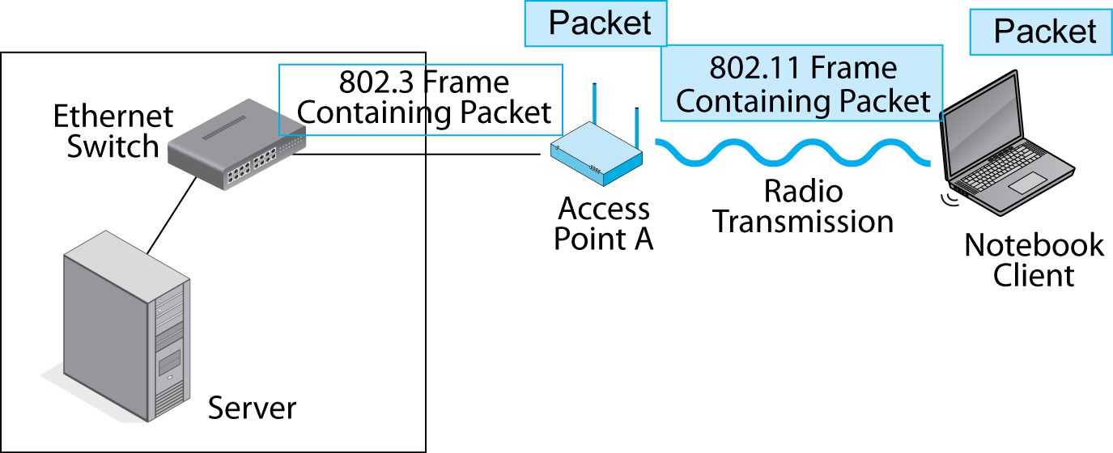
6.16 Typical 802.11 Wi-Fi Operation
The 802.11 frame has the wrong frame format to travel over an 802.3 Ethernet network. The switches and destination host would not know what to do with it.
The access point removes the packet from the 802.11 frame and discards the frame.

Slide 49
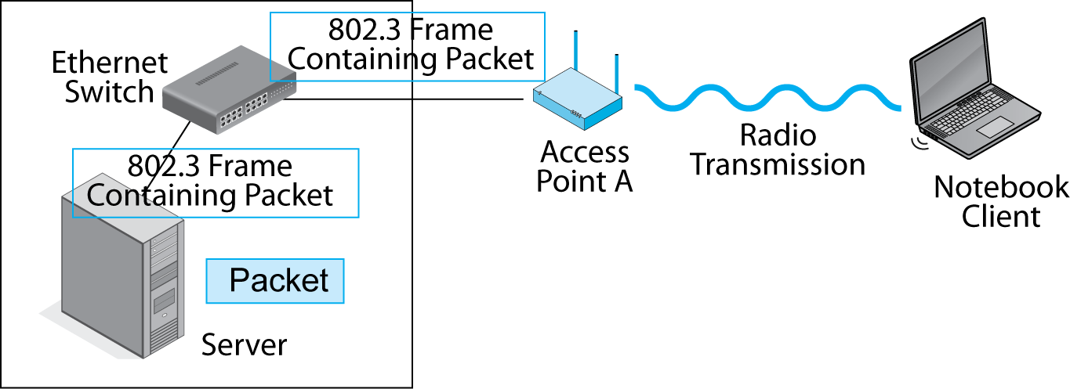
6.16 Typical 802.11 Wi-Fi Operation
The access point encapsulates the packet in an 802.3 frame and sends this frame on to the destination host via Ethernet switches.

Slide 50
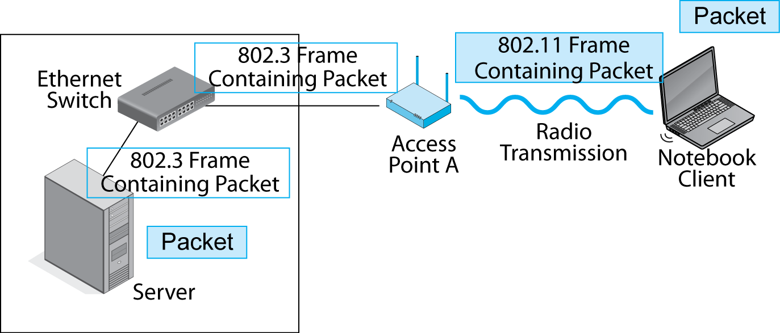
6.16 Typical 802.11 Wi-Fi Operation
The Wired Ethernet Network is called the Distribution System
The server removes the packet from the 802.3 frame.

Slide 51
6.16 Typical 802.11 Wi-Fi Operation
Does the IP packet travel all the way to the destination host?
Does the 802.11 frame travel all the way to the destination host? Why or why not?

Slide 52
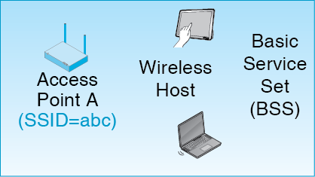
6-17: Basic Service Set (BSS)
An access point and its wireless hosts
Service Set ID (SSID) is the name of the network (abc)

Slide 53
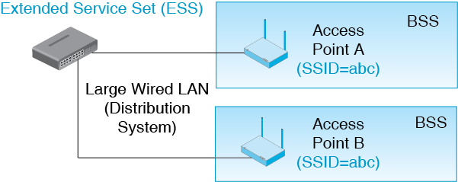
6-17: Extended Service Set (ESS)
Collection of access points that all have the same SSID

Slide 54
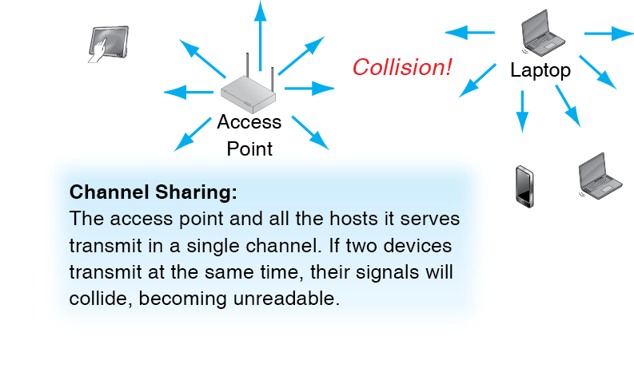
6.18: Transmitting in a Single Channel

Slide 55
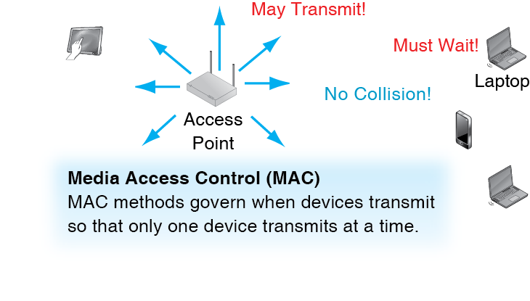
6.18: Transmitting in a Single Channel

Slide 56
6.19: CSMA/CA+ACK
Box
Carrier Sense Multiple Access with Collision Avoidance and Acknowledgement
  Mandatory for 802.11 Wi-Fi Operation
Carrier Sensing with Multiple Access
  Sender listens for traffic (senses the carrier)
  If another device is transmitting, it waits
  This controls access by multiple devices that must not transmit simultaneously

Slide 57
6.19: CSMA/CA+ACK
Box
Collision Avoidance
  When the current sender stops, two or more waiting devices may immediately want to transmit
  This will cause a collision
  Instead, the devices must wait a randomized amount of time before sending
  This usually avoids collision, but it is inefficient

Slide 58
6.19: CSMA/CA+ACK
Box
ACK (Acknowledgement) and Reliability
  Receiver immediately sends back an acknowledgement
  CA random delay for other devices guarantees there will be enough time for an immediate ACK
  If sender does not receive the acknowledgement, it retransmits using CSMA

Slide 59
6.19: CSMA/CA+ACK
Box
ACK (Acknowledgement) and Reliability
  CSMA/CA plus ACK is a reliable protocol
  Reliable protocols are rare in wired networks
  However, radio transmission is unreliable enough to warrant it

Slide 60
6.20: CSMA/CA+ACK
Box
Inefficiency
  There is a lot of waiting with CSMA/CA+ACK
  This makes it inefficient

Slide 61
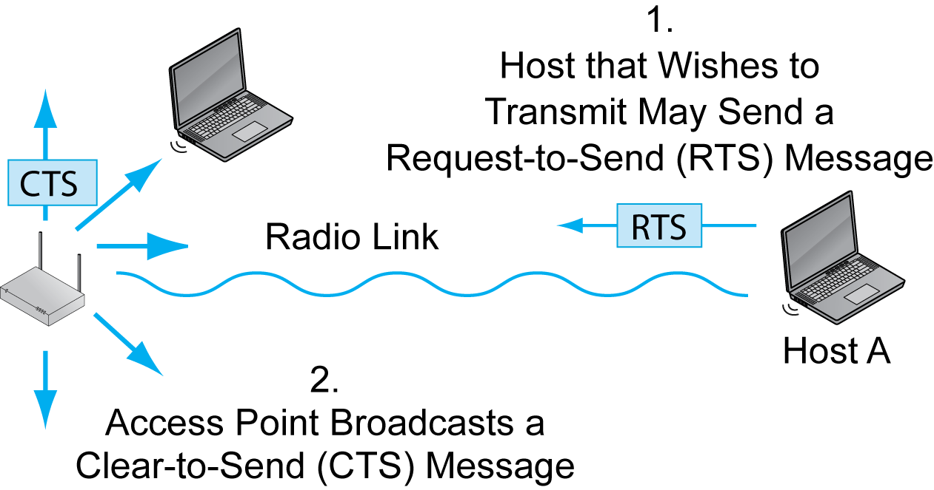
6.20: RTS-CTS
Box

Slide 62
6.20: RTS-CTS
Box

Slide 63
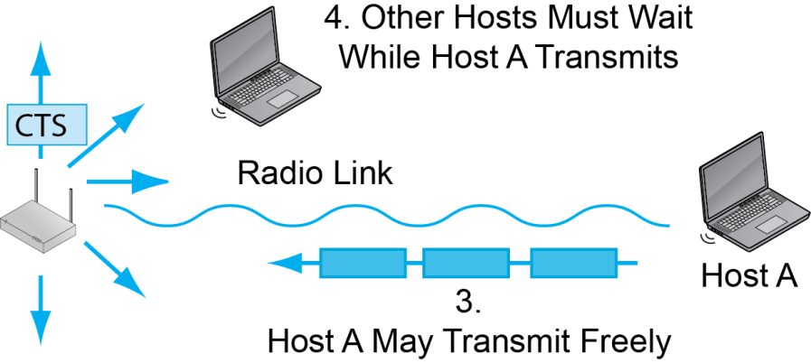
6.20: RTS-CTS
Box

Slide 64
6.20: RTS-CTS
Box
0

Slide 65
Comparison
Box
CSMA/CA is Mandatory
  It is the default MAC method.
  It is more efficient than RTS/CTS.
RTS/CTS
  Is usually optional.
  Is good if two or more client stations cannot hear each other.
  Stop them from transmitting at the same time.

Slide 66
Introduction
Radio Signal Propagation
Radio Bands and Bandwidth
Spread Spectrum Transmission
802.11 WLAN Operation
802.11 Transmission Standards
Wireless Mesh Networking

Slide 67
6.21 Major 802.11 Wi-Fi Standards
Standard | Rated Speed
802.1g | 54 Mbps
802.11a | 54 Mbps
802.1n | 100 to 600 Mbps 150 to 300 Mbps common
802.1ac | 433 Mbps to 6.93 Gbps 433 to 1.3 Gbps common

Slide 68
6.21 Major 802.11 Wi-Fi Standards
Standard | Status
802.1g | Obsolescent but still used
802.11a | Obsolescent but still used
802.1n | Dominates the installed base today
802.1ac | Dominates sales today

Slide 69
6.21 Major 802.11 Wi-Fi Standards
Standard | Unlicensed Bands
802.1g | 2.4 GHz
802.11a | 5 GHz
802.1n | 2.4 GHz and 5 GHz
802.1ac | 5 GHz

Slide 70
6.21 Major 802.11 Wi-Fi Standards
Standard | Channel Bandwidth
802.1g | 20 MHz
802.11a | 20 MHz
802.1n | 40 MHz but will drop back to 20 MHz if there is interference from a 802.1g or 802.1a channel
802.1ac | 80 MHz and 160 MHz

Slide 71
6.21 Major 802.11 Wi-Fi Standards
Standard | Channels in 5 GHz Band in the USA
802.1g | NA (2.4 GHz only)
802.11a | 20-25
802.1n | 20-25 at 20 MHz 8-12 at 40 MHz
802.1ac | 4-6 at 80 MHz 1-2 at 160 MHz
Wider channels means fewer channels

Slide 72
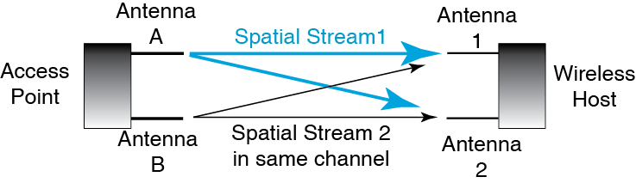
6.22: MIMO
Access point transmits two signals in the same channel—one from Antenna A and
one from Antenna B.
These are called spatial streams.

Slide 73
6.22: MIMO
The two signals arrive at different times at the two receiving antennas. Time differences allow them to be separated and understood.

Slide 74
6.22: MIMO (Multiple Input/Multiple Output)
MIMO Two Benefits
  MIMO brings higher speeds because it can send more information in a channel.
  MIMO also brings longer propagation distances for technical reasons we will not discuss.

Slide 75
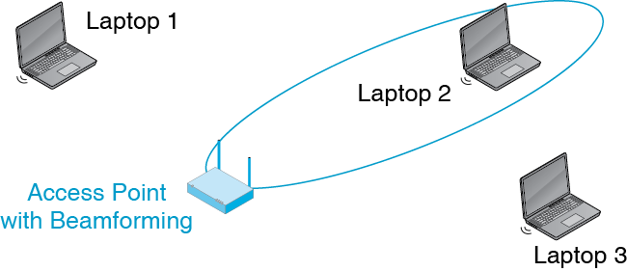
6.23: Beam Forming
Beamforming allows an access point to focus its transmissions and reception

Slide 76
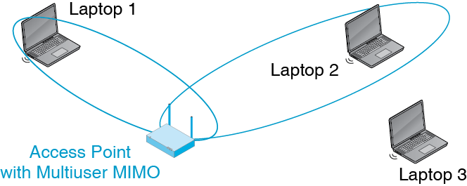
6.23: Beam Forming
Multiuser MIMO (MU-MIMO) allows two wireless hosts
to transmit at the same time.

Slide 77
Multiuser MIMO
Defined in 802.11n, but a single method was not defined
Defined in 802.11ac, and there is a single standard, so adoption is more likely
However, initial pre-standard 802.11ac products typically do not offer it.

Slide 78
6.21 Major 802.11 Wi-Fi Standards
Standard | MIMO? | Maximum Spatial Streams | MU-MIMO?
802.1g | No | NA | No
802.11a | No | NA | No
802.1n | Yes | 4 | No
802.1ac | Yes | 8 | Yes

Slide 79
6.24 Speed, Distance, and Throughput
Rated Speed versus Throughput
  Rated speed is the speed the standard specifies
  Throughput is the speed that is actually delivered
  Total throughput is substantially lower than rated speed—sometimes 50% lower

Slide 80
6.24 Speed, Distance, and Throughput
Aggregate versus Individual Throughput
  Access point throughput is aggregate throughput for all devices transmitting and receiving
  Its capacity is shared by all stations currently sending or receiving
  Individual throughput can be much lower than aggregate throughput

Slide 81
6.24 Speed, Distance, and Throughput
Throughput versus Distance
  As distance from the access point increases, signals get weaker
  Wireless hosts must use slower but more reliable bit encoding methods—send fewer bits per clock cycle
  This reduces individual throughput for these devices

Slide 82
6.25 Backward Compatibility
Devices Built for Newer Standards Still Implement Older Standards
  This is called backward compatibility
  This Allows Older and Newer Devices to Communicate

Slide 83
6.25 Backward Compatibility
Example of Backward Compatibility
  Newer product: 802.11ac in the 5 GHz band
  Older product: 802.11n in the 2.4 GHz band
  The newer product will drop back to the standard the older product can use
  They will communicate using the 802.11n standard in the 2.4 GHz band
  They will only get 802.11n speeds

Slide 84
Introduction
Radio Signal Propagation
Radio Bands and Bandwidth
Spread Spectrum Transmission
802.11 WLAN Operation
802.11 Transmission Standards
Wireless Mesh Networking

Slide 85
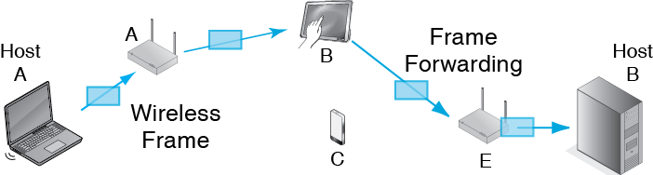
6.26: Wireless Mesh Network
There is no Ethernet network
(distribution system)
Frames are forwarded by access points
and wireless hosts

Slide 86
6.26: Wireless Mesh Network
Mesh networks are governed by 802.11s
It is not a mature standard

