Slide 1
Wireless LANs II
Chapter 7
Panko and Panko
Business Data Networks and Security
Copyright © 2015 Pearson Education, Inc.

Slide 2
The TJX Breach
Introduction
802.11i LAN Security
802.11i Security is Not Enough
802.11 Wi-Fi WLAN Management
Decibels
Bluetooth
Other Local Wireless Technologies

Slide 3
TJX Breach
Broke into a TJ Maxx store in Florida through a weakly protected access point
TJX is the parent company of TJ Maxx and other stores
Use of 802.11i security would have made this impossible
Broke into headquarters through the store

Slide 4
TJX Breach
Downloaded millions of credit card numbers and related information
Extremely time-intensive and expensive handling of the breach
Thieves were a loose international group
Protect your end points!

Slide 5
The TJX Breach
Introduction
802.11i LAN Security
802.11i Security is Not Enough
802.11 Wi-Fi WLAN Management
Decibels
Bluetooth
Other Local Wireless Technologies

Slide 6
7.1 Wireless LAN Security Threats
War Drivers | Drive-By Hackers
Lurk Outside Building | Lurk Outside Building
Collect Access Point Data SSID, strength of signal, security | Collect Access Point Data SSID, strength of signal, security
May publicize findings Do not read messages Do not send attacks | Read messages Send attacks that bypass the firewall
Legal | Illegal

Slide 7
The TJX Breach
Introduction
802.11i LAN Security
802.11i Security is Not Enough
802.11 Wi-Fi WLAN Management
Decibels
Bluetooth
Other Local Wireless Technologies

Slide 8
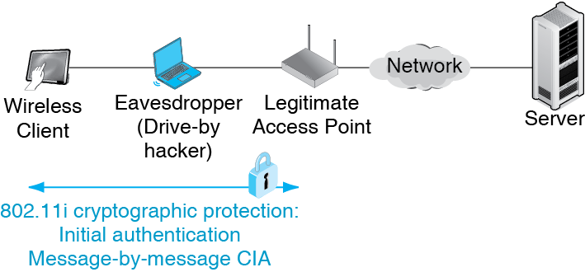
7.2 Scope of 802.11i Security Protection

Slide 9
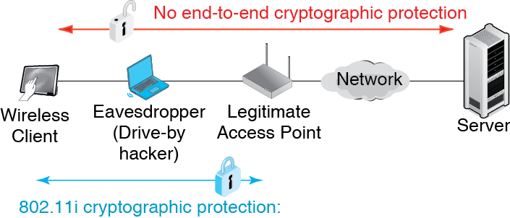
7.2 Scope of 802.11i Security Protection

Slide 10
7.3 802.11i Security
802.11i Provides Security between the Wireless Host and the Wireless Access Point
  Initial authentication
  Encryption of messages for confidentiality, authentication, and message integrity
  Uses strong cryptographic standards, including AES for encryption for confidentiality

Slide 11
7.3 802.11i Security
Configuring an Access Point
  Select 802.11i (sometimes called WPA2)
  Do not select Wireless Protected Access (WPA), an earlier, weaker security standard created by the Wi-Fi Alliance
  Never ever select Wired Equivalent Privacy (WEP), an earlier security standard created by the 802.11 Working Group
  Earlier standards do not provide acceptable security

Slide 12
7.4 802.11i Modes of Operation
 | Pre-Shared Key (PSK) Mode | 802.1X Mode
Environment | Home, Business with a single access point | Companies with multiple access points
Uses a Central Authentication Server? | No | Yes
Authentication | Knowledge of Pre-Shared Key | Credentials on authentication server
Technical Security | Strong | Very Strong
Human Security | Vulnerable | Very Strong

Slide 13
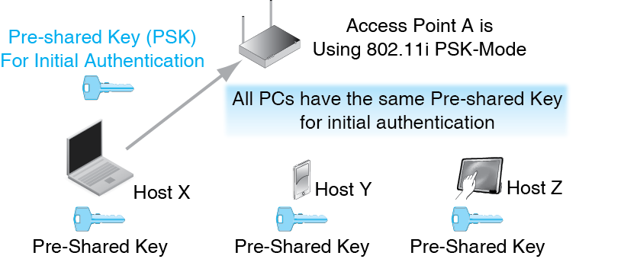
7.5 802.11i PSK Mode: Initial Authentication

Slide 14
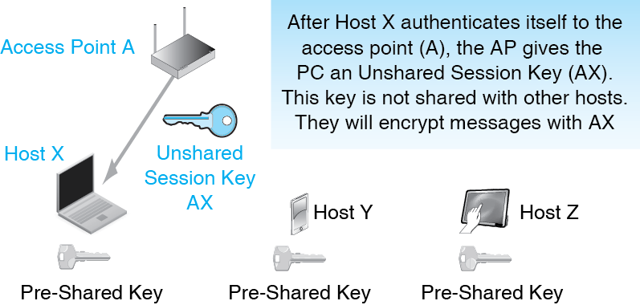
7.6 802.11i PSK Mode: Unshared Session Key

Slide 15
7.7 Security Threats in 802.11i PSK Mode
Someone may give the PSK to unauthorized people
  It does not seem secret, so employees tend to share it
PSKs are generated from passphrases
  Passphrases must be at least 20 characters long
Wireless Protected Setup (WPS)
  Created by Wi-Fi Alliance to make PSK setup easier
  User enters an 8-digit PIN for a particular access point
  Unfortunately, easily cracked and should be turned off on the access point if possible

Slide 16
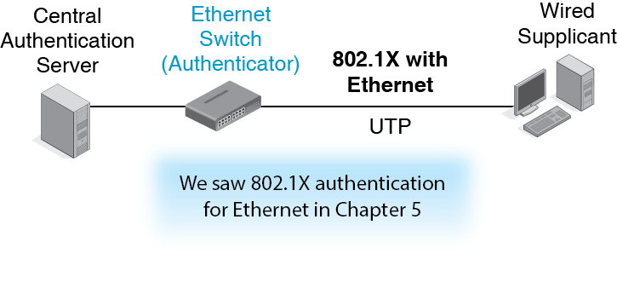
7-8: 802.11i in 802.1X mode

Slide 17
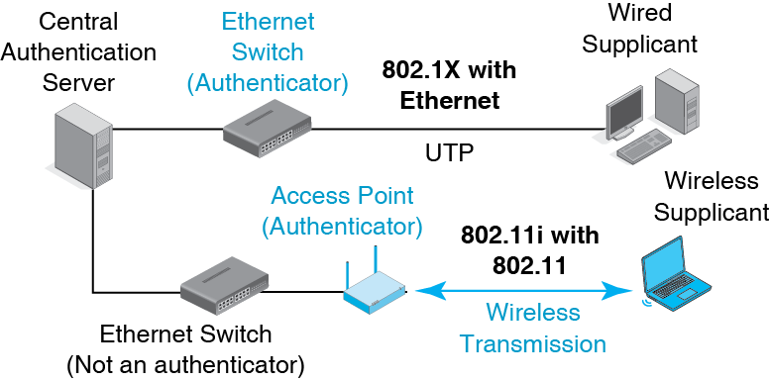
7-8: 802.11i in 802.1X mode

Slide 18
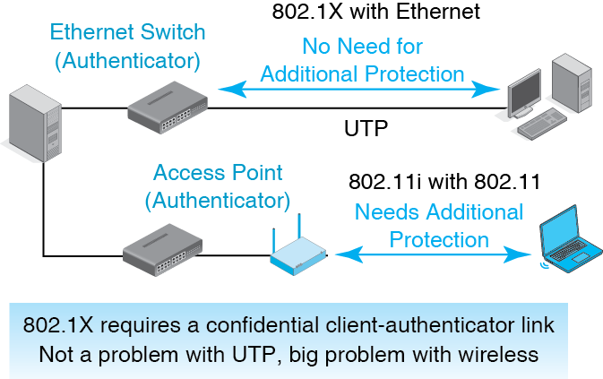
7-8: 802.11i in 802.1X mode

Slide 19
7-8: 802.11i in 802.1X mode
Create an SSL/TLS VPN between the access point/authenticator and the client/supplicant
This will protect the confidentiality of subsequent 802.1X message exchanges
The most popular standard for using SSL/TLS with 802.1X is the PEAP standard.

Slide 20
The TJX Breach
Introduction
802.11i LAN Security
802.11i Security is Not Enough
802.11 Wi-Fi WLAN Management
Decibels
Bluetooth
Other Local Wireless Technologies

Slide 21
802.11i Security is Not Enough
802.11i Only Protects from Some Threats
Other Threats Must Also Be Addressed
  Rogue Access Points
  Evil Twin Access Points

Slide 22
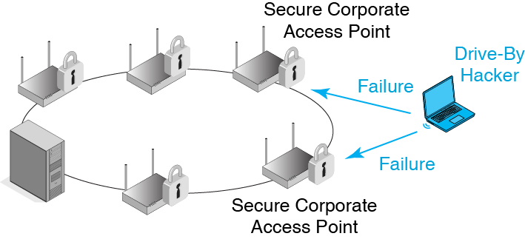
7.9 Rogue Access Point

Slide 23
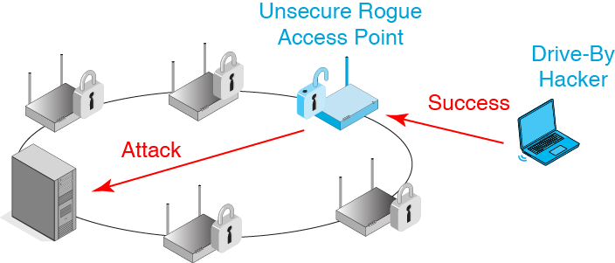
7.9 Rogue Access Point

Slide 24
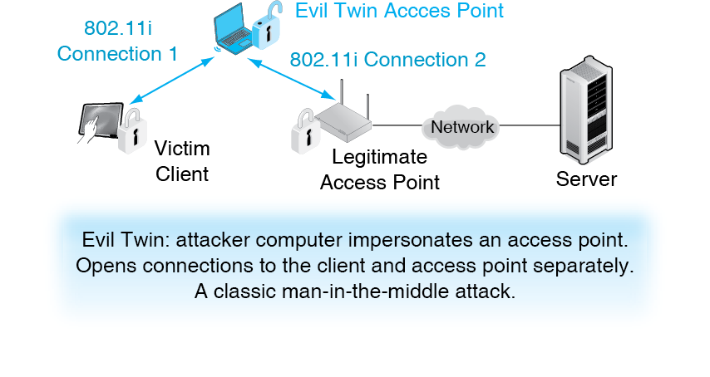
7.10 Evil Twin AP Operation

Slide 25
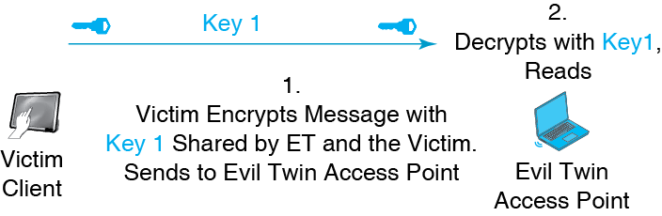
7.11 Evil Twin Decryption, Reading, and Reencryption

Slide 26
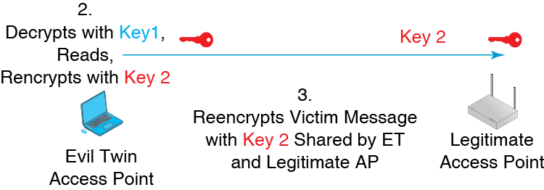
7.11 Evil Twin Decryption, Reading, and Reencryption

Slide 27
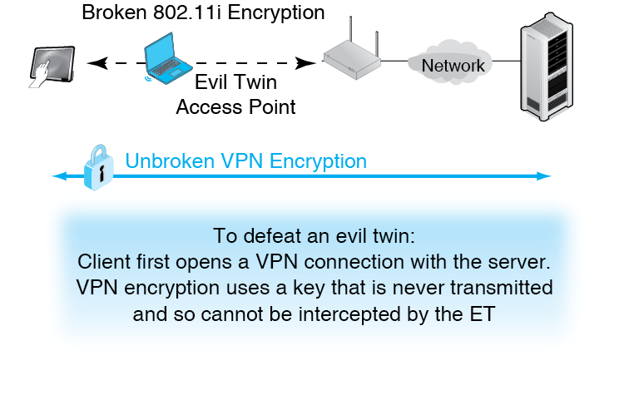
7.12 Using a Virtual Private Network to Defeat an Evil Twin Attack

Slide 28
7.13 Using a VPN to Defeat Evil Twin Decryption
Without a VPN
  Client encrypts with the key it shares with the evil twin
  The evil twin decrypts the message and reads it
  ET reencrypts message with the key it shares with the victim access point and sends it on to the AP

Slide 29
7.13 Using a VPN to Defeat Evil Twin Decryption
With a VPN
  Client encrypts first with the VPN key
  Client encrypts again with the key it shares with the evil twin
  ET decrypts with the key it shares with the client
  The decrypted message is still encrypted with the VPN key
  The evil twin cannot read the original message

Slide 30
The TJX Breach
Introduction
802.11i LAN Security
802.11i Security is Not Enough
802.11 Wi-Fi WLAN Management
Decibels
Bluetooth
Other Local Wireless Technologies

Slide 31
7.14 Building Access Point Placement
Planning
  Must be done carefully for good coverage and to minimize interference between access points
  Lay out roughly 10-meter overlapping circles on blueprints
  Adjust for obvious potential problems such as thick walls and filing cabinets
  In multistory buildings, must consider placement in three dimensions

Slide 32
7.14 Building Access Point Placement
Installation
  Install access points and do site surveys to determine signal quality
  Adjust placement and signal strength as needed
  (Keep doing this constantly because conditions change constantly)

Slide 33
7.15 Remote Access Point Management
The Manual Labor to Manage Many Access Points
  Can be very high expensive
  Automation is critical

Slide 34
7.15 Remote Access Point Management
Access Points are Managed Devices (Figure 7-16)
  Send data to the administrator at the management console
  Administrator can send commands to the access points

Slide 35
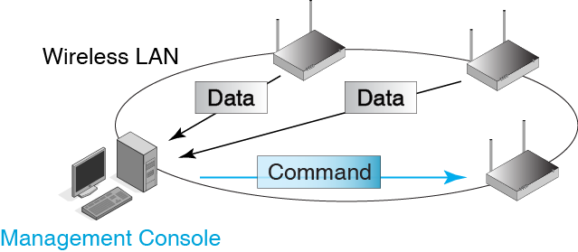
7.16 Remote Access Point Management

Slide 36
7.15 Remote Access Point Management
Desired Network Management Functionality
  Notify the WLAN administrators of failures immediately
  Continuous transmission quality monitoring
  Remote access point power adjustment
  Push software updates to access points
  Work automatically whenever possible

Slide 37
7.15 Remote Access Point Management
Desired Security Management Functionality
  Notify administrator of rogue access points
  Notify administrator of evil twin access points
  Notify the administration of access points that have improperly configured security
  Do all this as automatically as possible

Slide 38
The TJX Breach
Introduction
802.11i LAN Security
802.11i Security is Not Enough
802.11 Wi-Fi WLAN Management
Decibels
Bluetooth
Other Local Wireless Technologies

Slide 39
7-17 Decibel Calculation for Relative Power Levels
Power Ratios Can Be Given as Simple Ratios
  Initial Power = 30 mW
  Final Power = 10 mW
  Power ratio of final to initial = 1/3

Slide 40
7-17 Decibel Calculation for Relative Power Levels
But Powers are Often Reported in Decibels
  dB = 10 * LOG10(P2/P1)
  Initial Power = 30 mW
  Final Power = 10 mW
  Power ratio of final to initial = 1/3
  dB = 10 * LOG10(10/30)
  dB = -4.77

Slide 41
7-17 Decibel Calculation for Relative Power Levels
Data or Formula | Example 1: Attenuation | Example 2: Amplification
P1 (mw) | 40 | 10
P2 (mw) | 10 | 30
P2/P1 | 0,25 | 3
LOG10(P2/P1) | -0.60206 | 0.47712
10*LOG10(P2/P1) | -6.0206 dB | 4.7712 dB
Attenuation leads to negative decibel values.
Amplification leads to positive decibel values.

Slide 42
7-18 Decibel
Approximations
Powers of 2
Power Ratio | Approximate dB Value
2 | 3 dB
4 | 6 dB
8 | 9 dB
16 | ?
32 | ?
1/2 | -3 dB
1/4 | -6 dB
1/8 | ?
Each doubling means an increase of approximately 3 dB
Each halving means a decrease of approximately 3 dB

Slide 43
7-18 Decibel
Approximations
Powers of 10
Power Ratio | Approximate dB Value
10 | 10 dB
100 | 20 dB
1000 | 30 dB
10,000 | ?
100,000 | ?
1/10 | -10 dB
1/100 | -20 dB
1/1000 | ?
Each increase by ten means an increase of 10 dB
Each decreasing by 10 means a decrease of approximately -10 dB

Slide 44
7-19 dBm
Calculations
Powers of 10
Transceiver Power | dBm
4 mW | 6 dBm
10 mW | 10 dBm
10 W | 40 dBm
0.5 mW | -3 dBm
In dBm calculations, P1 is always 1 mW (milliwatt)
This allows you to talk about the power of a radio in terms that allow comparisons of the power of different radios
Compare the power of two radios, one with 4 mW of power and the other with 10 mW

Slide 45
The TJX Breach
Introduction
802.11i LAN Security
802.11i Security is Not Enough
802.11 Wi-Fi WLAN Management
Decibels
Bluetooth
Other Local Wireless Technologies

Slide 46
Bluetooth
Created for relatively low-speed transmission over small distances
Cable replacement technology for devices around your body or desk
Not a full WLAN technology
Classic Bluetooth gives only about 3 Mbps, but gives a long battery life

Slide 47
7.20 Bluetooth Modes of Operation
Operating Mode | Classic Bluetooth | High-Speed Bluetooth
Principal Benefit | Decent speed at low power (Long battery life) | High-Speed transfers available when needed. Longer distance
Speed | Up to 3 Mbps | Up to about 24 Mbps
Expected Duty Cycle | Low to High | Low (only use occasionally)
Power Required | Low | High
Maximum Distance | About 10 m | About 30 m

Slide 48

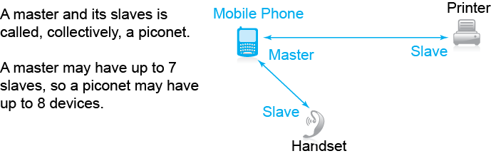
7.14: Bluetooth Operation

Slide 49
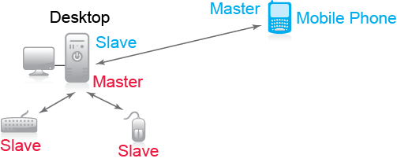
7.14: Bluetooth Operation
A device, in this case the Desktop, can be simultaneously a master and a slave.

Slide 50
7.22 Bluetooth Profiles
Bluetooth Profiles
  Specify how devices will work together for different applications
  Nothing like this in 802.11 Wi-Fi

Slide 51
7.22 Bluetooth Profiles
Headset Profile
  For using a mobile phone through a headset
  Features usually accessed through manual controls
  Rings, answers a call, hangs up, adjusts volume
Hands-Free Profile
  For using a mobile phone in an automobile
  Features accessed through voice commands
  Headset profile plus last number redial, call waiting, and voice dialing

Slide 52
7.22 Bluetooth Profiles
Basic Printing Profile
  Print to any BPP printer without having to load a printer driver
Synchronization Profile
  For synchronizing information with a desktop computer

Slide 53
7.22 Bluetooth Profiles
Human Interface Device Profile
  Bluetooth mice, keyboards, etc.
Bluetooth Smart
  Permits devices without full operating systems to interact
  Created for the Internet of things
  The phone in Figure 7-21 can upload photos to a cloud service via a nearby access router

Slide 54
The TJX Breach
Introduction
802.11i LAN Security
802.11i Security is Not Enough
802.11 Wi-Fi WLAN Management
Decibels
Bluetooth
Other Local Wireless Technologies

Slide 55
7-23 Near Field Communication (NFC)
For Very Small Distances and Low Speed
  Up to 4 cm (about 2 inches)
  Limited to 424 kbps
  So uses very little battery power
Operation in the 13.56 kHz Band
  Dedicated for this use
  Also gives low power consumption

Slide 56
7-23 Near Field Communication
No need to make physical contact, say when paying a bus fair
However, usually slap a wallet against a reader to be sure to get close enough
However, no need to take out and swipe a card

Slide 57
7-23 Near Field Communication (NFC)
Sample Applications
  Payment of bus fares (already popular in some countries)
  Unlocking car doors and turning on the ignition
  Building door entry control
  Sharing electronic business cards and other files between mobile devices
  Retail payments, including loyalty points and coupons (beginning to be popular)

Slide 58
7-23 Near Field Communication (NFC)
Passive Radio Frequency ID (RFID) Tags
  Goal: to replace bar codes
  Tags are electronic but have no power source
  When scanned by a reader, use power of the scan to generate a reply
  Inexpensive compared to powered devices
  Can only send a small amount of information
  Cannot do encryption

Slide 59
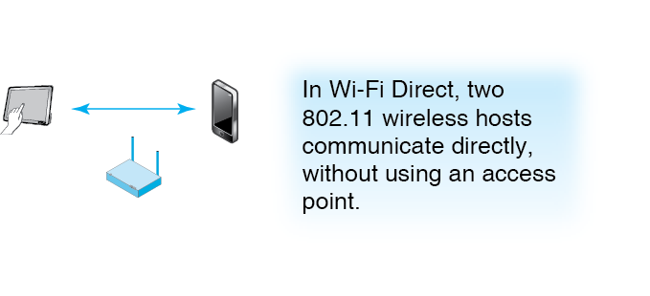
7-24 Wi-Fi Direct

Slide 60
7-25 Security in Emerging Local Wireless Technologies
Threats
  Eavesdropping
  Data modification
  Impersonation

Slide 61
7-25 Security in Emerging Local Wireless Technologies
Cryptological Security
  Some have no cryptological security
  Example: Near field communication for reading passive RFID tags
  They rely on short transmission distances to foil eavesdroppers
  However, directional antennas and amplifiers can read signals are far longer than distances in standards

Slide 62
7-25 Security in Emerging Local Wireless Technologies
Strength of Security
  Some have reasonably good security
  Example: Bluetooth
  However, still not as strong as 802.11i security

Slide 63
7-25 Security in Emerging Local Wireless Technologies
Device Loss or Theft
  In this age of bring your own device (BYOD) to work, this is a serious problem
  Most devices are only protected by short PINs

Slide 64
7-25 Security in Emerging Local Wireless Technologies
Maturity
  In general, new security technologies take some time to mature
  During this period, they often have vulnerabilities that must be fixed quickly
  User companies must master security for each new technology they use

