Slide 1
TCP/ IP Internetworking I
DiffServ or service point?
Chapter 8
Panko and Panko
Business Data Networks and Security, 10th Edition
Copyright © 2015 Pearson Education, Inc.

Slide 2
Perspective
Chapter (s) | Coverage | Layers
1–4 | Core concepts and principles | All
5 | Single switched networks | 1–2
6–7 | Single wireless networks | 1–2
8–9 | Internets | 3–4
10 | Wide Area Networks | 1-4
11 | Applications | 5

Slide 3
Recap of TCP/IP concepts
Hierarchical IP addresses
Router Operation
Address Resolution Protocol
IPv4 and IPv6
TCP and UDP

Slide 4
Perspective
Single switched and wireless networks
  Operate at Layers 1 and 2 (physical and data link)
  Standards come almost entirely from OSI
Internets
  Operate at Layers 3 and 4 (internet and transport)
  Standards come predominantly from the Internet Engineering Task Force (IETF)
  Called TCP/IP standards
  Publications are Requests for Comments (RFCs)

Slide 5
8.1: Major TCP/IP Standards
5 Application | User Applications |  |  | Supervisory Applications
 | HTTP | SMTP | Many Others | DNS |  | Dynamic Routing Protocols | Many Others
4 Transport | TCP |  |  |  |  | UDP
3 Internet | IP |  |  |  | ICMP |  | ARP
2 Data Link | None: Use OSI Standards
1 Physical | None: Use OSI Standards
TCP/IP has core internet and transport standards:
IP, TCP, and UDP.

Slide 6
8.1: Major TCP/IP Standards
5 Application | User Applications |  |  | Supervisory Applications
 | HTTP | SMTP | Many Others | DNS |  | Dynamic Routing Protocols | Many Others
4 Transport | TCP |  |  |  |  | UDP
3 Internet | IP |  |  |  | ICMP |  | ARP
2 Data Link | None: Use OSI Standards
1 Physical | None: Use OSI Standards
TCP/IP also has many application standards.

Slide 7
8.1: Major TCP/IP Standards
5 Application | User Applications |  |  | Supervisory Applications
 | HTTP | SMTP | Many Others | DNS |  | Dynamic Routing Protocols | Many Others
4 Transport | TCP |  |  |  |  | UDP
3 Internet | IP |  |  |  | ICMP |  | ARP
2 Data Link | None: Use OSI Standards
1 Physical | None: Use OSI Standards
TCP/IP also has many supervisory standards at the internet and application layers.

Slide 8
Recap of TCP/IP Concepts
Hierarchical IP addresses
Router Operation
Address Resolution Protocol
IPv4 and IPv6
TCP and UDP

Slide 9
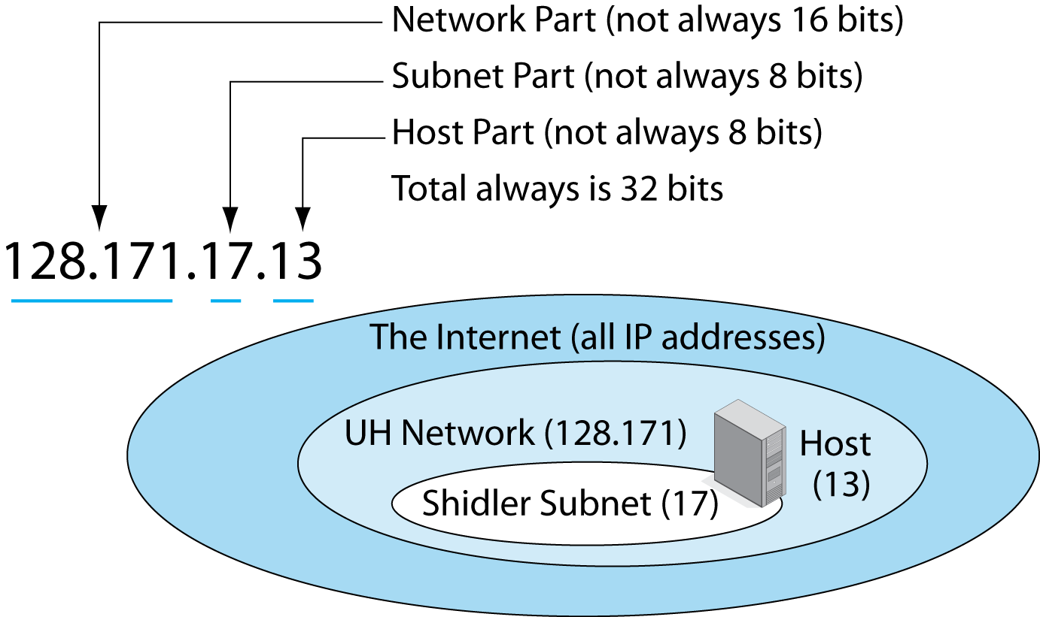
8.2: Hierarchical IPv4 Address
An IPv4 address usually has three parts.

Slide 10
8.2: Hierarchical IPv4 Address
The network part is given to a firm, ISP, or other entity by a registered number provider.
  The firm divides its address space into subnets.
    On each subnet, the host part indicates a particular host.

Slide 11
8.2: Hierarchical IPv4 Address
In an IPv4 address, how long are the network, subnet, and host parts?

Slide 12
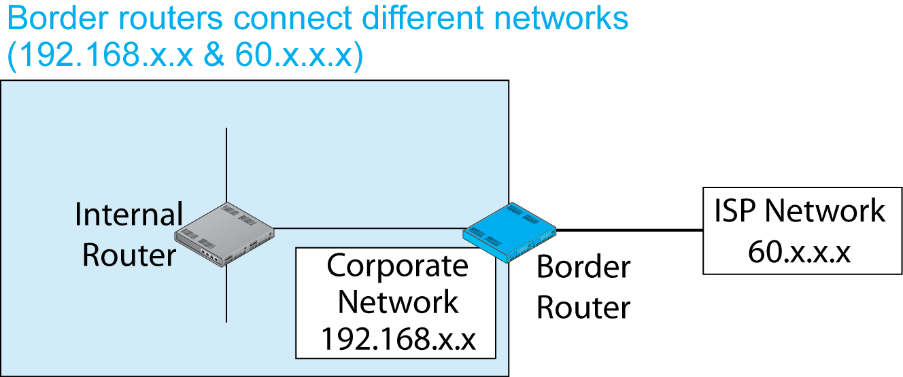
8.3: Border Router, Internal Router, Networks, and Subnets

Slide 13
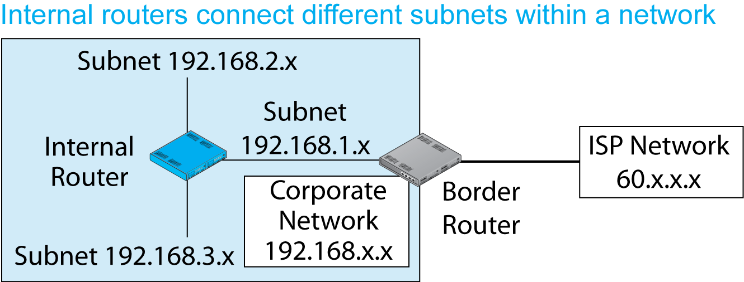
8.3: Border Router, Internal Router, Networks, and Subnets

Slide 14
8.4: IPv4 Network and Subnet Masks
The Problem
  There is no way to tell by looking at an IPv4 address the sizes of the network, subnet, and host parts individually—only that their total is 32 bits.
  The solution: masks

Slide 15
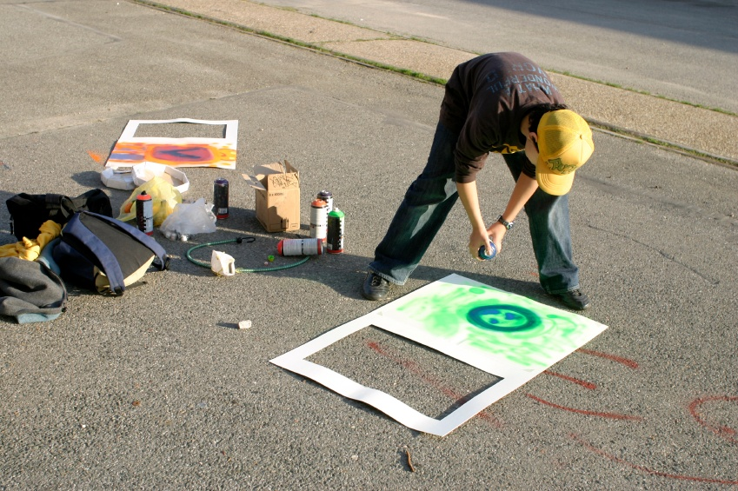
8.4: IPv4 Network and Subnet Masks
Masks
  In spray painting, you often use a mask (stencil).
  The mask allows part of the paint through but stops the rest from going through.
  Network and
  subnet masks
  do something
  similar.

Slide 16
8.4: IPv4 Network and Subnet Masks
The solution: masks
  A mask is a series of initial ones followed by series of final zeros, for a total of 32 bits.
  Example 1: Sixteen 1s followed by Sixteen 0s
    11111111 11111111 00000000 00000000
    Eight 1s is 255 in dotted decimal notation.
    Eight 0s is 0 in dotted decimal notation.
    In dotted decimal notation, 255.255.0.0.
    In prefix notation, /16 (the initial number of 1s)

Slide 17
8.4: IPv4 Network and Subnet Masks
The solution: masks
  A mask is a series of initial ones followed by series of final zeros, for a total of 32 bits.
  Example 2: Twenty-four 1s followed by eight 0s
    11111111 11111111 11111111 00000000
    Eight 1s is 255 in dotted decimal notation.
    Eight 0s is 0 in dotted decimal notation.
    In dotted decimal notation, 255.255.255.0.
    In prefix notation, /24.

Slide 18
8.4: IPv4 Network and Subnet Masks
The solution: masks
  Your turn
  Draw the 32 bits of the mask /14. Do not do it in dotted decimal notation. Write the bits in groups of eight. Here’s a start:
  11111111 11

Slide 19
8.4: IPv4 Network and Subnet Masks
Masks are applied to 32-bit IPv4 addresses.
IP Address bit | 1 | 0 | 1 | 0
Mask bit | 1 | 1 | 0 | 0
Result bit | 1 | 0 | 0 | 0
If the mask bit = 0, the result is always 0.
If the mask bit = 1, the result is always the IP address bit in that position.

Slide 20
8.4: IPv4 Network and Subnet Masks
Network Mask | Dotted Decimal Notation
Destination IP Address | 128 | 171 | 17 | 13
Network Mask (/16) | 255 | 255 | 0 | 0
Bits in network part, followed by zeros | 128 | 171 | 0 | 0

Slide 21
8.4: IPv4 Network and Subnet Masks
Subnet Mask | Dotted Decimal Notation
Destination IP Address | 128 | 171 | 17 | 13
Subnet Mask (/24) | 255 | 255 | 255 | 0
Bits in network part, followed by zeros | 128 | 171 | 17 | 0

Slide 22
Recap of TCP/IP Concepts
Hierarchical IP Addresses
Router Operation
Address Resolution Protocol
IPv4 and IPv6
TCP and UDP

Slide 23
Router Operation
We have talked about routers since
Chapter 1.
Now we will finally see what they do.
We will see what happens after a packet addressed to a particular IP address arrives at a router.
But we will first recap the simpler way in which Ethernet switches handle arriving frames.

Slide 24
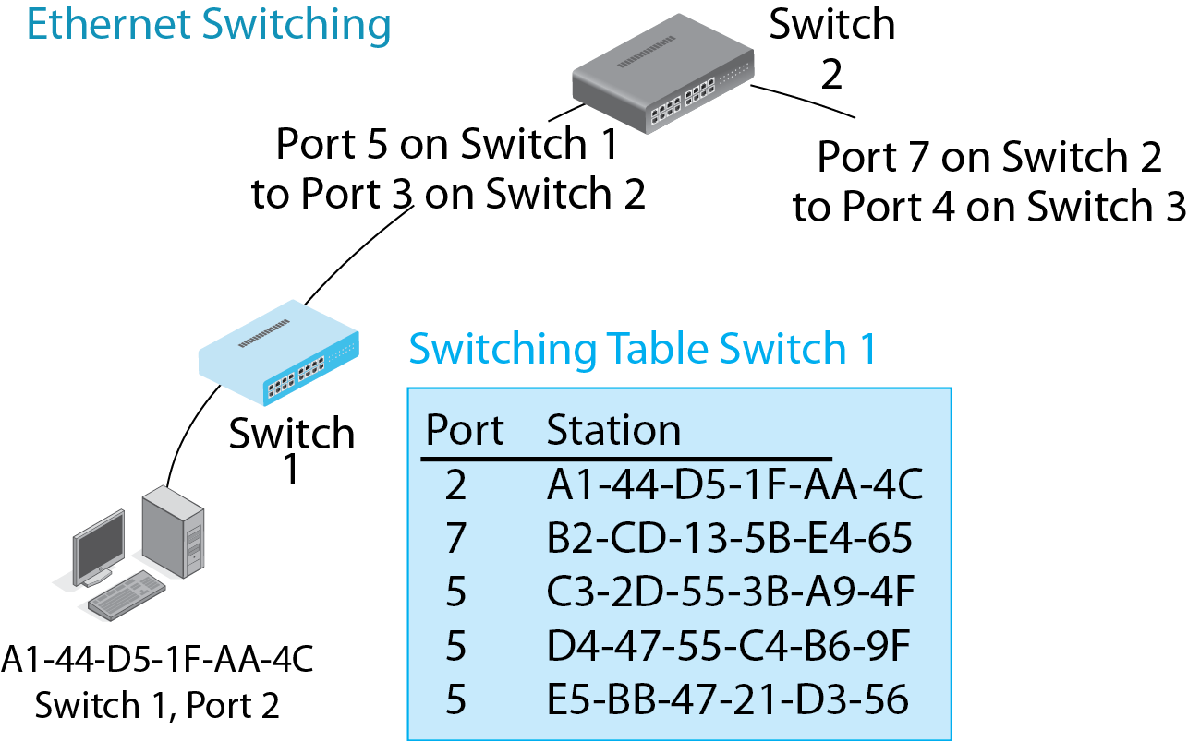
8.5: Ethernet Switching versus IP Routing
Ethernet switches are organized in a hierarchy, so there is only one possible port to send a frame out and so only one row per address.

Slide 25
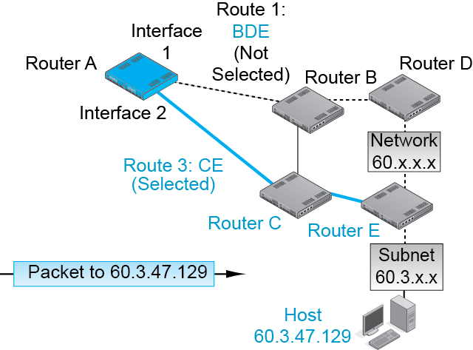
8.5: Ethernet Switching versus IP Routing
Routers are arranged
in meshes with
multiple alternative routes.
So a router may send a packet out more than one interface (port) and still get the packet to its destination host.

Slide 26
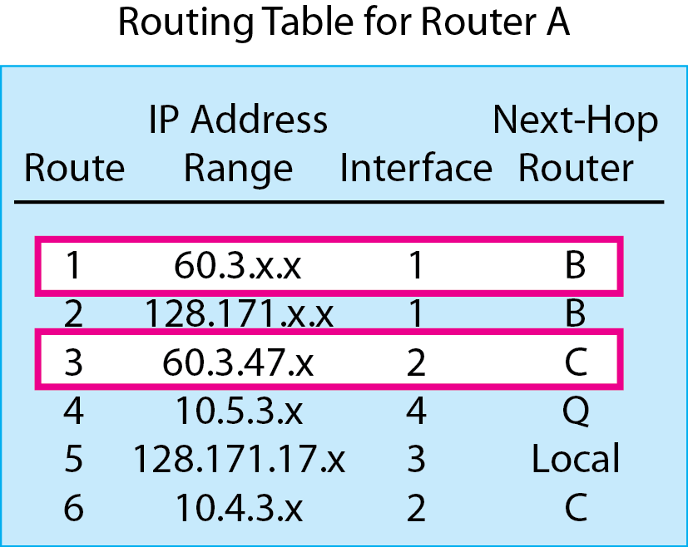
8.5: Ethernet Switching versus IP Routing
So in routing tables, multiple rows may give conflicting information about what to do with a packet.

Slide 27
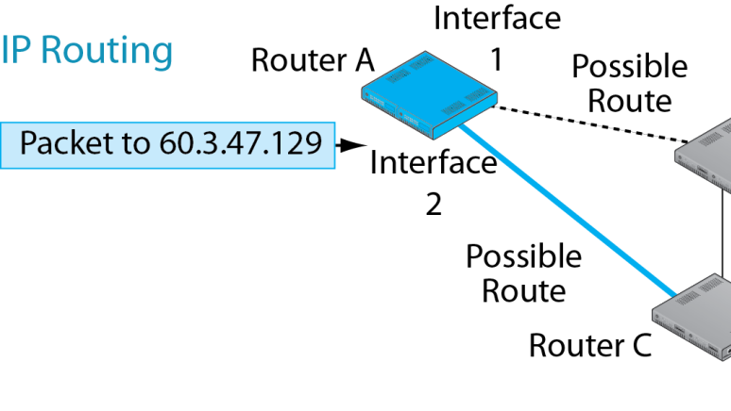
8.6: The Routing Process
Routing
  Processing an individual packet and passing it on its way is called routing.

Slide 28
8.6: The Routing Process
The Routing Table
  Each router has a routing table that it uses to make routing decisions.
  Routing Table Rows
    Each row represents
    a route for a range
    of IP addresses—
    often packets going
    to the same network
    or subnet.

Slide 29
8.6: The Routing Process
Ethernet switching table rows are rules for handling individual Ethernet EUI-48 addresses.
Router routing table rows are rules for handling ranges of IP addresses.

Slide 30
Routing Table Columns
Column | Meaning
Row Number | Designates the row in the routing table
Destination | Range of IP addresses governed by the row
Mask | Mask for the row
Metric | Quality of the route listed in this row
Interface | The interface (port) to use to send the packet out
Next-Hop Router | The device (router or destination host) on the interface subnet to receive the packet

Slide 31
8.7: Routing Table
Row | Destination Network or Subnet | Mask (/Prefix) | Metric (Cost) | Interface | Next-Hop Router
1 | 127.171.0.0 | 255.255.0.0 (/16) | 47 | 2 | G
2 | 172.30.33.0 | 255.255.255.0 (/24) | 0 | 1 | Local
3 | 60.168.6.0 | 255.255.255.0 (/24) | 12 | 2 | G
4 | 123.0.0.0 | 255.0.0.0 (/8) | 33 | 2 | G
5 | 172.29.8.0 | 255.255.255.0 (/24) | 34 | 1 | F
6 | 172.40.6.0 | 255.255.255.0 (/24) | 47 | 3 | H
7 | 128.171.17.0 | 255.255.255.0 (/24) | 55 | 3 | H
8 | 172.29.8.0 | 255.255.255.0 (/24) | 20 | 3 | H

Slide 32
8.7: Routing Table
Row | Destination Network or Subnet | Mask (/Prefix) | Metric (Cost) | Interface | Next-Hop Router
9 | 172.12.6.0 | 255.255.255.0 (/24) | 23 | 1 | F
10 | 172.30.12.0 | 255.255.255.0 (/24) | 9 | 2 | G
11 | 172.30.12.0 | 255.255.255.0 (/24) | 3 | 3 | H
12 | 60.168.0.0 | 255.255.0.0 (/16) | 16 | 2 | G
13 | 0.0.0.0 | 0.0.0.0 (/0) | 5 | 3 | H

Slide 33
8.8: The Routing Process
A Routing Decision
  Whenever a packet arrives, the router looks at its IP address, then…
  Step 1: Finds All Row Matches
  Step 2: Finds the Best-Match Row
  Step 3: Sends the Packet Back out According to Directions in the Best-Match Row

Slide 34
8.8: The Routing Process
Step 1: Finding All Row Matches
  The router looks at the destination IP address in an arriving packet.
  It matches this IP address against each row.
    It begins with the first row.
    It looks at every subsequent row.
    It stops only after it looks at the last row.

Slide 35
8.8: The Routing Process
Step 1: Finding All Row Matches
  Each row is a rule for routing packets within a range of IP addresses. The IP address range is indicated by a destination and a mask.
Row | Destination Network or Subnet | Mask
1 | 128.171.0.0 | /16
2 | 172.30.33.0 | /24
3 | 60.168.6.0 | /24

Slide 36
8.8: The Routing Process
Step 1: Finding All Row Matches
  Each row is a rule for routing packets within a range of IP addresses.
  The router has the IP address of an arriving packet.
  It applies the mask in the row to the arriving IPv4 address.
  If the result is equal to the value in the destination column, then the IP address of the packet is in the row’s range. The row is a match.
Copyright © 2015 Pearson Education, Inc.

Slide 37
8.8: The Routing Process
Example 1: A Destination IP Address that Is NOT in the Range of the Row
  Dest. IP Address of Packet 60. 43. 7. 8
  Apply the (Network) Mask 255.255. 0. 0
  Result of Masking 60. 43. 0. 0
  Destination Column Value 128.171. 0. 0
  Does Destination Match the Masking Result? No
  Conclusion: Not a Match
Don’t forget the final step: Giving your conclusion!

Slide 38
8.8: The Routing Process
Example 2: A Destination IP Address that IS in the Range of the Row
  Dest. IP Address of Packet 128.171. 17. 13
  Apply the (Network) Mask 255.255. 0. 0
  Result of Masking 128.171. 0. 0
  Destination Column Value 128.171. 0. 0
  Does Destination Match the Masking Result? Yes
  Conclusion: Is a Match
Don’t forget the final step: Giving your conclusion!

Slide 39
8.8: The Routing Process
Step 1: Finding All Row Matches
  The router does this to ALL rows because there may be multiple matches.
  Question 1: If there are 127,976 rows and the only rows that match are the second and seventh rows, what row will the router examine first?
  Question 2: If there are 127,976 rows and the only rows that match are the second and seventh rows, how many rows will the router have to check to see if they match?

Slide 40
8.8: The Routing Process
A Routing Decision
  Whenever a packet arrives, the router looks at its IP address, then…
  Step 1: Finds All Row Matches
  Step 2: Finds the Best-Match Row
  Step 3: Sends the Packet Back out According to Directions in the Best-Match Row

Slide 41
8.8: The Routing Process
To find the best-match row, the router uses the mask column and perhaps the metric column.
Row | Mask | Metric (Cost)
1 | /16 | 47
2 | /24 | 0
3 | /24 | 12

Slide 42
8.8: The Routing Process
Step 2: Find the Best-Match Row
  The router examines the matching rows it found in Step 1 to find the best-match row.
  Basic Rule: it selects the row with the longest match (Initial 1s in the row mask).
    Row 99 matches, mask is /16 (255.255.0.0)
    Row 78 matches, mask is /24 (255.255.255.0)
    Select Row 78 as the best-match row.

Slide 43
8.8: The Routing Process
Step 2: Find the Best-Match Row
  Basic Rule: it selects the row with the longest match (Initial 1s in the row mask).
  Tie Breaker: if there is a tie for longest match, select among the tie rows based on metric.
    There is a tie for longest length of match.
    Row 668 has match length /16, cost metric = 20.
    Row 790 has match length /16, cost metric = 16.
    Router selects 790, which has the lowest cost.

Slide 44
8.8: The Routing Process
Step 2: Find the Best-Match Row
  Basic Rule: it selects the row with the longest match (Initial 1s in the row mask).
  Tie Breaker: if there is a tie on longest match, select among the tie rows based on metric.
    There is a tie for longest length of match.
    Row 668 has match /16, speed metric = 20.
    Row 790 has a match /16, speed metric = 16.
    Router selects 668, which has the highest speed.

Slide 45
8.8: The Routing Process
Step 2: Find the Best-Match Row
  The following rows are matches.
    Row / Mask / Metric
    220 /24 / speed metric = 40
    345 /18 / speed metric = 50
    682 /8 /speed metric = 40
  Question: What is the best-match row? Why?

Slide 46
8.8: The Routing Process
Step 2: Find the Best-Match Row
  The following rows are matches.
    Row / Mask / Metric
    107 / 12 / speed metric = 30
    220 / 14 / speed metric = 100
    345 / 18 / speed metric = 50
    682 / 18 / speed metric = 40
  Question: What is the best-match row? Why?

Slide 47
8.8: The Routing Process
Step 2: Find the Best-Match Row
  The following rows are matches.
    Row / Mask / Metric
    107 / 12 / cost metric = 30
    220 / 14 / cost metric = 100
    345 / 18 / cost metric = 50
    682 / 18 / cost metric = 40
  Question: What is the best-match row? Why?

Slide 48
8.8: The Routing Process
A Routing Decision
  Whenever a packet arrives, the router looks at its IP address, then…
  Step 1: Finds All Row Matches
  Step 2: Finds the Best-Match Row
  Step 3: Sends the Packet Back out According to Directions in the Best-Match Row

Slide 49
8.8: The Routing Process
Router Port = Interface
Step 3: Send the Packet Back out
  Send the packet out the router interface (port) designated in the best-match row.
  Send the packet to the router in the next-hop router column.
Row | Interface | Next-Hop Router
1 | 2 | G
2 | 1 | Local
3 | 2 | H

Slide 50
8.8: The Routing Process
Step 3: Send the Packet Back out
  If the address says Local, the destination host is out that interface.
    Sends the packet to the destination IP address in a frame.
Row | Interface | Next-Hop Router
1 | 2 | G
2 | 1 | Local
3 | 2 | H

Slide 51
8.8: The Routing Process
Recap
A Routing Decision
  Whenever a packet arrives, the router looks at its IP address, then…
  Step 1: Finds All Row Matches
  Step 2: Finds the Best-Match Row
  Step 3: Sends the Packet Back out According to Directions in the Best-Match Row

Slide 52
Decision Caching (Cheating)
We have said consistently that the router must look at ALL rows when it receives an incoming packet.
That was, to use a technical term, a lie.
Some routers remember decisions and put them in a list called a cache.
If an incoming destination IP address matches an IP address range in the cache, the same decision is used.

Slide 53
Decision Caching (Cheating)
However, caching is dangerous.
Routers and transmission lines come and go.
The best route to a destination host changes frequently.
A cache-based decision may be inefficient or even wrong.
If caching is done, cached entries should be deleted very quickly after they are created.

Slide 54
8.9: Masks that Don’t End at 8-Bit Boundaries
So far, all of the masks we have seen have broken the network, subnet, and host parts at 8-bit boundaries.
This was done for ease of reading in dotted decimal notation.
However, mask parts often do not break at 8-bit boundaries.
The solution: Work in binary, not dotted decimal notation.
Box

Slide 55
8.9: Masks that Don’t End at 8-Bit Boundaries
Box
IP address = 3.143.12.12
Mask = 255.248.0.0
Destination Value = 3.264.0.0
Is this a match?

Slide 56
8.9: Masks that Don’t End at 8-Bit Boundaries
The solution: Work in binary, not dotted decimal notation
IP address = 3.143.12.12
  00000011 10001111 00001100 00001100
Mask = 255.248.0.0
  11111111 11111000 00000000 00000000
Destination Value = 3.264.0.0
  00000011 10001000 00000000 00000000
Box

Slide 57
8.9 Masks that Don’t End at 8-Bit Boundaries
 | Octet 1 | Octet 2 | Octet 3 | Octet 4
IP Address | 00000011 | 10001111 | 00001100 | 00001100
Mask | 11111111 | 11111000 | 00000000 | 00000000
Result | 00000011 | 10001000 | 00000000 | 00000000
Destination | 00000011 | 10001000 | 00000000 | 00000000
The result and the destination match!
So this row is a match.
Box

Slide 58
Recap of TCP/IP Concepts
Hierarchical IP Addresses
Router Operation
Address Resolution Protocol
IPv4 and IPv6
TCP and UDP

Slide 59
8.10: Address Resolution Protocol (ARP)
Box
The Problem
  The router wants to send the packet to a next-hop router or to the destination host.
  The router knows the IP address of the NHR or destination host.
  But it must send the packet in a frame suitable for that subnet.
Packet
Frame
Destination IP address of the next-hop router or destination host is known from the routing table.

Slide 60
8.10: Address Resolution Protocol (ARP)
Box
The Problem
  The router does NOT know the destination device’s data link layer address.
  It must learn it using the address resolution protocol (ARP).
Packet
???
Frame
Destination DLL address of the next-hop router or destination host is NOT known from the routing table.

Slide 61
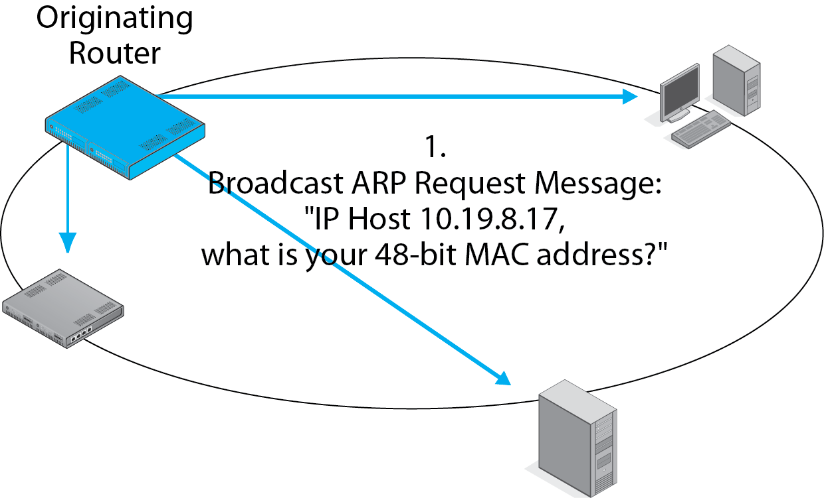
8.10: Address Resolution Protocol (ARP)
Box
1.
Broadcast ARP Request Message:
“IP host 10.19.8.17
What is your EUI-48 address?”

Slide 62
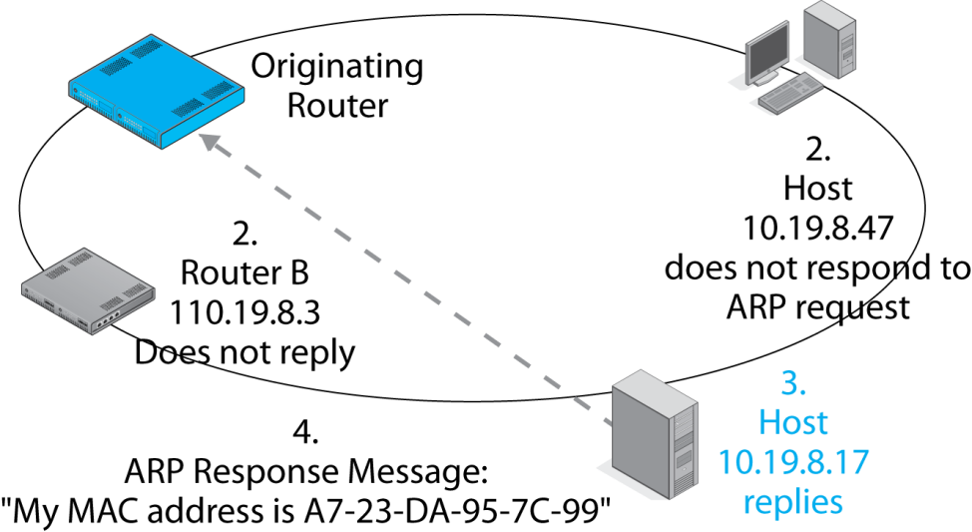
8.10: Address Resolution Protocol (ARP)
Box
4.
ARP Response Message:
“My EUI-48 address is A7-23-DA-95-7C-99”

Slide 63
8.10: Address Resolution Protocol (ARP)
Box
ARP Cache
Destination IP Address of Packet | Destination EUI-48 Address of Frame
… | …
10.19.8.17 | A7-23-DA-95-7C-99
… | …
… | …
Router places IP address / DLL address pair in an ARP cache. No need to run ARP again for 10.19.8.17

Slide 64
Recap of TCP/IP Concepts
Hierarchical IP Addresses
Router Operation
Address Resolution Protocol
IPv4 and IPv6
TCP and UDP

Slide 65
8.11: IPv4 Packet
Bit 0
IP Version 4 Packet
Bit 31
Version
(4 bits)
Value
is 4
(0100)
Header
Length
(4 bits)
DSCP
(6 bits)
Total Length
(16 bits)
Length in octets
ECN
(2)
IPv4 is the dominant version of IP today.
The version number in its header is 4 (0100).
The Header Length and Total Length fields tell the size
of the packet.
The Differentiated Service Control Point field can be used
for quality of service labeling.
Identification (16 bits)
Unique value in each original
IP packet
Flags
(3 bits)
Fragment Offset (13 bits)
Octets from start of
original IP fragment’s
data field
Time to Live
(8 bits)
Protocol (8 bits)
1=ICMP, 6=TCP,
17=UDP
Header Checksum
(16 bits)

Slide 66
8.11: IPv4 Packet
Bit 0
The second row is used for reassembling
fragmented IP packets, but IP fragmentation
is quite rare, so we will not look at
these fields.
IP Version 4 Packet
Bit 31
Version
(4 bits)
Value
is 4
(0100)
Header
Length
(4 bits)
Diff-Serv
(8 bits)
Total Length
(16 bits)
Length in octets
Identification (16 bits)
Unique value in each original
IP packet
Flags
(3 bits)
Fragment Offset (13 bits)
Octets from start of
original IP fragment’s
data field
Time to Live
(8 bits)
Protocol (8 bits)
1=ICMP, 6=TCP,
17=UDP
Header Checksum
(16 bits)

Slide 67
8.11: IPv4 Packet
Bit 0
IP Version 4 Packet
The sender sets the Time-to-Live value (usually 64
to 128). Each router along the way decreases the
value by one. A router decreasing the value to zero
discards the packet. It may send an ICMP error
Message (discussed later).
Bit 31
Version
(4 bits)
Value
is 4
(0100)
Header
Length
(4 bits)
Diff-Serv
(8 bits)
Total Length
(16 bits)
Length in octets
Identification (16 bits)
Unique value in each original
IP packet
Flags
(3 bits)
Fragment Offset (13 bits)
Octets from start of
original IP fragment’s
data field
Time to Live
(8 bits)
Protocol (8 bits)
1=ICMP, 6=TCP,
17=UDP
Header Checksum
(16 bits)

Slide 68
8.11: IPv4 Packet
Bit 0
IP Version 4 Packet
Bit 31
Version
(4 bits)
Value
is 4
(0100)
Header
Length
(4 bits)
DSCP
(6 bits)
Total Length
(16 bits)
Length in octets
ECN
(2)
The Protocol field describes the message in the
data field (1 = ICMP, 6 = TCP, 17 = UDP, etc).
Identification (16 bits)
Unique value in each original
IP packet
Flags
(3 bits)
Fragment Offset (13 bits)
Octets from start of
original IP fragment’s
data field
Time to Live
(8 bits)
Protocol (8 bits)
1=ICMP, 6=TCP,
17=UDP
Header Checksum
(16 bits)

Slide 69
8.11: IPv4 Packet
Bit 0
IP Version 4 Packet
Bit 31
As we saw in earlier chapters, the Header Checksum
field is used to find errors in the IP packet header.
If a packet has an error, the router drops it.
There is no retransmission at the internet layer,
so the internet layer is still unreliable.
Version
(4 bits)
Value
is 4
(0100)
Header
Length
(4 bits)
Diff-Serv
(8 bits)
Total Length
(16 bits)
Length in octets
Identification (16 bits)
Unique value in each original
IP packet
Flags
(3 bits)
Fragment Offset (13 bits)
Octets from start of
original IP fragment’s
data field
Time to Live
(8 bits)
Protocol (8 bits)
1=ICMP, 6=TCP,
17=UDP
Header Checksum
(16 bits)

Slide 70
8.11: IPv4 Packet
Bit 0
IP Version 4 Packet
Bit 31
Source IP Address (32 bits)
Destination IP Address (32 bits)
Options (if any)
Padding
Data Field
The Source and Destination IP Addresses
are 32 bits long, as you would expect.
Options can be added, but these are rare
and may indicate a malicious packet.

Slide 71
Outgrowing IPv4
IPv4 32-bit addresses allow more than 4 billion addresses.
However, addresses were given out by the Internet Assigned Number Authority (IANA) in chunks.
Today, only 14% of IPv4 addresses are in use, but we have run out of IPv4 addresses to assign to new organizations and ISPs.

Slide 72
Outgrowing IPv4
IPv6, fortunately, has 128-bit addresses.
This is an enormous address space (2¹²⁸).
IPv6 traffic is still very small.
However, firms must plan to support IPv6 now.
Graduates need a solid understanding of IPv6.

Slide 73
8.12: Writing IPv6 Addresses
IPv4 addresses are written in dotted decimal notation.
  Divide the 32-bit address into four 8-bit segments.
  Convert each segment to a decimal number.
  Place dots between the segments.

Slide 74
8.12: Writing IPv6 Addresses
IPv6 addresses are written in hexadecimal
  Convert each 4 bits to hex symbol
    Write letter symbols (a … f) in lower case
  Combine 4 symbols into a segment
  Separate 4-symbol segments by colons.
2001:0027:fe56:0000:0000:0000:cd3f:0fca

Slide 75
8.12: Writing IPv6 Addresses
There are rules to shorten this notation.
  Leading zeroes in each segment can be dropped.
  A segment with 4 zeroes had 4 leading zeroes.
2001:0027:fe56:0000:0000:0000:cd3f:0fca
2001:27:fe56::::cd3f:fca

Slide 76
8.12: Writing IPv6 Addresses
If there is a single set of consecutive segments that are all zeroes, only the outer colons are kept.
2001:27:fe56::::cd3f:fca
2001:27:fe56::cd3f:fca

Slide 77
8.12: Writing IPv6 Addresses
What if there is more than one consecutive group of segments that is all zeroes?
  Remove inner colons in the LONGEST one.
  Do not remove any other inner colons.
2001:0000:0000:dfca:0000:0000:0000:cd3f
2001:::dfca::::cd3f
2001:::dfca::cd3f

Slide 78
8.12: Writing IPv6 Addresses
What if there is a tie for the longest group of all-zero segments?
  Remove the inner colons from the first one
2001:0000:0000:dfca:0000:0000:abcd:cd3f
2001::dfca:::abcd:cd3f

Slide 79
8.12: Writing IPv6 Addresses (Recap)
Convert each 4 bits to a hex symbol.
  Write letter symbols in lower case.
Group the symbols into segments of four.
Place colons between each pair of segments.
Remove initial zeroes in each segment.
  If there are is a group of segments with all zeroes, remove the inner colons.
  Only do this to one segment—the longest one (or the first if there is a tie for longest).

Slide 80
8.13: IPv6 Packet Header
Bit 0
Version field
is 6 (0110).
IP Version 6 Packet
Bit 31
Version
(4 bits)
Value
is 6
(0110)
Diff-Serv
(8 bits)
Flow Label (20 bits)
Marks a packet as part of a specific flow
Payload Length
(16 bits)
Next Header
(8 bits) Name
of next header
Hop Limit
(8 bits)
Source IP Address (128 bits)
Destination IP Address (128 bits)
Next Header or Payload (Data Field)

Slide 81
8.13: IPv6 Packet Header
Bit 0
IP Version 6 Packet
Bit 31
Version
(4 bits)
Value 6
(0110)
Traffic Class
(8 bits)
Diffserv (6)
Congestion
Notification (2)
Flow Label (20 bits)
Marks a packet as part of a specific flow
Payload Length
(16 bits)
Next Header
(8 bits) Name
of next header
Hop Limit
(8 bits)
Diff-Serv (Differentiated Services) field
specifies the quality of service
requested for this packet.
Source IP Address (128 bits)
Destination IP Address (128 bits)
Next Header or Payload (Data Field)

Slide 82
8.13: IPv6 Packet Header
Bit 0
IP Version 6 Packet
Bit 31
Version
(4 bits)
Value
is 6
(0110)
Traffic Class
(8 bits)
Diffserv (6)
Congestion
Notification (2)
Flow Label (20 bits)
Marks a packet as part of a
specific flow of packets
Payload Length
(16 bits)
Next Header
(8 bits) Name
of next header
Hop Limit
(8 bits)
Flow Label specifies that this packet
is part of a specific flow of packets
to be treated in a particular way
defined at the start of the flow.
Source IP Address (128 bits)
Destination IP Address (128 bits)
Next Header or Payload (Data Field)

Slide 83
8.13: IPv6 Packet Header
Bit 0
IP Version 6 Packet
Bit 31
Version
(4 bits)
Value
is 6
(0110)
Traffic Class
(8 bits)
Diffserv (6)
Congestion
Notification (2)
Flow Label (20 bits)
Marks a packet as part of a
specific flow of packets
Payload Length
(16 bits)
Next Header
(8 bits) Name
of next header
Hop Limit
(8 bits)
Source IP Address (128 bits)
IPv6 header is always 40 octets long.
Payload Length is the length of the
remainder of the packet in octets.
Destination IP Address (128 bits)
Next Header or Payload (Data Field)

Slide 84
8.13: IPv6 Packet Header
Bit 0
IP Version 6 Packet
Bit 31
Version
(4 bits)
Value
is 6
(0110)
Traffic Class
(8 bits)
Diffserv (6)
Congestion
Notification (2)
Flow Label (20 bits)
Marks a packet as part of a
specific flow of packets
Payload Length
(16 bits)
Next Header
(8 bits) Name
of next header
Hop Limit
(8 bits)
Source IP Address (128 bits)
IPv6 Hop Limit works exactly like
the Time-to-Live field in IPv4.
The name change was
done to confuse students.
Destination IP Address (128 bits)
Next Header or Payload (Data Field)

Slide 85
8.13: IPv6 Packet Header
Bit 0
IP Version 6 Packet
Bit 31
Version
(4 bits)
Value
is 6
(0110)
Traffic Class
(8 bits)
Diffserv (6)
Congestion
Notification (2)
Flow Label (20 bits)
Marks a packet as part of a specific flow
Source and Destination Addresses
are 128 bits long.
Payload Length
(16 bits)
Next Header
(8 bits) Name
of next header
Hop Limit
(8 bits)
Source IP Address (128 bits)
Destination IP Address (128 bits)
Next Header or Payload (Data Field)

Slide 86
8.14: IPv6 Packet Header
IPv4 Addresses
IPv6 Addresses
32 bits long
2³² possible addresses
About 4 billion possible addresses
Have run out of these
128 bits long
2¹²⁸ possible addresses
340,282,366,920,938,000,000,000,000,000,000,000,000 addresses
Growth will be in IPv6

Slide 87
8.14: IPv6 Packet Header
Where’s all that fragmentation stuff from IPv4?
  Gone, packet fragmentation is not done in IPv6.
  What if a packet is too big for a network along the way?
    It is discarded.
  So the sending host first determines the MTU (maximum transmission unit)—largest packet size along the route—before transmission.

Slide 88
8.14: IPv6 Packet Header
Hey, where is the Header Checksum?
  Gone, let the transport layer worry about errors.
  This avoids the work of error checking on each router along the way.
  Reduces per-packet routing time and cost.

Slide 89
8.15: Next Headers in IPv6 Packet Headers
Bit 0
IP Version 6 Packet
Bit 31
Version
(4 bits)
Value
is 6
(0110)
Traffic Class
(8 bits)
Diffserv (6)
Congestion
Notification (2)
Flow Label (20 bits)
Marks a packet as part of a
specific flow of packets
Payload Length
(16 bits)
Next Header
(8 bits) Name
of next header
Hop Limit
(8 bits)
Source IP Address (128 bits)
IPv6 has many next headers,
each is linked to the next
via the Next Header field
Destination IP Address (128 bits)
Next Header or Payload (Data Field)

Slide 90
8.15: Next Headers in IPv6 Packet Headers
Main Header
0
Next Header
Hop-by-Hop Options Header (0)
6
Next Header
TCP Segment (6)

Slide 91
8.15: IPv6 Next Header Values
Header Type | Value
Extension Header
Hop-by-Hop Options Header | 0
Routing Header | 43
Fragmentation Header | 44
Authentication Header | 51
Encapsulating Security Protocol Header | 50
Destination Options Header | 60
Mobility Header | 135
No Next Header | 59
Routers along the packet’s route typically only have to examine the hop-by-hop options header.
This reduces the processing time per packet.

Slide 92
8.15: IPv6 Next Header Values
Header Type | Value
Extension Header
Hop-by-Hop Options Header | 0
Routing Header | 43
Fragmentation Header | 44
Authentication Header | 51
Encapsulating Security Protocol Header | 50
Destination Options Header | 60
Mobility Header | 135
No Next Header | 59

Slide 93
8.15: IPv6 Next Header Values
Header Type | Value
Upper Layer messages
TCP | 6
UDP | 17
ICMPv6 | 58

Slide 94
Recap of TCP/IP Concepts
Hierarchical IP Addresses
Router Operation
Address Resolution Protocol
IPv4 and IPv6
TCP and UDP

Slide 95
8.16: TCP and UDP
TCP Process
  Receives an application message from the application layer process
  Fragments the application message into segments
  Sends each segment in a separate IP packet

Slide 96
8.16: TCP and UDP
TCP Process
  Places a sequence number in each segment.
  Receiver uses these sequence numbers to reassemble the application message.
  When receiver receives a TCP segment correctly, it sends back an acknowledgement segment.
  This acknowledgement segment has an acknowledgement number that indicates which segment is being acknowledged.

Slide 97
8.16: TCP and UDP
UDP Process
  Does not do fragmentation.
  Does not need sequence numbers, acknowledgement numbers, or acknowledgements.
  This simplifies UDP.
  However, the entire application message must fit in a single UDP datagram field—a maximum size of 65,536 octets.

Slide 98
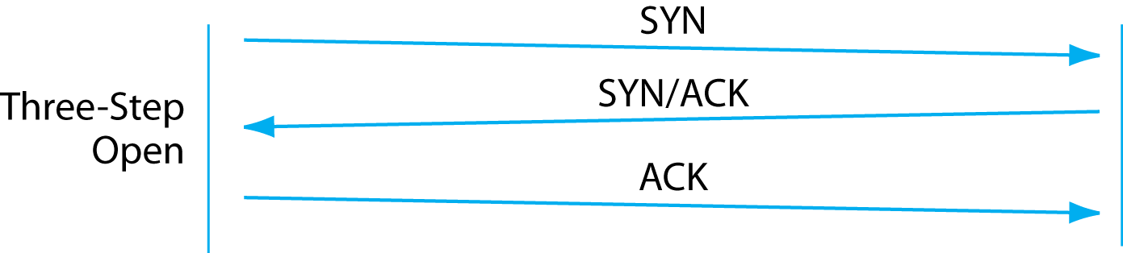
8.17: TCP Session Openings and Closings
Normal TCP Open
(from Chapter 2)

Slide 99
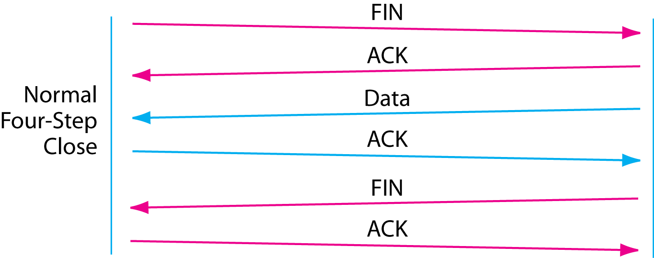
8.17: TCP Session Openings and Closings
Normal TCP Close
(also from Chapter 2)

Slide 100
8.17: TCP Session Openings and Closings
Abrupt TCP Close
closes the connection immediately.
Other side does not acknowledge.
New. Not in Chapter 2.

