Slide 1
TCP/IP Internetworking II
Chapter 9
Panko and Panko
Business Data Networks and Security, 9th Edition
© 2015 Pearson Education

Slide 2
Perspective
Chapter (s) | Coverage | Layers
1–4 | Core concepts and principles | All
5 | Single switched networks | 1–2
6–7 | Single wireless networks | 1–2
8–9 | Internets | 3–4
10 | Wide Area Networks | 1-4
11 | Applications | 5

Slide 3
Perspective
Chapter 8
  Major TCP/IP standards
  Router operation
Chapter 9
  Managing Internets
  Securing Internets

Slide 4
IP Subnetting
Network Address Translation (NAT)
Domain Name System (DNS)
Simple Network Management Protocol
IP Security (IPsec)
IPv6 Management
Other TCP/IP Supervisory Standards

Slide 5
9.1: IPv4 Subnetting
Companies are given network parts by their ISP or an Internet number authority.
They divide the remaining bits between a subnet part and a host part.
Larger subnet parts mean more subnets, but this results in smaller host parts, which means fewer hosts per subnet.
The reverse is also true.

Slide 6
9.1: IPv4 Subnetting
If a part has N bits, it can represent 2^{N} - 2 subnets or hosts per subnet.
  2^{N} because if you have N bits, you can represent 2^{N} possibilities.
  Minus 2 is because
  you cannot have a
  part that is all
  zeros or all ones.
Part Size
(bits)
2^{N}
2^{N}-2
4
2⁴ = 16
16-2 = 14
8
?
?
10
?
?
12
4,096
4,094
16
65,536
65,534

Slide 7
9.1: IPv4 Subnetting
Step
Description
1
Total size of IP address
(bits)
32
By definition
2
Size of network part
assigned to firm (bits)
16
Assigned to
the firm
3
Remaining bits for firm
to assign
16
Bits for the
firm to assign
4
Selected subnet/host part
sizes (bits)
8 / 8
The firm’s
decision
Number of possible
subnets (2^{N} - 2)
254
(2⁸ - 2)
Number of possible hosts
per subnet (2^{N} - 2)
254
(2⁸ - 2)

Slide 8
9.1: IPv4 Subnetting
Step
Description
1
Total size of IP address
(bits)
32
By definition
2
Size of network part
assigned to firm (bits)
16
Assigned to
the firm
3
Remaining bits for firm to
assign
16
Bits for the
firm to assign
4
Selected subnet/host part
sizes (bits)
6/10
The firm’s
decision
Number of possible
subnets (2^{N} - 2)
62
(2⁶ - 2)
Number of possible hosts
per subnet (2^{N} - 2)
1,022
(2¹⁰ - 2)

Slide 9
9.1: IPv4 Subnetting
Step
Description
1
Total size of IP address
(bits)
32
By definition
2
Size of network part
assigned to firm (bits)
8
Assigned to
the firm
3
Remaining bits for firm to
assign
24
Bits for the
firm to assign
4
Selected subnet/host part
sizes (bits)
12/12
The firm’s
decision
Number of possible
subnets (2^{N} - 2)
4,094
(2¹² - 2)
Number of possible hosts
per subnet (2^{N} - 2)
4,094
(2¹² - 2)

Slide 10
9.1: IPv4 Subnetting
Step
Description
1
Total size of IP address
(bits)
32
By definition
2
Size of network part
assigned to firm (bits)
8
Assigned to
the firm
3
Remaining bits for firm to
assign
24
Bits for the
firm to assign
4
Selected subnet/host part
sizes (bits)
8/16
The firm’s
decision
Number of possible
subnets (2^{N} - 2)
254
(2⁸ - 2)
Number of possible hosts
per subnet (2^{N} - 2)
65,534
(2¹⁶ - 2)

Slide 11
9.1: IPv4 Subnetting
Exercise
Step
Description
2
Size of IP address
32
2
Size of network part
assigned to firm (bits)
20
3
Remaining bits for firm to
assign
12
Added
Selected subnet part
size (bits)
4
4
Host part size (bits)
?
Number of possible
subnets (2^{N} - 2)
?
Number of possible hosts
per subnet (2^{N} - 2)
?

Slide 12
9.1: IPv4 Subnetting
Exercise
Step
Description
2
Size of IP address
32
2
Size of network part
assigned to firm (bits)
20
3
Remaining bits for firm to
assign
12
Added
Selected subnet part
size (bits)
6
4
Host part size (bits)
?
Number of possible
subnets (2^{N} - 2)
?
Number of possible hosts
per subnet (2^{N} - 2)
?

Slide 13
IP Subnetting
Network Address Translation (NAT)
Domain Name System (DNS)
Simple Network Management Protocol
IP Security (IPsec)
IPv6 Management
Other TCP/IP Supervisory Standards

Slide 14
9.2: Network Address Translation (NAT)
NAT
  Sends packets with false external source IP addresses and port numbers that are different from internal source IP addresses and port numbers
  To expand the number of IP addresses inside the firm
  For security purposes

Slide 15
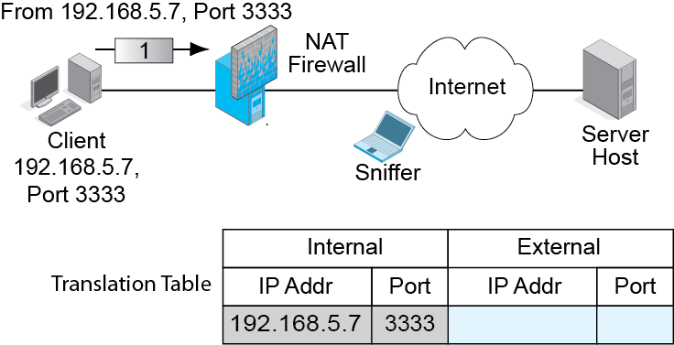
9.3: NAT Operation
NAT Firewall puts the real source IP address and port number in the table.

Slide 16
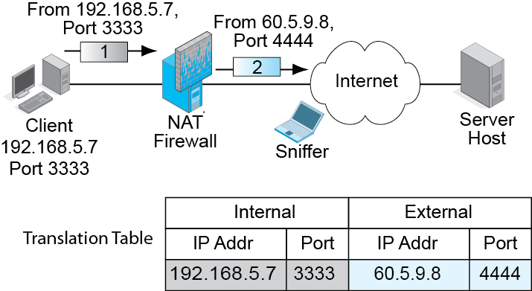
9.3: NAT Operation
NAT Firewall replaces the source IP address and port number of the packet with a false source IP address and port number.
Adds to table.

Slide 17
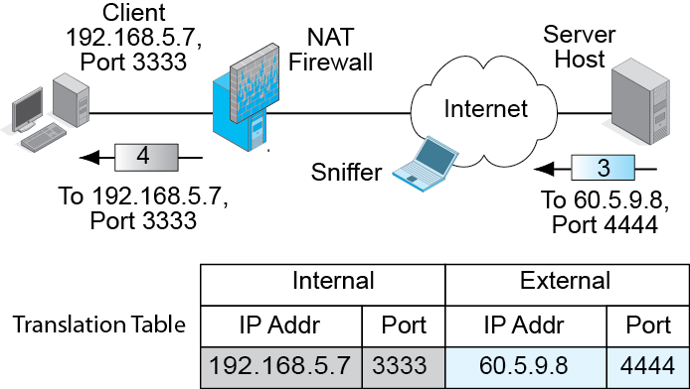
9.3: NAT Operation
NAT Firewall reverses the process for incoming packets.

Slide 18
9.3: NAT Operation
NAT Firewall reverses the process for incoming packets.

Slide 19
9.2: Network Address Translation
NAT is Transparent to Internal and External Hosts.
  The NAT firewall does all the work.
  Neither host knows that NAT is taking place.
  So there is no need to modify how hosts work.

Slide 20
9.2: Network Address Translation
Security Reasons for Using NAT
  External attackers can put sniffers outside the corporation.
  Sniffers read IP addresses and port numbers.
  Attackers can send attacks to these addresses and port numbers.
  With NAT, attackers learn only false
  external IP addresses. Cannot use this
  information to attack internal hosts.

Slide 21
9.2: NAT
Expanding the Number of Available IP Addresses
  Companies may receive a limited number of IP addresses from their ISPs.
  There are roughly 4,000 possible ephemeral port numbers for each client IP address.
  So for each IP address, there can be up to about 4,000 external connections.
  If a firm is given 248 IP addresses, there can be roughly one million external connections (254 x 4000}

Slide 22
9.2: NAT
Expanding the Number of Available IP Addresses
  If each internal device averages several simultaneous external connections, each one will require a different port number.
  However, there should not be a problem with this many possible external IP addresses and port numbers.

Slide 23
9.2: NAT
Companies often use private IP addresses internally.
These can be used only within companies—never on the Internet.
There are three Private IP address ranges.
  10.x.x.x
  172.16.x.x through 172.31.x.x
  192.168.x.x (most popular)

Slide 24
9.2: NAT
There Are Protocol Problems Caused by NAT
  IPsec, VoIP, and other applications have a difficult time with NAT firewall traversal.
  They must know the real IP address and port number of the host on the other side of the NAT firewall.
  There are NAT firewall traversal techniques, but they must be managed carefully.

Slide 25
IP Subnetting
Network Address Translation (NAT)
Domain Name System (DNS)
Simple Network Management Protocol
IP Security (IPsec)
IPv6 Management
Other TCP/IP Supervisory Standards

Slide 26
The Domain Name System (DNS)
A domain is any group of resources (routers, single networks, hosts, etc.) under the control of an organization.

Slide 27
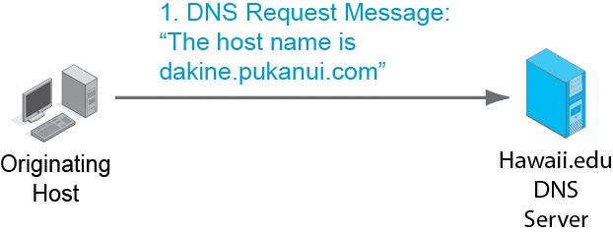
9.4: Domain Name System (DNS) Lookup
Originating host needs the IP address of host dakine.pukanui.com.
Asks its local DNS server at Hawaii.edu.

Slide 28
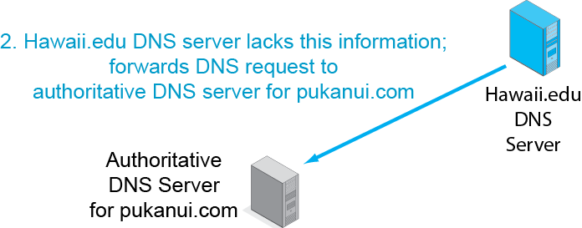
9.4: Domain Name System (DNS) Lookup

Slide 29
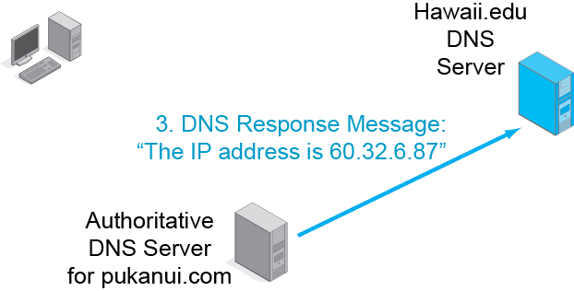
9.4: Domain Name System (DNS) Lookup
Sends response to local DNS server, not the client host.

Slide 30
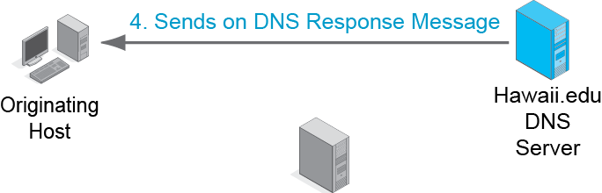
9.4: Domain Name System (DNS) Lookup
Note that the local DNS server always sends back the response message.

Slide 31
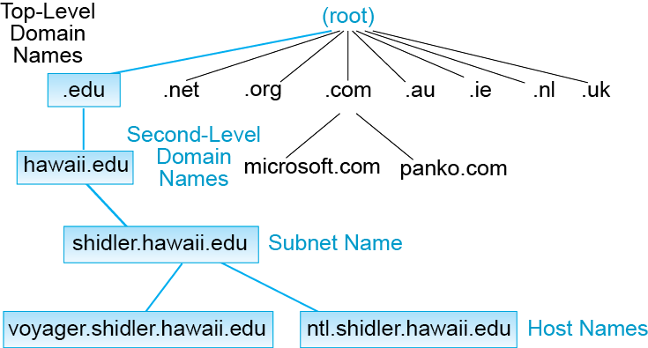
9.5: Domain Name System (DNS) Hierarchy
The DNS really is a general naming system for the Internet.
A domain is a set of resources under the control of an organization.
There is a hierarchy of domains.

Slide 32
9.5: Domain Name System (DNS) Hierarchy
The root is all domains.
There are 13 DNS root servers.

Slide 33
9.5: Domain Name System (DNS) Hierarchy
There are two kinds of top-level domains.
Generic top-level domains indicate organization type (.com, .edu, .gov, etc.).
Country top-level domains are specific to a country (.au, .ie, .ch, etc.).

Slide 34
9.5: Domain Name System (DNS) Hierarchy
Traditionally, generic top-level domains were strongly limited in number.
There have been a few additions over the year, such as .museum, .name, and .co.
Since 2012, any individual or company can propose to administer a generic top-level domain.

Slide 35
9.5: Domain Name System (DNS) Hierarchy
Companies want second-level domain names.
(Microsoft.com, apple.com, panko.com, etc.).
Competition for these names is fierce.

Slide 36
9.5: Domain Name System (DNS) Hierarchy
Most companies further divide their organizations into subdomains or subnets.

Slide 37
9.5: Domain Name System (DNS) Hierarchy
At the bottom of the hierarchy are individual hosts.

Slide 38
IP Subnetting
Network Address Translation (NAT)
Domain Name System (DNS)
Simple Network Management Protocol
IP Security (IPsec)
IPv6 Management
Other TCP/IP Supervisory Standards

Slide 39

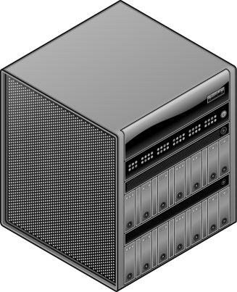


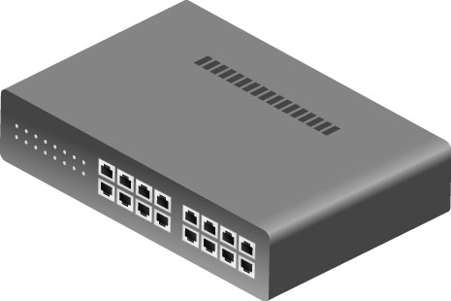
9.6: Simple Network Management Protocol (SNMP)
Core Elements (from Chapter 4)
  Manager program
  Managed device
  Agents (communicate with the manager on behalf of the managed device)
Agents
Manager
Managed
Devices

Slide 40

9.6: Simple Network Management Protocol (SNMP)
Core Elements (from Chapter 4)
  Management information base (MIB).
  Stores the retrieved information.
  “MIB” can refer to either the database on the manager or to the database schema.
Manager
MIB

Slide 41
9.6: Simple Network Management Protocol (SNMP)
Messages
  Commands (sent by a manager to an agent)
    Get (to get information from the agent)
    Set (to tell the agent to change how the managed devices is operating)
  Responses (sent from agent to manager)
Get or Set Command
Response

Slide 42
9.6: Simple Network Management Protocol (SNMP)
Messages
  Traps (alarms sent by agents).
  SNMP uses UDP at the transport layer to minimize the burden on the network.
Trap

Slide 43
9.6: Simple Network Management Protocol (SNMP)
Set Commands
  Dangerous if used by attackers.
  Many firms disable Set to thwart such attacks.
  However, they give up the ability to manage remote resources without travel.
  SNMPv1: community string shared by the manager and all devices (poor).
  SNMPv3: each manager–agent pair has a different password (good).

Slide 44
9.6: Simple Network Management Protocol (SNMP)
Objects (Figure 9-7)
  Specific pieces of information
  Number of rows in the routing table
  Number of discards caused by lack of resources (indicates a need for an upgrade)
Objects are NOT managed devices!
Objects are specific pieces of data about a managed device.

Slide 45
Hierarchical SNMP Database
System: Router XYZ
System
Objects
(1/system)
IP, TCP, UDP, ICMP Objects
(1/system)
Interface Objects
(1/interface)
IP, TCP, UDP, ICMP Objects
(1/system)
Interface Objects
(1/interface)
IP, TCP, UDP, ICMP Objects
(1/system)
Interface Objects
(1/interface)
System Objects:
System Name,
System Uptime
(since last reboot),
…
IP Objects:
Forwarding.
Row Discards,
Errors,
…
Interface Objects:
Speed,
Up/Down/Testing,
…

Slide 46
9.6: SNMP
SNMP Manager program collects data.
  Places it in the MIB.
Visualization Program.
  The administrator’s interface to the MIB.
  Helps the administrator visualize patterns in the MIB data.
  Can order the SNMP Manager to collect certain data or to send set commands to change the configurations of managed devices.

Slide 47
9.6: Simple Network Management Protocol (SNMP)
User Functionality
  Reports, diagnostics tools, and so on, are very important.
  They are not built into the standard.
  They are added by network visualization program vendors.
  Critical in selection of a network management vendor.

Slide 48
IP Subnetting
Network Address Translation (NAT)
Domain Name System (DNS)
Simple Network Management Protocol
IP Security (IPsec)
IPv6 Management
Other TCP/IP Supervisory Standards

Slide 49
VPNs
Virtual Private Networks
Really, just cryptographically protected communication over an untrusted network
  The Internet
  Wireless networks
But it is private in the sense that no one else can see the contents
We saw host-to-host VPNs in Chapters 3 and 7

Slide 50
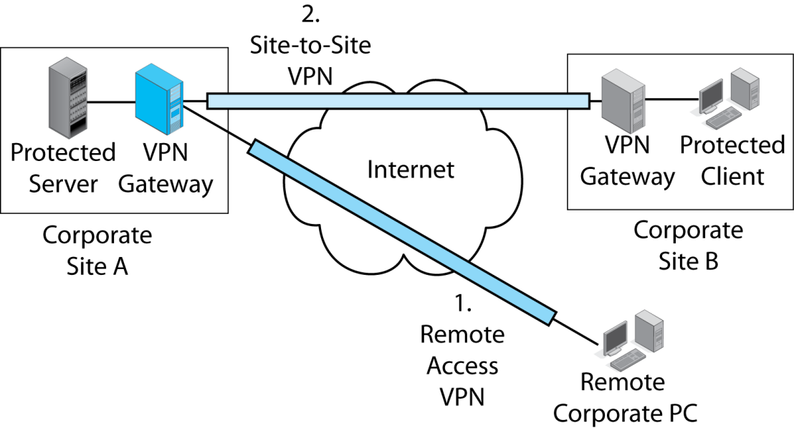

9.8: VPNs
There are two types of VPN:
Remote access VPNs connect a remote user to a corporate site.
The user connects to a VPN gateway at the site.
Copyright © 2015 Pearson Education, Inc.

Slide 51
9.8: VPNs
There are two types of VPNs:
Site-to-site VPNs protect all traffic
traveling between two sites.
Each site has a gateway to encrypt outgoing traffic and decrypt incoming traffic.
Copyright © 2015 Pearson Education, Inc.

Slide 52
IPsec VPNs
Governed by the IPsec protocols
  Operate at the internet layer
  Protect transport header, application content, and at least some IP header content.
  Protection is transparent. Upper-level content does not even know that it is being protected
Confidentiality, Authentication, Message Integrity
IP Header
TCP Header
App Content
Copyright © 2015 Pearson Education, Inc.

Slide 53
9.9: IPsec in Transport and Tunnel Modes
IPsec has two modes (ways) of operating:
  Transport mode
  Tunnel mode
Both are IPsec
Each mode has strengths and weaknesses
Copyright © 2015 Pearson Education, Inc.

Slide 54
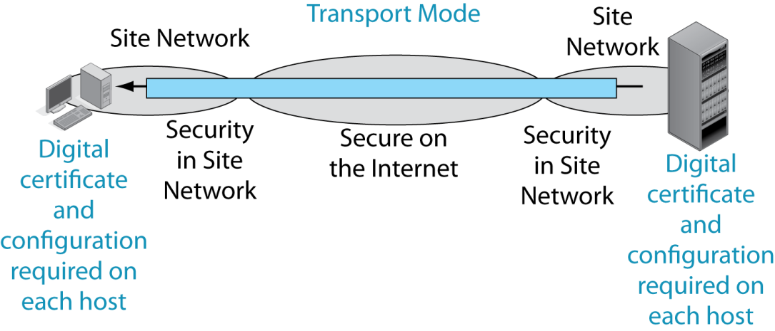

9.9: IPsec Transport and Tunnel Modes
In transport mode, IPsec provides protection over the Internet and also over site networks between the hosts.
Copyright © 2015 Pearson Education, Inc.

Slide 55
9.9: IPsec Transport and Tunnel Modes
Transport mode requires a digital certificate and configuration work on each host.
This is expensive.
Copyright © 2015 Pearson Education, Inc.

Slide 56
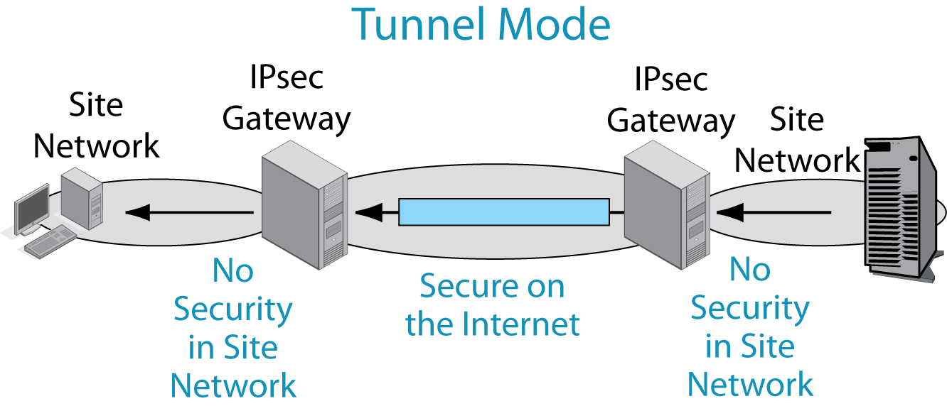
9.9: IPsec Transport and Tunnel Modes
In tunnel mode, IPsec only provides protection over
the Dangerous Internet—not within site networks.
Copyright © 2015 Pearson Education, Inc.

Slide 57
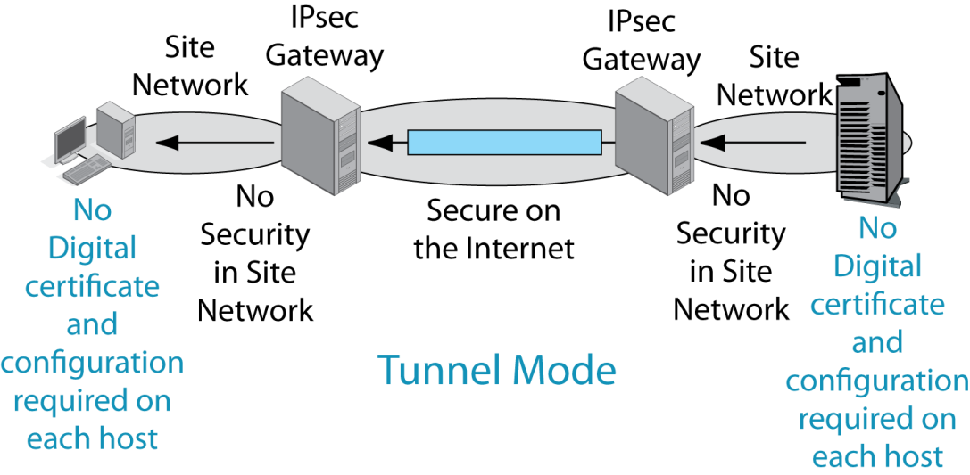
9.9: IPsec Transport and Tunnel Modes
Only the two IPsec gateways need digital certificates and configuration work.

Slide 58
9.9: IPsec Transport and Tunnel Modes
Criterion | Transport Mode | Tunnel Mode
Security | Better because it provides host-to-host protection. But firewalls cannot read encrypted traffic. | Not as good because it only provides security over the Internet or another trusted network (a wireless network, etc.).
Cost | Higher because of configuration work on each host. | Lower because IPsec operates only on the IPsec gateway .

Slide 59
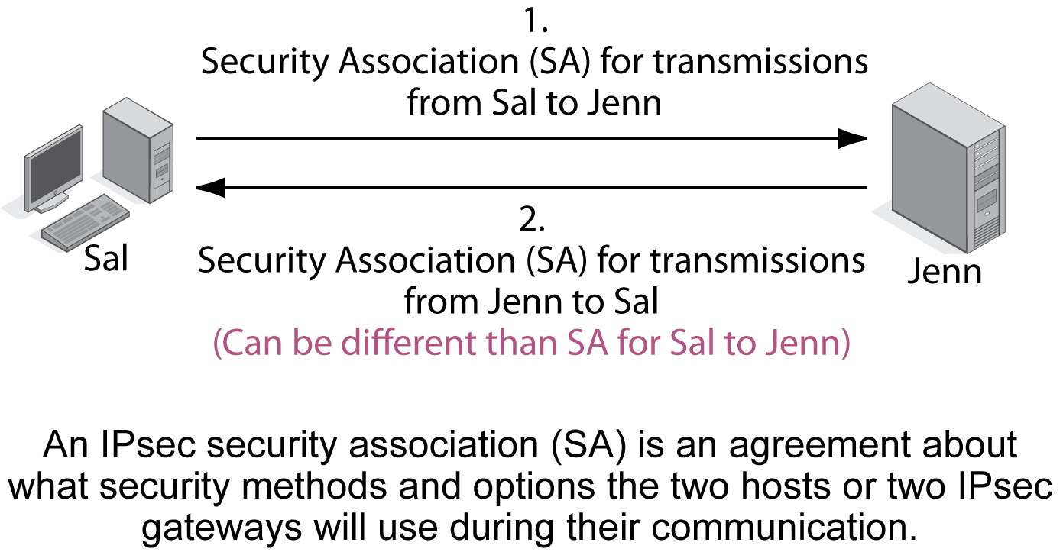
9.10: IPsec Security Associations and Policy Servers

Slide 60
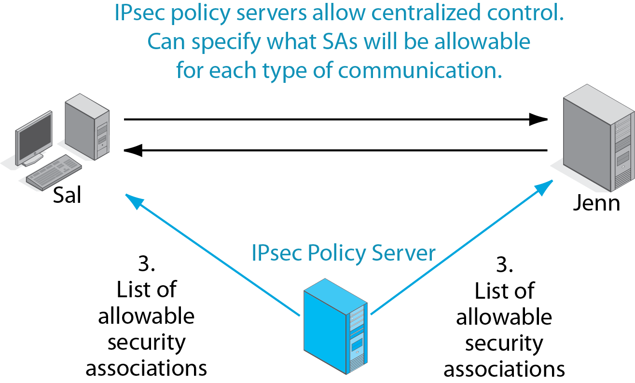
9.10: IPsec Security Associations and Policy Servers

Slide 61
9.11 IPsec vs. SSL/TLS VPNs
Characteristics of | IPsec | SSL/TLS
Standards Organization | IETF | IETF (created by Netscape as SSL, renamed TLS by the IETF)
Layer | Layer 3 | Layer 4
Built into Browsers, Webservers, and Mail Servers, So Protects These Applications at Little or No Cost | No | Yes

Slide 62
9.11 IPsec vs. SSL/TLS VPNs
Characteristic | IPsec | SSL/TLS
Can protect any application | Yes (also protects transport-layer header and some of the IP header) | No (Only SSL/TLS-aware applications such as web and e-mail)
Type of VPNs Supported in the Standard | Host-to-Host Remote Site Access Site-to-Site | Host-to-Host

Slide 63
9.11 IPsec vs. SSL/TLS VPNs
Characteristic | IPsec | SSL/TLS
Strength of Security | Excellent | Good
Security can be Managed Centrally | Yes | No

Slide 64
Why IPsec is Not Enough
New. Not in the book.
IPsec provides security to application content transparently
Makes protection automatic
However, this means that the application cannot tell if it is being protected
So the application designer often requires SSL/TLS in order to be sure

Slide 65
IP Subnetting
Network Address Translation (NAT)
Domain Name System (DNS)
Simple Network Management Protocol
IP Security (IPsec)
IPv6 Management
Other TCP/IP Supervisory Standards

Slide 66
IPv6 Management Issues
Transition from IPv4 to IPv6
IPv6 subnetting
IPv6 configuration
Other IPv6 standards
  Extending DNS
  …

Slide 67
9.12 Internet Layer Protocol Stacks
Application
Transport
Initially, devices only had an IPv4 protocol stack
IPv4 Only
Single Network

Slide 68
9.12 Internet Layer Protocol Stacks
Application
The IETF assumed that vendors would create dual-stack products and that IPv4 would gradually fade away.
Transport
IPv4
IPv6
Single Network

Slide 69
9.12 Internet Layer Protocol Stacks
Application
However, we have run out of IPv4 addresses.
Many new devices only have IPv6 addresses and so only have an IPv6 protocol stack.
Companies must reengineer their networks to support IPv6-only clients.
Transport
IPv6 Only
Single Network

Slide 70
9.13 IPv6 Subnetting
Must deal with global IPv6 unicast addresses
  Like public IPv6 addresses
  Have 3 parts but different names
IPv4 | IPv6 | IPv4 Part Length | IPv6 Part Length
Network Part | Routing Prefix | Variable | Variable
Subnet Part | Subnet ID | Variable | Variable
Host Part | Interface ID | Variable | 64 bits
32 bits | Total | 32 bits | 128 bits

Slide 71
9.13: Global Unicast Addresses in IPv6
Global Routing Prefix
(network part in IPv4)
Subnet ID
(subnet part in IPv4)
Interface ID
(host part in IPv4)

Slide 72
9.13: Global Unicast Addresses in IPv6
(Almost)
Always 64 bits
Global Routing Prefix
(network part in IPv4)
Subnet ID
(subnet part in IPv4)
Interface ID
(host part in IPv4)
Interface ID is not of variable length like IPv4 host parts.
“Wastes” 64 bits, but there are plenty of bits to lose.

Slide 73
9.13: Global Unicast Addresses in IPv6
(Almost)
Always 64 bits
Global Routing Prefix
(network part in IPv4)
Subnet ID
(subnet part in IPv4
Interface ID
(host part in IPv4)
m bits
n bits
64 bits
m + n = 64

Slide 74
9.14: 64-Bit Unicast Interface ID
Modified 64-bit Extended Unique Identifier (EUI) Format
First, display the EUI-48 address in hexadecimal notation (48 bits)
  Remove dashes
  Convert text
  to lower case
AD-B1-C2-D3-E5-F5
adb1c2d3e5f5

Slide 75
9.14: 64-Bit Unicast Interface ID
Second, divide the address in half
Insert fffe in the middle
This creates a 64-bit address
adb1c2 fffe d3e5f5
adb1c2fffed3e5f5

Slide 76
9.14: 64-Bit Unicast Interface ID
Third, in the second nibble (d) (1101)
Invert the second bit from the right (1111) (f)
This is called Modified 64-bit EUI
adb1c2fffed3e5f5
afb1c2fffed3e5f5

Slide 77
9.14: 64-Bit Interface ID Recap
1. Begin with EUI-48 in hexadecimal notation
2. Remove dashes and make lower case
2. Divide the 48 bits into 2 halves of 24 bits
3. Insert fffe between the two halves
4. Place in 4-hex groups separated by colons
5. Flip the second-least significant bit in the first octet (origin of the “Modified”

Slide 78
Other IPv6 Standards
Domain Name System (DNS)
  The DNS information for a host is contained in several records.
  DNS A Record. The A record contains the IPv4 address for the target host name.
  DNS AAAA Record. For IPv6 addresses, a new address record had to be added for each host name.
    IPv6 addresses are four times as long as IPv4 addresses, so the added record is called the AAAA record.

Slide 79
IP Subnetting
Network Address Translation (NAT)
Domain Name System (DNS)
Simple Network Management Protocol
IP Security (IPsec)
IPv6 Management
Other TCP/IP Supervisory Standards

Slide 80
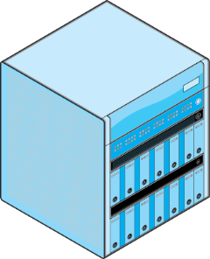
Dynamic Routing Protocols
How do routers get their routing tables?
  They constantly exchange information
  Communication must be standardized by dynamic routing protocol
  There are several dynamic routing Protocols
Routing Table
Information
Router
Router
Dynamic
Routing Protocol

Slide 81
Dynamic Routing Protocols
Note that “Routing” means two things in TCP/IP
  The process of forwarding an incoming packet
  The process of exchanging routing table information through dynamic routing protocols
  This sort of thing is somewhat common due to the IETF’s casual nature

Slide 82
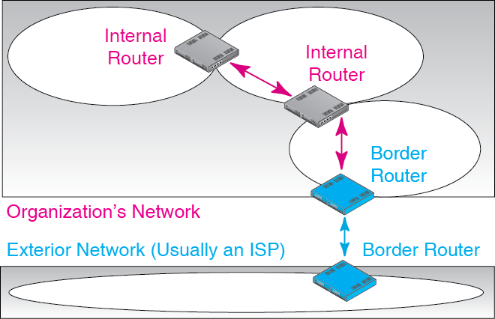
8.15: Dynamic Routing Protocols

Slide 83
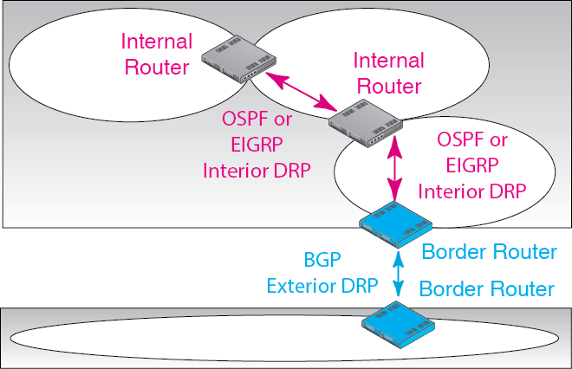
8.15: Dynamic Routing Protocols

Slide 84
8.16: Dynamic Routing Protocols
Dynamic Routing Protocol | Interior or Exterior Routing Protocol? | Remarks
OSPF (Open Shortest Path First) | Interior | For large autonomous systems that use only TCP/IP
EIGRP (Enhanced Interior Gateway Routing Protocol) | Interior | Proprietary Cisco Systems protocol. Not limited to TCP/IP routing. Also handles IPX/SPX, SNA, etc.

Slide 85
8.16: Dynamic Routing Protocols
Dynamic Routing Protocol | Interior or Exterior Routing Protocol? | Remarks
BGP (Border Gateway Protocol) | Exterior | Organization cannot choose what exterior routing protocol it will use

Slide 86
Internet Control Message Protocol
ICMP
  To handle supervisory communication between internet layer processes on different hosts or routers
  Avoids making IP handle this type of message
  Standardized by the Internet Control Message Protocol

Slide 87
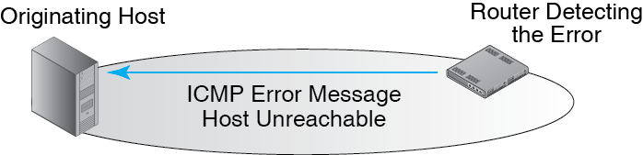
9.17: Internet Control Message Protocol
ICMP provides error advisement messages
Helps in the diagnosis of errors
Does not bring reliability

Slide 88
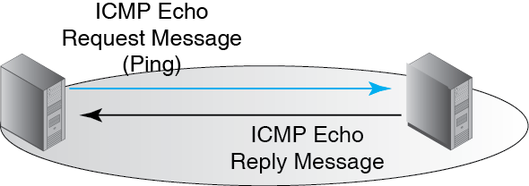
9.17: Internet Control Message Protocol
Ping tells the pinger that the pingee is available.
It also gives round-trip latency

Slide 89
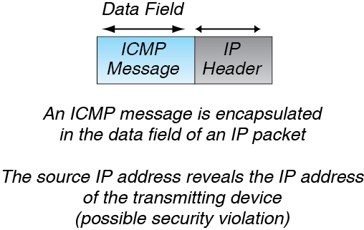
9.17: Internet Control Message Protocol

Slide 90
Where We are Going
Chs. | Title | Layers
1-4 | Core Concepts | All
5-7 | Single Networks | 1 and 2
8-9 | Internets | 3 and 4
10 | Wide Area Networks | 1-4
11 | Networked Applications | 5

