Slide 1
Music Recommendation System
Group: Double Eleven
Yang Xu, Muyan Li

Slide 2
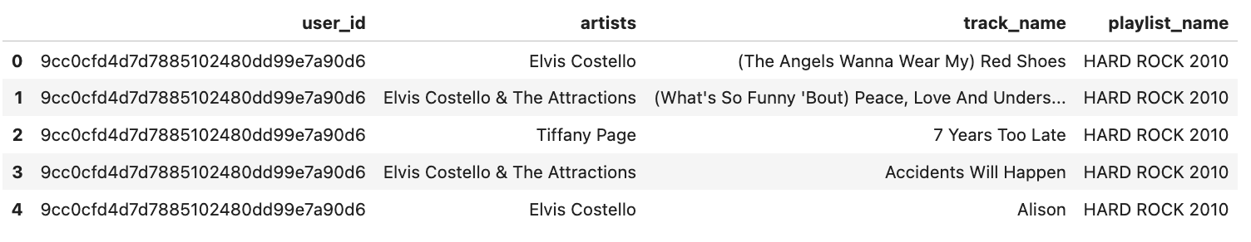
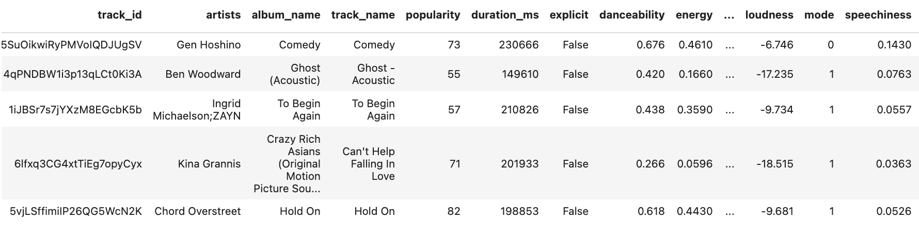
EDA
We have 2 datasets: one of users’ playlists, one of songs’ features.

Slide 3
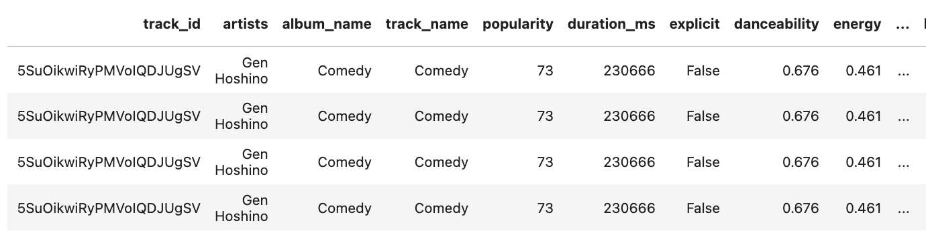
Duplicate songs exist in either dataset:
Drop songs with same artists and name for the model.

Slide 4
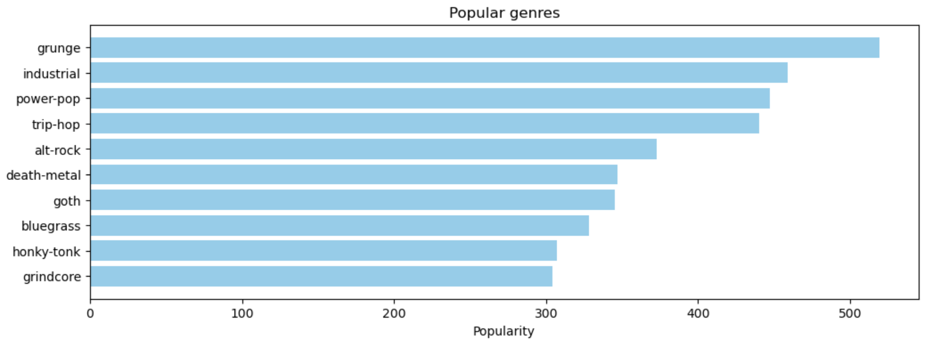
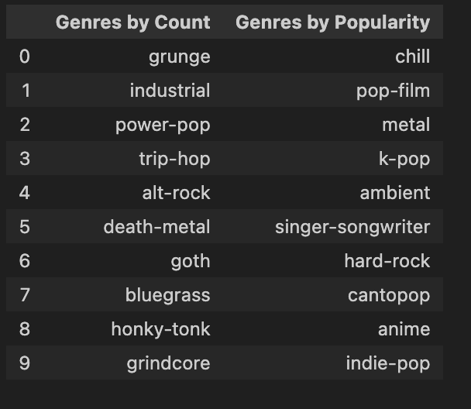
First let’s take a look at popular genres.
Rock wins!

Slide 5
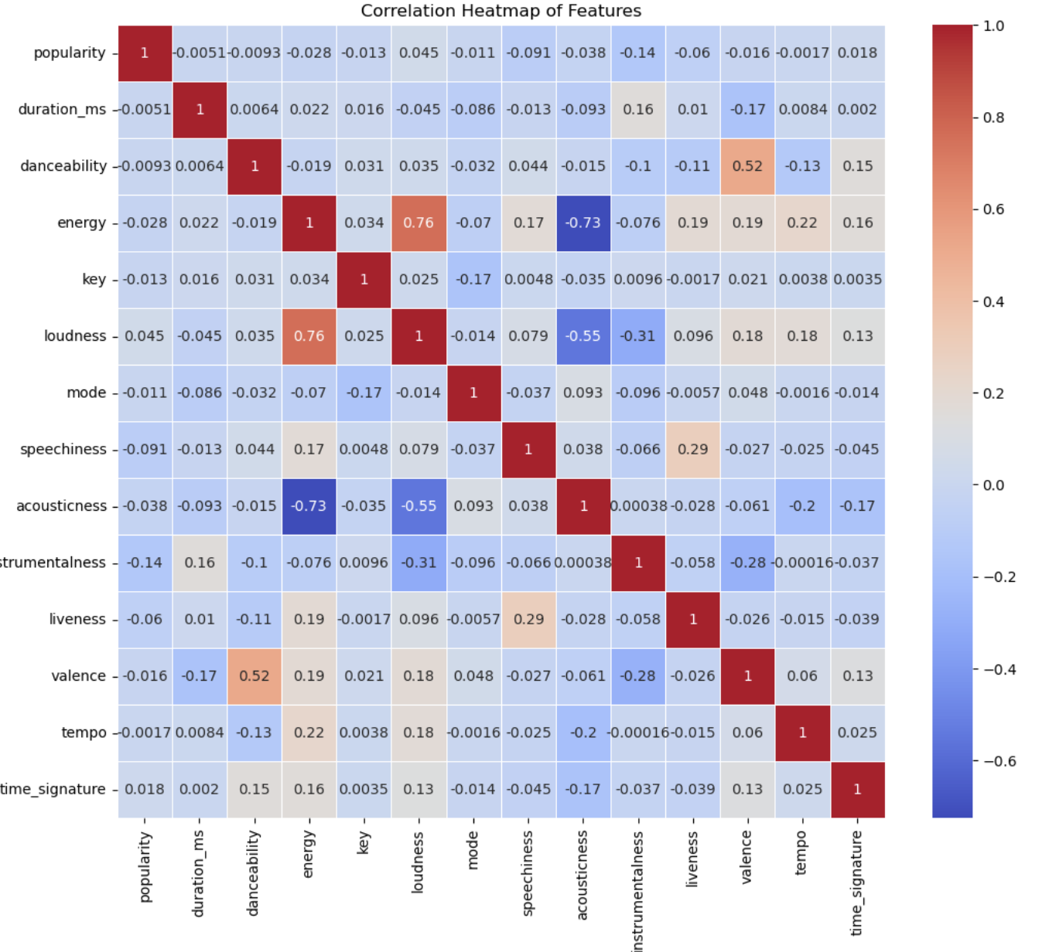
Heatmap of numerical features
Drop ‘energy’ in the model.

Slide 6
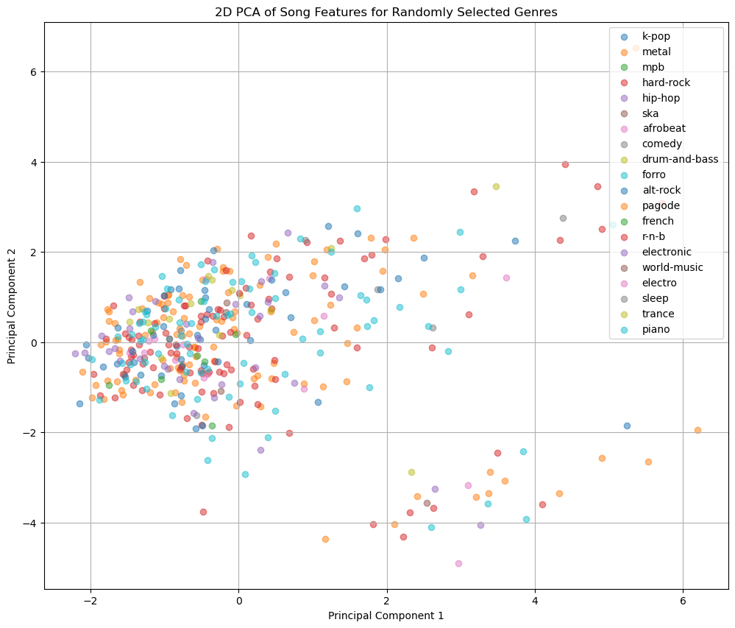

Slide 7
2. Model - Main idea
Use vectors to represent songs
For a user
Get his/her taste vector based on the song he/she likes
Identify k song vectors closest to the taste vector
Recommend them !

Slide 8
2. Model - Main idea
How to define the vector for each song?
Use vectors to represent songs
For a user
Get his/her taste vector based on the song he/she likes
Identify k song vectors closest to the taste vector
Recommend them !

Slide 9
?
 | Numerical features | Text features
song1
song2
```
Text Vectors | Numerical Vectors

Slide 10
Our target ……
The songs liked by the same user should be closer ！

Slide 11
Our target ……
The songs liked by the same user should be closer ！
Word2vec !

Slide 12
Word2vec
Words in
similar contexts
Word vectors
with closer distance
[
Sentence 1
,
Sentence 2
,
Sentence n
]

Slide 13
Word2vec
Song features
liked by same user
Feature vectors
with closer distance
[
User 1
,
User 2
,
User n
]

Slide 14
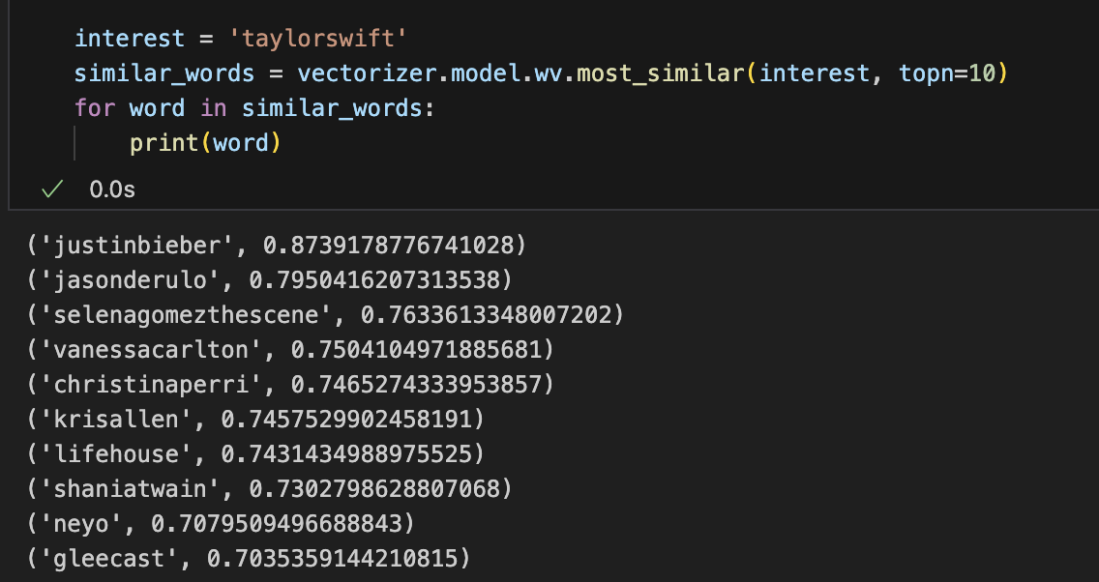
Example

Slide 15
Hit@ K
A user’s playlist with N songs
song1
song2
``````
song m
song m+1
``````
song N
Taste vector
Recommended
songs
Left
N-m
songs
Hit songs
Recommendation
System
Hit@K = hit songs/ (N-m)
Recommend K songs

Slide 16
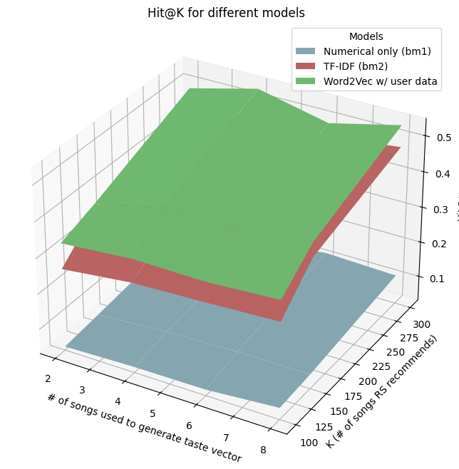
Test Result
Mean value
0.422
0.368
0.073

