Slide 1
Outline
Introduction
Research Experience
Industry Experience
01
02
03
Skill & Talent
Future Research Interests
04
05

Slide 2
Introduction
TIANQI YU
Birth: 1997/11/20
Birthplace: Harbin
Current Location: Nanjing
2016 - 2020
Mobileye
2021 - 2022
DiDi
2023 - Current
TJUT
2019
UoM
2022
China Unicom
TOEFL 2018
GRE 2019
TIANJIN VICO 2020

Slide 3
Introduction
01
Exploration
Why PhD
02
Curiosity
03
Opportunities

Slide 4



Research Experience
01
Paper
Large Language Models in Intelligent Service System:
Evaluation, Analysis and Distillation
02
Research Project
Z3 Rule-Based Multi-Step Reasoning: DAG-Driven Dataset Generation
With Variable and Semantic Constraints
03
Patent
Method for Mining Customer Demands and Automatically Generating FAQs
Based on Large Language Models and Unsupervised Clustering

Slide 5
Research Experience 1
Large Language Models in Intelligent Service System: Evaluation, Analysis and Distillation
Notes:
Large Language Models in Intelligent Service System: Evaluation, Analysis and Distillation——Introduction & Motivation & Contribution

Slide 6
Research Experience
Large Language Models in Intelligent Service System:
Evaluation, Analysis and Distillation
Notes:
Large Language Models in Intelligent Service System: Evaluation, Analysis and Distillation——Methodology, Evaluation

Slide 7
Research Experience 2
Z3 Rule-Based Multi-Step Reasoning: DAG-Driven Dataset Generation With Variable and Semantic Constraints
Notes:
Z3 Rule-Based Multi-Step Reasoning: DAG-Driven Dataset Generation With Variable and Semantic Constraints —— Introduction, Motivation, Contribution

Slide 8
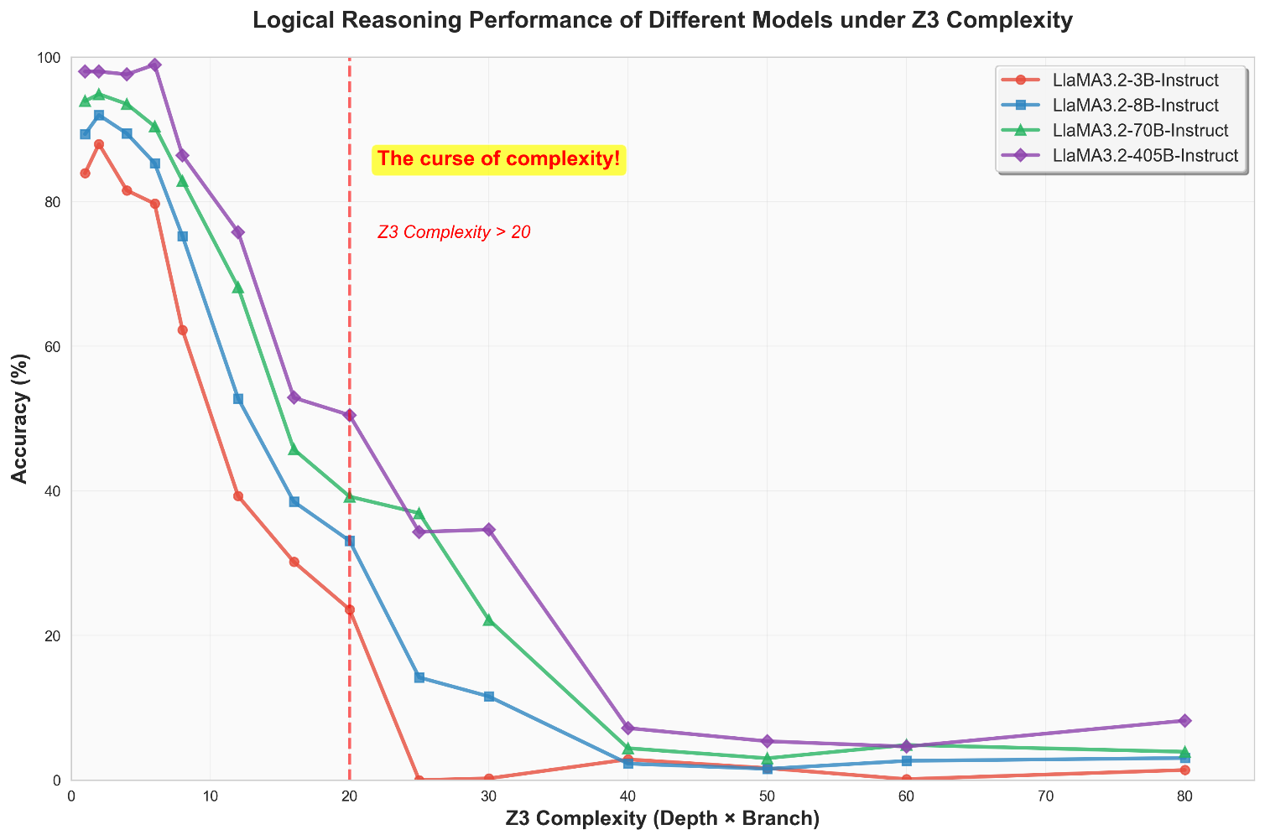
Research Experience
Notes:
Z3 Rule-Based Multi-Step Reasoning: DAG-Driven Dataset Generation With Variable and Semantic Constraints —— Methodology

Slide 9
Research Experience 3
Z3 Rule-Based Multi-Step Reasoning: DAG-Driven Dataset Generation With Variable and Semantic Constraints
Notes:
Z3 Rule-Based Multi-Step Reasoning: DAG-Driven Dataset Generation With Variable and Semantic Constraints —— Implementation

Slide 10
Research Experience
Method for Mining Customer Demands and Automatically Generating FAQs
Based on Large Language Models and Unsupervised Clustering
Notes:
Method for Mining Customer Demands and Automatically Generating FAQs Based on Large Language Models and Unsupervised Clustering —— Introduction, Motivation, Contribution

Slide 11
Research Experience
Method for Mining Customer Demands and Automatically Generating FAQs
Based on Large Language Models and Unsupervised Clustering
Notes:
Method for Mining Customer Demands and Automatically Generating FAQs Based on Large Language Models and Unsupervised Clustering —— Implementation

Slide 12
Industry Experience
01
Industry Project1
Multimodal image-text understanding and Knowledge Retrieval
02
Industry Project2
Small-parameter Large Language Model: Pre-training and Fine-Tuning
03
School Project
Twitter-based COVID-19 Social Media Analytics on HPC cluster

Slide 13
Industry Experience 1
Multimodal image-text understanding and Knowledge Retrieval
Traditional RAG: OCR Chunks Embedding Recall & Re-rank
Something is lost: Layout, Table Structure, Images, Hyperlink…
What we really like! Layout, charts, tables, fonts, and other visual cues remains semantically consistent!
What we really want
Faster!
Precise
Various Input formula
Stability
Generalization
Notes:
Multimodal image-text understanding and Knowledge Retrieval —— Overview

Slide 14
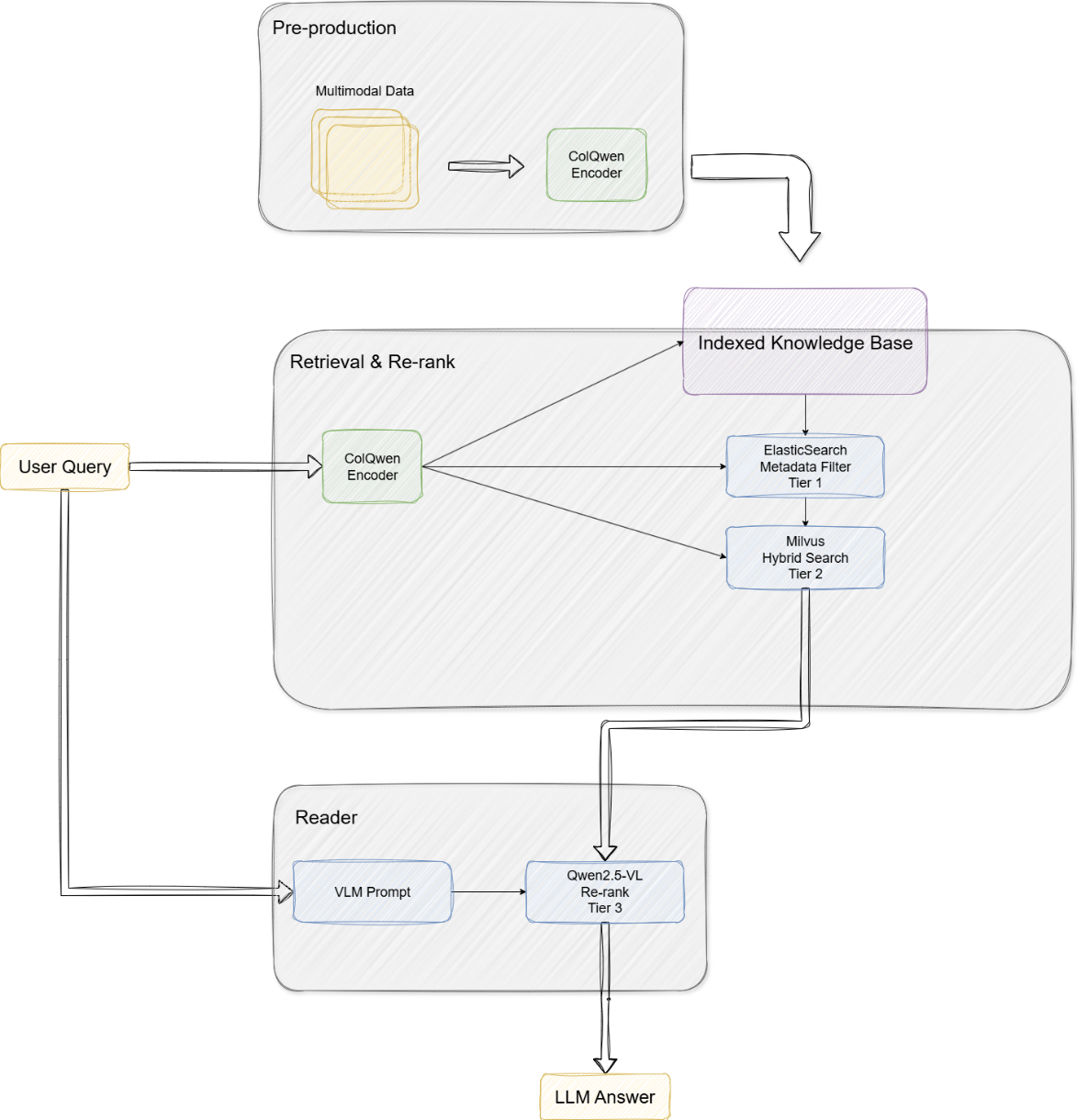
Industry Experience 1
Text
Chart patch-level vectors
Table
ColBERT
ColPali
ColQwen
Three tier of retrieval
Notes:
Multimodal image-text understanding and Knowledge Retrieval —— Achievements, Contribution

Slide 15
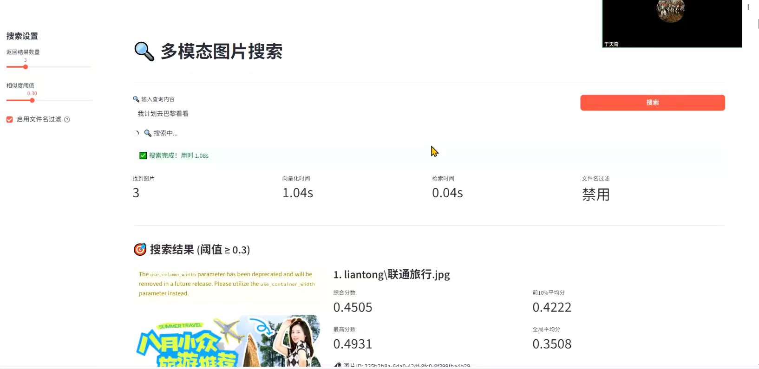
Industry Experience
Compared to traditional solution:
Recall@10: 27% Improved
nDCG@10: 13% Improved
Average latency: 35% Saved
In financial Auditing/industrial maintenance: (compare to ColPali 8% Recall Improved)
Notes:
Multimodal image-text understanding and Knowledge Retrieval —— Techology

Slide 16
Industry Experience 2
Small-parameter Large Language Model: Pre-training and Fine-Tuning
Traditional Small-parameter Intent Recognition
Lack of Generalization
Needs Continuous Update
Not able to Deal with Other Tasks
Small-parameter Large Language Model
Not Need to Continuous Update
Able to Deal with Several Tasks
End to End Efficiency
Saves Computing Resources
Easier to Implement: Smaller Data, Low Risk of Pre-training(Fast Convergence, low overload)
Notes:
Small-parameter Large Language Model: Pre-training and Fine-Tuning —— Overview

Slide 17
Industry Experience
Small-parameter Large Language Model: Pre-training and Fine-Tuning
Notes:
Small-parameter Large Language Model: Pre-training and Fine-Tuning —— Achievements, Contribution, Technology

Slide 18
Industry Experience
Small-parameter Large Language Model: Pre-training and Fine-Tuning
Notes:
Small-parameter Large Language Model: Pre-training and Fine-Tuning —— Outcome

Slide 19
Industry Experience 3
Twitter-based COVID-19 Social Media Analytics on HPC cluster
Notes:
Twitter-based COVID-19 Social Media Analytics on HPC cluster —— Overview

Slide 20
Industry Experience
Twitter-based COVID-19 Social Media Analytics on HPC cluster
Notes:
Twitter-based COVID-19 Social Media Analytics on HPC cluster —— Achievements & Contributions & Technology

Slide 21
Industry Experience
Twitter-based COVID-19 Social Media Analytics on HPC cluster
Notes:
Twitter-based COVID-19 Social Media Analytics on HPC cluster —— Outcome

Slide 22
Skills & Talent
CV
01
NLP
02
LLM
03
Object Detection
Multi-Object Tracking
Text Summarization
Text Classification
Semi-supervised Learning
Pre-training
Fine-Tuning
Inference, RAG
Backend
04
Others
05
Certificate
06
Spring Boot, Spring MVC
Django, Flask, FastApi
Docker
Kubernetes
Cloud Production
AWS Cloud Practitioner
Artificial Intelligence Engineer Senior - MIIT

Slide 23
Future Research Interests
1. Efficient Knowledge Retrieval for Large Language Models
2. Vector Databases and Multimodal Information Integration
3. Scalability and Efficiency in Large Language Models Inference & Deployment

