Slide 1
Motivation
Traditional: Dense Vector
Query: one vector
Doc: several chunks
Really not good at multi-hop
Context Length
Cost on index & Time Consuming
Early: ColBERT & ColPali MVR
Token-level & Patch-level
More Precise
Multimodal-transferable
Too Finer: Victoria Hong Kong has many what types of building?
Victoria Hong Kong
Perhaps coarser? phrases
buildings
How to Decompose | Non-differentiable | KELDaR | Query Decomposer
How to eval | Expensive | LLM-Optimizer Training Algorithm | Performance-Oriented

Slide 2
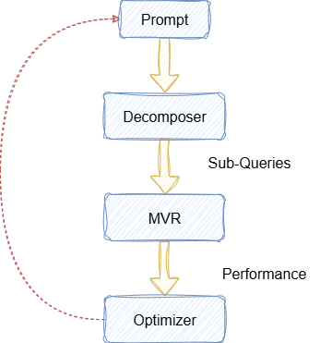
Approach
Sub-queries relies on prompt and model parameters
Sub-queries cannot be differentiated
Training model’s parameters: θ and β
End2end

Slide 3
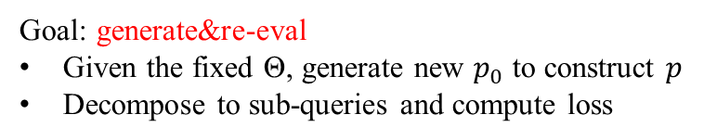
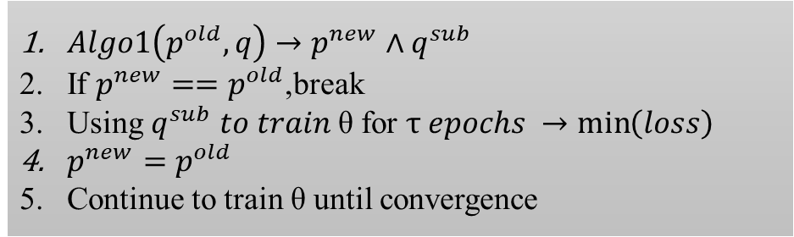
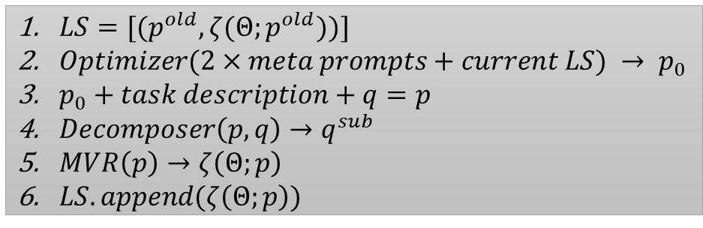
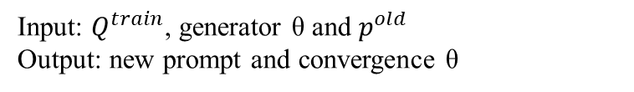
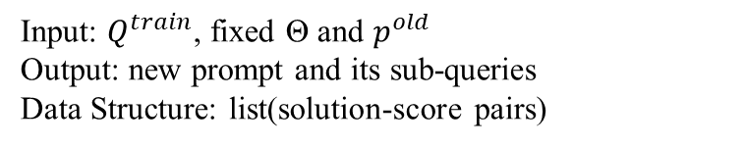
Approach
Algorithm 1
Algorithm 2
Goal: generate&re-eval
Given the fixed Θ, generate new $p_{0}$ to construct $p$
Decompose to sub-queries and compute loss
Goal: alternation&incremental training
Joint Optimization among prompt and Θ
Enable model to generate better in the downstream
Input: $Q^{train}$, fixed Θ and $p^{old}$
Output: new prompt and its sub-queries
Data Structure: list(solution-score pairs)
Input: $Q^{train}$, generator θ and $p^{old}$
Output: new prompt and convergence θ
$LS=[(p^{old},ζ(Θ;p^{old}))]$
$Optimizer(2×meta prompts+current LS) → p_{0}$
$p_{0}+task description+q=p$
$Decomposer\left(p,q\right)→q^{sub}$
$MVR\left(p\right)→ζ\left(Θ;p\right)$
$LS.append(ζ\left(Θ;p\right))$
$Algo1\left(p^{old},q\right)→p^{new}∧q^{sub}$
If $p^{new}==p^{old}$,break
Using $q^{sub} to train \text{θ} \text{for} τ epochs →\min\left(loss\right)$
$p^{new}=p^{old}$
Continue to train θ until convergence
End condition: $ζ\left(Θ;p\right)−ζ\left(Θ;p_{old}\right)≤α OR k times$
End condition:${ p}^{new}==p^{old}$

Slide 4
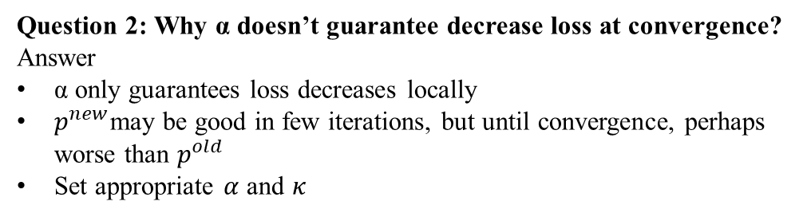
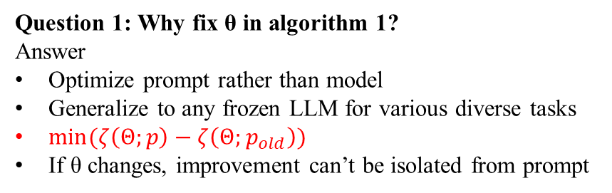
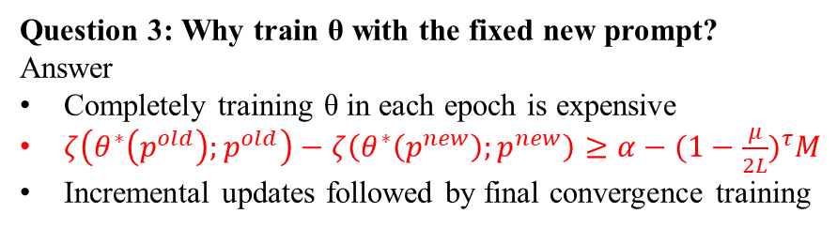
Approach
Question 1: Why fix θ in algorithm 1?
Answer
Optimize prompt rather than model
Generalize to any frozen LLM for various diverse tasks
$min⁡(ζ\left(Θ;p\right)−ζ\left(Θ;p_{old}\right))$
If θ changes, improvement can’t be isolated from prompt
Question 2: Why α doesn’t guarantee decrease loss at convergence?
Answer
α only guarantees loss decreases locally
$p^{new}$may be good in few iterations, but until convergence, perhaps worse than $p^{old}$
Set appropriate $α$ and $κ$
Question 3: Why train θ with the fixed new prompt?
Answer
Completely training θ in each epoch is expensive
$ζ\left(θ^{∗}\left(p^{old}\right);p^{old}\right)−ζ\left(θ^{∗}\left(p^{new}\right);p^{new}\right)≥α−{(1−\frac{μ}{2L})}^{τ}M$
Incremental updates followed by final convergence training
Question 4: How to select α and τ?
Answer
α is too small, queries are over-decomposed
α is too large, queries are rarely decomposed
τ is too small, larger residuals weaken α’s gain
τ is too large, smaller residuals slow convergence

Slide 5
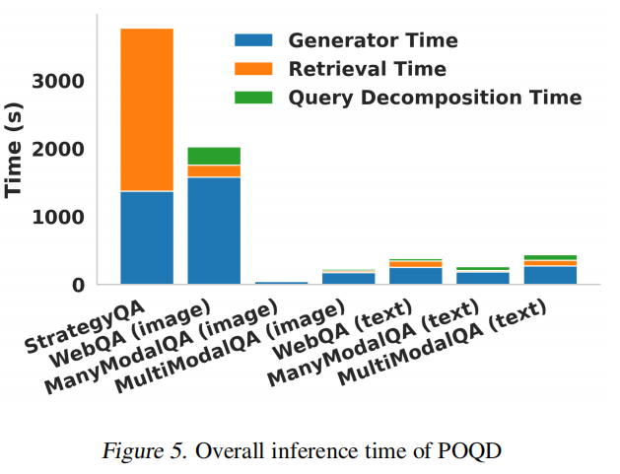
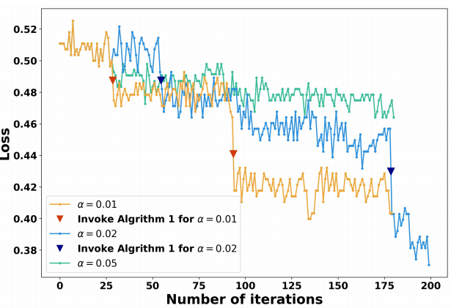
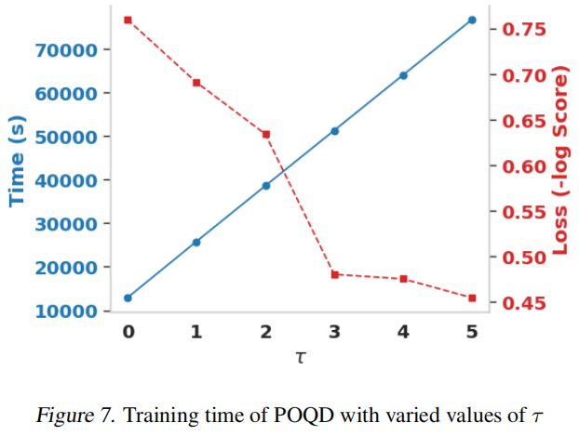
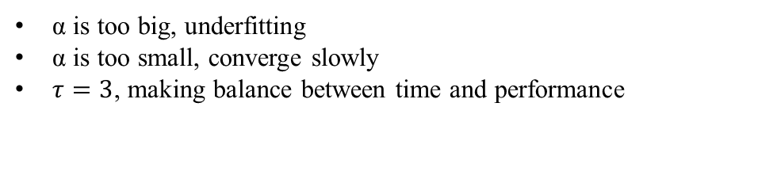
Result Analysis
POQD introduced minimal additional time overhead, aligning with the earlier part that it can be seamlessly integrated into RAG
α is too big, underfitting
α is too small, converge slowly
$τ=3$, making balance between time and performance

Slide 6
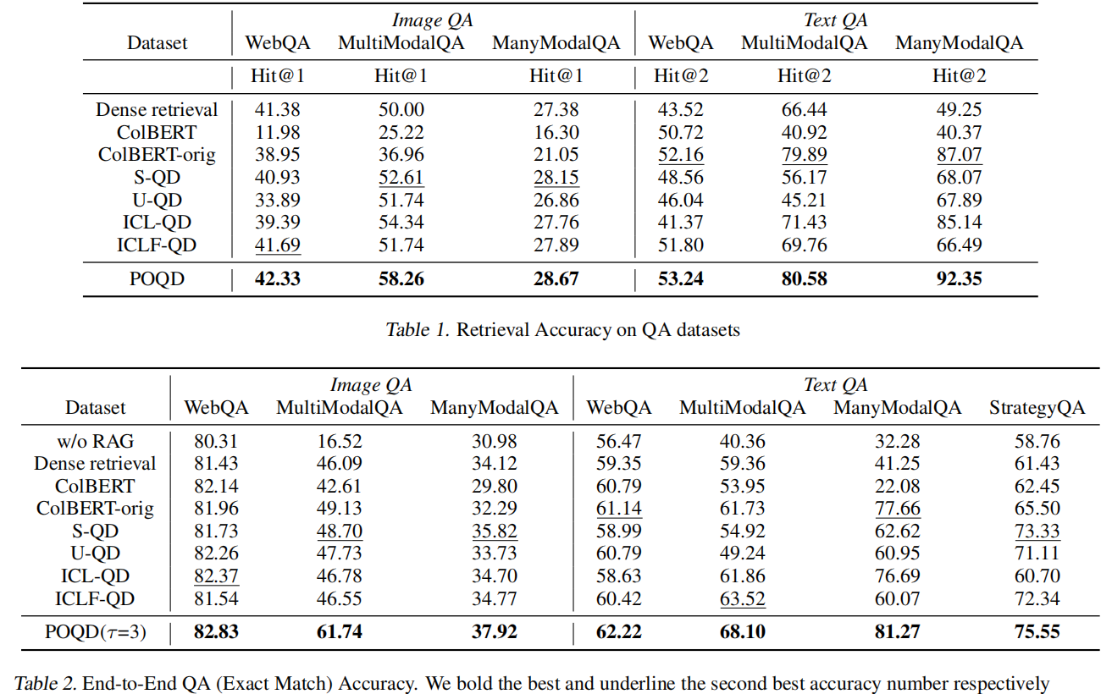
Result Analysis
Overall SOTA, but:
Not good in high-noise and cross-modal reference settings
Underperforms on short-length queries and unstructured data
Sometimes, generator only can achieve good performance
Why don’t set Hit@n on StrategyQA?

Slide 7
Pros and Cons
Pros
Decomposition costs few time, can be seamlessly integrated in RAG
The whole experiments are comprehensive and convincing
Coarser-grain matching is awesome
Theoretical analysis provides formal convergency guarantees
Interpretability and controllability, LLM as planner
Unified the framework for multimodal queries
Cons
Short on visual sub-queries examples
Sub-queries hallucination
Lacks Hit@n in StrategyQA task
Completely ignore the retriever parameter
Heavily rely on powerful LLM
Evals on Top-k and re-rank, more metrics

