Slide 1
iTIME: A shiny app for the visualization of immune cell distributions in the tumor microenvironment
Brooke Fridley
Chris Wilson
Jordan Creed

Slide 2
Cancer Immunology
Immune modulation is considered a hallmark of cancer initiation and progression, and decades of research has offered promising opportunities for therapeutics
Immunotherapies, agents that activate or act as a substitute for host antitumor immunity, has ushered in a new era of cancer treatment
Novel approaches are that can be used to identify which cancer patients will benefit from immunotherapy
Multiplex immunofluorescence (IF) microscopy (and other technologies) combined with automated image analysis is a novel and increasingly used technique that allows for the assessment and visualization of the tumor immune microenvironment (TIME).

Slide 3
IF Studies
IF studies completed using regions of interest (ROIs) selected from a tissue slide or TMAs.
Many cancer epidemiology studies have TMAs collected
High-throughput way to assess the immune landscape in a tumor tissue

Slide 4
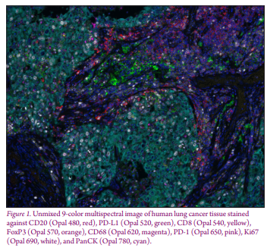
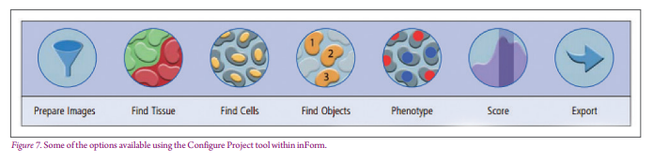
Data Acquisition Process for IF
Vectra (or other system) is used to assess multiple overlapping biomarkers (immune markers) on a single tissue section using multispectral imaging.
Can do often up to 9 markers (colors) per assay (aka “panel”).
DAPI marker = cell segmentation
Pancytokeratin/PCK = tissue segmentation (tumor / stroma)
Often HALO or inForm software is then used to process the imaging data and generate locations of “events” and summaries at the tissue level.
Notes:
https://www.perkinelmer.com/lab-solutions/resources/docs/PRD_Vectra-Polaris_013272_01.pdf
https://www-punchout.perkinelmer.com/product/halo-plus-3-ws-license-cls141255

Slide 5
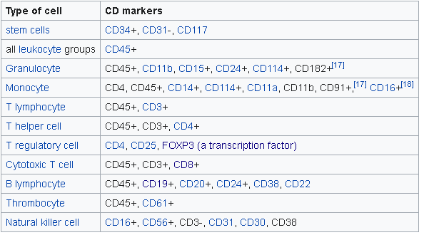
Cell types represented by Immune Markers

Slide 6
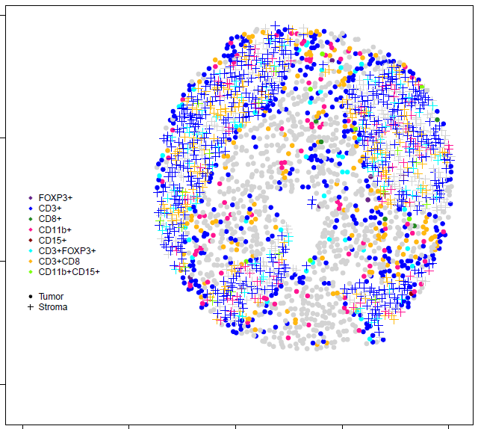
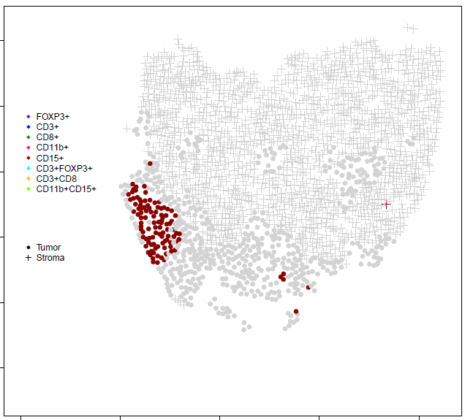
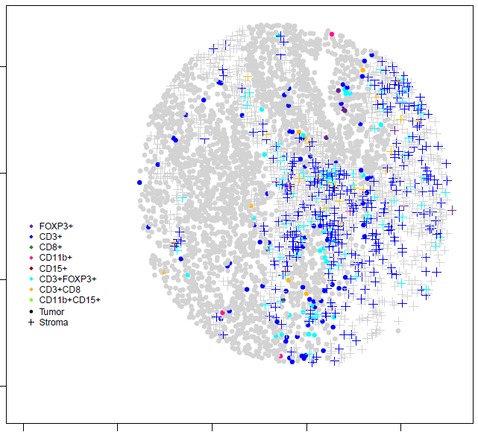
Tumor vs Stroma
IF is summarized for all cells, and then by tumor and stroma
Different immune marker levels by tumor/stroma
Stratified analysis by cell type

Slide 7
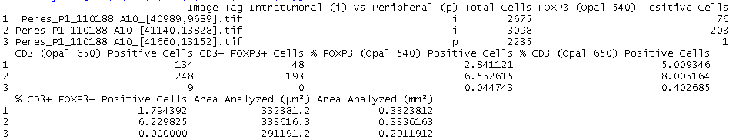
Summary information files
Have for all cells and by tumor and stroma cells
ID of image (maps to a tumor sample and then a subject)
Often have multiple samples per subject

Slide 8
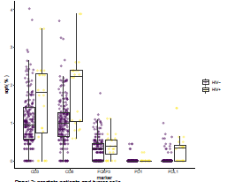
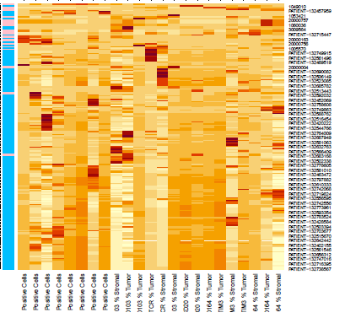
Plots of summary data
Can do for count, proportion, percentage
Note: number of cells differ between TMA cores and then the proportion/percentage recommended
Can do on raw scale or completed a transformation
Log(p), ln(p), logit = log(p/1-p), arcsine(p) = two times the arcsine of the square root of the proportion, sqrt(p)
Note: if have no positive cells (0.0) or all positive cells (1.0) not all transformations are possible
Boxplots, violin plots, heatmaps on the measures to show distribution
By group variable (HIV status, treatment group) that is in the clinical data file

Slide 9
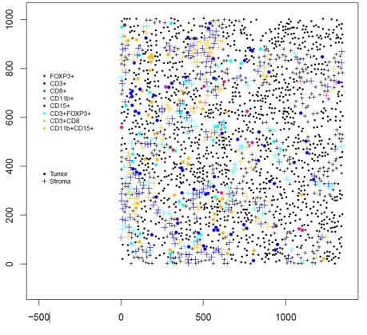
Spatial Information
Plot all cells measured, whether tumor or stroma for difference markers or “phenotype” (combination of markers)

Slide 10
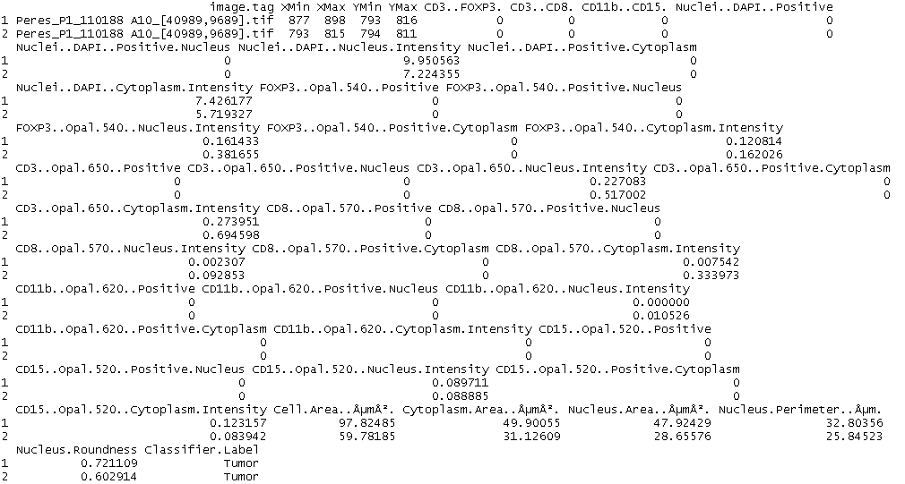
Output from HALO from Vectra Image
Calls of positive/negative based on the intensity value; these 2 cells are not positive for CD3+CD8+ (cytotoxicity t-cell)
Spatial information for each slide/TMA core
Take the mean of the min and max location

Slide 11
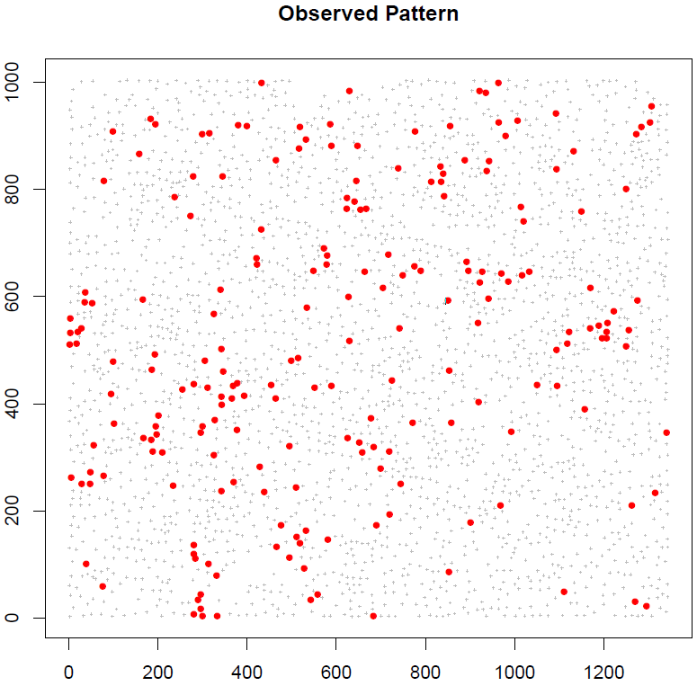
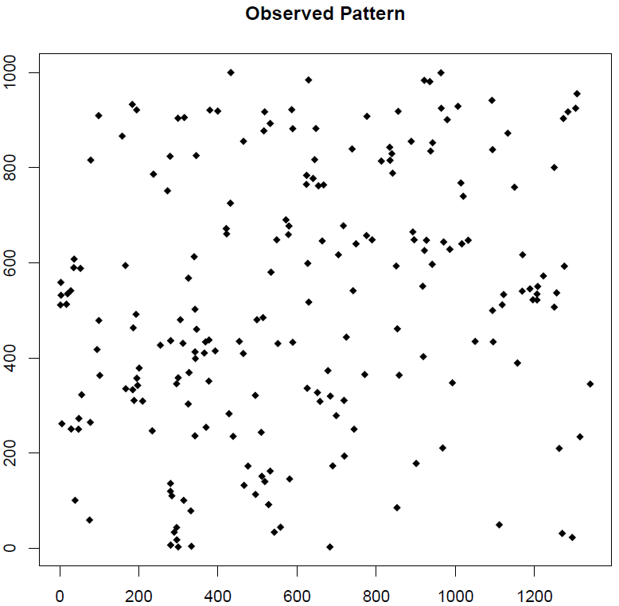
Spatial Clustering
Have a point process with location of cells positive for a biomarker.
Assuming we can have positive cells at any location, if random the point process would follow a homogenous Poisson process with common event rate.
Spatial point process

Slide 12
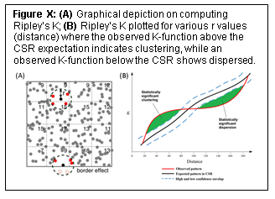
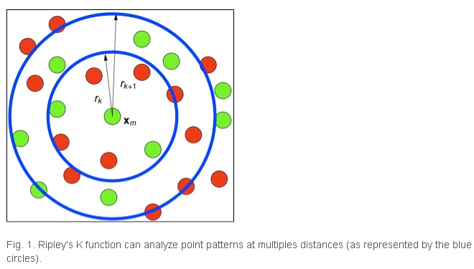

Ripley’s K and Besag’s L
Spatial Point Process: Ripley’s K (Besag’s L)
Border effect correction
Isotropic, Translational

Slide 13
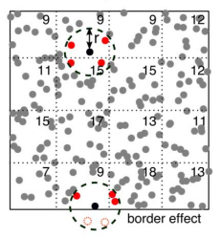
Edge Correction
Completed with two different edge corrections for Riley’s K:
Translational: Applies a “shift”
Isotropic: computes fraction of diameter of a circle centered around the point of interest and the circle passes over the other point of interest.
Find similar results between the two edge correction methods.
Border correction method is not stable when have small number of points so did not complete this correction.

Slide 14
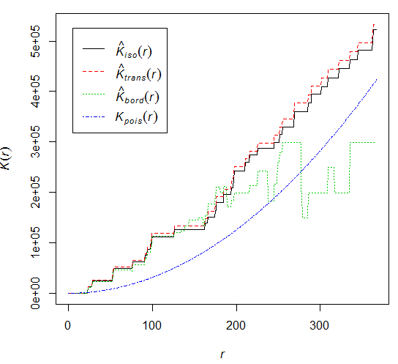
Plot of Ripley’s K for various r values
Steps:
Make window W using disc() function (region of interest)
Make point process object using ppp() function
Need x and y locations for positive cells (all, tumor or stroma) and window W.
Estimate K with Kest() function
Plot K function with plot()
Use R library spatstat
https://www.jstatsoft.org/article/view/v012i06

