Slide 1
How does the method of ones' complement work for UDP and TCP checksum Calculation?

Slide 2
Imagine we have a UDP segment or a TCP packet. The first thing that we do is to divide and slice it up to 16 bit pieces. Let's assume we have three 16 bit data as below.
1 0 0 1 1 0 1 0 0 1 0 1 0 1 1 0
0 0 0 0 1 0 1 1 1 0 0 0 1 1 1 0
0 0 0 0 1 1 0 1 1 1 0 0 1 1 0 0

Slide 3
If we add those three 16 bit data using binary addition. We get the below 16 bit data (Its simple binary addition).
1001101001010110
+ 0000101110001110
+ 0000110111001100
1011001110110000

Slide 4
Ones complement of our result
1011001110110000
is
0100110001001111
(This is our checksum).

Slide 5
So we need to basically send our data (which is the three binary 16 bit numbers) along with its checksum to a receiver.
The reciever will get the below things.
1 0 0 1 1 0 1 0 0 1 0 1 0 1 1 0 (data)
0 0 0 0 1 0 1 1 1 0 0 0 1 1 1 0 (data)
0 0 0 0 1 1 0 1 1 1 0 0 1 1 0 0 (data)
0 1 0 0 1 1 0 0 0 1 0 0 1 1 1 1 (Checksum)

Slide 6
The receiver will simply add all the above 4 things. Data as well as checksum are added together.
1001101001010110
0000101110001110
0000110111001100
0100110001001111
1111111111111111
If the output of sum of 16 bit data and checksum is 1111111111111111. All fields will be 1s. Even if there is one 0, then that means errors were introduced in the data during transit.

Slide 8
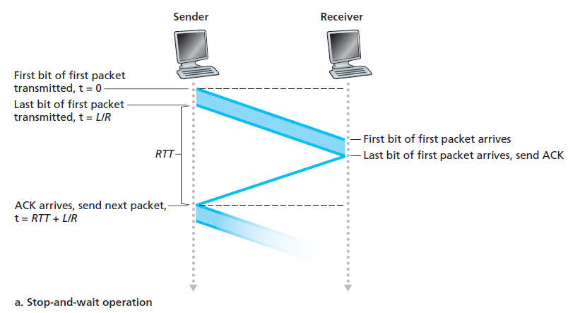
Stop-and-wait behavior

Slide 9

Suppose that A and B are connected by a channel with a transmission rate, R, of 1 Gbps (10⁹ bits per second). With a packet size, L, of 1,000 bytes (8,000 bits) per packet, including both header fields and data, the time needed to actually transmit the packet into the 1 Gbps link is
If the sender begins sending the packet at t = 0, then at t = L/R = 8 microseconds, the last bit enters the channel at the sender side.

Slide 10
The packet then makes its 15-msec A to B, with the last bit of the packet emerging at the receiver at t = RTT/2 + L/R = 15.008 msec.
Assuming for simplicity that ACK packets are extremely small (so that we can ignore their transmission time) and that the receiver can send an ACK as soon as the last bit of a data packet is received, the ACK emerges back at the sender at t = RTT + L/R = 30.008 msec.

Slide 11

At this point, the sender can now transmit the next
message. Thus, in 30.008 msec, the sender was sending for only 0.008 msec.
The sender was able to send only 1,000 bytes in 30.008 milliseconds, an effective throughput of only 267 kbps—even though a 1 Gbps link was available!

Slide 13
Compare GBN, SR, and TCP (no delayed ACK).
Assume that the timeout values for all three protocols are sufficiently long such that 5 consecutive data segments and their corresponding ACKs can be received (if not lost in the channel) by the receiving host (Host B) and the sending host (Host A) respectively.
Suppose Host A sends 5 data segments to Host B, and the 2nd segment (sent from A) is lost. In the end, all 5 data segments have been correctly received by Host B.

Slide 14
How many segments has Host A sent in total and how many ACKs has Host B sent in total? What are their sequence numbers? Answer this question for all three protocols.
GoBackN:
A sends 9 segments in total. They are initially sent segments 1, 2, 3, 4, 5 and later re-sent segments 2, 3, 4, and 5.
B sends 8 ACKs. They are 4 ACKS with sequence number 1, and 4 ACKS with sequence numbers 2, 3, 4, and 5.

Slide 15
Selective Repeat:
A sends 6 segments in total. They are initially sent segments 1, 2, 3, 4, 5 and later re-sent segments 2.
B sends 5 ACKs. They are 4 ACKS with sequence number 1, 3, 4, 5. And there is one ACK with sequence number 2.

Slide 16
TCP:
A sends 6 segments in total. They are initially sent segments 1, 2, 3, 4, 5 and later re-sent segments 2.
B sends 5 ACKs. They are 4 ACKS with sequence number 2. There is one ACK with sequence numbers 6. Note that TCP always send an ACK with expected sequence number.

Slide 17
If the timeout values for all three protocol are much longer than 5 RTT, then which protocol successfully delivers all five data segments in shortest time interval?
TCP.
This is because TCP uses fast retransmit without waiting until time out.

Slide 19
Host A and B are communicating over a TCP connection, and Host B has already received from A all bytes up through byte 126.
Suppose Host A then sends two segments to Host B back-to-back. The first and second segments contain 80 and 40 bytes of data, respectively.
In the first segment, the sequence number is 127, the source port number is 302, and the destination port number is 80. Host B sends an acknowledgment whenever it receives a segment from Host A.

Slide 20
In the second segment sent from Host A to B, what are the sequence number, source port number, and destination port number?
In the second segment from Host A to B, the sequence number is 207, source port number is 302 and destination port number is 80.

Slide 21
Suppose the two segments sent by A arrive in order at B. The first acknowledgment is lost and the second acknowledgment arrives after the first timeout interval. Draw a timing diagram, showing these segments and all other segments and acknowledgments sent. (Assume there is no additional packet loss.)
For each segment in your figure, provide the sequence number and the number of bytes of data; for each acknowledgment that you add, provide the acknowledgment number.

Slide 22
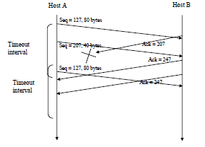

Slide 24
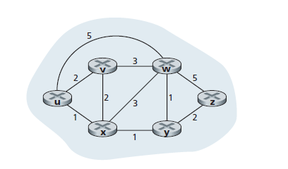

Slide 25
The Link-State (LS) Routing Algorithm
• D(v): cost of the least-cost path from the source node to destination v as of this iteration of the algorithm.
• p(v): previous node (neighbor of v) along the current least-cost path from the source to v.
• N : subset of nodes; v is in N if the least-cost path from the source to v is definitively known.

Slide 26
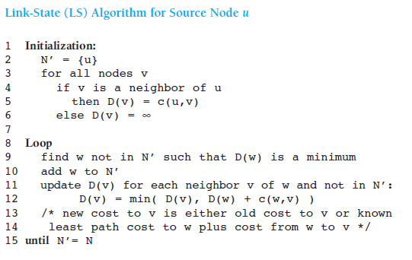

Slide 27
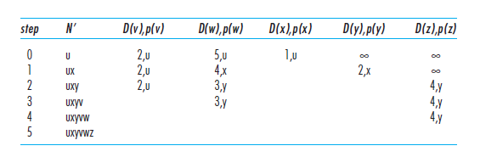

Slide 29
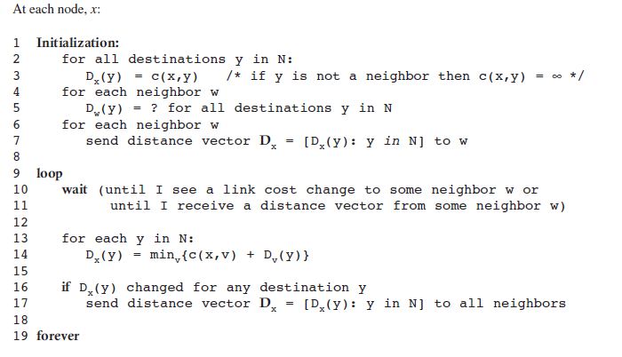
The Distance-Vector (DV) Routing Algorithm

Slide 30
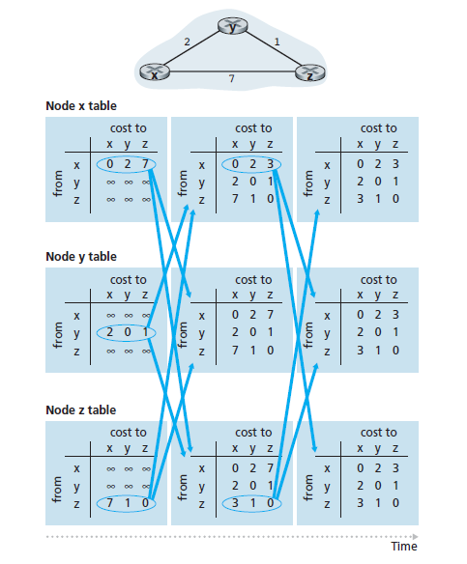

Slide 32
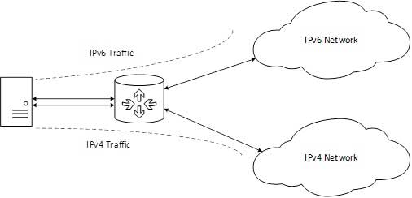
Dual Stack Routers

Slide 33
A router can be installed with both IPv4 and IPv6 addresses configured on its interfaces pointing to the network of relevant IP scheme.
In the above diagram, a server having IPv4 as well as IPv6 address configured for it can now speak with all the hosts on both the IPv4 as well as the IPv6 networks with the help of a Dual Stack Router. The Dual Stack Router, can communicate with both the networks.
It provides a medium for the hosts to access a server without changing their respective IP versions.

Slide 34
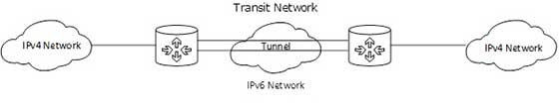
Tunneling

Slide 35
In a scenario where different IP versions exist on intermediate path or transit networks, tunneling provides a better solution where user’s data can pass through a non-supported IP version.
The above diagram depicts how two remote IPv4 networks can communicate via a Tunnel, where the transit network was on IPv6. Vice versa is also possible where the transit network is on IPv6 and the remote sites that intend to communicate are on IPv4.

Slide 36
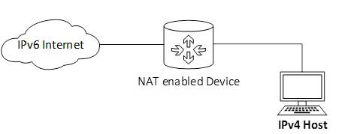
NAT Protocol Translation

Slide 37
This is another important method of transition to IPv6 by means of a NAT-PT (Network Address Translation – Protocol Translation) enabled device. With the help of a NAT-PT device, actual can take place happens between IPv4 and IPv6 packets and vice versa.

Slide 38
A host with IPv4 address sends a request to an IPv6 enabled server on Internet that does not understand IPv4 address. In this scenario, the NAT-PT device can help them communicate. When the IPv4 host sends a request packet to the IPv6 server, the NAT-PT device/router strips down the IPv4 packet, removes IPv4 header, and adds IPv6 header and passes it through the Internet. When a response from the IPv6 server comes for the IPv4 host, the router does vice versa.

