Slide 1
Round-Trip Time Estimation and
Timeout

Slide 2
Estimating the Round-Trip Time
SampleRTT : For a segment is the amount of time between when the segment is sent (that is, passed to IP) and when an acknowledgment for the segment is received.
Instead of measuring a SampleRTT for every transmitted segment, most TCP implementations take only one SampleRTT measurement at a time.

Slide 3
TCP never computes a SampleRTT for a segment that has been retransmitted; it only measures SampleRTT for segments that have been transmitted once.

Slide 4
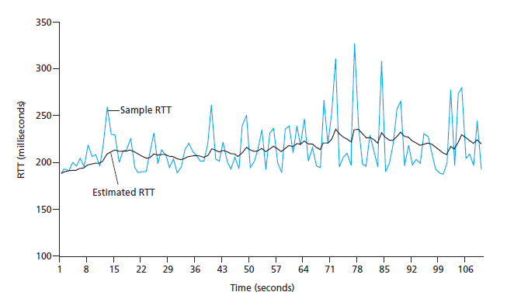

Slide 5
Exponential weighted moving average (EWMA)

Slide 6
Suppose that the five measured SampleRTT values are 106 ms, 120 ms, 140 ms, 90 ms, and 115 ms.
Compute the EstimatedRTT after each of these SampleRTT values is obtained, using a value of α = 0.125 and assuming that the value of EstimatedRTT was 100 ms just before the first of these five samples were obtained.
Compute also the DevRTT after each sample is obtained, assuming a value of β = 0.25 and assuming the value of DevRTT was 5 ms just before the first of these five samples was obtained.
Last, compute the TCP TimeoutInterval after each of these samples is obtained.

Slide 7
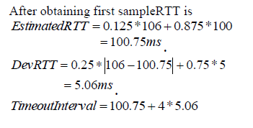

Slide 8
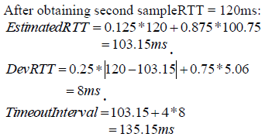

Slide 9
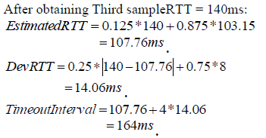

Slide 10
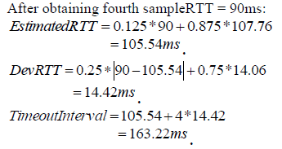

Slide 11
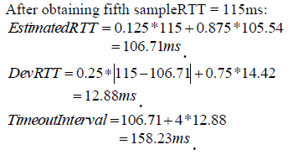

Slide 13
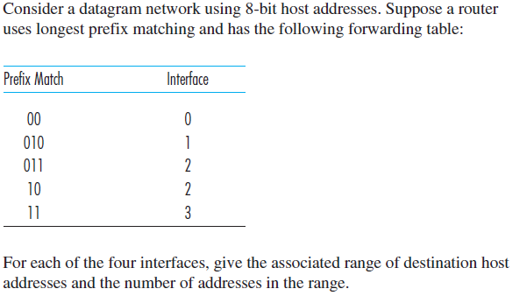

Slide 14
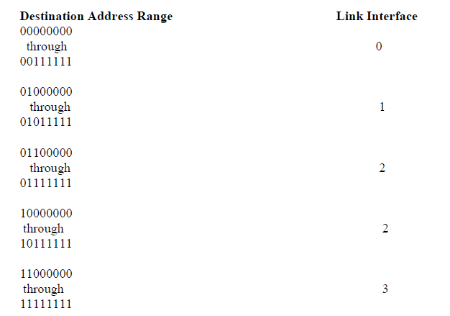

Slide 15
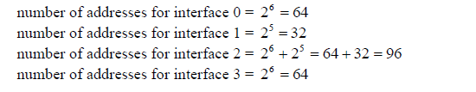

Slide 17
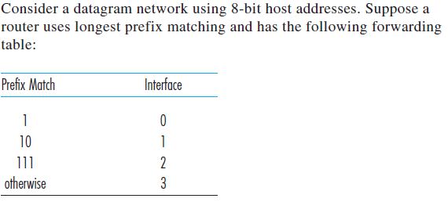

Slide 18
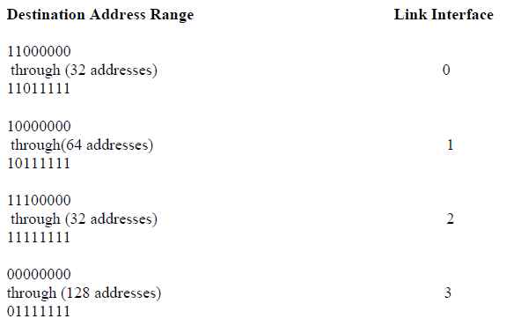

Slide 20
IP Datagram Fragmentation
Maximum Transmission Unit (MTU)
Smaller datagrams is referred to as a fragment.

Slide 21
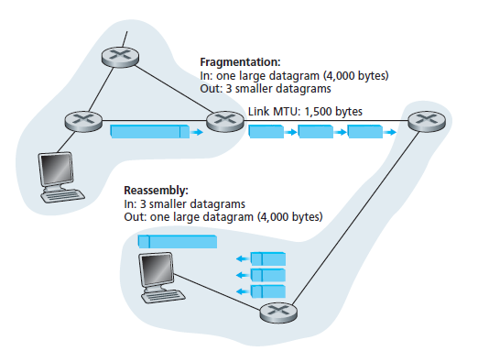
IP Datagram Fragmentation

Slide 22
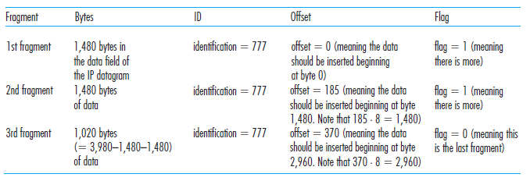

Slide 23
