Slide 1
Notes:
SAS and all other SAS Institute Inc. product or service names are registered trademarks or trademarks of SAS Institute Inc. in the USA and other countries. ® indicates USA registration. Other brand and product names are trademarks of their respective companies.

Slide 2
An Easier and Faster Way
to Untranspose a Wide File
Arthur Tabachneck
Toronto, ON Canada
Joe Matise
Chicago, IL
Matt Kastin
Hershey, PA
Gerhard Svolba
Wien, Austria

Slide 3
Presentation Overview
A journey through time
Why we created the macro
How do you use it?
Some useful techniques we used in creating it…

Slide 4


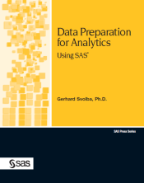

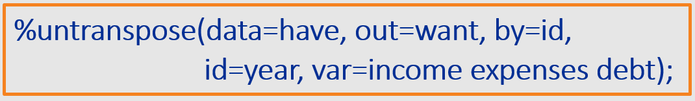
The Task to Un/Transpose Your Data
A Journey Through Time
Medical University of Vienna First version of the %MAKELONG, %MAKEWIDE macro
1997
Official version of the %MAKELONG, %MAKEWIDE macro as part of my first SAS Press book.
2007
Art Tabachneck contacts me with a highly improved approach to untranspose your data
2017
Notes:
“my 20 years history with efficient transposing/untransposing – it is still one of the key data preparation exercises”
1997: Working at the Department for medical Statistics, Medical Univ of Vienna. Medical Doctors “always” provide data in the wrong format. Automatic transposing/untransposing consumes much energy for all statisticians; Gerhard writes the first version of the MAKEWIDE and MAKELONG macro; from a programming style point of view nothing I should be proud of, but: it works and saves a lot of time.
2007: my first SAS Press book: Data Preparation for Analytics Using SAS is published; contains a refined version of the MAKEWIDE/MAKELONG macro, different approaches and lot of examples; training classes, lot of customer feedback and refinement of the macro capabilities
2017: Art contacts me whether I want to contribute to the “Untranspose paper/project” for SGF. His work/approach moves the solution how to untranspose data onto the next level. This is what Joe is going to present in this session.

Slide 5
Question
Have you ever needed to untranspose a wide file back
to the long or not-quite-as-wide file that was used to create it?

Slide 6
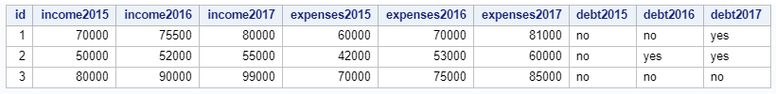
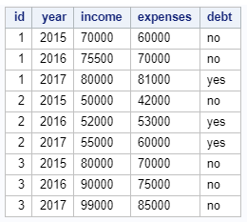
For Example
You were given/sent the following file
label: Yearly Income
label: Yearly Expenses
label: Expenses>Income
format: $deptcode.
and you needed to untranspose it to look like

Slide 7
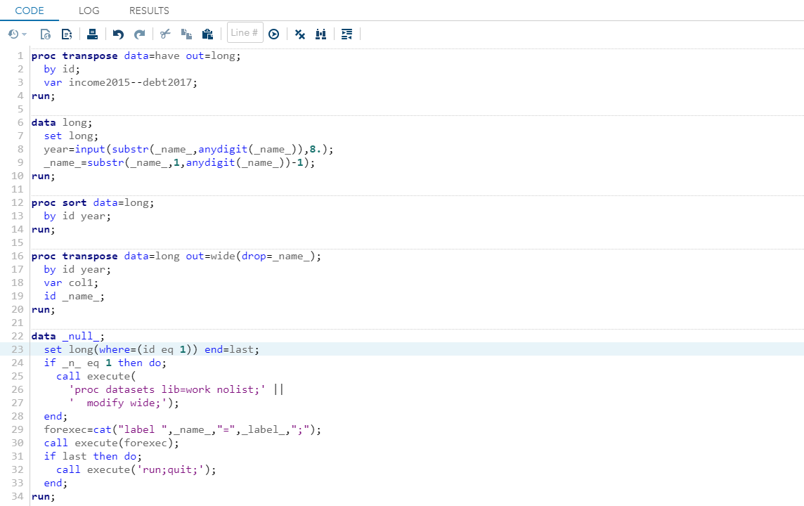
Use the Transpose Procedure
Method #1
make file long
parse year and varname from _name_
sort the file
make file wide
add variable labels

Slide 8
Use the Transpose Procedure
Method #1
Problems:
requires a lot of steps and coding
loses formats
converts numeric fields to character
will output records even if they only contain missing values
procedure creates output files that contain a lot of redundant metadata
make file long
parse name and varname from _name_
sort the file
make file wide
add variable labels

Slide 9
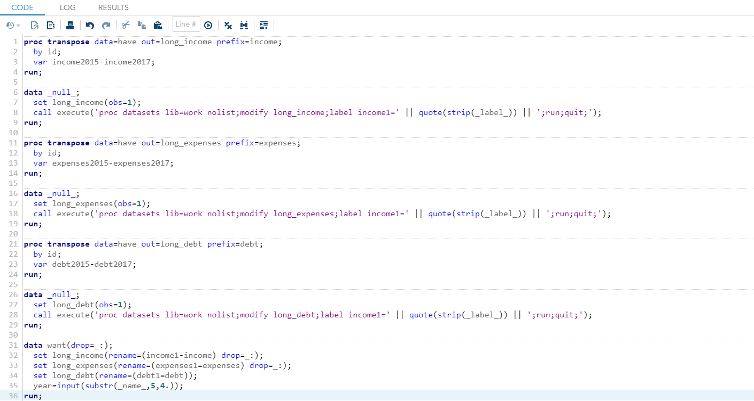
Use the Transpose Procedure
Method #2
make file long
transpose Income
parse name and varname from _name_
assign label
transpose expenses
sort the file
assign label
make file wide
transpose debt
add variable labels
assign label
combine files

Slide 10
Use the Transpose Procedure
Method #2
Fewer Problems but:
code requires more thought
greater chance of introducing error
code is less extensible
will output records even if they only contain missing values
procedure creates output files that contain a lot of redundant metadata
transpose Income
make file long
parse name and varname from _name_
assign label
transpose expenses
sort the file
assign label
make file wide
transpose debt
add variable labels
assign label
combine files

Slide 11

Use the Untranspose Macro
Method #3
Less code thus lower probability of user error
More extensible
You choose whether to output records with all missing values
All variables maintain their original types, formats and labels
Uses same options and statements as PROC TRANSPOSE
Lets you create a file with metadata
Much faster than either of the methods shown earlier

Slide 12
Use the Untranspose Macro
Method #3
Speed differential increases with both
number of records and number of variables
with 50,000 records and three variables
70 times faster than Method 1
11.6 times faster than Method 2
with 500,000 records and three variables
207.8 times faster than Method 1
27.2 times faster than Method 2

Slide 13
How to use %UNTRANSPOSE

Slide 14
Using Named Parameters
Benefits
You determine the default values for each parameter
You only need to specify the parameters if they're different than their default
No need to differentiate between options and statements, or the order in which they’re included
No relearning necessary; the macro uses the same names as proc transpose for all parameters to retain familiarity

Slide 15
%UNTRANSPOSE Usage
Named Parameters
libname_in id_format
libname_out var_first
data delimiter
out suffix
by copy
prefix missing
var metadata
id makelong
id_informat max_length

Slide 16
%UNTRANSPOSE Usage
Named Parameters
libname_in id_format
libname_out var_first
data delimiter
out suffix
by copy
prefix missing
var metadata
id makelong
id_informat max_length
you can change the default libnames used for one-level file names
e.g. libname_in = some_path

Slide 17
%UNTRANSPOSE Usage
Named Parameters
libname_in id_format
libname_out var_first
data delimiter
out suffix
by copy
prefix missing
var metadata
id makelong
id_informat max_length
var
<id>
<prefix>
<delimiter>
<suffix>
<id>
var
example transposed variable name
_04APR2018_Weight_Actual

Slide 18
%UNTRANSPOSE Usage
Named Parameters
libname_in id_format
libname_out var_first
data delimiter
out suffix
by copy
prefix missing
var metadata
id makelong
id_informat max_length
example transposed variable name
_04APR2018_Weight_Actual

Slide 19
%UNTRANSPOSE Usage
Named Parameters
libname_in id_format
libname_out var_first
data delimiter
out suffix
by copy
prefix missing
var metadata
id makelong
id_informat max_length
example transposed variable name
_04APR2018_Weight_Actual

Slide 20
%UNTRANSPOSE Usage
Named Parameters
libname_in id_format
libname_out var_first
data delimiter
out suffix
by copy
prefix missing
var metadata
id makelong
id_informat max_length
example transposed variable name
_04APR2018_Weight_Actual

Slide 21
%UNTRANSPOSE Usage
Named Parameters
libname_in id_format
libname_out var_first
data delimiter
out suffix
by copy
prefix missing
var metadata
id makelong
id_informat max_length
example transposed variable name
_04APR2018_Weight_Actual

Slide 22
%UNTRANSPOSE Usage
Named Parameters
libname_in id_format
libname_out var_first
data delimiter
out suffix
by copy
prefix missing
var metadata
id makelong
id_informat max_length
example transposed variable name
_04APR2018_Weight_Actual

Slide 23
%UNTRANSPOSE Usage
Named Parameters
libname_in id_format
libname_out var_first
data delimiter
out suffix
by copy
prefix missing
var metadata
id makelong
id_informat max_length
example transposed variable name
_04APR2018_Weight_Actual

Slide 24
%UNTRANSPOSE Usage
Named Parameters
libname_in id_format
libname_out var_first
data delimiter
out suffix
by copy
prefix missing
var metadata
id makelong
id_informat max_length
Specify whether the macro should output records that only have missing values for the variables listed in the var parameter

Slide 25
%UNTRANSPOSE Usage
Named Parameters
libname_in id_format
libname_out var_first
data delimiter
out suffix
by copy
prefix missing
var metadata
id makelong
id_informat max_length
Specify that you want the macro to output a dataset containing all of the variable types, lengths, formats, informats and labels

Slide 26
%UNTRANSPOSE Usage
Named Parameters
libname_in id_format
libname_out var_first
data delimiter
out suffix
by copy
prefix missing
var metadata
id makelong
id_informat max_length
Specify that you want the macro to output a long dataset (i.e., a separate record for each by, id and var combination)

Slide 27
%UNTRANSPOSE Usage
Named Parameters
libname_in id_format
libname_out var_first
data delimiter
out suffix
by copy
prefix missing
var metadata
id makelong
id_informat max_length
Minimize processing time (when untransposing to a long format) by indicating the maximum variable length

Slide 28

Where Do I Get It?
From the internet, of course!
https://github.com/gerhard1050/Untranspose-a-Wide-File
The page includes the paper, the macro, this Powerpoint, and a tip sheet
Then, save the file as untranspose.sas in a directory that exists in your SASAUTOS* path
*see: http://analytics.ncsu.edu/sesug/2008/SBC-126.pdf
Notes:
The page lets you download the paper, code and a tip sheet that includes a number of examples

Slide 29
development: some techniques we used
Identifying whether a 1 or 2-level name was used and, if necessary, parsing out all dataset options. e.g., to parse a data parameter like:
data=mylib.have(where=(gender eq 'male'))
%let lp=%sysfunc(findc(%superq(data),%str(%()));
%if &lp. %then %do;
%let rp=%sysfunc(findc(%superq(data),%str(%)),b));
%let dsoptions=%qsysfunc(substrn(%nrstr(%superq(data)),
&lp+1,&rp-&lp-1));
%let data=%sysfunc(substrn(%nrstr(%superq(data)),1,%eval(&lp-1)));
%end;
%else %let dsoptions=;

Slide 30
development: some techniques we used
Creating one record datasets and then using PROC SQL to create macro variables from dictionary.columns
data t_e_m_p;
set &libname_in..&data. (obs=1 keep=&copy.);
run;
proc sql noprint;
select name
into :to_copy separated by " "
from dictionary.columns
where libname="WORK" and
memname="T_E_M_P";
quit;

Slide 31
development: some techniques we used
Using a macro variable that contains a space-separated list of variable names to create a SAS dataset
data t_e_m_p;
array vars(*) &var.;
output;
run;

Slide 32
Your comments and questions
are valued and encouraged
Contact the Authors
Arthur Tabachneck, Ph.D., CEO
Analyst Finder, Inc.
Toronto, ON
art@analystfinder.com
Joe Matise
NORC @ the University of Chicago
Chicago, IL
snoopy369@gmail.com
Gerhard Svolba
SAS Institute
Wien, Austria
Gerhard.Svolba@sas.com
Matt Kastin
NORC @ the University of Chicago
Chicago, IL
fried.egg@verizon.com

Slide 33
Your Feedback Counts!
Don't forget to complete the session survey in your conference mobile app.
Go to the Agenda icon in the conference app.
Find this session title and select it.
On the Sessions page, scroll down to Surveys and select the name of the survey.
Complete the survey and click Finish.

