Slide 1
Excelling to Another
Level with SAS®
Arthur Tabachneck
Toronto, ON Canada
Tom Abernathy
New York, NY
Matthew Kastin
Hershey, PA

Slide 2
presentation overview:
What the ExportXL macro is and where you can download it
Why we created it and why it should be in your toolbox
How you can use the macro
Some useful techniques we used in creating it

Slide 3
question
Have you ever run into problems or limitations in exporting SAS datasets to Excel?

Slide 4
would you like to be able to:
avoid 32/64 bit clashes
work without needing SAS/Access for PC File Formats
export by either writing code or clicking on menu items
include or exclude a row with variable names or labels
export to a non-predefined range
add data to an existing worksheet
add a worksheet to an existing workbook
create workbooks using other workbooks as templates
simultaneously export files and create Pivot Tables
apply or not apply a dataset's formats
copy SAS datasets to your system's clipboard

Slide 5

answer
You can do all of those things with a macro you can download for FREE at:
http://www.sascommunity.org/wiki/Excelling_to_Another_Level_with_SAS

Slide 6
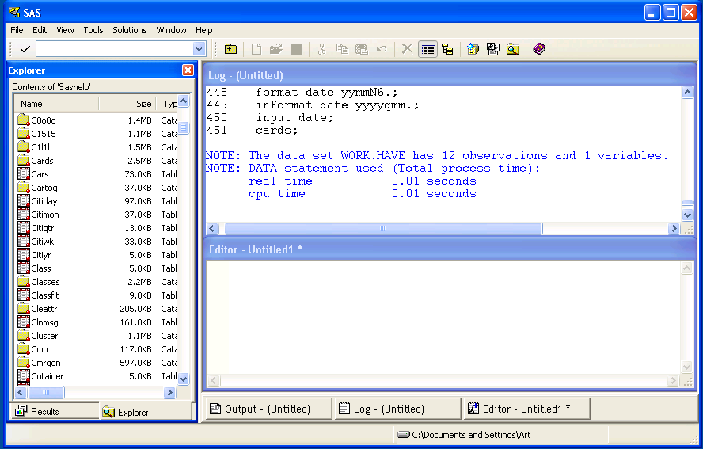
what one way to use the macro looks like
Right click on a dataset name in the SAS Explorer window

Slide 7
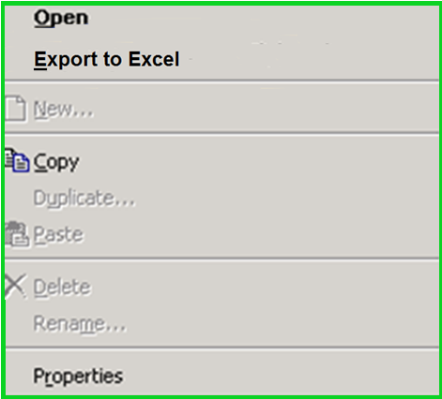
then select the desired Action

Slide 8
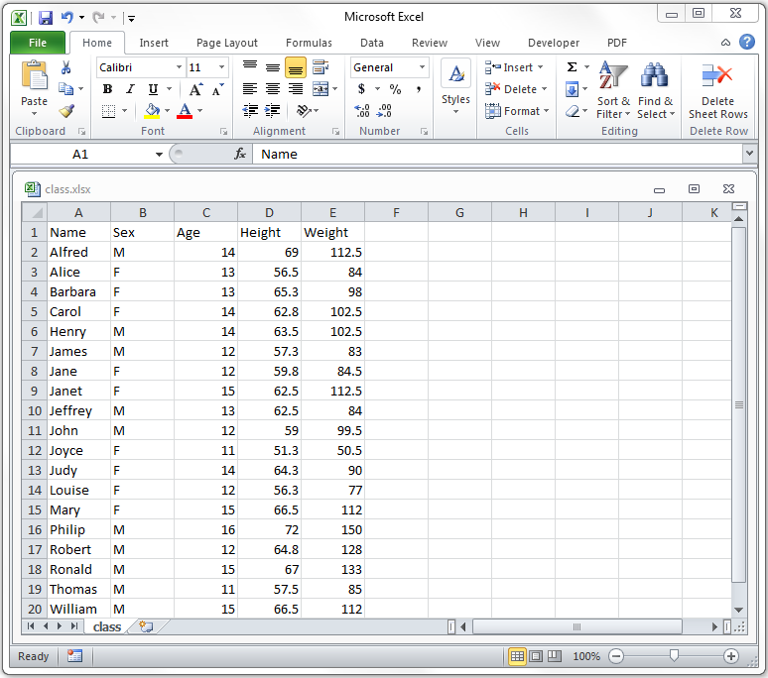
the workbook will be created automagically

Slide 9
or you can run the macro by submitting code
for example:
%exportxl( data=sashelp.class,
outfile=c:\temp\class.xlsx)

Slide 10
with the same result .. of course!

Slide 11
our paper presents a SAS macro: %exportxl
that can be used to drive hundreds of different actions
uses named parameters with familiar names
accepts all forms of variable lists and datastep options
works in both stand alone and server environments
paper includes step-by-step instructions for incorporating all of the macro’s capabilities
only works on windows or windows compatible systems

Slide 12

built-in screen prompts to accommodate
point-and-click use
for example:

Slide 13
the macro uses named parameters
Benefits
You determine the default values for each parameter
You only need to specify the parameters if they’re different than their default values
No need to differentiate between options and statements, or the order in which they’re included
No relearning necessary .. the macro uses the same names as proc export for all parameters

Slide 14
the macro's named parameters
data the dataset you want to export (i.e., a one or two level filename and, if desired, dataset options)
outfile the excel workbook you want to create or modify
type can have one of four values:
N to create a new workbook
M to modify an existing worksheet
A to add a new worksheet
C to copy a file to your system's clipboard
usenames gives you a way to specify that you want to include a row of either variable names or labels
useformats lets you specify whether formats should be applied

Slide 15
the macro's named parameters (continued)
range the upper left cell where you want the table to begin
sheet the excel worksheet you want to create or modify
template lets you indicate that you want your worksheet to be based on an existing template or workbook
templatesheet lets you specify the name of the worksheet that you want to use as a template
usenotepad lets you indicate whether Notepad is needed
pivot lets you create a pivot table

Slide 16
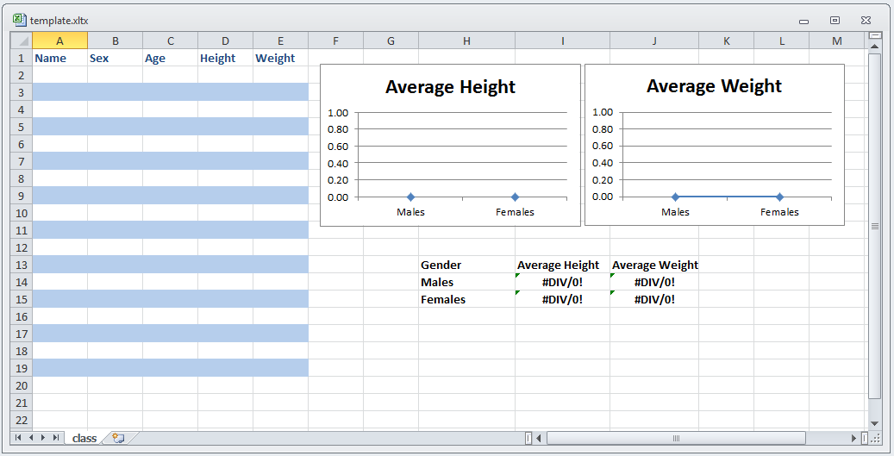
have you ever used an excel template?
It can include such things as:
font choice, color, size, etc.
graphs
highlighting
formulas: e.g., =averageif(B:B,”F”,D:D)

Slide 17
with an existing workbook or template
you can use code like the following:
%exportxl( data=sashelp.class,
template=c:\temp\template.xltx,
templatesheet=Template,
outfile=c:\temp\class.xlsx,
usenames=N,
range=A2,
sheet=Apr_2017)

Slide 18
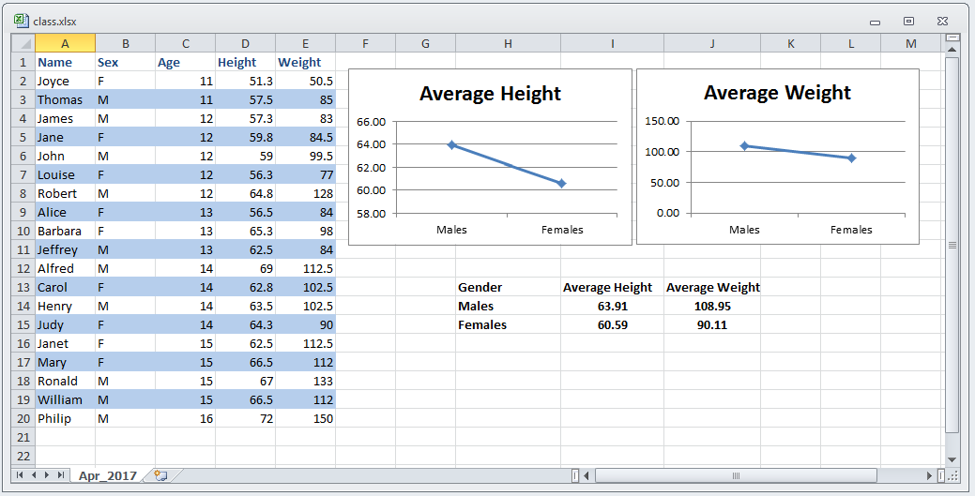
to create workbooks like:

Slide 19
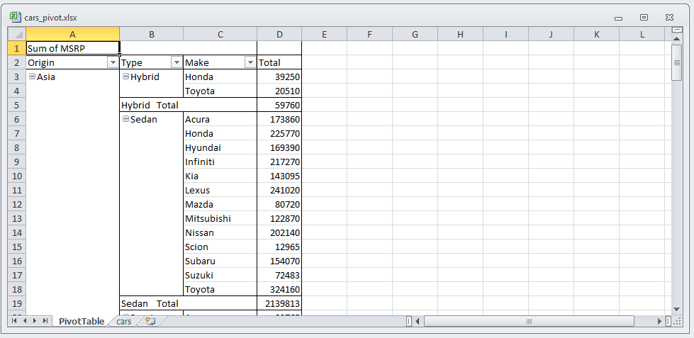
are you familiar with excel pivot Tables?
analysis variable

Slide 20
are you familiar with excel pivot Tables?
one or more class variables

Slide 21
are you familiar with excel pivot Tables?
if the user double clicks on cell A1

Slide 22

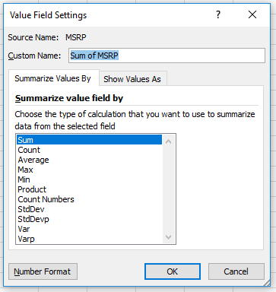
are you familiar with excel pivot Tables?
they get to choose how the analysis variable will be summarized

Slide 23
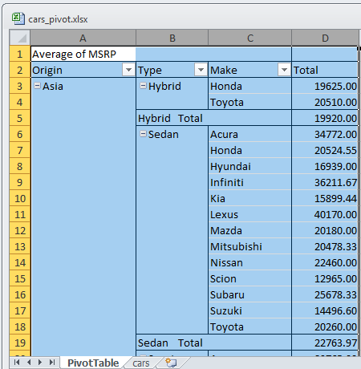
are you familiar with excel pivot Tables?
analysis variable
if they highlight all of the columns, they can easily insert any desired graph

Slide 24
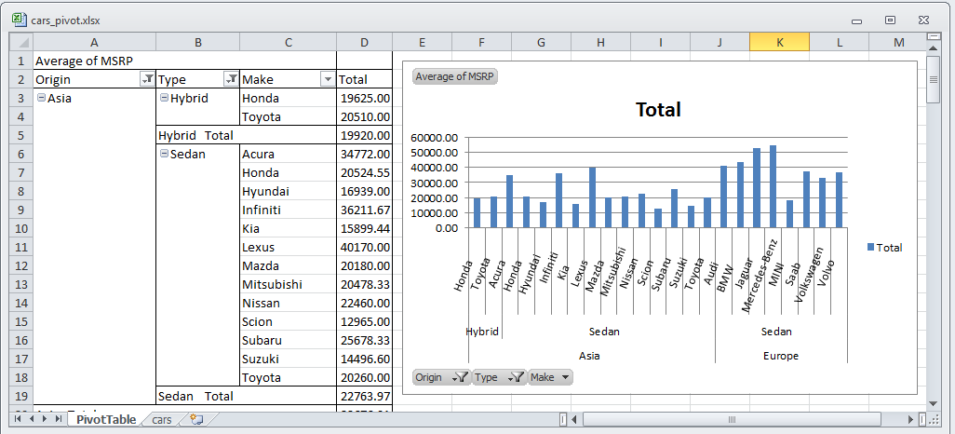
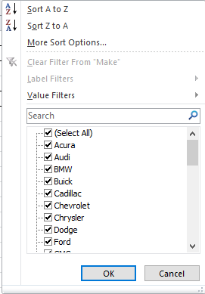
are you familiar with excel pivot Tables?
if they want to drill down, they can click on any class variable and sort and/or select any desired levels

Slide 25
it's really hard to create pivot tables with the %exportxl macro
%exportxl( data=sashelp.car,
outfile=c:\art\cars.xlsx,
pivot=origin type model msrp)

Slide 26
development: some techniques we used
%let lp=%sysfunc(findc(%superq(data),%str(%()));
%if &lp. %then %do;
%let dsoptions=%qsysfunc(substrn(%nrstr(%superq(data)),
&lp+1,&rp-&lp-1));
%let data%sysfunc(substrn(%nrstr(%superq(data)),1,%eval(&lp-1)));
%end;
%else %let dsoptions=;
%if %sysfunc(countw(&data.)) eq 2 %then %do;
%let libnm=%scan(&data.,1);
%let filenm=%scan(&data.,2);
%end;
%else %do;
%let libnm=work;
%let filenm=&data.;
%end;
Use FINDC function to separate dataset name and data set options from the data parameter

Slide 27
development: some techniques we used
%let lp=%sysfunc(findc(%superq(data),%str(%()));
%if &lp. %then %do;
%let dsoptions=%qsysfunc(substrn(%nrstr(%superq(data)),
&lp+1,&rp-&lp-1));
%let data%sysfunc(substrn(%nrstr(%superq(data)),1,%eval(&lp-1)));
%end;
%else %let dsoptions=;
%if %sysfunc(countw(&data.)) eq 2 %then %do;
%let libnm=%scan(&data.,1);
%let filenm=%scan(&data.,2);
%end;
%else %do;
%let libnm=work;
%let filenm=&data.;
%end;
Use COUNTW and %SCAN functions to separate libname and filename from the data parameter

Slide 28
development: some techniques we used
%else %do;
%if %upcase(&range.) eq Y %then %do;
data _null_;
window range rows=8 columns=80
irow=1 icolumn=2 color=black
#2 @3 'Enter the upper left cell where range should begin (e.g. D5): '
color=gray range $41. required=yes
attr=underline color=yellow;
DISPLAY range blank;
call symputx('range',range);
stop;
run;
%end;
%else %if %length(&range.) lt 2 %then %do;
%let range=A1;
%end;
Display window to let users identify range

Slide 29
development: some techniques we used
data t_e_m_p;
set &libnm..&filenm. (%unquote(&dsoptions.) obs=1);
run;
proc sql noprint;
select name,length,type,format,label
into :vnames separated by "~",
:vlengths separated by "~",
:vtypes separated by "~",
:vformats separated by "~",
:vlabels separated by "~"
from dictionary.columns
where libname="WORK" and
memname="T_E_M_P"
;
quit;
%let nvar=&sqlobs.;
Get one record applying dataset options

Slide 30
development: some techniques we used
data t_e_m_p;
set &libnm..&filenm. (%unquote(&dsoptions.) obs=1);
run;
proc sql noprint;
select name,length,type,format,label
into :vnames separated by "~",
:vlengths separated by "~",
:vtypes separated by "~",
:vformats separated by "~",
:vlabels separated by "~"
from dictionary.columns
where libname="WORK" and
memname="T_E_M_P"
;
quit;
%let nvar=&sqlobs.;
Use dictionary.columns to create macro variables for names, lengths, types, formats, and labels

Slide 31
and, not only can you do more, but
the macro only requires base SAS
runs 35 times faster than ODS methods
extremely simple to code
creates excel files that open more quickly than any other method
provides capabilities not available with other methods

Slide 32
and, not only can you do more, but
Capabilities not available with other methods
copying datasets to your clipboard
including a row of either variable names or labels
ability to apply or disregard a dataset's formats
using Excel templates
ability to modify existing worksheets
using ranges without having to predefine them
point and click compatible
ability to create Pivot Tables
no 32/64 bit compatibility issues
th
ru
extr
cr
pr

Slide 33

where to get the macro
Copy the SAS code from:
https://github.com/FriedEgg/Papers/tree/master/Excelling_to_Another_Level_with_SAS
or
https://goo.gl/YGYXoV
save the file as exportxl.sas in a directory that
exists in your SASAUTOS* path
* see: http://analytics.ncsu.edu/sesug/2008/SBC-126.pdf

Slide 34
summary of what I just presented:
What the ExportXL macro is and where you can download it
Why we created it and why it should be in your toolbox
How you can use the macro
Some useful techniques we used in creating it

Slide 35
Your comments and questions
are valued and encouraged
Contact the Authors
Arthur Tabachneck, Ph.D., CEO
Analyst Finder, Inc.
Toronto, ON
art@analystfinder.com
Tom Abernathy
Pfizer, Inc.
New York, NY
tom.abernathy@pfizer.com
Matt Kastin
NORC at the University of Chicago
Hershey, PA
fried.egg@verizon.net

