Slide 1
AMR Project Overview
Sept 15, 2021

Slide 2
Study Background
846 samples over a period of 3 years (2018-2020).
Samples consist of E. Coli isolates from a variety of livestock animals (pigs, cattle, horses, chickens, etc).
Samples were sequenced (whole genome sequencing) and searched for the presence of antimicrobial resistance genes with AMRFinder and Abricate.
Total # of AMR genes detected in each sample was compared across 4 databases (amrfinder, ncbi, plasmidfinder, resfinder).
Antimicrobial resistance assays (Sensititre BioMic Assay) were performed to check for AMR phenotypes (Sensitive, Intermediate, or Resistant).
AM Resistance conferred by specific genes was determined by referencing the Comprehensive Antimicrobial Resistance Database (CARD).

Slide 3
E. Coli Samples (n = 846)
Metadata
Sample id
Animal of origin
State of origin
Tissue sample
Genotype Data
Sample id
Gene name
Gene type (plasmid, chromosomal)
Database
% Coverage/identity
Phenotype Data
Sample id
Antimicrobial agent
Minimum Inhibitory Concentration
Breakpoint determinant
Phenotype
AMRFinder
BLASTX
% coverage > 90%
% identity > 75%
Abricate
BLASTN
NCBI, Resfinder, PlasmidFinder
% identity > 75%
Sensititre BioMic Assay
Determines ‘Minimum Inhibitory Concentration” of a given antimicrobial within a range.
AMR phenotype is determined by either;
CLSI breakpoints.
50/90% quantile.
Comprehensive Antimicrobial Resistance Database
Information on individual genes and whether they are known to confer resistance to a specific antimicrobial agent.

Slide 4
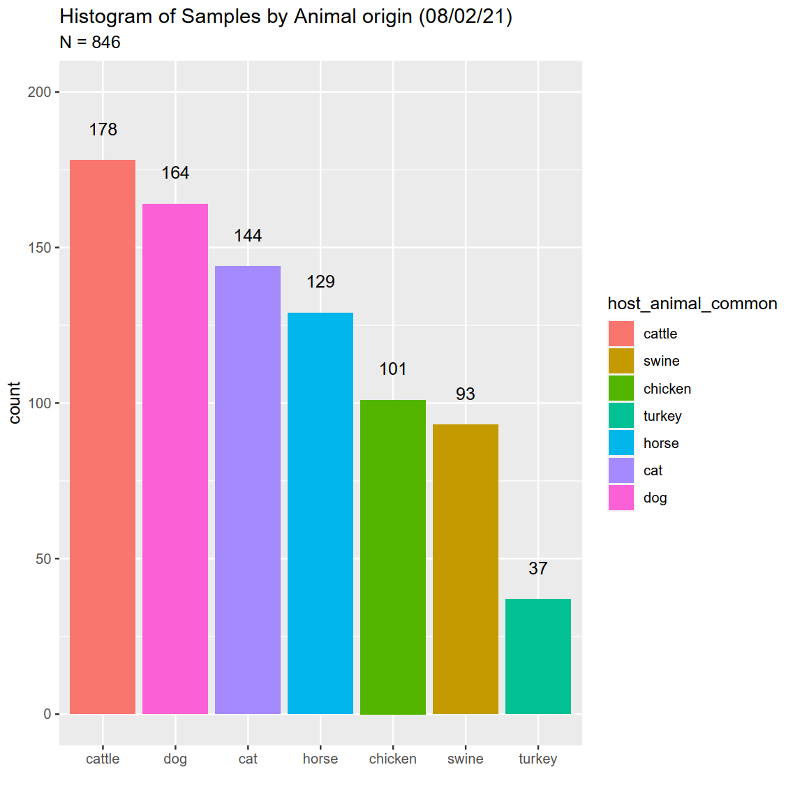
How are samples distributed by host animal?

Slide 5
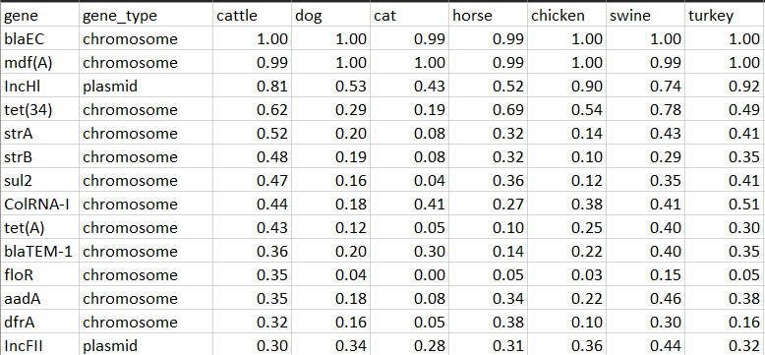
What are the most prevalent AMR genes found in samples? (n = 846)

Slide 6
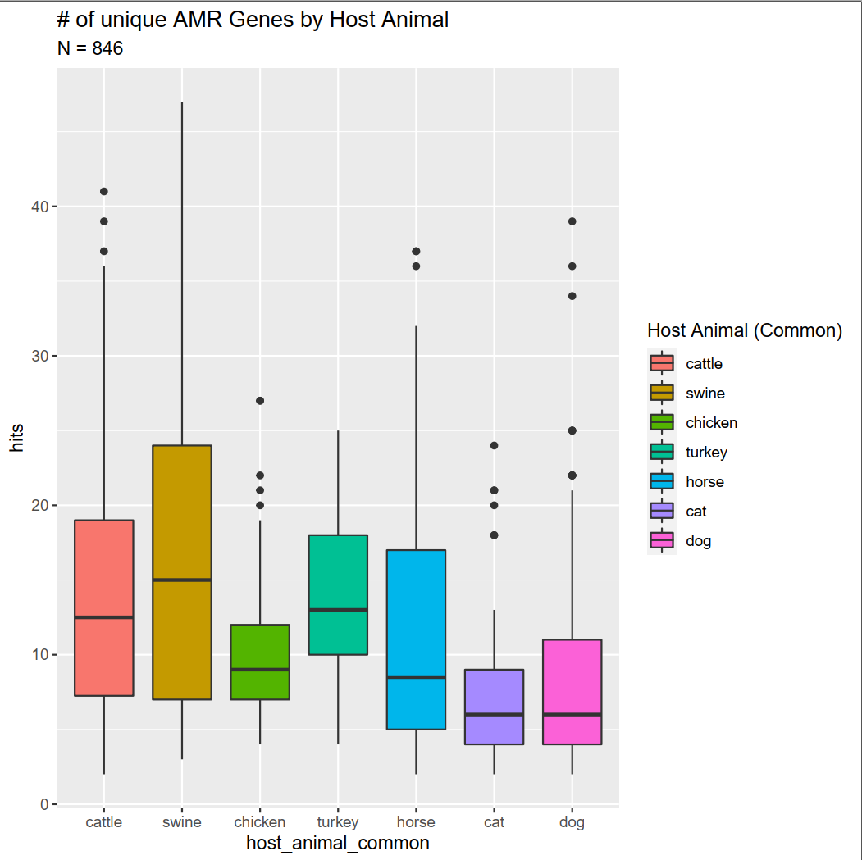
Is there a difference in number of AMR genes found across different animal samples?

Slide 7
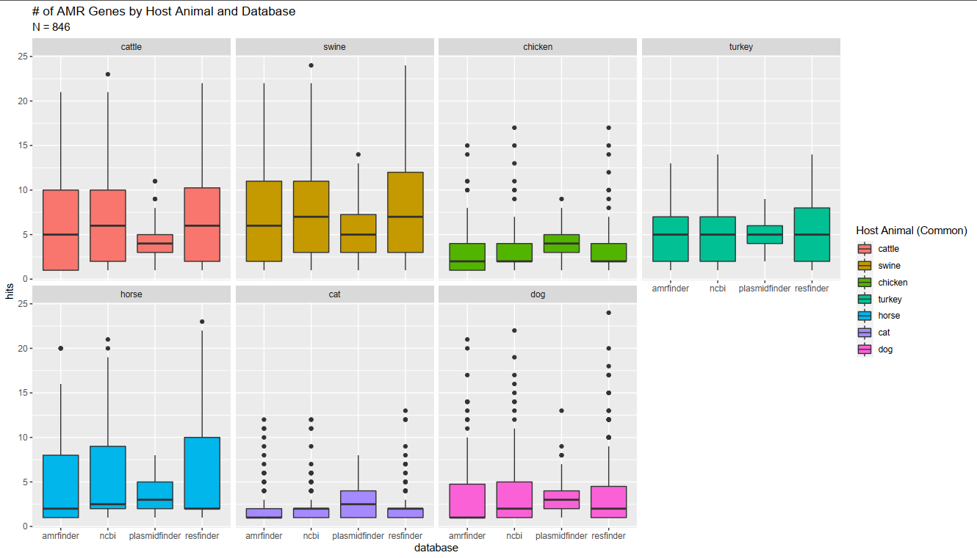
Is there a bias in # of AMR genes found by database?
Notes:
blaEC – beta lactamase – breaks up penicillin? < look up later

Slide 8
Project Objectives
Inference
Is there a relationship between genotype and phenotype (yes/no)?
What is the strength of the genotype / phenotype relationship?
Using the AMR gene data that we have, can we cluster profiles based on animal species of origin?
Prediction
Based on the AMR genotype, can we predict AB resistance phenotype?
Is there a characteristic of E. coli that we can use to predict the animal species of origin?

Slide 9
Inference: Is there a relationship between genotype and phenotype?
Logistic Regression with Animal Fixed Effect.
Testing only genes-AB combinations which are purported to confer antibiotic resistance.
Response: AB resistance phenotype
Predictor: 1,0 presence absence of a single gene.

Slide 10
Logistic Regression
Pros
Cons
Logistic Regression calculates the effect of genes on the likelihood a given response will occur as an odds-ratio.
This addresses the question of: What is the strength of the genotype / phenotype relationship?
Ex: A odds-ratio of 5.44 suggests that odds of being resistance is 5.44x greater when you have the gene than the odds of being resistance when you do not.
Looking at only a single gene at a time allows us to compare how well that gene confers resistance to drugs of the same class by looking at its odd-ratio.
If we have a tetO gene present in a sample, does that gene correlate with resistance to ALL tetracyclines (minocycline, tetracycline, doxycycline, etc.) we test against?
Incorporating an animal fixed effect accounts for the variability in gene effect across different animal species without discarding samples.
This analysis does not evaluate the combinatorial effect of genes on their ability to confer resistance.
Alternative approaches:
Combine multiple genes of the same gene functional family together
Considers more than one gene at a time but assumes a linear additive relationship in genes ability to confer resistance.
Treat the # of genes as a factor
useful if we believe a gene functional family only confers resistance once a certain threshold IS reached at the cost of obscuring the effect of an individual gene.
Treat each gene in a gene functional family as its own variable and add interaction terms between all possible combinations
Many interactions terms significantly lowers the ability of the model to assess main effect strength.

Slide 11
Using the AMR gene data that we have, can we cluster profiles based on animal species of origin?
Non-parametric K-Modes clustering
Where each sample is represented by a vector of 0,1s representing the presence absence of each gene.
Evaluation:
Use an Adjusted Rand Index to compare the clusters generated from the genotype data with known labels (ex: Animal species of origin) and compare agreement.
This analysis is simply a preliminary analysis checking whether genotype information could be used to predict any metadata labels.

Slide 12
Prediction
Based on the AMR genotype, can we predict AB resistance phenotype?
Is there a characteristic of E. coli that we can use to predict the animal species of origin?
Multi-output neural network model
Response: multiple AB resistance phenotypes and animal of origin.
Predictors: AMR genotype.

Slide 13
Neural Network
Pros:
A machine learning model is best suited for this dataset where we have a high number of predictor variables relative to the sample size.
Neural Network was chosen for its ability to handle multiple-outputs.
Uses entire dataset to draw conclusions on AMR gene detection > AMR prediction.
Cons
Very difficult to gain information on which specific predictors (genes) are contributing most to predictions.
Alternative Approaches
Build individual models for AMR phenotype target.
Pros: Easier to gain insight on how each predictor contributions to a prediction.
Cons: Assumes prediction targets are independent.

Slide 14
Project Objectives
Inference
Is there a relationship between genotype and phenotype (yes/no)? Logistic Regression
What is the strength of the genotype / phenotype relationship? Logistic Regression
Using the AMR gene data that we have, can we cluster profiles based on animal species of origin? Non-parametric K-Modes clustering
Prediction
Based on the AMR genotype, can we predict AB resistance phenotype? Neural Network
Is there a characteristic of E. coli that we can use to predict the animal species of origin? Neural Network

