Slide 1
AMR Project Followup
Oct 13, 2021

Slide 2
Study Background
846 samples over a period of 3 years (2018-2020).
Samples consist of E. Coli isolates from a variety of livestock animals (pigs, cattle, horses, chickens, etc).
Samples were sequenced (whole genome sequencing) and searched for the presence of antimicrobial resistance genes with AMRFinder and Abricate.
Total # of AMR genes detected in each sample was compared across 4 databases (amrfinder, ncbi, plasmidfinder, resfinder).
Antimicrobial resistance assays (Sensititre BioMic Assay) were performed to check for AMR phenotypes (Sensitive, Intermediate, or Resistant).
AM Resistance conferred by specific genes was determined by referencing the Comprehensive Antimicrobial Resistance Database (CARD).

Slide 3
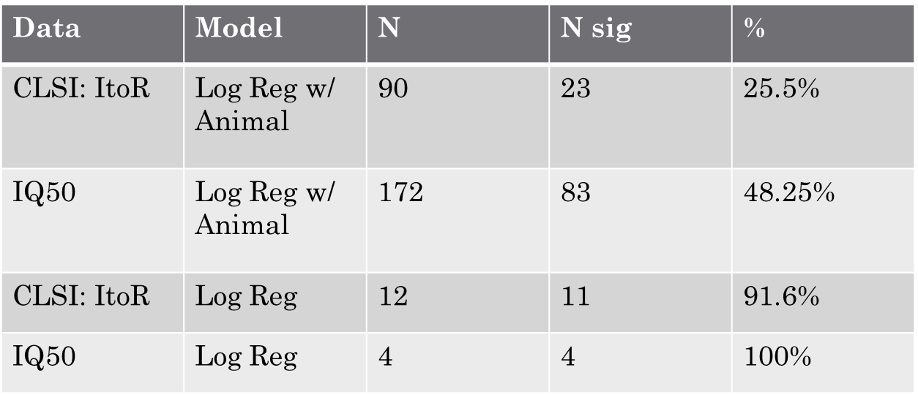
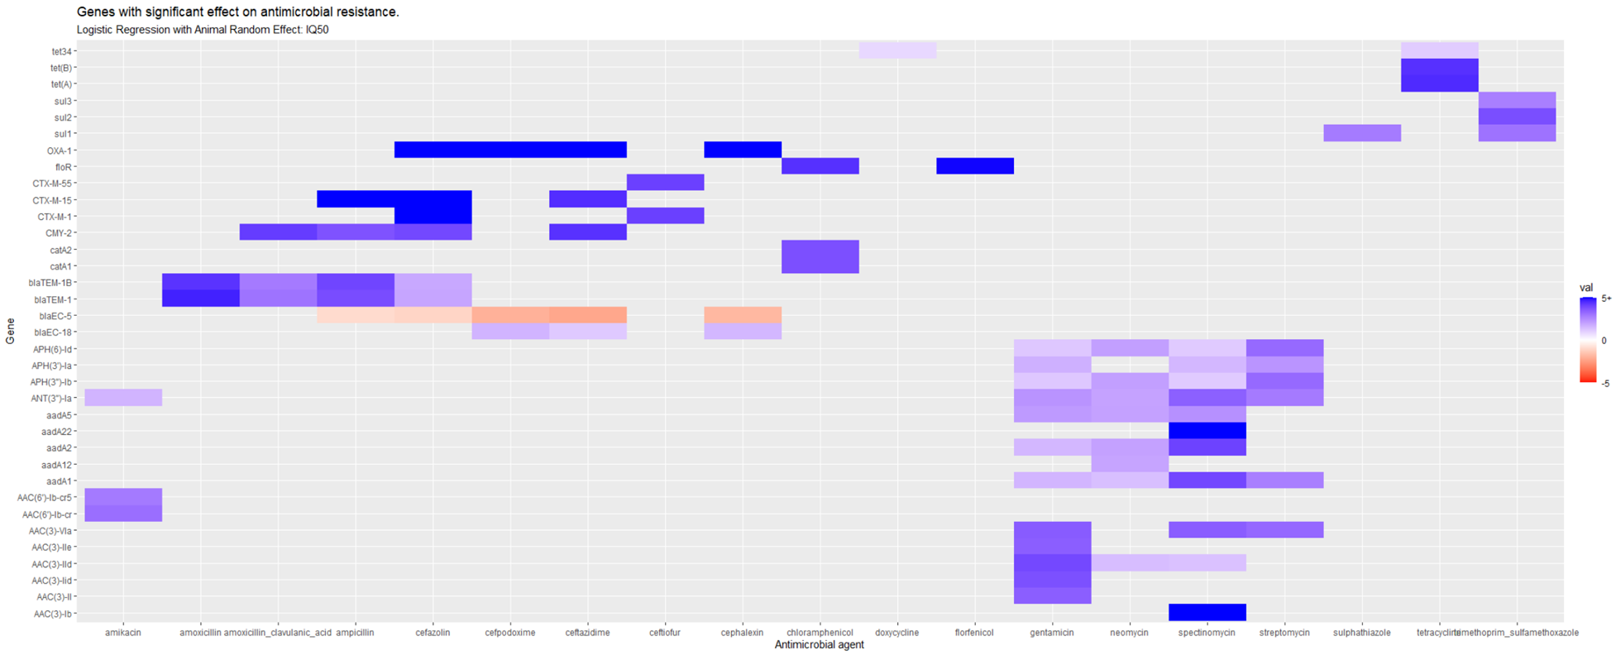
Logistic Regression
Results
Found some significant relationships
Quantified strength of those relationships.
Follow-ups
What was the number of significant vs non-significant relationships found in each drug class?
What is the Power of our tests?
Post-hoc analysis considering the effect of multiple genes vs 1 single gene.

Slide 4
What was the number of significant vs non-significant relationships found in each drug class?
mic_id | tests | sig | prop
doxycycline | 1 | 1 | 1.00
tetracycline | 3 | 3 | 1.00
ticarcillin | 2 | 2 | 1.00
ticarcillin_clavulanic_acid | 2 | 2 | 1.00
trimethoprim_sulfamethoxazole | 3 | 3 | 1.00
gentamicin | 27 | 24 | 0.89
chloramphenicol | 4 | 3 | 0.75
spectinomycin | 15 | 11 | 0.73
neomycin | 15 | 9 | 0.60
streptomycin | 10 | 6 | 0.60
cefazolin | 26 | 15 | 0.58
ceftiofur | 24 | 13 | 0.54
amoxicillin_clavulanic_acid | 6 | 3 | 0.50
florfenicol | 2 | 1 | 0.50
sulphathiazole | 3 | 1 | 0.33
ceftazidime | 23 | 7 | 0.30
amoxicillin | 10 | 2 | 0.20
cefpodoxime | 20 | 4 | 0.20
ampicillin | 28 | 5 | 0.18
cephalexin | 20 | 3 | 0.15
amikacin | 27 | 3 | 0.11
class | tests | sig | prop
folate pathway antagonist | 3 | 3 | 1.00
tetracycline | 4 | 4 | 1.00
aminocyclitol | 15 | 11 | 0.73
B lactam combo | 10 | 7 | 0.70
phenicol | 6 | 4 | 0.67
aminoglycoside | 79 | 42 | 0.53
cephalosporin | 113 | 42 | 0.37
sulfonamide | 3 | 1 | 0.33
penicillin | 38 | 7 | 0.18

Slide 5
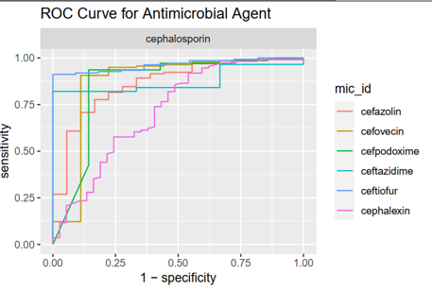
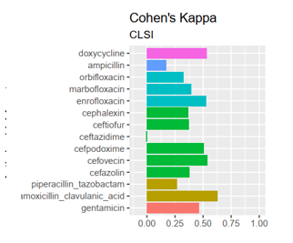
Machine Learning : Random Forest
Results: We can predict with resistance to some compounds over others.
Follow-up
Some results are confusing, is this caused by class imbalance? Can we address those?
What animals can we make predictions for?

Slide 6
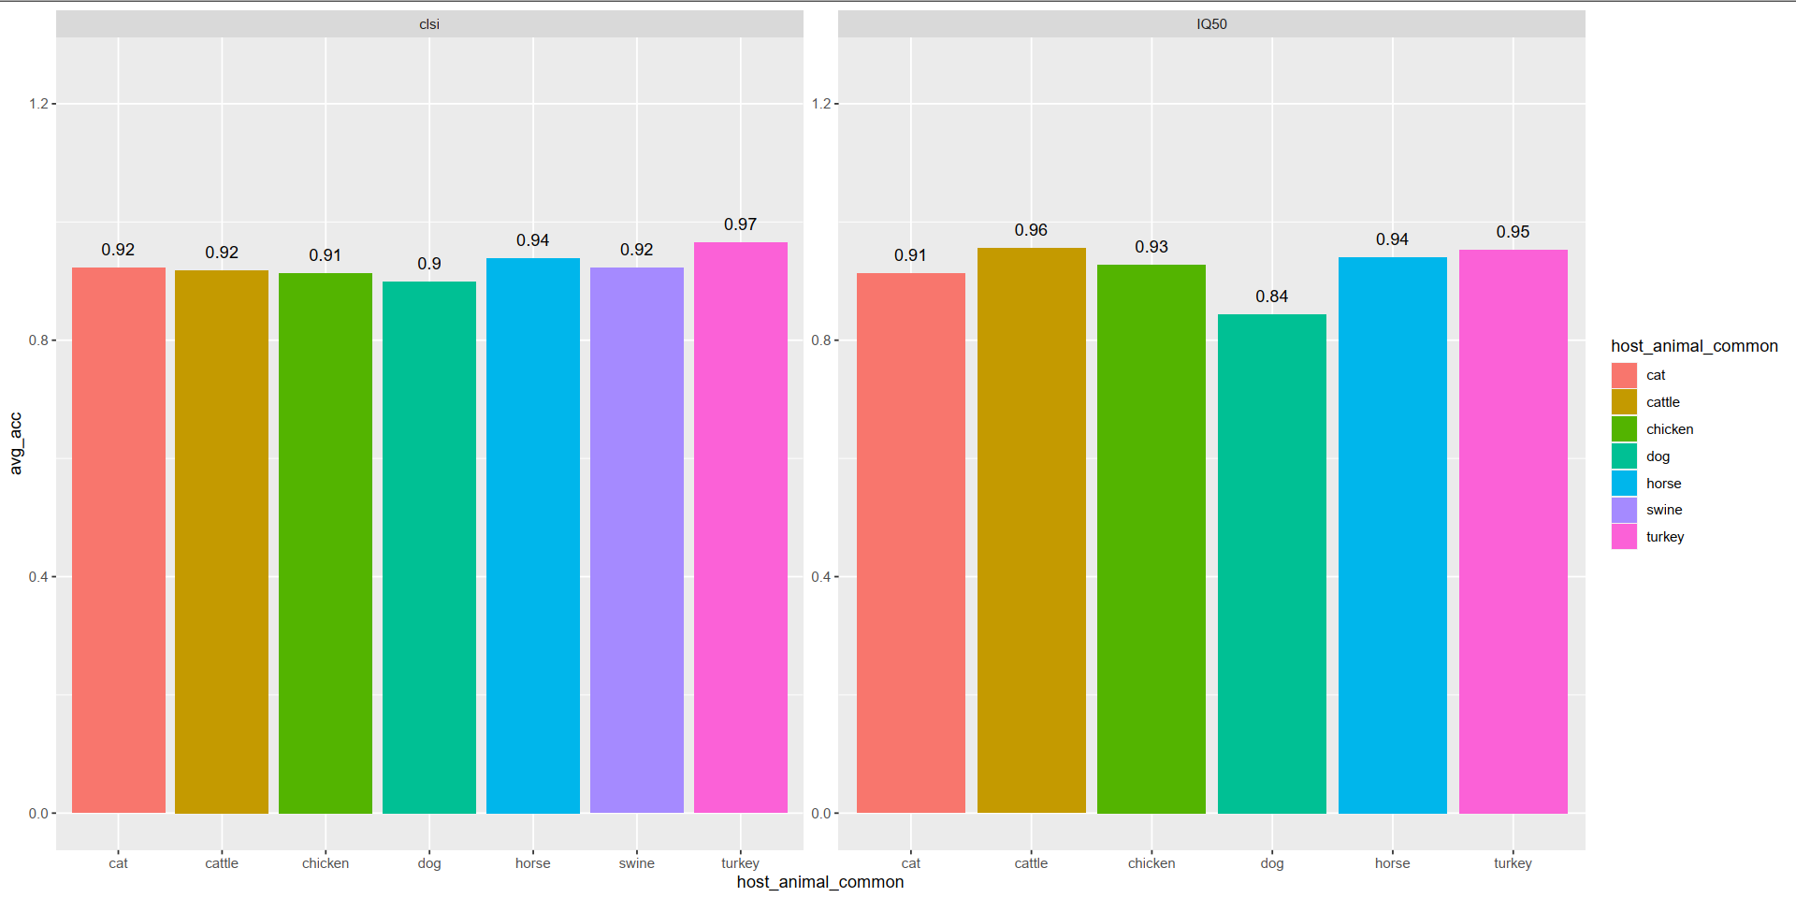
Average Prediction Accuracy by Animal

Slide 7
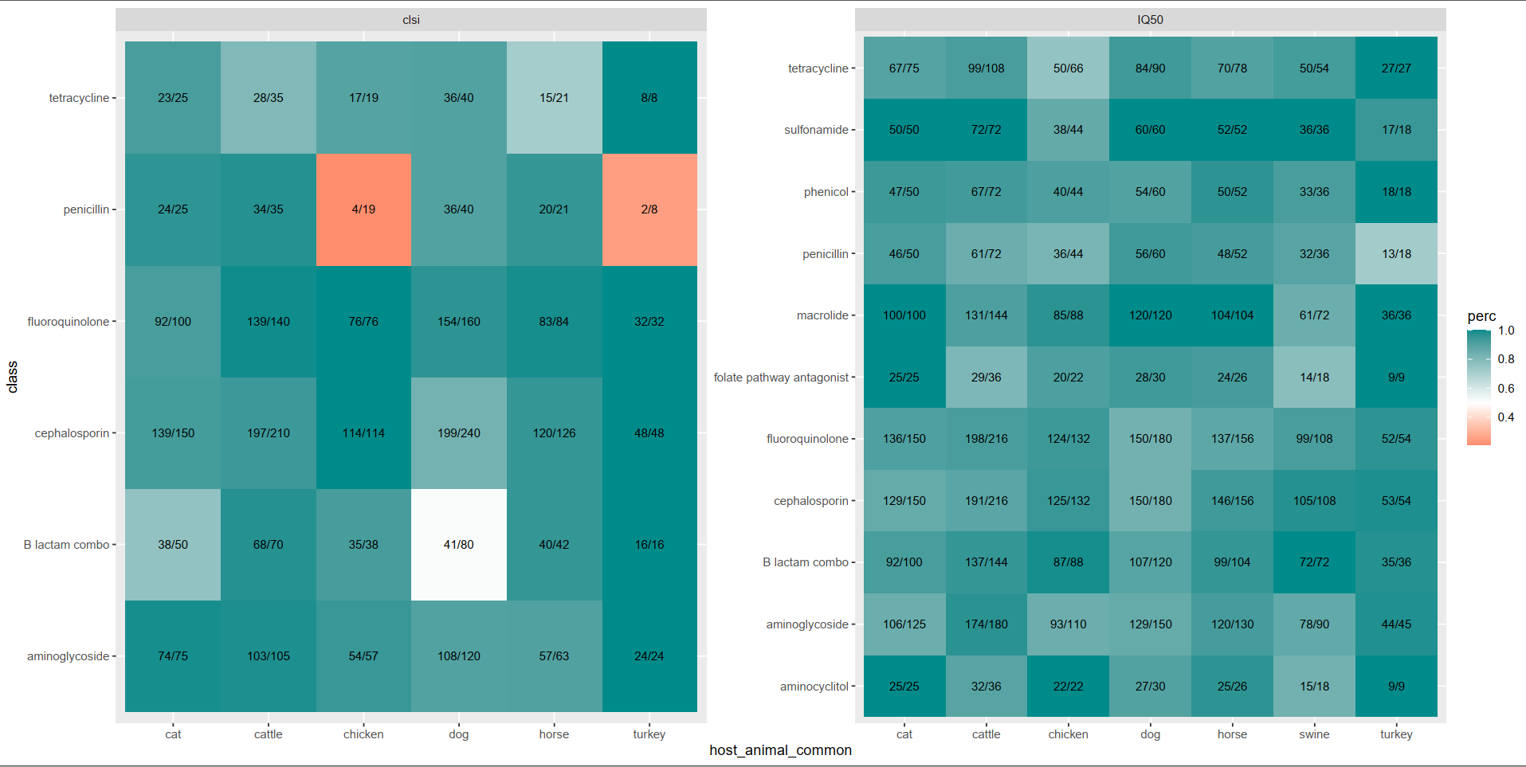
Prediction Accuracy for Animal by Antimicrobial Class

Slide 8
E. Coli Samples (n = 846)
Metadata
Sample id
Animal of origin
State of origin
Tissue sample
Genotype Data
Sample id
Gene name
Gene type (plasmid, chromosomal)
Database
% Coverage/identity
Phenotype Data
Sample id
Antimicrobial agent
Minimum Inhibitory Concentration
Breakpoint determinant
Phenotype
AMRFinder
BLASTX
% coverage > 90%
% identity > 75%
Abricate
BLASTN
NCBI, Resfinder, PlasmidFinder
% identity > 75%
Sensititre BioMic Assay
Determines ‘Minimum Inhibitory Concentration” of a given antimicrobial within a range.
AMR phenotype is determined by either;
CLSI breakpoints.
50/90% quantile.
Comprehensive Antimicrobial Resistance Database
Information on individual genes and whether they are known to confer resistance to a specific antimicrobial agent.

Slide 9
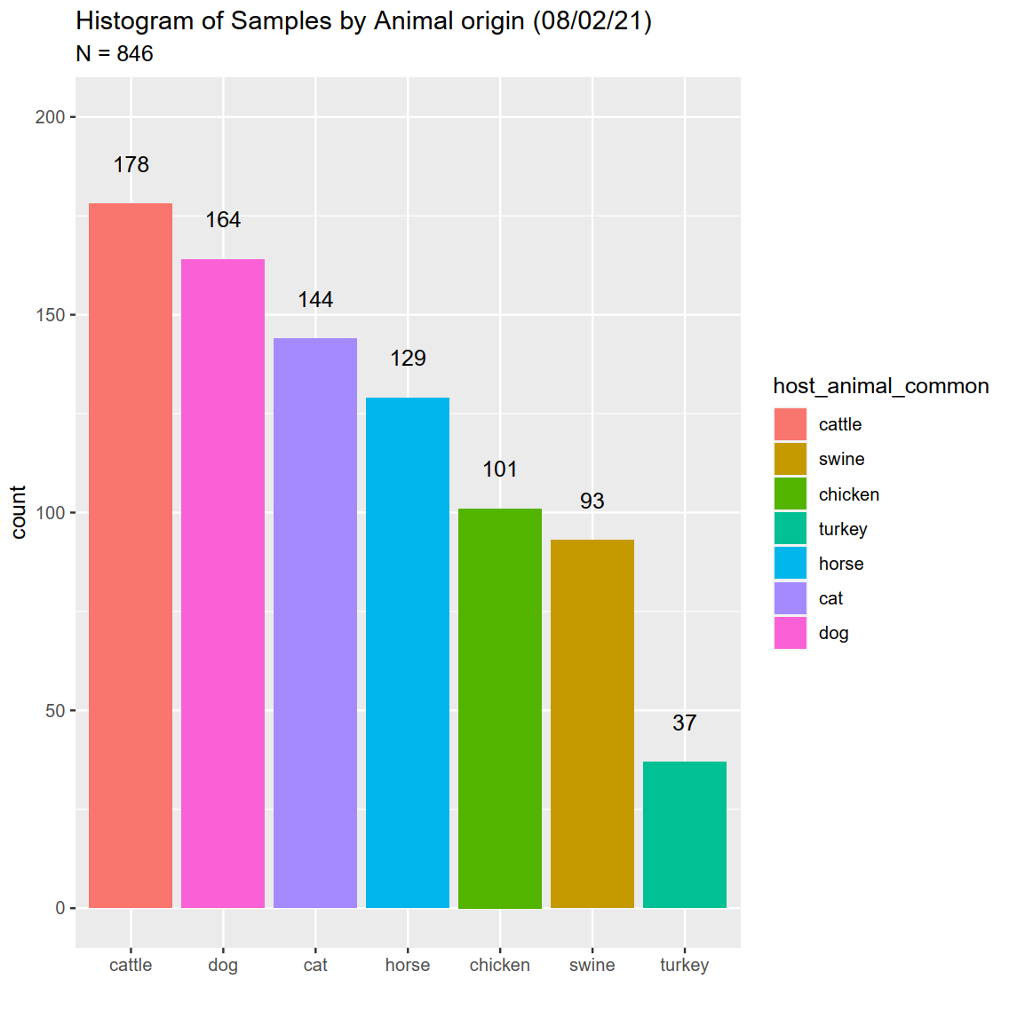
How are samples distributed by host animal?

Slide 10
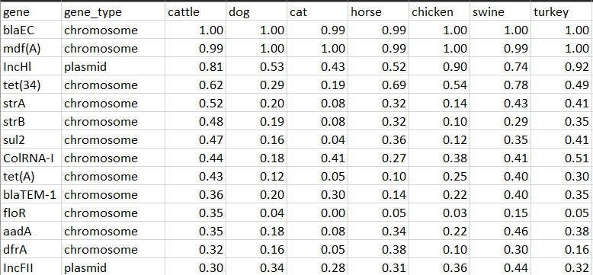
What are the most prevalent AMR genes found in samples? (n = 846)

Slide 11
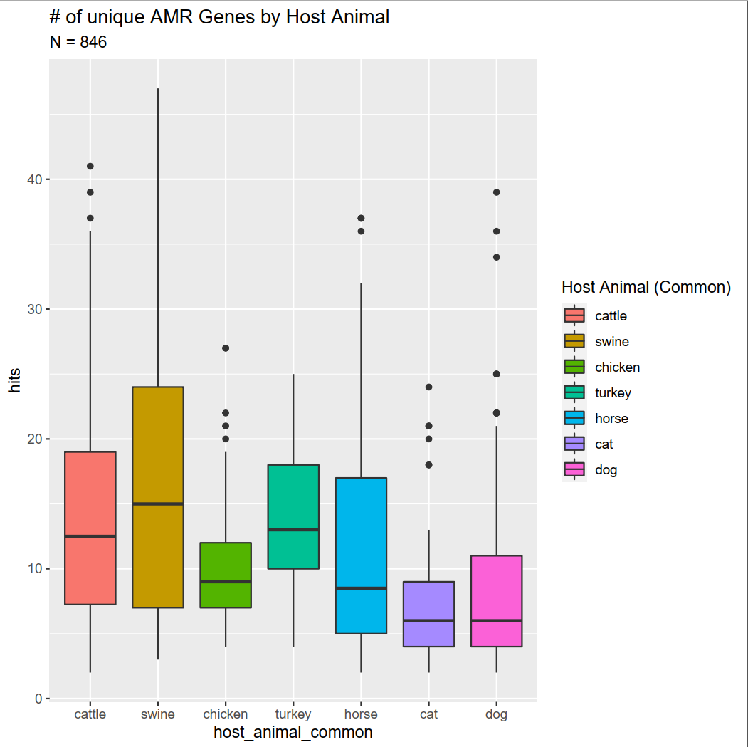
Is there a difference in number of AMR genes found across different animal samples?

Slide 12
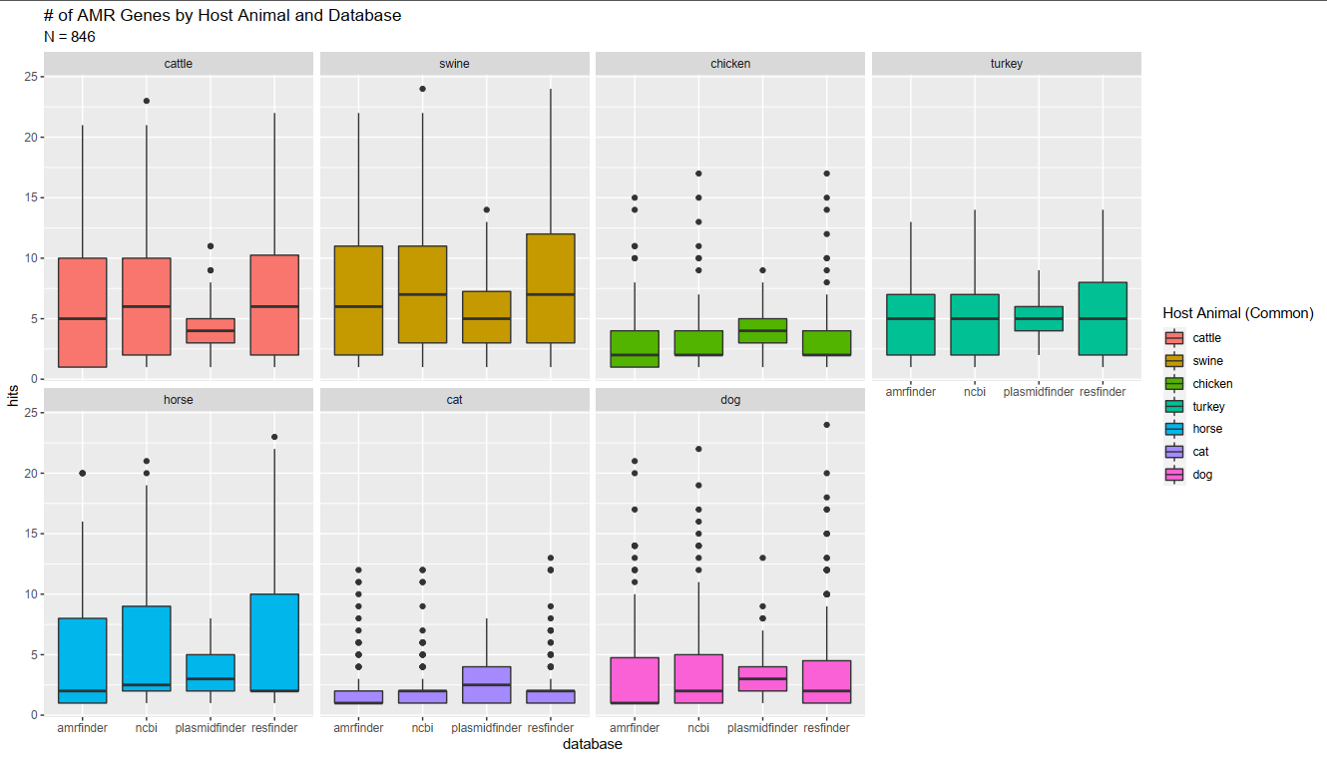
Is there a bias in # of AMR genes found by database?
Notes:
blaEC – beta lactamase – breaks up penicillin? < look up later

Slide 13
Project Objectives
Inference
Is there a relationship between genotype and phenotype (yes/no)?
What is the strength of the genotype / phenotype relationship?
Using the AMR gene data that we have, can we cluster profiles based on animal species of origin?
Prediction
Based on the AMR genotype, can we predict AB resistance phenotype?
Is there a characteristic of E. coli that we can use to predict the animal species of origin?

Slide 14
Inference: Is there a relationship between genotype and phenotype?
Logistic Regression with Animal Fixed Effect.
Testing only genes-AB combinations which are purported to confer antibiotic resistance.
Response: AB resistance phenotype
Predictor: 1,0 presence absence of a single gene.

Slide 15
Logistic Regression
Pros
Cons
Logistic Regression calculates the effect of genes on the likelihood a given response will occur as an odds-ratio.
This addresses the question of: What is the strength of the genotype / phenotype relationship?
Ex: A odds-ratio of 5.44 suggests that odds of being resistance is 5.44x greater when you have the gene than the odds of being resistance when you do not.
Looking at only a single gene at a time allows us to compare how well that gene confers resistance to drugs of the same class by looking at its odd-ratio.
If we have a tetO gene present in a sample, does that gene correlate with resistance to ALL tetracyclines (minocycline, tetracycline, doxycycline, etc.) we test against?
Incorporating an animal fixed effect accounts for the variability in gene effect across different animal species without discarding samples.
This analysis does not evaluate the combinatorial effect of genes on their ability to confer resistance.
Alternative approaches:
Combine multiple genes of the same gene functional family together
Considers more than one gene at a time but assumes a linear additive relationship in genes ability to confer resistance.
Treat the # of genes as a factor
useful if we believe a gene functional family only confers resistance once a certain threshold IS reached at the cost of obscuring the effect of an individual gene.
Treat each gene in a gene functional family as its own variable and add interaction terms between all possible combinations
Many interactions terms significantly lowers the ability of the model to assess main effect strength.

Slide 16
Model set up
Start with initial genotype – phenotype data consisting of :
846 samples
277 genes
51 antimicrobial agents.
Split data into phenotypes determined by CLSI breakpoints or 50th quantile.
Convert Intermediate phenotype to Resistant (ItoR)
Filter data to meet specific criteria;
Filter gene-antimicrobial agent combinations to genes predicted to confer antimicrobial resistance according to CARD database.
Filter data to fit model requirements.
Number of animal groups > 1, phenotypes > 1, gene values > 1.
Data that fit model requirements except # of animal groups is fit with a logistic regression without animal effect.
Total data
CLSI: one animal (n = 12)
IQ50: one animal (n = 4)
CLSI: multiple animals (n = 90)
IQ50: multiple animal (n = 172)

Slide 17
Significant Relationships Found
Data | Model | N | N sig | %
CLSI: ItoR | Log Reg w/ Animal | 90 | 23 | 25.5%
IQ50 | Log Reg w/ Animal | 172 | 83 | 48.25%
CLSI: ItoR | Log Reg | 12 | 11 | 91.6%
IQ50 | Log Reg | 4 | 4 | 100%

Slide 18

Assessing Animal effect
Significant Gene – Antimicrobial Combinations
Notes:
Tranpose maybe

Slide 19
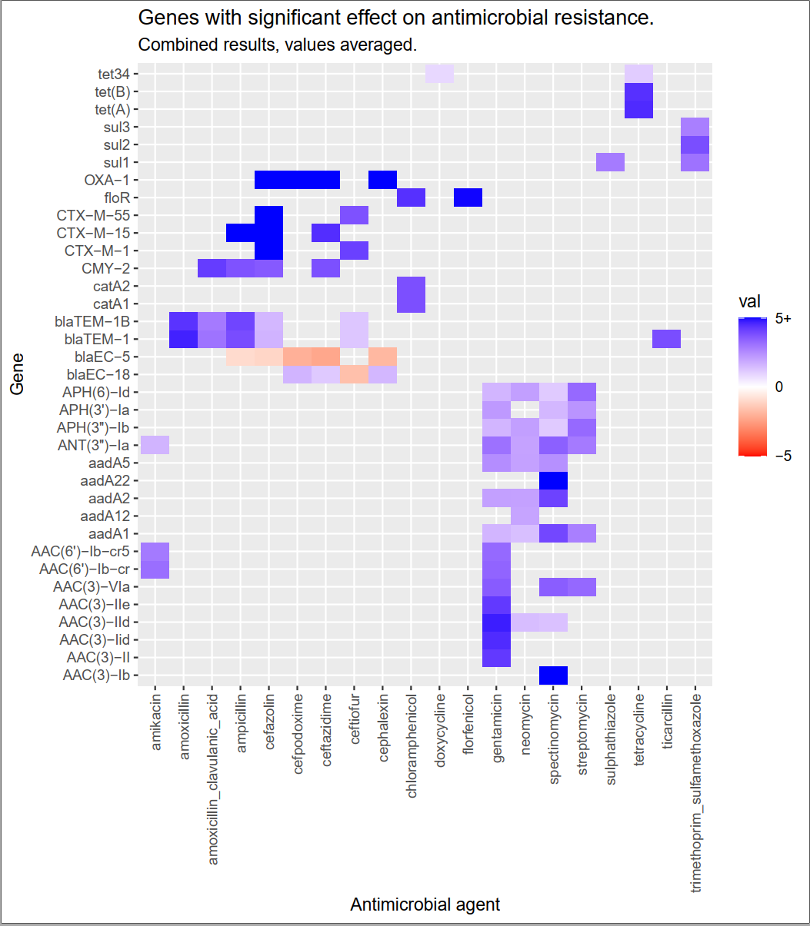

Slide 20
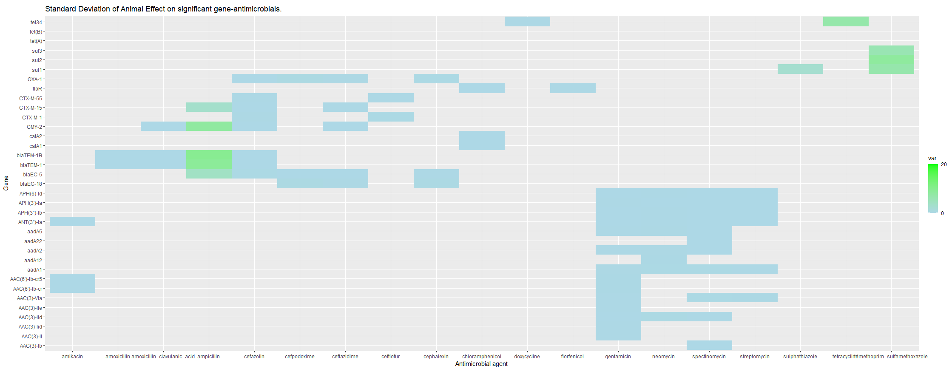
Assessing Animal effect
Animal effect table

Slide 21
Inflated Coefficients
combo | phenotype | values | n
cefazolin_OXA-1 | 0 | 0 | 184
cefazolin_OXA-1 | 1 | 0 | 95
cefazolin_OXA-1 | 1 | 1 | 10
cefazolin_CTX-M-15 | 0 | 0 | 184
cefazolin_CTX-M-15 | 1 | 0 | 92
cefazolin_CTX-M-15 | 1 | 1 | 13
gentamicin_AAC(3)-IIe | 0 | 0 | 241
gentamicin_AAC(3)-IIe | 1 | 0 | 35
gentamicin_AAC(3)-IIe | 1 | 1 | 13
gentamicin_AAC(3)-II | 0 | 0 | 241
gentamicin_AAC(3)-II | 1 | 0 | 35
gentamicin_AAC(3)-II | 1 | 1 | 13
cefazolin_CTX-M-1 | 0 | 0 | 184
cefazolin_CTX-M-1 | 1 | 0 | 93
cefazolin_CTX-M-1 | 1 | 1 | 12
cefazolin_CTX-M-55 | 0 | 0 | 184
cefazolin_CTX-M-55 | 1 | 0 | 98
cefazolin_CTX-M-55 | 1 | 1 | 7

Slide 22
Random Forest
Use a Random Forest model to predict the resistance phenotype for each antimicrobial agent.
Response: 0, 1 for sensitive, resistance.
Predictors : gene presence absence.
Model training
80:20 Training:Testing Split
5 fold cross-validation scheme.

Slide 23
Random Forest Results
Using CLSI breakpoints

Slide 24
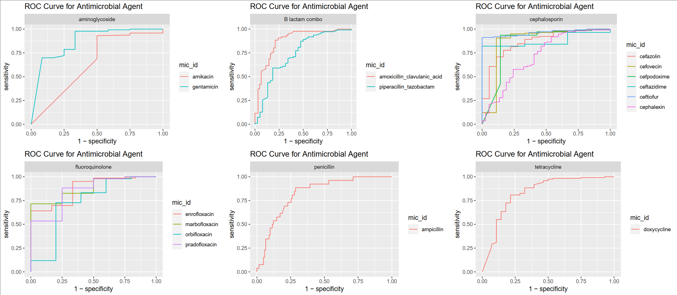

Slide 25
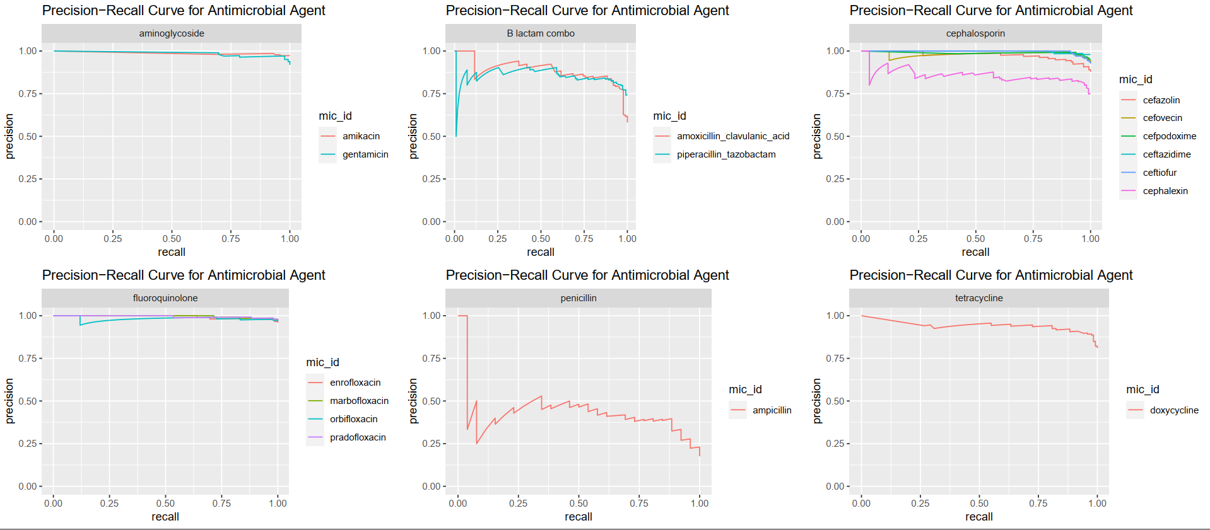

Slide 26
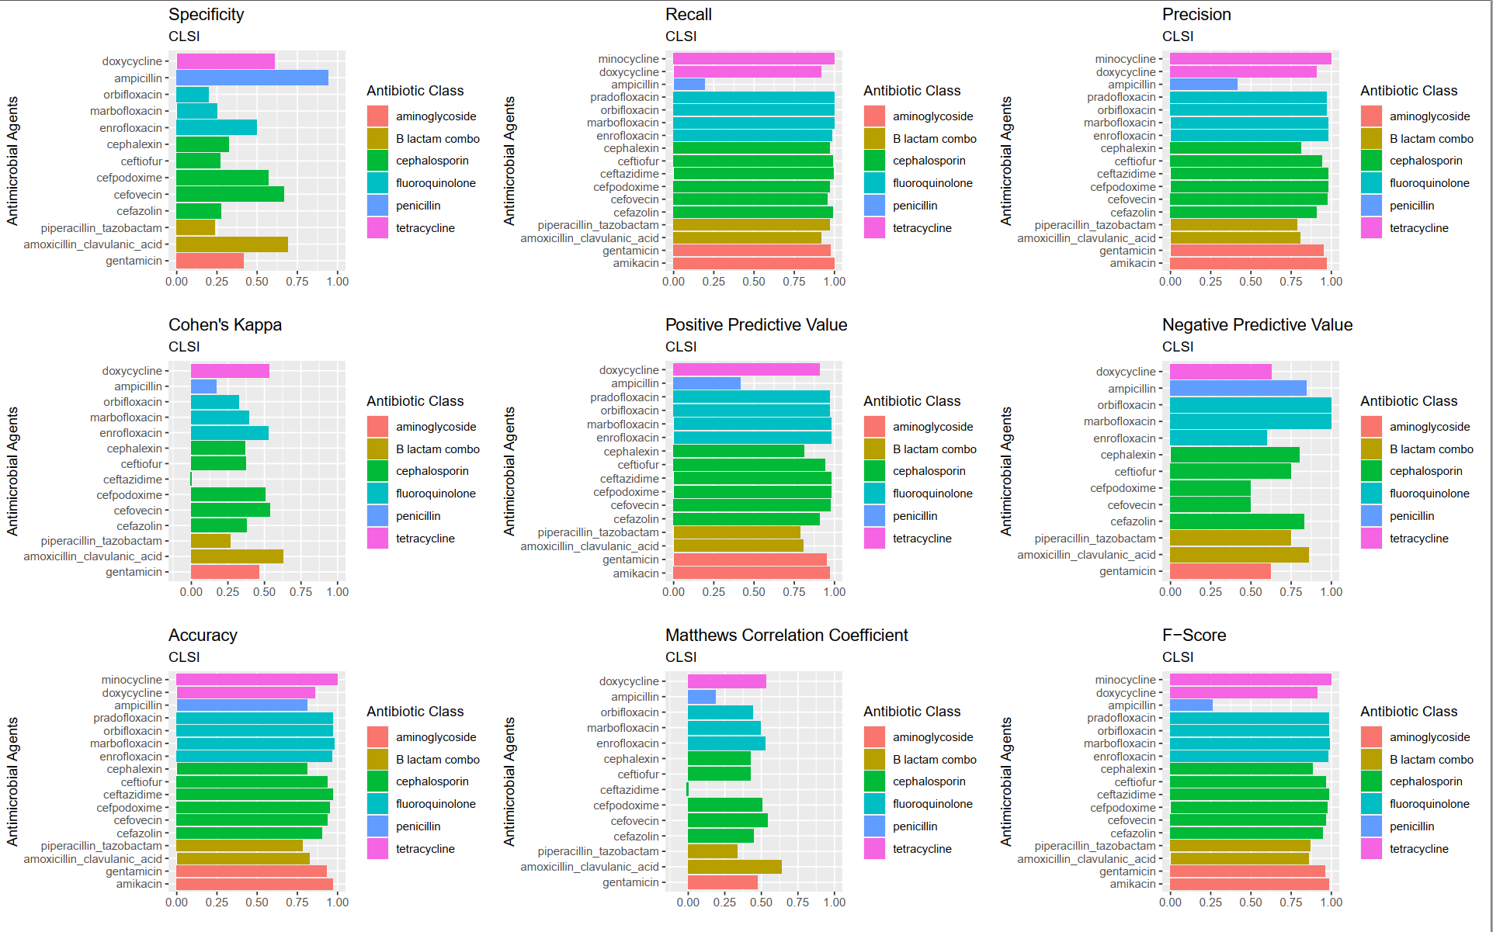

Slide 27
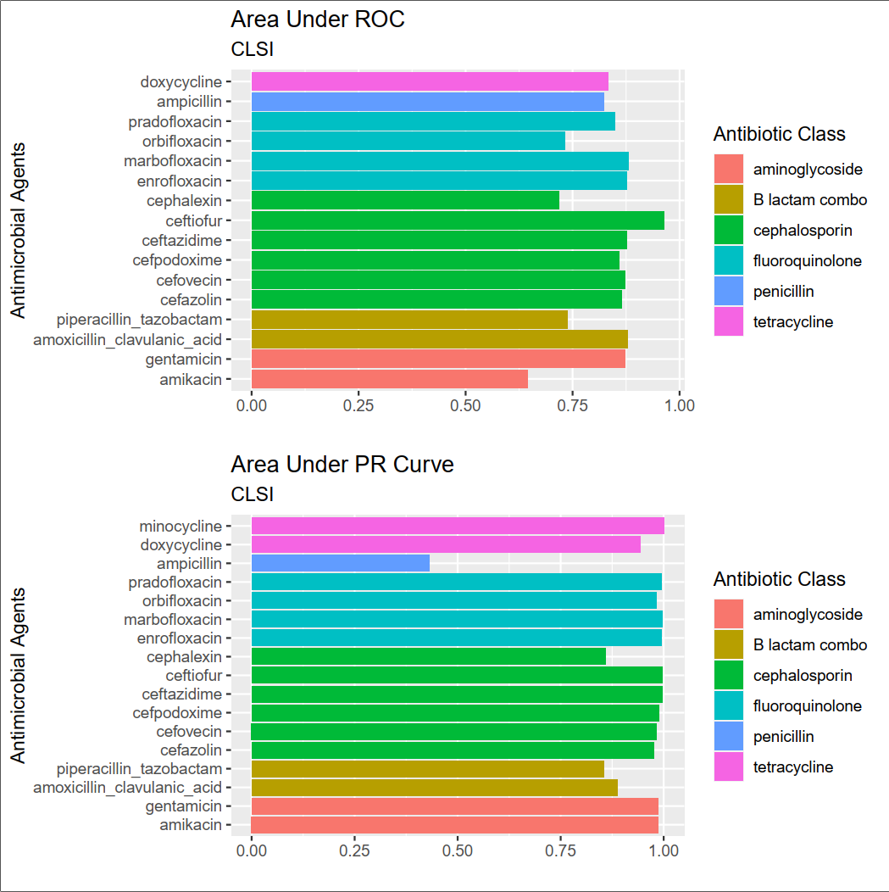

Slide 28
Random Forest Results
Using IQ90 breakpoints

Slide 29
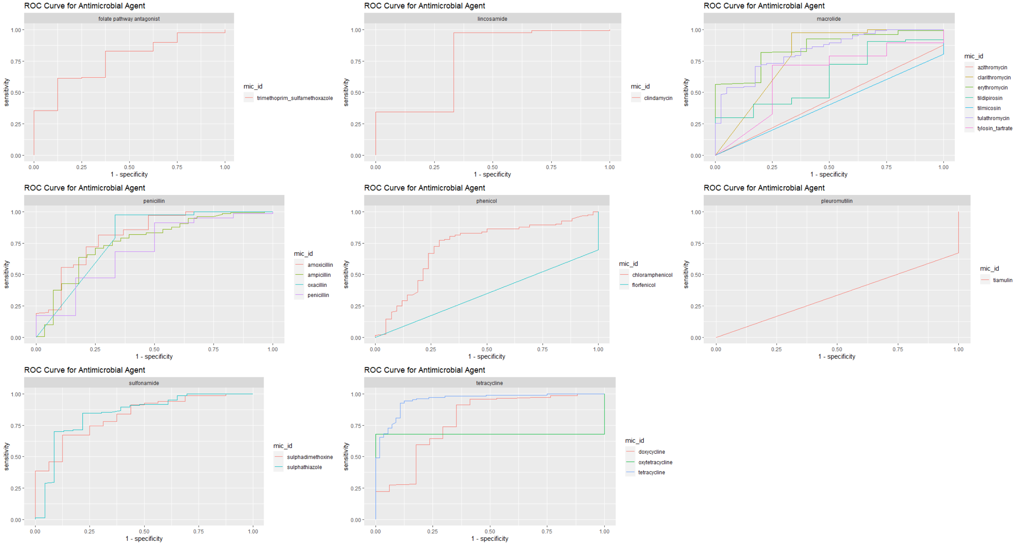

Slide 30
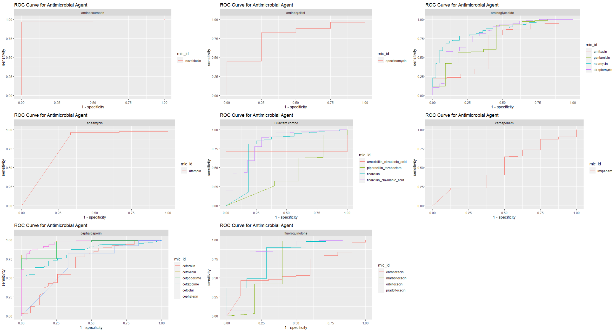

Slide 31
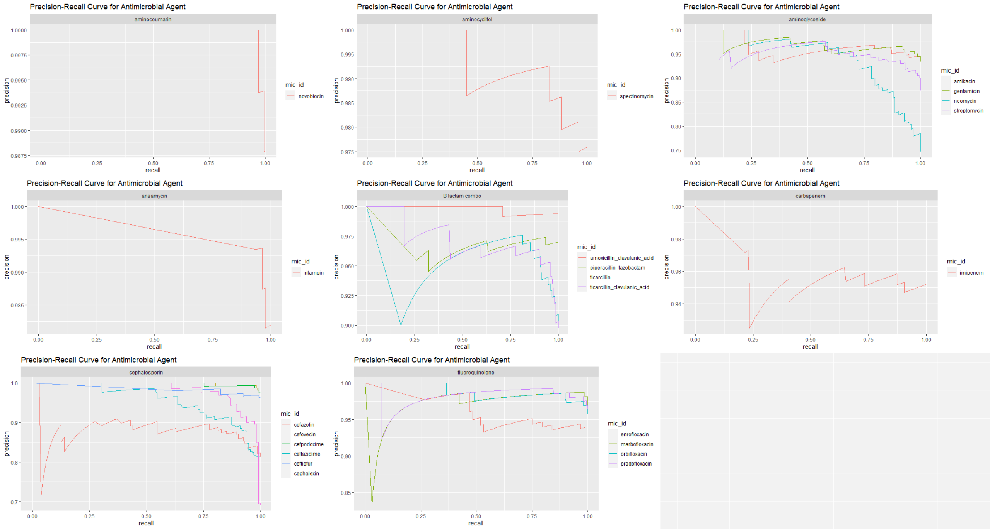

Slide 32
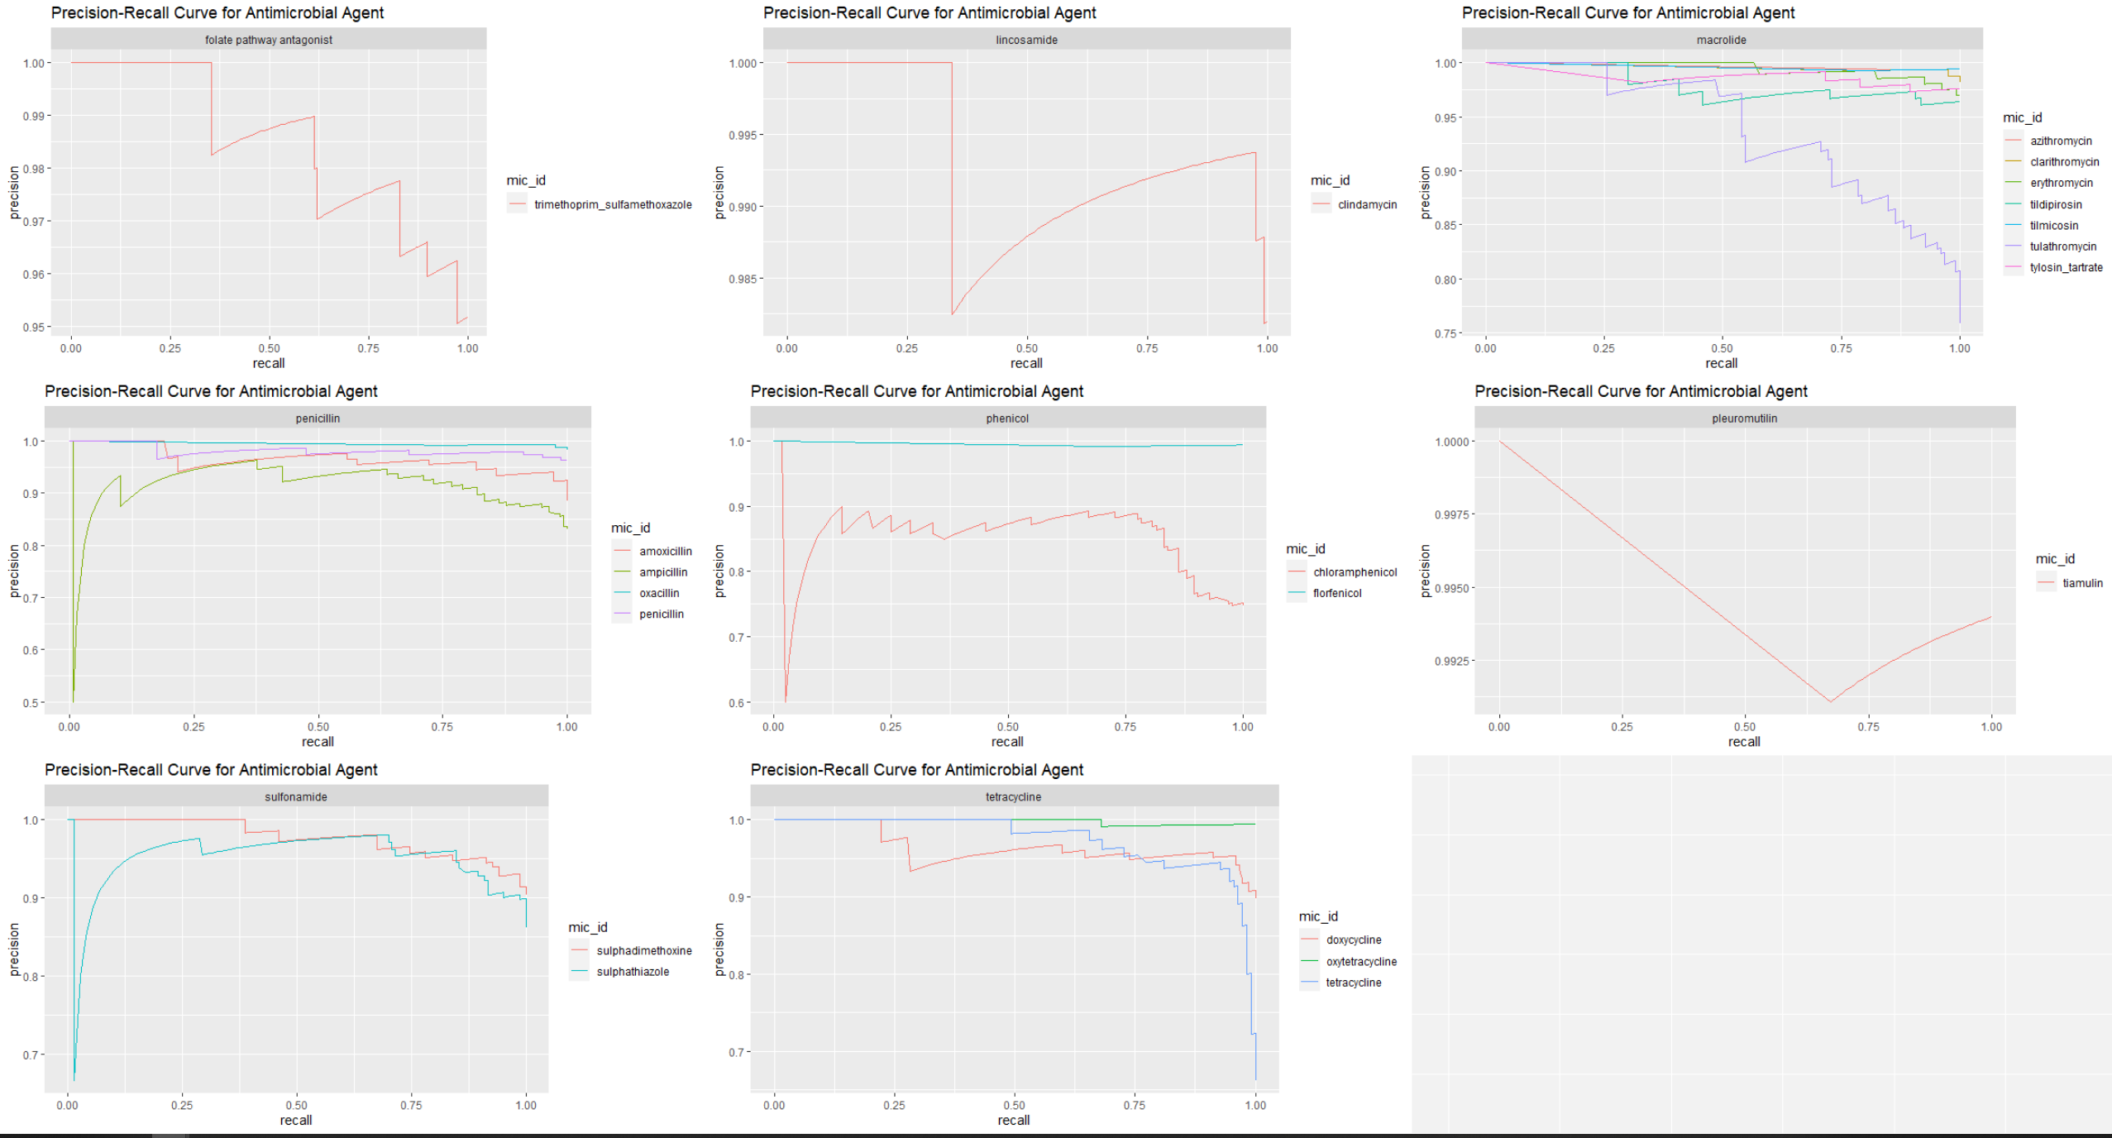

Slide 33
Extra Figures

Slide 34
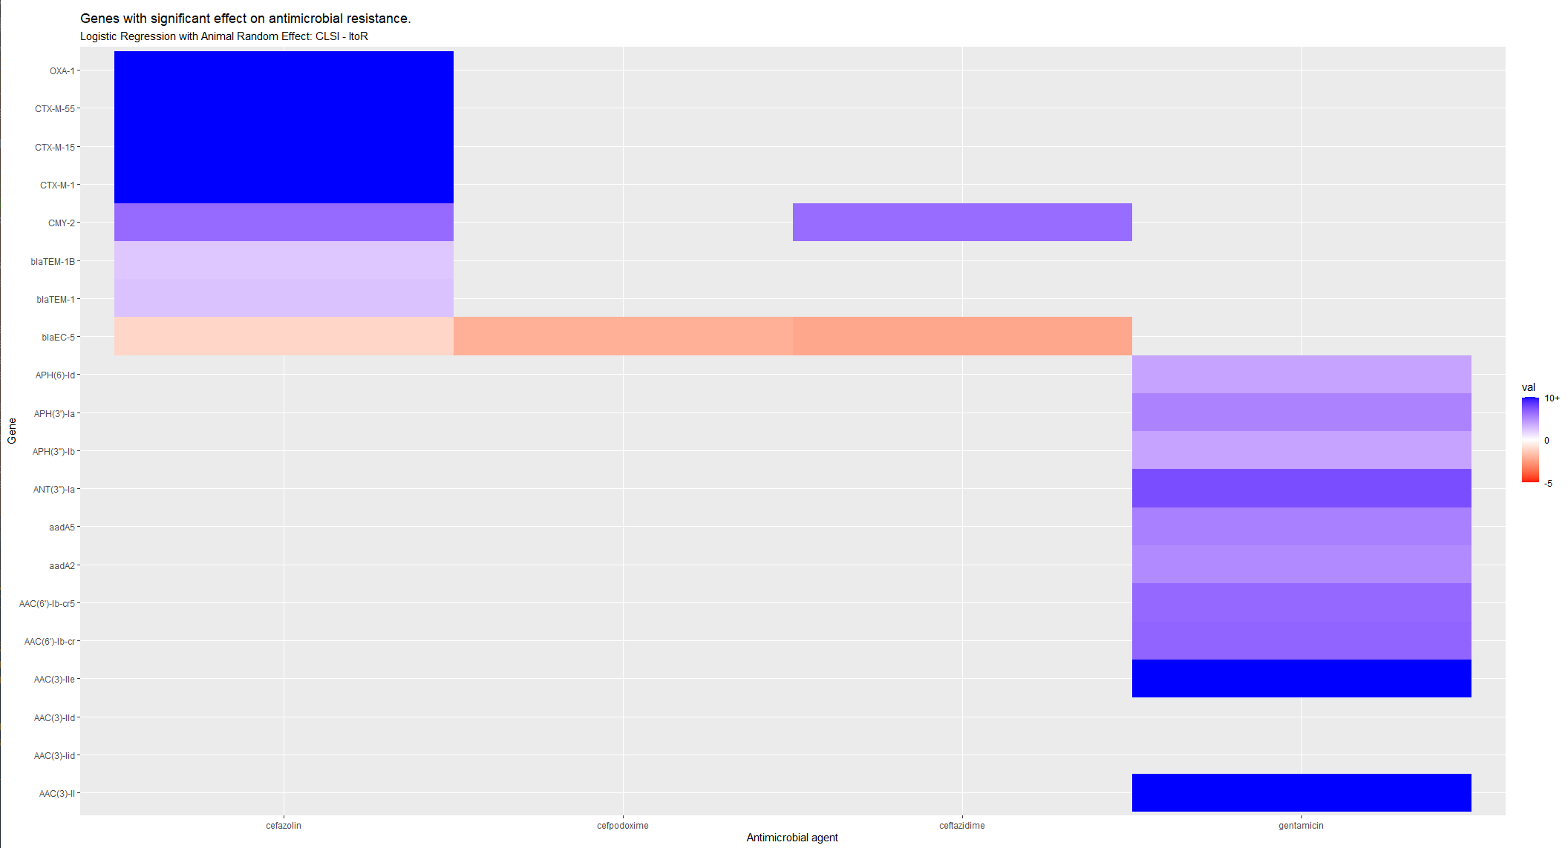

Slide 35
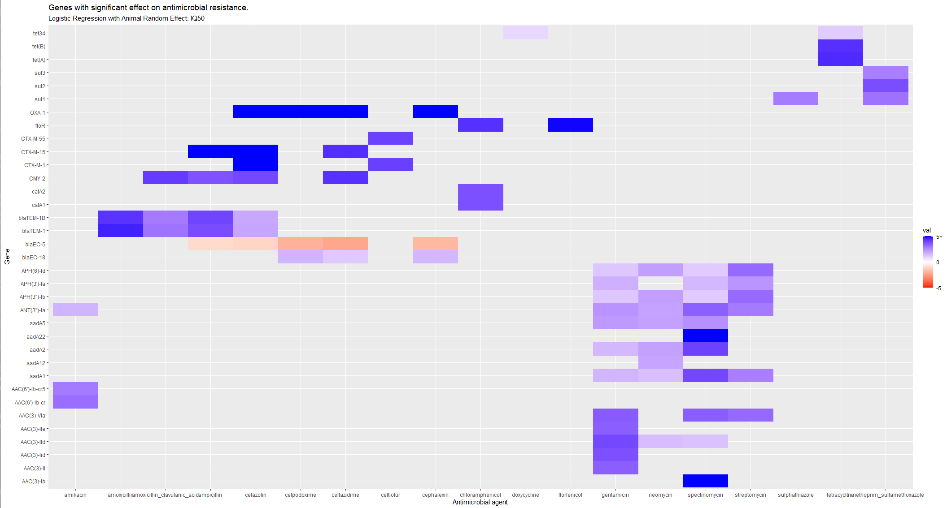

Slide 36
