Slide 1
Preliminary analysis of USDA AMR data
Henri Chung
05/26/21

Slide 2
Study Background
Samples are E. Coli isolates from a variety of livestock animals (pigs, cattle, horses, chickens, etc).
696 samples over a period of 3 years (2018-2020).
Samples were sequenced (whole genome sequencing) and searched for the presence of antimicrobial resistance genes.
Antimicrobial resistance assays (Sensititre BioMic Assay) were performed to check for AMR phenotypes (Sensitive, Intermediate, or Resistant).
Total # of AMR genes detected in each sample was compared across 4 databases (amrfinder, ncbi, plasmidfinder, resfinder).
125 unique AMR genes were identified (367 identifiers collapsed with duplicates included).

Slide 3
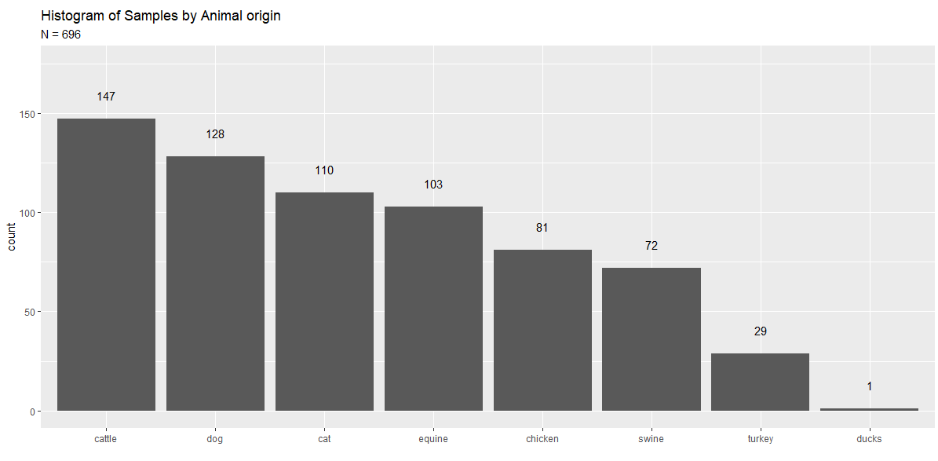
How are samples distributed amongst animals?

Slide 4
What are the most prevalent AMR genes found in samples? (n = 696)
Gene | # of Samples | Gene_type
BlaEC | 694 | Chromosome
mdf(A) | 691 | Chromosome
IncF | 450 | Plasmid
Tet(34) | 356 | Chromosome
ColRNA-I | 239 | Chromosome
strA | 207 | Chromosome
IncFII | 203 | Plasmid
blaTEM-1 | 193 | Chromosome
animal | #1 | #2 | #3 | #4
cat | blaEC | mdf(A) | IncF | ColRNA-I
cattle | blaEC | mdf(A) | IncF | tet(34)
dog | blaEC | mdf(A) | IncF | IncFII
equine | blaEC | mdf(A) | tet(34) | IncF
chicken | blaEC | mdf(A) | IncF | tet(34)
turkey | blaEC | mdf(A) | IncF | ColRNA-I
swine | blaEC | mdf(A) | tet(34) | IncF
Most prevalent genes found in samples by animal
Most prevalent genes found in all samples

Slide 5
Is there a bias in # of AMR genes found by database?
Animal | amrfinder | ncbi | plasmidfinder | resfinder | db_mean
swine | 7.37 (6.17) | 8.77 (7.36) | 5.00 (3.60) | 9.21 (8.05) | 7.66 (6.75)
cattle | 6.41 (5.66) | 7.95 (7.20) | 4.47 (2.62) | 8.31 (7.86) | 6.78 (6.35)
turkey | 5.57 (4.10) | 6.64 (4.55) | 6.36 (3.22) | 6.89 (4.71) | 6.37 (4.16)
equine | 4.64 (5.11) | 5.55 (5.63) | 3.17 (2.58) | 5.88 (6.17) | 4.81 (5.14)
chicken | 3.11 (2.97) | 3.69 (3.21) | 4.64 (2.85) | 3.81 (3.45) | 3.81 (3.16)
dog | 3.32 (3.94) | 3.71 (4.41) | 2.60 (2.25) | 3.86 (4.73) | 3.37 (3.96)
cat | 2.02 (2.01) | 2.22 (2.08) | 2.68 (1.96) | 2.29 (2.28) | 2.30 (2.09)
Average number of AMR gene hits per database : mean (sd)
Notes:
blaEC – beta lactamase – breaks up penicillin? < look up later

Slide 6
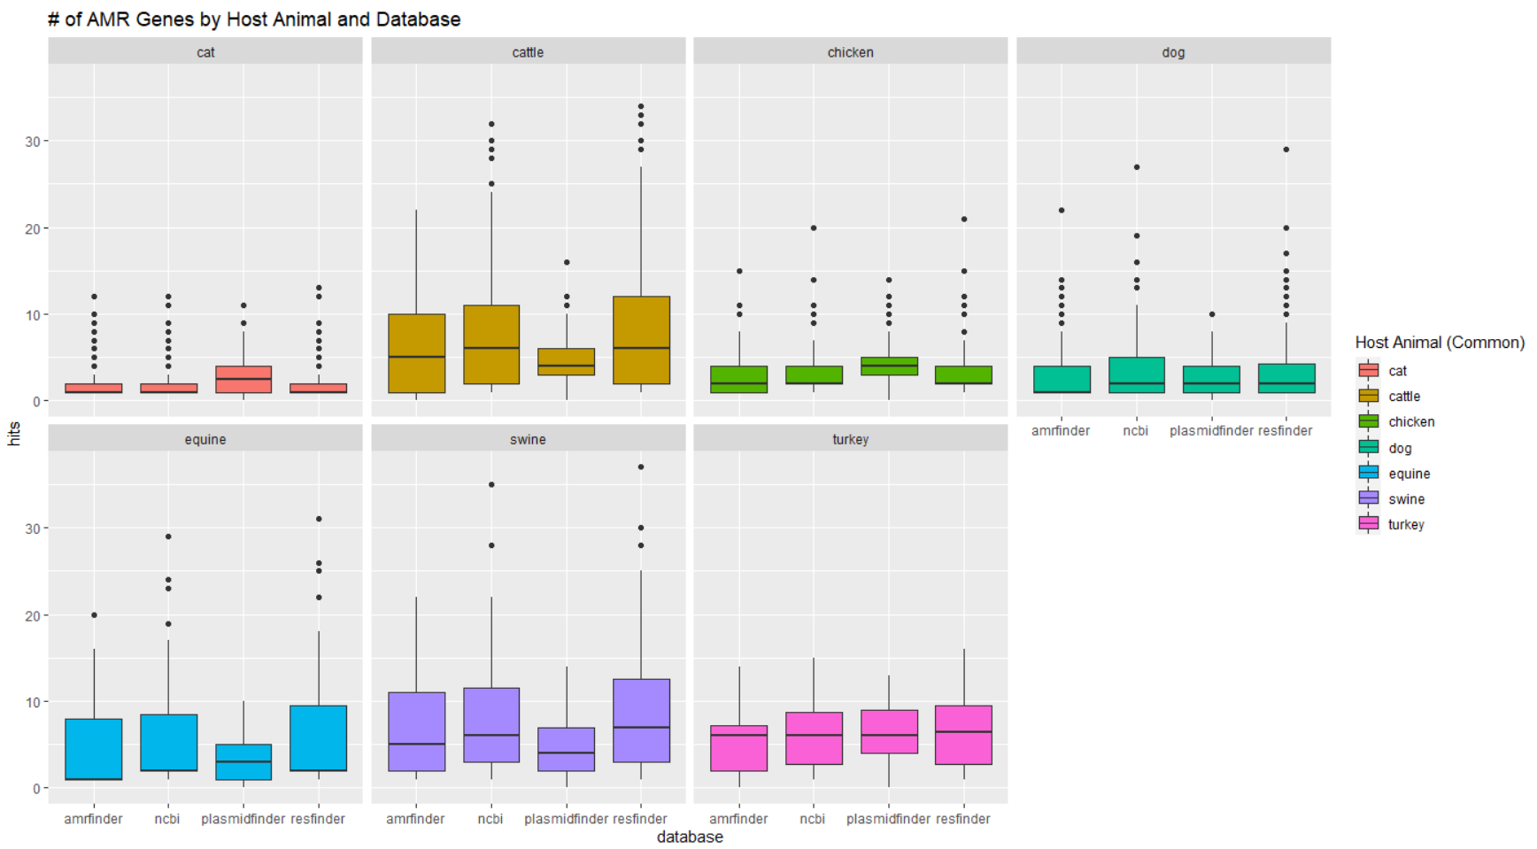
Is there a bias in # of AMR genes found by database?

Slide 7
how many AMR genes were found on average when comparing AMR phenotype?
Test for significant difference in mean number of AMR genes per AM phenotype.
Address statistical issues:
Use a Welch’s ANOVA to deal with unequal group variance.
Resampling groups to n = 10 to deal with unequal sample sizes.
Apply a Bonferroni correction to Alpha of 0.05 to deal with multiple comparisons.
animal | AM | sampleID | avg_AMR_genes | Phenotype
Dog | Cefovecin | 10001 | 4 | S
Dog | Cefovecin | 10002 | 5 | S
Dog | Cefovecin | 10003 | 4 | S
Dog | Cefovecin | 10004 | 6 | S
Dog | Cefovecin | 10005 | 4 | S
Dog | Cefovecin | 10006 | 10 | R
Notes:
Ask Christine for unique types of gene hits from each database <- redo analysis with total unique types of genes found across all 4 databases.

Slide 8
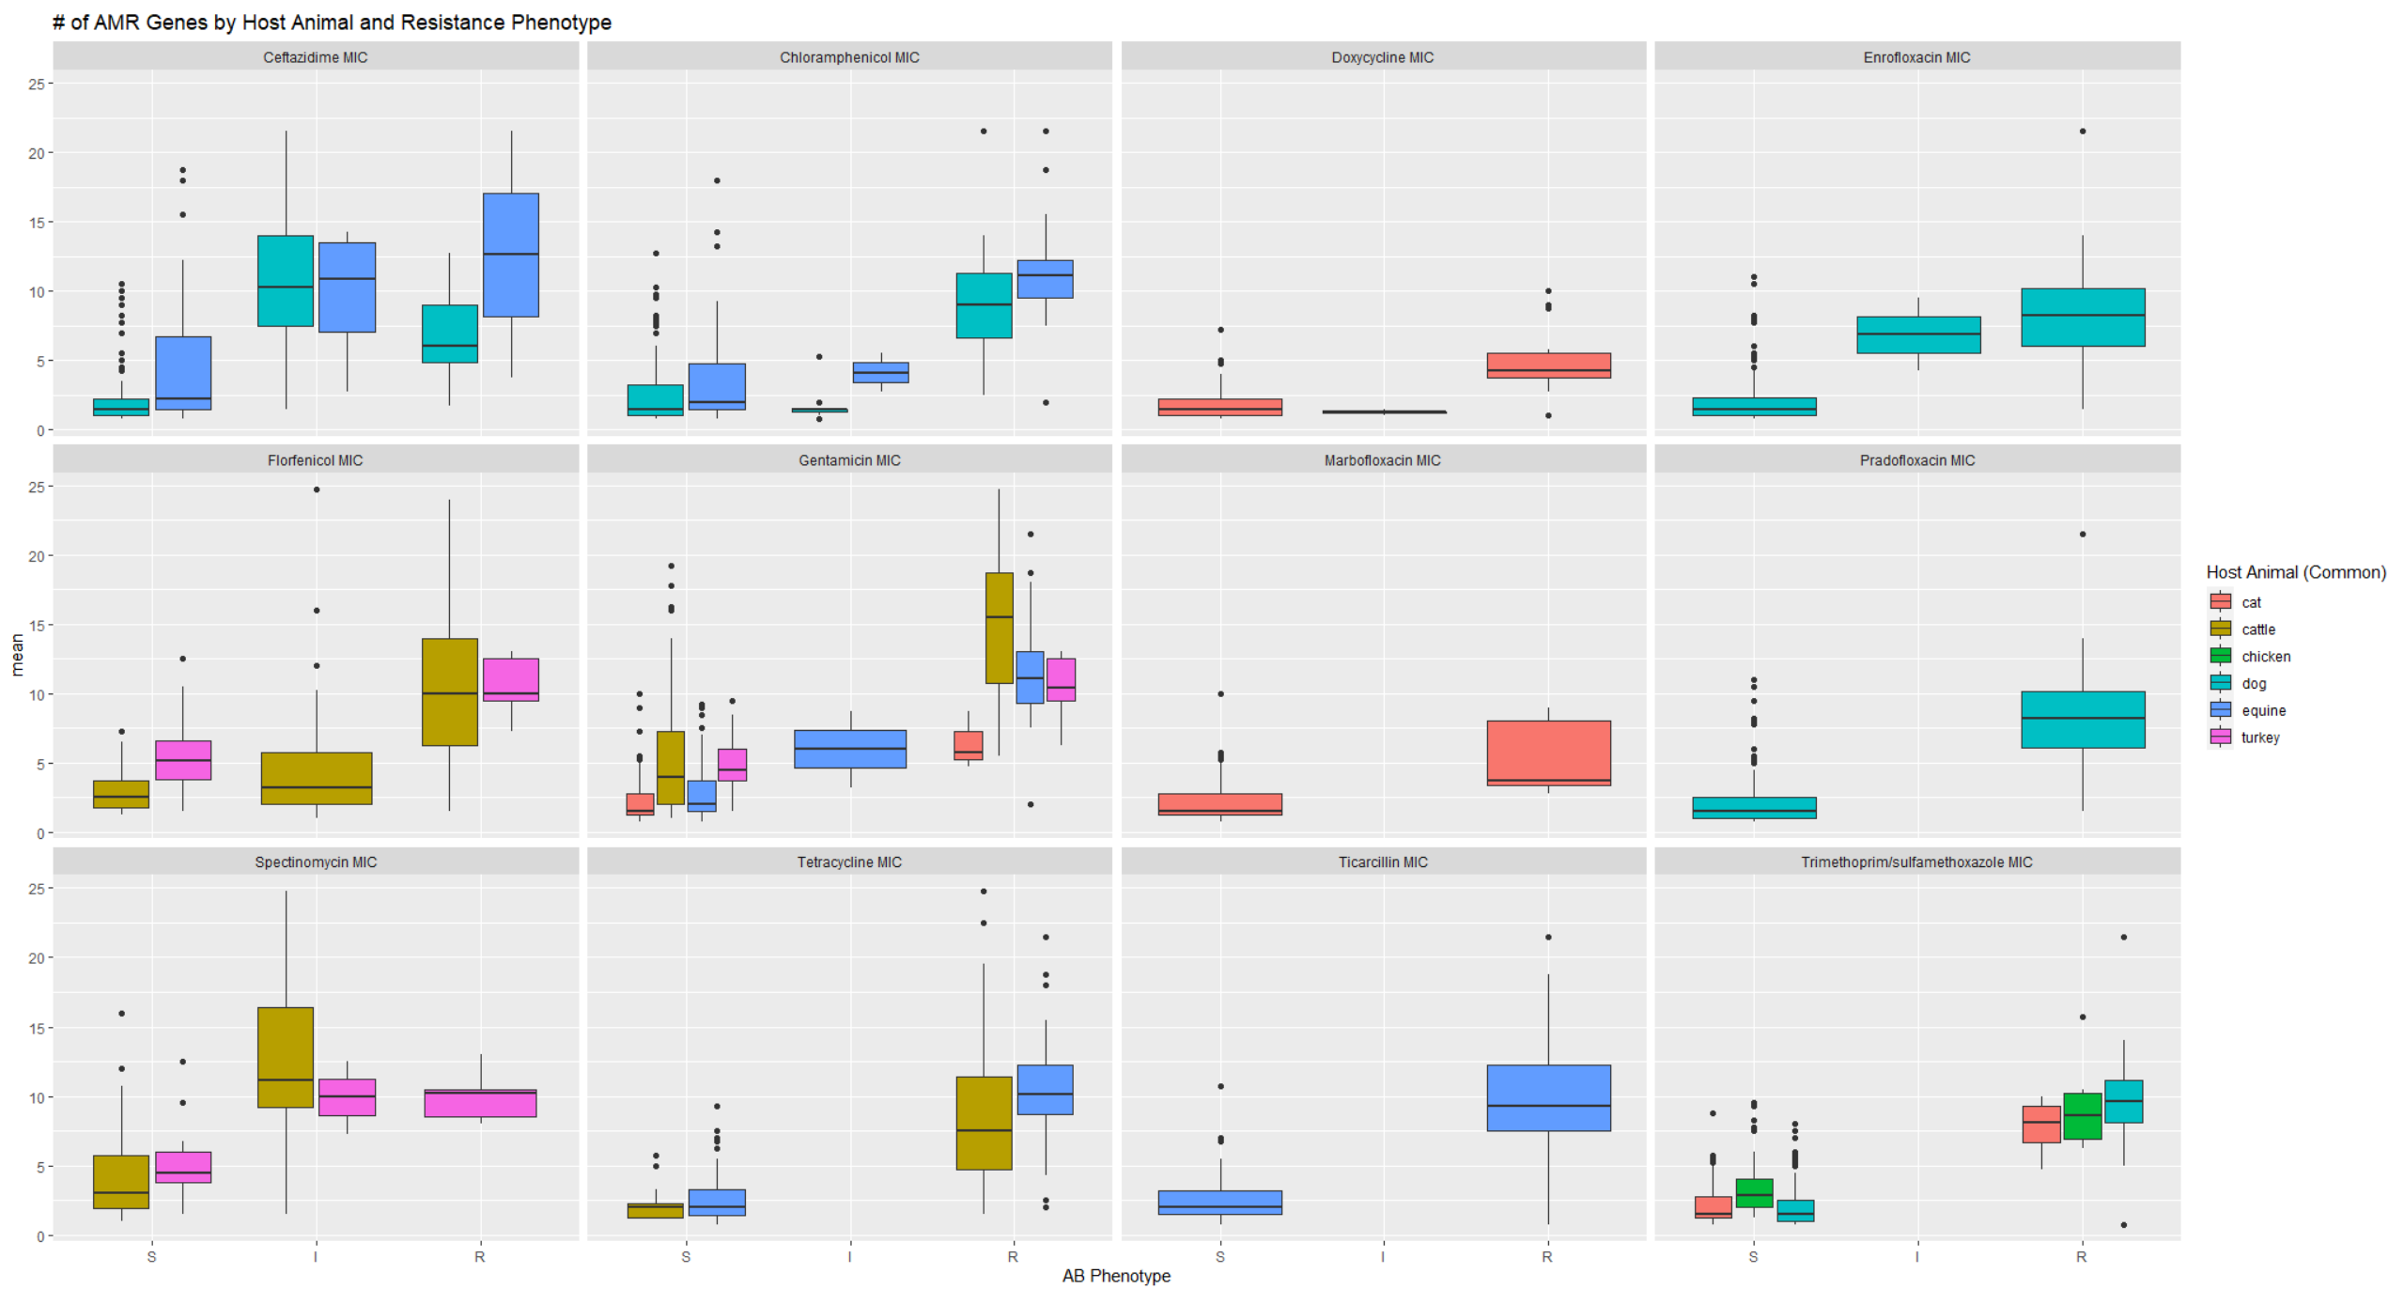

Slide 9
Gene Correlations
Spearman’s Rho - nonparametric measure of rank correlation. It assesses how well the relationship between two variables can be described using a monotonic function.
X (gene) – 0,1 absence, presence.
Y (AMR phenotype) – S,I,R, sensitive, intermediate, resistant.
Calculate Spearman’s Rho correlation for each gene and AMR phenotype.
Alpha = 0.05, Correct for multiple comparisons.
Results
oqxB – Amikacin (rho = 0.27)
Col(MP18) – Piperacillin/tazobactam (rho = 0.29)
pSL483 - Piperacillin/tazobactam (rho = 0.29)

Slide 10
Clustering
Does gene composition cluster into identifiable groups?

Slide 11
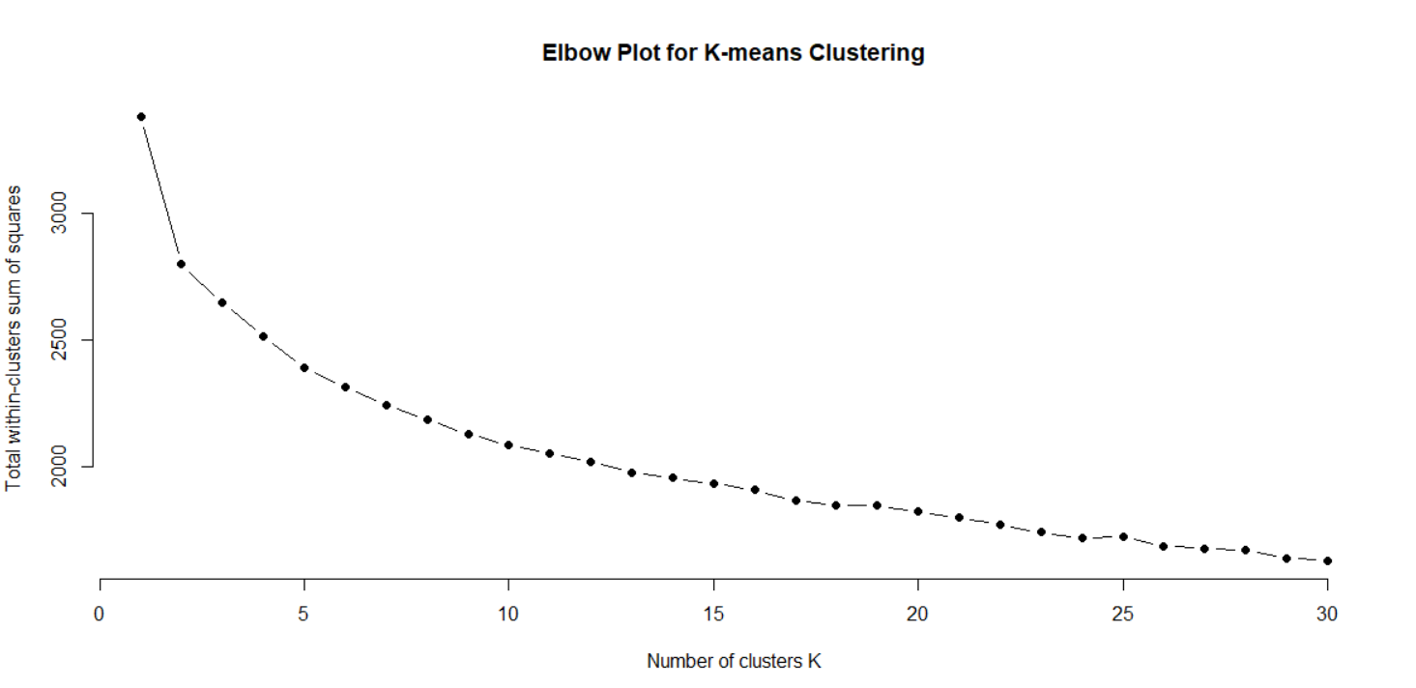
K-means

Slide 12
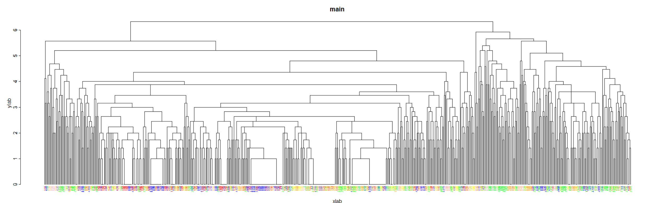
Hierarchical Clustering
Dog | Cattle | Cat | Swine | Equine | Chicken | Turkey
Red | Green | Yellow | Blue | Orange | Pink | Gray

Slide 13
Heatmap

Slide 14
PCA of ALL samples
Plots separated by animal
Are there pan-livestock gene identifiers for AMR resistance?

Slide 15
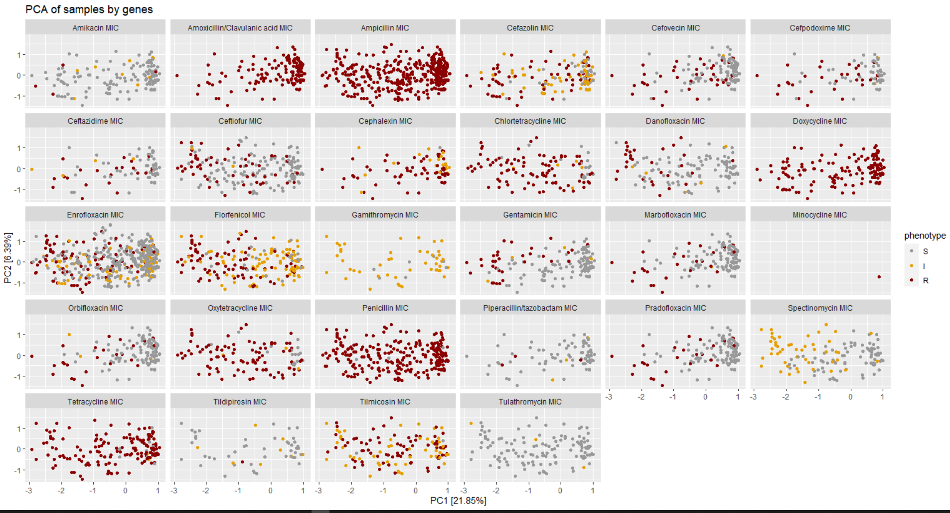

Slide 16
PCA of ALL samples by chromosomal genes
Plots separated by animal
Are there pan-livestock gene identifiers for AMR resistance?

Slide 17
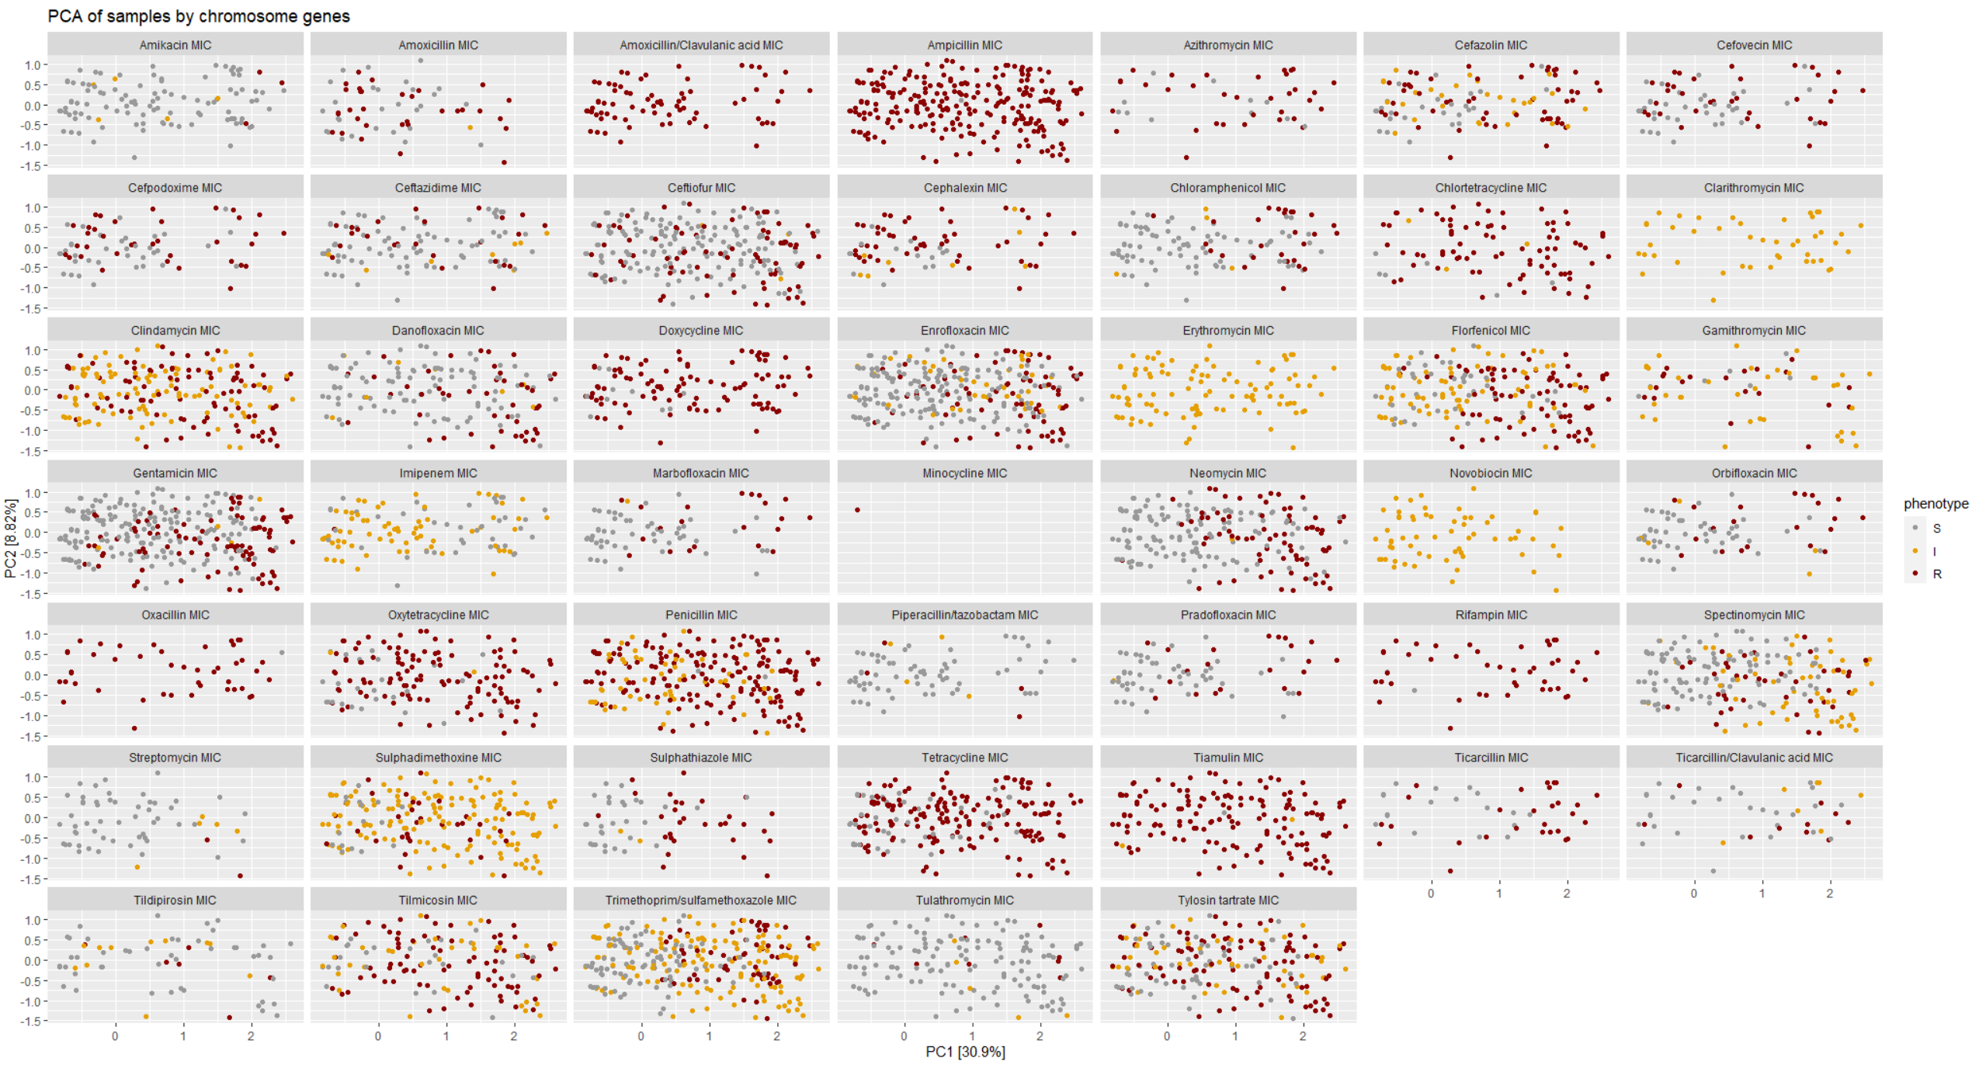

Slide 18
PCA of ALL samples by plasmid genes
Plots separated by animal
Are there pan-livestock gene identifiers for AMR resistance?

Slide 19
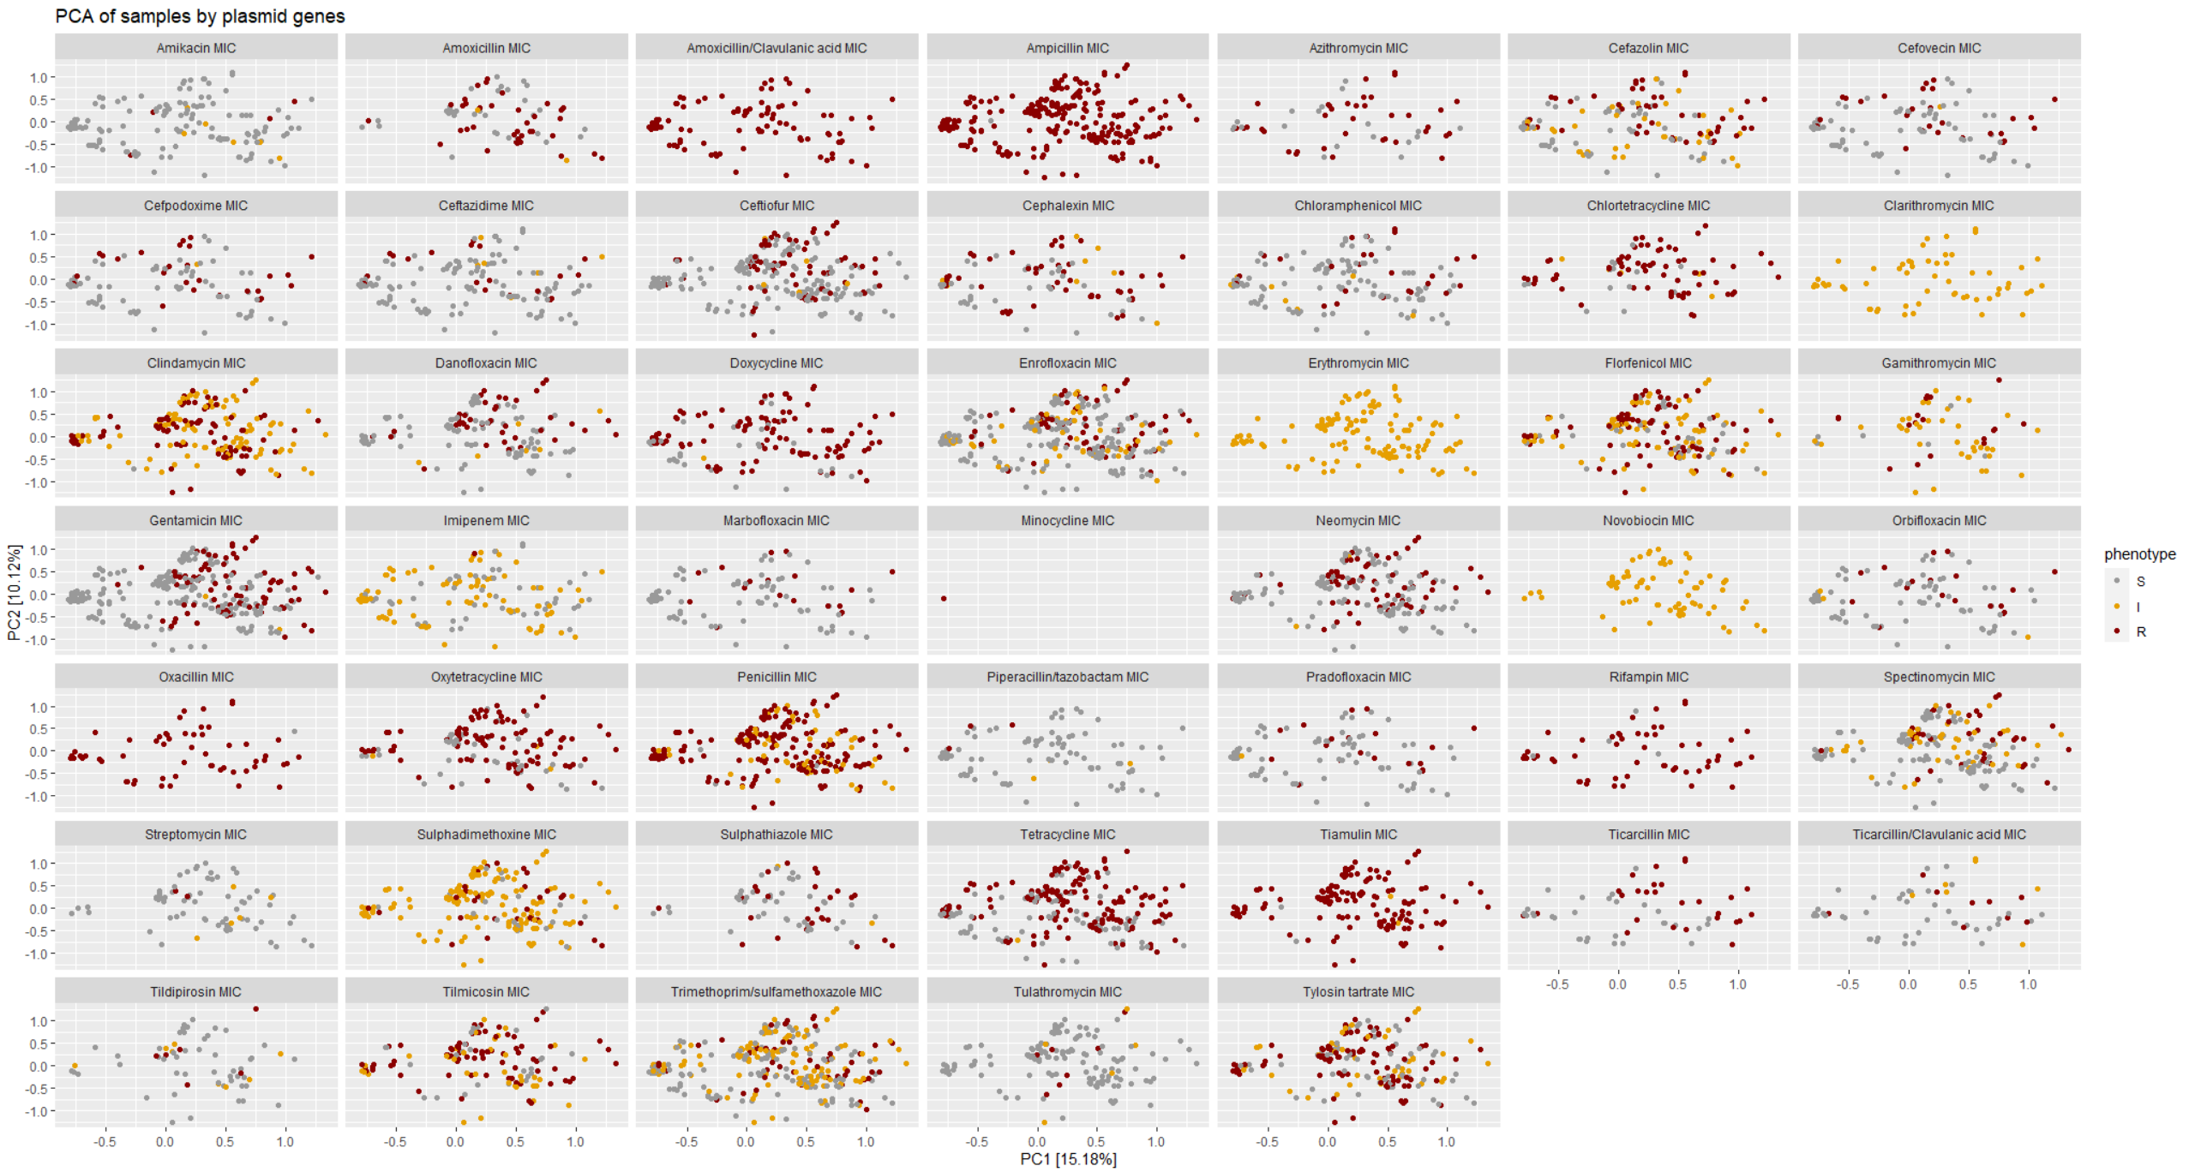

Slide 20
PCA for samples from specific animals.
Are there livestock specific gene identifiers for AMR resistance?

Slide 21
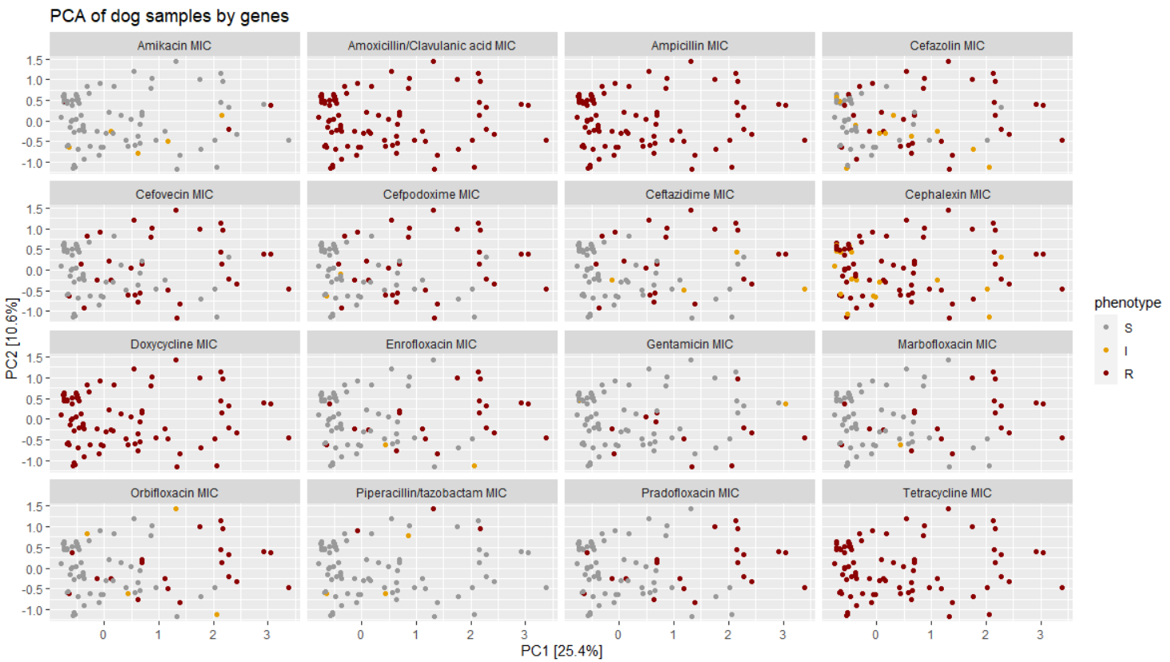
Notes:
Whats up dog?

Slide 22
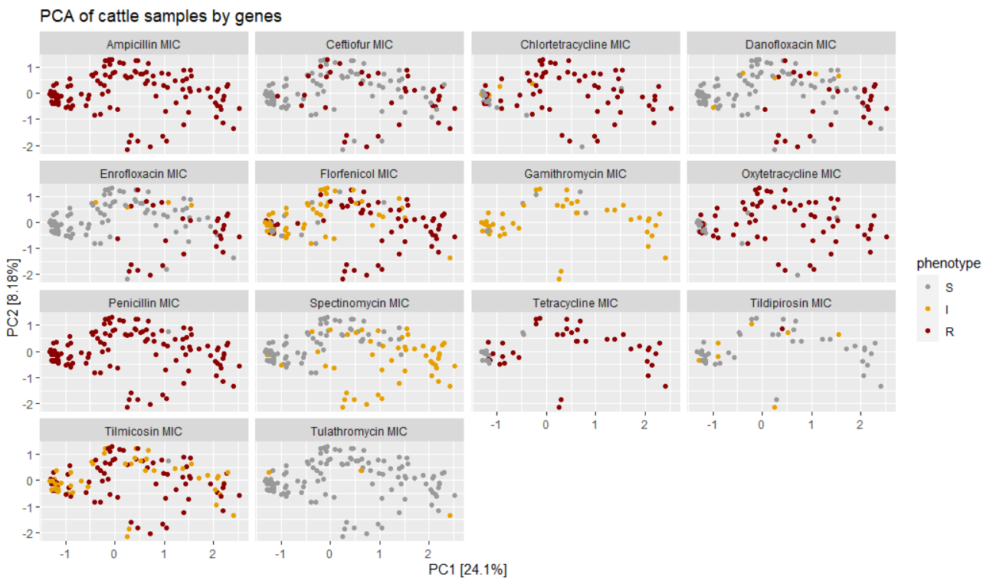

Slide 23
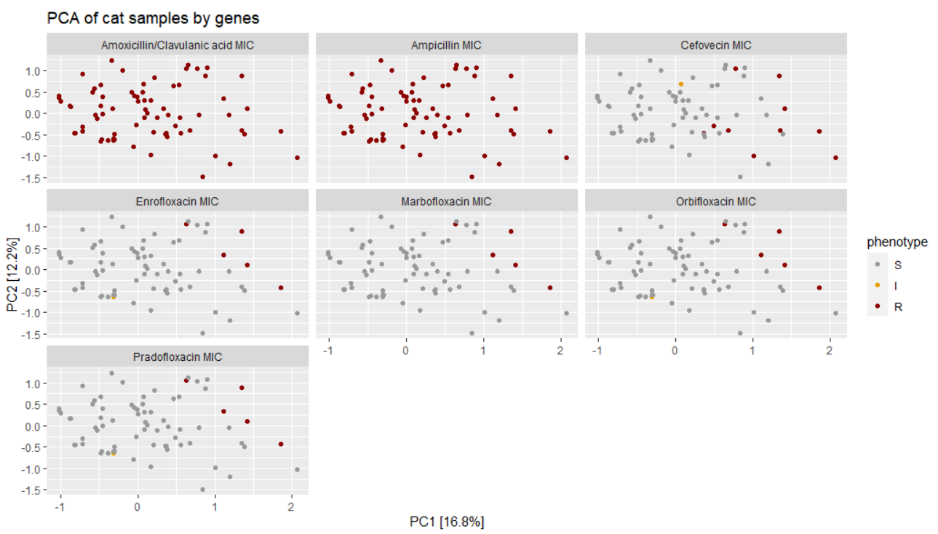

Slide 24
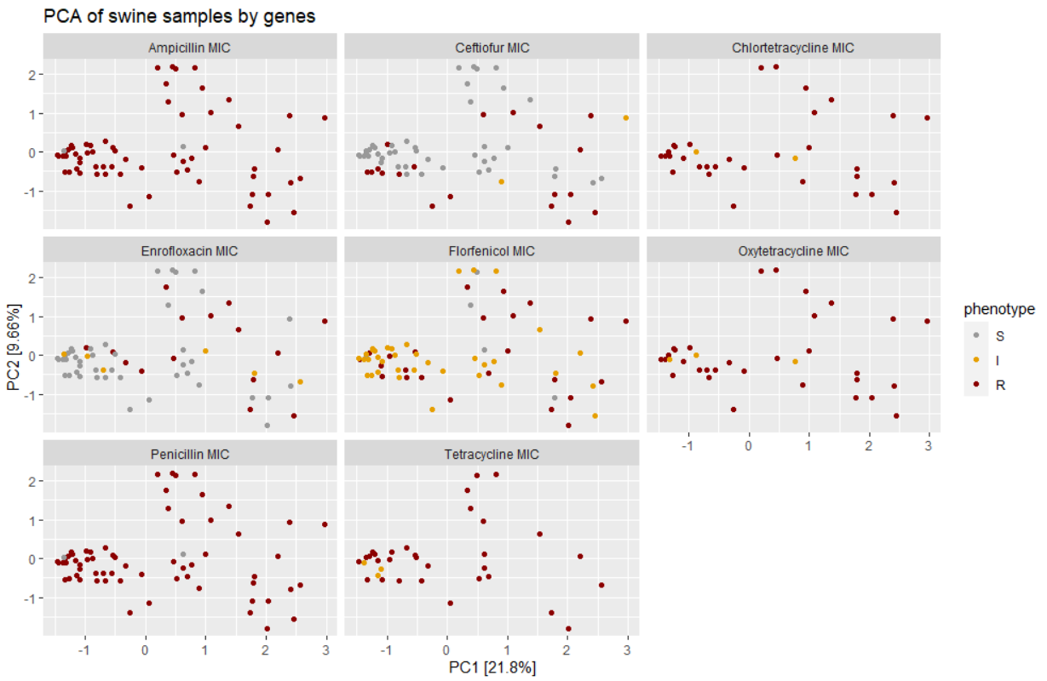

Slide 25
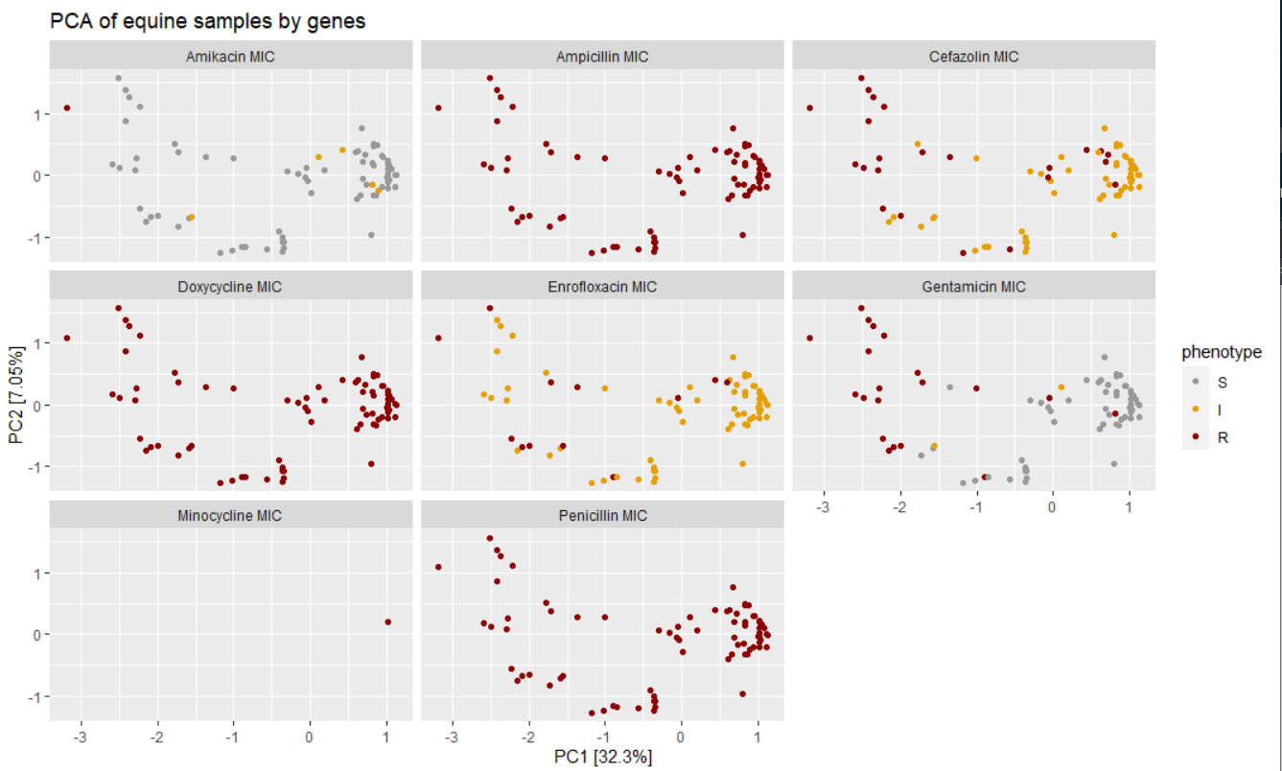

Slide 26
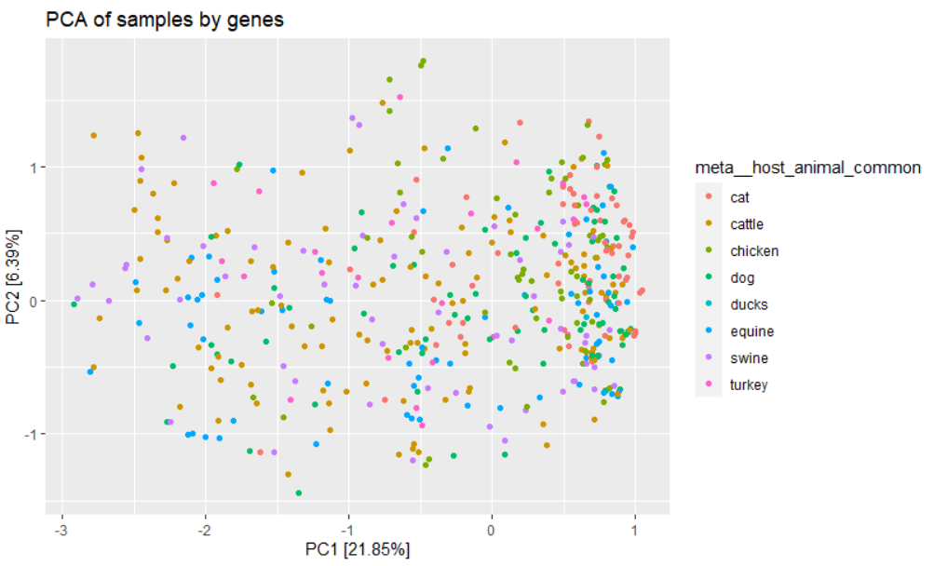
Can we identify what animal a sample came from based on its gene composition?

Slide 27
Future Directions
Look at difference between Plasmid and Chromosome Genes.
Check if PCA points cluster around lab/sequence date (check for batch effects).
Can you predict based on a composition of genes what animal it came from?
Notes:
tertile

