Slide 1
Preliminary analysis of USDA AMR data
Henri Chung
06/10/21

Slide 2
Study Background
696 samples over a period of 3 years (2018-2020).
Samples consist of E. Coli isolates from a variety of livestock animals (pigs, cattle, horses, chickens, etc).
Samples were sequenced (whole genome sequencing) and searched for the presence of antimicrobial resistance genes.
Antimicrobial resistance assays (Sensititre BioMic Assay) were performed to check for AMR phenotypes (Sensitive, Intermediate, or Resistant).
Total # of AMR genes detected in each sample was compared across 4 databases (amrfinder, ncbi, plasmidfinder, resfinder).
125 unique AMR genes were identified (367 identifiers collapsed with duplicates included).

Slide 3
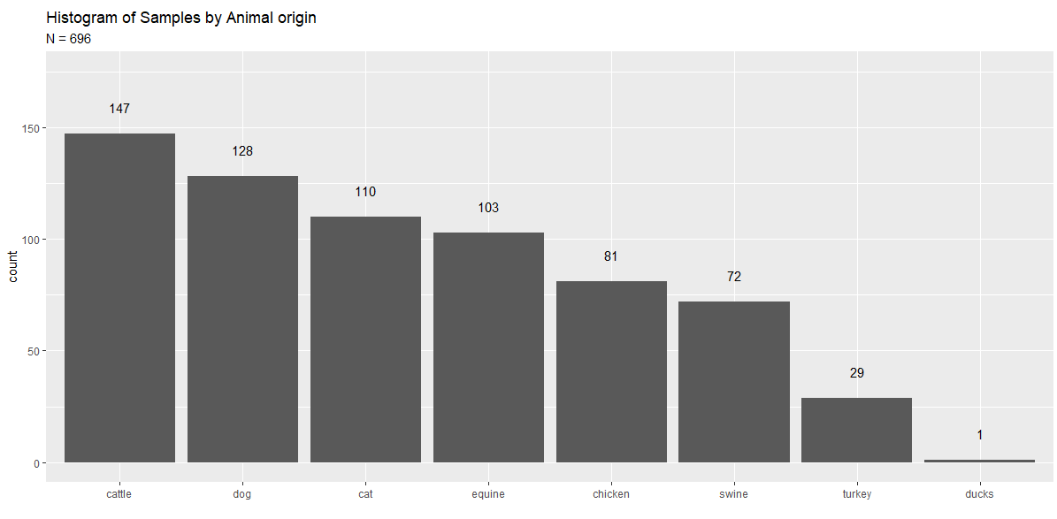
How are samples distributed amongst animals?

Slide 4
What are the most prevalent AMR genes found in samples? (n = 696)
Gene | # of Samples | Gene_type
BlaEC | 694 | Chromosome
mdf(A) | 691 | Chromosome
IncF | 450 | Plasmid
Tet(34) | 356 | Chromosome
ColRNA-I | 239 | Chromosome
strA | 207 | Chromosome
IncFII | 203 | Plasmid
blaTEM-1 | 193 | Chromosome
animal | #1 | #2 | #3 | #4
cat | blaEC | mdf(A) | IncF | ColRNA-I
cattle | blaEC | mdf(A) | IncF | tet(34)
dog | blaEC | mdf(A) | IncF | IncFII
equine | blaEC | mdf(A) | tet(34) | IncF
chicken | blaEC | mdf(A) | IncF | tet(34)
turkey | blaEC | mdf(A) | IncF | ColRNA-I
swine | blaEC | mdf(A) | tet(34) | IncF
Most prevalent genes found in samples by animal
Most prevalent genes found in all samples

Slide 5
Is there a bias in # of AMR genes found by database?
Animal | amrfinder | ncbi | plasmidfinder | resfinder | db_mean
swine | 7.37 (6.17) | 8.77 (7.36) | 5.00 (3.60) | 9.21 (8.05) | 7.66 (6.75)
cattle | 6.41 (5.66) | 7.95 (7.20) | 4.47 (2.62) | 8.31 (7.86) | 6.78 (6.35)
turkey | 5.57 (4.10) | 6.64 (4.55) | 6.36 (3.22) | 6.89 (4.71) | 6.37 (4.16)
equine | 4.64 (5.11) | 5.55 (5.63) | 3.17 (2.58) | 5.88 (6.17) | 4.81 (5.14)
chicken | 3.11 (2.97) | 3.69 (3.21) | 4.64 (2.85) | 3.81 (3.45) | 3.81 (3.16)
dog | 3.32 (3.94) | 3.71 (4.41) | 2.60 (2.25) | 3.86 (4.73) | 3.37 (3.96)
cat | 2.02 (2.01) | 2.22 (2.08) | 2.68 (1.96) | 2.29 (2.28) | 2.30 (2.09)
Average number of AMR gene hits per database : mean (sd)
Notes:
blaEC – beta lactamase – breaks up penicillin? < look up later

Slide 6
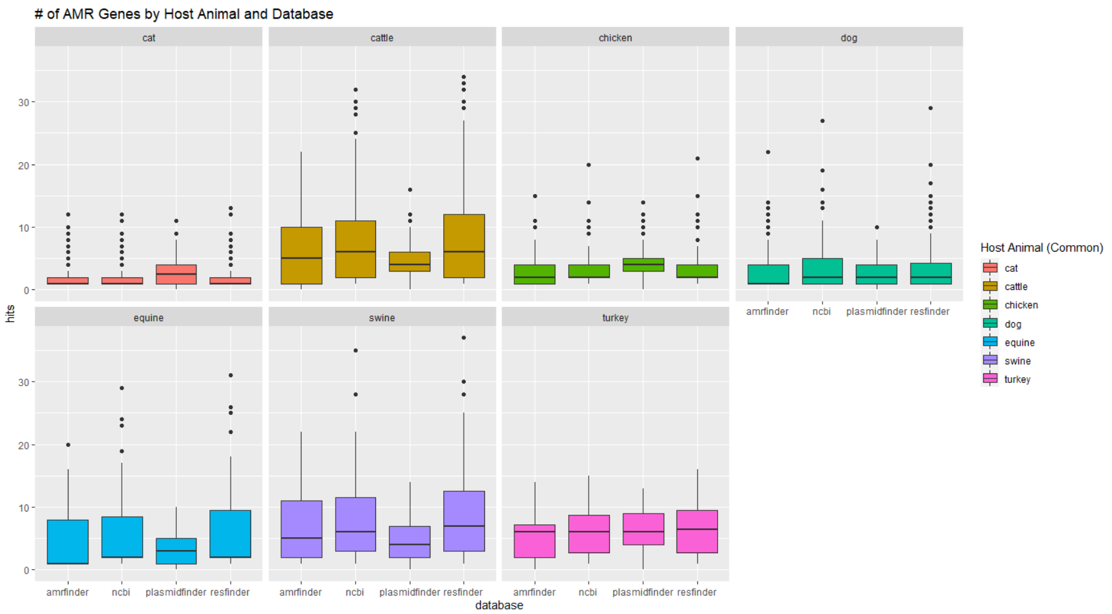
Is there a bias in # of AMR genes found by database?

Slide 7
Is there a significant difference in the number of unique AMR genes found between AM phenotypes?
Test for significant difference in unique number of AMR genes per AM phenotype compiled from all databases.
Address statistical issues:
Use a Welch’s ANOVA to deal with unequal group variance.
Resampling groups to n = 10 to deal with unequal sample sizes.
Correct for multiple comparisons by comparing p-value to 5% quantile null distribution of p-values generated with a permutation test (n = 10,000).
animal | AM | sampleID | avg_AMR_genes | Phenotype
Dog | Cefovecin | 10001 | 4 | S
Dog | Cefovecin | 10002 | 5 | S
Dog | Cefovecin | 10003 | 4 | S
Dog | Cefovecin | 10004 | 6 | S
Dog | Cefovecin | 10005 | 4 | S
Dog | Cefovecin | 10006 | 10 | R

Slide 8
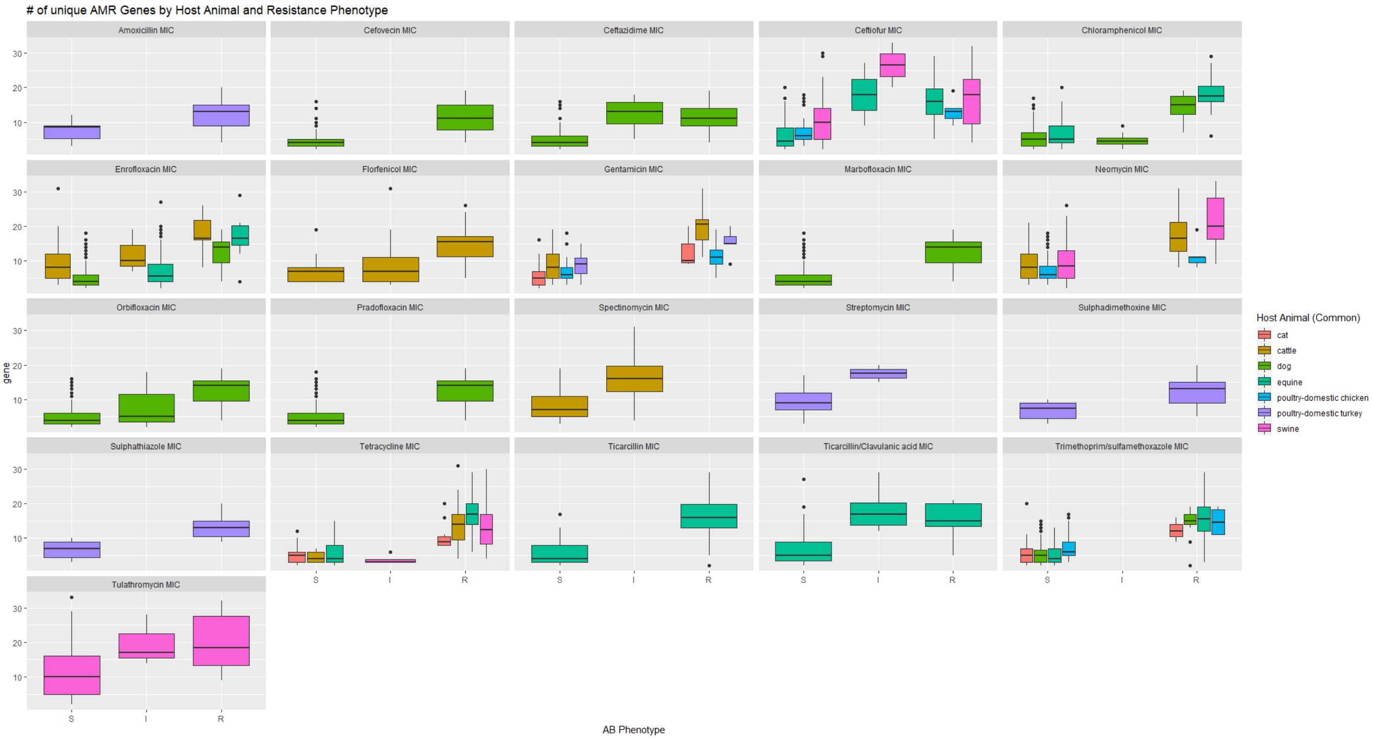

Slide 9
Are specific genes correlated with specific AM phenotypes?
Spearman’s Rho - nonparametric measure of rank correlation. It assesses how well the relationship between two variables can be described using a monotonic function.
X (gene) – 0,1 absence, presence.
Y (AMR phenotype) – S,I,R, sensitive, intermediate, resistant.
Calculate Spearman’s Rho correlation for each gene and AMR phenotype.
Correct for multiple comparisons by comparing p-value to 5% quantile null distribution of p-values generated with a permutation test (n = 10,000).
amr_correlations.csv
Notes:
Try the BH correction
Chi-Square – absence/presence vs sensitive/resistant.

Slide 10
Do samples cluster in identifiable patterns based on gene presence-absence data?
Can we identify what animal species a sample came from by its gene composition?

Slide 11
Heatmap (animal order)
Dog | Cattle | Cat | Swine | Equine | Chicken | Turkey
Red | Green | Yellow | Blue | Orange | Pink | Gray
Notes:
Add color dimensions for resistance.

Slide 12
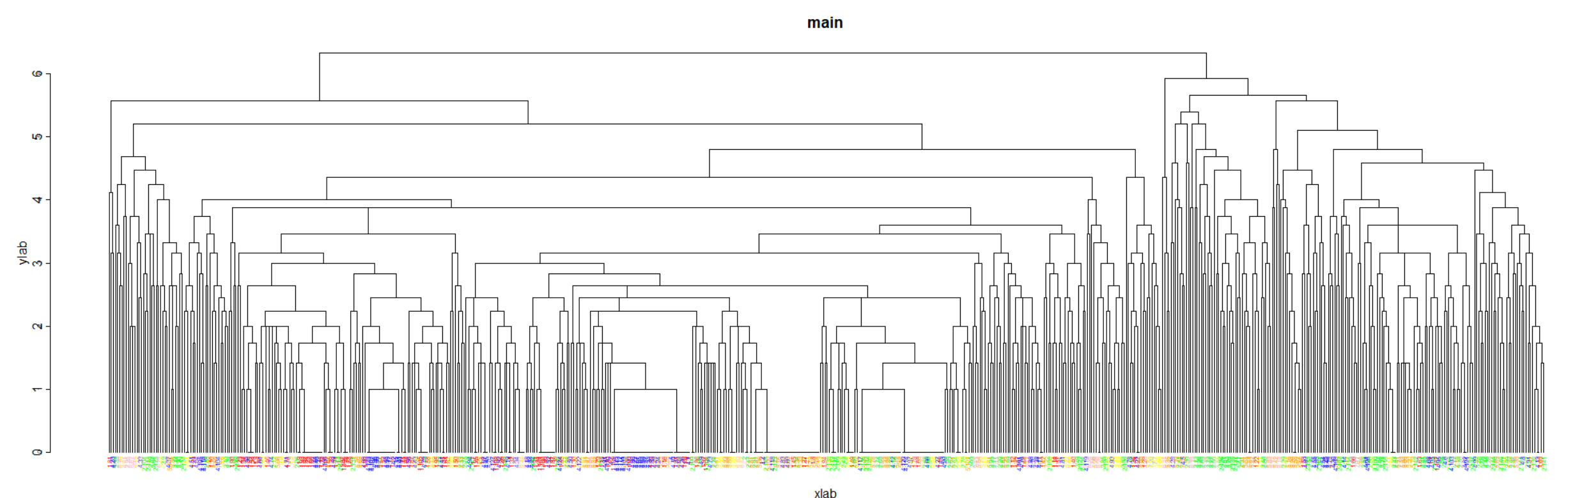
Hierarchical Clustering
Dog | Cattle | Cat | Swine | Equine | Chicken | Turkey
Red | Green | Yellow | Blue | Orange | Pink | Gray
Notes:
Manhattan distance using presence absence of gene hits.

Slide 13
Heatmap (hierarchical clustering)

