Slide 1
Preliminary analysis of USDA AMR data
Henri Chung
07/22/21

Slide 2
Study Background
846 samples over a period of 3 years (2018-2020).
Samples consist of E. Coli isolates from a variety of livestock animals (pigs, cattle, horses, chickens, etc).
Samples were sequenced (whole genome sequencing) and searched for the presence of antimicrobial resistance genes.
Antimicrobial resistance assays (Sensititre BioMic Assay) were performed to check for AMR phenotypes (Sensitive, Intermediate, or Resistant).
Total # of AMR genes detected in each sample was compared across 4 databases (amrfinder, ncbi, plasmidfinder, resfinder).
125 unique AMR genes were identified (367 identifiers collapsed with duplicates included).

Slide 3
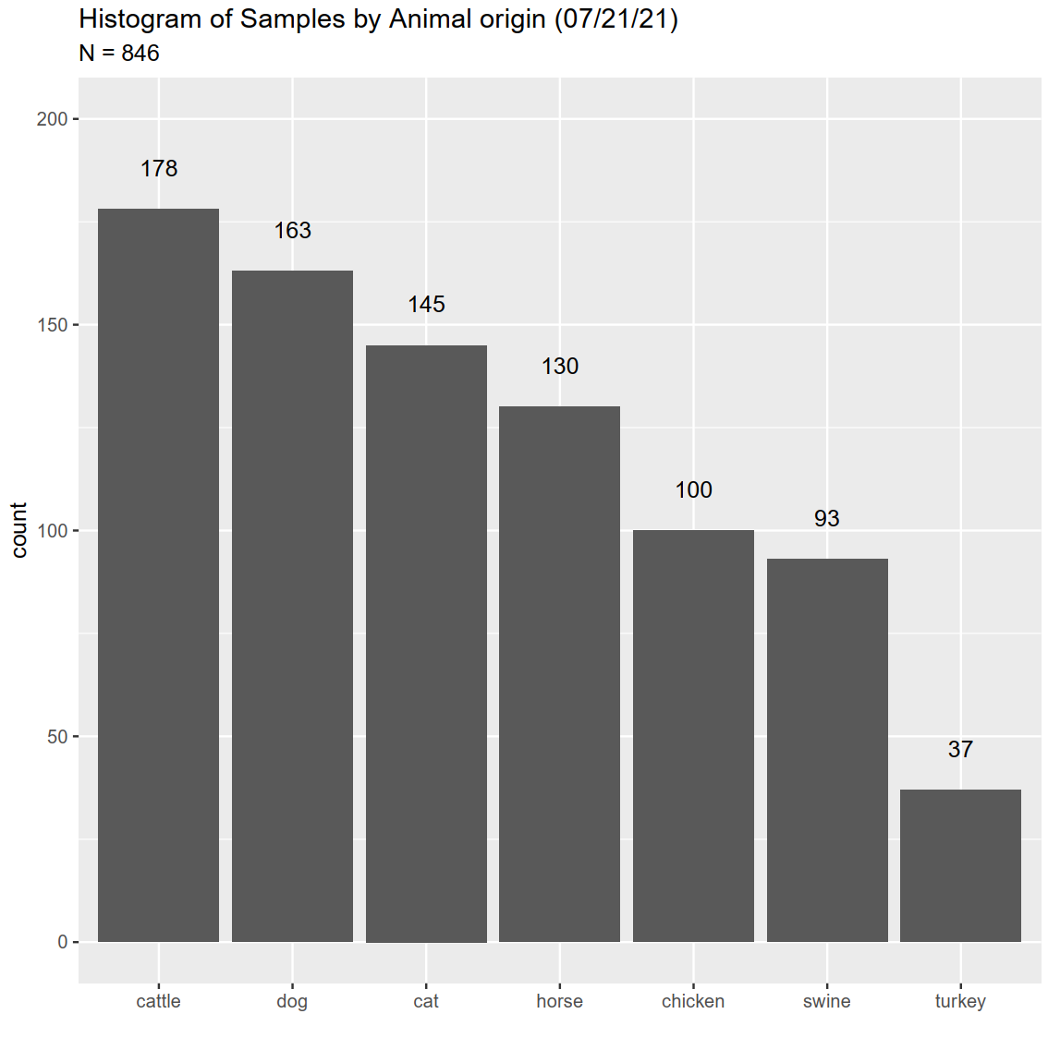
How are samples distributed amongst animals?

Slide 4
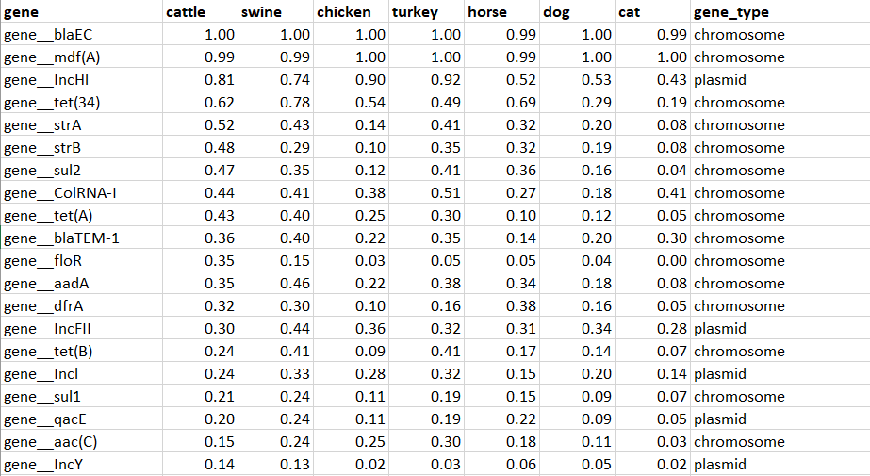
What are the most prevalent AMR genes found in samples? (n = 846)

Slide 5
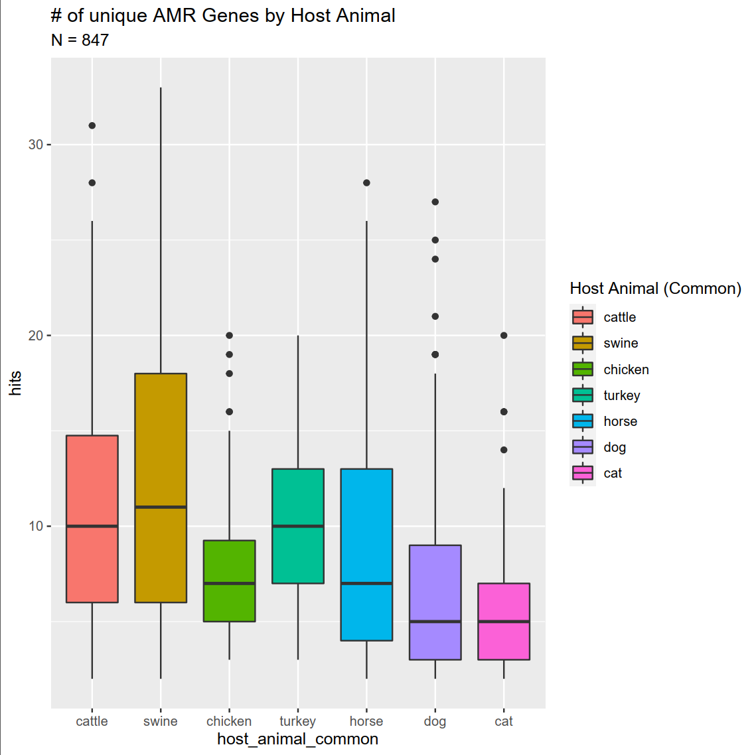
Is there a difference in number of AMR genes found across different animal samples?

Slide 6
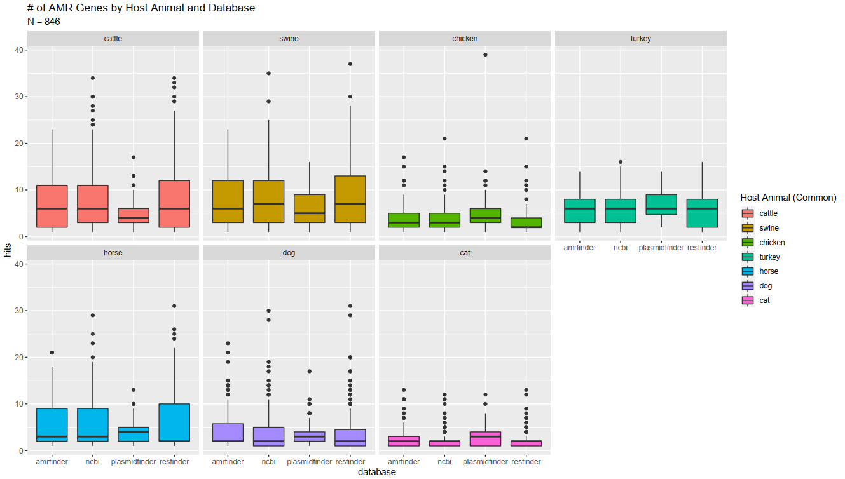
Is there a bias in # of AMR genes found by database?
Notes:
blaEC – beta lactamase – breaks up penicillin? < look up later

Slide 7
Is there a significant difference in the number of unique AMR genes found between AM phenotypes?
Test for significant difference in unique number of AMR genes per AM phenotype compiled from all databases.
Address statistical issues:
Use a Welch’s ANOVA to deal with unequal group variance.
Resampling groups to n = 10 to deal with unequal sample sizes.
Correct for multiple comparisons by comparing p-value to 5% quantile null distribution of p-values generated with a permutation test (n = 10,000).
animal | AM | sampleID | avg_AMR_genes | Phenotype
Dog | Cefovecin | 10001 | 4 | S
Dog | Cefovecin | 10002 | 5 | S
Dog | Cefovecin | 10003 | 4 | S
Dog | Cefovecin | 10004 | 6 | S
Dog | Cefovecin | 10005 | 4 | S
Dog | Cefovecin | 10006 | 10 | R

Slide 8
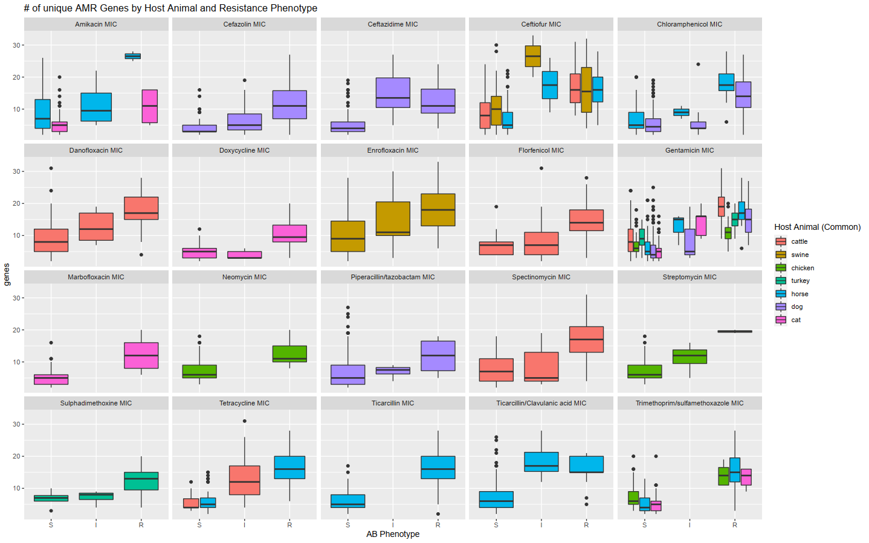

Slide 9
Is there a relationship between the presence of a gene and the AMR phenotype?
Chi-square test for independence – test to determine whether two categorical variables are related.
Gene presence/absence.
AMR phenotype (SIR).
Perform Chi-square test for each valid gene-AM-animal combinations (22,000) combinations.
Correct for multiple comparisons with Bonferroni correction.
Chi square results
Notes:
126 genes
50 Antimicrobials
7 animal species

Slide 10
Issues with Chi-Square
blaEC/Orbifloxacin/ cat | Absence | Presence
S | 1 | 123
I | NA | 1
R | NA | 9
Tet(34)/Azithromycin/ horse | Absence | Presence
S | 4 | 3
I | 11 | 24
R | 22 | 60
“Bad” case.
Missing data.
Random example | Absence | Presence
S | 24 | 15
I | NA | 1
“Good” case.
Obvious evidence of gene effect.
No missing data.
“Bad” case.
Missing phenotypes.
Linear Mixed Effect Models

Slide 11
Do samples cluster in identifiable patterns based on gene presence-absence data?
Can we identify what animal species a sample came from by its gene composition?

Slide 12
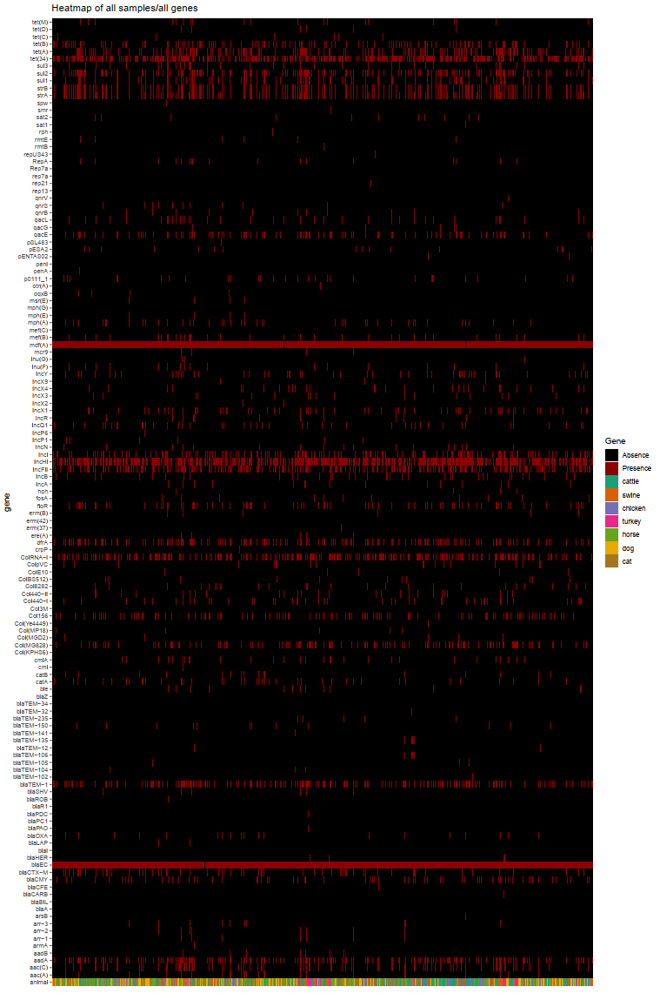
Heatmap – all genes
Notes:
Add color dimensions for resistance.

Slide 13
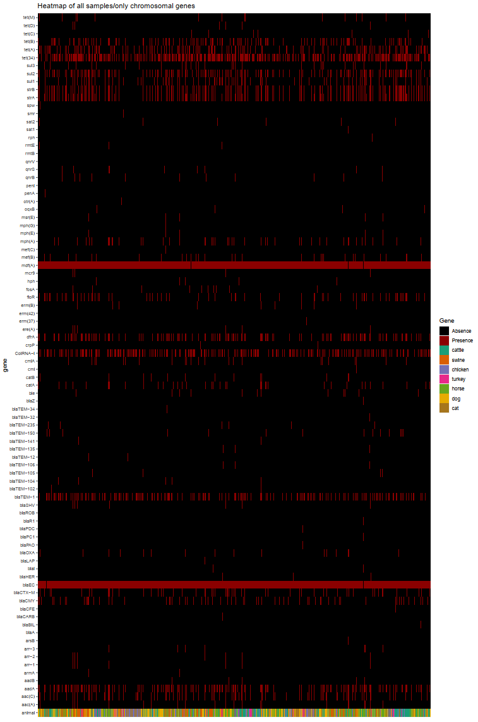
Heatmap – chromosomal
genes
Notes:
Add color dimensions for resistance.

Slide 14
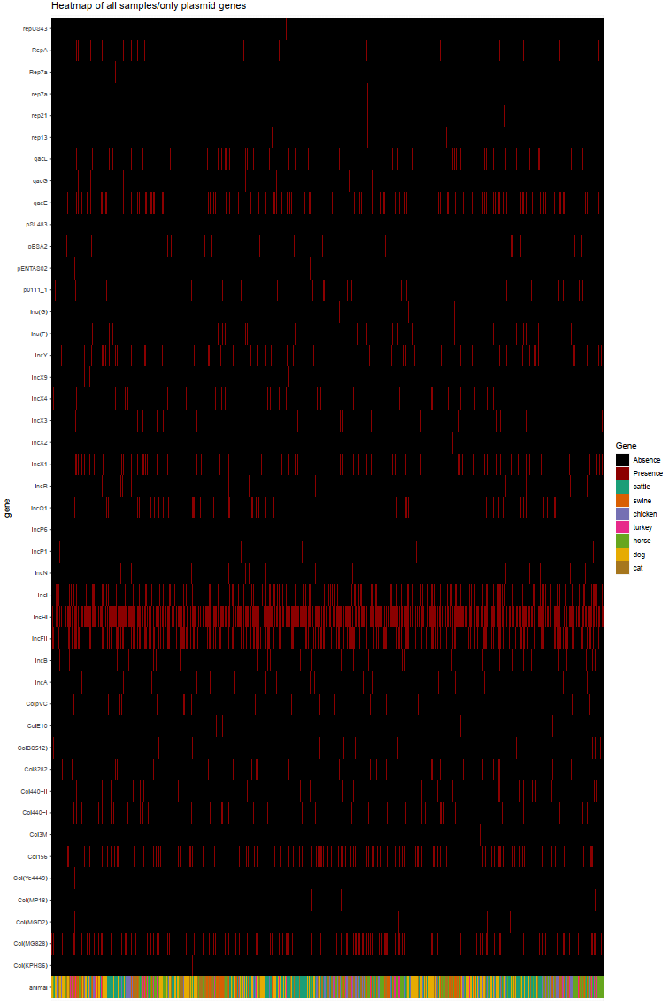
Heatmap – plasmid genes
Notes:
Add color dimensions for resistance.

Slide 15
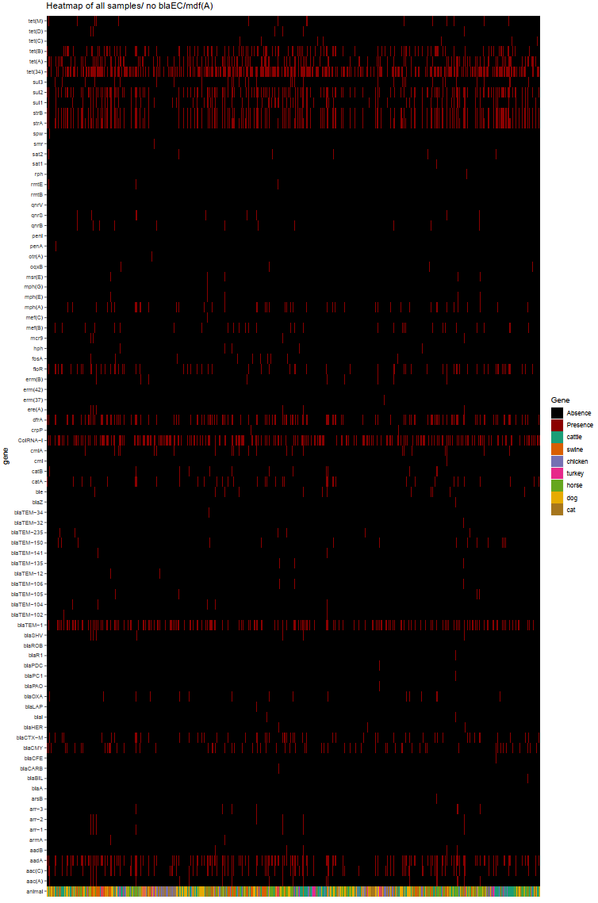
Heatmap –
remove blaEC and mdf(A)
Notes:
Add color dimensions for resistance.

Slide 16
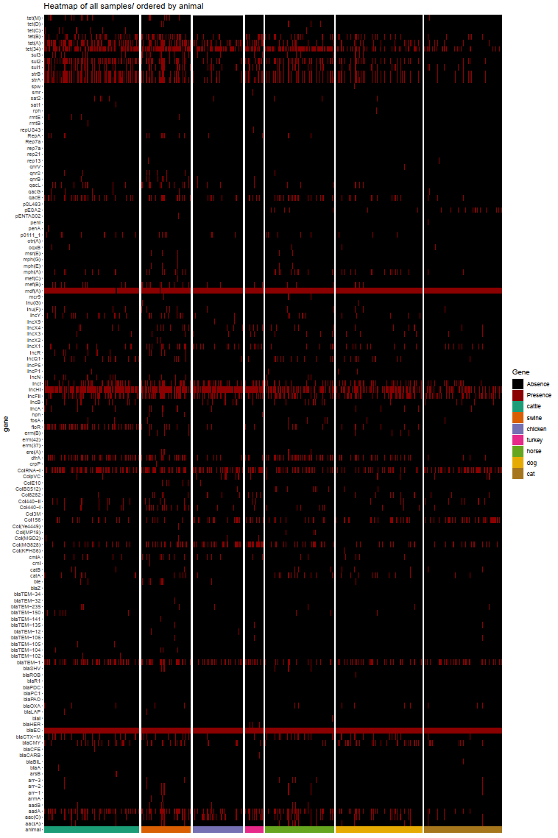
Heatmap – animals
(annotated)
Notes:
Add color dimensions for resistance.

