Slide 1
Preliminary analysis of USDA AMR data
Henri Chung
08/03/21

Slide 2
Study Goals
Can we predict resistance to specific antimicrobial agents in animals from the presence of antimicrobial resistance genes in E. Coli samples taken from those same animals?
Ex: Presence of gene A, gene B, and gene C in this sample suggest that the animal from which the sample was taken will be resistant to Ampicillin.
Can we determine patterns for antimicrobial resistance across different animals?
Presence of these antimicrobial resistance genes is most common in cattle and swine.

Slide 3
Study Background
846 samples over a period of 3 years (2018-2020).
Samples consist of E. Coli isolates from a variety of livestock animals (pigs, cattle, horses, chickens, etc).
Samples were sequenced (whole genome sequencing) and searched for the presence of antimicrobial resistance genes with AMRFinder and Abricate.
Total # of AMR genes detected in each sample was compared across 4 databases (amrfinder, ncbi, plasmidfinder, resfinder).
Antimicrobial resistance assays (Sensititre BioMic Assay) were performed to check for AMR phenotypes (Sensitive, Intermediate, or Resistant).
AM Resistance conferred by specific genes was determined by referencing the Comprehensive Antimicrobial Resistance Database (CARD).

Slide 4
E. Coli Samples (n = 846)
Metadata
Sample id
Animal of origin
State of origin
Tissue sample
Genotype Data
Sample id
Gene name
Gene type (plasmid, chromosomal)
Database
% Coverage/identity
Phenotype Data
Sample id
Antimicrobial agent
Minimum Inhibitory Concentration
Breakpoint determinant
Phenotype
AMRFinder
BLASTX
% coverage > 90%
% identity > 75%
Abricate
BLASTN
NCBI, Resfinder, PlasmidFinder
% identity > 75%
Sensititre BioMic Assay
Determines ‘Minimum Inhibitory Concentration” of a given antimicrobial within a range.
AMR phenotype is determined by either;
CLSI breakpoints.
50/90% quantile.
Comprehensive Antimicrobial Resistance Database
Information on individual genes and whether they are known to confer resistance to a specific antimicrobial agent.

Slide 5
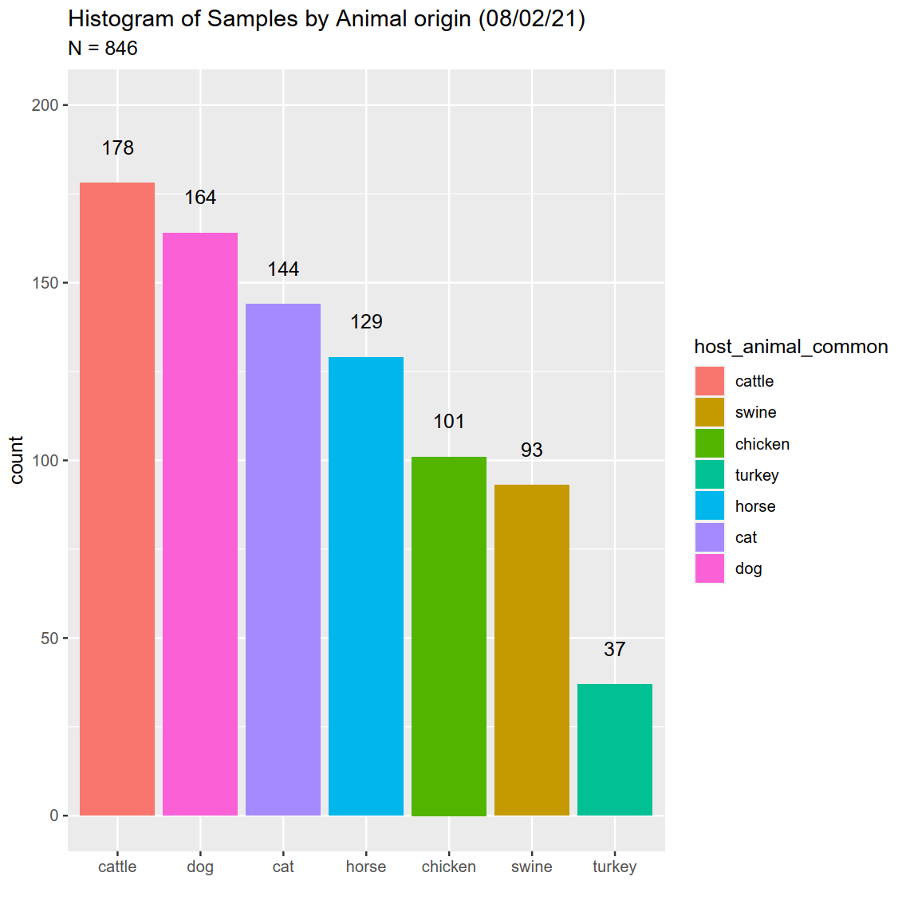
How are samples distributed by host animal?

Slide 6
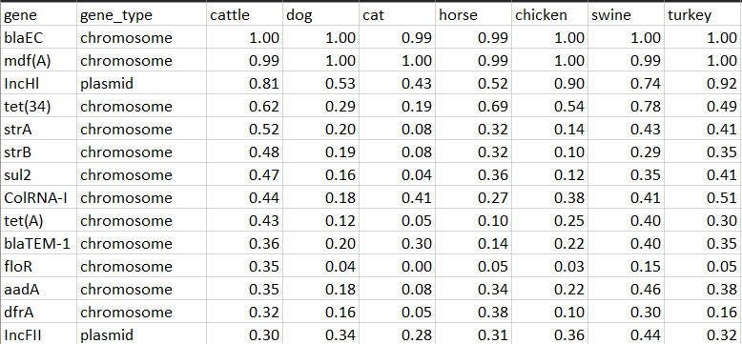
What are the most prevalent AMR genes found in samples? (n = 846)

Slide 7
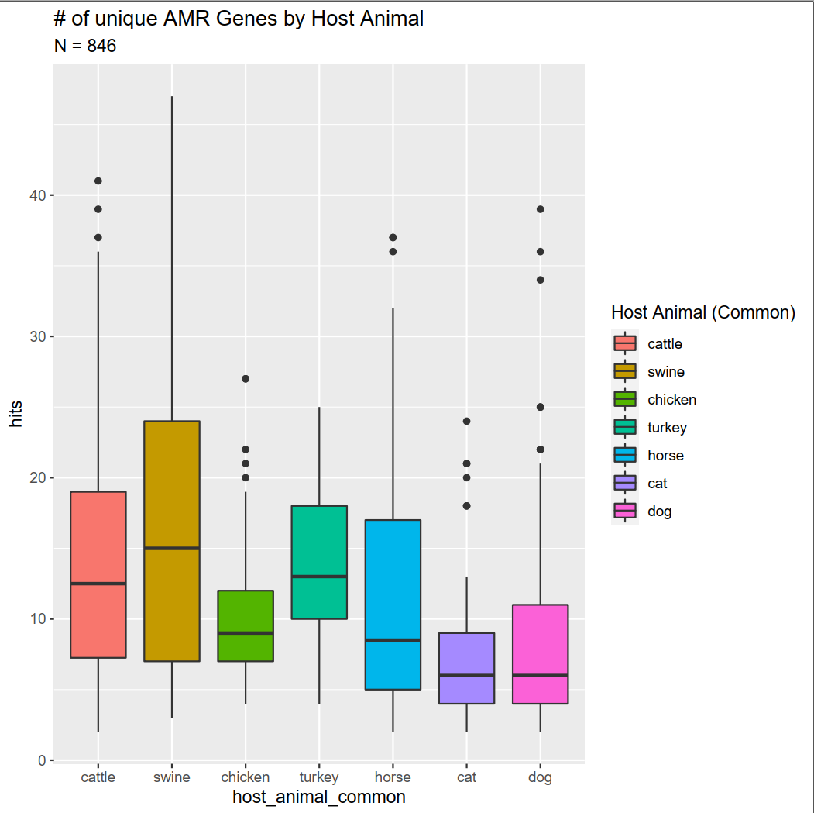
Is there a difference in number of AMR genes found across different animal samples?

Slide 8
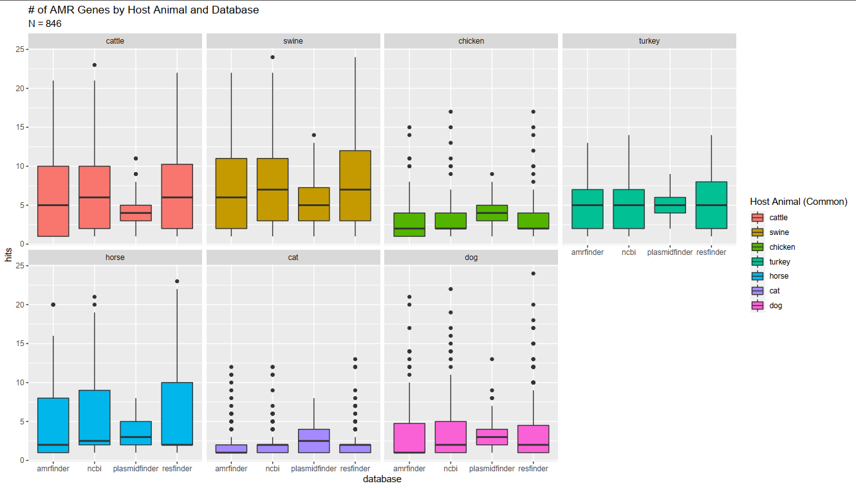
Is there a bias in # of AMR genes found by database?
Notes:
blaEC – beta lactamase – breaks up penicillin? < look up later

Slide 9
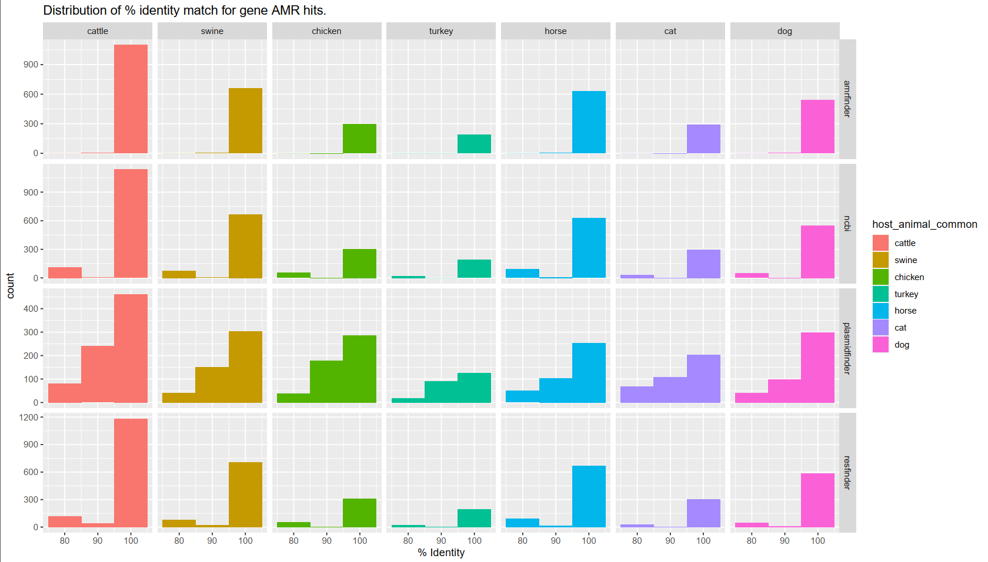

Slide 10
