Slide 1
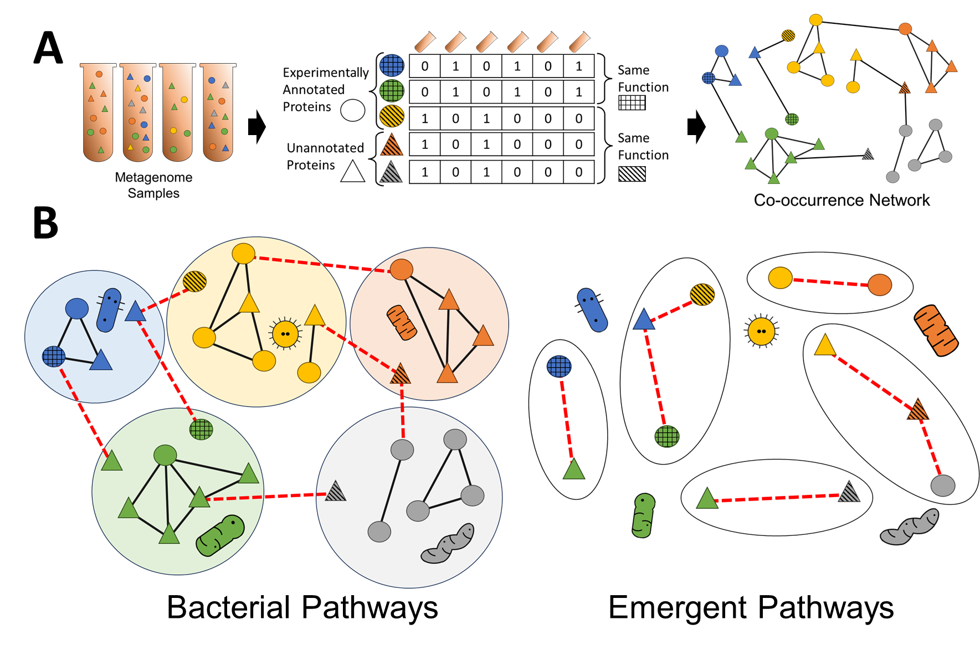

Slide 2


Slide 3



Slide 4


Slide 5


Slide 6


Slide 15
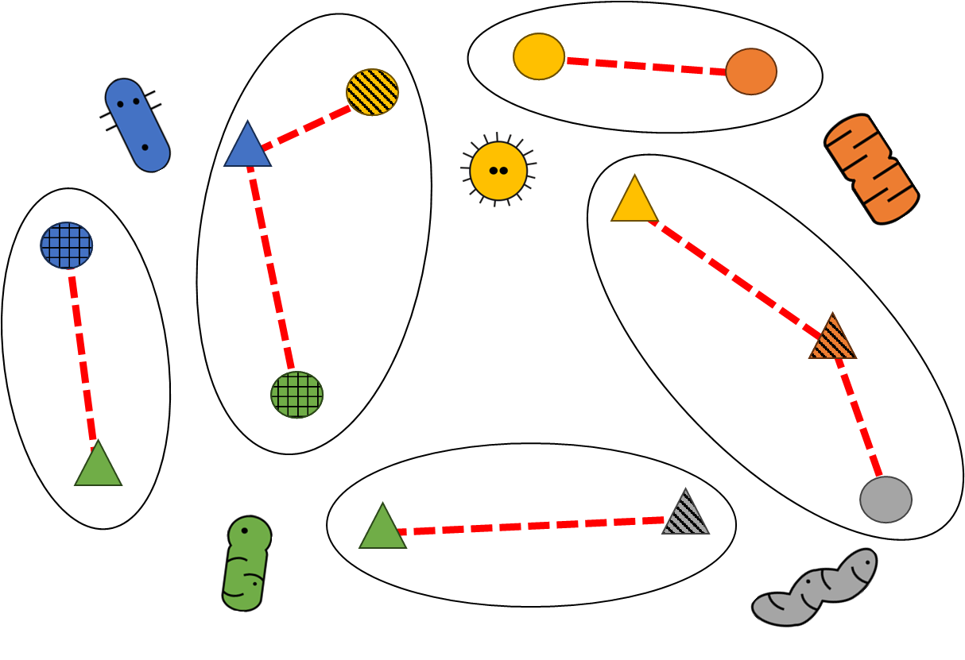

Slide 16
0 | 1 | 0 | 1 | 0 | 1
1 | 1 | 1 | 1 | 1 | 1
0 | 0 | 1 | 0 | 0 | 0
1 | 1 | 0 | 1 | 0 | 1
0 | 0 | 0 | 0 | 0 | 1
0 | 1 | 0 | 1 | 0 | 1
0 | 1 | 0 | 1 | 0 | 1
0 | 1 | 0 | 1 | 0 | 1
0 | 1 | 0 | 1 | 0 | 1
0 | 1 | 0 | 1 | 0 | 1

Slide 17


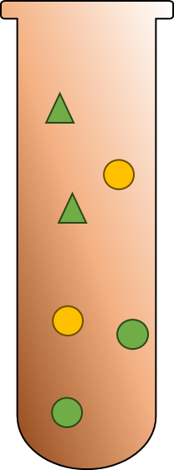
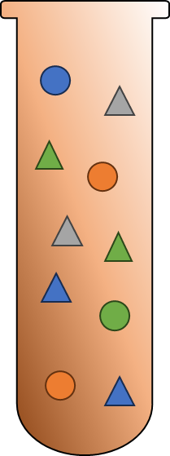

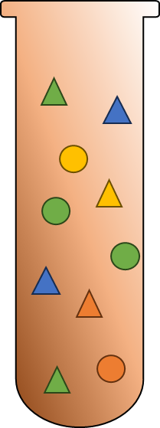
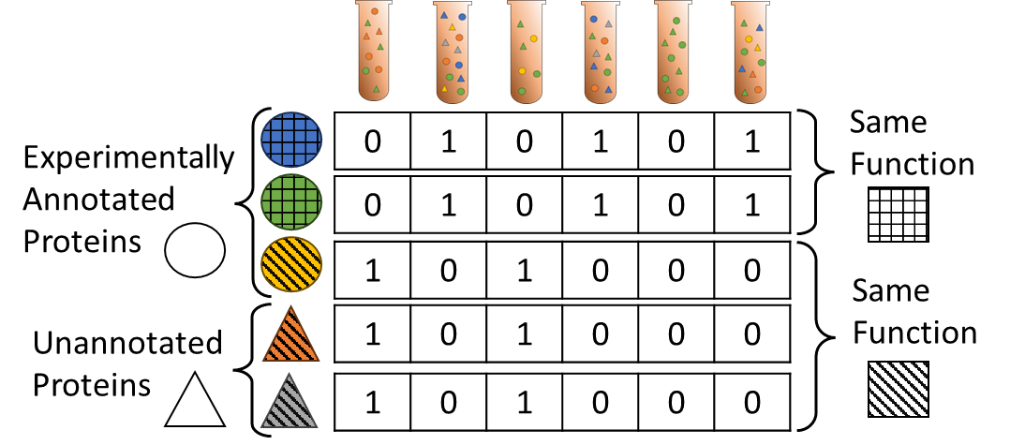
0 | 1 | 0 | 1 | 0 | 1
Same Function
Experimentally Annotated Proteins
0 | 1 | 0 | 1 | 0 | 1
1 | 0 | 1 | 0 | 0 | 0
Same Function
Unannotated Proteins
1 | 0 | 1 | 0 | 0 | 0
1 | 0 | 1 | 0 | 0 | 0

Slide 18
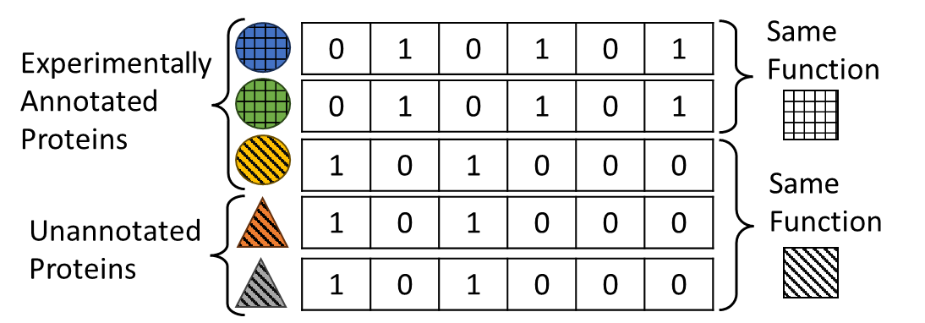
0 | 1 | 0 | 1 | 0 | 1
Same Function
Experimentally Annotated Proteins
0 | 1 | 0 | 1 | 0 | 1
1 | 0 | 1 | 0 | 0 | 0
Same Function
Unannotated Proteins
1 | 0 | 1 | 0 | 0 | 0
1 | 0 | 1 | 0 | 0 | 0

Slide 19

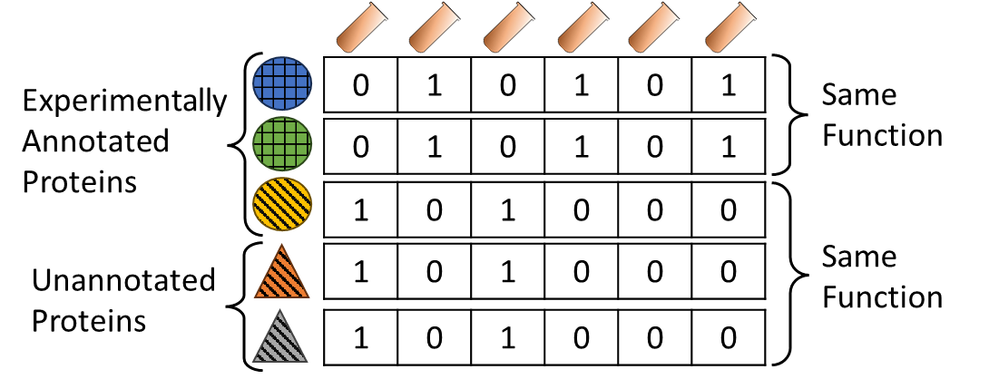
Experimentally Annotated Proteins
0 | 1 | 0 | 1 | 0 | 1
Same Function
0 | 1 | 0 | 1 | 0 | 1
1 | 0 | 1 | 0 | 0 | 0
1 | 0 | 1 | 0 | 0 | 0
Same Function
Unannotated Proteins
1 | 0 | 1 | 0 | 0 | 0

Slide 20
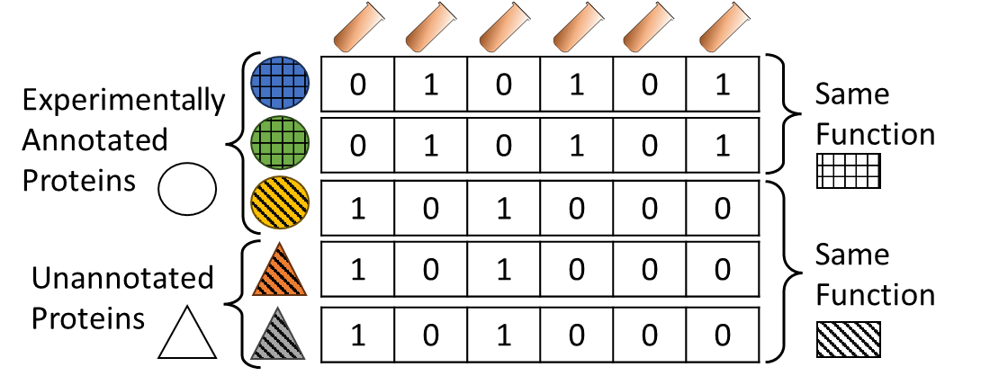
Experimentally Annotated Proteins
0 | 1 | 0 | 1 | 0 | 1
Same Function
0 | 1 | 0 | 1 | 0 | 1
1 | 0 | 1 | 0 | 0 | 0
1 | 0 | 1 | 0 | 0 | 0
Same Function
Unannotated Proteins
1 | 0 | 1 | 0 | 0 | 0

Slide 21
Metagenome Samples

Slide 22
Metagenome Samples

Slide 23
Metagenome Samples

Slide 24
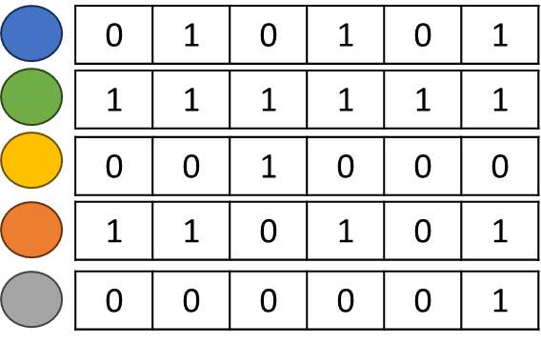
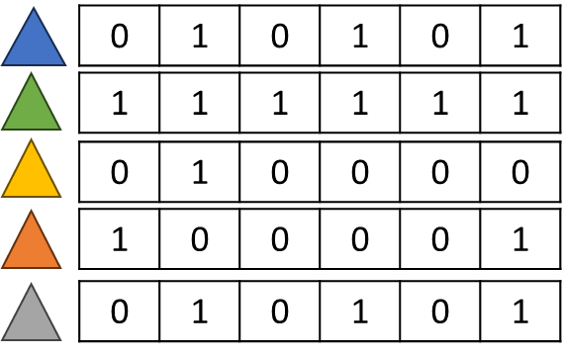
Known Functions
Unknown Functions
Fusion Phylogenetic Profiles

Slide 25
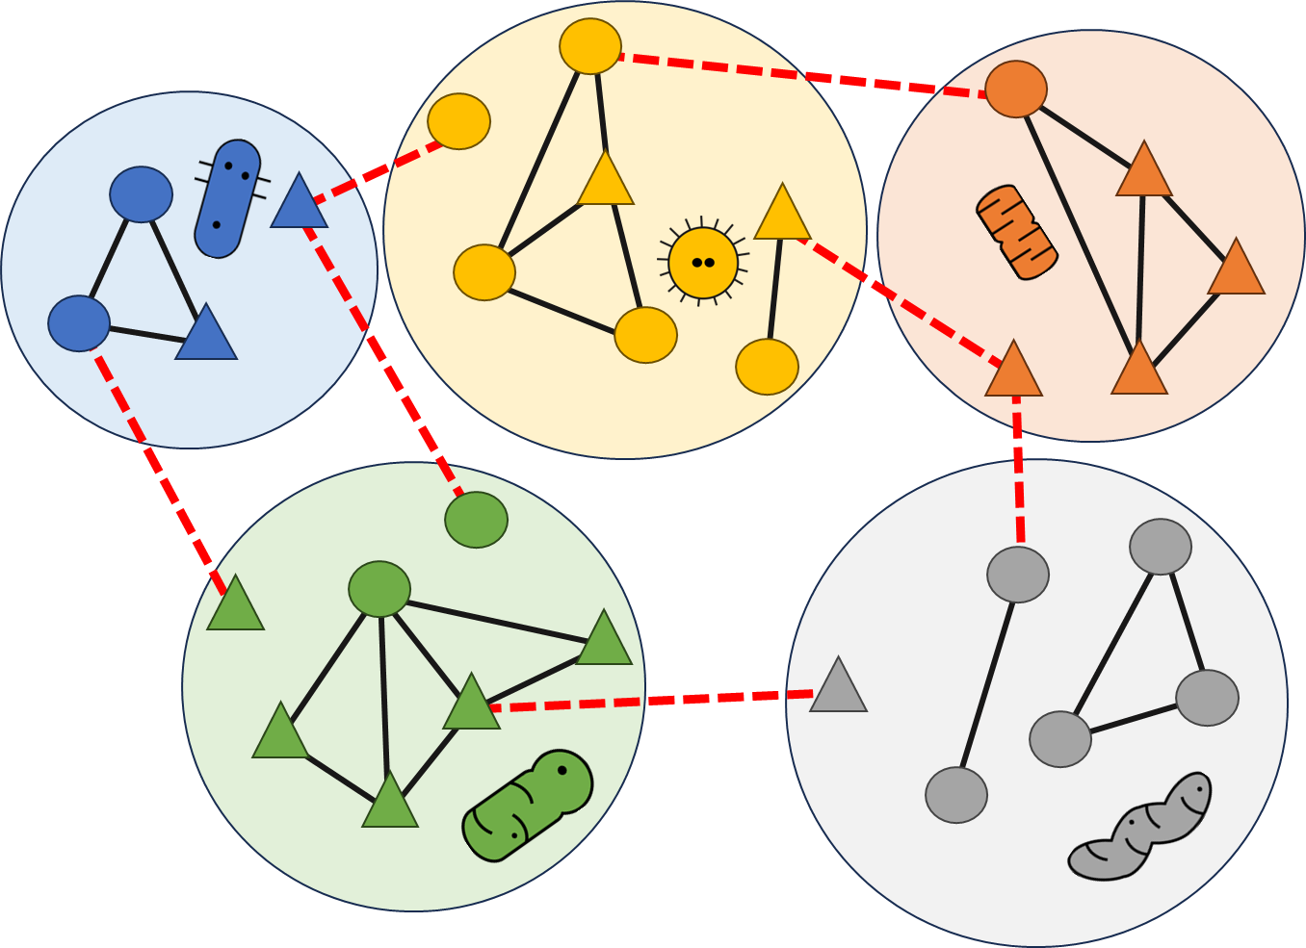
Bacterial Pathways

Slide 26

Emergent Pathways

Slide 27
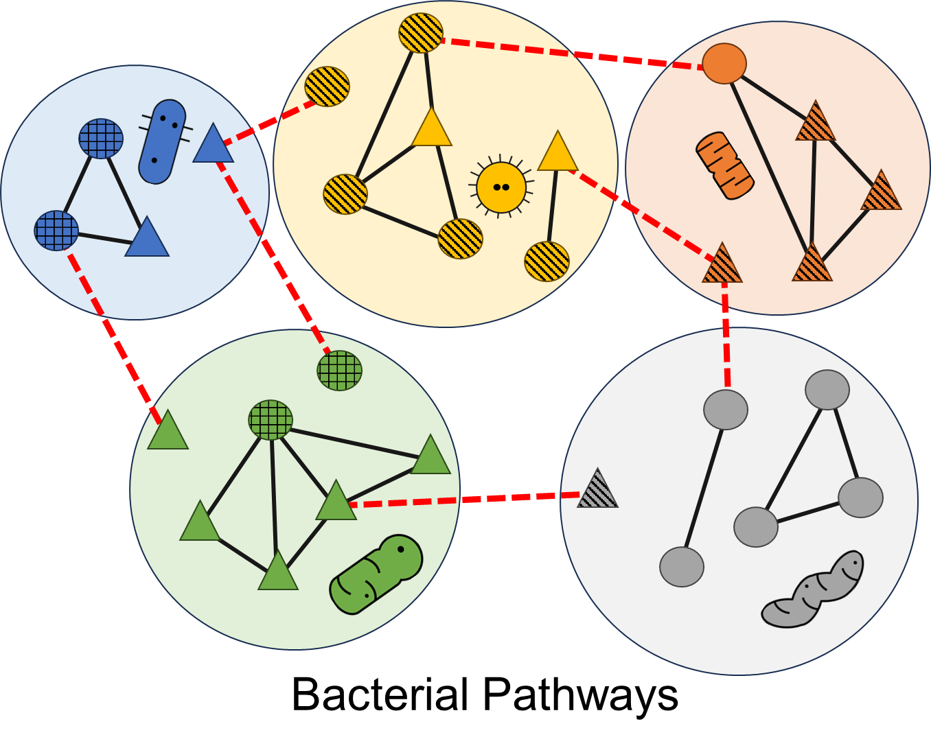

Slide 28
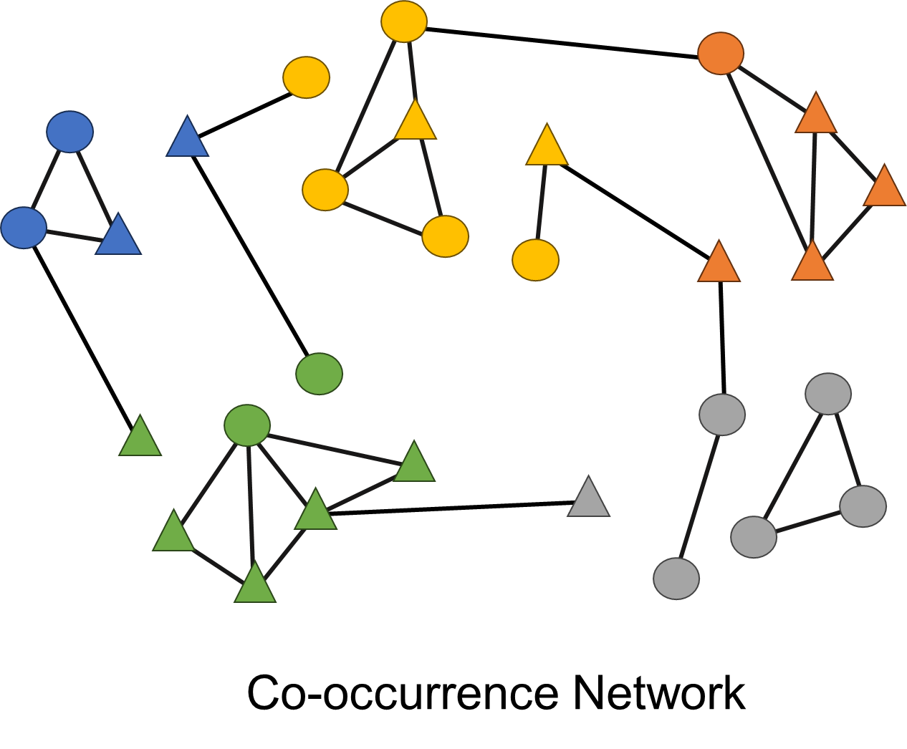
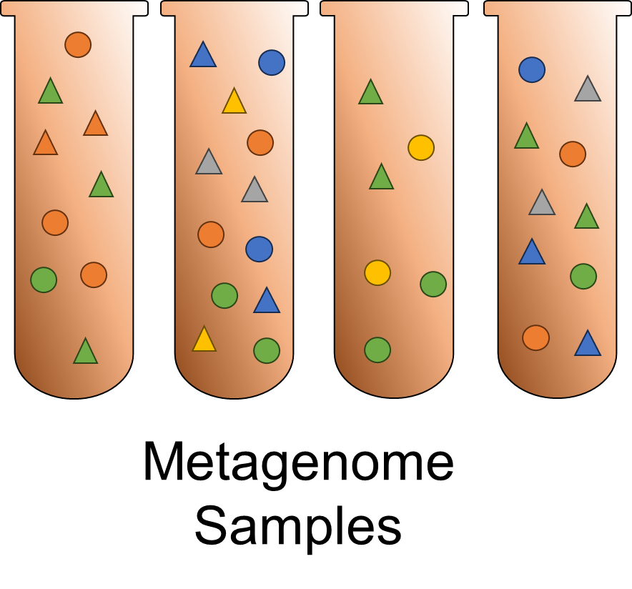
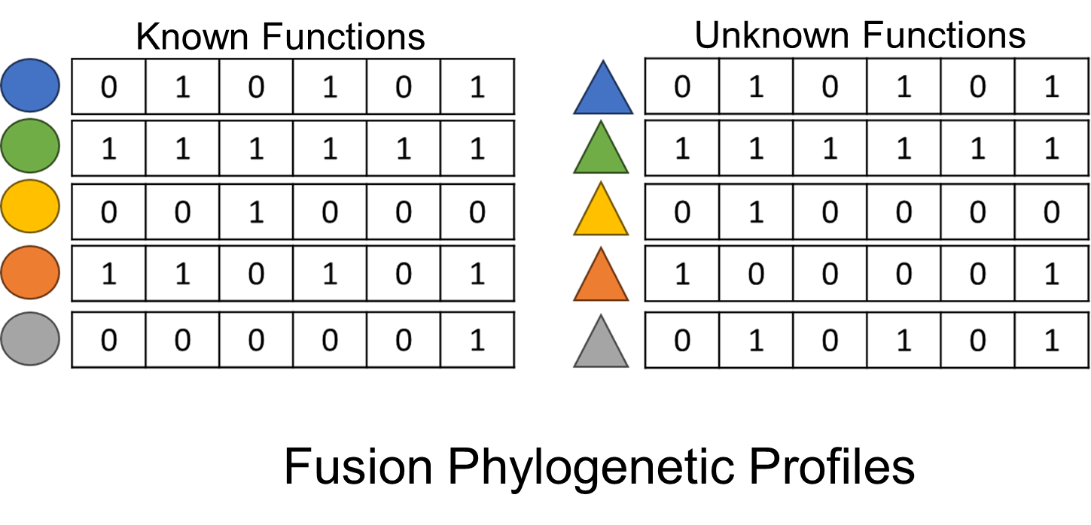
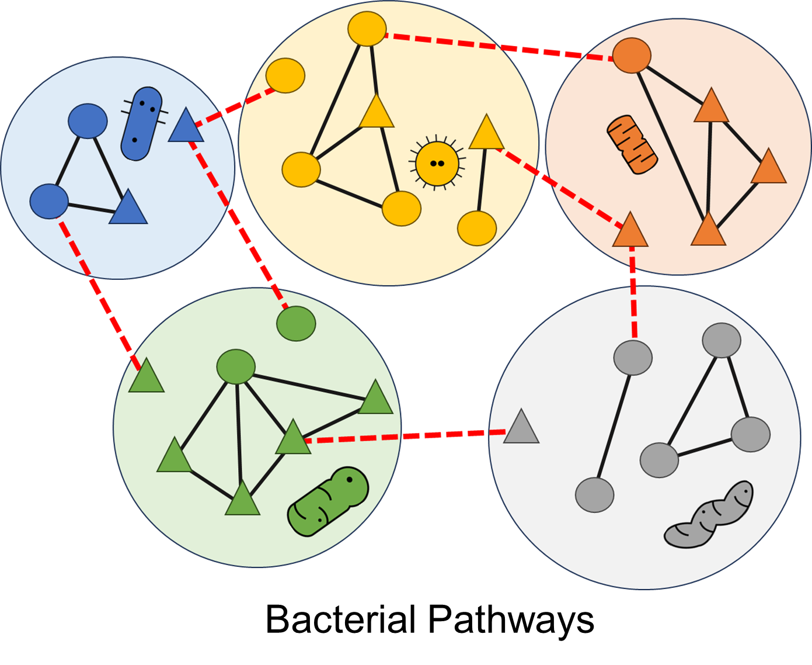
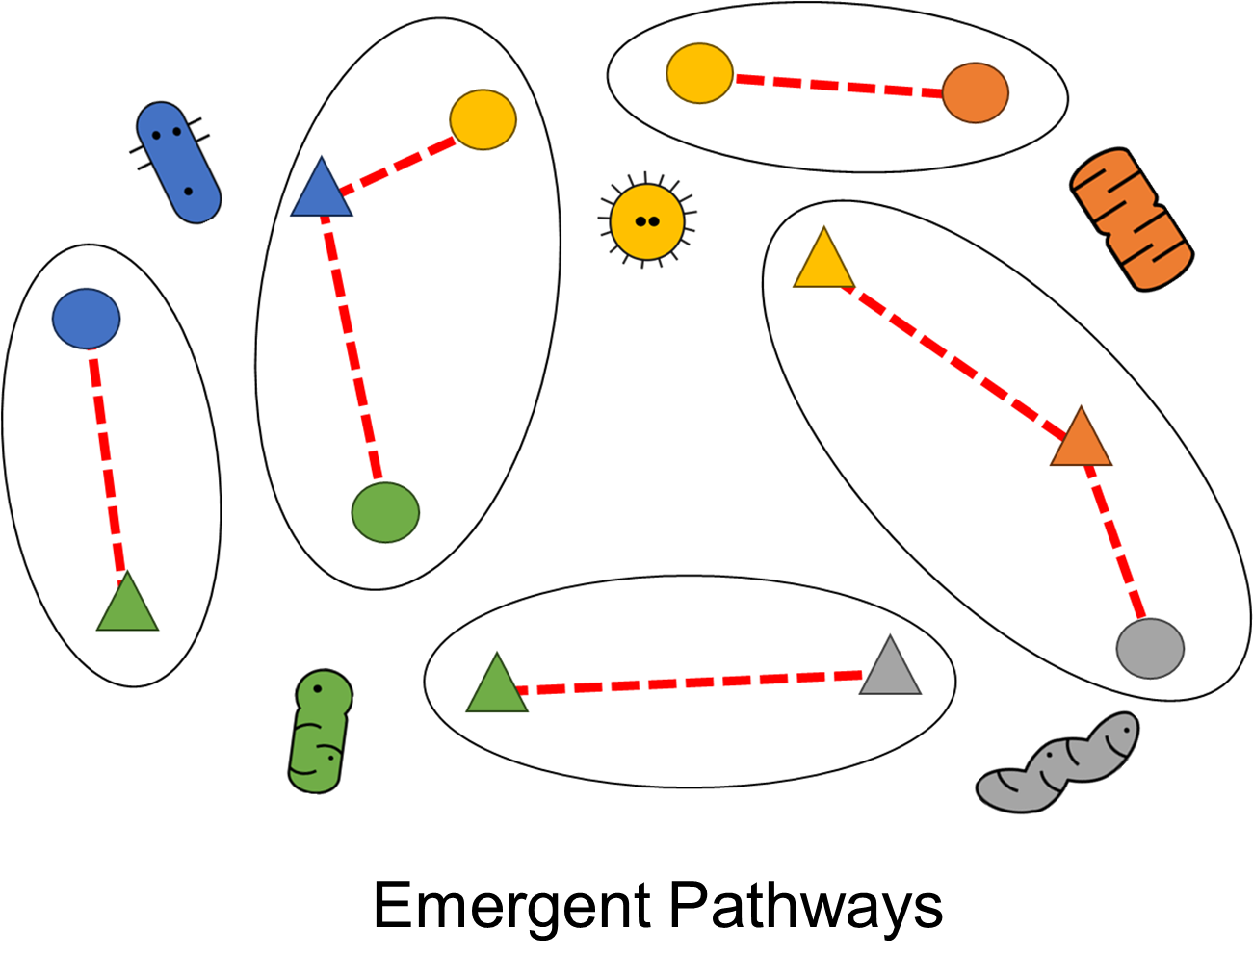
A
B

Slide 29
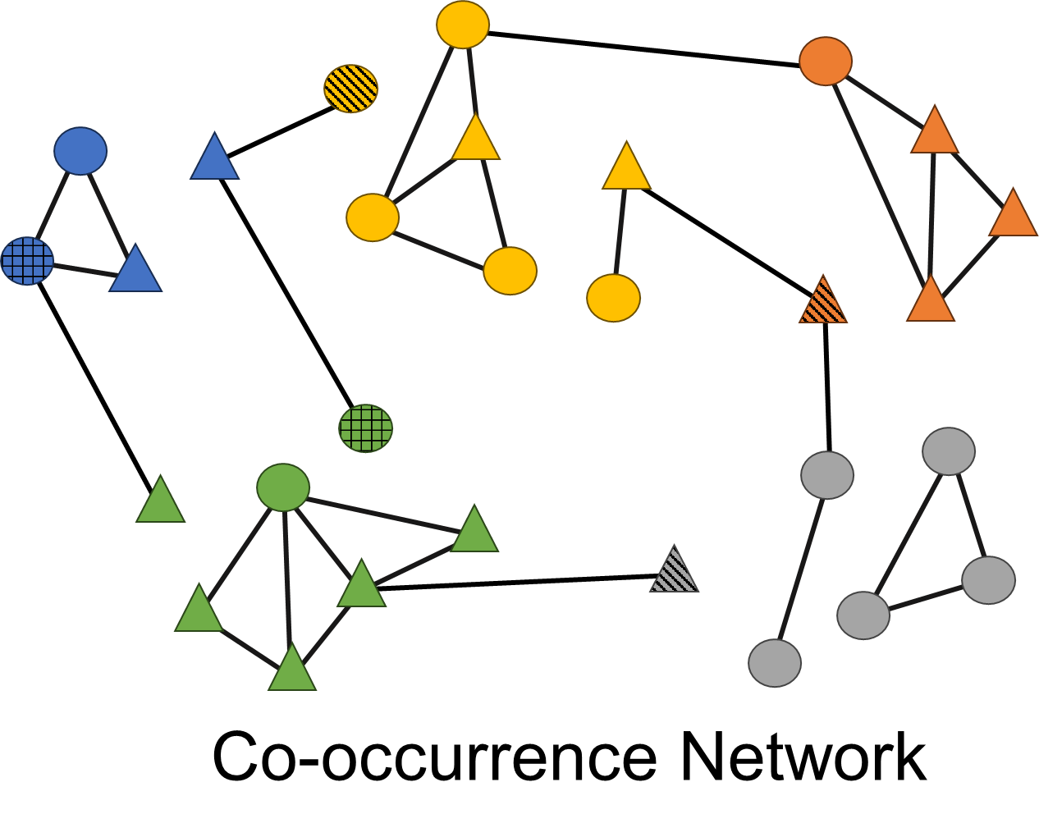
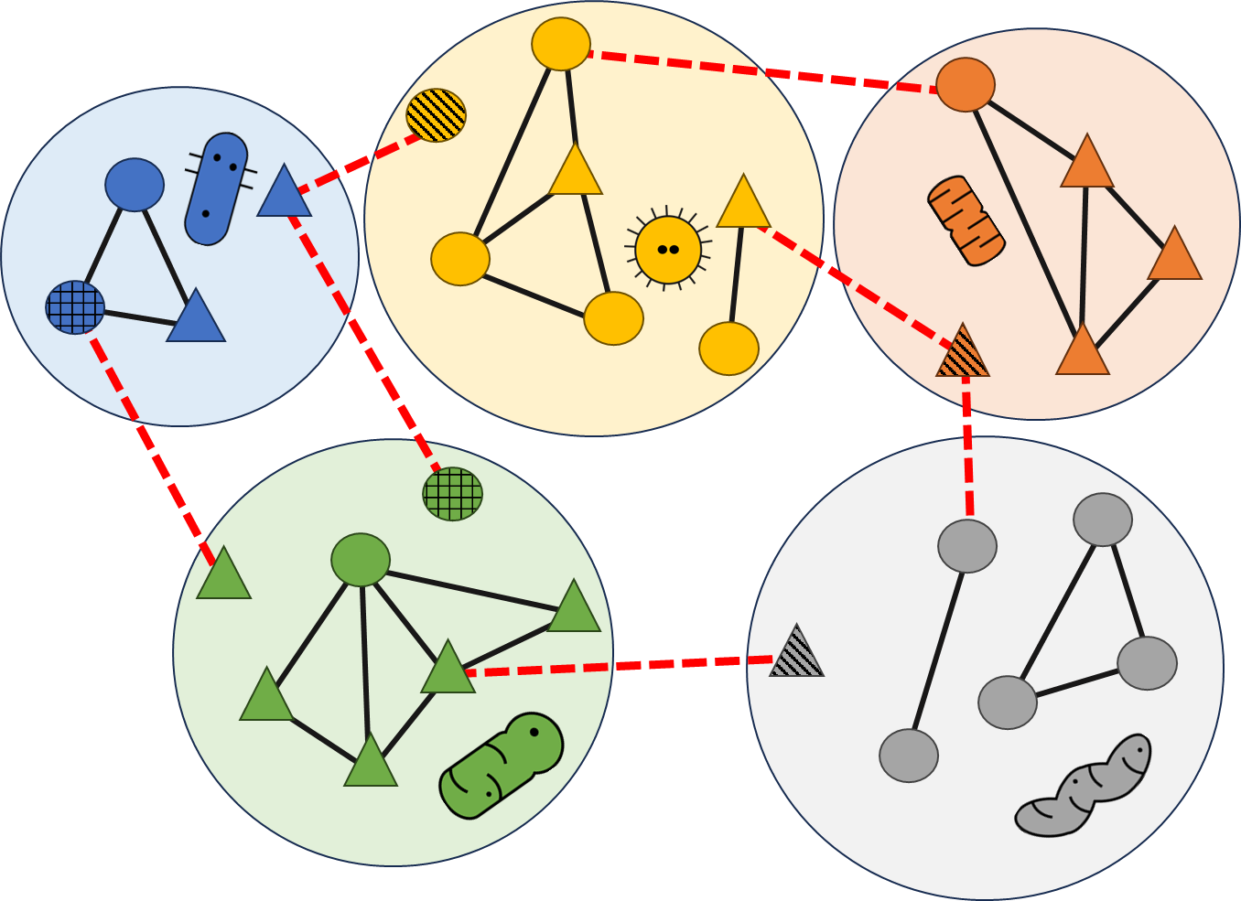
A
B
Bacterial Pathways
Emergent Pathways

