Slide 1
Code Topic 4
AJAX Requesting a JSON File
Laura Friedman
cit 261:02 (Online)

Slide 2
AJAX
Considered a developer’s “dream” because:
Read data from a web server AFTER page load
Update a web page without reloading it
Send data to a webserver – in the background

Slide 3
What is AJAX?
AJAX = Asynchronous JavaScript And XML
NOT a programming language
USES a combination of:
Browser built-in XMLHttpRequest object to request data from a web server
JavaScript and HTML DOM to display or use the data

Slide 4
AJAX is a Misleading Name
Applications are NOT limited to XML for data transport
It is EQUALLY COMMON to transport data as plain text or JSON text.

Slide 5
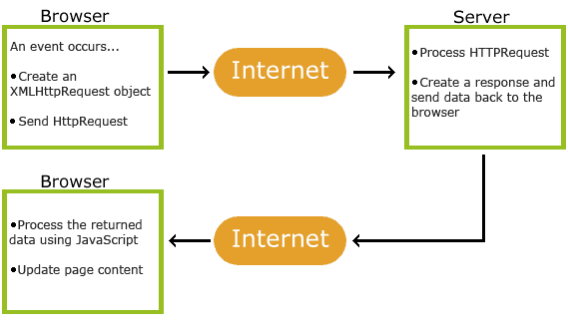
How AJAX Works
Source: https://www.w3schools.com/js/js_ajax_intro.asp

Slide 6
Steps
Event occurs in a web page (the page is loaded, a button is clicked)
XMLHttpRequest object is created by JavaScript
XMLHttpRequest object sends a request to a web server
Server processes the request
Server sends a response back to the web page
Response is read by JavaScript
Proper action (like page update) is performed by JavaScript

Slide 7
Create XMLHttpRequest Object
All modern browsers (Chrome, Firefox, IE7+, Edge, Safari, Opera) have a built-in XMLHttpRequest object.
Syntax:
variable = new XMLHttpRequest();
For security reasons, modern browsers do not allow access across domains.
This means that both the web page and the XML file it tries to load, must be located on the same server.

Slide 8
Object Methods
Method | Description
new XMLHttpRequest() | Creates a new XMLHttpRequest object
abort() | Cancels the current request
getAllResponseHeaders() | Returns header information
getResponseHeader() | Returns specific header information
open(method, url, async, user, psw) | Specifies the request method: the request type GET or POST url: the file location async: true (asynchronous) or false (synchronous) user: optional user name psw: optional password
send() | Sends the request to the server Used for GET requests
send(string) | Sends the request to the server. Used for POST requests
setRequestHeader() | Adds a label/value pair to the header to be sent

Slide 9
Object Properties
Property | Description
onreadystatechange | Defines a function to be called when the readyState property changes
readyState | Holds the status of the XMLHttpRequest. 0: request not initialized 1: server connection established 2: request received 3: processing request 4: request finished and response is ready
responseText | Returns the response data as a string
responseXML | Returns the response data as XML data
status | Returns the status-number of a request 200: "OK" 403: "Forbidden" 404: "Not Found" (Complete list: https://www.w3schools.com/tags/ref_httpmessages.asp)
statusText | Returns the status-text (e.g. "OK" or "Not Found")

Slide 10
AJAX Request
A simple GET request:
xhttp.open("GET", "ajax_info.txt", true);
xhttp.send();
A simple Post request:
xhttp.open("POST", "demo_post.asp", true);
xhttp.send();

Slide 11
Asynchronous – True or False?
Server requests should be sent asynchronously, so the async parameter of the open() method should be set to true:
xhttp.open("GET", "ajax_test.asp", true);
By sending asynchronously, the JavaScript does not have to wait for the server response, but can instead:
execute other scripts while waiting for server response
deal with the response after the response is ready

Slide 12
Resource for AJAX
https://www.w3schools.com/js/js_ajax_intro.asp

Slide 13
Demo

