Slide 1
Java Collections
Laura Friedman
cit 360:01 (Online)

Slide 2
Overview
Also called a Container
A general framework for storing and using data
Group similar elements into a single unit
NOT persistent
Memory resident
Only during program execution
Data is gone when the application ends

Slide 3
Collections Framework
Each collection type consists of:
Interfaces – abstract data types that allow collections to be manipulated independent of the details of their representation
Implementations – reusable data structures that allow for a concrete implementation of the collection interfaces.
Algorithms – methods that perform computations, such as searching and sorting. They are reusable functionality and polymorphic, meaning the same method can be used on different implementations.
The classes and interfaces are in the package java.util

Slide 4
Benefits
Gives the programmer access to prepackaged data structures and algorithms to manipulate them
Reduce programming effort
Increase program speed and quality
Allows interoperability among unrelated APIs
Reduce effort to learn and use new APIs
Reduce effort to design new APIs
Fosters software reuse

Slide 5
5 Basic Types
List – an ordered collection of objects that can contain duplicate values. It allows positional access and insertion of elements.
Set – an unordered collection of objects that can not contain duplicate values. If a duplicate is introduced, the older value will be replaced.
Queue – similar to a List, but is slightly different. Elements are inserted at the end and removed from the beginning. (FIFO)
Tree – non-linear data structure organized hierarchically. Each element is stored in a node. The topmost node is called the root node.
Map (not a true Collection) – an object that maps keys to values. Cannot have duplicate keys, but can have duplicate values. Three main implementations: HashMap, TreeMap, and LinkedHashMap.

Slide 6
Example of Each Type
List – A student’s transcript, which can list duplicate courses.
Set – a deck of cards.
Queue – Distribution of calls in a call center.
Tree – A family tree or business organizational chart.
Map (not a true Collection) – Grouping students by major or employees by department.

Slide 7
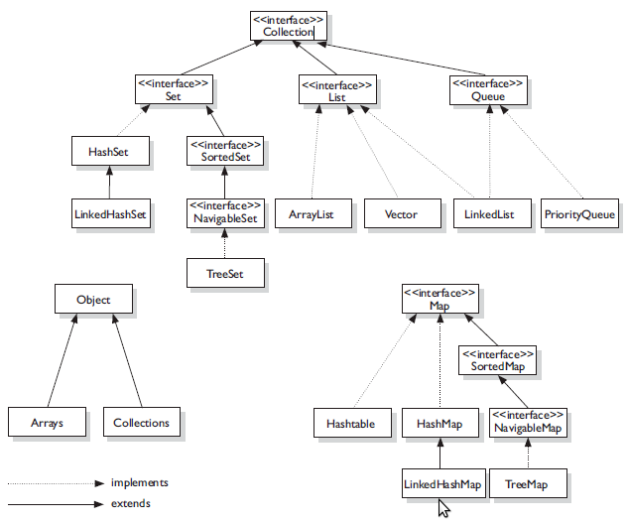
Diagram
https://en.proft.me/2013/11/3/java-collection-framework-cheat-sheet/

Slide 8
Demo

