Slide 1
Journal Report
Object-Oriented Programming II
CIT360:01 (Online) Laura Friedman July 2018

Slide 2
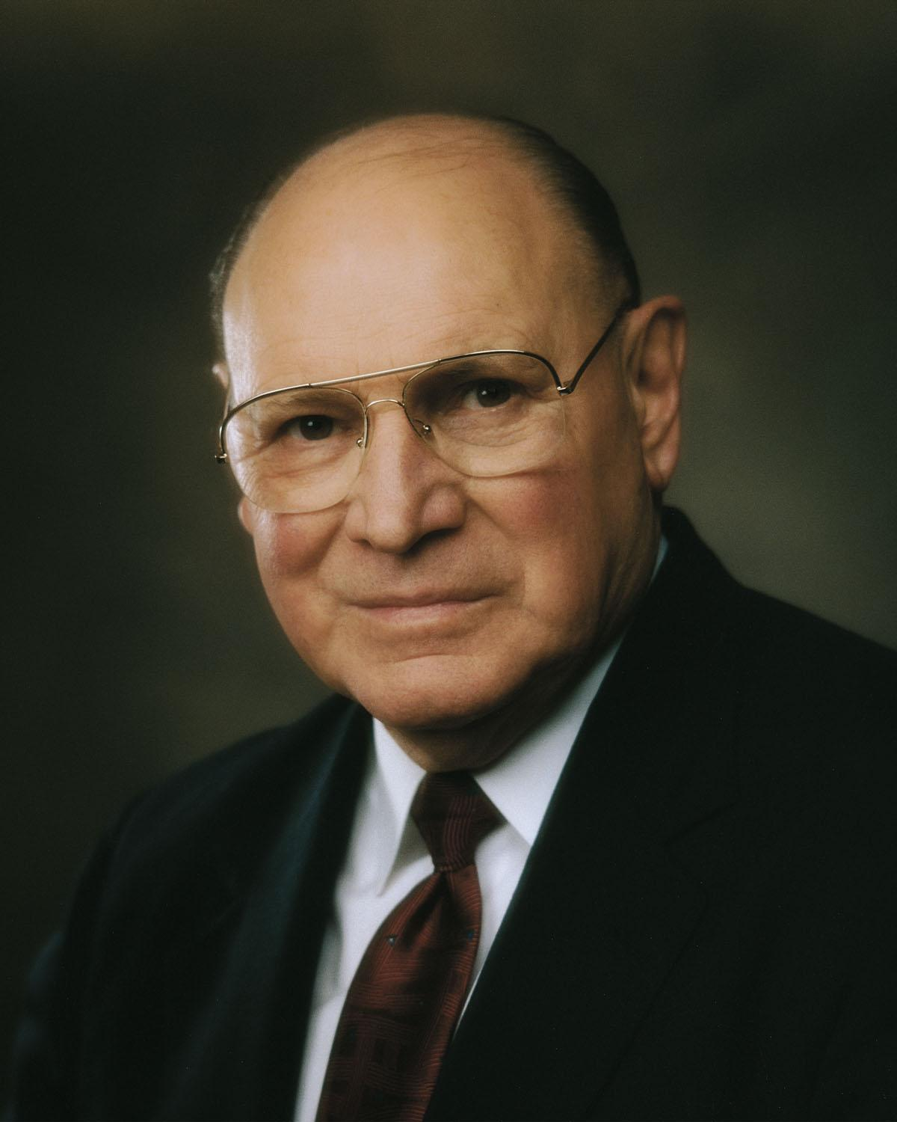
What I Did Well
Participated in all team meetings
Supported my team
Sandboxed code
Communicated via Google Hangouts
“The more class members read their scriptural assignments, the more they bring their scriptures to class, and the more they discuss what the gospel actually means in their lives, the more will be their inspiration, growth, and joy as they try to solve their personal concerns and challenges.” Elder Joseph B. Wirthlin, “Teaching by the Spirit,” Ensign, Jan. 1989, 15.

Slide 3
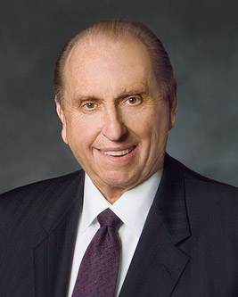
My Accomplishments
Completed Basic Level on All 14 Code Topics
Completed all assigned Teaching Presentations
Submitted a Personal Project Proposal
Worked Cohesively with my Team throughout the Semester
“It is not enough to want to make the effort and to say we’ll make the effort. We must actually make the effort. It’s in the doing, not just the thinking, that we accomplish our goals.” President Thomas S. Monson, “A Royal Priesthood,” General Conference, October 2007.

Slide 4
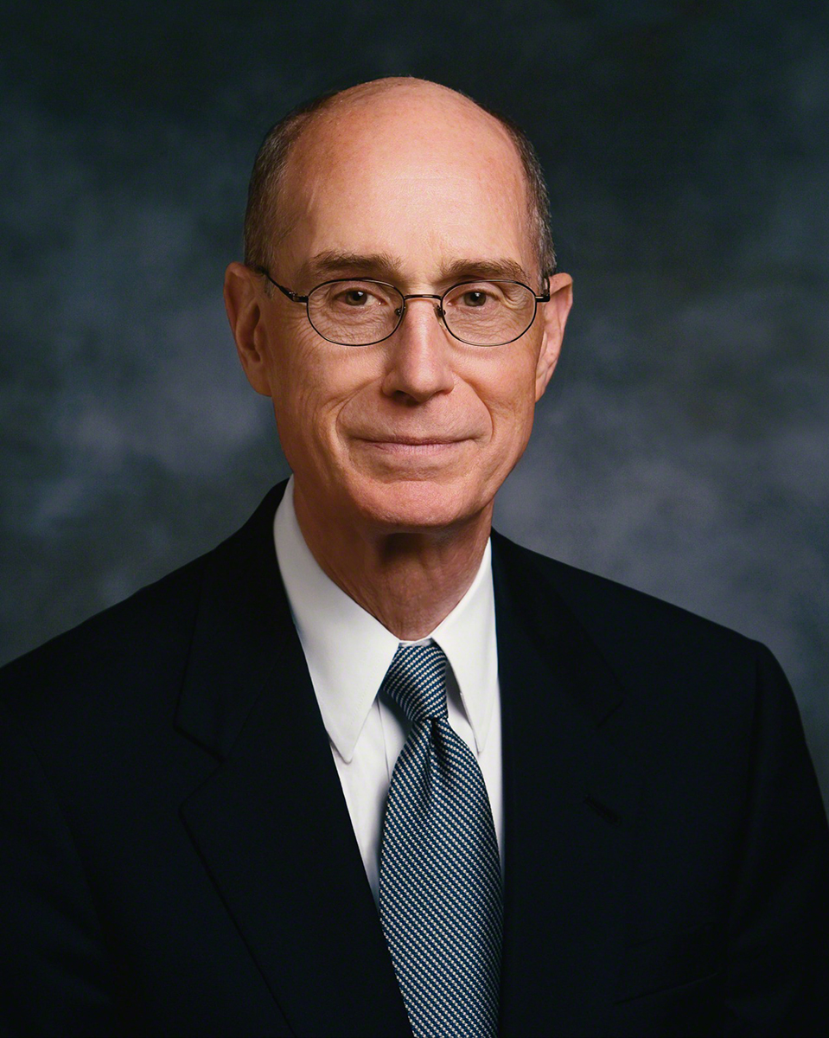
What I Can Improve On
Not allowing fear to stop me
“Most people stop learning out of fear. They are afraid they cannot learn. You need never have that fear if you are faithful. Your formal schooling may be interrupted for some reason, but I want you to know with absolute certainty that you can learn whatever God would have you learn. Great learners believe that. They have the attitude that they can learn.” Bishop Henry B. Eyring, “Do What They Think You Can’t Do,” Commencement Address at Ricks College, April 21, 1988.

Slide 5
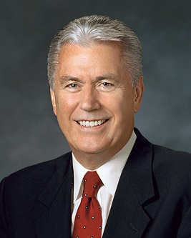
What I Can Improve On
Not allowing other’s opinions to shape my actions
“there are so many “shoulds” and “should nots” that merely keeping track of them can be a challenge. Sometimes, well-meaning amplifications of divine principles—many coming from uninspired sources—complicate matters further, diluting the purity of divine truth with man-made addenda. One person’s good idea—something that may work for him or her—takes root and becomes an expectation. And gradually, eternal principles can get lost within the labyrinth of “good ideas.” President Dieter F. Uchtdorf, “The Love of God,” General Conference, October 2009.

Slide 6
Openness to New Ideas
Object-Oriented Programming
Java Classes
Hibernate & Servlets
Self-Driven Learning
Support from Team
“You can change. You can be a little better. You can stand a little taller. You can love a little deeper. You can pick a different path. You can walk a different walk. you can find forgiveness. And joy. You can become your best you. Because He gave His life, you can change yours.”
https://www.lds.org/media-library/images/meme-change-better-different-1867718

Slide 7
How Did I Change?

Slide 8
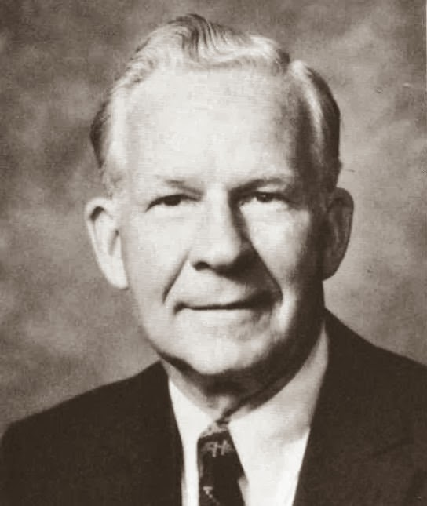
Progress Through Change
As opportunity for change reaches into our lives, as it always will, we must ask, “Where do I need development? What do I want out of life? Where do I want to go? How can I get there?” Weighing alternatives very carefully is a much needed prerequisite as one plans changes. In God’s plan we are usually free to choose the changes we make in our lives and we are always free to choose how we will respond to the changes that come. We need not surrender our freedoms . . .
C. S. Lewis indicated there is often pain in change when he wrote of God’s expectations for His children: “Imagine yourself as a living house. God comes in to rebuild that house. At first, perhaps, you can understand what He is doing. He is getting the drains right and stopping the leaks in the roof and so on: you knew those jobs needed doing and so you are not surprised. But presently he starts knocking the house about in a way that hurts abominably and does not seem to make sense. What on earth is He up to? The explanation is that He is building quite a different house from the one you thought of—throwing out a new wing here, putting on an extra floor there, running up towers, making courtyards. You thought you were going to be made into a decent little cottage: but He is building a palace” (C. S. Lewis, Mere Christianity, New York: MacMillan Co., 1960, p. 160).
Marvin J. Ashton, “Progress through Change,” General Conference, October 1979

Slide 9
Academic Growth
Stronger knowledge of Java
Stronger knowledge of Object-Oriented Programming
Stronger knowledge of Android App development
Final course for B.S. in Computer Information Technology
“Whatever principle of intelligence we attain unto in this life, it will rise with us in the resurrection. And if a person gains more knowledge and intelligence in this life through his diligence and obedience than another, he will have so much the advantage in the world to come.”
Doctrine & Covenants 130:18-19

Slide 10
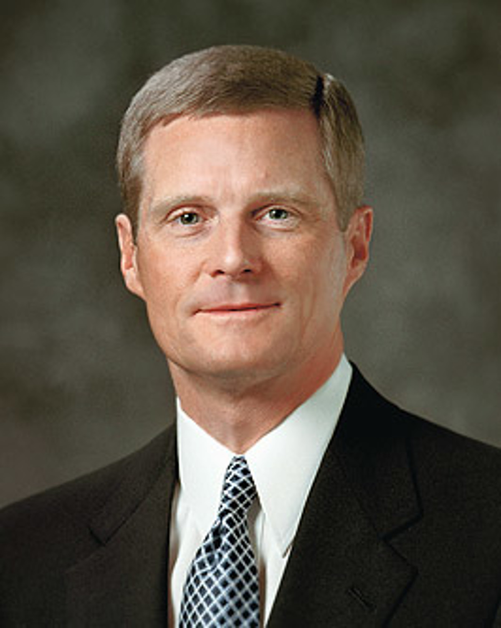
Spiritual Growth
Courage is not the absence of fear, rather it is taking action in the face of it through faith in Heavenly Father and Jesus Christ. “Correct knowledge of and faith in the Lord empower us to hush our fears because Jesus Christ is the only source of enduring peace.” (Elder David A. Bednar, “Therefore They Hushed Their Fears,” General Conference, April 2015.)
Whatever I do in life must be done for Heavenly Father and not for the people around me. “And whatsoever ye do, do it heartily, as to the Lord, and not unto men.” (Colossians 3:23)
Discipline and diligence are required to fulfill the purpose Heavenly Father has for me. “We are to learn our duty from the Lord, and then we are to act in all diligence, never being lazy or slothful.” (President Henry B. Eyring, “Act in All Diligence,” General Conference, April 2010.)

Slide 11
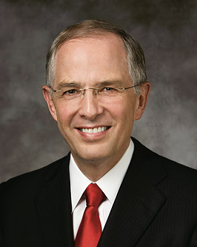
Courage ● Purpose ● Discipline ● Diligence ● Knowledge
“This is very important: as we do our best, He will not let us fail.” Elder Neil L. Anderson, “A Spiritual Work,” Broadcast.

