Slide 1






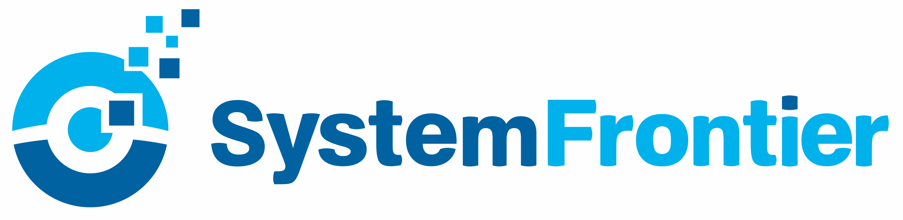




Logging in a DevOps world
PowerShell Conference Asia
Fred

Slide 2

Logging in a DevOps world
Fred
PowerShell Conference
Singapore 2018

Slide 3
about_Author
Friedrich "Fred" Weinmann
Former MVP (Cloud & Datacenter)
Premier Field Engineer for Security
Twitter: @FredWeinmann
PS Slack: Fred
https://psframework.org
https://github.com/FriedrichWeinmann
dbatools
PSFramework
PSModuleDevelopment
PSUtil
…
PowerShell Conference
Singapore 2018

Slide 4


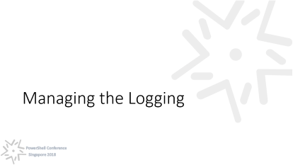
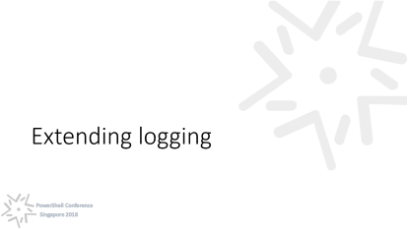


Slide 5
The Bastard Child
PowerShell Conference
Singapore 2018

Slide 6
Write-Verbose
PowerShell Conference
Singapore 2018

Slide 7
Logging in Action
PowerShell Conference
Singapore 2018

Slide 8
Going DevOps
PowerShell Conference
Singapore 2018

Slide 9
Requirements
Automatable
Scalable
Low Impact
Adaptable
Migratable
PowerShell Conference
Singapore 2018

Slide 10
Automatable & Adaptable
Controlled by Configuration
Deployable through:
GPO
SCCM
DSC
Puppet
Ansible
…
PowerShell Conference
Singapore 2018

Slide 11
Scalable & Low Impact
Data Provider, not Data Manager
Runspace-Safe
Asynchronous
PowerShell Conference
Singapore 2018

Slide 12
Migratable
Extensible with PlugIns (Logging Providers)
Provider Coexistence
PowerShell Conference
Singapore 2018

Slide 13
Extending logging
PowerShell Conference
Singapore 2018

Slide 14
Logging Provider
Logging is executed in a dedicated runspace
Offers 'events' that providers can 'subscribe' to
One resource scope, variables persist
Potential for conflict between providers
PowerShell Conference
Singapore 2018

Slide 15
The Event Chain
Begin
Finally
Start
Message
Error
End
PowerShell Conference
Singapore 2018

Slide 16
Managing the Logging
PowerShell Conference
Singapore 2018

Slide 17
Option a) Plain Consumption
Pro
Contra
Extremely simple to implement
No Code Impact
Troublesome to add providers
Only System-wide settings
PowerShell Conference
Singapore 2018

Slide 18
Option b) Master Configuration
Pro
Contra
Easy to Manage
Easy to implement
Runtime dependency on Infrastructure
Troublesome to add providers
Code Impact
PowerShell Conference
Singapore 2018

Slide 19
Option c) Intermediate Module
Pro
Contra
No Code Impact
Easy to add providers
Easy to update central resources
Implementation Overhead
Distribution necessary
Extra processing overhead
PowerShell Conference
Singapore 2018

Slide 20
Additional Resources
https://psframework.org
https://github.com/PowerShellFrameworkCollective/PSFramework
PowerShell Slack: #psframework channel
Configuration: https://psframework.org/documentation/documents/psframework/configuration.html
PowerShell Summit 2019
PowerShell Conference
Singapore 2018

Slide 21
Don’t Forget!
Fill in your survey – it’s how we do better!
Don’t lose you badge! You need it for the Social Events
Grab the Speakers for a chat – they all have time for you!
Let everyone know what they are missing on Social Media
#PowerShell
#PSConfAsia
@Psconf.Asia
Photos of Marina Bay Credit: Sebastian Szumigalski
PowerShell Conference
Singapore 2018

