Slide 1
Don't
Panic!

Slide 2


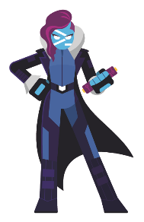





2018
2017
Build an immutable application infrastructure with Nano Server, PowerShell DSC, and the
release pipeline
The Hitchhiker’s Guide to
Userfriendly Module Design
Ravikanth Chaganti
Fred

Slide 3
Agenda
Identity
Documentation
Naming
Pipeline Design
Tab Completion
Bad Practices

Slide 4
1) Identity
Module
Resource 1
Resource 2
Resource 3
Resource 4
Resource 5
Resource n

Slide 5
1) Identity
Module
Component A
Component B
Resource 1
Resource 2
Resource 1
Resource 2
Resource 3
Resource 4
Resource 3
Resource 4
Resource 5
Resource n
Resource 5
Resource n

Slide 6
2) Documentation
DEMO

Slide 7
3) Command Prefix?
Get-ADComputer
Get-ADObject
Get-ADUser
Add-ADGroupMember
Set-ADUser
New-ADOrganizationalUnit
Remove-ADComputer
…

Slide 8
3) Command Prefix: Why?
Needed to avoid conflicts
PS> (Find-Module -Command Get-User).Count
7
Makes it easier to find commands
PS> Get-Command Get-AD*

Slide 9

3) Command Prefix: Default Prefix = Bad
No supported by many features (e.g. Find-Module)
Rarely used by user, if at all.
No technical benefit

Slide 10
4) Tab Completion
DEMO

Slide 11
5) Command Naming 101
Easy to find & easy to use
Logical Operation (from User perspective)
NOT technical, internal functionality
Add-AzureRMAccount
vs.
Connect-AzureRM(Account)

Slide 12
5) Command Naming: Verbs
Usually should use verbs
Should reflect action taken
Use approved verbs (Get-Verb)
Approved Verbs: https://msdn.microsoft.com/en-us/library/ms714428

Slide 13
5) Command Naming: Nouns
Don‘t use 'German' naming
IntelNetAdapterMaximumBandwidthPercentage
Singular
Include object worked with
Keep Get-Command in mind

Slide 14
5) Command Naming: Cheating
Ask someone familiar with the technology the module manages but unfamiliar with the module to search for the command.

Slide 15
6) Configuration
DEMO

Slide 16

7) No Littering!

Slide 17
7) No Littering!
Clean up temporary files you produce
Release resources
DEMO

Slide 18
8) Minding the Plumbing
Plan for the pipeline
Design commands to 'cooperate' with each other
Mind the code flow the user expects
Make 'Get-' commands optional
DEMO

Slide 19
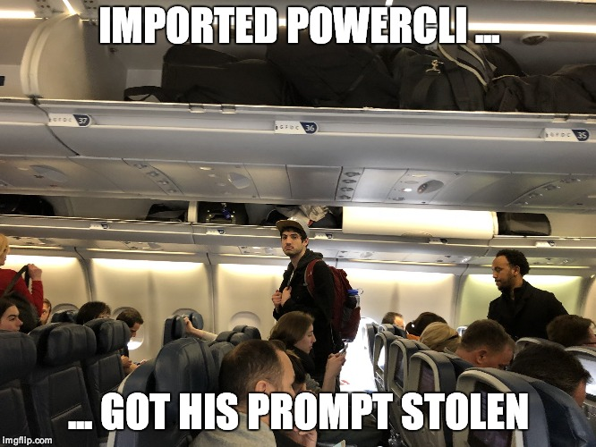
9) Things that make Joey sad

Slide 20
9) Things that make Joey sad
Interfering with user preferences
Prompt
Console Settings
Color Scheme
Preventing user choice
Disabling options
Hardcoding Colors

Slide 21
9) Things that make Joey sad
Interfering with other modules
Overriding commands*
Locking Resources*
→ Be polite to users and modules

Slide 22
10) The Need for Speed
Module import time
Build into fewest files possible
Optional dotsourcing vs. Invoking scriptblock
Command execution time
Caching
Optimize resource use
Measure execution time

Slide 23
10) The Need for Speed
DEMO

Slide 24
Summary
User Experience is a game of 1000 Caresses
Intuitive to use is critical
Documentation and support is an important component of the user experience

Slide 25
Next Steps
Now: 15 min break
Grab a coffee
Stay here to enjoy next presentation
Change track and switch to another room
Ask me questions or meet me in a breakout session room afterwards

Slide 26
Questions?

Slide 27
about_Author
Fred
PowerShell / devops consultant
(Friedrich Weinmann)
Twitter: @FredWeinmann
Github: FriedrichWeinmann
Email: friedrich.weinmann@powershell-stuttgart.de
Slack (PowerShell / SQL Community): Fred
PSFramework Project
PSFramework | PSUtil | PSModuleDevelopment
Owner
http://psframework.org
SQL Collaborative Project
dbatools | dbachecks
Infrastructure Architect
https://dbatools.io | https://dbachecks.io

