Slide 1
Making JEA Great Again
(And Accessible while we're at it)
Fred

Slide 2

Many thanks to our sponsors:

Slide 3

Fred
Cloud Solution Architect @Microsoft
Projects
PSFramework
Active Directory Management Framework
PSAzureMigrationAdvisor
…
Gamer, Reader, Barkeeper
Notes:
- https://github.com/FriedrichWeinmann

Slide 4
Agenda
Intro
Creating JEA Endpoints
Managing JEA Endpoints
Deploying at Scale

Slide 5
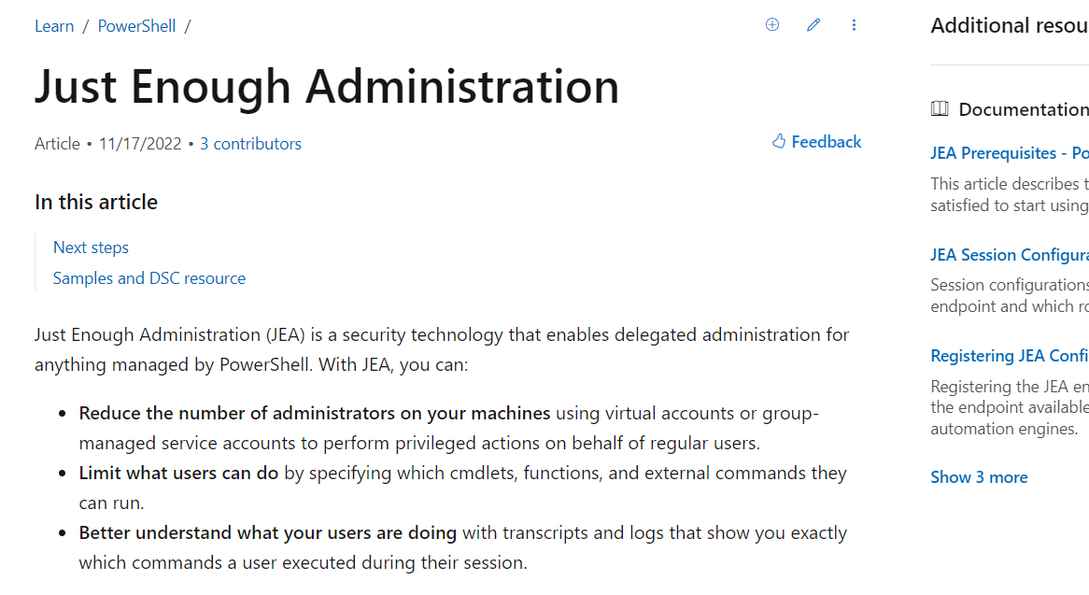
Hitting the docs
Notes:
https://learn.microsoft.com/en-us/powershell/scripting/learn/remoting/jea/overview?view=powershell-7.3

Slide 6
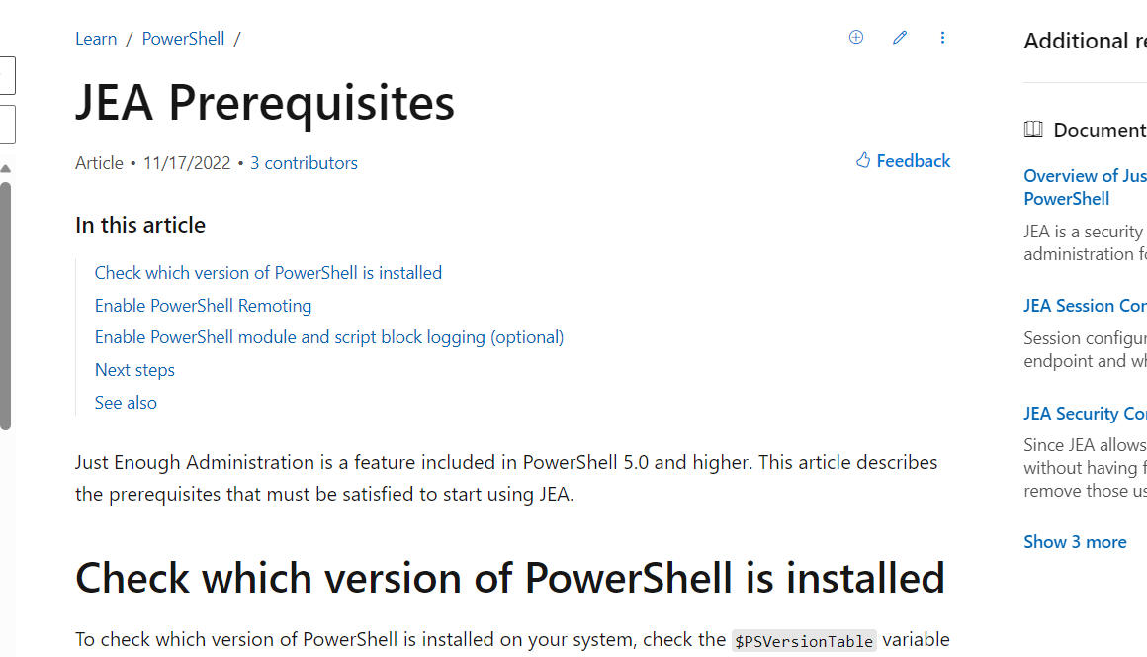
Hitting the docs
Notes:
https://learn.microsoft.com/en-us/powershell/scripting/learn/remoting/jea/overview?view=powershell-7.3

Slide 7
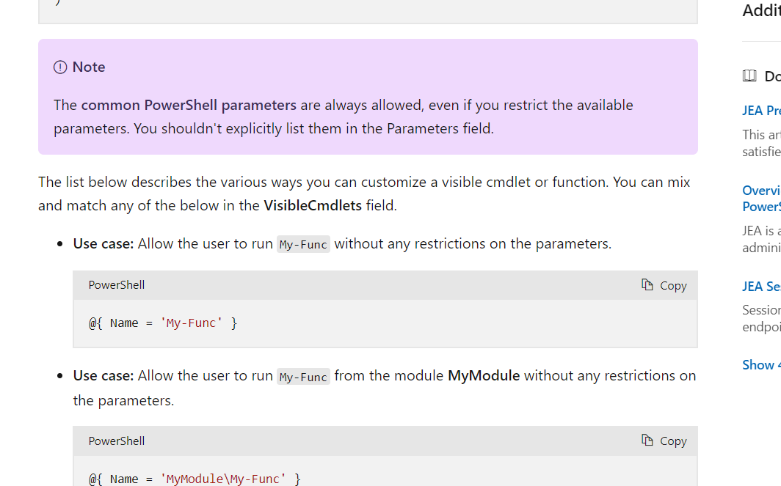
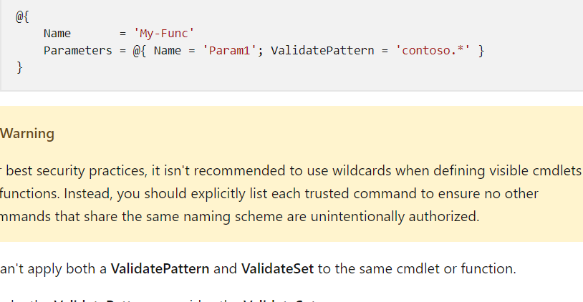
Hitting the docs
Notes:
https://learn.microsoft.com/en-us/powershell/scripting/learn/remoting/jea/overview?view=powershell-7.3

Slide 8

Hitting the dogs
Notes:
https://learn.microsoft.com/en-us/powershell/scripting/learn/remoting/jea/overview?view=powershell-7.3

Slide 9
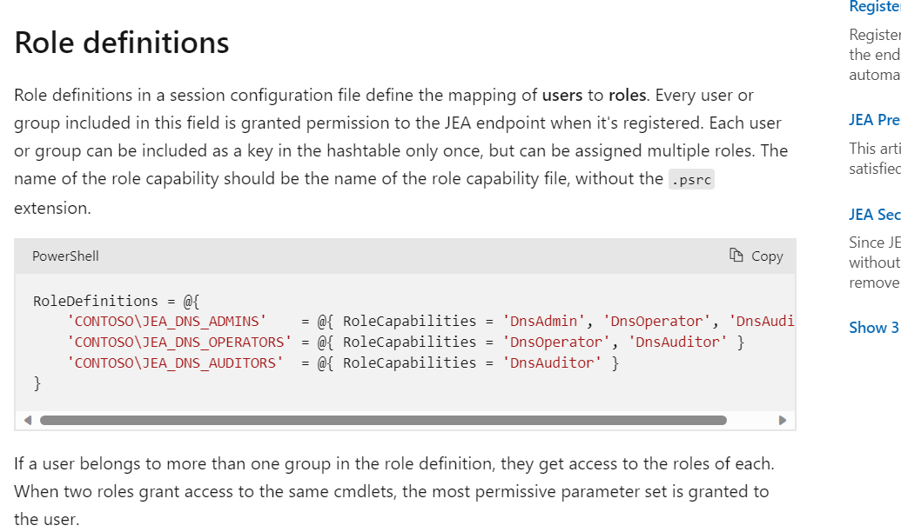
Hitting the docs
Notes:
https://learn.microsoft.com/en-us/powershell/scripting/learn/remoting/jea/overview?view=powershell-7.3

Slide 10
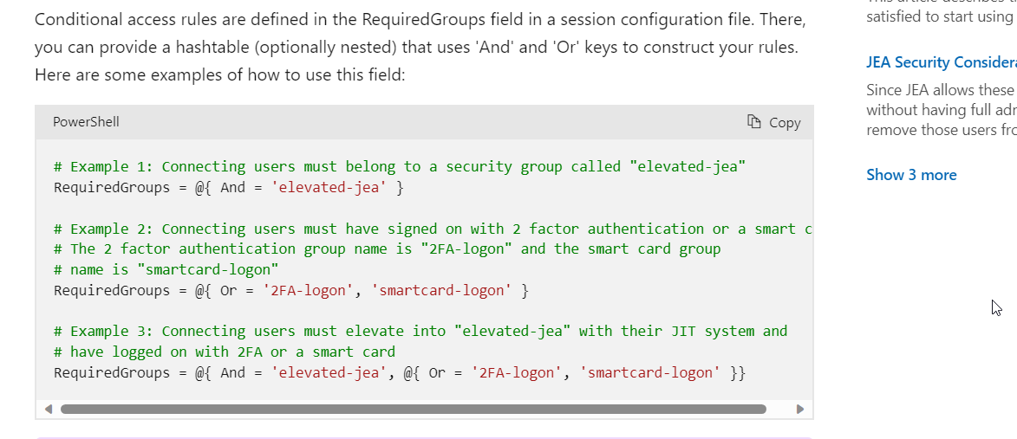
Hitting the docs
Notes:
https://learn.microsoft.com/en-us/powershell/scripting/learn/remoting/jea/overview?view=powershell-7.3

Slide 11
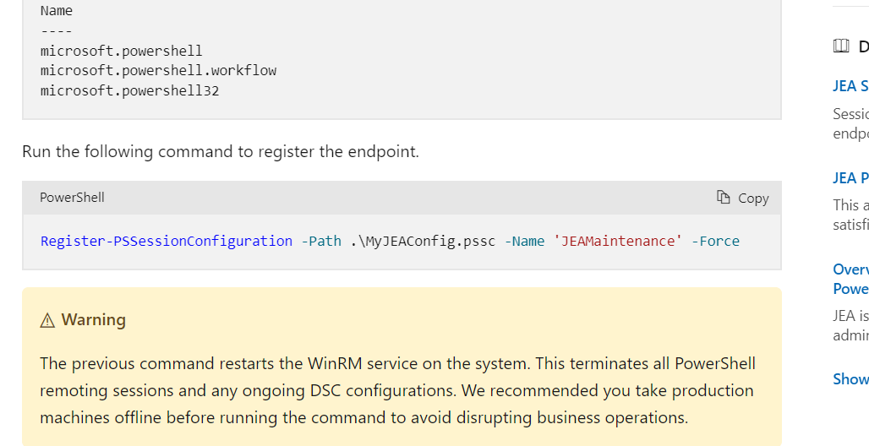
Hitting the docs
Notes:
https://learn.microsoft.com/en-us/powershell/scripting/learn/remoting/jea/overview?view=powershell-7.3

Slide 12
It works, but …
… what now?

Slide 14
Q&A
15 minutes

