Slide 1
PowerShell Module Mass Production
Templating in the Field
Fred
@FredWeinmann

Slide 2
about_speaker
Name: Fred
Job: Cloud Solution Architect @MSFT
Hobbies: Gaming, Reading, Bartending, Bragging about my toys
PS Discord: Fred (#psframework)
Toys:
PSFramework (https://psframework.org)
Active Directory Management Framework (https://admf.one)
Github (https://github.com/FriedrichWeinmann)

Slide 3
Agenda
Module Solution Reference Architecture
Templating Engine vs. Module Solution
Templating Engines
Module Solutions

Slide 4
Module Solution Reference Architecture
Framework Layer
Data Layer
Solution Layer
Process Layer
API Layer

Slide 5
Module Solution Reference Architecture
Project 1
Framework Layer
Data Layer
Solution Layer
Process Layer
API Layer

Slide 6
Module Solution Reference Architecture
Project 2
Framework Layer
Prod
QA
Dev

Slide 7
Module Solution Reference Architecture
Project N
Framework Layer

Slide 8
Templating Engine vs. Module Solution
Project Type 1
Project Type 2
Standalone
Project
Generator
Engine
Notes:
Engine != Module Solution
PSModuleDevelopment: Solutions already built in
Stucco & Plaster: Solution provided independently
Sampler: Solution without exposed engine

Slide 9
Templating Engines
Notes:
Plaster
PSModuleDevelopment
Dotnet
Reinvent the Wheel (but shinier!)

Slide 10
Scope of Use & Complexity
One Person
Group
Organization
People
Beginners
Mixed
Experts
Skill
Full Time
Part Time
Dev Time
Notes:
Who is writing templates?
How complex to use can the engine be?

Slide 11
Sticks & Stones
Time to Carrot
Size of Stick
Depth of Lake
Notes:
Effort needed to get result
Time to win
Flexibility & Extensibility

Slide 12
Capabilities
PS Modules
PS Anything
Any Language
Dynamic Content
Dynamic Files
Special File Types?
Unattended?
Template Nesting?
…

Slide 13
Distribution of Templates
PowerShell Gallery
Other Repository
Import Command
Policy
Git
Engine Only

Slide 14
Module Solutions
Notes:
PSModuleDevelopment – MiniModule / PSFProject
Stucco (Based on Plaster)
Sampler (Standalone)

Slide 15
Dependencies
At Generation
At Build
At Finished Module

Slide 16
Automation (CI/CD)
How?
What?
Platform Specific
Dependencies
Agnostic
Testing
No Automation
Build
Release

Slide 17
Testing
General Code Testing
Best Practices
Unit Tests
Help
Code Coverage
Syntax
☹ Linting ☹
…
Notes:
Custom Requirements: Blacklisting commands, encoding, manifest …

Slide 18
Build
Compile to single file?
Debugging in the field?
Manifest
Version
Commands to export
Importable without Build?

Slide 19
<DEMO>

Slide 20
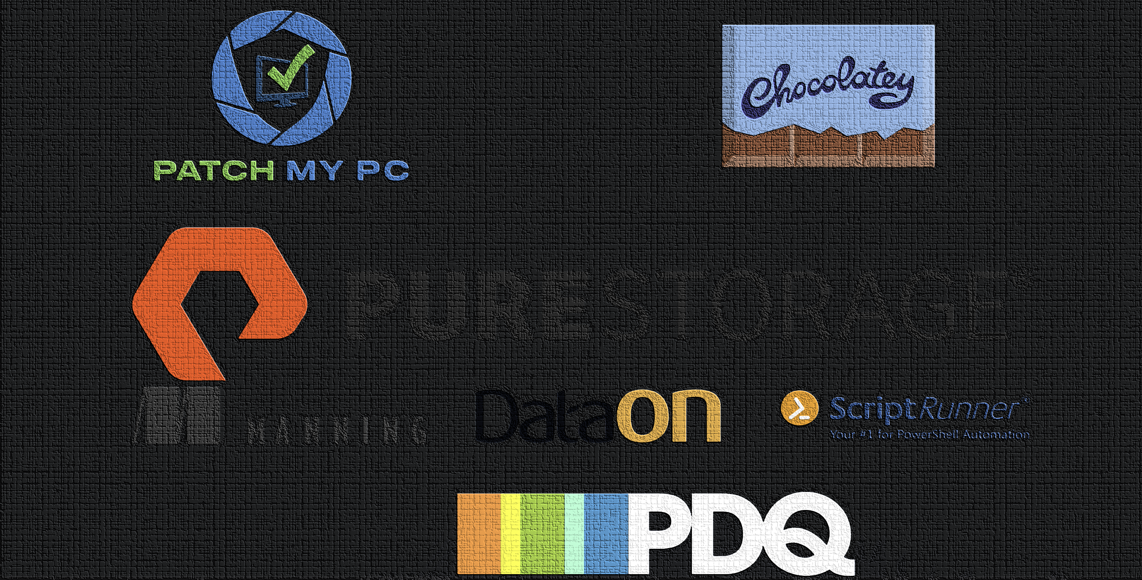

Slide 21

THANK YOU
Please review this session

