Slide 1
Active Directory Management Framework
An Introduction

Slide 2

about_speaker
Name: Fred
Cloud Solution Architect @MSFT
GitHub: github.com/FriedrichWeinmann
Twitter: @FredWeinmann
PS Discord / PS Slack: Fred
Projects: PSFramework.org | admf.one

Slide 3
Scope

Slide 4
In Scope:
Deploy & Manage Topology
Green Field
Brown Field
Latrine
Continual Process
Execute Project
Analyze for Best Practices*
Compromise Recovery
Security Policy Management
Delegation Analysis
Documenting Change
Logging**
Single Domain & Forest
Hundreds of Forests
Local Execution
Bastion Forest

Slide 5
Out of Scope:
Daily operations
Regular user accounts
Client computers
Other items in constant flux
Auditing Actual Change

Slide 6
The Problem

Slide 7
Changelog: Active Directory in Server 2022
…
Notes:
Administrative Practices have changed about the same amount

Slide 8
Changelog: Active Directory in Server 2025
Performance Improvements
Improved Monitoring
Security Enhancements
[More Details]

Slide 9
Active Directory Projects
Manual Labor
Architect
Production Environment
Test Environment
Automation
Tools
The Plan

Slide 10
On the topic of Environments …
Production Environment 2
Production Environment 3
!=
Test Environment
Production Environment
Production Environment 4
Production Environment 5

Slide 11

Once upon a time …
The Plan
Notes:
Two Years Later
Plan only documentation, but environment moved on

Slide 12


Custom Development / Scripting

Slide 13

Consequences
"Wrong" Author
Redundant Code
Incompatibility
High Maintenance
Lengthy Projects

Slide 14
The new Workflow

Slide 15
The Management Process
Test Environment
Test
Apply
ADMF
Changes
Test
Architect
The Plan
Apply
Production Environment
Test
Apply
Changes
Production Environment 1
Changes
Production Environment n

Slide 16
Architecture

Slide 17
Contexts
Prod
Hyper-V
Forest
Contoso
Default
QA
Root Domain
Dev
Break Glass
Child Domain

Slide 18
The Context
Context A
GPO
Schema
Extension
Access Rules
Dependencies
Mutual
Exclusion
User
Sites
GP Link
Other
Metadata
Groups
OUs
…

Slide 19
Combining multiple Contexts
Schema Ext.
GPO
Groups
Access Rules
Group Member

Slide 20
Turning code
New-ADUser -SamAccountName 'Captain.Microsoft' `
-GivenName 'Mark' `
-Surname 'Russinovich' `
-Description “They might call it the cloud but it is, in fact, just someone else’s computer."
-PasswordNeverExpires $false
-Path "OU=Users,DC=contoso,DC=com"
-UserPrincipalName Captain.Microsoft@contoso.com

Slide 21
Turning code into configuration
{
"SamAccountName": "Captain.Microsoft",
"GivenName": "Mark",
"Surname": "Russinovich",
"Description": "They might call it the cloud but it is, in fact, just someone else’s computer.",
"Path": "OU=Users,DC=contoso,DC=com",
"UserPrincipalName": "Captain.Microsoft@contoso.com"
}

Slide 22
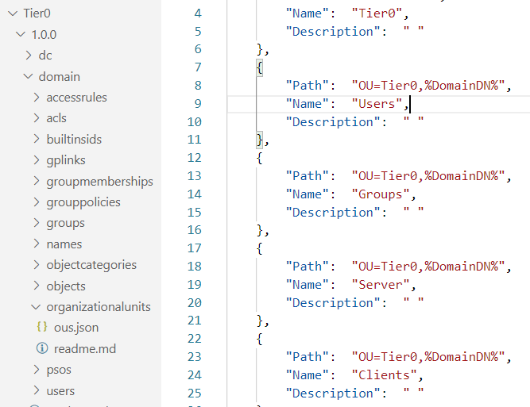
Turning code into configuration that scales

Slide 23
Demo

