Slide 1
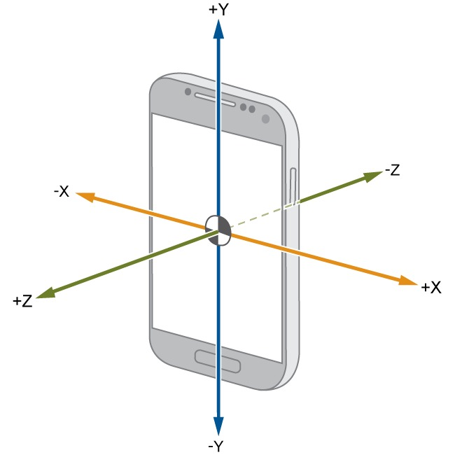
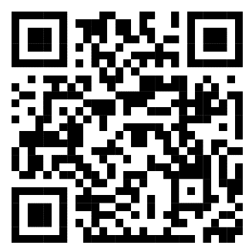

Read out your Phone Sensors with MATLAB
Wednesday, June 29th, 2022 16:30 – 19:00 CET
TUM Campus Garching - MW Building Room to be announced after registration
Who Should Attend
TUM students (all disciplines)
Basic knowledge in MATLAB is required. If necessary, we recommend taking MATLAB Onramp (link in QR Code)
You will need to bring a computer and a mobile device (Android or iOS)
MATLAB® should be installed on your computer before the event (installation instructions in the QR code)
Please also install the MATLAB App on your mobile device
What You’ll Learn
How to connect your phone with MATLAB
How to use data from sensors such as accelerometer and gyroscope through iterative projects
How to estimate your phone's orientation in 3D
Register at linkin.bio/matlab-tum
3 Amazon Gift Cards
(25, 15 and 10 €) and
MATLAB Goodies Raffle!
Notes:
Long Option #3
The first column features a sub-heading with 4-5 bullets underneath. Each bullet can only be a max of 45 characters including spaces.
The second column features another sub-heading with 3–4 bullets underneath. Each bullet can only be a max of 45 characters including spaces.
The registration (or a different CTA) link will be placed above the footer in the first column

Slide 2








































































































Notes:
Icons available to use for your posters

