Slide 1
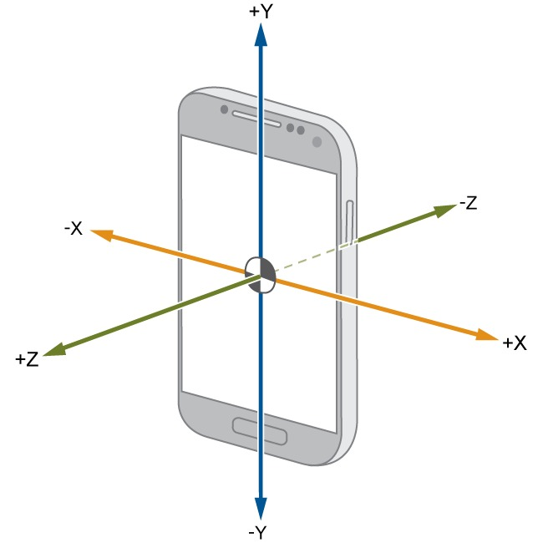
Read out your Phone Sensors with MATLAB
Paola Canuto, Samuel Zeitler
29.06.2022

Slide 2
Today:
5:00 pm – 5.15 pm: Set-up
Intro
Create MathWorks account
Download Simulink Onramp
5.15 pm – 6.45 pm: Simulink Onramp
6.45 pm – 7.00 pm: Prize Draw

Slide 3
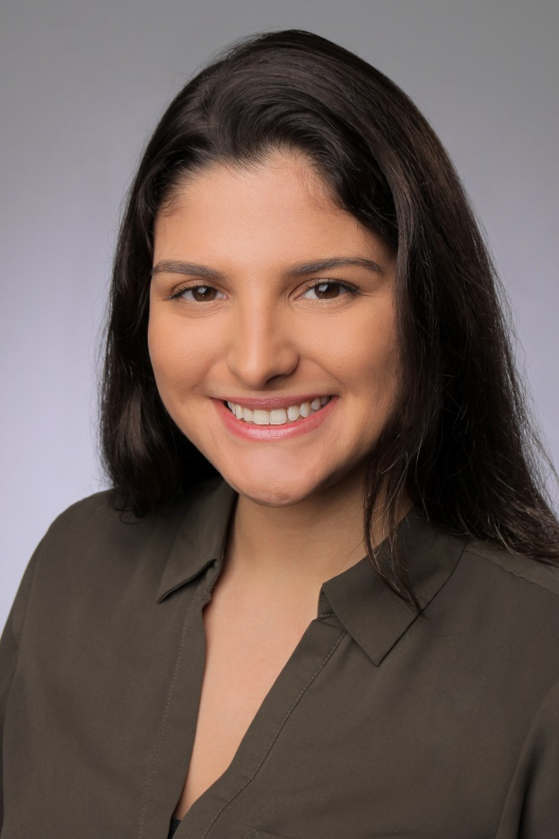
Event Hosts: MATLAB Student Ambassadors
Paola Canuto
M.Sc. Automotive Engineering Student
Barlas Türkyilmaz
M.Sc. Aerospace Student

Slide 4

Stud|Lab
We are a student group at the TU Munich working with MATLAB & Simulink. We offer tutorials and help with concrete problems.
You are also welcome to program with us during our consultation hours.
Consulting hours: Thursday from 5:00 p.m. to 6:00 p.m. via Zoom.
Homepage: http://www.fsmb.de/fsmb/uebers-studium/it/matlab/
E-Mail: studlab.tum@gmail.com
If you haven't done it yet,
follow our Instagram account
@matlab.tum

Slide 5
To Do
Use your MATLAB account data (ab12xyz@matlab.rbg.tum.de)
Log in here and join the TUM group:
https://mathworks.force.com/MATLABAmbassadorCommunity/s/
Download and extract zip folder

Slide 6
Introduction

Slide 7
Mobile Sensors
Acceleration [m/s²]
X, Y, Z
Magnetic Field [µT]
X, Y, Z
Orientation [º]
Pitch (X), Roll (Y), Azimuth/Yaw (Z)
Angular Velocity [rad/s]
X, Y, Z
Position
Latitude, Longitude, Course [º]
Speed [m/s]
Altitude [m]
Horizontal Accuracy [m]
…

Slide 9
Project 1: Sensor Fusion for Orientation Estimation

Slide 10
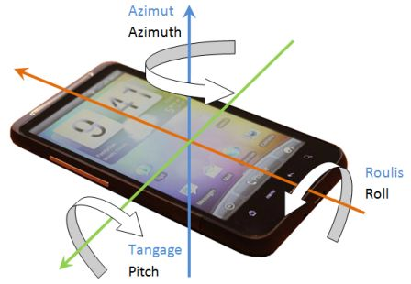
Orientation Estimation
Roll, Pitch and Yaw Angles
Orientation Sensor
“The orientation sensor derives its data by processing the raw sensor data from the accelerometer and the geomagnetic field sensor. Because of the heavy processing that is involved, the accuracy and precision of the orientation sensor is diminished. Specifically, this sensor is reliable only when the roll angle is 0.”

Slide 11
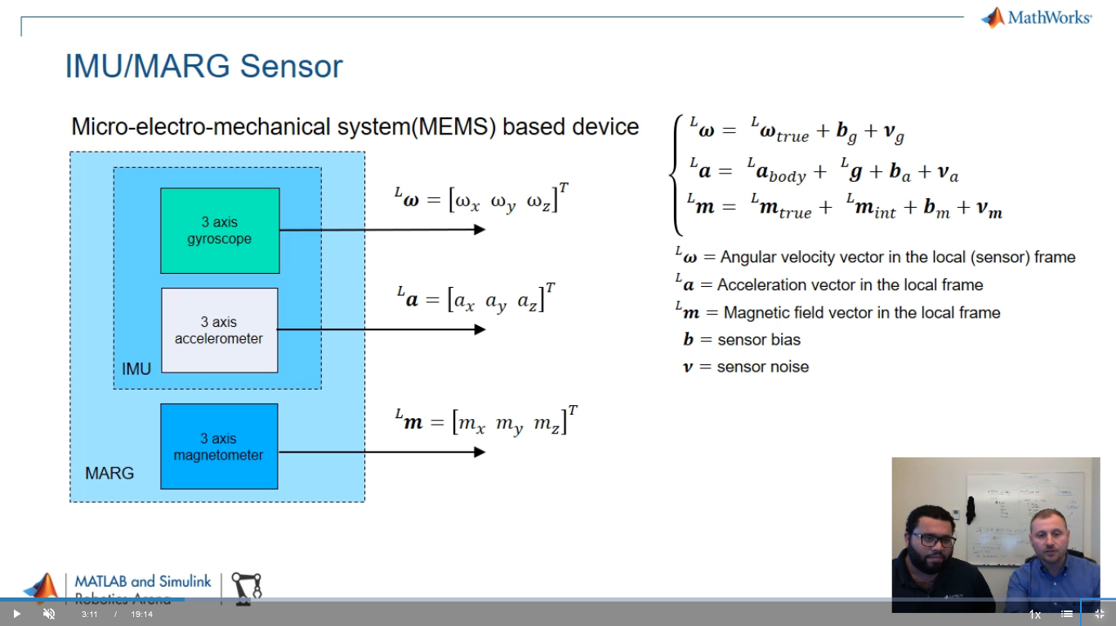
IMU/MARG Sensor

Slide 12
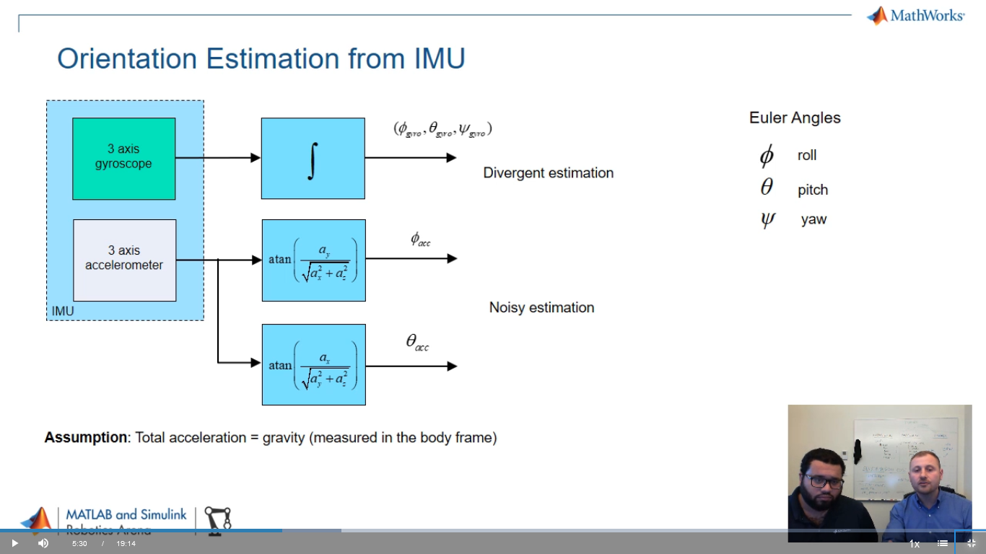
Orientation Estimation from IMU

Slide 13
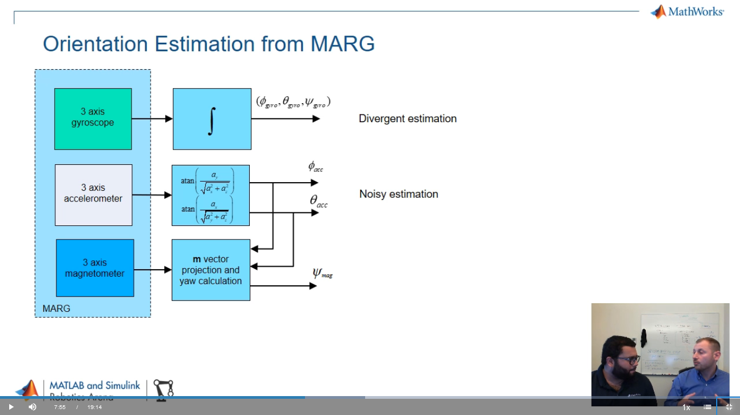
Orientation Estimation from MARG

Slide 14
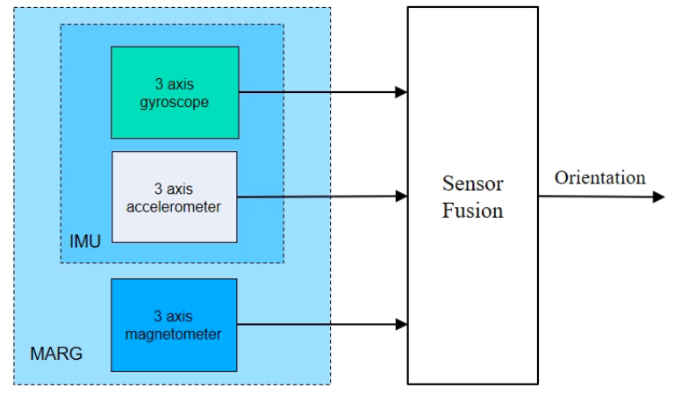
Sensor Fusion for Orientation Estimation

Slide 15
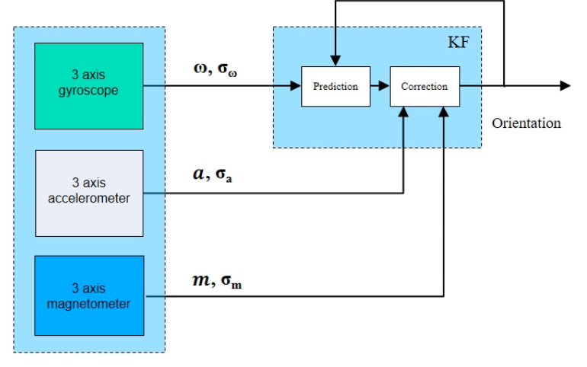
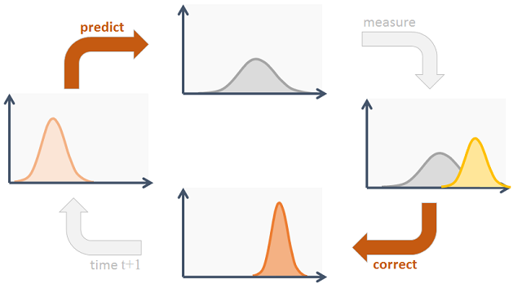
Sensor Fusion: Kalman Filter

Slide 16
Task Statement
In the IMU file you find a ready-made example of orientation estimation using the Sensor Fusion and Tracking Toolbox and data from the accelerometer and gyroscope.
At the end, you can see the results of the estimations made by the mobile device itself and by MATLAB.
Make the necessary changes to the code to use MARG (accelerometer, gyroscope and magnetometer) in the AHRS file.

Slide 17
Using the Corporate Template
Avoid manually formatting whenever possible. Instead, use built-in styles, templates, layouts, and colors.
When creating new presentations, select the slide layout that best suits your needs from the built-in theme, then add content.
When creating custom shapes, text boxes, and other elements, start from scratch rather than reformatting template shapes.
When applying the new template to existing presentations, review your presentation carefully and manually adjust any formatting issues that have occurred. For additional help, contact Creative Services.
V22.0 Delete this slide before finalizing your presentation.

Slide 18
Color Palette
MathWorks Brand Colors
The corporate colors are included in the Theme Colors of this PowerPoint file; the primary brand colors and HEX values are shown below. For more colors such as utility and neutral colors, visit the brand guide Color Palette.
MATLAB Code Colors
Below are the color values for MATLAB code. They are not included in this file’s default Color Themes due to limited colors, but you can either enter the values below or use the Eyedropper or Format Painter to copy and apply them.
PRIMARY COLORS
REGULAR CODE
HEX: 000000
RGB: 0, 0, 0
KEYWORD
HEX: 0000ff
RGB: 0, 0, 255
HEX: 0076A8
HEX: D78825
STRING
HEX: A020F6
RGB: 160, 32, 240
COMMENT
HEX: 228B22
RGB: 34, 139, 34
SECONDARY COLOR
WARNING
HEX: FF6400
RGB: 255, 100, 0
ERROR
HEX: FF0000
RGB: 255, 0, 0
HEX: 004B87
V22.0 Delete this slide before finalizing your presentation.

