Slide 1
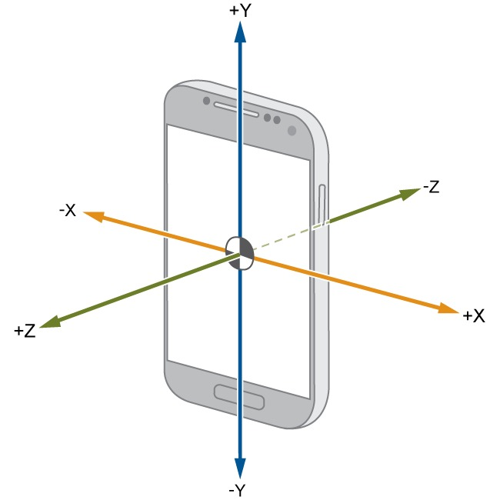
Read out your Phone Sensors with MATLAB
Paola Canuto, Samuel Zeitler
29.06.2022

Slide 2
Today:
4.30 pm – 4.50 pm: Set-up
Intro
Create MathWorks account
Download Scripts
4.50 pm – 6.45 pm: Read out your Phone Sensors with MATLAB Workshop
Project 1: Introduction to the Smartphone Coordinate System
Project 2: Sensor Fusion for Orientation Estimation
Project 3: Read your Phone Sensors with Simulink
6.45 pm – 7.00 pm: Prize Draw
Amazon Gift Cards (25, 15 and 10 EUR)
T-Shirts
Playing Cards, Bags, Caps, Sunglasses

Slide 3
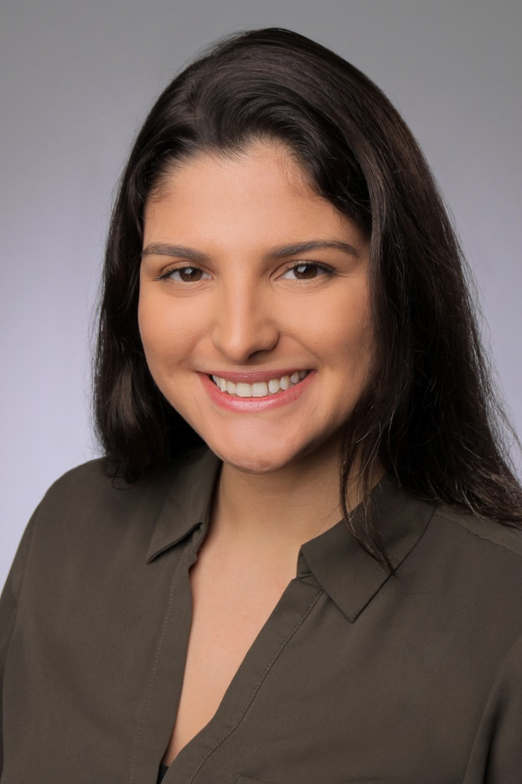

Event Hosts: MATLAB Student Ambassadors
Paola Canuto
M.Sc. Automotive Engineering Student
Samuel Zeitler
M.Sc. Mechatronics and Robotics Student

Slide 4
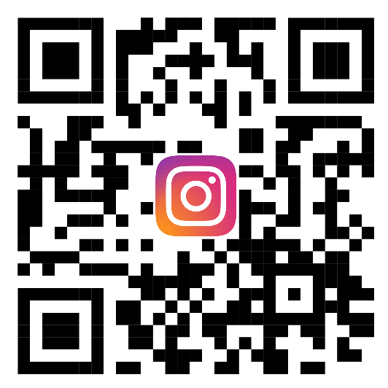
Stud|Lab
We are a student group at the TU Munich working with MATLAB & Simulink. We offer tutorials and help with concrete problems.
You are also welcome to program with us during our consultation hours.
Consulting hours: Thursday from 5.00 p.m. to 6.00 p.m. via Zoom.
Homepage: http://www.fsmb.de/fsmb/uebers-studium/it/matlab/
E-Mail: studlab.tum@gmail.com
If you haven't done it yet,
follow our Instagram account
@matlab.tum

Slide 5
To Do
Use your MATLAB account data (ab12xyz@matlab.rbg.tum.de)
Log in here and join the TUM group:
https://mathworks.force.com/MATLABAmbassadorCommunity/s/
Download and extract zip folder mobile_sensor_workshop

Slide 6
Introduction

Slide 7
Mobile Sensors
Acceleration [m/s²]
X, Y, Z
Magnetic Field [µT]
X, Y, Z
Orientation [º]
Pitch (X), Roll (Y), Azimuth or Yaw (Z)
Angular Velocity or Gyroscope [rad/s]
X, Y, Z
Position
Latitude, Longitude, Course [º]
Speed [m/s]
Altitude [m]
Horizontal Accuracy [m]
Barometer, Proximity Sensor…

Slide 8
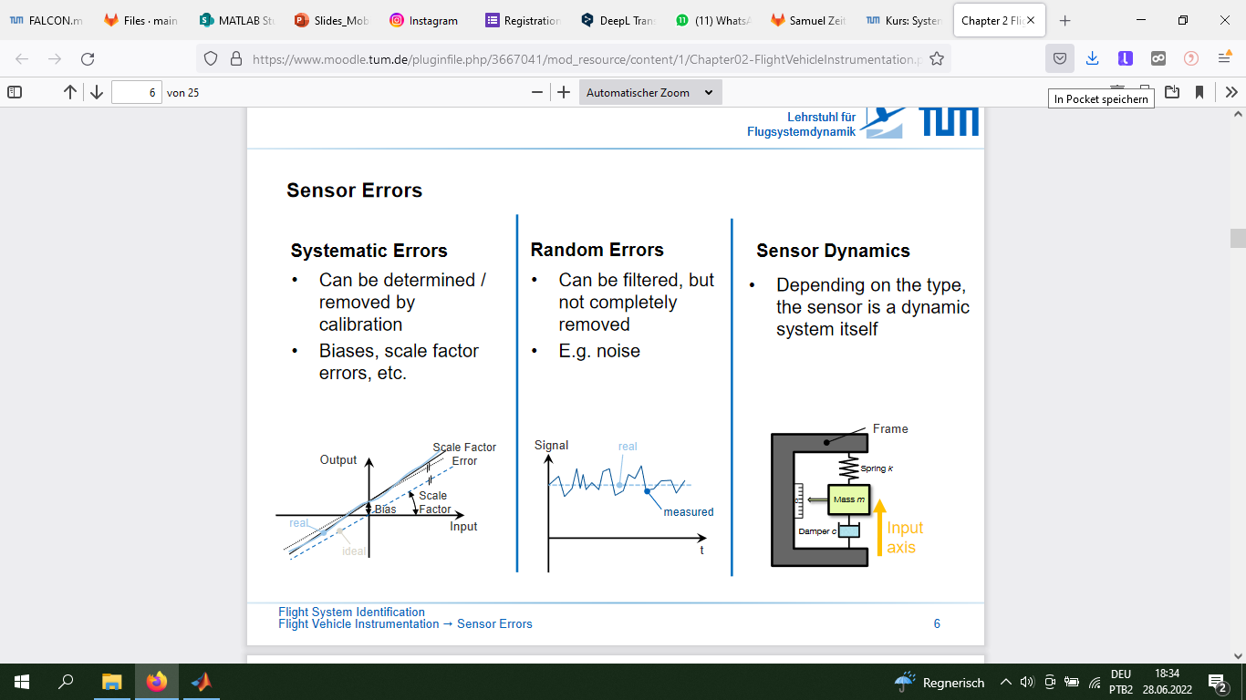
Sensors Errors (Flight System Identification Lecture)
Systematic Errors
Can be determined /removed by calibration
Biases, scale factor errors, etc
Random Errors
Can be filtered, but not completely removed
E.g. noise

Slide 9
Project 1: Introduction to the Smartphone Coordinate System and Working with the Sensor Data from Smartphone
Task 1: smartphone_coordinates.mlx
Task 2: smartphone_sensors.mlx

Slide 10
Project 2: Sensor Fusion for Orientation Estimation

Slide 11
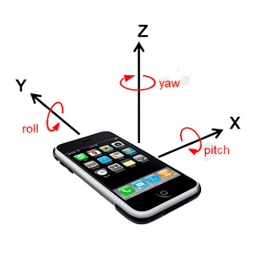
Orientation Estimation
Roll, Pitch and Yaw Angles
Orientation Sensor
“The orientation sensor derives its data by processing the raw sensor data from the accelerometer and the geomagnetic field sensor. Because of the heavy processing that is involved, the accuracy and precision of the orientation sensor is diminished. Specifically, this sensor is reliable only when the roll angle is 0.”

Slide 12
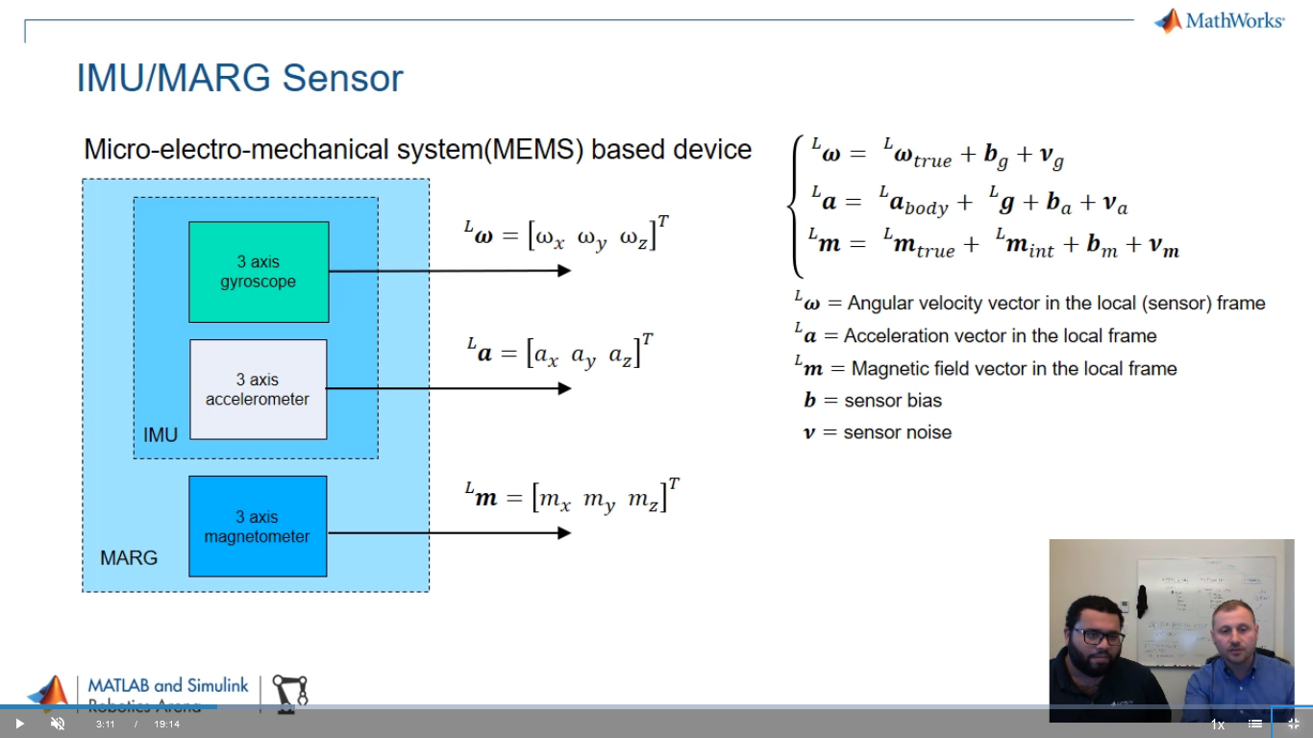
IMU/MARG Sensor

Slide 13
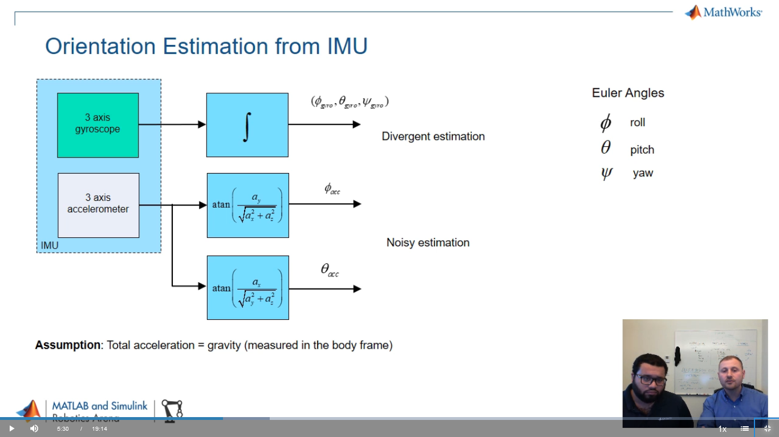
Orientation Estimation from IMU

Slide 14
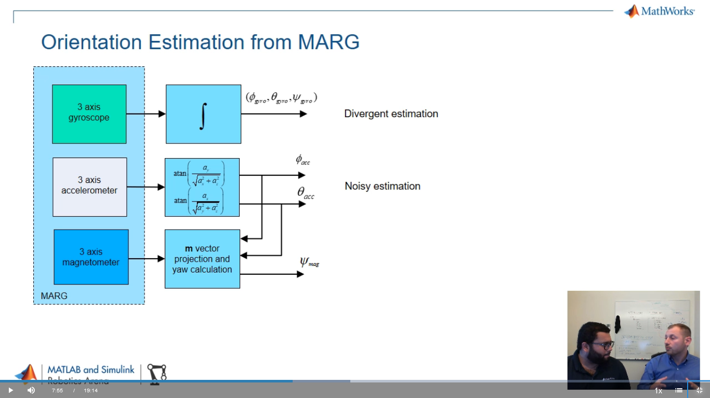
Orientation Estimation from MARG

Slide 15
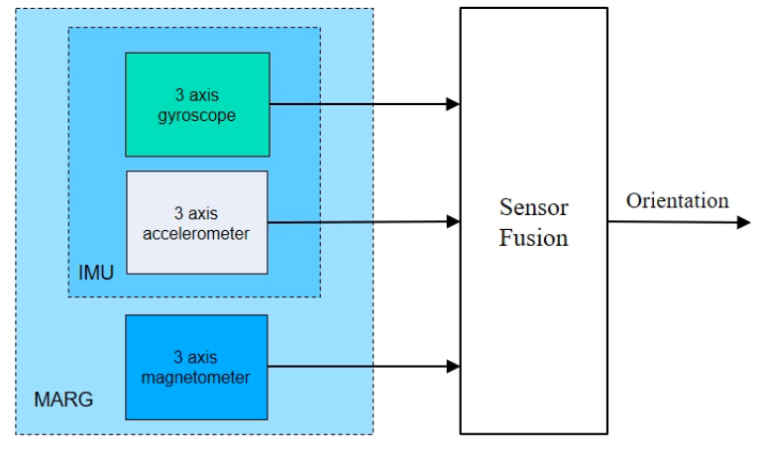
Sensor Fusion for Orientation Estimation

Slide 16
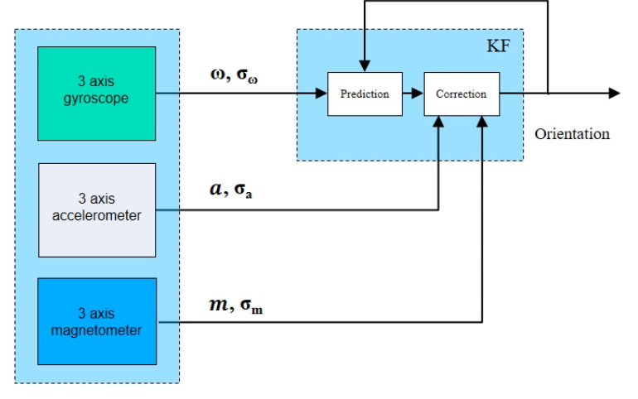
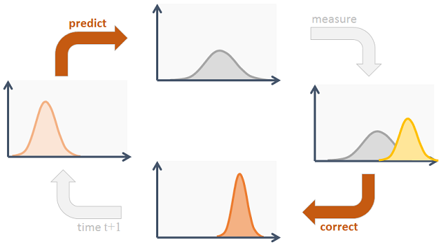
Sensor Fusion: Kalman Filter

Slide 17
Task Statement
In the IMU file you find a ready-made example of orientation estimation using the Sensor Fusion and Tracking Toolbox and data from the accelerometer and gyroscope.
At the end, you can see the results of the estimations made by the mobile device itself and by MATLAB.
Make the necessary changes to the code to use MARG (accelerometer, gyroscope and magnetometer) in the AHRS file.

Slide 18
Project 3: Read your Phone Sensors with Simulink

Slide 19
Raffle
Open the link2raffle.txt file in the mobile_sensor_workshop folder
Go to the link and you will access a form
Enter your name, TUM email and a number between 100000 and 999999 (6 digits)
Good Luck!

