Slide 1
Hello! My name is
Josiah Gipson
In this presentation I am going to
go over fire detection data in the US

Slide 2
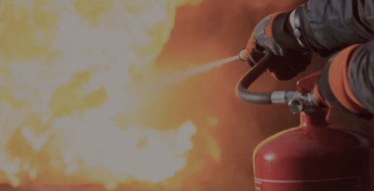
Why fires?
Well fires can be dangerous, and it is always helpful to know when and where fires happen;
And I found they can happen almost anywhere.

Slide 3
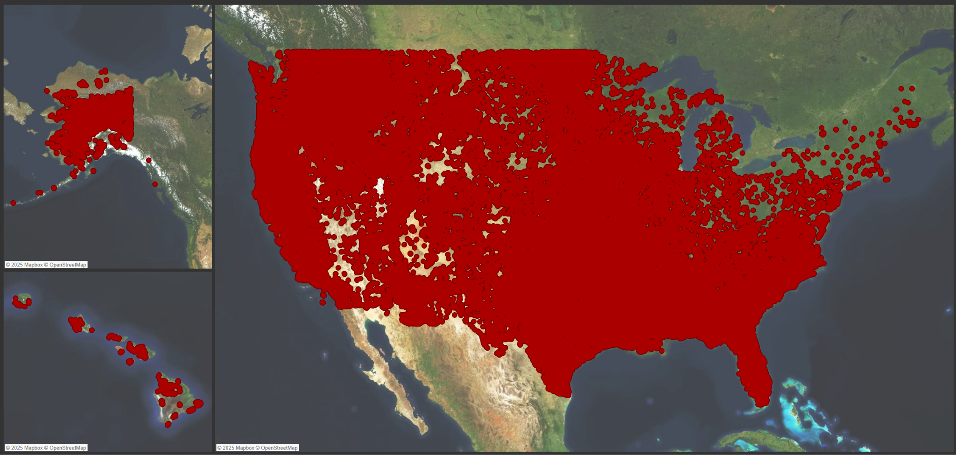
Below you can see detected fires in the US since the year 2000
And it shows how almost nowhere is safe from fire.

Slide 4
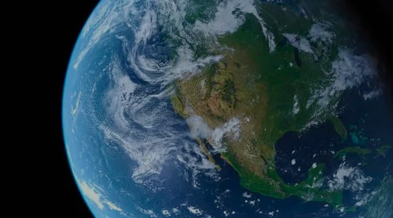
Now before I go into a deeper geographical and temporal analysis of where and when fires happen, I want to talk to you about FIRMS.

Slide 5
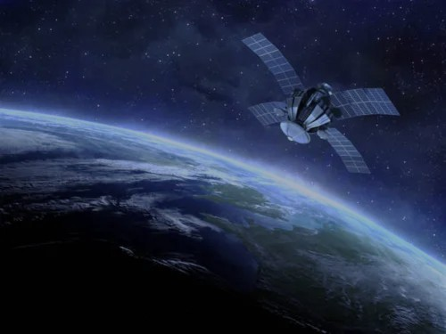
FIRMS stands for “Fire Information for Resource Management System”, and it is hosted by NASA. It is also the source for my data.

Slide 6
The data I used for this presentation was limited to the US, and has nearly 3 Million entries.

Slide 7
How does FIRMS work?:
FIRMS provides near real time fire detection data from satellites
It has two main types of sensors MODIS and VIIRS
The sensors detect when there is a thermal anomaly, usually from infrared radiation
When the thermal anomaly persits for an amount of time it detects a fire

Slide 8
When a fire is detected it is also associated with a confidence level that has a value from 0 to 100 which is grouped into High(greater than 80), Nominal/Normal(greater than 30), and Low(under 30), and I wanted to know what related to that confidence level, and if I could predict it based off of the other data in the dataset.

Slide 9

My methods
Models: Linear regression,
Logistic regression,
Polynomial features,
Random Forest Regressor,
Random Forest Classifier
Analysis: R2 score,
MSE(Mean square error),
Accuracy score,
Classification report,
Feature importances

Slide 10
What is the difference between models?
The Forests are essentially A collection of decision trees that compare the independent variables to set values. The Regressor is used for numerical values, while the Classifier is used for categorical values
The regression models use mathematical formulas to find the relation between independent and target variables, Linear is for numerical values, while Logistic is for categorical values.

Slide 11
What do the values mean?
R2 score represents how well the model predicts,
MSE represents the average prediction error squared,
Precision is the ratio of correct positives over all predicted positives
Recall is the ratio of correct positives over all actual positives
f1-score is the average of precision and recall

Slide 12
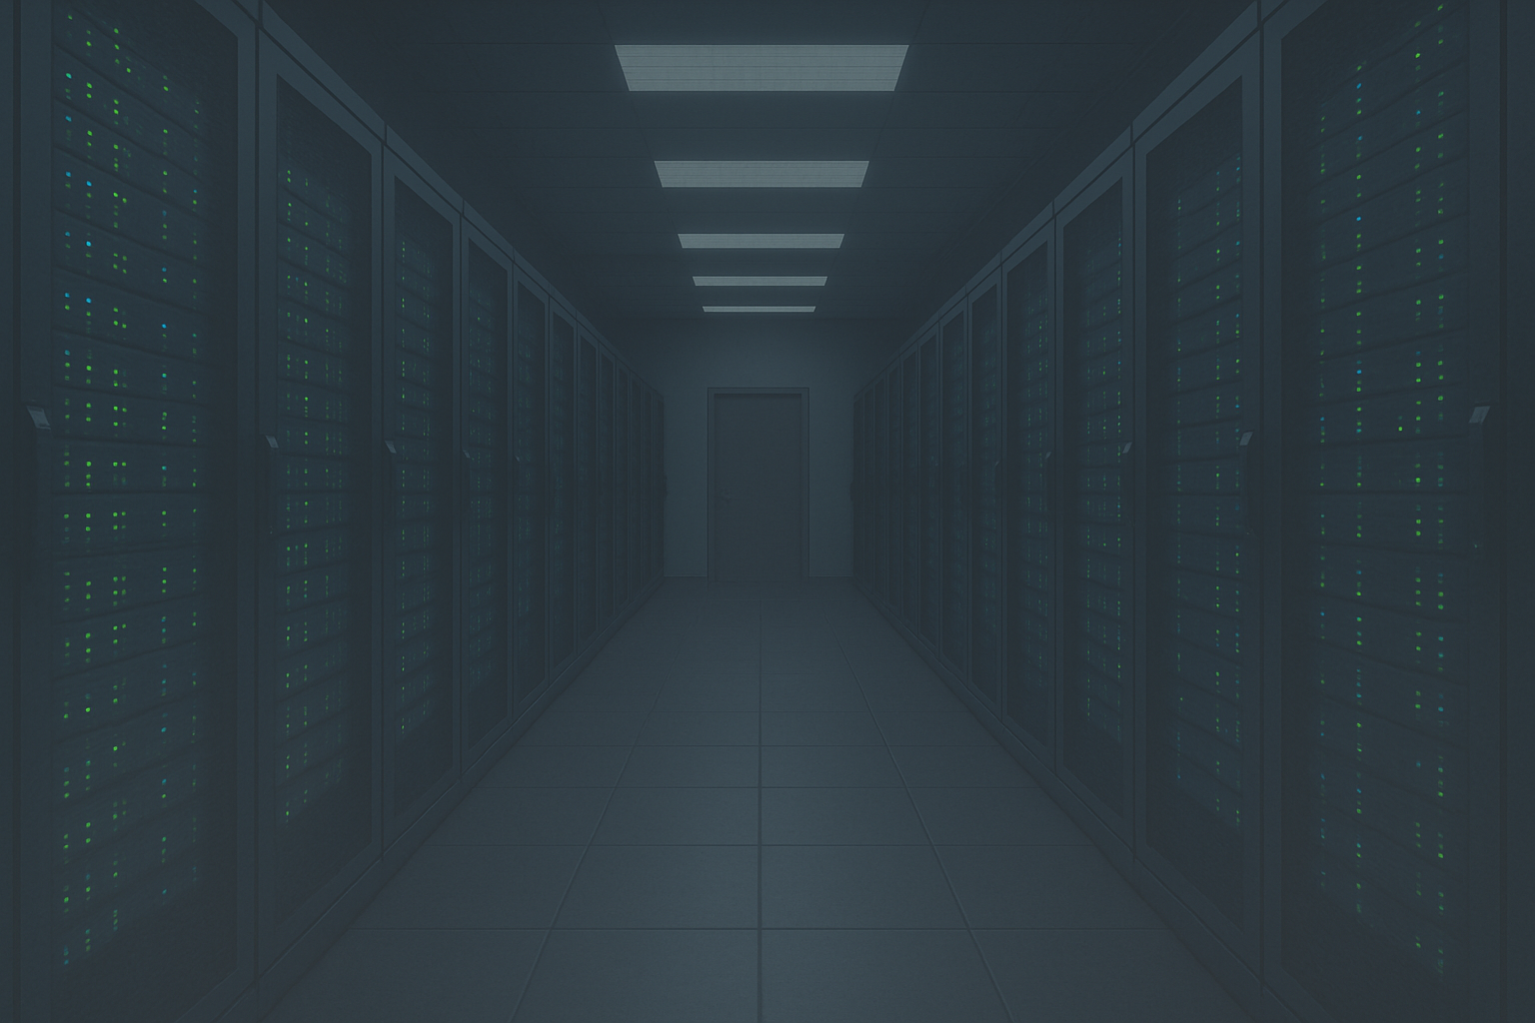
First I made a linear regression model than I added polynomial features for non linear relationships
The normal regression model had a
R2 score of ~0.44, and a MSE of ~0.17
The polynomial regression model had a
R2 score of ~0.57, and a MSE of ~0.15
Numbers rounded for simplicity

Slide 13
Next I made a Random Forest Regressor model
The random forest regressor had a
R2 score of ~0.70, and a MSE of ~0.13
Top feature importances
Brightness at 0.539, and bright_t31 at 0.060
latitude at 0.064, and longitude at 0.068
and frp(Fire Radiative Power) at 0.093
Numbers rounded for simplicity

Slide 14
Next I made a logistic regression and used polynomial features on logistic regression
Logistic regression
Polynomial Logistic regression
precision
recall
f1-score
support
precision
recall
f1-score
support
high
0.86
0.76
0.81
185330
high
0.86
0.67
0.75
185524
nominal
0.81
0.94
0.87
355943
nominal
0.78
0.95
0.86
355483
low
0.00
0.00
0.00
36574
low
0.00
0.00
0.00
36840
accuracy
0.82
577847
accuracy
0.80
577847
Macro avg
0.56
0.57
0.56
577847
Macro avg
0.55
0.54
0.54
577847
Weighted avg
0.79
0.82
0.80
577847
Weighted avg
0.76
0.80
0.77
577847
Numbers rounded for simplicity

Slide 15
And finally I made a Decision Tree Classifier
Decision tree
Top feature importances
precision
recall
f1-score
support
high
0.86
0.85
0.86
185618
nominal
0.87
0.86
0.86
355185
Brightness at 0.527, and bright_t31 at 0.074
latitude at 0.052, and longitude at 0.056
and frp(Fire Radiative Power) at 0.054
low
0.29
0.32
0.30
37044
accuracy
0.82
577847
Macro avg
0.67
0.68
0.67
577847
Weighted avg
0.83
0.82
0.83
577847
Numbers rounded for simplicity

Slide 16
Before we continue are there any questions about the data or the models I made?

Slide 17
Now that the we know about the source of the data let’s go into geographical and temporal analysis

Slide 18
First I want to know when the most fires have happened, and when they are most likely to happen.

Slide 19
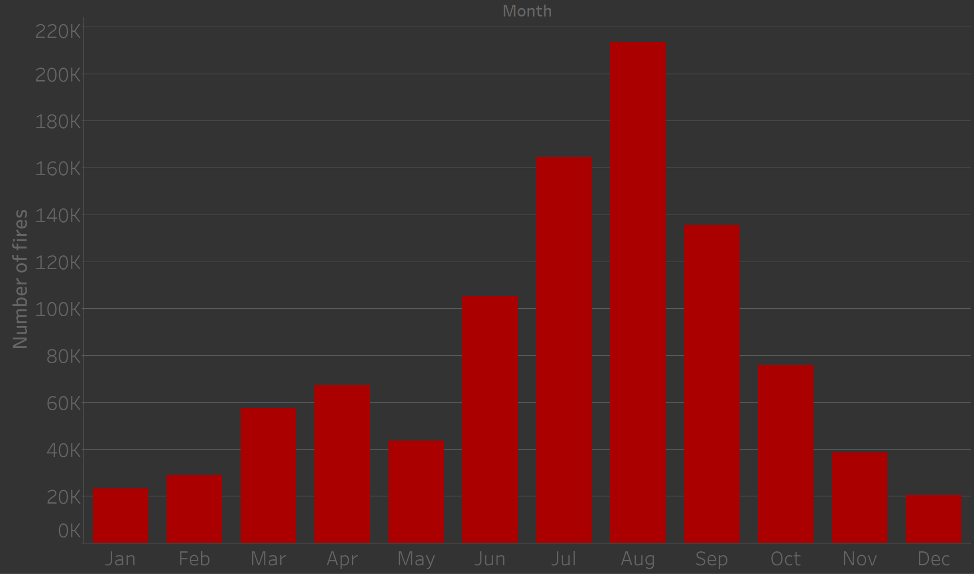
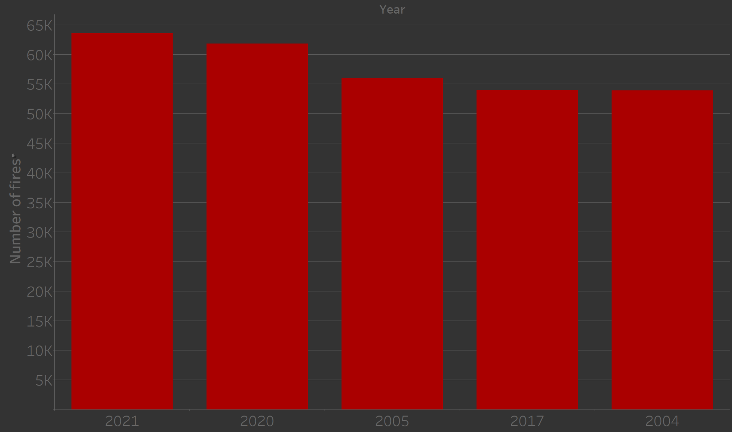
On the left you can see the number of fires for each month, and on the right you can see the top 5 years by number of fires.

Slide 20
Now I want to know where fires happen the most.

Slide 21
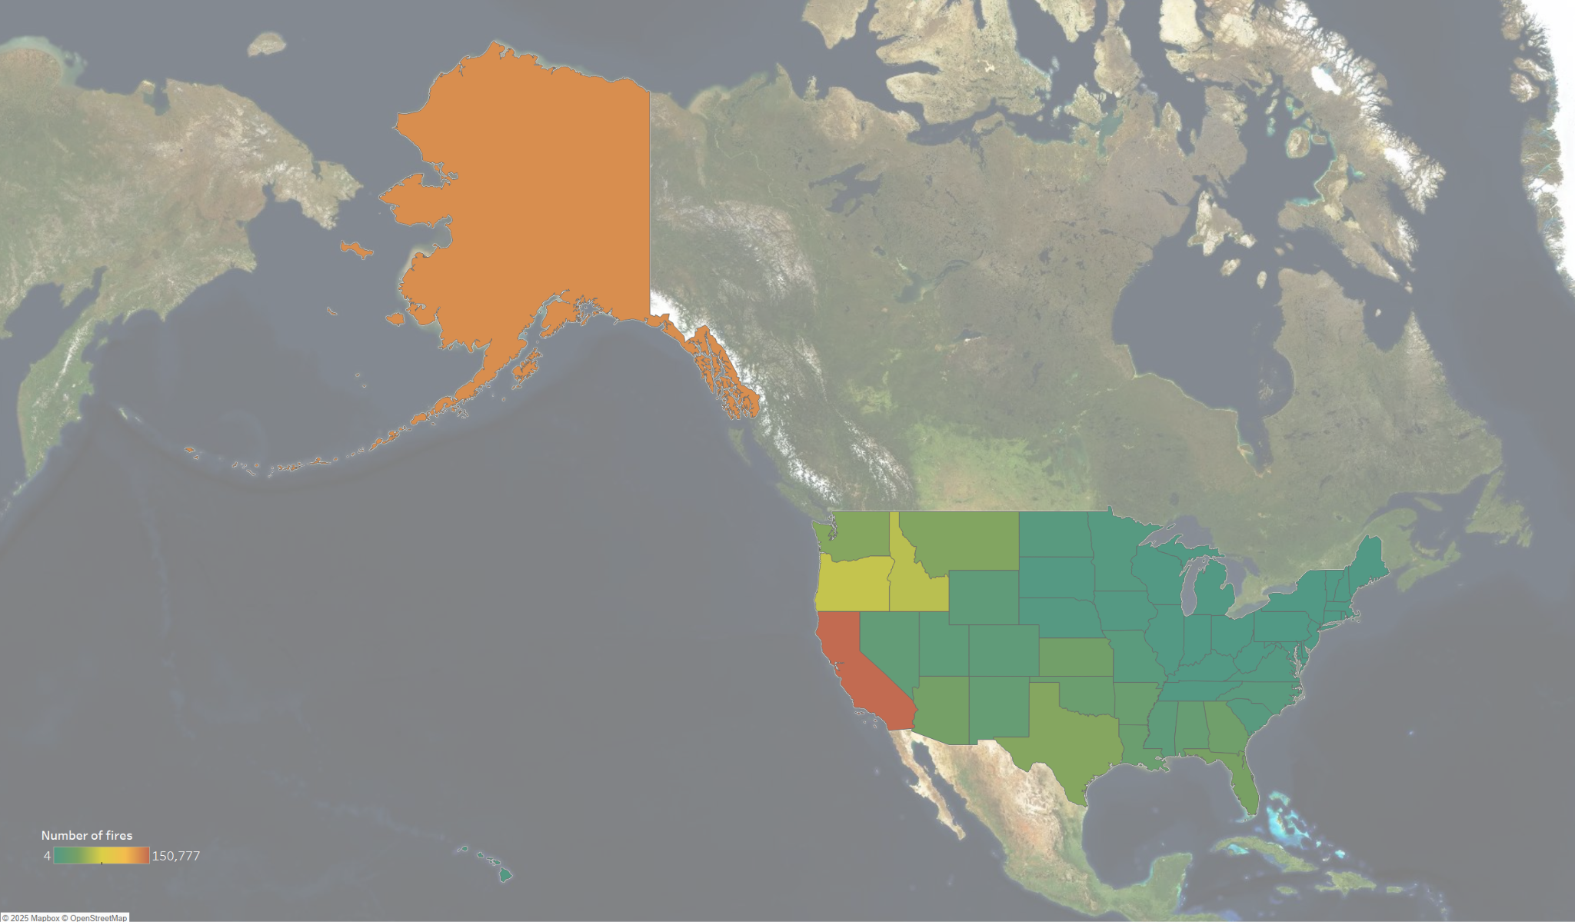
The graph below shows which states have had the most detected fires

Slide 22
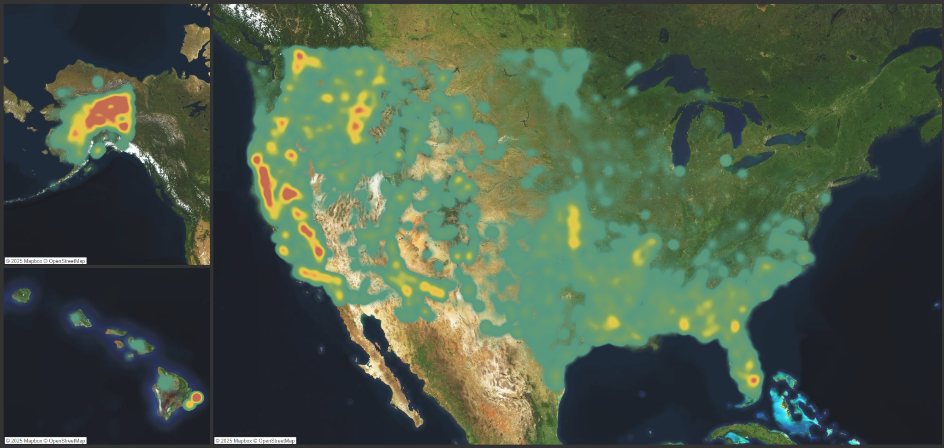
Below is the heat map of fires since the year 2000

Slide 23
Summary
FIRMS is a great source for knowing where and when fires happen
The brightness of the fire is the most important value for confidence of the data from the dataset
Fires happen the most in the summer and early fall months,
and there isn’t an outlier in the years recorded for number of fires
Fires happen the most in Alaska and California

