Slide 1
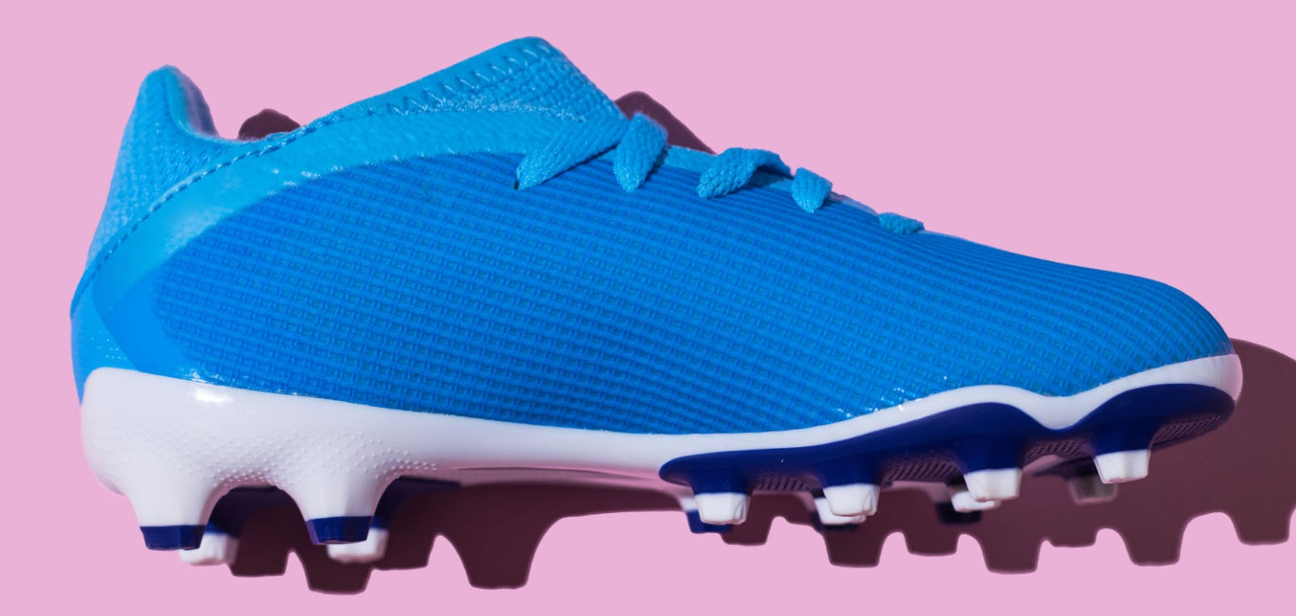

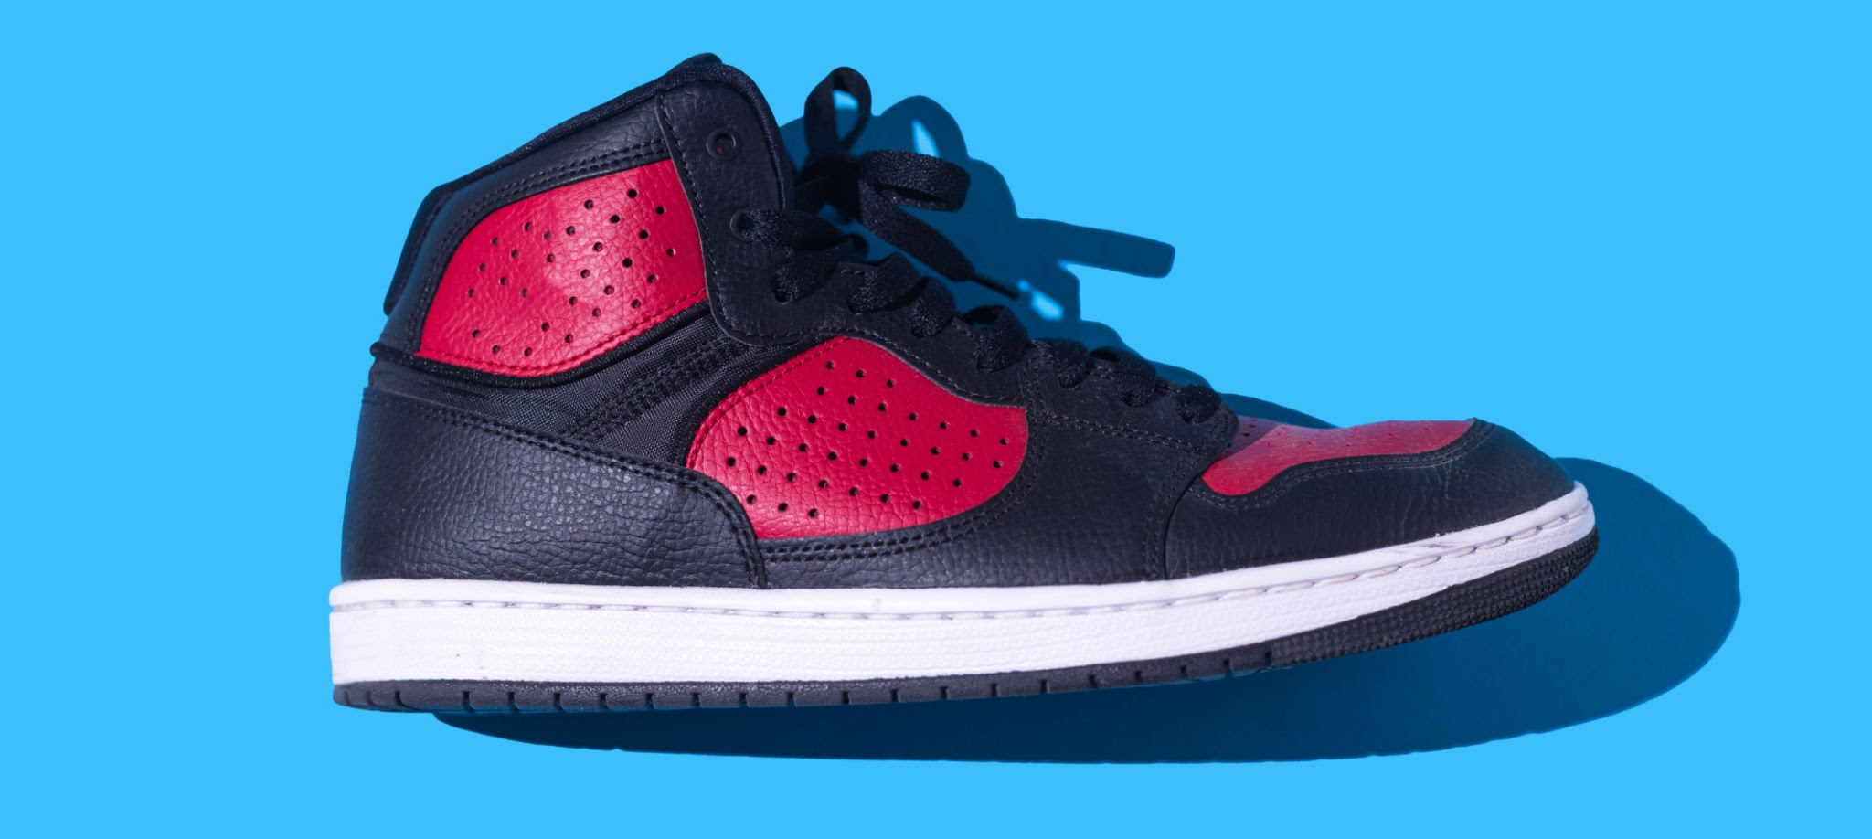
2017-2018
Youtube trends

Slide 2
What are the top trending videos of 2017-2018?

Slide 3
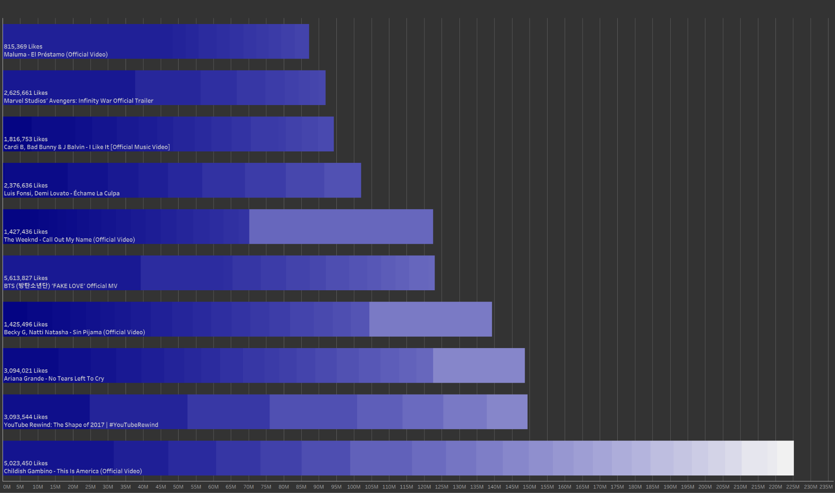

Slide 4
Childish Gambino is trending… A lot. But what categories are the most trending?

Slide 5
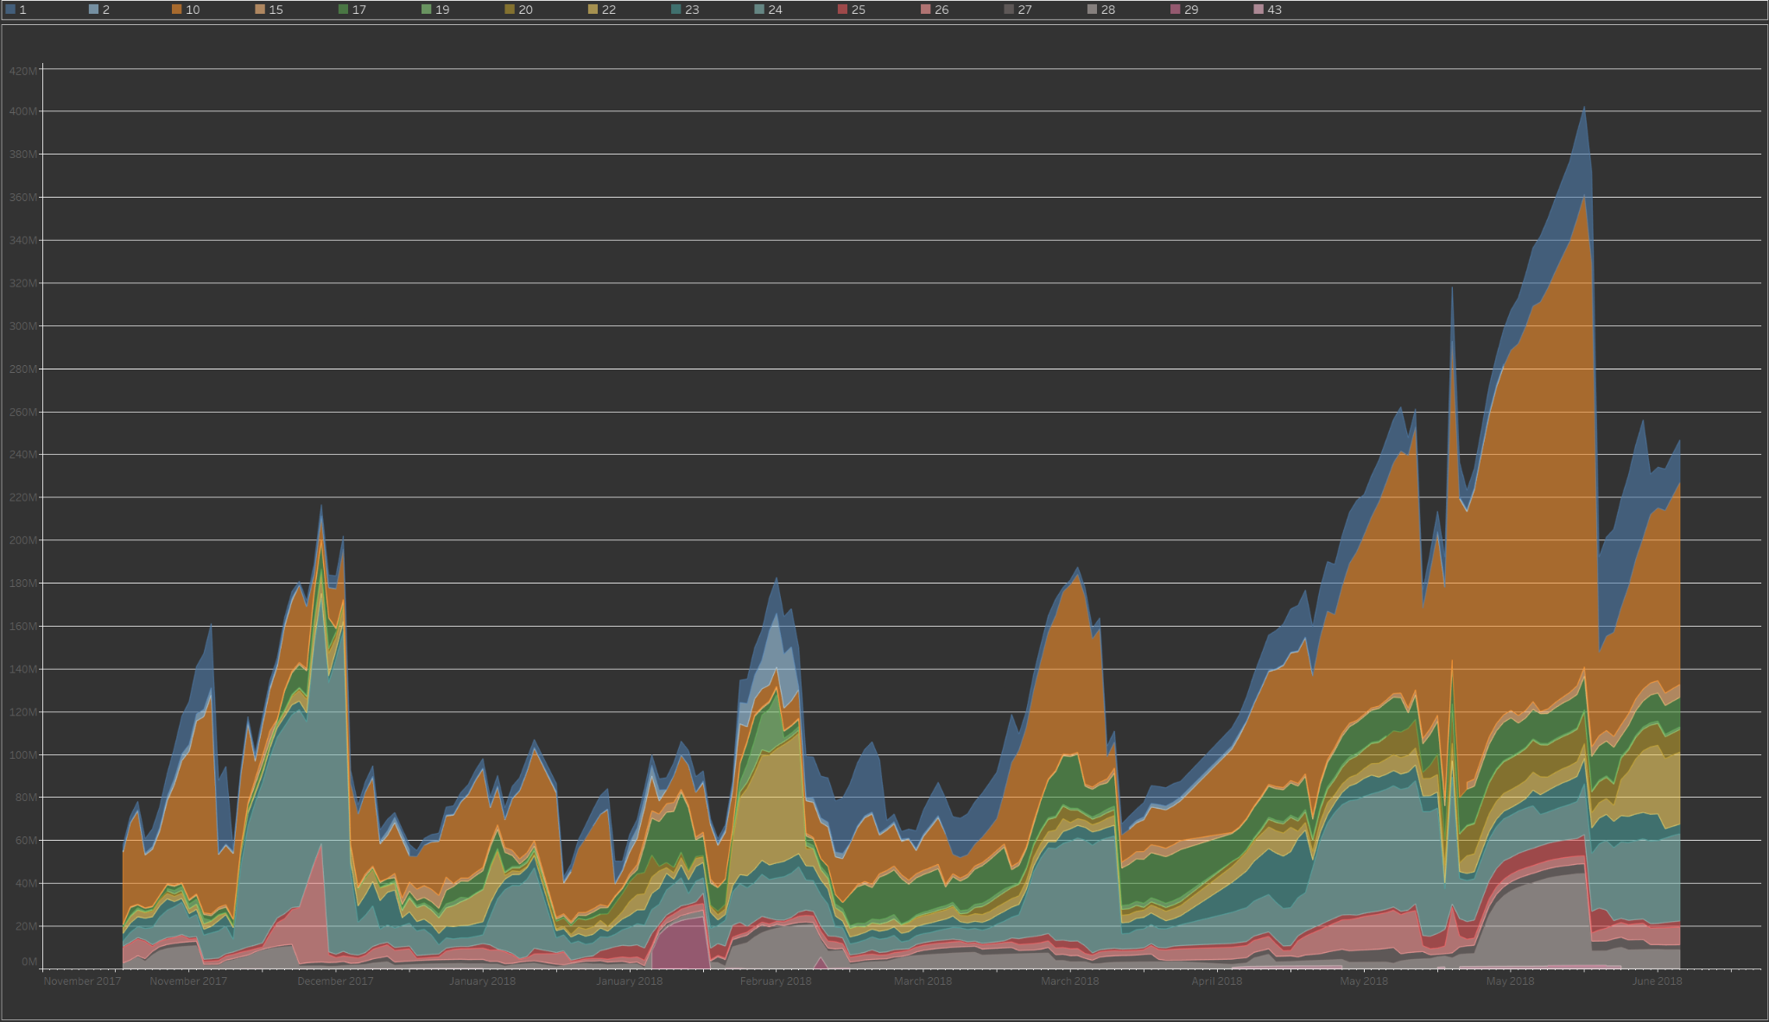

Slide 6
It looks like category 1 is the highest, but the graph also shows that around may 2018 the amount of views for trending videos grew massively

Slide 7
Any questions?

