Slide 1
Introduction to the WebDriver API
Notes:
Locators are a major part of any UI Automation, where you spend the majority of your time maintaining
More learning – Next workshop, my blog.
Structured learning, see – Evil Tester, http://davehaeffner.com/selenium-guidebook/
ChromeDriver – InternetExplorer services
http://t.co/exf7HHQgHl CSS Selector game
WebDriver essentially takes a selfie
Ask me questions on GitHub

Slide 2
Boring Stuff!
Coding along is not required, but if you wish to do so, workshop material is in C# and Java so you will need Visual Studio, the express version is free. Or IntelliJ & Maven for Java.
www.github/friendlytester

Slide 3

Notes:
This is a workshop, not a lecture, if you have a question, ask it.
Following methods are allowed:-
QUESTIONNNNNNNNNNN!!!!!!
Richard, I have a question
Or your preferred method of getting someone’s attention

Slide 4


Slide 5



Slide 6
The Plan
How does WebDriver work?
Code
Recap
Further learning
Driver.findElement(By.id(“awesome”));

Slide 7
How does WebDriver work?

Slide 8




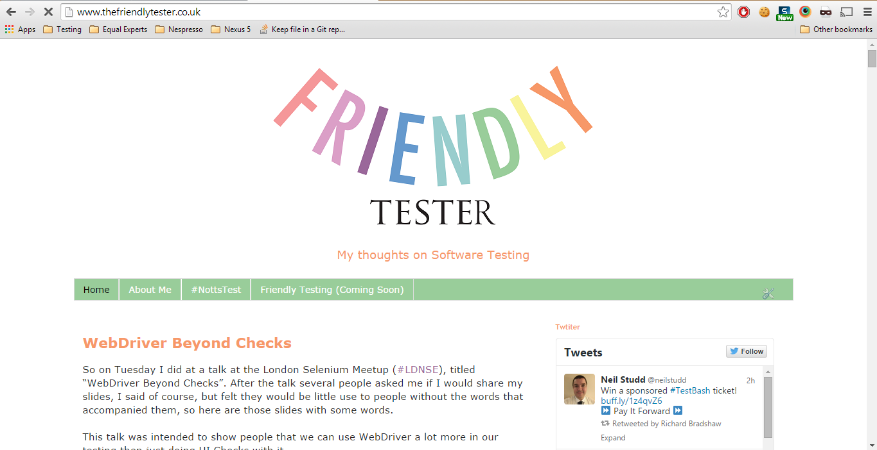




HTTP Requests
JSON Wire Protocol
Locators
&
Commands

Slide 9
CODE

Slide 10
RECAP
Notes:
How it all hangs together
Drivers
Locators
Basic commands
Screenshots
Few tool examples

Slide 11
Resources
www.thefriendlytester.co.uk
www. seleniumsimplified.com
www.davehaeffner.com/selenium-guidebook
http://elementalselenium.com/
https://groups.google.com/forum/#!forum/selenium-users
http://www.seleniumhq.org/

Slide 12
Thank you.
Twitter: @FriendlyTester
Email: RichardBradshaw@gmail.com
Blog: www.thefriendlytester.co.uk

