Slide 1
Customer Segmentation Project
Marketing Analytics using PCA + Clustering + Streamlit Deployment

Slide 2
1. Introduction
Goal: Understand customer behavior and group customers into meaningful segments.
Purpose: Improve targeting, reduce marketing cost, and increase campaign efficiency.

Slide 3
2. Business Problem
Companies often send the same offer to everyone, causing:
- Low conversion rates
- Wasted budget
- Poor customer engagement
Solution: Segment customers using machine learning.

Slide 4
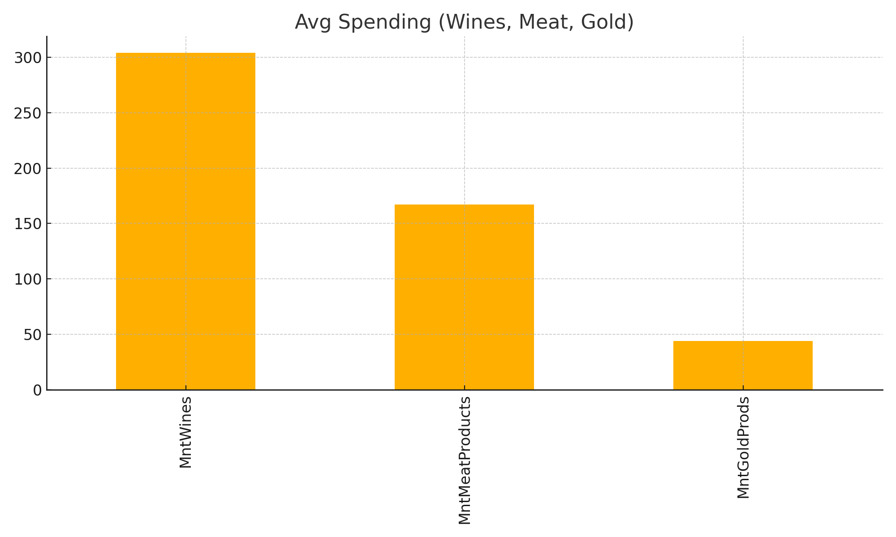
Spending Pattern

Slide 5
3. Dataset Summary
Dataset includes:
- Demographics (Age, Education, Income)
- Spending habits (Wines, Meat, Fruits, Gold)
- Web interactions (Visits, Web purchases)
- Campaign responses
- Customer relationship info (Recency, Enrollment Date)

Slide 6
4. Data Cleaning Performed
- Removed missing/invalid values
- Fixed categorical inconsistencies
- Treated outliers using IQR and z-score
- Validated numeric ranges

Slide 7
5. Feature Engineering
New meaningful features created:
- Age
- Family Size
- Total Spending
- Customer Since Days
- Campaign Acceptance Count

Slide 8
6. Data Transformations
To handle skewed data:
- Log, sqrt, Box-Cox transforms
- Standard scaling applied to all numerical features
Result: Balanced distribution and smooth clustering performance.

Slide 9
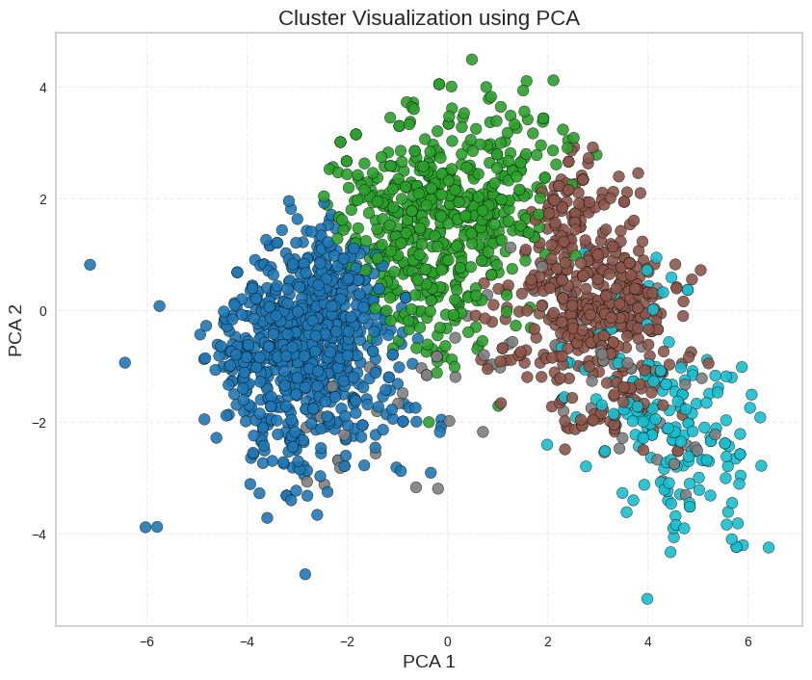
PCA Visualization

Slide 10
7. Dimensionality Reduction (PCA)
Reasons for PCA:
- Reduce noise
- Remove multicollinearity
- Convert 20+ features into 2–3 key components
- Improve clustering clarity

Slide 11
8. Clustering Approach
K-Means chosen because it is:
- Fast and efficient
- Good for numerical scaled data
- Produces clear cluster separation
Chosen K = 5 using Elbow + Silhouette methods.

Slide 12
9. Cluster Insights
Cluster 0 → High-Value Loyal Customers
Cluster 1 → Budget-Conscious Shoppers
Cluster 2 → Family-Oriented Moderate Spenders
Cluster 3 → Inactive or Lost Customers
Cluster 4 → New or Potential High-Spenders

Slide 13
10. Business Recommendations
Cluster 0 → High-Value Loyal Customers
Cluster 1 → Budget-Conscious Shoppers
Cluster 2 → Family-Oriented Moderate Spenders
Cluster 3 → Inactive or Lost Customers
Cluster 4 → New or Potential High-Spenders

Slide 14
11. Deployment (Streamlit App)
App features:
- Upload CSV → returns clusters
- Enter customer data → predicts cluster
- Uses trained scaler, PCA, and KMeans
Result: Instant customer segmentation.

Slide 15
12. Conclusion
Project successfully delivered:
- Meaningful customer segments
- Full ML pipeline
- Deployed prediction app
Supports real-world marketing decisions.

Slide 16
🎯 Project Results Summary
• 4 customer clusters identified with clear behavioral differences
• PCA captured major variance and improved cluster separation
• Spending pattern clearly identified (Wines & Meat highest)
• High-value premium customers detected (Cluster 1)
• Business-focused insights generated for targeted marketing
• Model successfully deployed using Streamlit for real-time predictions

