Slide 1
ORGANIZATION NAME : CDK Global
PROBLEM STATEMENT : Portal for Farmers to sell their produce at a better rate.
System that provides farmers an interface to sell their product, and connect with the buyers all over India.
Simple interface that works on smart devices, SMS to upload product details and respond via phone and SMS .
Interface for anyone to buy the produce/vegetable – initially visit the place and buy or have courier service integrated to deliver the vegetables so Farmers can get a better price for their produce, no additional cost is spent in marketing and delivery of goods, however they can choose to charge more by delivering the items themselves.
PROBLEM CODE : RA27
TEAM LEADER NAME : Abhishek Gupta
COLLEGE CODE : #2274
TEAM NAME : AgroCraft.
Agrocraft, is an online portal with a pure vision to consolidate farmers and buyers who can both be consumers or restaurant owners, and abolish the system of middlemen.

Slide 2
The farmer registers on the Multilingual portal.
Verification of legal documents (proof he’s a farmer) and quality of product on site.
The farmer can now upload his product via SMS, Website, Call.
FARMER
The farmer will be shown Minimum Selling Price, to give him estimate value.
As the date of expiry arrives, the price decreases by a certain percentage. On the expiry date, the product will be taken down.
Small scale farmers can form groups to cater to large orders.
The farmer has to deposit his produce at the nearby government warehouse for packaging and labelling, and then it will set out for delivery.

Slide 3
Notification
System
Personalized Chat section
Recommendation System
BUYER
FEATURES
Reporting System
Subscription feature. (Order once, product will be delivered for the specified duration). Government warehouses available for storage to reduce the repeated delivery charges.
Bookmark system (buyer prefers a farmer, he will be notified every time the farmer uploads).
Review System
Bestsellers
Filter System (stars and comments)

Slide 4
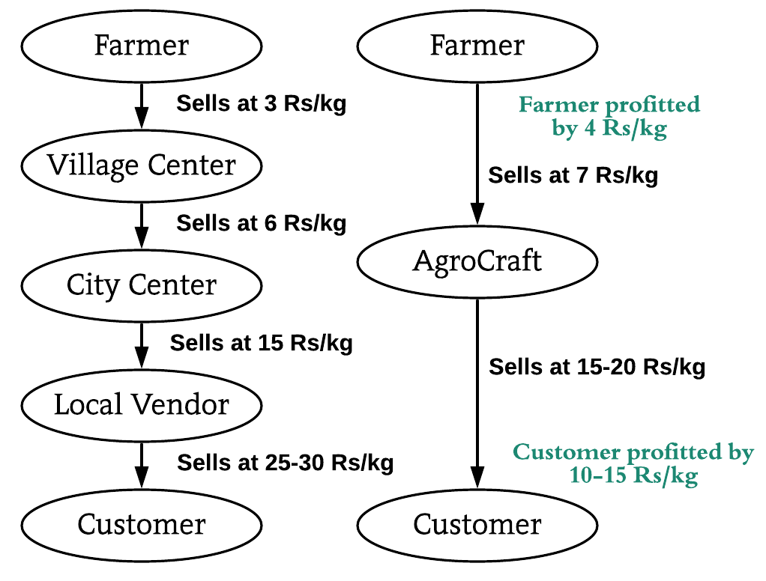
DELIVERY AND QUALITY VERIFICATION
CONVENTIONAL V/S AGROCRAFT
The farmer is given the opportunity to deliver, if he chooses not to, delivery system are integrated for the delivery service. Buyer also has the option to pickup his order.
The farmer has to take his products to the ware house nearest to his vicinity (rented by government at 7 Rs/ quintal) for packaging and labelling.
Agrocraft will verify the products at the warehouse, package it and then label it.
The delivery agent/buyer will pick it up from here or the farmer can now deliver his product.
Top Courier services and Indian post (covers all regions in India) are available for delivery in the portal.
TECHNOLOGY STACK
Modern Technology :- Big Data , Data Analytics , Visualization, Machine learning .
Mobile Development :-Android Studio, Android SDK and Jellybean version and above.
Backend Development : -MySQL Database and Firebase.
Web Technology : - HTML, CSS, JavaScript, AJAX, Bootstrap , Django and nodeJS
Programming languages : - Python.

Slide 5
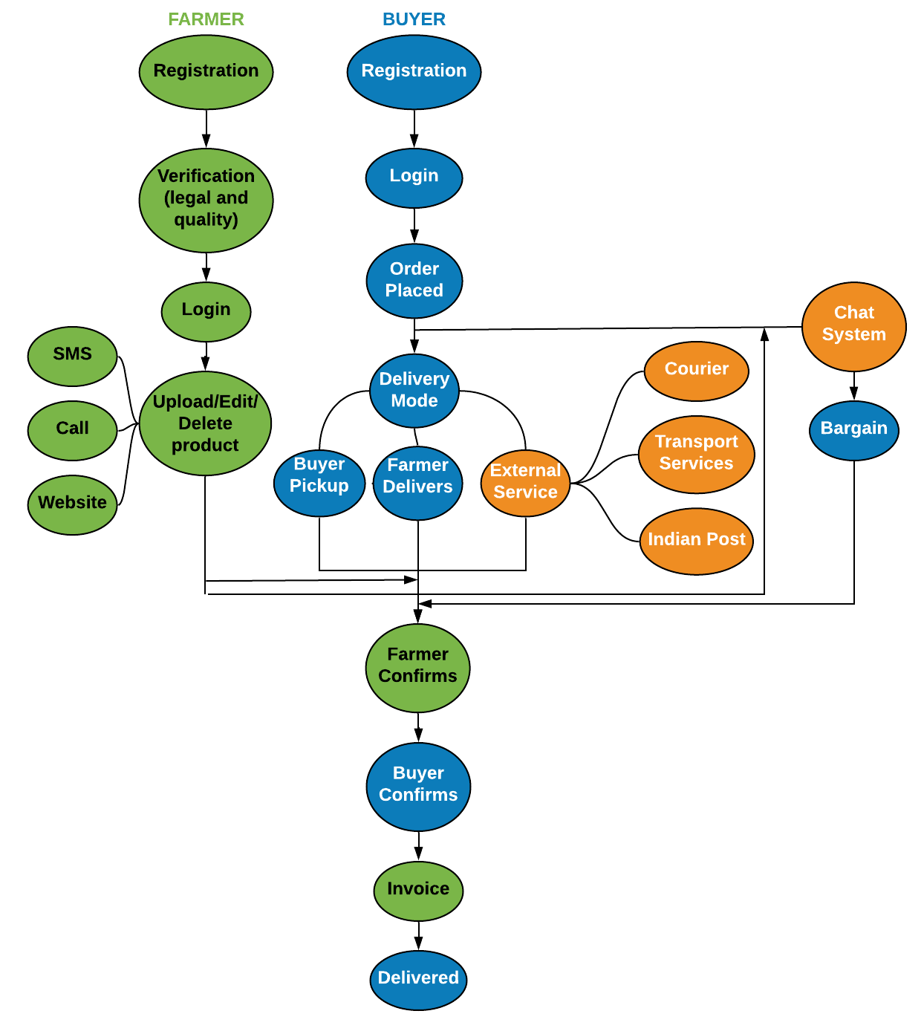
USE CASE
DEPENDENCIES
Farmer- basic phone and legal documents
This application can be installed in all devices having Android version Jellybean and higher.
An online portal generated shall require IE v9 or higher, Google Chrome, Mozilla Firefox, or any other web browser.
SHOWSTOPPERS
For the 47% of illiterate farmers, Multilingual SMS and Multilingual Call System has been designed.
Farmer profits - sells at better rates.
Buyer profits - buy at cheaper rates
Transport systems profit - increase of clients at their end.
Buyers are not restricted to buy products from their own city anymore.
Remote farmers come in contact with city buyers and they can negotiate using the chat system/call.

