Slide 2
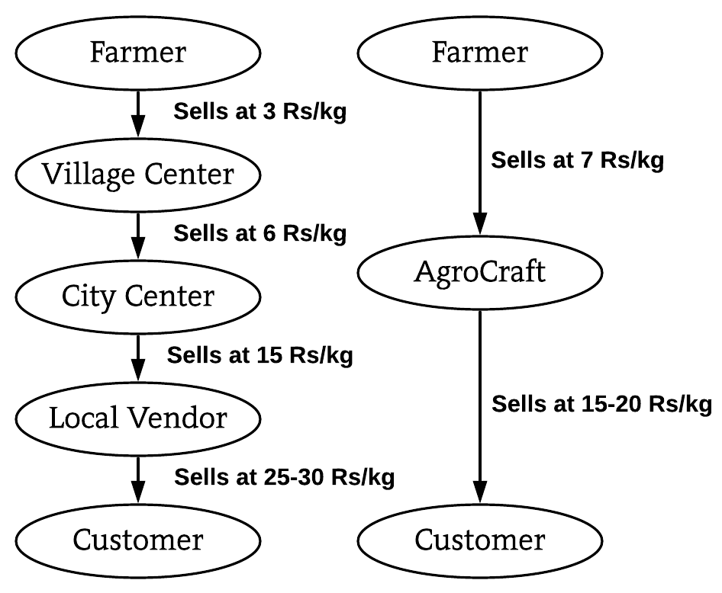
SOLUTION PROTOTYPE
Multilingual SMS and Call System for illiterate farmers to insert/edit/upload products & Multilingual portal also available.
Minimum selling price will be made visible to farmers for rough estimate to enter price of product.
Buyer can order from all over India, so if scarcity of a product arises, the buyer will be suggested of locations near to him, where the product is available.
Filter system(filter by price and location).
Review system & Reporting system(verification team will respond, guilty farmer will be penalised and buyer, compensated.
Bestseller feature.
Subscription feature. (Order once, product will be delivered for the specified duration). Government warehouses available for storage.
Bookmark system (buyer prefers a farmer, he will be notified every time the farmer uploads).
For packaging delivery, local transportation services, courier services and Indian postal(rural areas covered) will be integrated.
Conventional v/s AgroCraft
TECHNOLOGY STACK
Web Technology: - HTML, CSS, JavaScript, AJAX, Bootstrap , Django and nodeJS .
Programming languages: - Python.
Mobile Development:-Android Studio, Android SDK and Jellybean version and above.
Backend Development: -MySQL Database and Firebase.
Modern Technology:- Big Data , Data Analytics , Visualization, Machine learning .

Slide 4
IDEA/PROTOTYPE.
Since 47% of our farmers are illiterate, the farmers can use the multilingual SMS and call system to upload/edit delete his product.
The farmer will be shown the MSP(minimum selling price) when he uploads the product, to give him an estimate rate.
The buyer will have products all over India at his disposal, and even if scarcity arises at some place, he will be suggested alternate locations where the product is available, closest to his vicinity.
The multilingual portal will provide the filter system(filter by price and location), review system, bestseller feature.
If the buyer needs a particular product frequently, he can use the Subscription feature, where he has to order the product only once and it will be delivered on the specified days for the specified duration and warehouses provided by government will be used
Reporting system- If a farmer is reported, the verification team will respond immediately and if the farmer is found guilty, the buyer will be recompensed from the penalty extracted from the farmer.
Bookmark system- If a buyer prefers a particular farmer, he can bookmark him, so every time that farmer uploads, the product will be displayed to him on his homepage and if he chooses to receive notification, he will receive the same.

