Slide 1
ORGANIZATION NAME : CDK Global.
PROBLEM STATEMENT: Portal for Farmers to sell their produce at a better rate.
System that provides farmers an interface to sell their product, and connect with the buyers all over India.
Simple interface that works on smart devices, SMS to upload product details and respond via phone and SMS .
Interface for anyone to buy the produce/vegetable – initially visit the place and buy or have courier service integrated to deliver the vegetables so Farmers can get a better price for their produce, no additional cost is spent in marketing and delivery of goods, however they can choose to charge more by delivering the items themselves.
PROBLEM CODE: RA27 TEAM LEADER NAME: Abhishek Gupta COLLEGE CODE: #2274 TEAM NAME: AgroCraft
SOLUTION PROTOTYPE : - The solution can be classified into 3 sections
FARMERS
The farmers have to register on the Multilingual Portal following which a verification team will certify the farmer, also he will be familiarised with the user interface and the number of farmers and buyers registered all over India(statewise).
The farmer can insert, update and delete product details and send delivery information (such as Packaging ,Dispatch, On the Way ,Delivered ) via SMS, Call Centre and Website .
For larger quantities, small scale farmers can create groups and the admin of the group will be responsible for all the activities.
MSP(Minimum Selling Price) will be shown to the farmers when he enters the price for his product to give him in an estimate.
The farmer has to enter the expiry date and as the expiry date arrives the price will decrease by a certain percentage and on the expiry date, the product will be taken down from the portal.
The farmer can view all his transactions and can receive payments from the buyer via Paytms, Cash On Delivery or directly to his bank account.
In the initial stages the farmer doesn’t have to pay any commission, until he has earned a significant amount through the application.
.

Slide 2
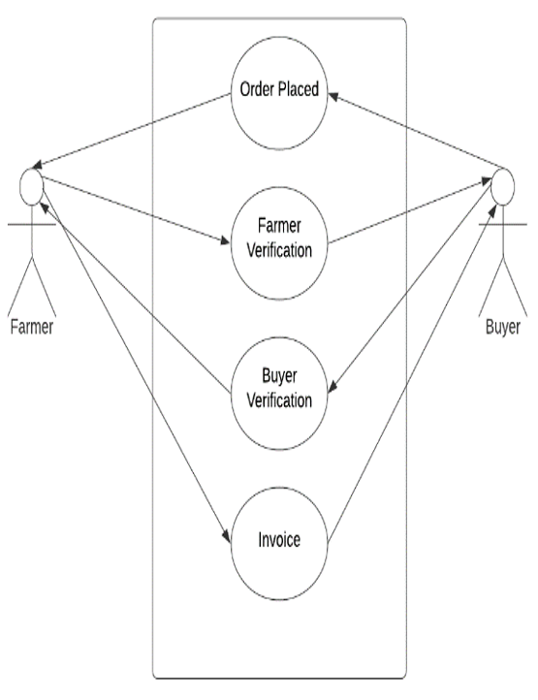
Buyer
The buyer can search products categorically by price or by location(state & district) thereby implementing the filter system.
The buyer can make use of bestsellers and recommendation system (frequently bought together), review(ratings & comments) which allows the user to buy best products from the best farmers.
If five negative reviews is noted against a farmer, the verification team will verify the farmer and if he’s found guilty, a certain amount of penalty will be extracted from the farmer and will be given to the buyer as compensation.
The subscription feature helps the buyer to buy the products which he requires on a daily basis, by ordering the product only once and specifying the duration.
The bookmark feature will display the products of bookmarked farmer on the buyers homepage and if he chooses to receive notifications (SMS), he will receive the same.
If scarcity of particular product occurs, then the buyer will be provided with closest locations to his vicinity where the product is available, also the buyer can keep track of his transactions and delivery.
The chat system helps the buyer to negotiate with the farmer, and the revised price is entered by the farmer during farmer verification once the order is placed and is re-verified by the buyer.
The buyer has to pay commission for every item purchased.
Courier & Delivery Services
When the farmer registers, he will be asked to register the transport service he has been availing to, so far. All the transport agencies from all the farmers will be integrated which gives us an array of delivery services.
Top courier systems will also be integrated along with the Indian post which covers every rural area.

Slide 3
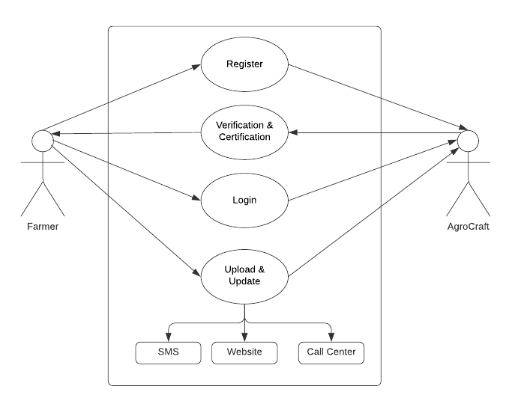
TECHNOLOGY STACK
Web Technology: - HTML, CSS, JavaScript, AJAX, Bootstrap , Flask and nodeJS .
Programming languages: - Python.
Mobile Development:-Android Studio, Android SDK and Jellybean version and above.
Backend Development: -MySQL Database and Firebase.
Modern Technology:- Big Data , Data Analytics , Visualization, Machine learning .
DEPENDENCIES
The farmer must possess a basic phone and legal documents.
This application can be installed in all devices having Android version Jellybean and higher.
An online portal generated shall require IE v9 or higher, Google Chrome, Mozilla Firefox, or any other web browser.
SHOWSTOPPERS
In India 47 percent of the farmer are illerates , to resolve this issue farmers can upload product through multilingual SMS and call centers.
The apllication ensures the farmer profits since he sells at better rates, the buyer profits since he can buy at cheaper rates, and the multiple transport systems because of the increase of clients at their end.
Buyers can get their hands directly on fresh products from all over India, and he is no longer restricted to his city.
Multiple farmers (many of which reside in remote areas) get in direct touch with buyers in capital cities and the prices are negotiable between them with no involvement of the admin whatsoever.
Use Cases :-

