Slide 1
S-Park (Smart Parking System)
PROBLEM STATEMENT : Develop an IoT enabled solution with Android application to give real-time parking space available on the Campus / City / Resident Societies .
The above mentioned will be applicable to those vehicles that have already registered in to the system and used the navigating system.
But we also need to consider those vehicles which have not registered and are manually finding parking space and heading towards the same parking slot.
Develop a smart efficient application system to solve the problem related to real-time parking space. Whenever a person wants to find a parking space on the campus, he has already registered to the application using his user id and password. When he finds for the parking space, the server will send a response with the available parking details, real-time mapped directions and real-time parking space to allocate parking according to the size of the vehicle.
The application would be smart enough to identify whether the car is heading towards the same parking space or If not, the application would re-route the same car to another nearest available parking space.
TEAM LEADER NAME : Abhishek Gupta
TEAM CODE : C17
TEAM NAME : S-Park.
S-Park is a smart parking system, with a pure vision to eliminate time wastage at parking spaces and increase the security factors. It helps in reducing human labour, fuel consumption and pollution ensuring the efficiency and reliability of the parking system.

Slide 2
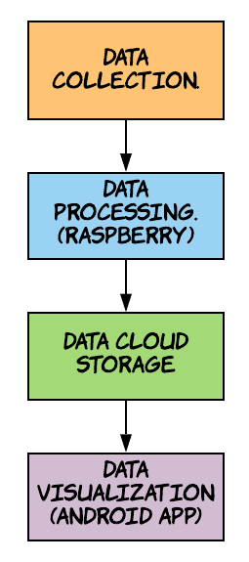
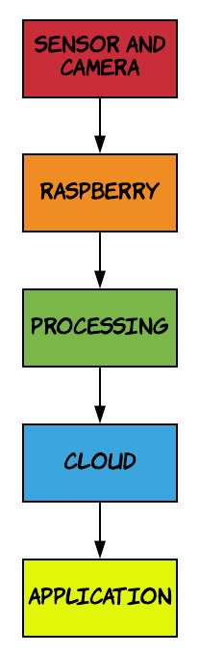
Solution/Prototype :-
Data Collections
At the gate , when IR sensor gets activated the camera module will be triggered and that specific data will be fed into Processing layer .
At the parking area the camera module will continously observe atleast 4 parking spaces and send the data to the processing layer.
Data Processing
At the gate, the number plate , vehicle type (Car , Bike , Truck ) and the entry-exit time is saved to the cloud using KNN algorithm and Conventional Neural Networks .
At the parking area, which vehicle (number plate) is parked in which slot is detected using vehicle classifier and the image of it is passed to number plate detection module.
Data Cloud Storage
The Output of data processing layer is saved into cloud that is vehicle type , entry-exit time , number plate , slot occupied and payment details .
Prototye Flow
System Flow

Slide 3
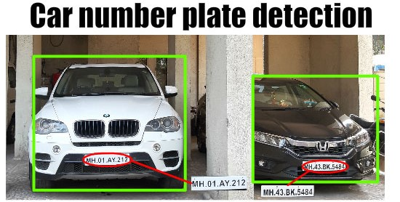
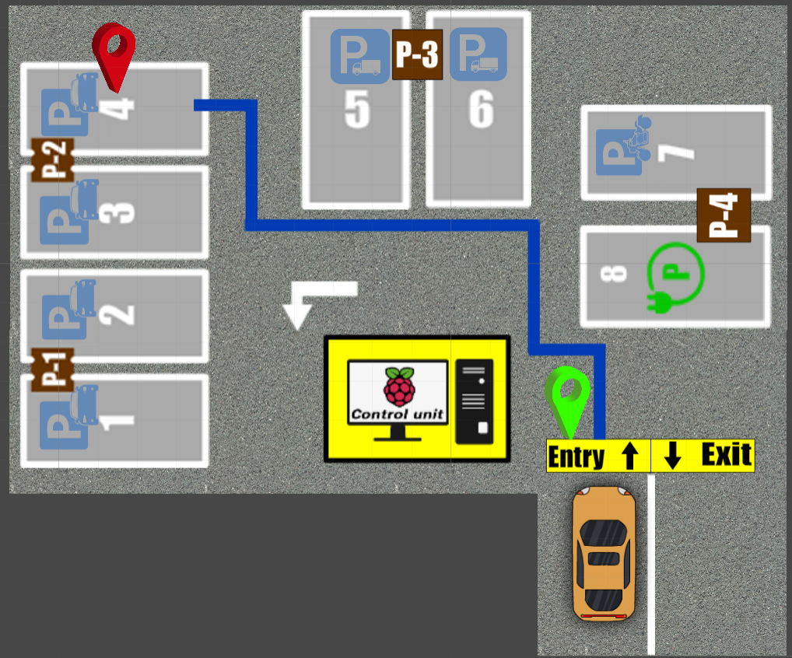
Data Visualizations (Android app)
The current vacant parking spots in each floor will be made visible on site and on the app after which he can move toward his desired floor and parking slot .
The user will be automatically shown shortest path to nearest free space available , once he clicks on map he also has the option to choose any free space available on the map and when he parks the slot number is made visible to him on the app.
When the user pulls out his vehicle for exiting, he will be notified on his app and this helps in preventing malpractices (stealing).
Additional Features
The user can pay at the cash counter on exit, or use Paytm.
If he loses track, he can opt for the “LOST” option, which will detect his location on certain parameters and redirect him.
Register User Benefits
The staff will have fixed parking spot .
Monthly payment. (For the time, the parking slot was used) .
Net banking. (Automatically montly money deducted).
All the visit details (entry and exit time) will be visible to him at all times.
If his slot gets occupied by someone else, the admin will be notified immediately.
Data Processing
Data Visualization

Slide 4
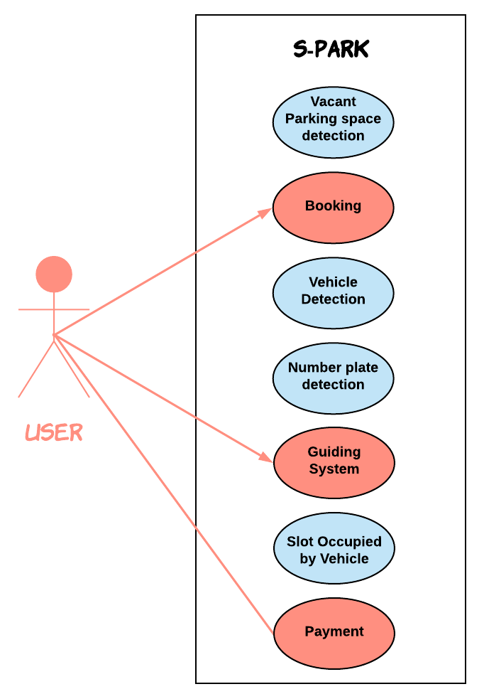
Technology Stack
Modern Technology :- Machine learning and Deep learning, Visualization .
Mobile Development :-Android Studio, Android SDK .
Backend Development :- Firestore and Firebase.
Hardware Components :- Raspberry pi 4, Sensors, Servo motors , Cameras , LCD, BULB etc .
Dependencies
Requires Android version Jellybean and higher .
Hardware components and their installation and power supply .
Use Case

Slide 5
SHOWSTOPPERS
EASY ACCESS
The user can locate his vehicle by entering the number plate details in the app and they will be provided by the shortest path .
BOOKING SYSTEM
The user can book his parking slot when he is in queue and according to his queue number .
DIMING LIGHTS
When no vehicles in motion are detected(using radar sensor), the lights will dim which saves energy .
PARKING ALLOCATION
Every type of vehicle will have its own parking area. Electric cars will have slots with the charging segment .
LIGHTING SYSTEM
The color of the lights indicate the occupancy of the slot.
Red-Occupied,
Green-Vacant.

