Slide 1
PROBLEM STATEMENT : Portal for Farmers to sell their produce at a better rate.
System that provides farmers an interface to sell their product, and connect with the buyers all over India.
Simple interface that works on smart devices, SMS to upload product details and respond via phone and SMS .
Interface for anyone to buy the produce/vegetable – initially visit the place and buy or have courier service integrated to deliver the vegetables so Farmers can get a better price for their produce, no additional cost is spent in marketing and delivery of goods, however they can choose to charge more by delivering the items themselves.
TEAM LEADER NAME : Abhishek Gupta
TEAM NAME : S-Park.
S-Park is a smart parking system, with a pure vision to eliminate time wastage at parking spaces and increase the security factors. It helps in reducing human labour, fuel consumption and pollution ensuring the efficiency and reliability of the parking system.

Slide 2
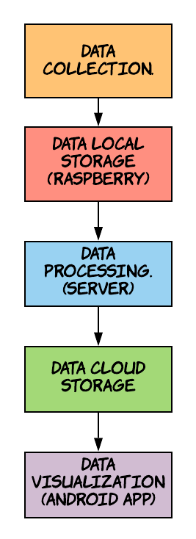
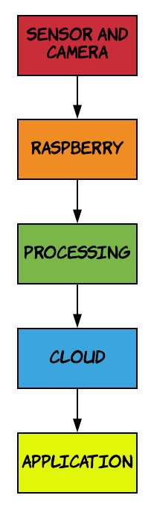
Solution/Prototype :-
Data Collections
At the gate, the number plate , vehicle type (Car , Bike , Truck ) and the entry-exit time is saved to the cloud using KNN algorithm and Conventional Neural Networks
At the parking area, which vehicle (number plate) is parked in which slot is also saved to the cloud.
Data Local Storage
The images taken by the camera will be locally stored in the raspberry pi.
Once the data is processed, the raspberry will automatically free the data.
Data Processing
The number plate detection, motion detection, entry-exit time detection will take place.
The output of the processed data will be stored in the cloud.
Data Cloud Storage
The filtered output will be stored in the cloud. The data required for the android app and the website that has to be shown to the user, will be retrieved from the cloud
Prototye Flow
System Flow

Slide 3
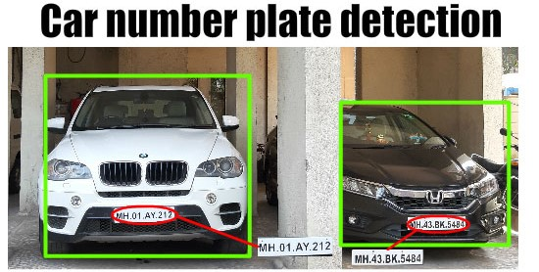
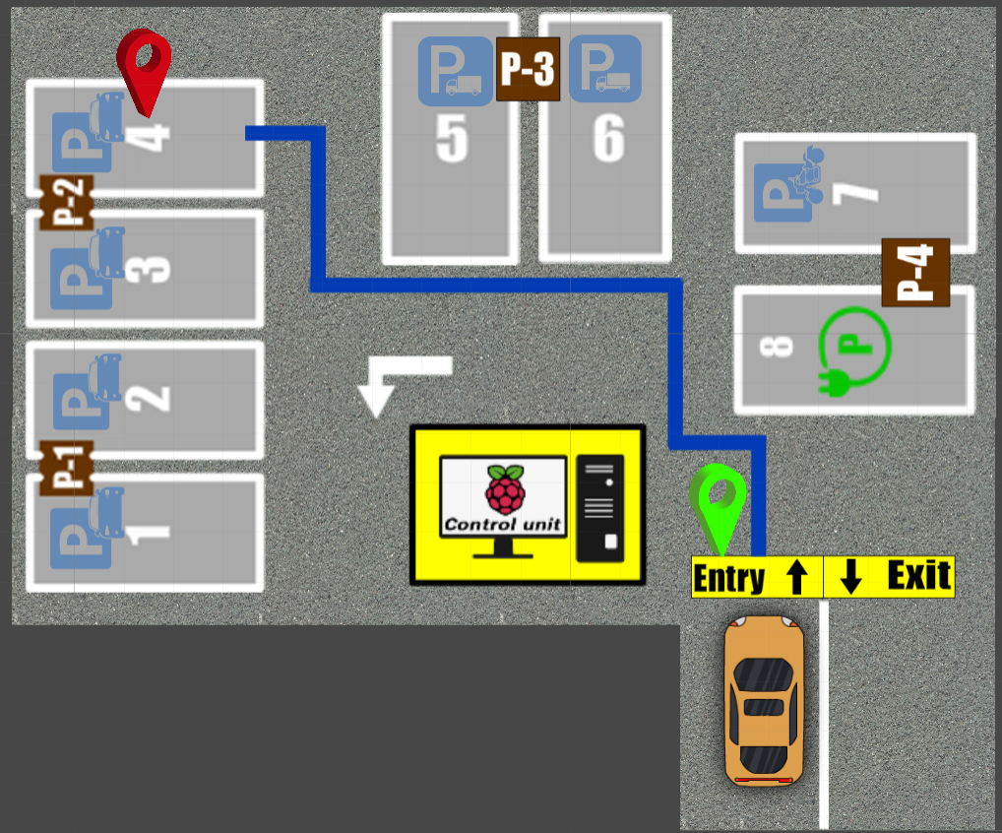
Data Visualizations (Android app)
The current vacant parking spots in each floor will be made visible on site and on the app after which he can move toward his desired floor and parking slot
The user will, automatically shown shortest path to nearest free space available once he clicks on map, he also has the option to choose any free space available on the map
Additional Features
The user can pay at the cash counter on exit, or use Paytm.
If he loses track, he can opt for the “LOST” option, which will detect his location on certain parameters and redirect him.
Register User Benefits
The staff will have fixed parking spot
Monthly payment. (For the time, the parking slot was used)
Net banking. (Automatically money deducted).
All the visit details (entry and exit time) will be visible to him at all times.
If his slot gets occupied by someone else, the admin will be notified immediately.
Data Processing
Data Visualization

Slide 4
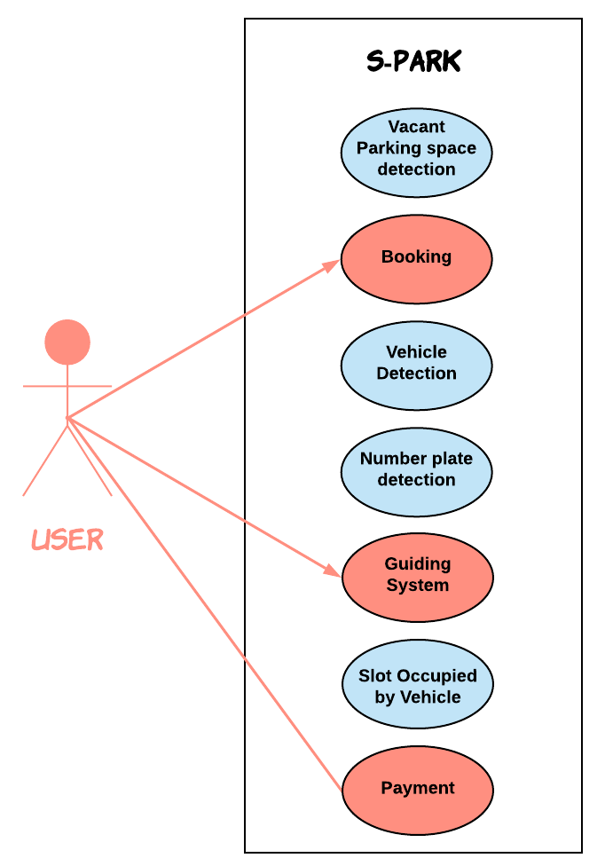
Technology Stack
Modern Technology :- Machine learning and Deep learning, Cloud Computing, Visualization
Mobile Development :-Android Studio, Android SDK
Backend Development :- Firestore and Firebase.
Hardware Components :- Raspberry pi 4, Sensors, Servo motors , Cameras , LCD, BULB etc .
Dependencies
Requires Android version Jellybean and higher
Hardware components and their installation and power supply
Use Case

Slide 5
SHOWSTOPPERS
EASY ACCESS
The user can locate his vehicle by entering the number plate details in the app and they will be provided by the shortest path
BOOKING SYSTEM
The user can book his parking slot when he is in queue and according to his queue number
DIMING LIGHTS
When no vehicles in motion are detected(using radar sensor), the lights will dim which saves energy
PARKING ALLOCATION
Every type of vehicle will have its own parking area. Electric cars will have slots with the charging segment
LIGHTING SYSTEM
The color of the lights indicate the occupancy of the slot.
Red-Occupied.
Green-Vacant

