Slide 1




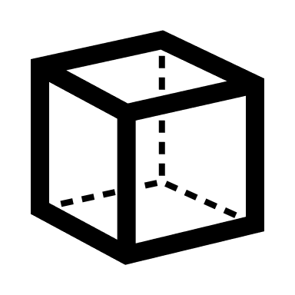



.NET marshaller
Koordináta detektálás
C++
Papír és rajz
RayCasting
normalizálás
DisplayMatrix

Slide 2




Edge detection
grayscale
blur
Contour detection
Find the paper-like one

Slide 3
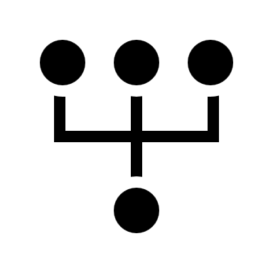
Adaptive Thresholding
grayscale
blur
Edge detection
Hough Line Transform
Merge the colinear lines

