Slide 1
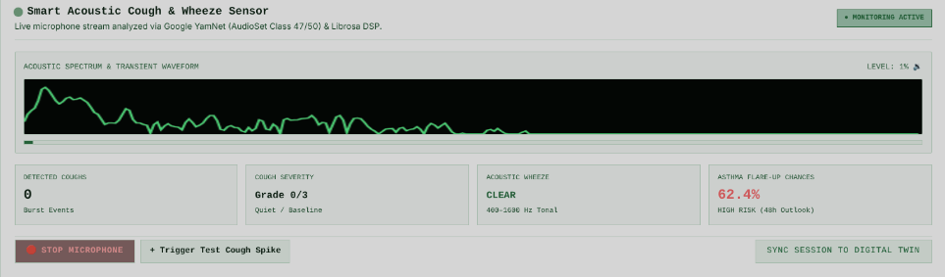
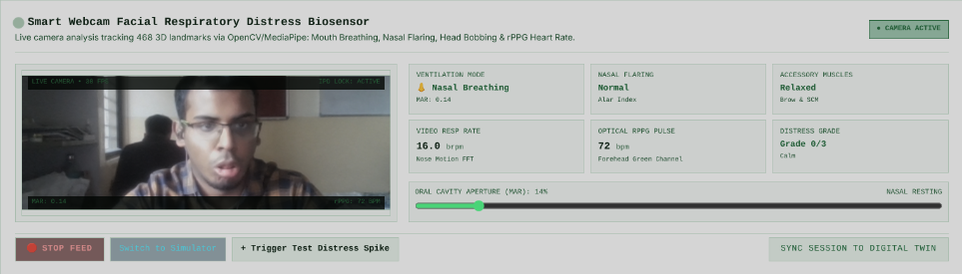
B R E A T H T W I N / P R O J E C T O V E R V I E W
05B / MULTIMODAL BIOSENSORS
PATIENT-PORTAL BIOMARKER INGESTION
Smart acoustic audio and webcam facial distress tracking
Continuous edge pipelines convert spontaneous microphone audio and camera frames into quantified clinical biomarkers and real-time digital twin adaptation.
STREAM 04 • ACOUSTIC SENSING
Smart Acoustic Cough & Wheeze Sensor
Live microphone audio analyzed via Google YamNet (AudioSet Class 47/50) & Librosa DSP
STREAM 05 • FACIAL COMPUTER VISION
Smart Webcam Facial Distress Biosensor
Live webcam analysis tracking 468 3D landmarks via OpenCV/MediaPipe + optical rPPG
• 512-bin STFT Spectrum: Real-time frequency power & transient cough burst detection
• Tracked Biomarkers: Hourly Cough Count (0 bursts), Graded Severity (0–3), Wheeze (400–1600 Hz)
• Prospective Risk Ingestion: Real-time 48h flare-up risk calculation (62.4% High Risk outlook)
• 468 3D Landmark Mesh: Real-time 30 FPS facial geometry with IPD stabilization lock
• Tracked Biomarkers: Oral Breathing (MAR: 0.14 vs >0.35), Alar Flaring, SCM Accessory Strain
• Contactless Vitals: Forehead green-channel pulse (72 bpm) & nose-motion resp rate (16.0 brpm)
CLOSED-LOOP DIGITAL TWIN INTEGRATION
Acoustic cough bursts and facial respiratory distress telemetry stream into the 12-hour rolling wearable feature window, modulate the latent mucosal inflammation state I(t) in the Euler-Maruyama ODE, and trigger clinician outlier retraining via Elastic Weight Consolidation (EWC).
INTER-COLLEGE COLLABORATION • LNMIIT + NSUT
05B

Slide 2
B R E A T H T W I N / P R O J E C T O V E R V I E W
05C / ACOUSTIC PIPELINE
BIOACOUSTIC SIGNAL PROCESSING
Acoustic frequency spectrum and transient cough burst detection
Client-side Web Audio API and Google YamNet DSP extract paroxysmal cough frequency and wheeze signatures to detect early mucosal narrowing without hospital spirometry.
INGESTION & STFT DSP
Continuous Waveform Analysis
• Web Audio API captures browser mic at 16 kHz
• 512-point Fast Fourier Transform (FFT) array
• 300–1400 Hz bandpass cough resonance window
• Audio normalization with moving energy threshold
• Interactive client-side stop/start controls
MACHINE LEARNING INFERENCE
YamNet Classification & Wheeze
• AudioSet Class 47 (Cough) & Class 50 (Wheeze)
• Spectral peak centroid distinguishes speech vs cough
• 400–1600 Hz tonal wheeze detection algorithm
• Automated burst count and paroxysm duration
• Grade 0/3 (Baseline) to Grade 3/3 (Severe)
PROSPECTIVE TWIN IMPACT
Early Exacerbation Warning
• Injected into 12-hour rolling patient telemetry
• Modulates latent mucosal inflammation state I(t)
• Dynamic recalculation of 48h flare-up risk (62.4%)
• Detects nocturnal worsening 24–36h in advance
• Doctor alert generated in Clinical Outliers triage
INTER-COLLEGE COLLABORATION • LNMIIT + NSUT
05C

Slide 3
B R E A T H T W I N / P R O J E C T O V E R V I E W
05D / COMPUTER VISION PIPELINE
FACIAL BIOMETRICS & OPTICAL DSP
Optical facial geometry, mouth breathing, and rPPG vital signs
MediaPipe 468 3D landmark mesh and optical green-channel rPPG extract breathing pattern changes, accessory muscle recruitment, and pulse from ordinary webcam video.
FACIAL LANDMARK TRACKING
468 3D Landmark Mesh & MAR
• Real-time 30 FPS MediaPipe FaceMesh processing
• Interpupillary Distance (IPD) head pose lock
• Mouth Aspect Ratio (MAR): resting 0.14 vs open
• Oral breathing triggered when MAR > 0.35
• Interactive calibration & threshold slider (5–85%)
DISTRESS BIOMARKERS
Nasal Flaring & Accessory Strain
• Alar width expansion index (Normal vs Dilated)
• Sternocleidomastoid (SCM) neck strain detection
• Rhythmic head bobbing amplitude tracking
• Clinical Distress Grade: 0 (Calm) to 3 (Severe)
• Built-in simulation avatar for zero-camera setups
OPTICAL VITALS EXTRACTION
Contactless rPPG Pulse & Resp Rate
• Forehead green-channel reflectance tracking
• Peak optical FFT extracts rPPG pulse (72 bpm)
• Nose tip vertical motion FFT computes resp rate (16 brpm)
• Continuous frame streaming every 2.5s to FastAPI
• Synced to doctor adaptation view and replay buffer
INTER-COLLEGE COLLABORATION • LNMIIT + NSUT
05D

