Slide 1
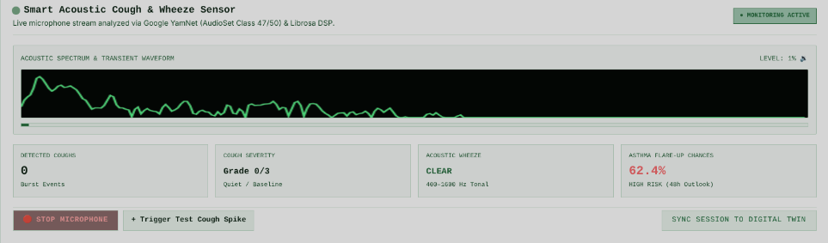
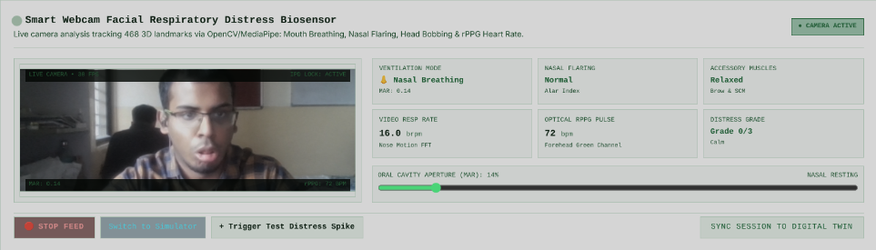
B R E A T H T W I N / P R O J E C T O V E R V I E W
05B / MULTIMODAL INGESTION
MULTIMODAL BIOSENSOR TELEMETRY
Smart acoustic audio and webcam facial distress tracking
Two continuous patient-portal pipelines convert spontaneous microphone audio and camera frames into quantified clinical biomarkers and real-time digital twin adaptation.
STREAM 04 • ACOUSTIC SENSING
Smart Acoustic Cough & Wheeze Sensor
Live microphone audio analyzed via Google YamNet (AudioSet Class 47/50) & Librosa DSP
STREAM 05 • FACIAL COMPUTER VISION
Smart Webcam Facial Distress Biosensor
Live webcam analysis tracking 468 3D landmarks via OpenCV/MediaPipe + optical rPPG
• 512-bin STFT Spectrum: Real-time frequency power & transient energy cough burst detection
• Tracked Biomarkers: Hourly Cough Count (0 bursts), Graded Severity (0–3), Wheeze (400–1600 Hz)
• Prospective Risk Ingestion: Real-time 48h flare-up risk calculation (62.4% High Risk outlook)
• 468 3D Landmark Mesh: Real-time 30 FPS facial geometry with IPD stabilization lock
• Tracked Biomarkers: Oral Breathing (MAR: 0.14 vs >0.35), Alar Flaring, SCM Accessory Strain
• Contactless Vitals: Forehead green-channel pulse (72 bpm) & nose-motion resp rate (16.0 brpm)
CLOSED-LOOP DIGITAL TWIN INTEGRATION
Acoustic cough bursts and facial respiratory distress telemetry stream into the 12-hour rolling wearable feature window, modulate the latent mucosal inflammation state I(t) in the Euler-Maruyama ODE, and trigger clinician outlier retraining via Elastic Weight Consolidation (EWC).
INTER-COLLEGE COLLABORATION • LNMIIT + NSUT
05B

