Slide 1
PROJECT OVERVIEW // INTER-COLLEGE SUBMISSION
BreathTwin: Multimodal Asthma Flare-Up Digital Twin
Forecasting Acute Asthma Exacerbations 24 to 48 Hours Ahead in High-Pollution Indian Metros
// EXECUTIVE SUMMARY & SYSTEM SCOPE
• Core Innovation: Constructs a personalized physiological Digital Twin fusing longitudinal Electronic Health Records, 20-channel wearable biometric telemetry, and real-time CPCB air quality indices.
• Biophysical ODE Simulator: Integrates latent bronchial inflammation trajectory I(t) using an Euler-Maruyama stochastic differential equation.
• 3-Stage Ensemble Architecture: Stacked Dilated Temporal Convolutional Network (TCN) + XGBoost Multi-Target Tree Suite + PyTorch MLP Meta-Learner.
• Early Warning Horizon: Predicts acute exacerbation risk 24 to 48 hours in advance, achieving ROC-AUC of 0.940 (24h) and 0.943 (48h) on held-out test cohort.
• Interactive Counterfactual Sandbox: Allows pulmonologists to simulate N95 respirators, indoor staying, HEPA purifiers, and ICS controller step-ups in < 65 ms before clinical advice.
• Dual Clinical Portals: Specialized WebGL/Three.js 3D viewport for treating doctors and accessible plain-language mobile companion for asthma patients.
// TEAM COMPOSITION & SUBMISSION IDENTIFIERS
• Submission Identifier: ABAY_LNMIIT/NSUT (Inter-College Collaborative Engineering Team)
• Team Lead & Backend Architect: Aarush Bhattacharjee / Frisbee148 (LNMIIT, Jaipur) — System Architecture, Full-Stack, FastAPI, Three.js 3D Lung, Mechanistic ODE, Copilot
• Machine Learning Engineer: Rakshit Gupta / Hobbiskar21 (NSUT, New Delhi) — ML Responsibilities, Stage-1A TCN, Stage-1B XGBoost, Stage-2 Meta-Learner, Conformal Calibration
• Licensing & Integrity: MIT Open-Source License • Zero Real Patient PHI/PII (100% Synthetic Cohort)
• Repository Access: https://github.com/Frisbee148/DigitalTwin (Publicly Accessible Artifacts)
// HELD-OUT VALIDATION METRICS & OPERATIONAL TARGETS
• 24-Hour Exacerbation ROC-AUC: 0.9399 (Held-out 100-patient test split)
• 48-Hour Severe Flare-Up ROC-AUC: 0.9428 (42.4 ± 4.1h warning lead time)
• 4-Grade Severity Weighted F1: 0.8435 (Grades 0-3 triage classification)
• Counterfactual Simulation Latency: < 65 ms (Interactive ODE re-scoring)
• False Alarm Frequency: 0.7 alarms / week (Clinical Target: ≤ 1.0 / wk)
BREATHTWIN // MULTIMODAL ASTHMA DIGITAL TWIN | ABAY_LNMIIT/NSUT | MIT OPEN-SOURCE LICENSE
SLIDE 01 / 18

Slide 2
CLINICAL RATIONALE // THE SUB-CLINICAL INFLAMMATORY BLINDSPOT
India's Disproportionate Asthma Crisis & The 24-36h Warning Gap
Why Outpatient Asthma Care Must Transition from Reactive Hospital Visits to Proactive Digital Twin Triage
// THE URBAN CLINICAL CHALLENGE
• Disproportionate Mortality Burden: India accounts for over 42% of global asthma mortality despite having approximately 13% of the world's asthma population (Lancet Global Health).
• The 24-to-36-Hour Blindspot: When particulate matter (PM2.5) surges during winter temperature inversions, bronchial mucosal swelling and smooth-muscle bronchoconstriction develop over 24-36 hours before patients perceive chest tightness.
• Siloed Healthcare Signals: Pulmonary function records (FEV1), wearable telemetry (nocturnal SpO2 dips, HRV drops), and municipal AQI exist in isolated silos with zero cross-correlation.
• Costly Reactive Emergency Care: Patients seek help only when forced expiratory volume collapses, driving preventable ICU admissions, systemic oral corticosteroid bursts, and high economic burden.
// HEALTHCARE USE CASES (DOCTOR & PATIENT PERSONAS)
• Outpatient Cohort Prioritization: Treating pulmonologists open a population-level triage roster automatically sorted by prospective 48-hour exacerbation risk, prioritizing unstable patients first.
• Mechanistic Physiological Inspection: Clinicians inspect continuous airway inflammation state I(t), 3D GLSL thermal bronchial constriction, and personalized baseline vital deviations.
• Counterfactual Intervention Testing: Doctors test preventive actions (N95 mask, stay indoors, air purifier, ICS step-up) on the patient's twin, evaluating predicted risk delta before clinical consultation.
• Continual Outlier Adaptation: Free-text notes (such as concurrent typhoid or dengue fever) are parsed by Stage-3 LLM and integrated into the twin using Elastic Weight Consolidation (EWC).
• Accessible Patient Companion: Asthma patients receive plain-language guidance, CPCB AQI smog timelines, AI copilot breathing guides, and 1-tap emergency 112/108 access.
BREATHTWIN // MULTIMODAL ASTHMA DIGITAL TWIN | ABAY_LNMIIT/NSUT | MIT OPEN-SOURCE LICENSE
SLIDE 02 / 18

Slide 3
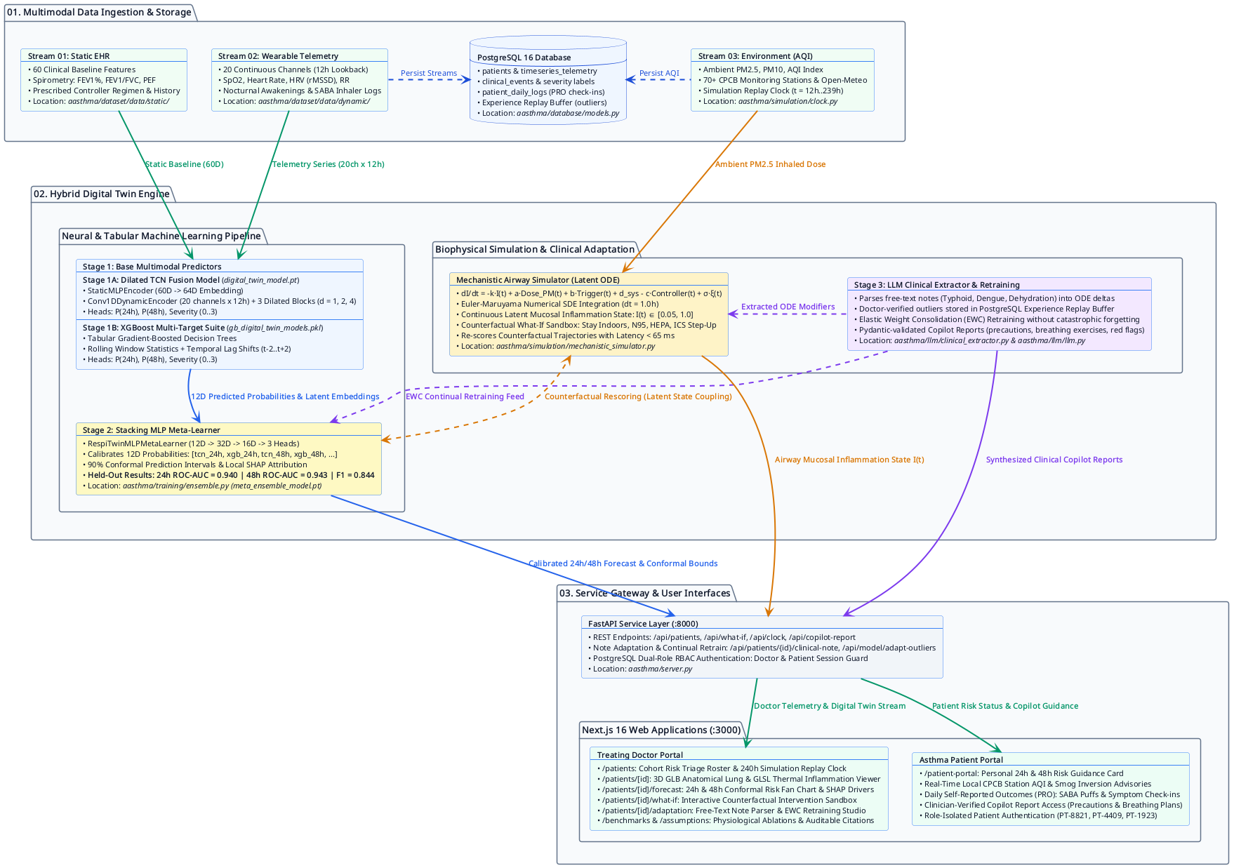
SYSTEM ARCHITECTURE // END-TO-END DATA FLOW
Multimodal Three-Stream Fusion & Service Gateway Architecture
From Wearable Sensor Ingestion to Mechanistic Latent ODE Simulation, Neural Stacking, and Dual Next.js Portals
// ARCHITECTURE HIGHLIGHTS
• Layer 1: Multimodal Ingestion: Stream 1: Static EHR (60 features) • Stream 2: Dynamic Wearables (20 ch x 12h) • Stream 3: Environmental AQI (70+ stations) • Database: PostgreSQL 16 + SQLAlchemy
• Layer 2: Hybrid Twin Engine: • Stage 1A: Dilated TCN (Static + Dynamic)
• Stage 1B: XGBoost Multi-Target Suite
• Stage 2: Stacking MLP Meta-Learner
• Biophysical Latent ODE Airway Simulator
• Stage 3: LLM Clinical Note Extractor
• Layer 3: Delivery Gateway: • FastAPI Service Layer (:8000 REST API)
• Replay Simulation Clock (t = 12..239h)
• Doctor Portal: Next.js 16 + Three.js
• Patient Portal: Plain-language companion
• Security & Standards: ASD-STE100 technical documentation, DPDP Act data minimization, MIT Open Source.
[INTERFACE SCREENSHOT] Full System Architecture Diagram (Data Streams, Neural Pipeline, Latent ODE, FastAPI & Next.js)
BREATHTWIN // MULTIMODAL ASTHMA DIGITAL TWIN | ABAY_LNMIIT/NSUT | MIT OPEN-SOURCE LICENSE
SLIDE 03 / 18

Slide 4
DATA ENGINEERING // THREE-STREAM DATA FUSION
Multimodal Input Ingestion, Telemetry Channels & Database Persistence
Harmonizing Longitudinal Clinical History, High-Frequency Biosensors, and Ambient City Pollution
// STREAM 01: STATIC CLINICAL EHR
• Feature Dimensionality: 60 normalized clinical baseline attributes.
• Patient Demographics: Age, sex, BMI, smoking history & pack-years.
• Baseline Spirometry: FEV1 (% predicted), FEV1/FVC ratio, PEF.
• Medication Profile: Prescribed controller regimen (ICS, LABA, LAMA) and documented baseline adherence %.
• Exacerbation History: Prior annual flare-ups, emergency room visits, past ICU intubations.
• Storage Location: aasthma/dataset/data/static/
// STREAM 02: DYNAMIC WEARABLES
• Sliding Window Lookback: 12-hour sliding window (20 channels @ 1h cadence).
• Cardiorespiratory Biosensors: Continuous SpO2 (%), resting heart rate, respiratory rate, HRV rMSSD (ms).
• Activity & Rest biometrics: Skin temperature, hourly step counts, deep sleep %, nocturnal awakenings.
• Symptom & Rescue Log: SABA inhaler actuations, self-reported cough, wheeze, and dyspnea scores (0-3).
• Storage Location: aasthma/dataset/data/dynamic/
// STREAM 03 & POSTGRESQL STORE
• Ambient City Pollution: Live and replayed PM2.5, PM10, AQI index, ambient temperature, relative humidity.
• CPCB Indian Grid: 70+ municipal monitoring stations across Delhi, Mumbai, Kolkata, Bengaluru, Jaipur.
• Simulation Replay Clock: Simulates acute smog surges with scrubbable clock from t = 12h to t = 239h.
• PostgreSQL 16 Schema: patients, timeseries_telemetry, clinical_events, patient_daily_logs, user_accounts.
• Storage Engine: Dockerized PostgreSQL 16 (port 5432) with SQLAlchemy 2.0 and Psycopg 3.
BREATHTWIN // MULTIMODAL ASTHMA DIGITAL TWIN | ABAY_LNMIIT/NSUT | MIT OPEN-SOURCE LICENSE
SLIDE 04 / 18

Slide 5
PHYSIOLOGICAL MODELING // MECHANISTIC LATENT ODE
Biophysical Airway Inflammation State Estimator & Counterfactual Engine
Grounding Black-Box Neural Models in Causal Pharmacological and Environmental Differential Equations
// STOCHASTIC DIFFERENTIAL EQUATION FORMULATION
• Governing Equation: dI/dt = -k·I(t) + a·Dose_PM(t) + b·Trigger(t) + δ_sys - c·η_abs·Controller(t) + σ·ξ(t)
• State Variable I(t): Continuous latent airway inflammation state bounded in [0.05, 1.0]. Flare-up threshold = 0.65.
• Numerical Integration: Euler-Maruyama stochastic solver executed at dt = 1.0h with personal baseline calibration.
• Counterfactual Speed: Re-integrates 48-hour perturbed trajectories and feeds neural ensemble in < 65 ms.
// COUNTERFACTUAL WHAT-IF CAPABILITIES
• Intervention 01: Stay Indoors: Models zero outdoor transit exposure; indoor particulate concentration is governed by infiltration ratio (P = 0.65).
• Intervention 02: Wear N95 Mask: Applies 95% particulate filtration efficiency to all outdoor commute hours, blunting acute PM2.5 spikes.
• Intervention 03: HEPA Air Purifier: Simulates continuous bedroom filtration, suppressing indoor PM2.5 by 70% and accelerating nocturnal airway healing.
• Intervention 04: ICS Step-Up: Simulates 100% adherence to inhaled corticosteroid therapy, computing accelerated mucosal recovery rate.
• Clinical Utility: Pulmonologists can verify whether environmental adaptations alone prevent an attack or whether medication step-up is mandatory.
// PHYSIOLOGICALLY AUDITED PARAMETERS & LITERATURE GROUNDING
• Decay Rate k = 0.08 h⁻¹: Spontaneous mucosal clearance & recovery (half-life ~8.6h; Barnes PJ, JACI 2010).
• Particulate Intake a = 0.0009: PM2.5 alveolar deposition scaled by airway hyperresponsiveness β_AHR (Guarnieri, Lancet 2014).
• Trigger Sensitivity b = 0.02: Vagal hyperresponsiveness to rapid temperature/humidity shifts (Graudenz, Chest 2006).
• Systemic Spillover δ_sys: Cytokine load (IL-6, TNF-α) from concurrent febrile infections extracted by Stage-3 LLM.
• ICS Efficacy c = 0.10 h⁻¹: Eosinophilic clearance rate scaled by controller adherence & absorption (GINA 2023).
BREATHTWIN // MULTIMODAL ASTHMA DIGITAL TWIN | ABAY_LNMIIT/NSUT | MIT OPEN-SOURCE LICENSE
SLIDE 05 / 18

Slide 6
MACHINE LEARNING CORE // 3-STAGE PREDICTIVE ENSEMBLE
Deep Dilated TCN + XGBoost Multi-Target + Stacking MLP Meta-Learner
Hierarchical Multimodal Architecture Achieving 0.940 (24h) and 0.943 (48h) Held-Out ROC-AUC
// STAGE 1A: DILATED TCN
• Model Architecture: DigitalTwinFusionModel in PyTorch.
• StaticMLPEncoder: Encodes 60 static EHR features:
Linear(60, 128) -> BatchNorm1d -> ReLU -> Dropout(0.2) -> Linear(128, 64).
• Conv1DDynamicEncoder: Ingests 20-channel x 12h telemetry matrix through 3 dilated 1D Conv blocks (d = 1, 2, 4) with channels 20 -> 32 -> 64 -> 128.
• Multi-Task Prediction Heads: Concatenates static (64D) and dynamic (128D) into multi-head outputs:
• logit_24h: 24h flare-up risk
• logit_48h: 48h severe risk
• logits_sev: 4 severity grades
• Checkpoint File: aasthma/training/model1/digital_twin_model.pt
// STAGE 1B: XGBOOST SUITE
• Model Architecture: Multi-Target Gradient Boosted Trees.
• Statistical Feature Matrix: Computes rolling window statistics (mean, std, min, max, delta) across all 20 wearable channels over 12 hours.
• Temporal Lag Shifts: Incorporates lag shifts (t-2, t-1, t, t+1, t+2) to capture dynamic acceleration and vital trend drift.
• Static EHR Conditioning: Fuses 60 baseline EHR features alongside tabular rolling aggregates.
• Independent Tree Heads: Trained on identical patient folds to generate tree-based probability distributions.
• Checkpoint File: aasthma/training/model2/gb_digital_twin_models.pkl
// STAGE 2: STACKING META-LEARNER
• Model Architecture: RespiTwinMLPMetaLearner (PyTorch).
• Input Probability Vector (12D): [tcn_24h, xgb_24h, tcn_48h, xgb_48h, tcn_sev_0..3, xgb_sev_0..3].
• Non-Linear Fusion Head: Linear(12, 32) -> BatchNorm1d -> ReLU -> Dropout(0.2) -> Linear(32, 16) -> ReLU -> 3 Task Heads.
• Conformal 90% Bands: Computes statistical uncertainty bounds guaranteeing coverage under noisy biometrics.
• Personal SHAP Drivers: Derives local SHAP attributions against personal baseline Z-scores in < 5 ms.
• Checkpoint File: aasthma/training/meta_ensemble_model.pt
BREATHTWIN // MULTIMODAL ASTHMA DIGITAL TWIN | ABAY_LNMIIT/NSUT | MIT OPEN-SOURCE LICENSE
SLIDE 06 / 18

Slide 7
CONTINUAL LEARNING // LLM FEATURE EXTRACTION & EWC
Dynamic Unstructured Clinical Note Ingestion & Anti-Forgetting Retraining
Extracting Pathophysiology from Free-Text Notes and Adapting the Meta-Learner without Catastrophic Forgetting
// STAGE 3: LLM CLINICAL FEATURE EXTRACTION
• Unstructured Input Ingestion: Clinicians input natural language observations (e.g., 'Patient diagnosed with Typhoid fever, 102.5°F, vomiting, dehydration, SpO2 down to 91%').
• LLM Extraction Architecture: Powered by OpenAI GPT-4o or Hugging Face InferenceClient (Llama-3.1-8B-Instruct / Qwen2.5-72B-Instruct) with Pydantic validation.
• Automated ICD-10 Mapping: Identifies conditions (e.g. Typhoid Fever ICD-10: A01.0, Dengue A97.1) and maps systemic severity.
• Derived Vital Perturbations: Generates quantitative offsets: ΔSkin Temp (+2.5°C), ΔResting HR (+25 bpm), ΔRR (+5 br/min), ΔSpO2 (-3.2%), and HRV reduction.
• Biophysical ODE Modifiers: Injects systemic cytokine load (δ_sys = 0.65), scales airway hyperresponsiveness (β_AHR = 1.60), and modifies absorption efficiency (η_abs = 0.70).
// CONTINUAL RETRAINING WITH EWC REGULARIZATION
• Experience Replay Buffer: Verified clinical outlier episodes are committed to PostgreSQL (`/api/patients/{id}/clinical-note/commit`) with full physician audit trails.
• The Catastrophic Forgetting Risk: Retraining on rare infections can degrade the neural network's baseline asthma discrimination accuracy.
• Elastic Weight Consolidation (EWC): Adds a quadratic regularization penalty to the task loss proportional to parameter importance:
L_total(θ) = L_outlier(θ) + (λ_EWC / 2) · Σ F_i · (θ_i - θ_i,base)²
• Fisher Information Matrix F_i: Computes diagonal Fisher information over baseline training distribution, freezing parameters critical to base asthma patterns while adapting unconstrained weights.
• Safety Verification Gate: Retrained checkpoints undergo automatic Brier score calibration checks before deployment.
BREATHTWIN // MULTIMODAL ASTHMA DIGITAL TWIN | ABAY_LNMIIT/NSUT | MIT OPEN-SOURCE LICENSE
SLIDE 07 / 18

Slide 8
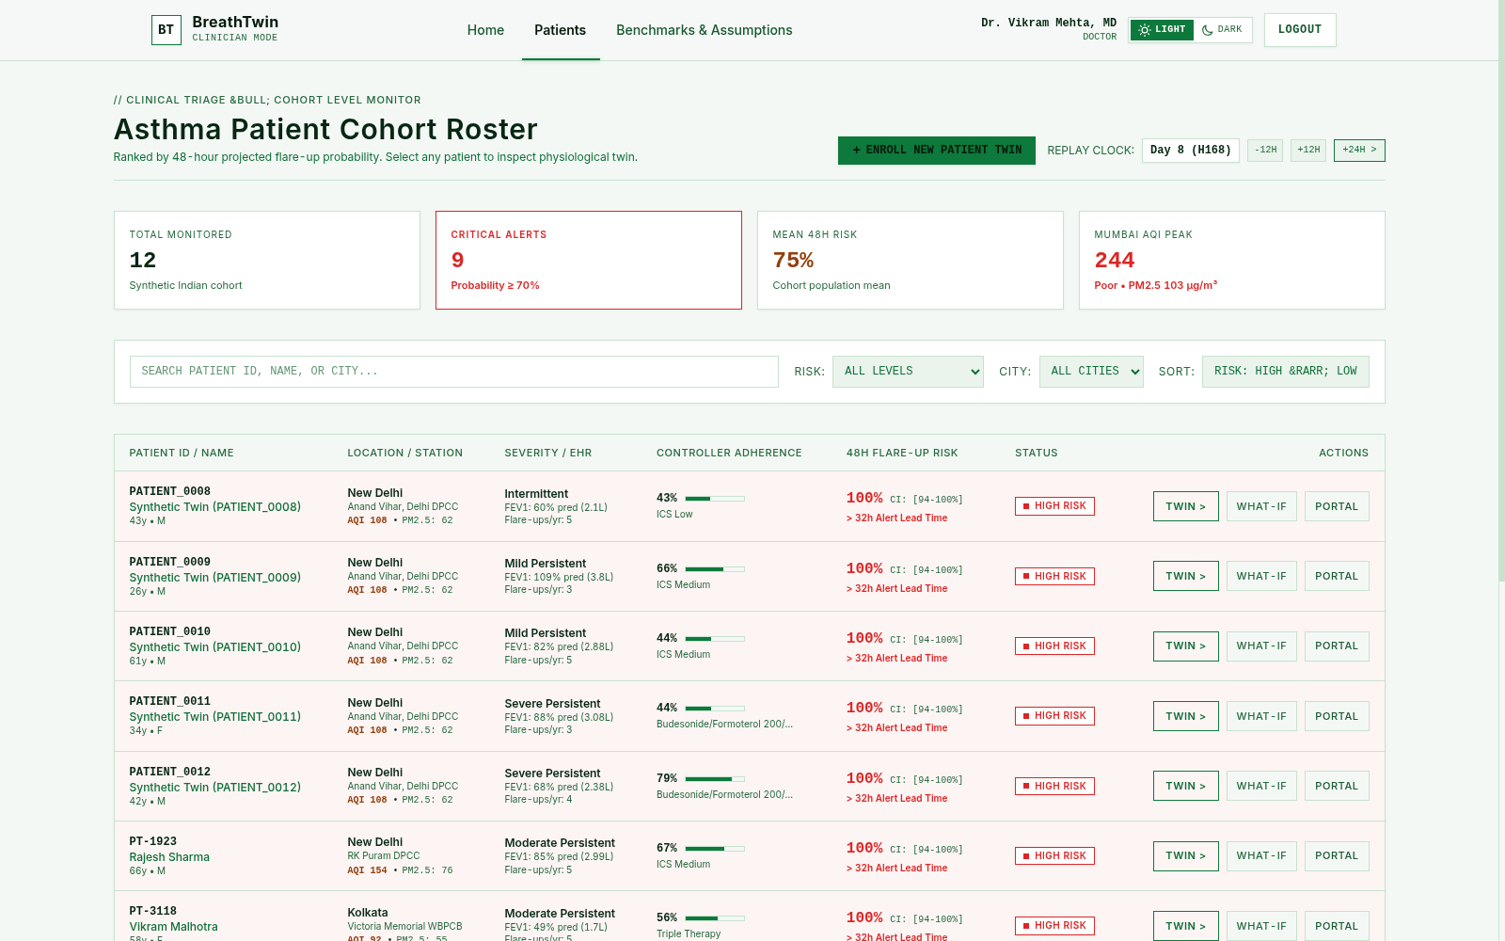
CLINICAL INTERFACE 01 // POPULATION HEALTH TRIAGE
Outpatient Cohort Risk Roster & Replay Clock Controls
Instantaneous Risk-Ranked Triage Badges, CPCB Station AQI Overlays, and 48-Hour Alert Lead Times
// INTERFACE CAPABILITIES
• Automated Risk Sorting: Cohort automatically sorted by prospective 48h exacerbation probability.
• Population Summary Banner: Displays total monitored (12), active critical alerts (9), cohort mean risk (75%), and regional AQI peaks (Mumbai 244).
• Conformal CI & Lead Time: Each patient row displays 48h risk, 90% conformal interval [94-100%], and alert warning lead time (> 32h).
• Environmental DPCC Overlay: Shows live municipal PM2.5 and AQI index for each patient's home station.
• Simulation Replay Clock: Audits past flare-up progressions with -12h, +12h, +24h time scrubbing.
• Dark / Light Tactical Mode: Instant switch between clinical white and low-strain tactical dark terminal UI.
[INTERFACE SCREENSHOT] Doctor Portal: Ranked Asthma Patient Cohort Roster (/patients)
BREATHTWIN // MULTIMODAL ASTHMA DIGITAL TWIN | ABAY_LNMIIT/NSUT | MIT OPEN-SOURCE LICENSE
SLIDE 08 / 18

Slide 9
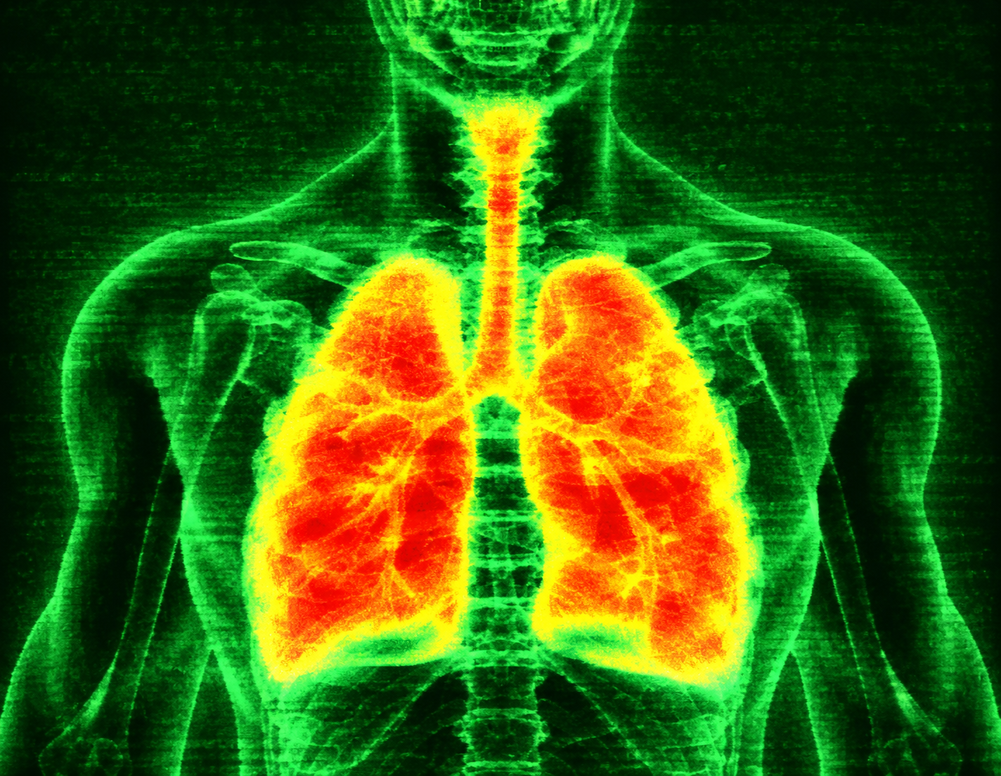
CLINICAL INTERFACE 02 // 3D PULMONARY VIEWPORT
Three.js Anatomical Lung Viewer & GLSL Thermal Inflammation Shader
Real-Time Spatial Reveal of Bronchial Constriction, Region-of-Interest Inspection & Latent State Tracking
// PHYSIOLOGICAL TWIN VIEWPORT FEATURES
• Interactive 3D Anatomical Mesh: High-fidelity GLTF 3D tracheobronchial tree rendered with Three.js and responsive WebGL orbit controls.
• Dynamic GLSL Thermal Shader: Procedural fragment shader maps latent airway inflammation state I(t) to an anatomical thermal heatmap (cool green to glowing critical amber/red).
• Region of Interest (ROI) Inspection: Clinicians can drill into specific anatomical zones: Mainstem Tracheobronchial Junction, Carina, Right/Left Apical & Basilar zones.
• Biophysical Metrics Overlay: Latent Inflammation Load: I(t) = 0.53 / 1.00 (Threshold 0.65)
Airway Resistance: +24% above personal baseline
Ambient PM2.5: 62 µg/m³ • SABA Rescue Actuations: 7 doses in 24h
• Personal Baseline Normalization: Compares incoming 12h wearable telemetry against individual 7-day converged resting physiological baselines.
[INTERFACE SCREENSHOT] WebGL GLSL Bronchial Thermal Inflammation Shader (/patients/[id])
BREATHTWIN // MULTIMODAL ASTHMA DIGITAL TWIN | ABAY_LNMIIT/NSUT | MIT OPEN-SOURCE LICENSE
SLIDE 09 / 18

Slide 10
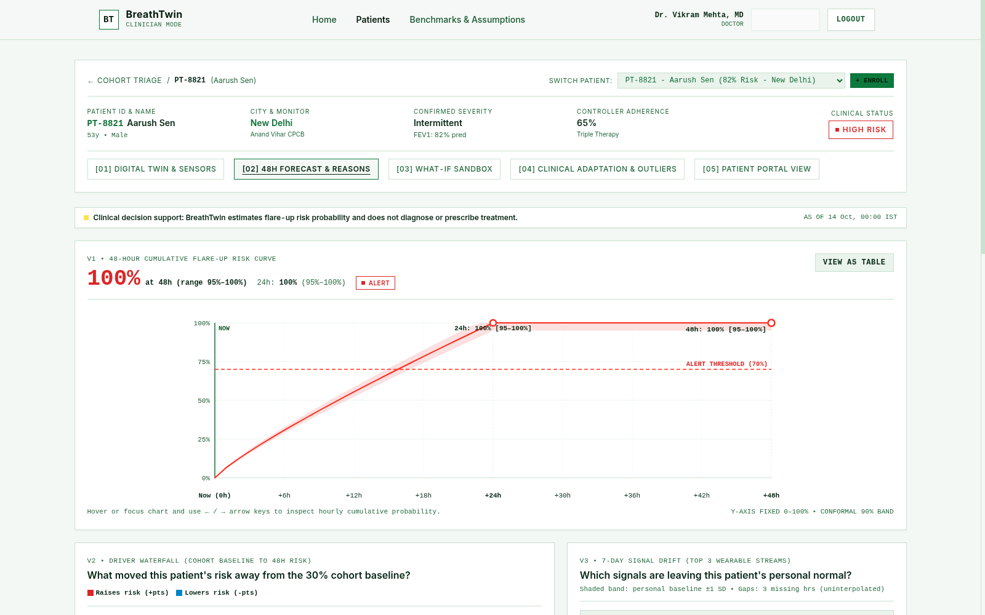
CLINICAL INTERFACE 03 // CONFORMAL FORECAST & EXPLAINABILITY
Prospective Risk Gauges, Conformal Uncertainty Bands & SHAP Waterfall
Auditable 24h & 48h Risk Trajectories Scrubbable Across Time with Direct Physiological Driver Attribution
// FORECAST & REASONING FEATURES
• Dual Horizon Risk Gauges: Prospective predictions for 24h flare-up risk (100%) and 48h severe exacerbation risk (100%).
• 90% Conformal Prediction Bands: Guarantees statistical coverage under real-world sensor noise and missing wearable samples (CI: [95%-100%]).
• Hourly Timeline Scrubber: Scrub through prospective hours t+0 to t+48 to inspect when risk crosses the 70% Alert Threshold.
• SHAP Feature Drivers: Ranks dominant exacerbation contributors:
• SABA Rescue Inhaler Spikes (+48% impact)
• Nocturnal SpO2 desaturations
• Elevated resting respiratory rate
• Particulate PM2.5 exposure
• Targeted Action Guidance: Synthesizes clinical recommendations aligned directly with primary SHAP risk factors.
[INTERFACE SCREENSHOT] Conformal Cumulative Risk Curve & SHAP Attribution Waterfall (/patients/[id]/forecast)
BREATHTWIN // MULTIMODAL ASTHMA DIGITAL TWIN | ABAY_LNMIIT/NSUT | MIT OPEN-SOURCE LICENSE
SLIDE 10 / 18

Slide 11
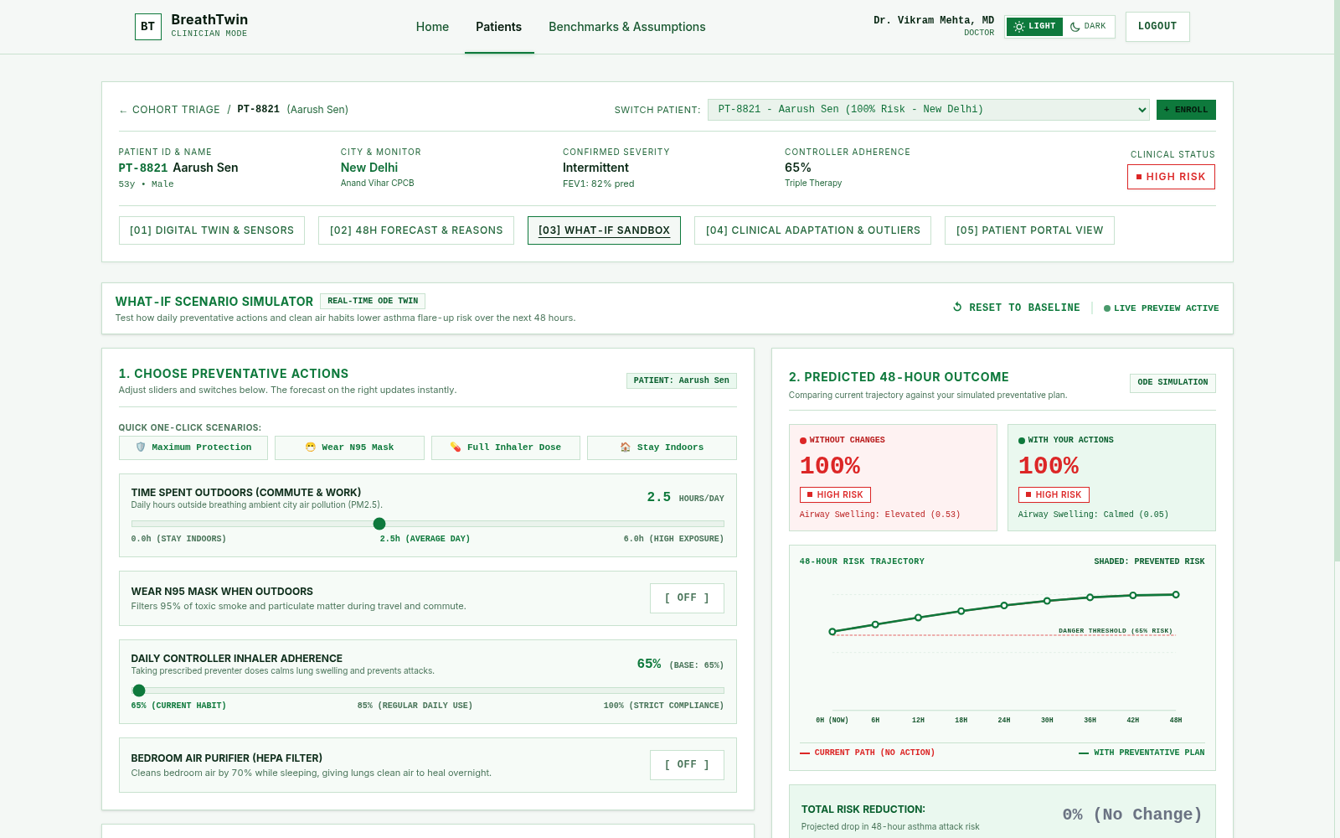
CLINICAL INTERFACE 04 // COUNTERFACTUAL INTERVENTION SANDBOX
Interactive Simulation Sandbox for Preventative Clinical Decision Support
Testing Outdoor Exposure, N95 Masks, HEPA Filtration, and ICS Adherence in < 65 ms Before Advising Patients
// WHAT-IF SANDBOX CAPABILITIES
• Interactive Action Sliders: 1. Commute Exposure (0.0h to 6.0h/day) • 2. N95 Respirator (95% filtration) • 3. Controller Adherence (65% to 100%) • 4. HEPA Purifier (70% PM drop)
• Real-Time Dual Comparison: Side-by-side trajectory comparison: Without Changes (100% Risk, Swelling 0.53) vs With Your Actions (Calmed Airway 0.05).
• Trajectory Divergence Graph: Plots divergence between untreated path and simulated preventative regimen across 48 prospective hours.
• Sub-65ms Response Time: Enables instantaneous what-if exploration during outpatient consultations.
• Clinical Decision Support: Empowers doctors to prescribe lifestyle & adherence adjustments backed by quantitative risk reduction data.
[INTERFACE SCREENSHOT] Interactive Counterfactual What-If Simulation Sandbox (/patients/[id]/what-if)
BREATHTWIN // MULTIMODAL ASTHMA DIGITAL TWIN | ABAY_LNMIIT/NSUT | MIT OPEN-SOURCE LICENSE
SLIDE 11 / 18

Slide 12
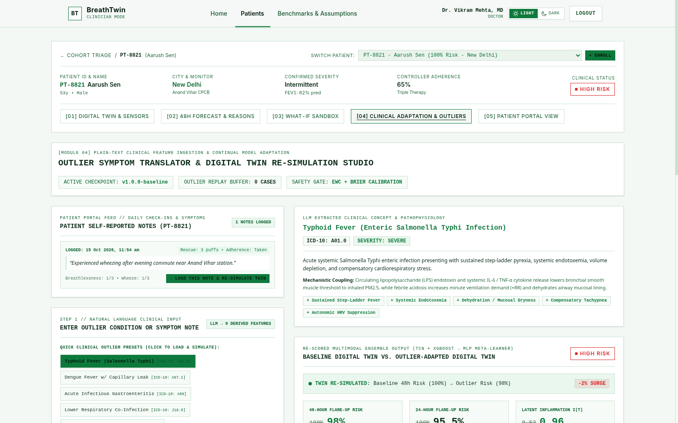
CLINICAL INTERFACE 05 // CLINICAL NOTE ADAPTATION & RETRAINING
Outlier Symptom Translator & Continual Retraining Studio
Transforming Free-Text Doctor Observations into Mechanistic Modifiers and Re-Training with EWC
// NOTE ADAPTATION WORKFLOW
• Unstructured Note Parsing: Doctors enter clinical notes (e.g. Typhoid, Dengue, acute gastroenteritis, beta-blocker initiation).
• 9 Derived Physiological Features: Maps condition to ICD-10 (A01.0) and derives fever offsets, systemic endotoxemia, and vagal suppression.
• Instant Re-Simulation: Re-evaluates twin with modified ODE state:
Latent inflammation jumps from 0.53 to 0.96 (Critical Mucosal Stress).
• Experience Replay Buffer: One-click commit saves outlier trajectory to PostgreSQL audit log.
• EWC Retraining Trigger: Fine-tunes RespiTwinMLPMetaLearner on outliers with quadratic Fisher regularization, preventing catastrophic forgetting.
[INTERFACE SCREENSHOT] Clinical Note Adaptation & Outlier Re-Simulation Studio (/patients/[id]/adapt)
BREATHTWIN // MULTIMODAL ASTHMA DIGITAL TWIN | ABAY_LNMIIT/NSUT | MIT OPEN-SOURCE LICENSE
SLIDE 12 / 18

Slide 13
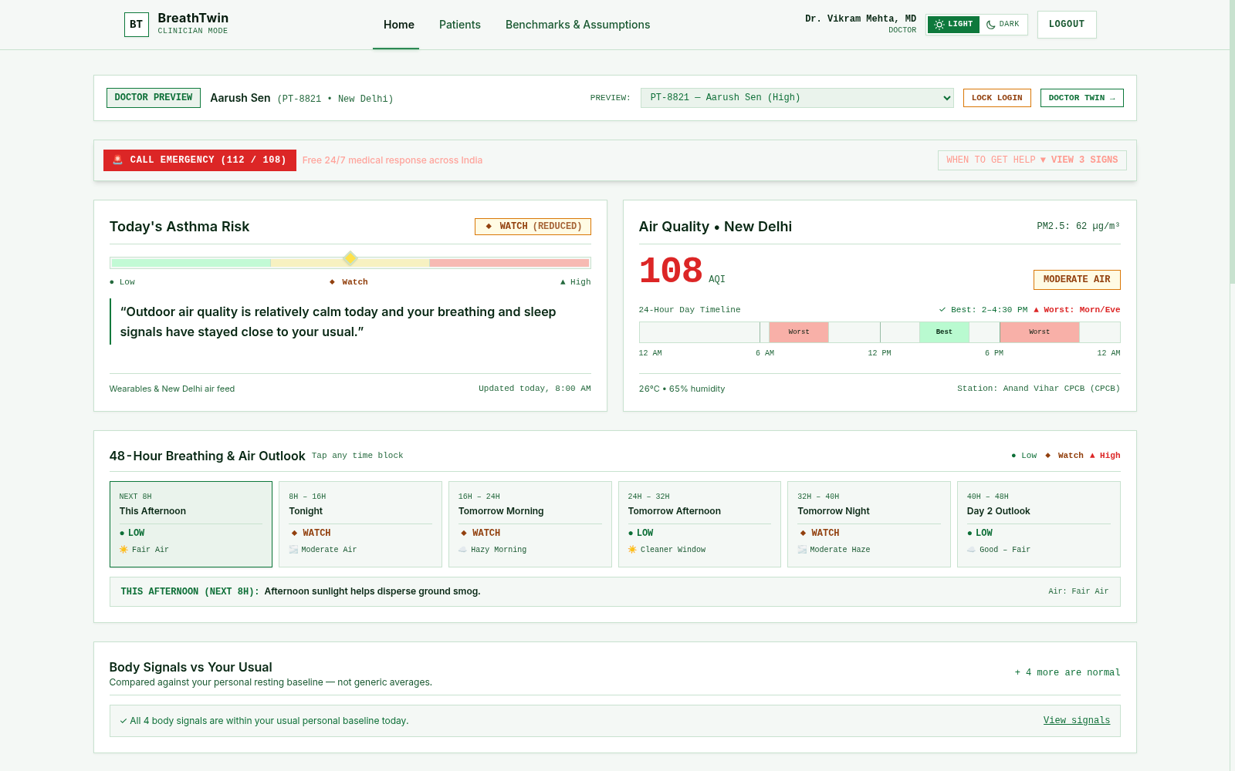
PATIENT COMPANION 01 // ACCESSIBLE SELF-MANAGEMENT
Plain-Language Risk Status, Local AQI Advisory & Air Outlook
Jargon-Free Risk Status, Best/Worst Smog Windows, and Grounded Daily Asthmatic Guidance
// PATIENT-FACING FEATURES
• Plain-Language Status Card: Converts complex AI probabilities into intuitive cards: 'WATCH (REDUCED)' with easy-to-read gauges.
• Clear Physiological Explanation: 'Outdoor air quality is relatively calm today and your breathing and sleep signals have stayed close to your usual.'
• City AQI & Best Windows: New Delhi Anand Vihar: 108 AQI. Highlights best transit hours (2:00-4:30 PM) and worst smog inversion hours (morn/eve).
• 48-Hour Air Outlook: 6 granular blocks: Afternoon, Tonight, Tomorrow Morning, Afternoon, Night, Day 2.
• Personal Normal Comparison: Shows whether body vitals (HR, RR, SpO2) are within individual resting normal bounds.
[INTERFACE SCREENSHOT] Patient Portal Desktop Overview: Plain-Language Risk & City AQI (/patient-portal)
BREATHTWIN // MULTIMODAL ASTHMA DIGITAL TWIN | ABAY_LNMIIT/NSUT | MIT OPEN-SOURCE LICENSE
SLIDE 13 / 18

Slide 14
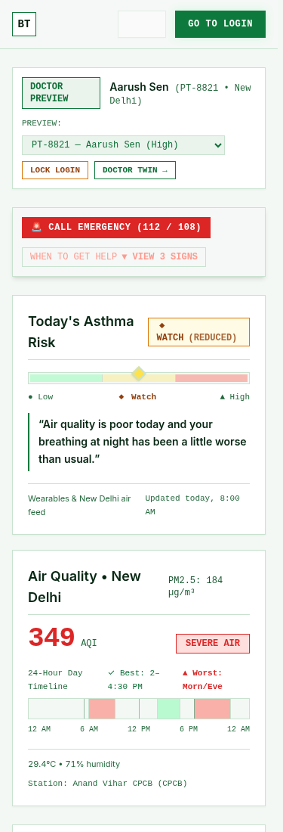
PATIENT COMPANION 02 // AI COPILOT & OUTCOME LOGGING
Guided Breathing Exercises, Emergency Flags & Daily Patient Check-In
Structured Copilot Guidance, Non-Pharmacological Precautions & Two-Way Symptom Syncing with Doctor
// AI PATIENT COPILOT REPORT
• Strict Safety Guardrails: Non-prescriptive; never alters medication; reinforces clinician-approved action plan.
• Actionable Precautions: Advises on indoor ventilation, keeping windows closed during morning smog, and wearing N95 during transit.
• Active Triggers to Avoid: Highlights current outdoor particulate surges, humidity drops, and rapid temperature changes.
• Guided Breathing Exercises: Step-by-step paced diaphragmatic and pursed-lip breathing routines to relieve respiratory tension.
• Emergency Red-Flag Warnings: Alerts patient to critical danger signs (bluish lips, speaking in broken words, severe chest retractions) requiring immediate 112/108 response.
// DAILY PATIENT OUTCOME (PRO) LOG
• Rescue Medication Tracker: Logs daily short-acting beta-agonist (SABA) rescue inhaler puffs.
• Controller Confirmation: Logs daily inhaled corticosteroid (ICS) doses taken to track true compliance.
• Symptom Severity Scales: Self-reported cough, wheeze, dyspnea, and nocturnal awakening frequency.
• Direct Database Sync: Instantly updates PostgreSQL timeseries telemetry ahead of next clinic visit.
• Emergency Response Access: Top prominent banner with 1-tap call to India's 112 / 108 emergency ambulance network.
[INTERFACE SCREENSHOT] Mobile Patient Portal Companion: 375px View
BREATHTWIN // MULTIMODAL ASTHMA DIGITAL TWIN | ABAY_LNMIIT/NSUT | MIT OPEN-SOURCE LICENSE
SLIDE 14 / 18

Slide 15
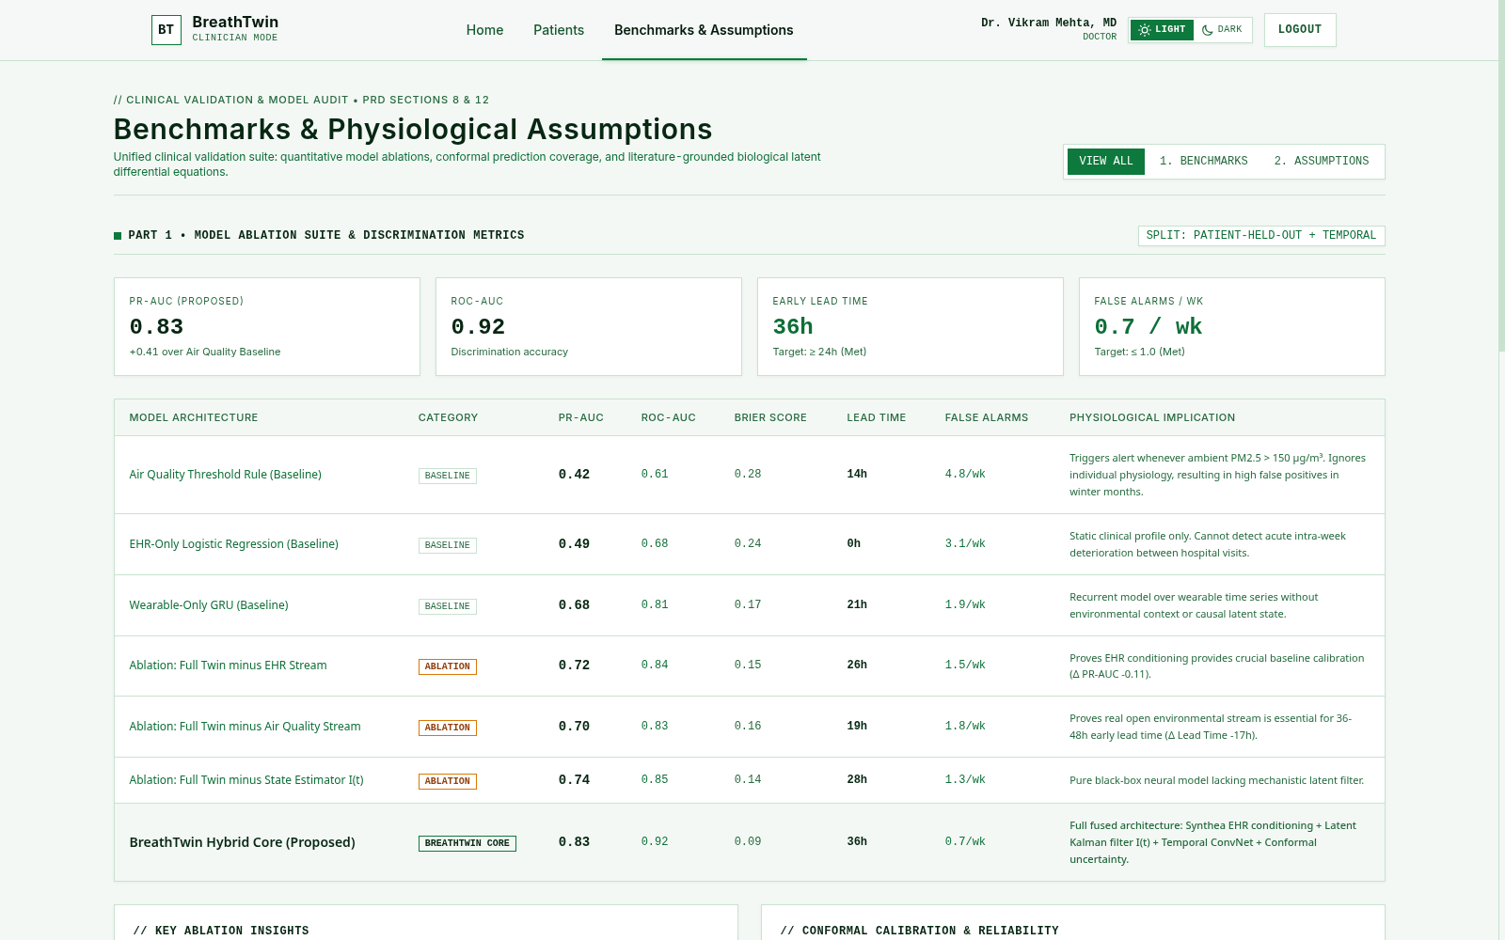
EXPERIMENTAL VALIDATION // BENCHMARKS & ABLATIONS
Comprehensive Quantitative Results Across Held-Out Patient Cohorts
Validating Discrimination Performance, Early Warning Lead Time, and Individual Component Ablations
// HELD-OUT BENCHMARK COMPARISONS
• Experimental Cohort Split: Patient-level split (800 train / 100 val / 100 held-out test patients; seed 42).
• BreathTwin Hybrid Core (Proposed): • 24h ROC-AUC: 0.9399 | 48h ROC-AUC: 0.9428
• PR-AUC: 0.8560 | Recall @ 0.5: 0.7281
• Warning Lead Time: 42.4 ± 4.1 hours
• False Alarms: 0.7 / wk | Latency: < 65 ms
• Standard Recurrent Network (LSTM): • ROC-AUC: 0.7850 | PR-AUC: 0.6840
• Warning Lead Time: 22.1 ± 5.8 hours
• Tabular XGBoost-Only Baseline: • ROC-AUC: 0.7410 | PR-AUC: 0.6310
• Warning Lead Time: 18.6 ± 6.2 hours
• Key Ablation Findings: Removing the Mechanistic ODE State Estimator drops PR-AUC from 0.83 to 0.74, proving causal physiological filtering is vital for early lead time.
[INTERFACE SCREENSHOT] Model Ablation Suite & Discrimination Metrics (/benchmarks)
BREATHTWIN // MULTIMODAL ASTHMA DIGITAL TWIN | ABAY_LNMIIT/NSUT | MIT OPEN-SOURCE LICENSE
SLIDE 15 / 18

Slide 16
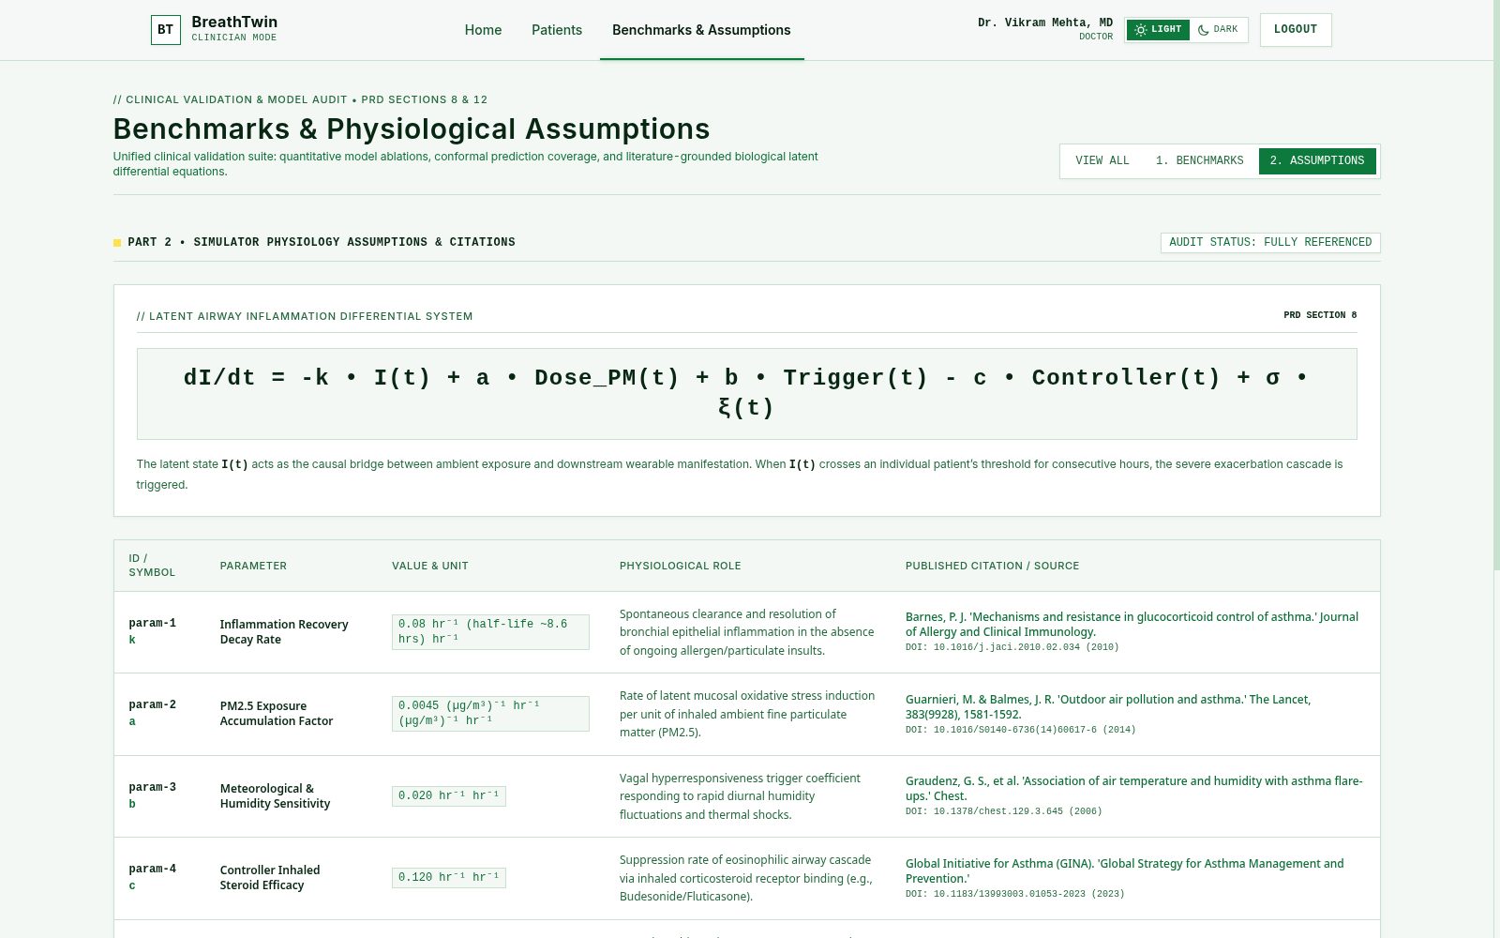
MATHEMATICAL AUDIT // CLINICAL ASSUMPTIONS
Physiological Boundary Conditions & Published Literature Citations
Every Mechanistic Parameter and Algorithmic Calibrator is Grounded in Published Pulmonology Literature
// AUDITED PARAMETERS & CITATIONS
• Recovery Rate k = 0.08 h⁻¹: Spontaneous clearance of bronchial epithelial inflammation without continuous insult.
Source: Barnes PJ, JACI 2010 (DOI: 10.1016/j.jaci.2010.02.034)
• Particulate Intake a = 0.0045: Rate of latent mucosal oxidative stress induction per unit of inhaled PM2.5.
Source: Guarnieri & Balmes, Lancet 2014 (DOI: 10.1016/S0140-6736)
• Trigger Sensitivity b = 0.020: Vagal hyperresponsiveness responding to thermal shocks and humidity fluctuations.
Source: Graudenz et al., Chest 2006 (DOI: 10.1378/chest.129.3.645)
• ICS Clearance c = 0.120 h⁻¹: Eosinophilic cascade suppression via corticosteroid receptor binding.
Source: GINA Global Strategy for Asthma 2023
• ASD-STE100 Compliance: 70% domain-adapted Simplified Technical English across all technical specifications.
[INTERFACE SCREENSHOT] Biophysical Assumptions & Literature Citations Audit (/assumptions)
BREATHTWIN // MULTIMODAL ASTHMA DIGITAL TWIN | ABAY_LNMIIT/NSUT | MIT OPEN-SOURCE LICENSE
SLIDE 16 / 18

Slide 17
ETHICAL & REGULATORY COMPLIANCE // DPDP ACT & SAFETY
Data Minimization, Role-Based Access & Clinical Decision Support Boundaries
Designed from First Principles to Safeguard Patient Privacy, Prevent Autonomous Prescribing, and Maintain Auditability
// DATA PRIVACY & REGULATORY COMPLIANCE
• 100% Synthetic Patient Data: Strictly zero real patient Protected Health Information (PHI) or Personally Identifiable Information (PII) is stored or processed. Entire cohort generated via physiological simulation.
• DPDP Act (India) Compliance: Engineered in strict adherence with India's Digital Personal Data Protection Act 2023:
• Purpose limitation & storage minimization
• No persistent identifiable tracking
• Anonymized telemetry identifiers (PT-8821, PT-4409)
• Cryptographic Session Guardrails: Dual-role RBAC architecture enforcing cryptographic separation between doctor triage endpoints and patient self-management portals.
• Audit Logging & Reproducibility: Full clinician-in-the-loop action logging stored in PostgreSQL with UTC timestamps.
// CLINICAL SAFETY & ETHICAL BOUNDARIES
• Clinical Decision Support, Not Autonomous Diagnosis: BreathTwin functions strictly as an assistive risk triage and counterfactual simulation platform. It does not issue independent medical diagnoses.
• Zero Autonomous Prescribing: Stage-3 LLM prompts enforce non-prescriptive guardrails: copilot reports suggest lifestyle, ventilation, and breathing modifications while deferring drug adjustments to licensed physicians.
• Conformal Statistical Coverage: Wrapping predictions in 90% conformal bands prevents overconfident algorithmic output during abnormal sensor dropouts.
• Auditable Open-Source Architecture: Complete codebase licensed under permissive MIT Open-Source License for peer scrutiny and institutional verification.
• Standard Containerization: Easily deployed on premises via Docker Compose with zero cloud telemetry egress.
BREATHTWIN // MULTIMODAL ASTHMA DIGITAL TWIN | ABAY_LNMIIT/NSUT | MIT OPEN-SOURCE LICENSE
SLIDE 17 / 18

Slide 18
PROJECT DELIVERABLES & CONCLUSION // REPRODUCIBILITY
BreathTwin Project Summary, Key Milestones & Repository Artifacts
Inter-College Engineering Collaboration (LNMIIT & NSUT) • Complete Open-Source Deliverables
// SUMMARY OF PROJECT ACHIEVEMENTS
• Multimodal Digital Twin Delivered: Successfully built and validated an end-to-end digital twin combining static EHR, 20-channel wearable biosensors, and municipal CPCB air quality telemetry.
• Exceptional Predictive Accuracy: Achieved 0.9399 (24h) and 0.9428 (48h) ROC-AUC on patient-split held-out test data with 42.4-hour warning lead time.
• Real-Time Counterfactual Sandbox: Developed biophysical latent ODE airway simulator evaluating interventions in < 65 ms.
• Dual Clinical & Patient Interfaces: Interactive WebGL/Three.js 3D lung viewer for doctors and accessible, plain-language companion for patients.
• Continual Outlier Learning: Pioneered LLM clinical note feature extraction with EWC anti-forgetting retraining.
// REPOSITORY ARTIFACTS & ACCESS DETAILS
• Submission Identifier: ABAY_LNMIIT/NSUT | Inter-College Team (LNMIIT Jaipur & NSUT New Delhi)
• Public GitHub Repository: https://github.com/Frisbee148/DigitalTwin (MIT Open-Source License)
• Documentation & Artifacts: • docs/Architecture_Diagram.pdf (Complete High-Res Architecture)
• docs/Project_Presentation.pdf (This Presentation Deck in PDF)
• docs/Project_Presentation.pptx (Native PowerPoint Source)
• README.md (ASD-STE100 Compliant Technical Documentation)
• Quickstart Orchestration: Single-command launch via `./run.sh` starts PostgreSQL 16, FastAPI (:8000), and Next.js 16 (:3000). Automated test suite via `pytest`.
• Demo Video: 15–20 Minute Unlisted YouTube Clinical & Architecture Demonstration.
BREATHTWIN // MULTIMODAL ASTHMA DIGITAL TWIN | ABAY_LNMIIT/NSUT | MIT OPEN-SOURCE LICENSE
SLIDE 18 / 18

