Slide 1

Open science
in stroke research
What stroke research makes available
Sebastian Fridman, MD
Western University · London Health Sciences Centre
Notes:
Ten seconds. This benchmark measures transparency and the availability of research materials; it does not test whether reported findings reproduce or replicate. Official WSC banner, used at the speaker's request: https://worldstrokecongress.org/promotional-toolkit/ ; asset: https://wsc2026.kenes.com/wp-content/uploads/sites/32/2025/11/WSC-2026-banner-900x90px_v3.jpg

Slide 2
Disclosure
×
No, nothing to disclose
Yes, please specify
Company
Honoraria / expenses
Consulting / advisory
Funded research
Royalties / patent
Stock options
Ownership / equity
Employee
Other
None
2
Notes:
Required by the congress as the second slide: nothing to disclose. Two seconds, then move on.

Slide 3
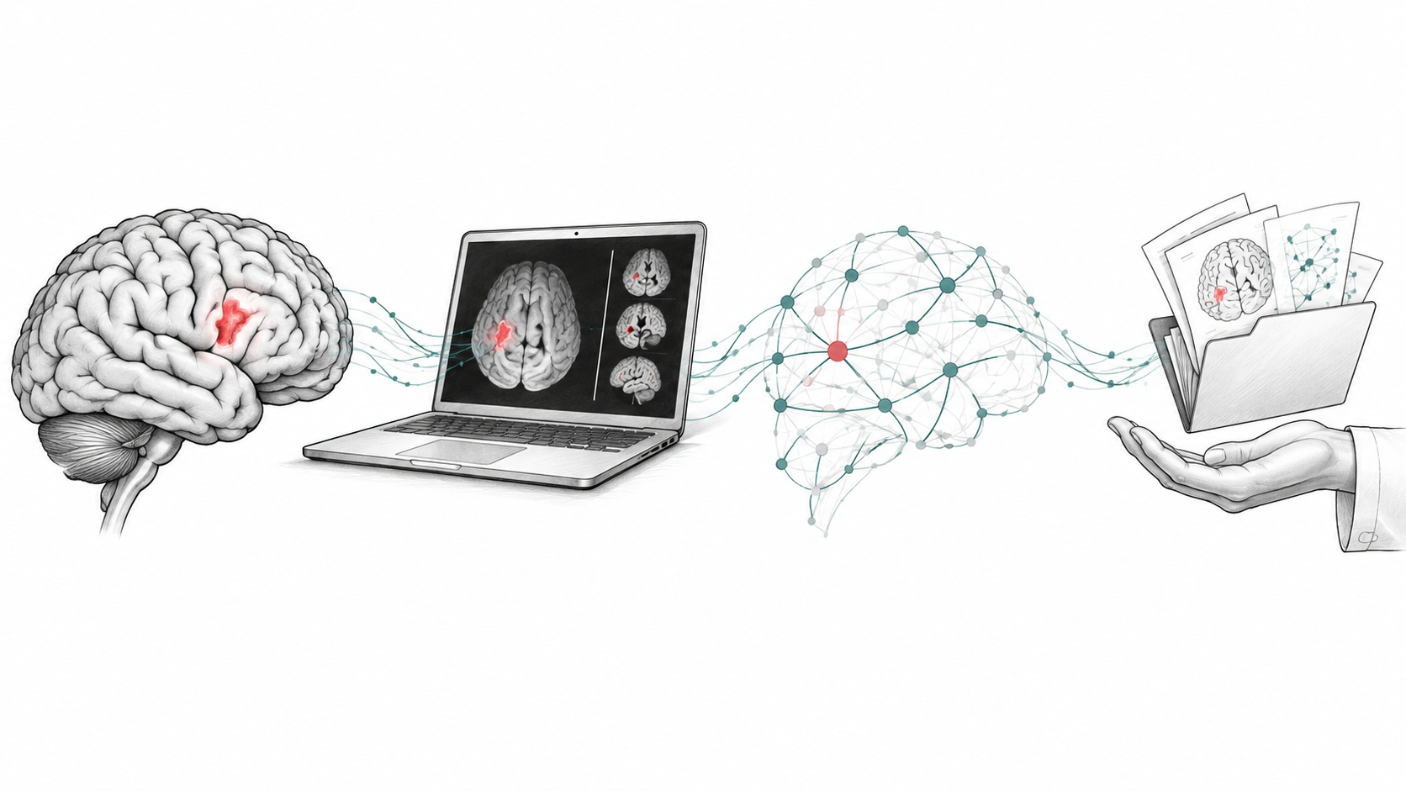
Open tools shaped my stroke research
Open imaging tools. Reusable lesion datasets.
Sharing enables independent checks.
References 1–13
3
Notes:
Fifty seconds, first person. I came to stroke from imaging and neuroscience, where tools such as ITK-SNAP, DeepISLES, SPM Clinical Toolbox, ANTs, VLSM, LESYMAP and BCBtoolkit could be inspected and reused. BIDS and OpenNeuro support sharing. ATLAS v2.0 released 955 public MRIs with lesion masks; ISLES 2022 released 250 cases. These are examples, not a claim that every imaging workflow is open. Liew 2022 found that 12 of 17 ATLAS-based methods did not report public code. Open data alone is not enough. The illustration is conceptual artwork generated with OpenAI Image Generation, not a patient scan or empirical network.

Slide 4
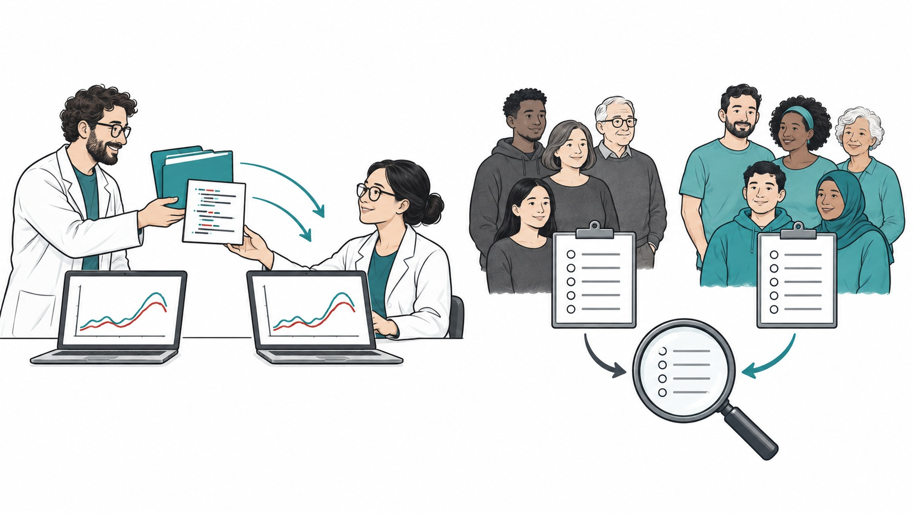
Reproducibility and replication
Reproducibility
Replication
Same data, same analysis.
New data, same question.
Reference 14
4
Notes:
Forty-five seconds. Use the National Academies' 2019 definitions. Reproducibility means obtaining consistent computational results with the original data, code, methods and analysis conditions. Replication asks whether a finding is consistent in a study collecting its own data to answer the same question. Different populations or interventions instead bear on generalizability. Transparency makes the material available for inspection; it does not itself establish successful reproduction or replication. The paired illustration is conceptual OpenAI-generated artwork, not measured findings. https://www.nationalacademies.org/read/25303/chapter/2

Slide 5
SCORE: 55% of claims replicated
Social and behavioural science
Replicated
Not replicated
References 15, 16 · One mark per tested claim
5
Notes:
Sixty seconds. This slide shows a single endpoint, replication, in one project. SCORE directly replicated 151 of 274 claims drawn from social and behavioural science papers published in 2009-2018 (55.1%; Nature 2026). Each mark is one assessed claim; red marks meet the project's primary replication criterion. Outcomes depend on that criterion and this selected sample. This is not a stroke replication rate, nor a before/after trend. The 2015 psychology project found 35 significant replications among 97 tested for significance; its different sample and endpoint cannot establish improvement over time. Statistical power, researcher surveys and data availability measure other constructs and are not pooled here. Tyner et al. doi:10.1038/s41586-025-10078-y.

Slide 6
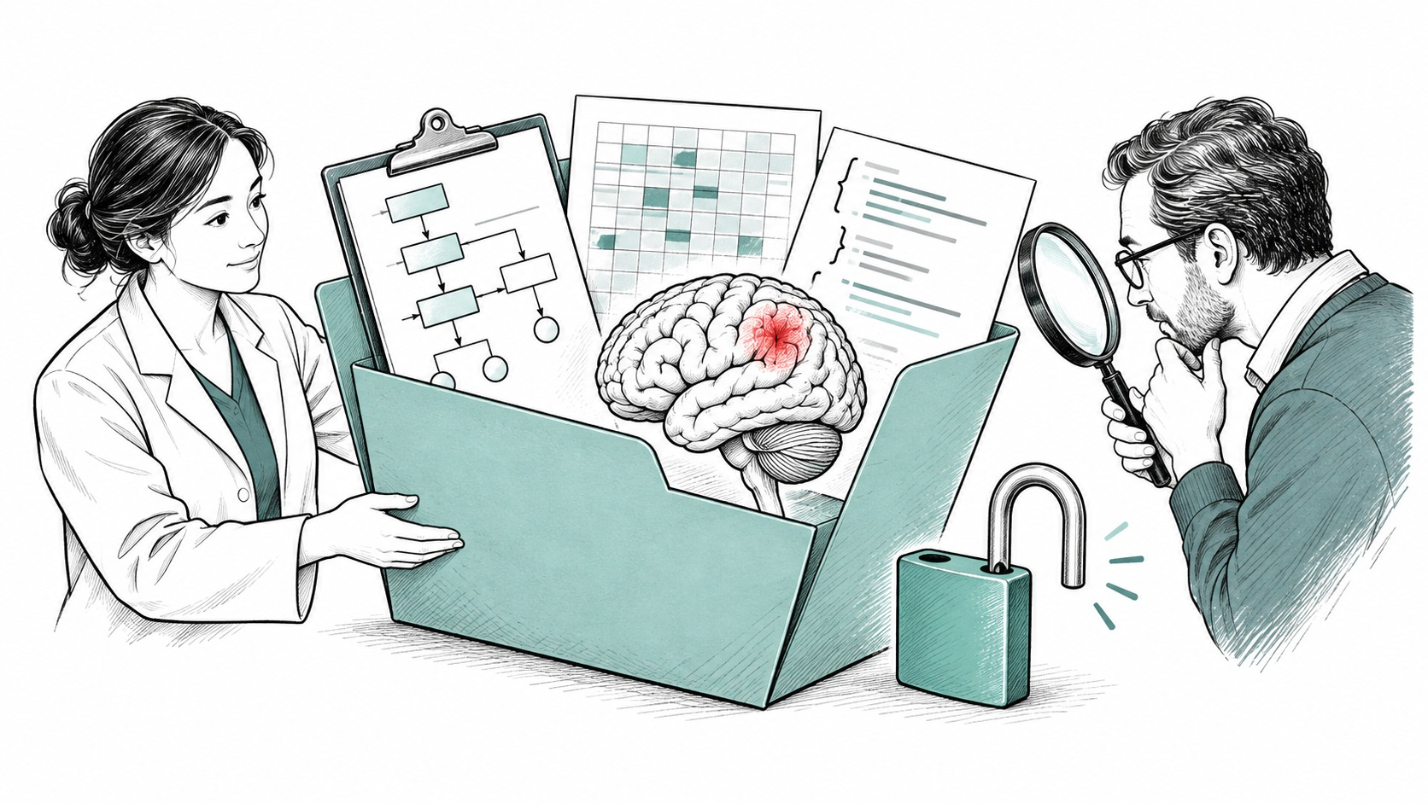
Stroke research needs inspectable evidence
Protocols explain what was planned.
Data and code enable independent checks.
Different patients can produce different results.
References 14, 17
6
Notes:
Fifty seconds. Now move from replication evidence in other disciplines to transparency in stroke. Animal-to-human translation is a generalizability problem. Trials enrolling different patients or using different interventions do not automatically test replication of the same claim. Tirofiban and subdural-haematoma trial contrasts have therefore been removed as evidence of a stroke reproducibility crisis. Access to protocols, data and code helps us investigate differences, with controlled access where patient privacy requires it. Missing public materials does not prove incorrect results. Our benchmark measures these enabling practices, not successful independent replication. Conceptual illustration generated with OpenAI Image Generation; not patient data.

Slide 7

Four transparency checks
Can we read the paper?
Can we inspect and reuse materials?
Was the study registered?
Stroke publications since 2015
References 17–22
7
Notes:
Forty-five seconds. Audits like this exist for neurology (Rauh 2020) and cardiology (Heckerman 2025), and data requests have been tested in vascular and cognitive trials (Scutt 2020); we found none of stroke publications. The benchmark reads OpenAlex for every stroke journal article and review with a DOI since 2015 (140,281 for 2015-2025, title search), then reads up to 1,500 open-access full texts a year through Europe PMC (16,362 for stroke), with neurology, neuroscience and cardiology measured the same way. It re-runs every six months; code and data are open, and every number on the next slides is on the public dashboard: the QR code. Open-access full text only, so full-text rates run high. The four indicators are access, data, code and registration. Data and code are grouped in one spoken question. These measure transparency, not successful reproducibility.

Slide 8
Stroke papers became easier to read
80%
75% Stroke
60%
40%
2015
2024
Reference 22 · Stroke articles · 2015–2024
8
Notes:
Thirty-five seconds. The good-news slide. Open access = any OpenAlex status other than closed. Stroke sits between cardiology and neurology in every complete year (2015-2024); in the incomplete 2025 it edges past cardiology. Do not rank neuroscience: about 45% of it comes from the title term 'neural', much of it machine learning. Figure shows stroke only; comparators remain on the live dashboard.

Slide 9
Gold and hybrid drove access growth
Gold / hybrid
Diamond / green
Bronze
Closed
2015
19%
2024
44%
Reference 22 · All stroke articles · Publication routes
9
Notes:
Forty seconds. Gold/hybrid stroke publication routes increased from 18.6% in 2015 to 44.1% in 2024; diamond/green from 18.9% to 23.9%; bronze declined from 15.3% to 7.2%. The remaining share was closed. These classify publication routes, not observed payments. Waivers and funding agreements are not measured. The two bars each include all stroke articles in that year and sum to 100%.

Slide 10
Funding is associated with open access
Stroke · High-income first authors
Funder listed
83%
No funder listed
56%
Reference 22 · OpenAlex funding metadata · 2015–2025
10
Notes:
Forty-five seconds. Stroke articles, 2015-2025, high-income first-author group: 83% open access when OpenAlex lists a funder (29,055 articles), versus 56% without a listed funder (44,147). This is a descriptive association, not a causal estimate of funding. No listed funder does not prove no funding: acknowledgements may be missing. The groups may differ in year, journal and study type. Source: benchmark 2026-10-13, Income groups.

Slide 11
Access differs across stroke research communities
Gold / hybrid
Diamond / green
Bronze
Closed
Indonesia
95%
Netherlands
90%
Korea
75%
United States
58%
Reference 22 · Selected first-author countries · 2015–2025
11
Notes:
Forty seconds. Selected stroke first-author countries, 2015-2025: Indonesia, Netherlands, Korea and United States. Components use the same corpus and years. These are descriptive examples, not a ranking or a causal effect of policy or wealth. Gold and hybrid often charge fees, but article-level payments, waivers and funding agreements were not observed. Diamond and green are publishing or repository routes.

Slide 12
Access grew; sharing links remained scarce
From abstracts and metadata
Open access
75%
Data links
0.2%
Code links
<0.1%
Reference 22 · Stroke articles · 2024
12
Notes:
Thirty-five seconds. Lower bounds from abstracts and metadata, 2024: data in a repository 0.2% (0.2% in 2015, never above 0.6%); code links below 0.1% in every complete year. What did move: registration IDs, 2.8% to 5.3% of articles with an abstract, and preprints, 2.7% in 2024, partly publisher-driven (Research Square, SSRN). Pooled over 2015-2025, high-impact articles are barely better at sharing (data 0.45% vs 0.34%). Then the pivot: so we read the full text. The figure measures detected links, not the availability of all underlying data or code.

Slide 13
Statements outnumber deposits and public sources
Statement
74%
On request
29%
Deposit / public source
9.8%
References 19, 22, 23 · OA stroke full texts · 2025
13
Notes:
Sixty seconds; the slide people photograph. Open-access stroke full texts published in 2025 (the audit reads 1,500 a year, so the year is complete for the audit): 74% write a data statement (14% in 2015), 29% say 'available on request', now the most common answer, and 9.8% deposit data or name a public source (own repository deposit 5.9%). In 2024: 69%, 30% and 7.3%. 'On request' delivers little: 6.8% of authors shared when asked (Gabelica 2022); 20% of 391 vascular and cognitive trials, median 241 days (Scutt 2020). Against the other fields, 2022-2025, stroke says 'on request' most often (30%; neurology 27%, neuroscience 26%, cardiology 24%). Open-access full texts only, so these rates are optimistic for stroke overall. Statement presence overlaps the other indicators; these rows do not partition all statements.

Slide 14
Stroke data access differs by income
Deposited or public source
High income
4.0%
Upper-middle
5.2%
Lower-middle
1.8%
Reference 22 · OA stroke audit · 2015–2025
14
Notes:
Forty seconds. Among the three larger income groups, lower-middle-income first authors are the most open to read (75%, 42% through diamond or green), yet in open-access full texts, 2015-2025, they write a data statement in 23% (high 43%, upper-middle 57%) and deposit or name a public source in 1.8% (4.0%, 5.2%), from 609 audited articles; the gap holds in 2022-2025. Both panels use the same scale, which is the point: deposit is tiny everywhere. Low-income countries (400 articles, 77 audited) are too few to show. Korea: 5,490 first-author articles, 75% open. This figure shows only deposit/public-source rates, with a 0-6% scale.

Slide 15
Sharing practices can be measured
Deposit · Code · Registration
Charité
4.4×
Oxford
2.9×
UKE Hamburg
2.6×
Edinburgh
2.5×
Relative to the stroke average
Reference 22 · Descriptive index · Sample sizes differ
15
Notes:
Forty-five seconds. The index is the mean, over three full-text signals (data deposited or public source, GitHub, trial registration), of an institution's rate divided by the stroke rate; 1 = stroke average. Shown: the top of the 60 institutions with the most audited articles (82 or more each), as on the dashboard. Charité is counted once: OpenAlex lists its Center for Stroke Research Berlin and the Berlin Institute of Health separately, and those are merged into it (133 audited articles; deposit or public source 9.8%, GitHub 10.5%, trial registration 37%). Small counts are a hint, not a ranking. Journals: among the 40 largest on the dashboard, the Journal of Cerebral Blood Flow and Metabolism leads (2.7x) and Stroke is fourth (1.5x); among smaller journals with at least 30 audited articles, Nature Communications, Brain Communications and PeerJ lead. The point: the measurement exists, is cheap, and is what a prize would recognise. Four descriptive examples; sample sizes and full comparison remain on the dashboard.

Slide 16
A rule does not ensure access
Obtainable data from surgical trials
Before ICMJE rule
3.1%
After ICMJE rule
3.1%
Reference 24 · Bergeat et al. · JAMA Network Open
16
Notes:
Fifty seconds. One medical example, not a pooled estimate: Bergeat et al., JAMA Network Open 2022, surgical RCTs before and after the ICMJE data-availability statement requirement. Obtainable datasets were 3.1% in both periods. This descriptive before/after comparison does not establish a causal effect. Evidence on badges, promotion criteria and Registered Reports measures other outcomes and is kept off this visual. doi:10.1001/jamanetworkopen.2022.15209.

Slide 17
A proposal for the WSO
Create a WSO task force.
Reward verified sharing.
Track progress through this benchmark.
17
Notes:
One minute forty-five. Proposal: ask WSO to convene a task force and develop a position statement; retire 'available on request' in Stroke, IJS, ESJ and JSCVD in favour of a repository, VISTA or Vivli, or a stated reason; Registered Reports for stroke trials with in-principle acceptance tied to WSO and ESO grants; embargoed sharing as the trial default, twelve months after publication. Prize: the commitment index, verified in full text and recomputed every six months, for institutions, journals, funders and countries. Awareness: the public benchmark; open-science items in promotion criteria (in 2020, 1 of 92 guidelines mentioned data sharing, and none open access or registration). Targets to discuss: data in a repository or controlled-access platform for 25% of stroke articles by 2030 (own repository deposit was 5.9% of 2025 open-access full texts); 'on request' under 10%; one Registered Report track in a stroke journal by 2028. The statement, retiring 'on request' and promotion criteria cost nothing; Registered Reports, the prize and the infrastructure need money, and the infrastructure mostly exists: VISTA and Vivli for trial data, ATLAS and OpenNeuro for imaging, ENIGMA for pooled analysis. Invite the WSO leadership in the room to take the task force home. Proposed targets and deadlines are discussion points, not commitments or current WSO policy.

Slide 18



Measure, share, and improve stroke research
Benchmark
Code and data
References
Sebastian Fridman · sfridma@uwo.ca
18
Notes:
Thirty seconds. One line, then stop. Leave the QR codes up during questions: the benchmark dashboard, the code and data, and the references. Thank the session chairs.

Slide 19

References
1
Yushkevich PA et al. Neuroimage. 2006
7
Boes AD et al. Brain. 2015
2
de la Rosa E et al. Nat Commun. 2025
8
Foulon C et al. Gigascience. 2018
3
Rorden C et al. Neuroimage. 2012
9
Gorgolewski KJ et al. Sci Data. 2016
4
Avants BB et al. Med Image Anal. 2008
10
Markiewicz CJ et al. Elife. 2021
5
Bates E et al. Nat Neurosci. 2003
11
Liew SL et al. Sci Data. 2022
6
Pustina D et al. Neuropsychologia. 2018
12
Hernandez Petzsche MR et al. Sci Data. 2022
Full list with DOIs
19
Notes:
Appendix: not presented. Full references with DOIs at the QR code link.

Slide 20
References, continued
13
Gibson M et al. Sci Data. 2024
19
Scutt P et al. BMJ Open. 2020
14
National Academies of Sciences et al.
20
Priem J et al. arXiv. 2022
15
Open Science Collaboration. Science. 2015
21
Rosonovski S et al. Nucleic Acids Res. 2024
16
Tyner AH et al. Nature. 2026
22
Fridman S. Stroke Open-Science Benchmark, run of 2026-10-13
17
Rauh S et al. Res Integr Peer Rev. 2020
18
Heckerman GO et al. Elife. 2025
23
Gabelica M et al. J Clin Epidemiol. 2022
24
Bergeat D et al. JAMA Netw Open. 2022
20
Notes:
Appendix: not presented. Full references with DOIs at the QR code link.

