Slide 1
Open science in stroke research
Measuring reproducibility and transparency, and what to do with the numbers
Sebastian Fridman, MD
Western University · London Health Sciences Centre · Canada
The latest in stroke implementation science · Thursday 22 October 2026
Notes:
One sentence, no agenda slide: I want to tell you how this project started, what it found, and what I think we should do with it.

Slide 2
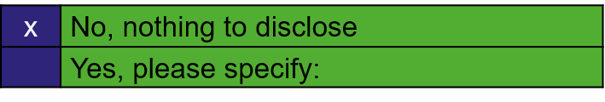
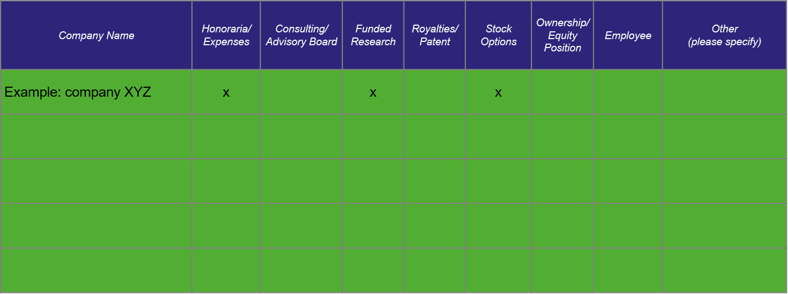
 | No, nothing to disclose
 | Yes, please specify:
Company Name | Honoraria/ Expenses | Consulting/ Advisory Board | Funded Research | Royalties/ Patent | Stock Options | Ownership/ Equity Position | Employee | Other (please specify)
Notes:
Required by the congress. Tick one box by typing an x in the blue cell, and list any company in the table. The congress's published faculty disclosure list shows Speakers Bureau, Regeneron/Bayer, under Other; confirm it, or ask wsc@kenes.com to correct it.

Slide 3
The moment this started
01 Where I come from
I came to stroke from imaging and neuroscience. [In 20__ I tried to build on a published result: the data were “available on request”, the code was not there, and the request went unanswered. I could not tell whether the finding was wrong or I was.]
imaging · neuroscience · neurology · stroke
Notes:
Thirty to forty seconds, first person, nothing read. Replace the bracketed sentence with the real episode: the point is that you have been on the receiving end of a closed literature. Alternatives if the draft is not right: a published model that could not be retrained because the training set was never released; a perfusion-threshold result two groups reproduced with opposite signs because the processing code differed.

Slide 4
The fields next door had their crisis first
02 Why open science
Psychology
36%
of 100 published findings replicated with a significant result; effect sizes about half the originals
Open Science Collaboration, Science 2015
Neuroscience
21%
median statistical power of neuroscience studies
Button et al., Nat Rev Neurosci 2013
Preclinical cancer
6 of 53
landmark findings that Amgen could reproduce
Begley and Ellis, Nature 2012
Across science
70%
of 1,576 researchers had failed to reproduce another group’s experiment; 52% called it a significant crisis
Baker, Nature 2016
What those fields did about it
Preregistration and Registered Reports in more than 300 journals, open-data badges, the Open Science Framework, data and code as a condition of publication. In Registered Reports, 44% of results are positive, against 96% in the standard literature (Scheel 2021).
Psychology and neuroscience measured themselves, it hurt, and they changed how they publish.
Notes:
These are the speaker’s former fields; say so. One minute. The last line is the bridge to stroke.

Slide 5
Same question, different answers, and no way to tell why from the papers alone
03 Stroke is not immune
Preclinical
1,026 neuroprotectants tested in animal stroke; none translated. Publication bias overstated efficacy by about a third. NXY-059: SAINT I positive, SAINT II negative.
O’Collins 2006; Sena 2010; Lees 2006; Shuaib 2007
Tirofiban
No benefit before thrombectomy in RESCUE BT (2022). Benefit without a large-vessel occlusion in RESCUE BT2 (2023). A different question, or a different answer?
Qiu 2022, JAMA; Zi 2023, NEJM
Middle meningeal artery embolisation
Three trials in one NEJM issue: EMBOLISE positive (recurrence 4% vs 11%), STEM positive, MAGIC-MT neutral (6.7% vs 9.9%).
Davies, Fiorella, Liu 2024, NEJM
Replication is how a field finds out which result to trust. Without the protocols, the data and the code, we are left arguing about it.
Notes:
If asked: in the animal work one in seven experiments was never published (Sena 2010). One minute, three examples the room knows. Do not editorialise on any single trial; the point is heterogeneity that cannot be resolved from the papers alone. Confirm that the embolisation trio is the example you meant.

Slide 6
Four questions a field should be able to answer about its own literature
04 What open science is made of
Read it
Can people read it?
Open access, and by which route
Diamond, gold, hybrid, green, bronze or closed
Check it
Can they check it?
Data and code that someone else can run
Repository links, GitHub, data-availability statements
Reuse it
Can they reuse it?
Deposited, not promised on request
A repository or a controlled-access platform
Plan it
Was it planned in advance?
Registration and preregistration
Trial registries, PROSPERO, Registered Reports
Reproducibility audits exist for neurology, cardiology and general medicine. None existed for stroke. Rauh 2020; Heckerman 2025; Scutt 2020
Notes:
Forty-five seconds. Implementation science applied to research practice itself: you cannot improve what you do not measure.

Slide 7
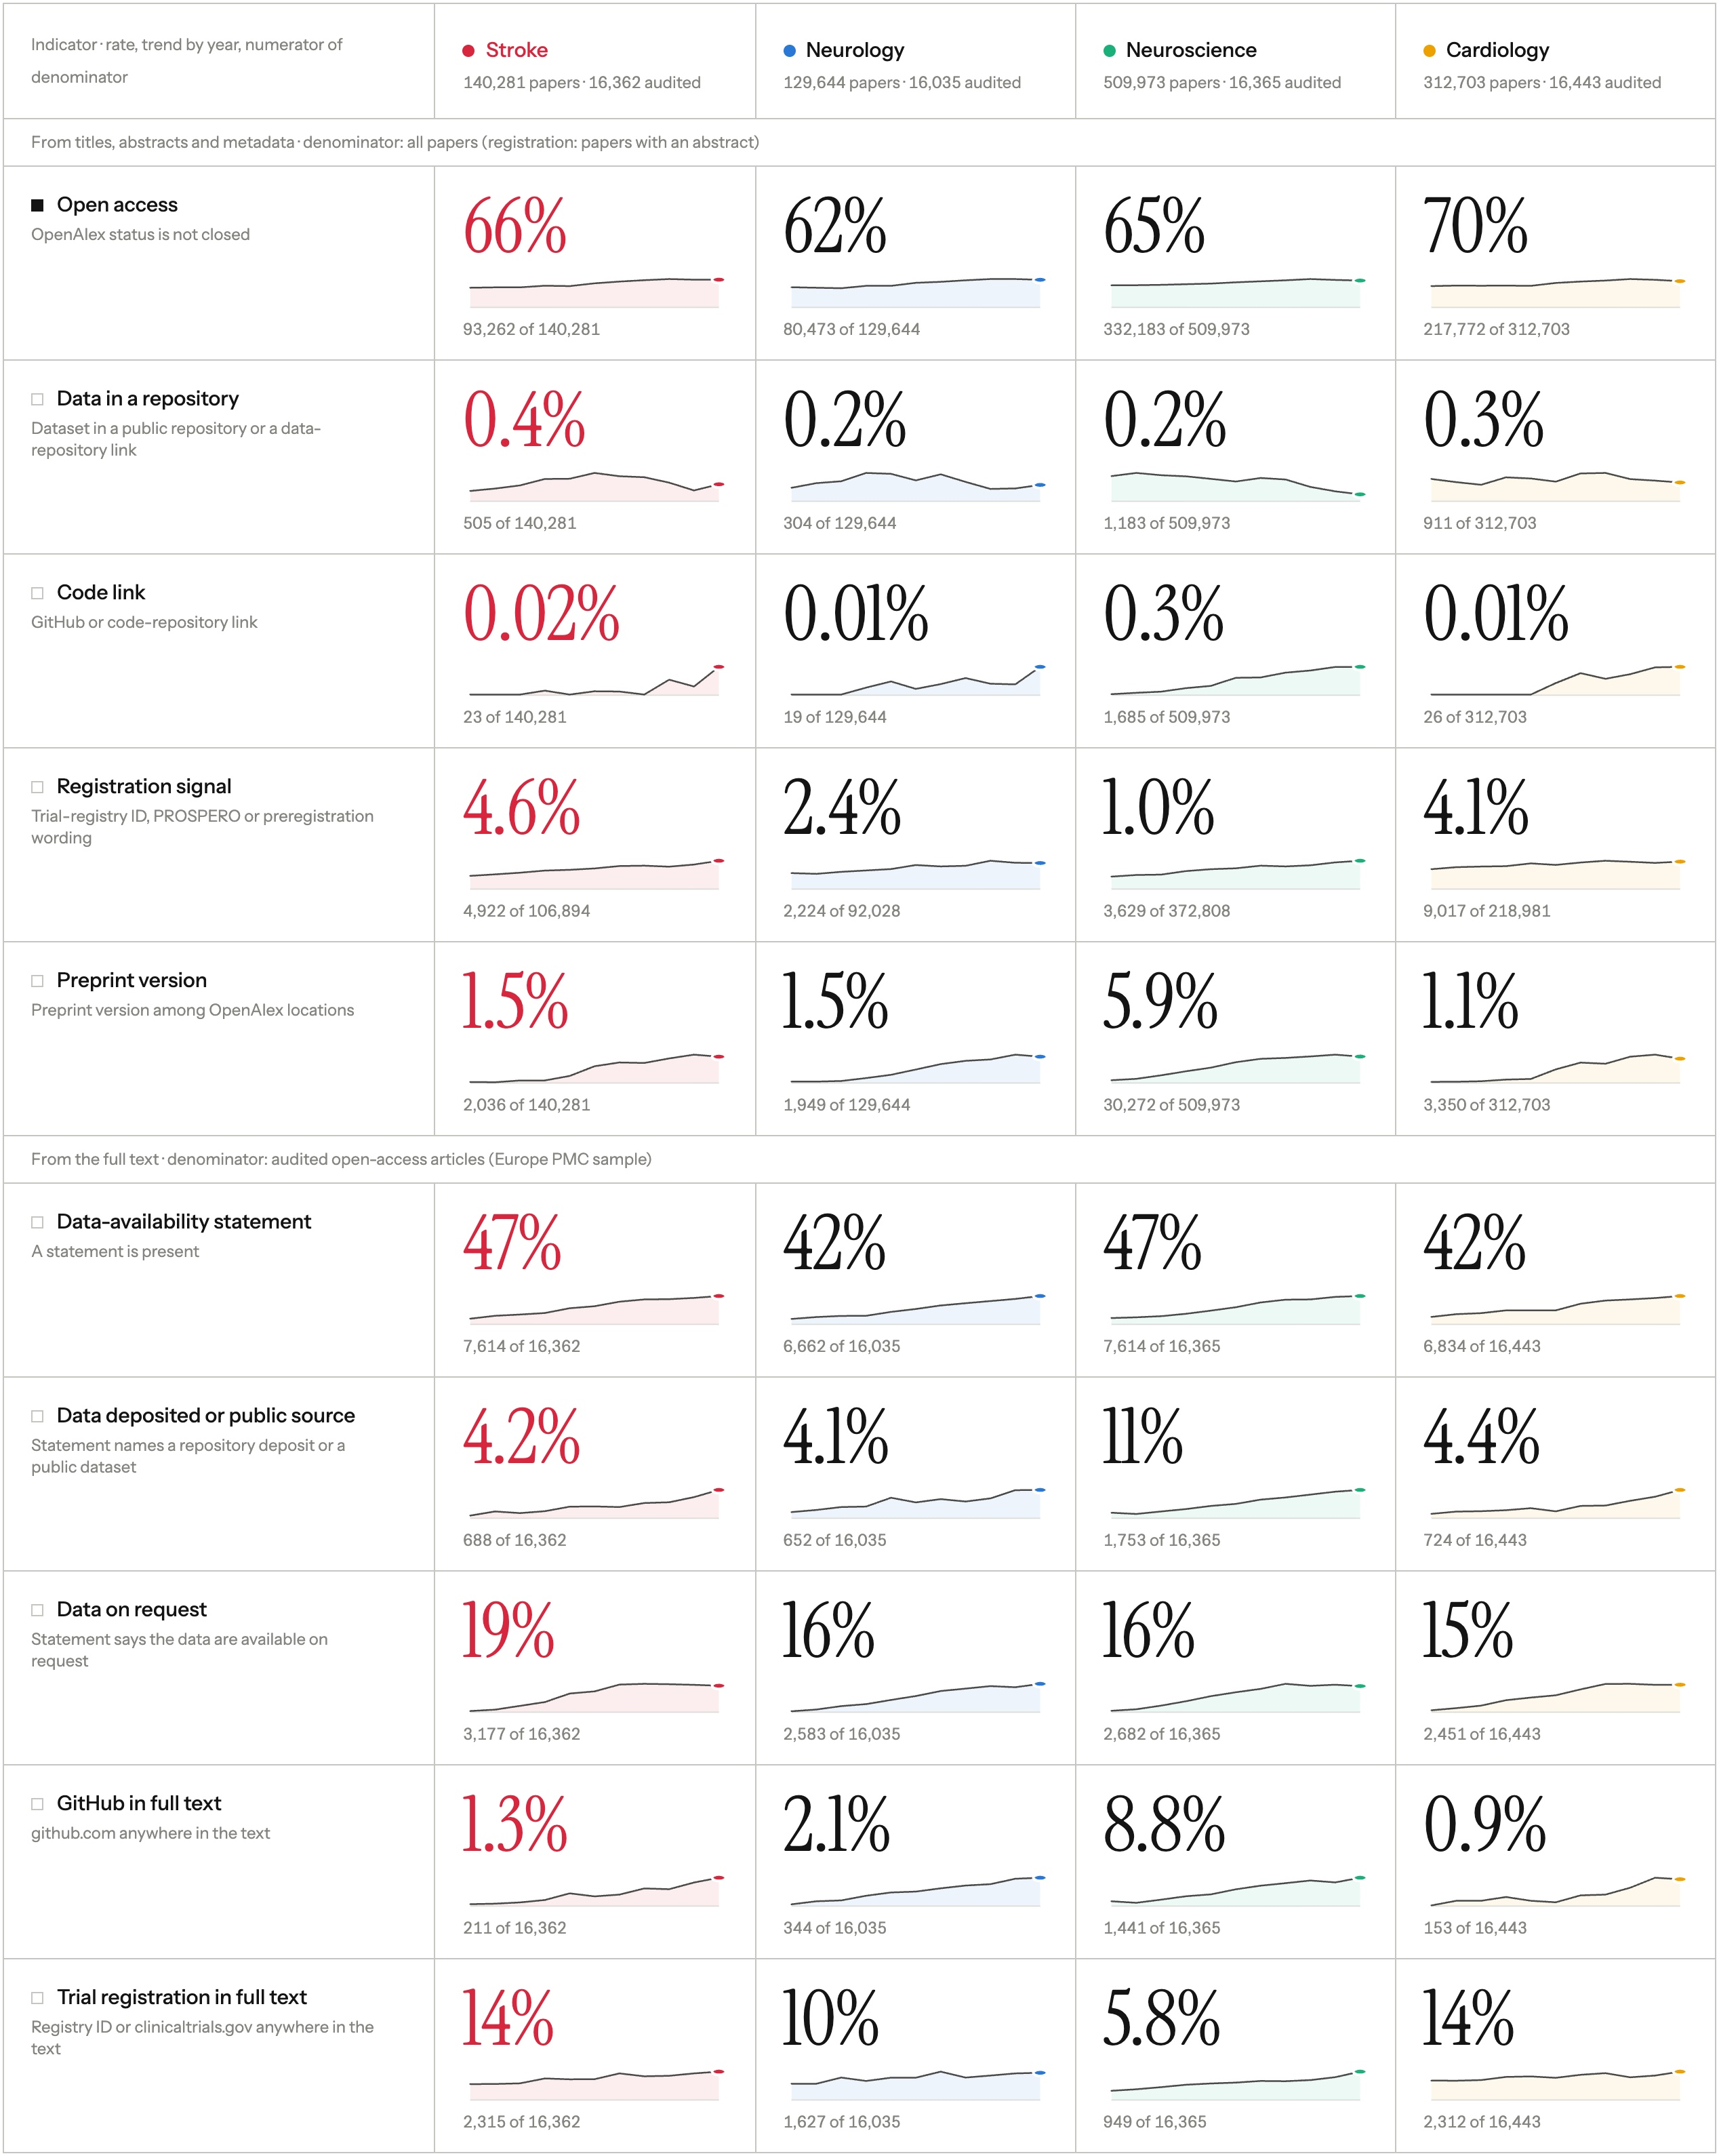
A living pipeline measures the stroke literature every six months
05 How we measured
Retrieve
OpenAlex, 2015 onward; stroke plus neurology, neuroscience, cardiology
Clean
Journal articles and reviews with a DOI; datasets, preprints, errata and chapters out
Detect
Open-access status, repository links, preprint versions, registration identifiers
Read
Data-availability statements in up to 1,500 open-access full texts per year, via Europe PMC
Publish
Open code, open data, public dashboard; re-run every six months
140,281
stroke articles and reviews
16,362
stroke full texts read
4
fields, 2015 to 2025
friseeb.github.io/stroke_open_science_outputs · Abstract and metadata signals are lower bounds; the full-text audit narrows the gap for data sharing.
Notes:
Forty-five seconds. The method is the credibility. One published run, 13 October 2026: 231,580 OpenAlex records from six title terms, 2015 to 2026, of which 140,281 are stroke journal articles and reviews with a DOI from 2015 to 2025. The full-text audit reads up to 1,500 open-access articles per year in each field through Europe PMC, 16,362 for stroke. Open-access full text only, so those rates run high, and a pooled rate gives every year the same weight, so I lead with single years and say "over the decade" when I pool. Everything that follows is on the dashboard, where the selection can be changed by anyone. On the card, neuroscience leads on code, GitHub, deposit and preprints, partly because its title term "neural", which brings in about 45% of that corpus, also catches machine-learning papers. If asked: neurology 129,644, cardiology 312,703, neuroscience 509,973 articles.

Slide 8
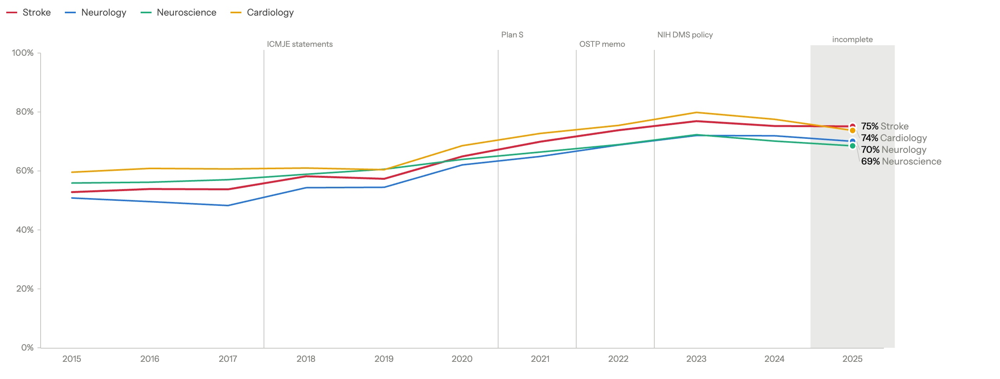
Stroke went open access: 53% in 2015, 75% in 2024
06 Finding 1
Open access = any OpenAlex status other than closed. Stroke 66% over the decade; cardiology 70%, neurology 62%, neuroscience 65% (its title term “neural” also catches machine-learning papers). 2025 is incomplete.
Notes:
The good-news slide. Let it land, then turn it on the next one. Stroke sits between cardiology and neurology every year through 2024; in the incomplete 2025 it is just above cardiology (75% vs 74%). The peak so far is 77% in 2023. Do not rank neuroscience: about 45% of it comes only from the title term “neural”, much of it machine learning; without those papers it is 67% open access. It is above stroke until 2019 and below neurology in 2024 and 2025.

Slide 9
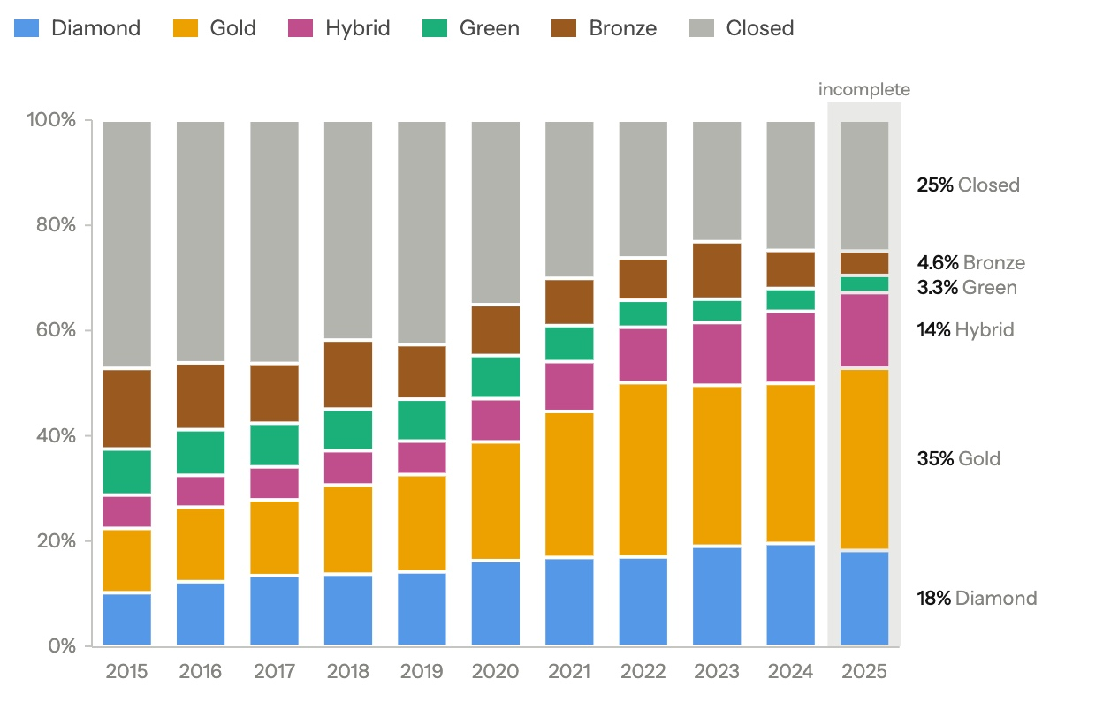
The growth in open access was paid for, not deposited
07 Finding 2
Route, 2015 to 2025
Share
Gold, paid journal
25%
Diamond, free journal
16%
Hybrid, paid in a subscription journal
10%
Bronze, free to read, no licence
10%
Green, repository copy
6%
Closed
34%
From 2015 to 2024 gold, a paid route, grew the most (+18 points); diamond (+9) outgrew hybrid (+7). Green fell from 9% in 2015 to 3% in 2025. Bronze can be withdrawn at any time.
Open access became a transaction between funders and publishers. It did not come with openness of anything else.
Notes:
For this room: diamond is a long tail of about 4,800 free journals. Cureus is the largest (1,187 articles), then Journal of Physical Therapy Science (487) and Journal of Stroke (334). About a quarter of Korean (27%) and Japanese (25%) first-author articles are diamond; Chinese 5%. Gold plus hybrid is about half of the open articles over the decade (52% with 2025, 49% through 2024) and the majority every year since 2021: 35% in 2015, 53% in 2021, 59% in 2024. One sentence on APCs and the equity angle; the equity slide comes later. The growth figures stop at 2024 because 2025 is still filling in. Green fills in last, as repository copies appear after embargoes end, but it was already down to 4% in 2024, so its fall does not rest on the partial year.

Slide 10
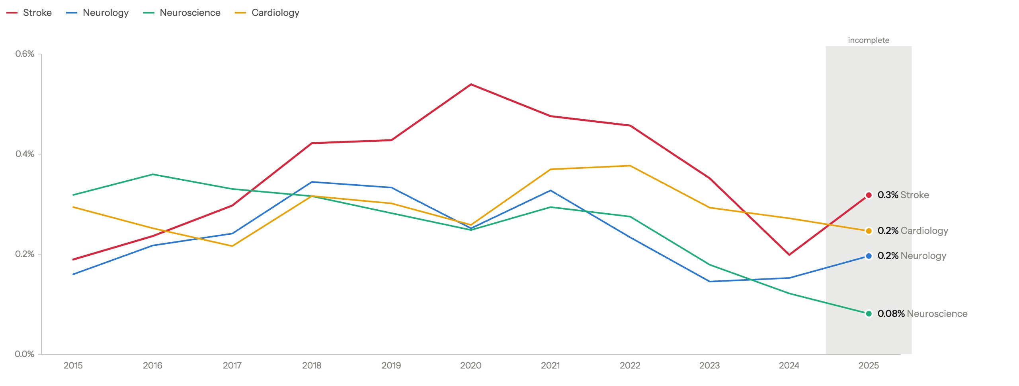
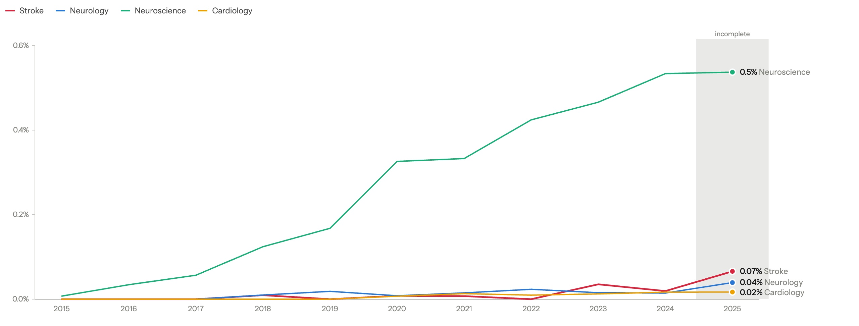
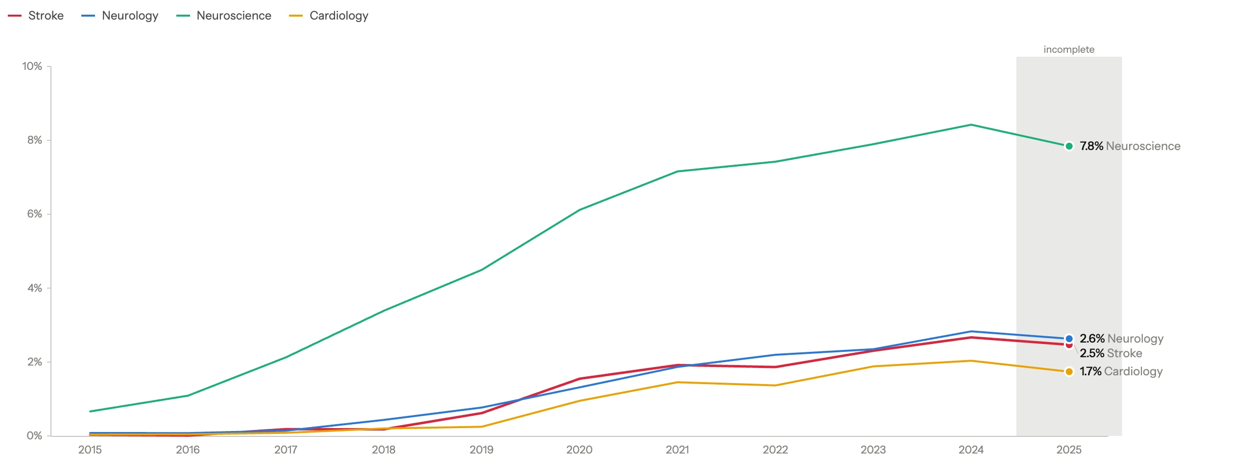
In abstracts, data and code did not move in ten years
08 Finding 3
Data in a public repository
GitHub or code link
Preprint version
Data in a repository
0.2%
of stroke articles in 2024; 0.2% in 2015, never above 0.6%
Code link
<0.1%
every year 2015-2024; GitHub in 2.5% of 2024 full texts
Preprint version
2.7%
in 2024; 1.5% in 2015-2025. A lower bound, partly publisher-driven
Registration ID in the abstract
5.3%
in 2024, from 2.8% in 2015; stroke ahead of cardiology, neurology and neuroscience
High impact is barely better at sharing: top-cited or IF 10+ articles (16% of the corpus) are 74% open access vs 65%, registration 10.0% vs 3.5%, but data 0.45% vs 0.34%, code 0.08% vs 0.06%. These are lower bounds from abstracts and metadata. So we read the full text.
Notes:
Say the caveat before anyone says it for you: lower bounds from abstracts. Preprints did move, from under 0.2% before 2019 to 2.7% in 2024, but only as far as OpenAlex links them (it merged many preprint records into their articles in early October), and about half are on Research Square or SSRN, mostly publisher routes at submission (In Review, Lancet and Elsevier). GitHub in full text: 2.5% of the 1,500 audited 2024 articles, 1.3% pooled over the decade with every year weighted the same; the code chart counts GitHub or code links in abstracts, and the high-impact line also counts Zenodo and OSF links. Registration nearly doubled, 2.8% to 5.3%, from a low base: stroke 4.6% over the decade, cardiology 4.1%, neurology 2.4%, neuroscience 1.0%; neuroscience's term "neural" pulls in machine-learning papers, and without them it is still only about 1.5%. The neuroscience preprint line also reflects "neural": machine-learning papers, many on arXiv. Then the pivot: so we read the full text.

Slide 11
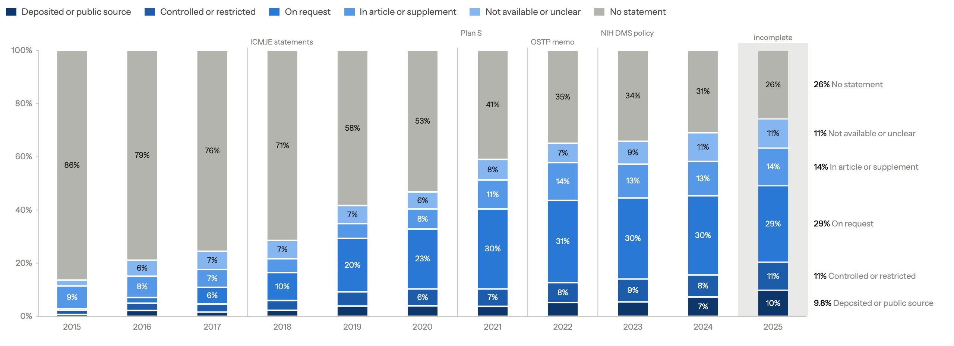
What data-availability statements actually say
09 The full-text audit
Write a statement
74%
in 2025, from 14% in 2015; arrived with the journal mandates
Say “available on request”
29%
in 2025, from 0.6% in 2015; now the largest answer
Deposit or public source
9.8%
in 2025, from 0.7% in 2015; own deposit 5.9%
16,362 open-access stroke full texts, up to 1,500 per year, Europe PMC; optimistic for stroke overall. Elsewhere, “on request” delivers little: 6.8% of authors shared when asked (Gabelica 2022); 20% of 391 vascular and cognitive trials, median 241 days (Scutt 2020).
Notes:
The slide people photograph. Three numbers, slowly. Against the other fields, 2022 to 2025: stroke says “on request” more than any other field (30%; neurology 27%, neuroscience 26%, cardiology 24%), writes statements as often as any of them (69%; neuroscience 72%, neurology 64%, cardiology 61%), and deposits or names a public dataset at the level of the other clinical fields (6.9%; cardiology 7.3%, neurology 5.6%), well under neuroscience (17.5%). Neuroscience caveat: its title term “neural” also catches machine-learning papers; without them neuroscience writes statements in 68% (stroke 69%) and deposits 13.6%. If asked for the decade: “on request” 19% and deposit or public source 4.2%, pooled over yearly samples of up to 1,500, so every year weighs the same; they are not corpus rates. Full text versus abstract for the same audited articles, 2015 to 2025 pooled the same way: GitHub in 1.3% of full texts vs code, OSF or Zenodo links in 0.07% of abstracts; trial registration 14.1% vs 7.5%. If asked about top journals: 0.6% of top-journal RCTs that declared sharing had downloadable data (Danchev 2021).

Slide 12
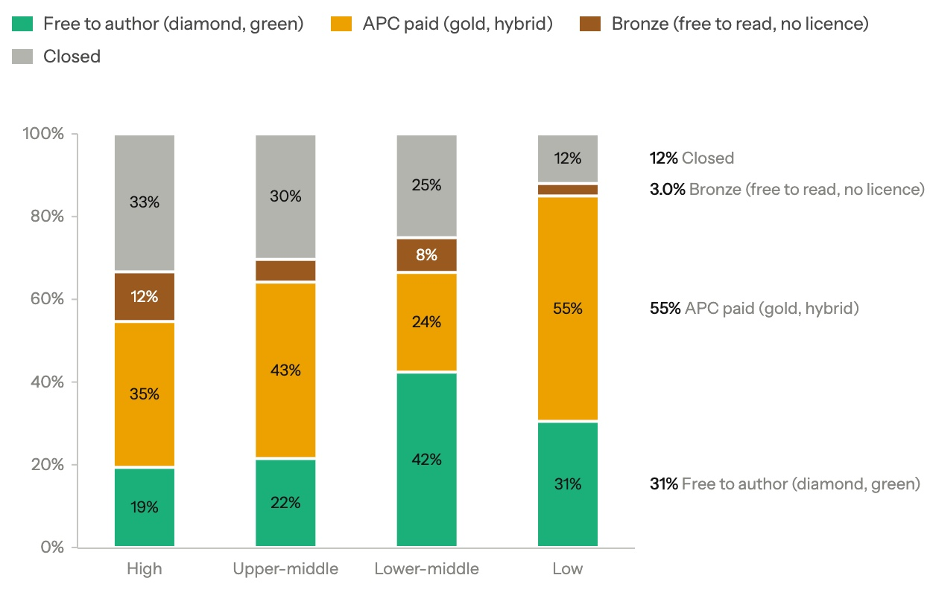
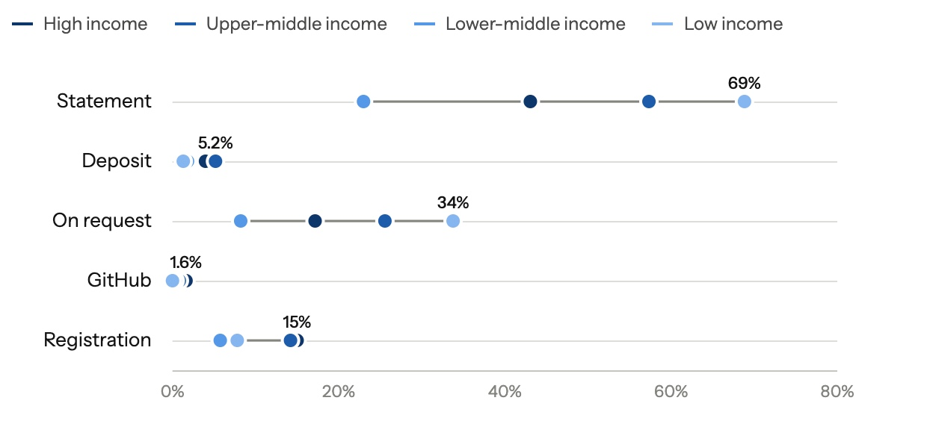
Reading access has been solved for the global South by free routes. Reuse has not.
10 Who pays to be read, and who shares
What the full text shows, by income group
Lower-middle-income authors publish 42% through routes that cost nothing (high income 19%), yet over 2015-2025 deposit or name public data in 1.8% (high 4.0%), mention GitHub in 0.3% (1.6%) and a trial registration in 5.7% (15.0%).
Open-access route by World Bank income group of the first author’s country
Income group known for 85% of the corpus: high 62%, upper-middle 32% (mostly China), lower-middle 6%, low 0.3% (400 articles). Korea: 5,490 first-author articles, 75% open access.
Notes:
Seoul is a high-income audience with LMIC trialists in the room. Open access rises as income falls: 67% high, 70% upper-middle, 75% lower-middle (88% low, only 400 articles, do not lean on it). Upper-middle-income authors pay an APC for 43%. The data and code that lower-income teams could build on are not there, and their own work is the least likely to be shared: a data statement in 23% of lower-middle-income full texts (high 43%, upper-middle 57%), from only 609 audited articles. These full-text rates pool 2015-2025 over the audit's sample of up to 1,500 open-access full texts a year, so they average equal yearly samples, not the corpus. The gap holds in 2022-2025 alone: a statement in 37% of lower-middle vs 65% high and 78% upper-middle; deposit or public source 3.0% vs 6.2% and 8.7%. That is the inequality open science can close. Korea: 5,490 first-author articles, 75% open access, none with a data-repository link in the abstract or metadata; 1.3% of 1,293 audited full texts deposit or name a public source.

Slide 13
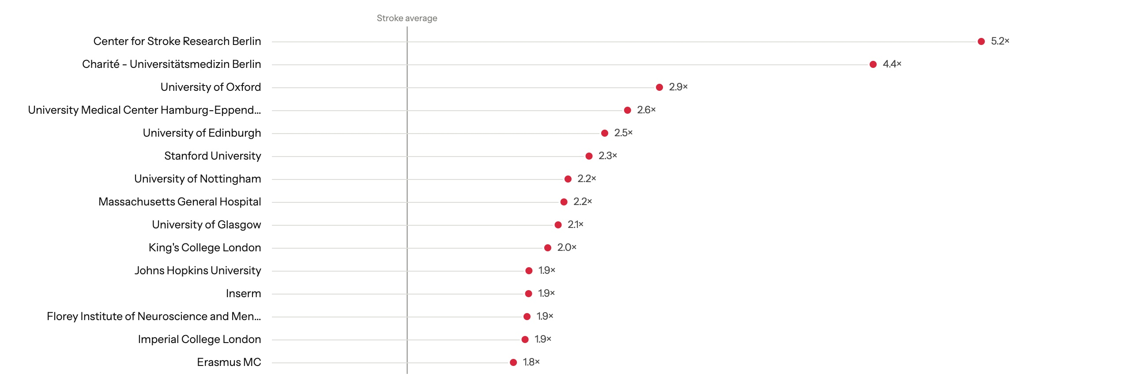
A commitment index, verified in the full text
11 Who is already doing it
Journals: Nature Communications, Brain Communications, PeerJ, NeuroImage Clinical lead; Stroke is about 15th of 99, at 1.5×. Funders: US federal institutes, ANR, Swiss Heart Foundation, Leducq, DFG. Countries: Belgium 2.4×, Germany 2.2×, Switzerland 2.0×, France 1.8×, UK 1.5×.
Index = mean over three full-text signals of the entity’s rate ÷ the stroke audit rate: data deposited or public source (4.2%), GitHub (1.3%), trial registration (14.1%). 1 = stroke average. Institutions: the 60 with the most audited articles (82+ each); countries 50+, journals and funders 30+.
Notes:
Recomputed every six months. Say the n out loud: Charité 129 audited articles, Oxford 177, Hamburg-Eppendorf 109; Nature Communications 30, PeerJ 31 (25 of them deposit). The top two in the figure are both Charité: the Center for Stroke Research Berlin (5.2×) is part of it (4.4×). The figure ranks the 60 institutions with the most audited articles (82 or more); with every institution at 50 or more, the German Center for Neurodegenerative Diseases (5.6×, 61 audited) and the Berlin Institute of Health at Charité (5.2×, 64) also lead, then Zurich (4.7×, 64). Small counts are a hint, not a ranking: GitHub is rare (1.3%), so one more GitHub mention in 100 audited articles adds about 0.26, and the order shifts between runs. Countries need 50 audited articles: at 30, Russia, with 43 audited, would be second at 2.2×. The baselines pool the 2015-2025 audit with every year weighted the same, and the signals rose over the decade (deposit or public source 0.7% in 2015, 9.8% in 2025), so an index also reflects which years an entity published in. Stroke sits above the average, not among the leaders of the 99 journals; the dashboard keeps only the 40 largest journals and 25 largest countries, so there Stroke ranks third and Belgium and Ireland do not appear. Oxford is also listed as a funder in OpenAlex (4.9×, 33 audited); it is an institution, so I leave it out of the funders. Also on the lists: PeerJ deposits in 81%; funders NIDCD, NIBIB, HHS, Horizon 2020 and BMBF; Ireland 1.7×. The point is not the names: the measurement exists, is cheap, and is what a prize would recognise.

Slide 14
Rules produced statements. Incentives produce data.
12 Why mandates alone did not work
3.1% to 3.1%
Data obtainable from surgical trials before and after the ICMJE statement requirement.
Bergeat 2022, JAMA Netw Open
OR 0.9
Open-data badges in the only medical randomised trial, at BMJ Open. The same badges took Psychological Science from under 3% to 39% open data.
Rowhani-Farid 2020; Kidwell 2016
0 of 92
Biomedical promotion guidelines worldwide that mention data sharing, registration or open access.
Rice 2020, BMJ
44% vs 96%
Positive results in Registered Reports versus the standard literature. Changing when review happens changes what gets published.
Scheel 2021
Stroke researchers are not less honest than psychologists. They respond to the same incentives, and ours point the other way.
Cardiology survey, n = 198: funding named the most essential incentive; “policy alone will not lead to implementation” (Cobey 2024).
Notes:
The pivot of the talk. Four numbers, then the sentence in serif. No more studies here; the evidence brief has them if asked.

Slide 15
A task force, a prize, and awareness
13 What to do next
1
A WSO task force on open science
A position statement: no stroke society has one
Retire “available on request” in Stroke, IJS, ESJ and JSCVD: a repository, VISTA or Vivli, or a stated reason
Registered Reports for stroke trials, with in-principle acceptance tied to WSO and ESO grants
Embargoed sharing as the trial default, twelve months after publication
2
A prize for the teams that share
The commitment index: verified in the full text, recomputed every six months
Institutions, journals, funders and countries
On the Einstein Foundation model, presented at this congress
3
Awareness
The public benchmark, updated every six months
Open-science items in promotion criteria: 0 of 92 guidelines today
Targets to discuss: data in a repository or controlled-access platform for 25% of stroke articles by 2030; “on request” under 10%; one Registered Report track in a stroke journal by 2028
The statement, retiring “on request” and promotion criteria cost nothing. Registered Reports, the prize and the infrastructure need money, and the infrastructure mostly exists: VISTA, ATLAS, ENIGMA.
Notes:
Two minutes fifteen. Invite the WSO leadership in the room to take the task force home. Say which items cost nothing and which need money.

Slide 16


We measured ourselves. The numbers are not flattering, but they are measurable, which means they are improvable.
COLLABORATE
Stroke Open-Science Benchmark
friseeb.github.io/stroke_open_science_outputs
Explore it, challenge it, run it on your field
Code and data
github.com/Friseeb/stroke_open_science
Open source; the next run is January 2027
Sebastian Fridman · sfridma@uwo.ca
Western University · London Health Sciences Centre
Write to join the task force or to audit your own field
Notes:
One line, then stop. Leave the links and the QR codes up during questions. Thank the session chairs.

