Slide 1

Open science
in stroke research
A living benchmark, 2015–2025
Sebastian Fridman, MD
Western University · London Health Sciences Centre · Canada
Thursday 22 October 2026 · 15:45 · Conference Room 202-203
Notes:
One sentence, no agenda slide: I want to tell you how this project started, what it found, and what I think we should do with it.

Slide 2
WORLD STROKE CONGRESS 2026 · SEOUL
Conflict-of-interest disclosure
Disclosures
×
No, nothing to disclose
Yes, please specify
Company name
Honoraria / expenses
Consulting / advisory board
Funded research
Royalties / patent
Stock options
Ownership / equity position
Employee
Other (please specify)
None
Notes:
Required by the congress as the second slide: the congress's conflict-of-interest form, with the same two boxes and nine categories as the World Stroke Congress 2026 template. Nothing to disclose; a second, then move on.

Slide 3
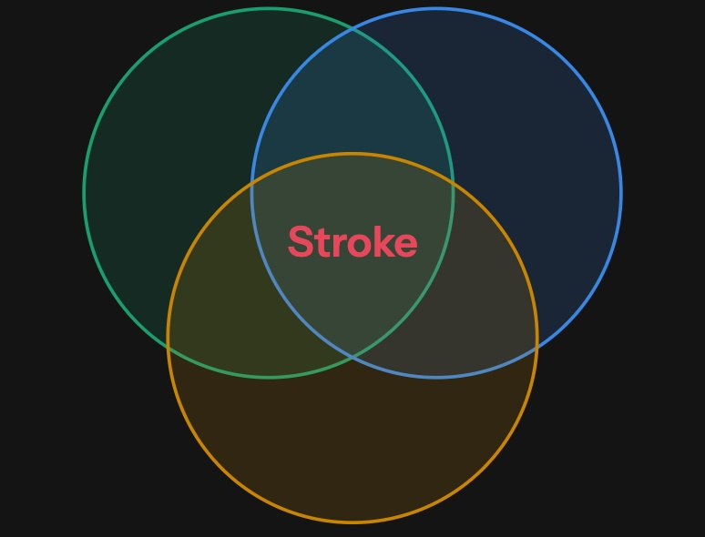
WORLD STROKE CONGRESS 2026 · SEOUL
01 Background
Hybrid discipline
Neuroscience
Lesion–symptom mapping, disconnection, connectomes
Neurology
Trials, outcomes, recovery
Cardiology
Atrial fibrillation, PFO, vascular risk
The benchmark compares stroke with the same three fields
Notes:
Fifty seconds, first person. As a stroke neurologist, I went to cognitive neuroscience: lesions are how we learn where functions live and how brain networks connect. Stroke is hybrid by definition, and we work with all three of these fields every day. Neuroscience gives us the lesion: lesion-symptom mapping, disconnection, connectomes. Neurology gives us the trials, the outcomes and recovery. Cardiology gives us the heart and the vessels: atrial fibrillation, PFO, vascular risk. So stroke inherits its neighbours' methods, and also their problems, which is the next part; and these are the three fields the benchmark compares stroke with. The colours are the same in every chart that follows: stroke red, neuroscience green, neurology blue, cardiology yellow; the circles sit in the legend's order (neuroscience top left, neurology top right, cardiology below). On the neuroscience side, a lesion study is built from open parts at every step: segmentation (MRIcron, ITK-SNAP, LINDA, nnU-Net; DeepISLES, an ensemble of the ISLES 2022 winners, was validated on 1,685 external scans and neuroradiologists preferred its masks to manual ones in a Turing-like test), normalisation that respects the lesion (cost-function masking, enantiomorphic normalisation, the SPM Clinical Toolbox, ANTs), lesion-symptom mapping (VLSM since Bates 2003; NiiStat, SVR-LSM, LESYMAP), disconnection (lesion network mapping, BCBtoolkit, the Lesion Quantification Toolkit) and sharing (BIDS, OpenNeuro with 1,913 public datasets today, NeuroVault). Most are BSD, GPL or Apache licensed; a few need MATLAB. The datasets are real: ATLAS v2.0 (1,271 MRIs, 955 public; raw data under a data use agreement), ISLES 2022 (250 of 400 public), the Aphasia Recovery Cohort (230 people with aphasia, 902 sessions, CC0) and SOOP (1,715 admissions with clinical MRI, CC0) on OpenNeuro. Open data did not bring open code by itself: 12 of 17 methods published on ATLAS released no code (Liew 2022). The contrast that started this project: on the neuroscience side the tools and data are open; on the clinical side, trial data and code are not. [Optional, your call: one sentence on your own lesion-mapping study at ESOC 2026 (351 patients) and the open tools it used.] Sources: talk/evidence_intro.md.

Slide 4
WORLD STROKE CONGRESS 2026 · SEOUL
02 Open science
Purpose
Reproducibility
1
Access
2
Value
3
Notes:
Twenty seconds. Three reasons a field opens its work. Reproducibility: others can check it. Access: anyone can read it and use it, wherever they work. Value: public money buys the knowledge once, not again and again. One slide each, with an example from stroke where there is one.

Slide 5
WORLD STROKE CONGRESS 2026 · SEOUL
03 Reproducibility · Access · Value
Reproducibility
Stroke and its neighbours
Neuroscience
Neurology
Cardiology
Preclinical stroke
200+
8 years
43%
10 of 525
lesion network mapping studies, challenged in 2026 with public data alone
before the NINDS rt-PA data could be checked independently; the benefit held
higher odds of MI on rosiglitazone, in results the maker had to post
animal studies reported no effect
Analysis choices
Closed data
Unpublished results
Publication bias
van den Heuvel 2026 · Ingall 2004 · Nissen 2007 · Sena 2010
Notes:
Forty-five seconds. One case from each neighbour, then our own; the bottom line of each card is what went wrong. Neuroscience, in my own method: lesion network mapping has been used in more than 200 studies. In January 2026 a Nature Neuroscience re-analysis (van den Heuvel and colleagues), using only public data (the GSP1000 connectome, NeuroVault maps, LesionBank), argued that it maps any set of lesions, even random ones, onto the same normative network. Present it as a live debate: Zalesky and Cash wrote on null models (Nat Neurosci, March 2026); Pini, Salvalaggio and Corbetta on its biological limitations (Nat Neurosci, May 2026); Siddiqi, Fox and colleagues (preprint) report that specificity holds across 1,090 lesions from 34 studies; a multicentre study of 2,950 stroke patients (Petersen, medRxiv) found domain-specific maps with case-control designs, so specificity depends on design. The point for this talk: the challenge and the replies were possible because the maps and the connectome were public. Michael Fox: 'Such debate will move the field forward.' Neurology: the NINDS rt-PA data were closed for eight years; when an independent committee re-analysed them, the benefit held. That is the next slide. Cardiology: rosiglitazone. Nissen and Wolski used the trial results GSK had to post under a 2004 New York settlement: 42 trials, odds ratio for myocardial infarction 1.43 (1.03-1.98) (NEJM 2007). Regulators restricted the drug in 2010; the FDA lifted the restrictions in 2013 after the RECORD readjudication. When a Yale group obtained individual patient data for 33 trials, 26 of 29 showed more MIs than the summaries earlier meta-analyses had used (Wallach, BMJ 2020). Preclinical stroke: only 10 of 525 animal stroke publications (2%) reported no significant effect on infarct volume; publication bias accounts for about a third of reported efficacy (31.3% falling to 23.8% after trim-and-fill) and about 14% of experiments were never published (Sena 2010, CAMARADES). Behind it: 1,026 experimental treatments for acute stroke, and the 114 that reached clinical use were no more effective in animals than the 912 tested only in animals (O'Collins 2006); NXY-059 looked effective in animals, but only 2 of 9 publications reported randomisation, concealed allocation and blinded outcome assessment (Macleod 2008), and SAINT I was positive while SAINT II was neutral. If asked about lesion mapping more broadly: fewer than 40% of samples of 30 patients reached significance, against virtually all at 180 or more (Lorca-Puls 2018); the vascular shape of stroke lesions displaces lesion-symptom maps by about 16 mm (Mah 2014; Sperber and Karnath 2017); shared resting-state data showed cluster false-positive rates of up to 70% against a nominal 5% in standard fMRI software (Eklund 2016). Keep the constructs separate: computational reproducibility reruns the same data and code; replicability tests a finding in new data; power describes study sensitivity (National Academies 2019, doi:10.17226/25303). If asked about psychology, where the crisis was named: 36% of 100 findings replicated (Open Science Collaboration 2015); ten years on, 55% of 274 claims (SCORE, Nature, April 2026), with data available for only 24% of 600 papers; in 2022, 7% of psychology articles were preregistered and 14% shared raw data (Hardwicke 2024); 70% of 1,576 researchers had failed to reproduce another group's experiment (Baker 2016). If asked about cancer: Amgen confirmed 6 of 53 landmark preclinical findings (Begley 2012). Sources: talk/evidence_reanalysis.md; talk/evidence_intro.md.

Slide 6
WORLD STROKE CONGRESS 2026 · SEOUL
04 Reproducibility · Access · Value
NINDS rt-PA
1995
2003
2004
2009–23
2026
Published
Released
Re-analysed
Debated
Closed
624 patients; benefit at 3 months
8 years later; US$79 CD, no codebook
Benefit holds (OR 2.1); BP data unusable
Critics and trialists, same file
“Contact the Principal Investigators”
NINDS 1995 · Dachs 2008 · Ingall 2004 · UK MHRA 2015 · NINDS archive, 15 Oct 2026
Notes:
Sixty seconds. The trial this room knows best. Say as you click: the data were refused until 2003 even after a Freedom of Information petition; a regulator weighed the methods in 2015; the archive now stops taking requests. Takeaway, said not shown: the open data defended the trial, and showed what the paper could not. 1995: two parts, 624 patients; part 2 global OR 1.7 (1.2-2.6); symptomatic haemorrhage 6.4% vs 0.6%. Critics pointed to a baseline imbalance: more mild strokes in the tPA arm (NIHSS 0-5 in 42 vs 16 patients). Outside researchers asked for the data and were refused, even after a Freedom of Information petition to the FDA; meanwhile the trial's authors published at least 27 reports from the same dataset (Dachs 2008). After BMJ reporting in 2002, NINDS commissioned an independent committee, and in October 2003 the data went on sale: a CD-ROM for US$79 plus shipping, 100 variables, several SAS conversions and no key to the variables. The committee (Ingall 2004; none of its members had any connection with NINDS, the trial or the manufacturer; it first replicated the trial's tables from the data) analysed 622 of the 624 patients and found the benefit held after adjustment, OR 2.1 (1.5-2.9). It also found two things the papers had not said: no effect of time to treatment within 3 hours could be detected, and the blood-pressure records could not be analysed: 112 patients (18%) had identical admission and randomisation readings, 22 had none, and treatment after randomisation was not recorded. The committee said this 'seriously undermines' the claim that BP management contributed to the trial's success, yet still recommended rigorous BP management in t-PA protocols; Lindley, Wardlaw and Sandercock (2005) said the BP recommendations derived from NINDS needed reconsidering. Say it that way: the evidence for the BP rule was weaker than believed, not that BP control should stop. Then critics and defenders argued from the same file: Hoffman and Schriger 2009 (differences diminish on change in NIHSS), Mandava 2010 (benefit 13-23% smaller after matching, still significant), Saver 2010 (benefit confirmed). The UK regulator's expert group (2015) judged the adjusted analyses more appropriate than change-from-baseline, found that half of the 0-90 minute patients were treated at 89-90 minutes, so NINDS cannot test time-is-brain, and saw no regulatory implications. 2022-2023: a selection-bias claim and the investigators' reply that every randomisation error was disclosed to the FDA and most went against tPA. Today the NINDS archive page says data requests are no longer accepted; contact the Principal Investigators. In other words, available on request. The line to say: opening the data did not sink tPA; it defended it, and it found what the paper could not show. Do not present the critics' conclusions as settled. Sources: talk/evidence_reanalysis.md.

Slide 7
WORLD STROKE CONGRESS 2026 · SEOUL
05 Reproducibility · Access · Value
Access
Readers
Tools
+89%
2.8%
downloads when randomised to open access
thrombectomy access, median country
£15–30k
1.6×
a year per centre, imaging AI licence
citations, open vs closed stroke articles
Free
DeepISLES, validated on 1,685 scans
No open stroke tool is yet regulated or tested in low- and middle-income countries.
Davis, BMJ 2008 · this benchmark, 2015–2023 · MT-GLASS, Circulation 2023 · NICE 2024 · de la Rosa, Nat Commun 2025
Notes:
Forty-five seconds. Access has two halves. Off the slide, say: citations did not change in the randomised trial; in our data the 1.6x is 1.3x once funding is matched, and deposited data earn no citation advantage. Readers: in the only randomised trials of open access (Davis, BMJ 2008; FASEB J 2011), open articles got 89% more full-text downloads and no more citations at one and three years. In our own stroke corpus, articles free to read by any route are cited about 1.6 times as often as closed ones in the same journal and year, and about 1.3 times once funding status is matched (funded papers are 41% of open and 20% of closed articles); data deposited in a repository earn no citation advantage at all. So: open work is read more, cited somewhat more, and sharing data is not rewarded by citations; that is why the proposals at the end matter. Tools: thrombectomy reaches a median 2.8% of eligible patients across countries, 88% lower in low-income countries (MT-GLASS). Commercial imaging AI helps where hospitals can pay for it: a cluster randomised trial of Viz.ai cut door-to-groin by 11 minutes, and thrombectomy rates rose in English hospitals using Brainomix. But licences cost about 15,000 to 30,000 pounds a year per centre (NICE, manufacturers' estimates); in Korea these tools are not covered by national insurance, and the price of non-contrast CT LVO screening is capped at 18,100 won per scan. The late-window selection rules came from one vendor's software (DAWN, DEFUSE 3), and on the same 54 patients two packages disagreed on thrombectomy eligibility in 15% (Mallon 2022), although newer packages mostly agree. Simpler imaging works in the late window (MR CLEAN-LATE; CLEAR). The open alternative exists for MRI: DeepISLES, three challenge winners merged, Apache licence, validated on 1,685 Johns Hopkins scans, preferred to manual tracing by neuroradiologists. The gap is stewardship: no open stroke tool is regulated, maintained, or tested in a low- or middle-income country, and none for CT perfusion or LVO detection has peer-reviewed validation. If asked about Korea: 22.5% of ischaemic stroke patients live in a district without a thrombectomy centre (2021). Sources: talk/evidence_benefits.md; talk/outputs/tables/stroke_citations_by_open_practice.csv.

Slide 8
WORLD STROKE CONGRESS 2026 · SEOUL
06 Reproducibility · Access · Value
Value
Waste
Reuse
Saved
Lost
85%
209
$0.9–1.7B
20–30%
of research investment, estimated
outside papers from 336 shared trials
to collect again the data behind 913 papers
less follow-on research, licensed genes
Chalmers and Glasziou, Lancet 2009 · Taherifard, BMJ 2026 · Milham, Nat Commun 2018 · Williams, J Polit Econ 2013
Notes:
Forty-five seconds. Public money pays for most stroke research; openness decides how many times it pays off. Waste: Chalmers and Glasziou estimated that 85% of health research investment is lost, roughly half at each of three stages: design, publication, reporting (Lancet 2009; the derivation is in their 2016 BMJ blog). Reuse: of 336 Johnson and Johnson trials shared through the YODA platform, 265 (79%) produced secondary papers, 1,167 in all, 209 by outside teams, and the outside share keeps rising (BMJ 2026). Saved: openly shared brain-imaging data were used in 913 papers by 2017, by authors in 50 countries; collecting those data again would have cost 893 million to 1.71 billion dollars (Milham 2018). Lost: genes that the company Celera held under licence for up to two years saw 20 to 30% less follow-on research and product development than public-domain genes (Williams 2013). The cost of not sharing in our field: when Bath's group asked 391 vascular and cognitive trials for their data, they obtained it for 78 (20%), after a median 241 days (Scutt 2020). Funders already require it: the NIH data-sharing policy has been in force since January 2023. The 2014 Lancet series on value and waste opened with a paper whose authors include Malcolm Macleod and Rustam Al-Shahi Salman (Edinburgh) and Ulrich Dirnagl (Center for Stroke Research Berlin). Sources: talk/evidence_benefits.md.

Slide 9
WORLD STROKE CONGRESS 2026 · SEOUL
07 Benchmark
Method
Audits exist for neurology, cardiology and medicine. None for stroke.
Retrieve
OpenAlex, stroke and its three neighbours, 2015 to 2025
What it measures
Open access
Clean
Articles and reviews with a DOI
Detect
Open access, links, preprints, registration
Data and code
Read
Up to 1,500 full texts a year
Preprints
Publish
Code, data, dashboard; every six months
Registration
140,281
16,362
4
stroke articles and reviews
stroke full texts read
fields
friseeb.github.io/stroke_open_science_outputs · Rauh 2020 · Heckerman 2025 · Scutt 2020
Notes:
Forty-five seconds. Audits of open practices exist for neurology, cardiology and general medicine (Rauh 2020; Heckerman 2025; Scutt 2020); none existed for stroke. What it measures, in detail: open access and its route (diamond, gold, hybrid, green, bronze); data and code (repository links, GitHub, data-availability statements); preprints (a version on a preprint server); registration (trial registries, PROSPERO, Registered Reports). Abstract and metadata signals are lower bounds; the full-text audit narrows the gap for data sharing. You cannot improve what you do not measure; this is implementation science applied to research practice itself. Audits exist next door, none for stroke, so we built one that keeps running. One published run, 13 October 2026: 231,580 OpenAlex records from six title terms, 2015 to 2026, of which 140,281 are stroke journal articles and reviews with a DOI from 2015 to 2025. The full-text audit reads up to 1,500 open-access articles per year in each field through Europe PMC, 16,362 for stroke. Open-access full text only, so those rates run high, and a pooled rate gives every year the same weight, so I lead with single years and say "over the decade" when I pool. Everything that follows is on the dashboard, where anyone can change the selection. Neuroscience's title term "neural" brings in about 45% of that corpus and also catches machine-learning papers. If asked: neurology 129,644, cardiology 312,703, neuroscience 509,973 articles.

Slide 10
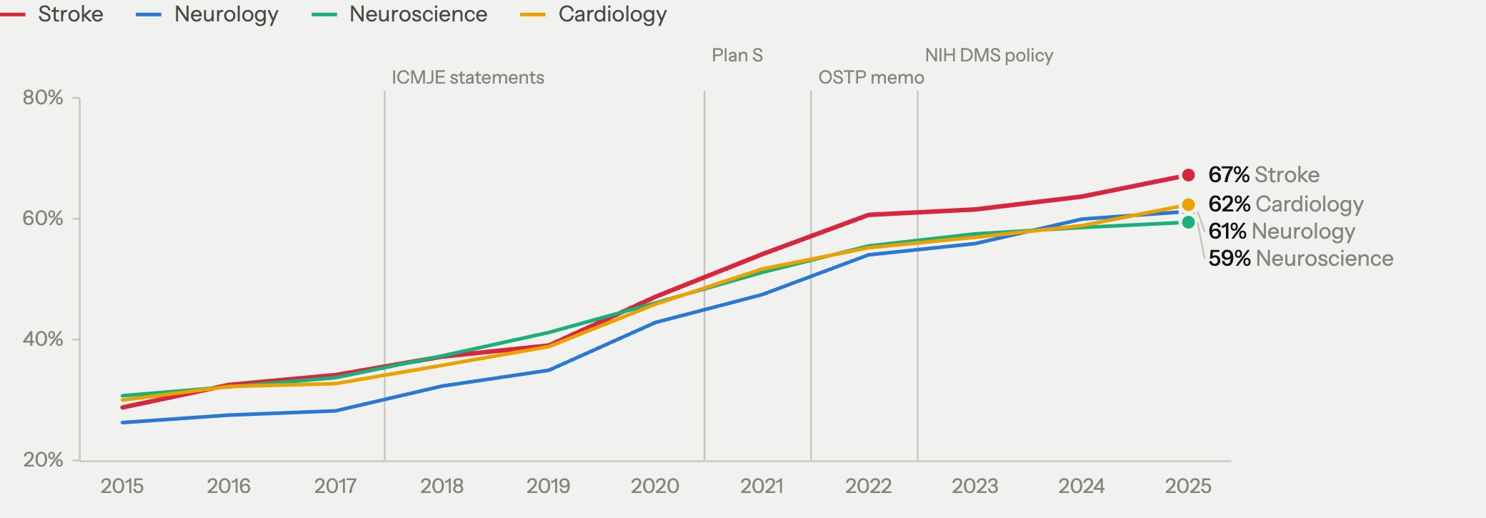
WORLD STROKE CONGRESS 2026 · SEOUL
08 Finding 1
29% → 67%
75%
Open access
published open,
stroke, 2015 to 2025
free to read by
any route, 2025
Published open = gold, diamond or hybrid in OpenAlex · free to read = any status other than closed
Notes:
The good-news slide, on the strict measure. Published open means gold, diamond or hybrid in OpenAlex: an open-access journal or an open licence, fixed at publication. In stroke it more than doubled: 29% in 2015, 47% in 2020, 64% in 2024, 67% in 2025. Stroke has led the four fields every year since 2020, by 4 to 6 points since 2022; in 2025 cardiology 62%, neurology 61%, neuroscience 59%. Over 2015-2025: stroke 50%, neuroscience 49%, cardiology 48%, neurology 45%. Let it land, then turn it on the next one. If asked why not the bigger number: free to read by any route adds bronze (free on the publisher site without a licence, which the publisher can withdraw) and green (a repository copy); it is 75% for stroke in 2025, but it depends on the database. On the same articles PubMed's own free-full-text flag gives 68% for 2022 against OpenAlex's 74%, and the gap is mostly bronze and green; for gold, diamond and hybrid the two agree on 91 to 100% of articles (sample of 8,000 articles, talk/outputs/tables/oa_openalex_vs_pubmed_sample.csv). Cardiology leads on free to read (78% vs 75% in 2024) mostly through bronze (15% of its articles, stroke 7%), including free conference abstracts in JACC and European Heart Journal supplements; on published open it trails stroke. The dashboard's open-access indicator is the free-to-read one, so the dashboard link shows 75%. 2025 needs no caveat on this measure: the route is fixed at publication, and only green and bronze still fill in. Do not rank neuroscience: about 45% of it comes only from the title term "neural", much of it machine learning; without those papers it is 63% published open in 2025, still below stroke.

Slide 11
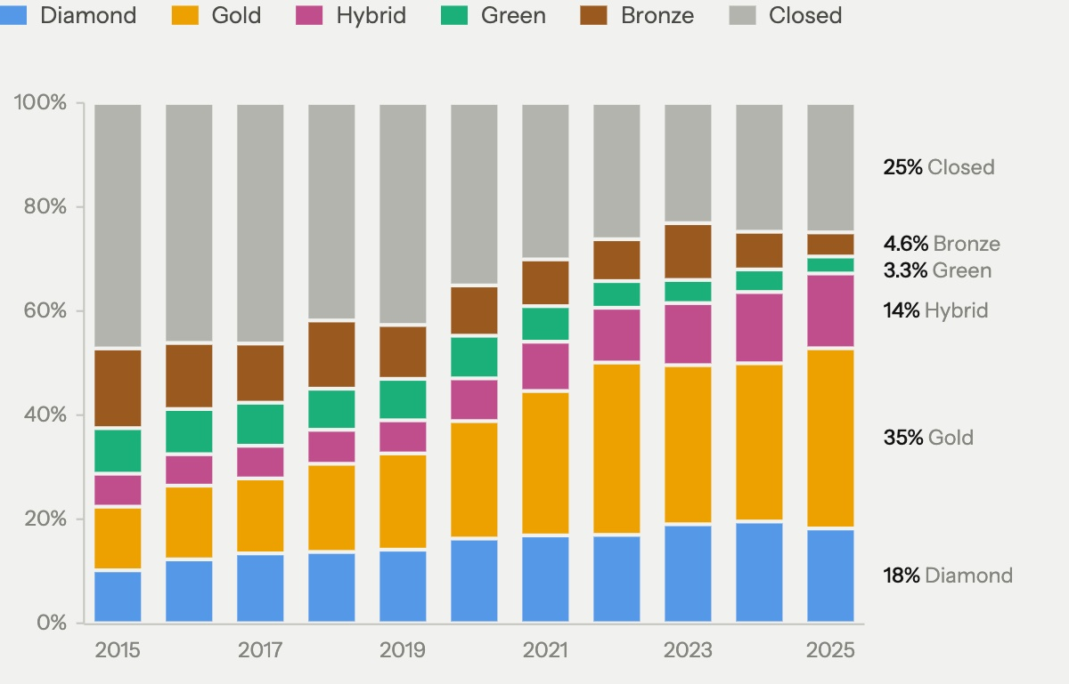
WORLD STROKE CONGRESS 2026 · SEOUL
09 Finding 2
Open-access routes
+18 points
gold, a paid route, 2015 to 2024
9% → 3%
green, a repository copy, 2015 to 2025
Share of stroke articles by OpenAlex status · 2025: counts complete; open-access status still settling
Notes:
The line to say: open access became a transaction between funders and publishers; it did not come with openness of anything else. Shares 2015 to 2025: gold, paid journal 25%; diamond, free journal 16%; hybrid, paid in a subscription journal 10%; bronze, free to read, no licence 10%; green, repository copy 6%; closed 34%. Gold, diamond and hybrid together are the published-open measure on the previous slide (51% over the decade, 67% in 2025); bronze and green are what free to read adds. From 2015 to 2024 gold grew the most (+18 points); diamond (+9) outgrew hybrid (+7). Green fell from 9% in 2015 to 3% in 2025. Bronze can be withdrawn at any time. For this room: diamond is a long tail of about 4,800 free journals. Cureus is the largest (1,187 articles), then Journal of Physical Therapy Science (487) and Journal of Stroke (334). About a quarter of Korean (27%) and Japanese (25%) first-author articles are diamond; Chinese 5%. Gold plus hybrid is about half of the open articles over the decade (52% with 2025, 49% through 2024) and the majority every year since 2021: 35% in 2015, 53% in 2021, 59% in 2024. One sentence on APCs and the equity angle; the equity slide comes later. The growth figures stop at 2024 because 2025's open-access status is still settling (its article counts are complete). Green fills in last, as repository copies appear after embargoes end, but it was already down to 4% in 2024, so its fall does not rest on the partial year.

Slide 12
WORLD STROKE CONGRESS 2026 · SEOUL
10 Finding 3
Data and code
Data in a repository
Code link
Preprint version
Registration ID
0.2%
<0.1%
2.7%
1.5%
in 2024; never above 0.6%
every year since 2015
in 2024
of non-trial studies in 2024; trials 35%
Abstracts and metadata, 2015 to 2024: lower bounds
Notes:
Card details: data in a repository 0.2% of stroke articles in 2024, 0.2% in 2015, never above 0.6%; code link under 0.1% every year 2015-2024, GitHub in 2.5% of 2024 full texts; preprint version 2.7% in 2024, 1.5% over 2015-2025, a lower bound and partly publisher-driven; registration ID in the abstract: 1.5% of observational, imaging, lab and animal studies in 2024 (0.8% in 2015), against 35% of trials (21% in 2015) and 22% of systematic reviews (PROSPERO); pooled, 5.3% in 2024 from 2.8% in 2015. High impact is barely better at sharing: top-cited or IF 10+ articles (16% of the corpus) are no more often published open (49% vs 51%), though more are free to read (74% vs 65%, through publisher free access and repository copies: bronze 14% vs 9%, green 12% vs 5%); registration 10.0% vs 3.5%, but data 0.45% vs 0.34%, code 0.08% vs 0.06%. Say the caveat before anyone says it for you: lower bounds from abstracts. Preprints did move, from under 0.2% before 2019 to 2.7% in 2024, but only as far as OpenAlex links them (it merged many preprint records into their articles in early October), and about half are on Research Square or SSRN, mostly publisher routes at submission (In Review, Lancet and Elsevier). GitHub in full text: 2.5% of the 1,500 audited 2024 articles, 1.3% pooled over the decade with every year weighted the same; the code chart counts GitHub or code links in abstracts, and the high-impact line also counts Zenodo and OSF links. Registration is a trial habit, not a field habit (the dashboard's new Design filter splits every indicator into trials and other studies). Read in the full text (open-access reports, 2022-2025), 68% of stroke trials state their own registration, 45% of systematic reviews and 7% of everything else; in abstracts, 35%, 22% and 1.5% (2024). So most trials are registered, though a third of open-access trial reports still state no registration, and the rest of stroke research almost never is: the cohorts, registries, imaging, lab and animal studies that make up 88% of what we publish. Of registered stroke trials, 57% name ClinicalTrials.gov and 16% ChiCTR; the rest ISRCTN, ANZCTR, UMIN, KCT, IRCT and others. The pooled rise, 2.8% to 5.3%, comes mostly from trials and systematic reviews. Same picture next door: trials 23-31% in abstracts and other papers 0.5-2.4% in neurology, neuroscience and cardiology. And across biomedicine: a registered protocol in 67% of clinical trials against 3% of other research (Serghiou 2021, PLoS Biol). Method: a paper is a trial when PubMed indexes it with a trial publication type or its title and abstract describe one; 6.8% of stroke articles. Sources: talk/outputs/tables/stroke_registration_by_design.csv. The neuroscience preprint line also reflects "neural": machine-learning papers, many on arXiv. Then the pivot: so we read the full text.

Slide 13
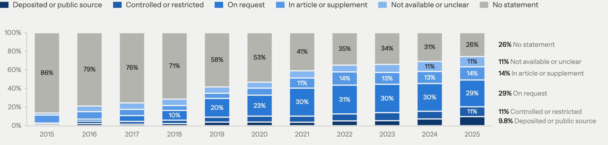
WORLD STROKE CONGRESS 2026 · SEOUL
11 Finding 4
Data-availability statements
Write a statement
Say “on request”
Deposit or public dataset
Shared when asked
74%
29%
9.8%
6.8%
2025, from 14% in 2015
2025, from 0.6%
2025, from 0.7%
of authors, elsewhere
16,362 open-access stroke full texts, up to 1,500 a year · Gabelica 2022
Notes:
Sample: 16,362 open-access stroke full texts, up to 1,500 per year, Europe PMC; optimistic for stroke overall. Own deposit 5.9% in 2025. Statements arrived with mandates. Elsewhere, "on request" delivers little: 6.8% of authors shared when asked (Gabelica 2022); 20% of 391 vascular and cognitive trials, median 241 days (Scutt 2020). The slide people photograph. Three numbers, slowly. Against the other fields, 2022 to 2025: stroke says “on request” more than any other field (30%; neurology 27%, neuroscience 26%, cardiology 24%), writes statements as often as any of them (69%; neuroscience 72%, neurology 64%, cardiology 61%), and deposits or names a public dataset at the level of the other clinical fields (6.9%; cardiology 7.3%, neurology 5.6%), well under neuroscience (17.5%). Neuroscience caveat: its title term “neural” also catches machine-learning papers; without them neuroscience writes statements in 68% (stroke 69%) and deposits 13.6%. If asked for the decade: “on request” 19% and deposit or public source 4.2%, pooled over yearly samples of up to 1,500, so every year weighs the same; they are not corpus rates. Full text versus abstract for the same audited articles, 2015 to 2025 pooled the same way: GitHub in 1.3% of full texts vs code, OSF or Zenodo links in 0.07% of abstracts; trial registration 14.1% vs 7.5%. If asked about top journals: 0.6% of top-journal RCTs that declared sharing had downloadable data (Danchev 2021).

Slide 14
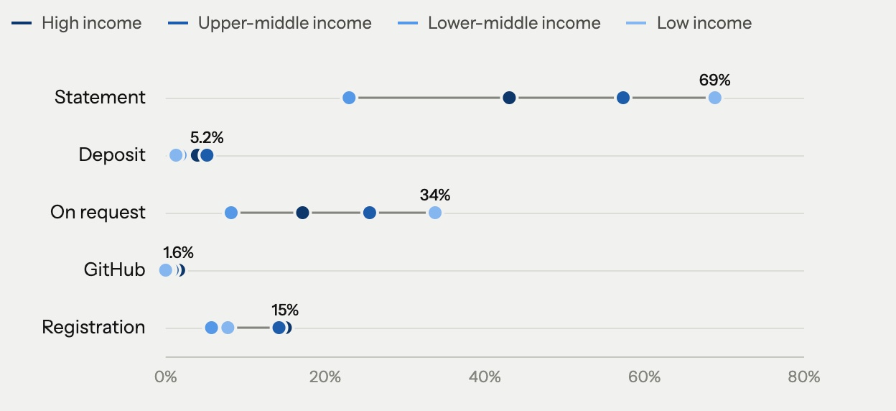
WORLD STROKE CONGRESS 2026 · SEOUL
12 Finding 5
Income groups
42% vs 19%
free open-access routes, lower-middle vs high income
1.8% vs 4.0%
deposit or public data in the full text
World Bank income group of the first author’s country, 2015–2025 · deposit from audited full texts
Notes:
Off the slide: lower-middle-income authors publish 42% through routes that cost nothing (high income 19%), yet over 2015-2025 deposit or name public data in 1.8% (high 4.0%), mention GitHub in 0.3% (1.6%) and a trial registration in 5.7% (15.0%). The open-access route chart by income group was dropped from the slide. Income group known for 85% of the corpus: high 62%, upper-middle 32% (mostly China), lower-middle 6%, low 0.3% (400 articles). Seoul is a high-income audience with LMIC trialists in the room. Published open rises as income falls: 45% high, 61% upper-middle, 64% lower-middle (83% low, only 400 articles, do not lean on it); free to read by any route 67%, 70%, 75%. Upper-middle-income authors pay an APC for 43%. The data and code that lower-income teams could build on are not there, and their own work is the least likely to be shared: a data statement in 23% of lower-middle-income full texts (high 43%, upper-middle 57%), from only 609 audited articles. These full-text rates pool 2015-2025 over the audit's sample of up to 1,500 open-access full texts a year, so they average equal yearly samples, not the corpus. The gap holds in 2022-2025 alone: a statement in 37% of lower-middle vs 65% high and 78% upper-middle; deposit or public source 3.0% vs 6.2% and 8.7%. That is the inequality open science can close. Korea: 5,490 first-author articles, 64% published open (75% free to read), none with a data-repository link in the abstract or metadata; 1.3% of 1,293 audited full texts deposit or name a public source.

Slide 15
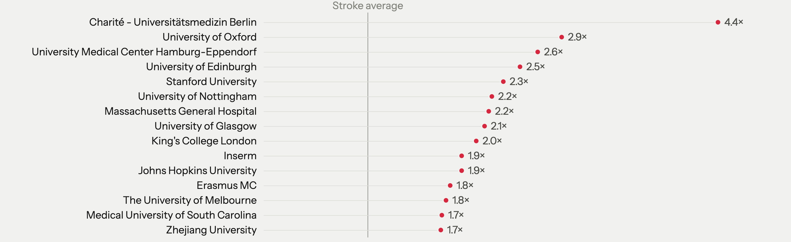
WORLD STROKE CONGRESS 2026 · SEOUL
13 Finding 6
Commitment index
1 = stroke average · deposit, GitHub and registration in the full text · top 15 of the 60 institutions with most audited articles
Notes:
Journals: Nature Communications, Brain Communications, PeerJ, NeuroImage Clinical lead; Stroke is about 15th of 99, at 1.5x. Funders: US federal institutes, ANR, Swiss Heart Foundation, Leducq, DFG. Countries: Belgium 2.4x, Germany 2.2x, Switzerland 2.0x, France 1.8x, UK 1.5x. Index = mean, over data deposited or public source in the statement, GitHub and trial registration in the full text, of the entity's rate divided by the stroke audit rate (4.2%, 1.3%, 14.1%); 1 = stroke average. Institutions: the 60 with the most audited articles (each 82+ in 2015-2025); countries 50+, journals and funders 30+. The current analysis merges Charité and its Center for Stroke Research before calculating the index: 133 audited articles, 4.36 times the stroke average. Oxford has 177 audited articles and Hamburg-Eppendorf 109. This descriptive index averages deposit/public-source, GitHub and registration rates relative to stroke-wide audited rates. It measures recorded practices, with small counts and publication-year composition affecting the order. It is not a validated measure of research quality. The chart shows the top 15 among the 60 institutions with most audited articles. Source: talk/outputs/tables/stroke_commitment_institutions.csv.

Slide 16
WORLD STROKE CONGRESS 2026 · SEOUL
14 Next
Incentives
3.1% → 3.1%
data obtainable, before and after the ICMJE rule
Bergeat 2022
0 of 14
stroke and neurology journals offer Registered Reports
COS list 2026
0 of 92
promotion guidelines mention open science
Rice 2020
44% vs 96%
positive results, Registered Reports vs standard
Scheel 2021
Our incentives point the other way.
Notes:
Rules produced statements; incentives produce data. Full rows: data obtainable from surgical trials before and after the ICMJE statement requirement, 3.1% and 3.1% (Bergeat 2022, JAMA Netw Open); open-data badges in the only medical randomised trial, at BMJ Open, OR 0.9, while the same badges took Psychological Science from under 3% to 39% open data (Rowhani-Farid 2020; Kidwell 2016); 0 of 92 biomedical promotion guidelines worldwide mention data sharing, registration or open access (Rice 2020, BMJ); positive results 44% in Registered Reports vs 96% in the standard literature, so changing when review happens changes what gets published (Scheel 2021). Original line: stroke researchers are not less honest than psychologists; they respond to the same incentives, and ours point the other way. Cardiology survey, n = 198: funding named the most essential incentive; "policy alone will not lead to implementation" (Cobey 2024). The pivot of the talk. Four numbers, then the sentence in serif. No more studies here; the evidence brief has them if asked. Journals, checked October 2026: none of 14 stroke and neurology journals offers Registered Reports (Stroke, IJS, ESJ, JSCVD, Stroke and Vascular Neurology, Journal of Stroke, Cerebrovascular Diseases, Translational Stroke Research, JCBFM, Neurology, JAMA Neurology, Lancet Neurology, Annals of Neurology, Frontiers in Neurology), and none is on the Center for Open Science list of about 300 journals that do. Frontiers in Neuroscience offers them; Frontiers in Neurology, same publisher, does not. A few take protocols for non-trial designs (Stroke and Vascular Neurology, Cerebrovascular Diseases for funded studies, Lancet Neurology, JAMA Neurology, Frontiers in Neurology for a fee), but none gives in-principle acceptance. JSCVD's instructions: 'Purely observational studies… do not require registration.' ICMJE encourages registration of non-trial designs but does not require it. The same split across biomedicine: a registered protocol in 67% of clinical trials against 3% of other research (Serghiou 2021, PLoS Biol); 10% of observational studies in the top five general journals were registered in 2022 (Leducq 2024). Preclinical: about 550 preregistered animal studies worldwide by 2025, and 10% of Swiss animal study directors have ever preregistered (Priboi 2026). The badge card moved here: open-data badges in the only medical randomised trial, at BMJ Open, OR 0.9 (Rowhani-Farid 2020). Sources: talk/evidence_registration.md.

Slide 17
WORLD STROKE CONGRESS 2026 · SEOUL
15 Next
Proposals
1
2
3
Task force
Toolkits
Prize
WSO, on open science
WSO-backed, open, maintained
For the teams that share
A position statement
Imaging, tested where most strokes happen
Commitment index, every six months
Retire “available on request”
Preregistration beyond trials
Trial templates, data elements, consent
Promotion criteria: 0 of 92 today
This benchmark, for anyone
Targets 25% deposited data by 2030 · “on request” under 10% · non-trial registration 10% by 2030
Notes:
Say, do not show: the statement, retiring "on request" and promotion criteria cost nothing; Registered Reports, the prize and the toolkits need money, and most of the tools already exist. Full bullets: task force = a position statement (no stroke society has one); retire "available on request" in stroke journals in favour of a repository, a controlled-access platform, or a stated reason; a preregistration route for studies that are not trials (Registered Reports, or an analysis plan registered on OSF or ClinicalTrials.gov before the data are seen), with in-principle acceptance tied to WSO and ESO grants. Toolkits = imaging models and benchmarks tested in low- and middle-income settings; protocol and analysis templates, common data elements, consent that allows sharing; this benchmark for any journal, centre or country. Prize = the commitment index, verified in the full text, recomputed every six months, for institutions, journals, funders and countries, awarded at WSC; open-science items in promotion criteria (0 of 92 guidelines today). Targets in full: data in a repository or controlled-access platform for 25% of stroke articles by 2030; "on request" under 10%; registration for 10% of non-trial stroke studies by 2030 (1.5% of their abstracts in 2024), helped by a Registered Report or preregistration track in at least one stroke journal by 2028. Why not trials: they are already registered. ICMJE has required it since 2005, and 68% of open-access stroke trial reports (2022-2025) state a registration, most on ClinicalTrials.gov. The gap is everything else, 88% of what we publish: observational, imaging, lab and animal studies, where 7% of full texts and 1.5% of abstracts name one. And no stroke journal offers Registered Reports today (0 of 14 stroke and neurology journals), so the route has to be built. Two minutes. Three proposals, one per purpose. Task force, for reproducibility: a position statement (no stroke society has one), retiring "available on request" in Stroke, IJS, ESJ and JSCVD in favour of a repository, a controlled-access platform such as Vivli, or a stated reason, and a preregistration route for studies that are not trials (Registered Reports, or an analysis plan registered on OSF or ClinicalTrials.gov before the data are seen), with in-principle acceptance tied to WSO and ESO grants; embargoed sharing twelve months after publication can be the trial default. Toolkits, for access: WSO does not need to build them; most pieces exist (DeepISLES and nnU-Net for imaging, the NINDS stroke common data elements, published utility weights for the mRS, BIDS for imaging data). What is missing is stewardship: curating, validating, maintaining, and testing in low- and middle-income settings. Regulation is the real barrier for clinical imaging tools: under EU rules a hospital cannot hand its in-house tool to another hospital without a legal manufacturer, which a society-backed consortium could take on or broker. Consent matters too: the MR CLEAN Registry data cannot be shared because consent for sharing was never asked; IST-3 shows the alternative, its individual patient data open since 2021. Prize, for value: citations do not reward data sharing (no citation difference in our data), so the field has to, on the model of the Einstein Foundation Award, using the commitment index. Note that VISTA's rules exclude re-analysis of treatment effects, so it is not the model for open trial data. Invite the WSO leadership in the room to take the task force home. Say which items cost nothing and which need money.

Slide 18


WORLD STROKE CONGRESS 2026 · SEOUL
Collaborate
감사합니다
Stroke Open-Science Benchmark
Code and data
Sebastian Fridman
github.com/Friseeb/
stroke_open_science
Western University · London Health Sciences Centre
friseeb.github.io/
stroke_open_science_outputs
Open source; the next run is January 2027
sfridma@uwo.ca
Explore it, challenge it, run it on your field
Write to join the task force or to audit your own field
Disclosures: none.
Notes:
Say, do not show: we measured ourselves; the numbers are not flattering, but they can improve. One line, then stop. Leave the links and the QR codes up during questions. Thank the session chairs. Close with 감사합니다, gam-sa-ham-ni-da (thank you, formal).

