Slide 1




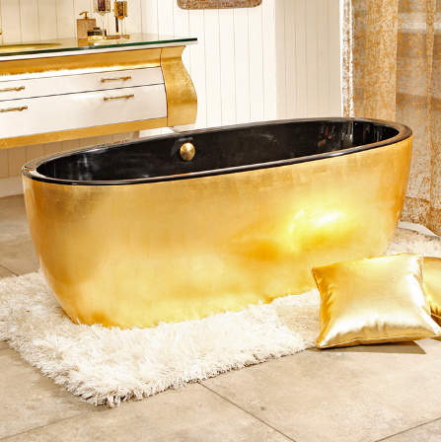

BATHCORP© CLIENT CARD
BATHTUB TOKENS
NAME : Clyde CIPEHER
MEMBER SINCE : 23/03/2130
ADRESS : ???
- 0000019931
20000
69
OWNED BATHTUBS
Premium package
Fish Stickers

Slide 2

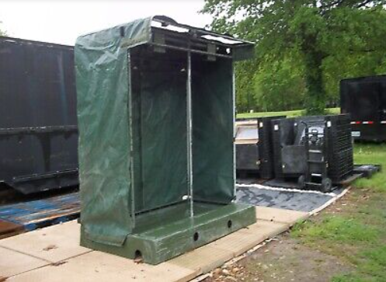
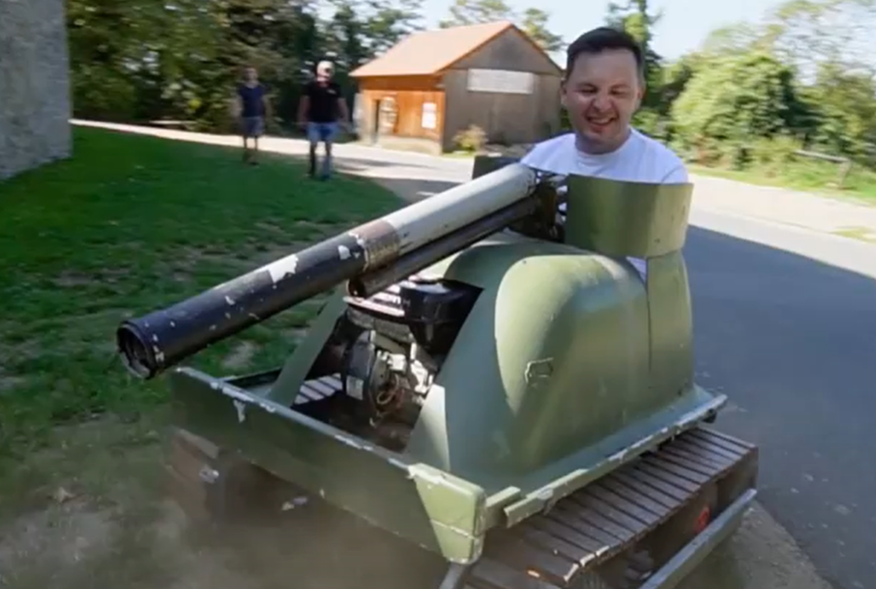
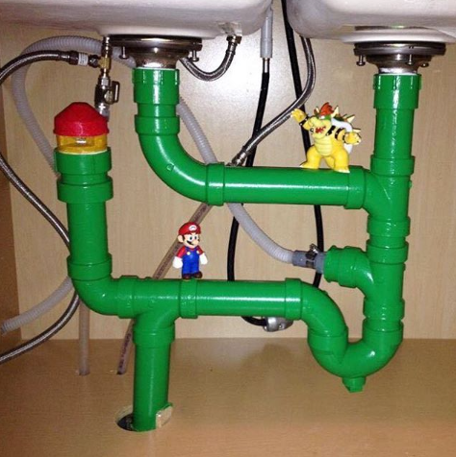
BATHCORP© CLIENT CARD
BATHTUB TOKENS
NAME : Clark ORINDEMTEP
MEMBER SINCE : 01/06/2125
ADRESS : 184.516.715.874
0000002603
500
2003
100
OWNED BATHTUBS
Warrior shower
Tank bathtub
Bathroom pipes

Slide 3

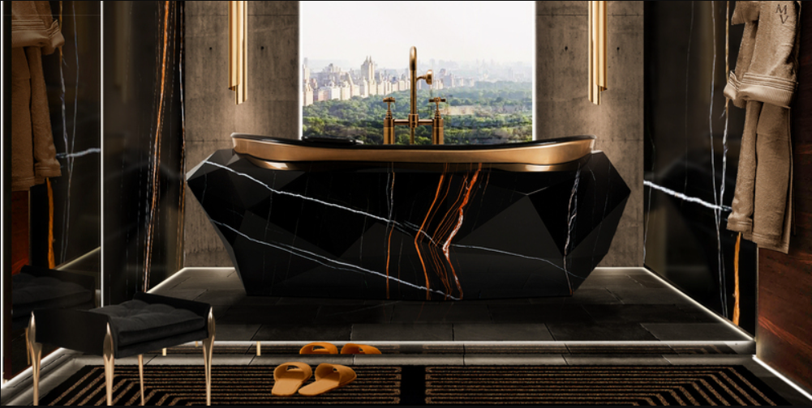
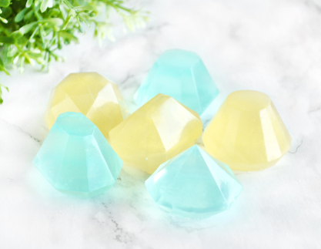

BATHCORP© CLIENT CARD
BATHTUB TOKENS
NAME : Amy FWEND
MEMBER SINCE : 14/01/2128
ADRESS : 128.032.518.720
8999444444
1 000 000
666 666
9 000 000 000
OWNED BATHTUBS
Distilled water installation
Diamond paradise
Diamond soap

Slide 4

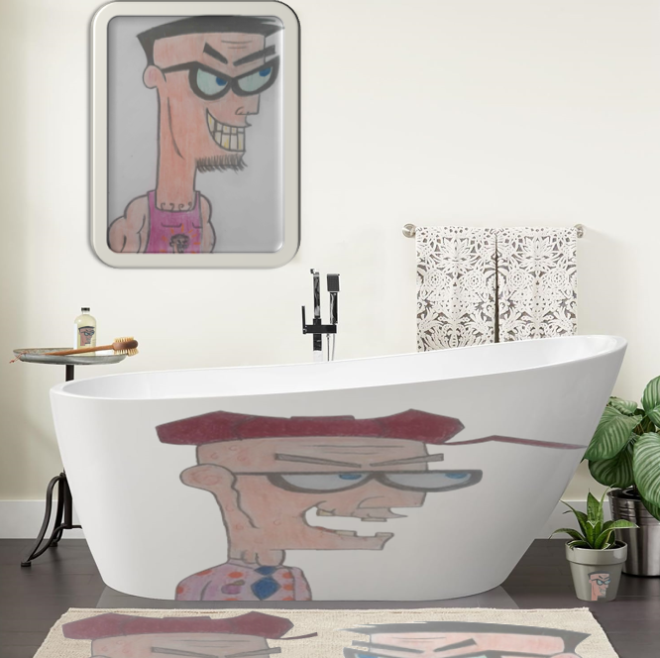
BATHCORP© CLIENT CARD
BATHTUB TOKENS
NAME : Lorentz FEIGNARD
MEMBER SINCE : 30/07/2135
ADRESS : 174.677.793.304
0000000000
30 072 135
x 2
OWNED BATHTUBS
Megalomaniac package

Slide 5

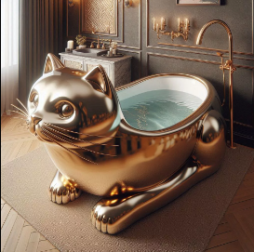
BATHCORP© CLIENT CARD
BATHTUB TOKENS
NAME : Dave OCCOULULUS
MEMBER SINCE : 30/07/2125
ADRESS : 144.146.090.081
- 0010000000
10 000 000
OWNED BATHTUBS
Meooow

