Slide 1
Security Verification and testing final project
Protocol verification using Proverif over “A Security Credential Management System for V2X Communications”
Filippo Maria Cardano
s292113

Slide 2
Agenda
Overview of protocol
Modelling
Rule Design
Sanity Checks
Security Properties
Proverif Implementation
Filippo Maria Cardano
s292113

Slide 3
Protocol
Vehicle-to-everything (V2X) communications
Security Credential Management System (SCMS)
Public Key Infrastructure (PKI)
Pseudonym certificates
Use cases
bootstrapping
certificate provisioning
misbehavior reporting
revocation
Filippo Maria Cardano
s292113

Slide 4
Modeling
Examine the protocol in detail, including its numerous steps. Determine which elements to exclude or modify in order to align them with Proverif rules.
Filippo Maria Cardano
s292113
Notes:
the modeling part is about studying the protocol and how it was repurposed to obtain a model compatible with the verification tool. Then specifically deciding which parts to keep, which to modify, or making assumptions in a way that does not compromise the original specification

Slide 5
Assumptions

Slide 6
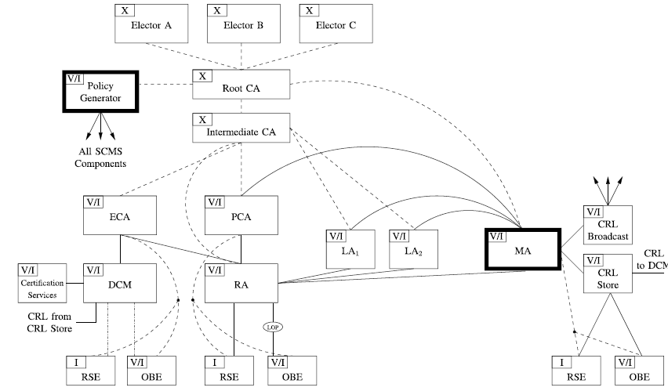
Components
Filippo Maria Cardano
s292113

Slide 7
Removed/modified components
Electors: unnecessary for the protocol bootstrapping/provisioning/revocation
Policy Generator: unnecessary for the protocol bootstrapping/provisioning/revocation
Intermediate CAs: territorial CAs that “shield” the RootCA from DDoS and other forms of attacks (unnecessary abstraction)
Enrollment CA (ECA): necessary for bootstrapping but is simplified
Device Configuration Manager (DCM): necessary for bootstrapping but is simplified
Road-Side Equipment (RSE): unnecessary for security properties (can assume it behaves like a vehicle (OBE))
CRL components: simplified and not described in detail

Slide 8
Components
Filippo Maria Cardano
s292113

Slide 9
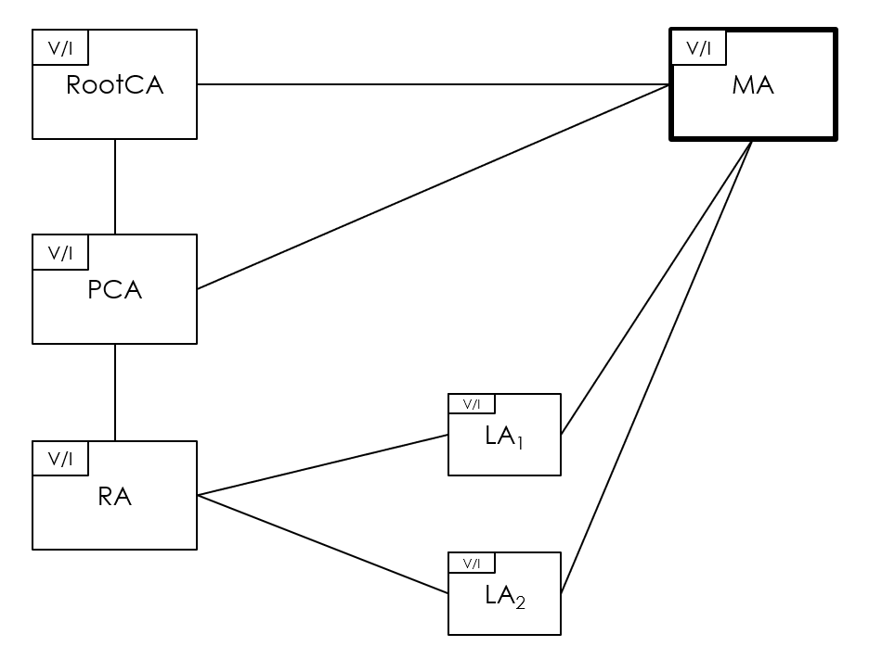
Components
Filippo Maria Cardano
s292113

Slide 10
Rule Design
Once the model with the various assumptions and simplifications was obtained, the design phase begun in which the various steps were translated into Proverif rules
Filippo Maria Cardano
s292113

Slide 11
Sanity Checks
Sanity checks are implemented to validate the accuracy of the translation into Proverif rules and ensure that the protocol correctly exchanges messages and successfully completes all its various steps
Filippo Maria Cardano
s292113

Slide 12
Security Properties
The most important part are the verification of security properties, which is the main purpose of formal verification, i.e., the protocol guarantees them and prevents possible attacks accurate to the model. Specifically, authenticity, anonymity and unlinkability will be analyzed.
Filippo Maria Cardano
s292113

Slide 13
Authentication
The authentication property is essential to ensure that the entities involved in the communication process are able to authenticate each other securely and reliably.
In Proverif using Correspondence assertions
Filippo Maria Cardano
s292113

Slide 14
Secrecy
Secrecy is the property of information being protected from disclosure to unauthorized parties. In this particular case, states that the attacker can not obtain the long-term key of the vehicle.
In the protocol, all messages are sent it cleartext, and signed so only key materials should be kept secret
In Proverif using “free [private]”
Filippo Maria Cardano
s292113

Slide 15
Anonymity
The adversary cannot distinguish whether the message has been signed with a valid pseudonym or a fake one. When a pseudonym certificate is requested, a vehicle can make n requests to the RA and an adversary and other entities are unable to associate a pseudonym certificate with the real identity of the vehicle.
In Proverif using “choice”
Filippo Maria Cardano
s292113

Slide 16
Unlinkability
The vehicle has many pseudonymous certificates that need to be changed regularly. The vehicles is sending messages, and it should not be linked by these messages
NOTE: As long as the vehicle uses the same pseudonym certificate it is always traceable.
In Proverif using “equivalence”
Filippo Maria Cardano
s292113

Slide 17
Proverif Implementation

Slide 18
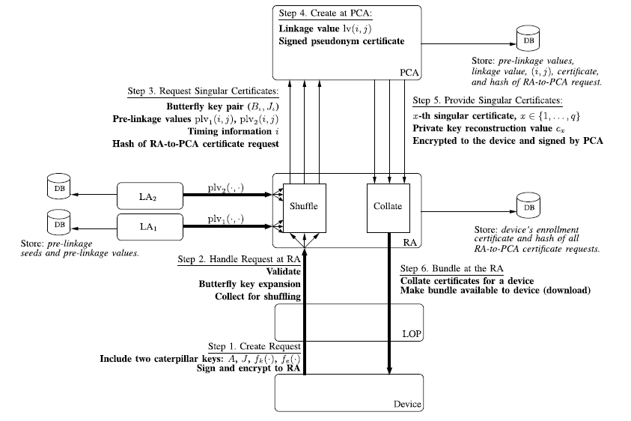
Certificate provisioning
Filippo Maria Cardano
s292113

Slide 19
Certificate provisioning
What we can test
Secrecy
Authentication
Anonimity
Unlinkability
Filippo Maria Cardano
s292113

Slide 20
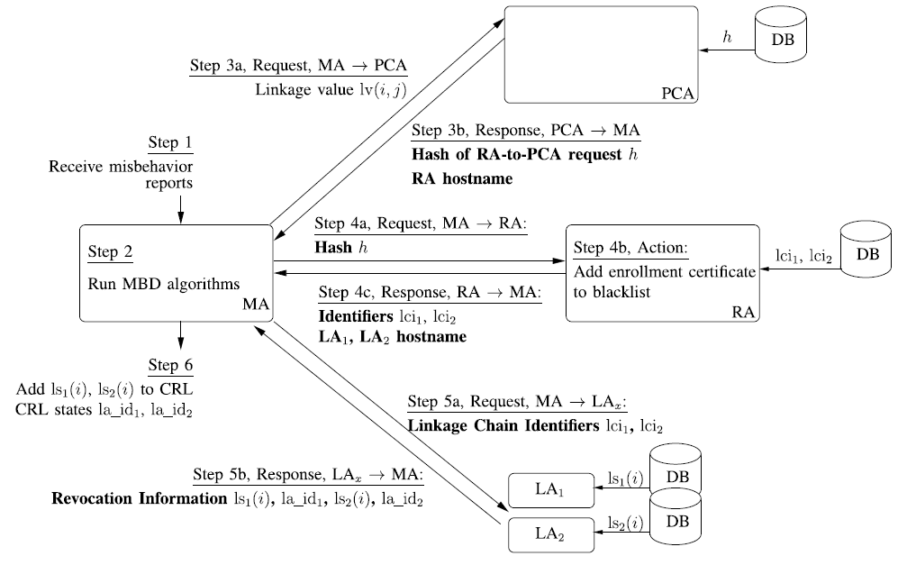
Revocation
Filippo Maria Cardano
s292113

Slide 21
Revocation
We cannot test any security properties because the vehicle (OBE) is deanonymized and added to the CRL
Filippo Maria Cardano
s292113

Slide 22
Steps took
Implement the Butterfly key expansion
Implement bootstrapping
Implement pseudonym provisioning simplified
Without LA
Without CRL
Implement full pseudonym provisioning with message exchange
Implement revocation of a bad vehicle (OBE)
Test Security Properties
Each Step implementation of Sanity Checks is included
Filippo Maria Cardano
s292113

Slide 23
Let look at the code

Slide 24
Thank you for your attention

