Slide 1


11:00
Tuesday, August 1
11:00 AM
6/17/2023

Slide 2
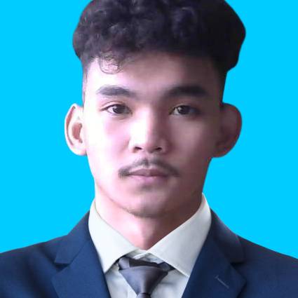
FRITZ DELAFER
SIGN IN

Slide 3




Introduction
CASES
ALV Report
Form Creation
Domain Upload and Creation
Dialog Programming
Requirements
Introduction
TECHNICAL (ABAP) CASE STUDY
Cases
Process
Insert Topic Title
11:00 AM
6/17/2023

Slide 4
INTRODUCTION
x
Introduction
I have been assigned to a project implementation. Company XYZ needs custom objects to be created in order for the client to generate reports and forms. Aside from that, Company XYZ needs a mass upload to speed up the creation of Master Data and dialog transaction to save entries.
Functional team hands over the Functional Specifications for one (1) report, one (1) form, one (1) conversion/upload and, one (1) dialog program.
Requirements
Cases
Process
Insert Topic Title
11:00 AM
6/17/2023

Slide 5
CASES
x
Introduction
CASE 1
CASE 2
CASE 3
CASE 4
Requirements
Cases
Process
Insert Topic Title
11:00 AM
6/17/2023

Slide 6
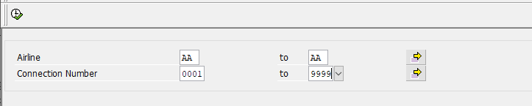
CASES
x
Introduction
CASE 1
CASE 2
CASE 3
CASE 4
Requirements
x
CASE 1
Create an ABAP Program that will generate a report. Output is an ALV Report.
Create a transaction code to call your custom report.
Cases
Process
Insert Topic Title
11:00 AM
6/17/2023

Slide 7
Requirements
x
Introduction
Process:
Use PARAMETERS AND SELECT-OPTIONS to create the selection parameters.
Tables and fields are given in the LOGIC part. You can display them in SE11 or in SE16N/SE16H to show fields and table contents.
Use SELECT Open SQL to select data from the given tables.
Use Internal Table to capture the data from the SELECT statements.
EXPECTED OUTPUT
Use function module such as REUSE_ALV_DISPLAY_GRID and pass the Internal Table to generate the ALV output. You can use other Function modules if you like.
Requirements
Cases
Process
Insert Topic Title
11:00 AM
6/17/2023

Slide 8
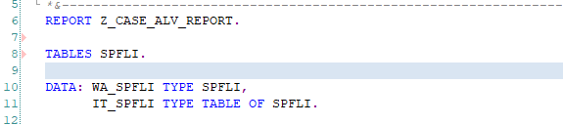

PROCESS
x
Introduction
Declare the TABLE we are using which is the SPFLI. We also declare the WA_SPFLI for the work area and the IT_SPFLI for the Internal Table which have types of SPFLI from our table SPFLI.
Requirements
Cases
Process
Insert Topic Title
11:00 AM
6/17/2023

Slide 9

PROCESS
x
Introduction
Requirements
Declare PARAMETERS by using SELECTION-SCREEN and SELECT-OPTIONS
Cases
Process
Insert Topic Title
11:00 AM
6/17/2023

Slide 10

PROCESS
x
Introduction
Using SELECT we select the data from the Internal Table we created
Requirements
Cases
Process
Insert Topic Title
11:00 AM
6/17/2023

Slide 11
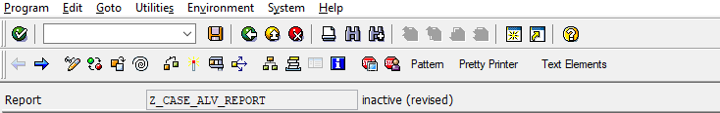

PROCESS
x
Introduction
To display the result in ALV we are using Function REUSE_ALV_DISPLAY_GRID by clicking the “Pattern” in the Toolbar
Requirements
Cases
Process
Insert Topic Title
11:00 AM
6/17/2023

Slide 12
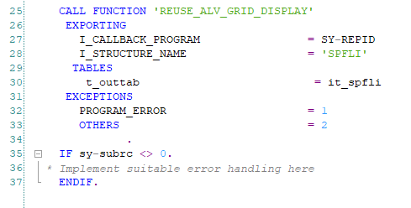
PROCESS
x
Introduction
Put the callback program as SY-REPID Structure name as ‘SPFLI’
And the outtab as IT_SPFLI
Requirements
Cases
Process
Insert Topic Title
11:00 AM
6/17/2023

Slide 13
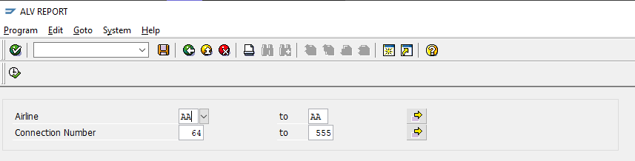
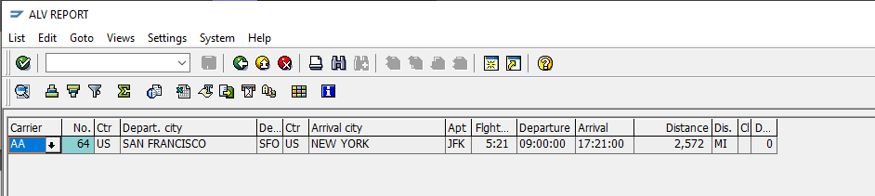
PROCESS
x
Introduction
OUTPUT:
Requirements
Cases
Process
Insert Topic Title
11:00 AM
6/17/2023

Slide 14
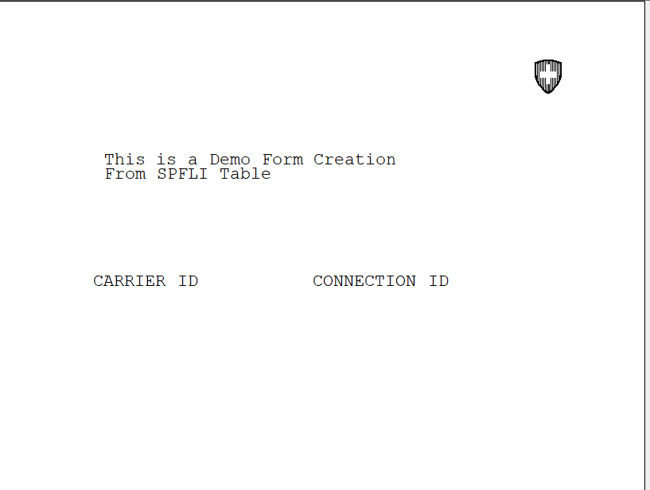
CASES
x
Introduction
CASE 1
CASE 2
CASE 3
CASE 4
Requirements
x
CASE 2
Create an ABAP program that will generate a FORM. Create a transaction code to call your custom report.
Cases
Process
Insert Topic Title
11:00 AM
6/17/2023

Slide 15
Requirements
x
Introduction
Process:
Use PARAMETERS AND SELECT-OPTIONS to create the selection parameters.
Tables and fields are given in the LOGIC part. You can display them in SE11 or in SE16N/SE16H to show fields and table contents.
Use SELECT Open SQL to select data from the given tables.
Use Internal Table to capture the data from the SELECT statements.
EXPECTED OUTPUT
Display the internal Table in a tabular form. Put any logo on the upper right side.
Requirements
Cases
Process
Insert Topic Title
11:00 AM
6/17/2023

Slide 16
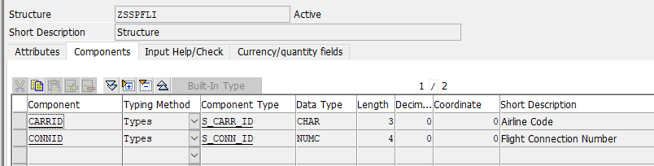
PROCESS
x
Introduction
First, We created a Data Structure on SE11 for our Data elements
Requirements
Cases
Process
Insert Topic Title
11:00 AM
6/17/2023

Slide 17
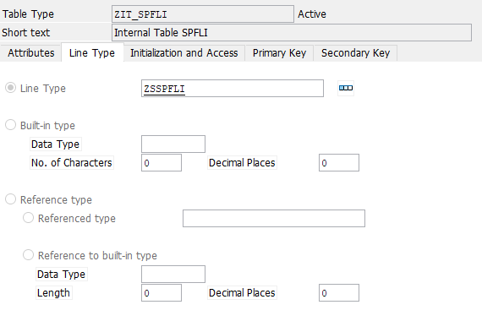
PROCESS
x
Introduction
We also created a Table Type based on the Structure we have created
Requirements
Cases
Process
Insert Topic Title
11:00 AM
6/17/2023

Slide 18
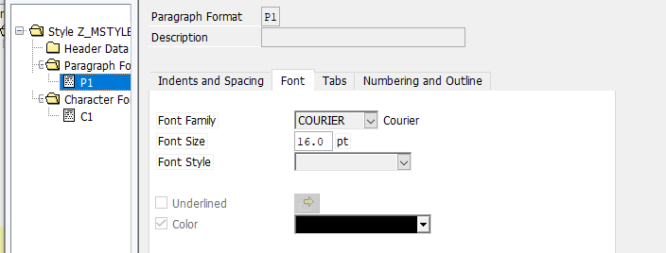
PROCESS
x
Introduction
Next, we go to SMARTFORMS, then create a style for our form.
Requirements
Cases
Process
Insert Topic Title
11:00 AM
6/17/2023

Slide 19
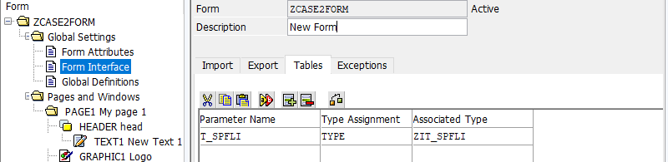
PROCESS
x
Introduction
After that we will create our Forms, after the creation I headed at the Form Interface to call the Table we have created
Requirements
Cases
Process
Insert Topic Title
11:00 AM
6/17/2023

Slide 20
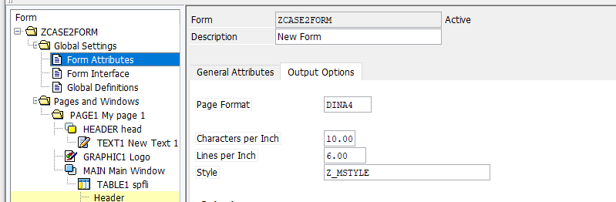
PROCESS
x
Introduction
Then in Form Attributes to put the Style we created
Requirements
Cases
Process
Insert Topic Title
11:00 AM
6/17/2023

Slide 21
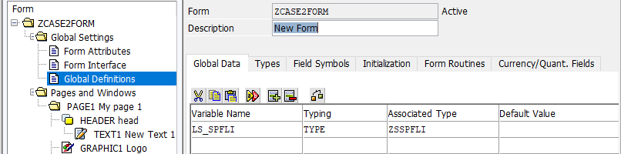
PROCESS
x
Introduction
And we go to the Global Definition on Global Data Tab to declare our structure
Requirements
Cases
Process
Insert Topic Title
11:00 AM
6/17/2023

Slide 22
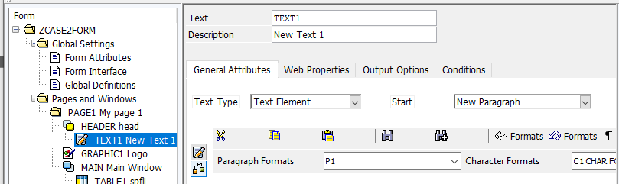
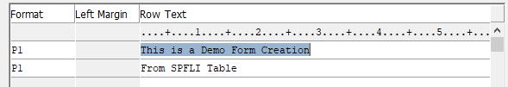
PROCESS
x
Introduction
Next, we created a window and call it a header and put a text on it.
Requirements
Cases
Process
Insert Topic Title
11:00 AM
6/17/2023

Slide 23

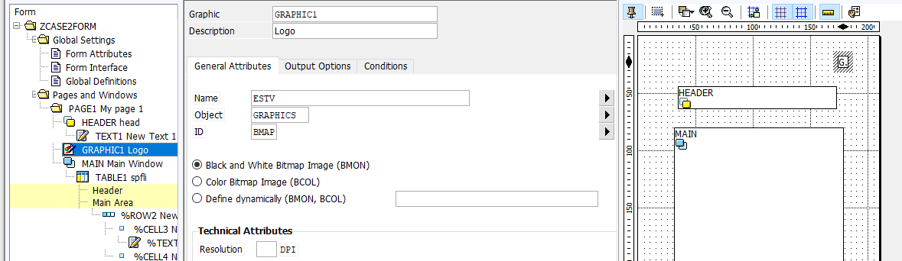
PROCESS
x
Introduction
We also created a graphics and call it a Logo and put it on the upper right side.
Requirements
Cases
Process
Insert Topic Title
11:00 AM
6/17/2023

Slide 24
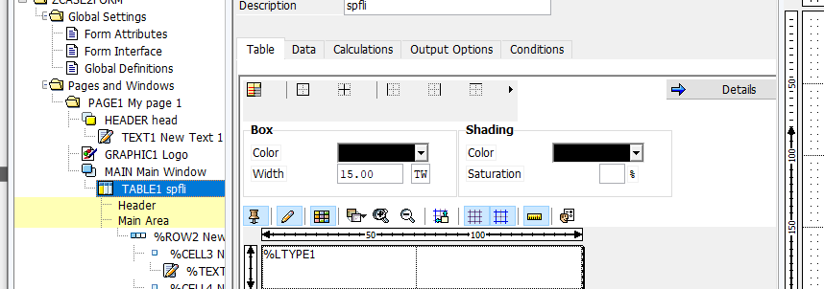
PROCESS
x
Introduction
On the main window, we draw the columns
Requirements
Cases
Process
Insert Topic Title
11:00 AM
6/17/2023

Slide 25
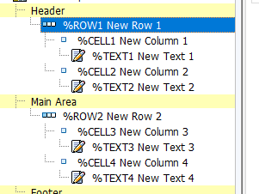
PROCESS
x
Introduction
Next on the header we created a table line and each line we created a text.
Requirements
Cases
Process
Insert Topic Title
11:00 AM
6/17/2023

Slide 26


PROCESS
x
Introduction
We have done the same for the main-area but on the main Area we have called the data from the tables
Requirements
Cases
Process
Insert Topic Title
11:00 AM
6/17/2023

Slide 27
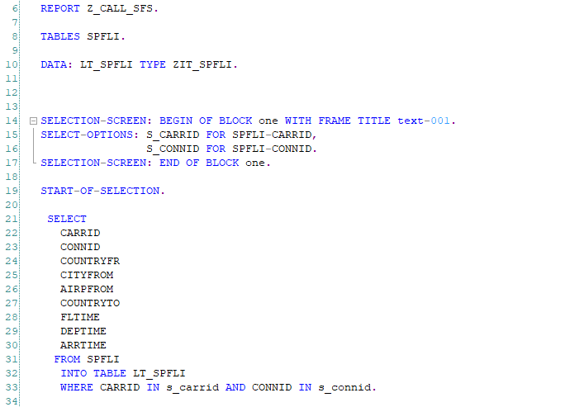
PROCESS
x
Introduction
Then go to SAP Editor
First, we declare the table that we are going to use
Next, is the data from the table we have created
Then, the input parameter
And the Selection for the data retrieval
Requirements
Cases
Process
Insert Topic Title
11:00 AM
6/17/2023

Slide 28
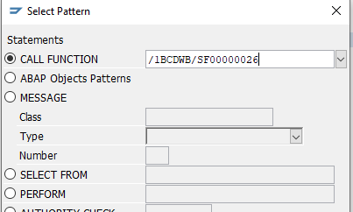
PROCESS
x
Introduction
Then we will click on pattern, and call function of the form we have just created.
Requirements
Cases
Process
Insert Topic Title
11:00 AM
6/17/2023

Slide 29
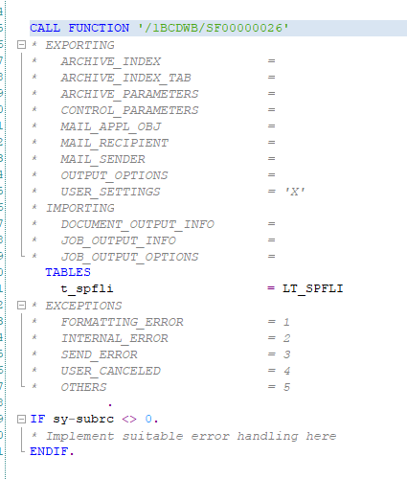
PROCESS
x
Introduction
On The tables section, we will put the data we have declare on the DATA above
Requirements
Cases
Process
Insert Topic Title
11:00 AM
6/17/2023

Slide 30
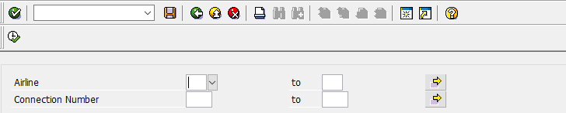
PROCESS
x
Introduction
We will click save and activate, and now we can execute
Requirements
Cases
Process
Insert Topic Title
11:00 AM
6/17/2023

Slide 31
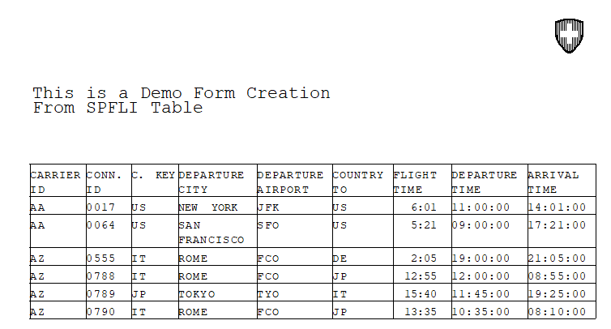
PROCESS
x
Introduction
Output:
Requirements
Cases
Process
Insert Topic Title
11:00 AM
6/17/2023

Slide 32
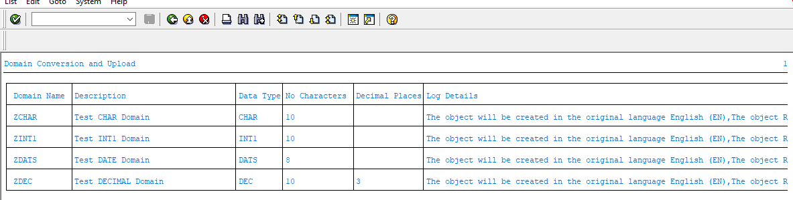
CASES
x
Introduction
CASE 1
CASE 2
CASE 3
CASE 4
Requirements
x
CASE 3
Create an ABAP program that will let you upload and create Domains from an excel file.
Cases
Process
Insert Topic Title
11:00 AM
6/17/2023

Slide 33
Requirements
x
Introduction
Process:
Create an ABAP Program to read an excel file.
The ABAP program will mass create Domain in SE11 and save it a local package ($TMP)
Fields in the excel must contain the following:
Domain Name
Description
Data Type
No. of Characters
Decimal Places
You may record using the SHDB transaction for the BDC (Batch Input Session)
In each loop in the records show a log after. You can use WRITE commands or show the report in other output methods.
Requirements
Cases
Process
Insert Topic Title
11:00 AM
6/17/2023

Slide 34


PROCESS
x
Introduction
To Start BDC, go to SHDB for recording
Requirements
Cases
Process
Insert Topic Title
11:00 AM
6/17/2023

Slide 35
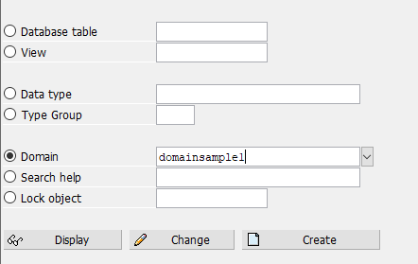
PROCESS
x
Introduction
Record how you declare Domain in SE11. Put a name
Requirements
Cases
Process
Insert Topic Title
11:00 AM
6/17/2023

Slide 36
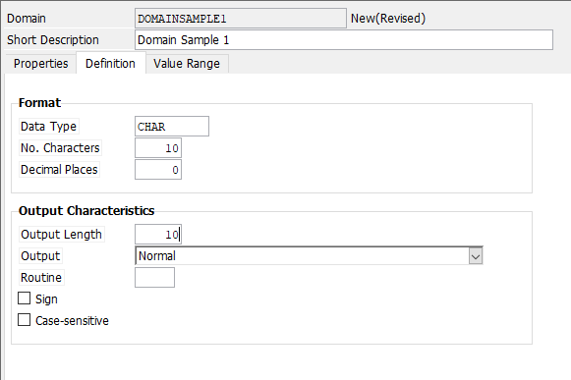
PROCESS
x
Introduction
Put a short description, Data type, No. Characters, Decimal Places, and output length.
Requirements
Cases
Process
Insert Topic Title
11:00 AM
6/17/2023

Slide 37
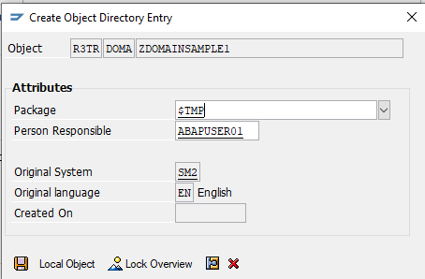
PROCESS
x
Introduction
Save it on $TMP Package.
Requirements
Cases
Process
Insert Topic Title
11:00 AM
6/17/2023

Slide 38
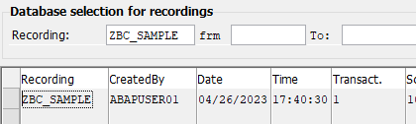
PROCESS
x
Introduction
The Recording will appear at the database
Requirements
Cases
Process
Insert Topic Title
11:00 AM
6/17/2023

Slide 39
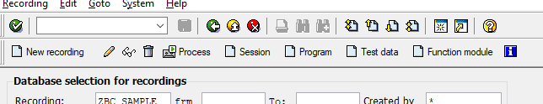
PROCESS
x
Introduction
From the toolbar you will click the “Program”
Requirements
Cases
Process
Insert Topic Title
11:00 AM
6/17/2023

Slide 40
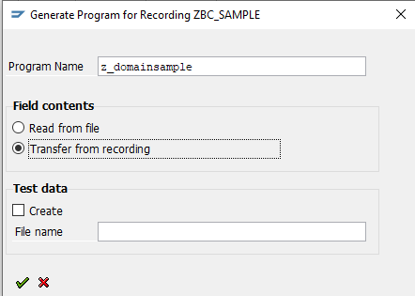
PROCESS
x
Introduction
Put the program name and select the “Transfer From Recording”
Hit Check
Requirements
Cases
Process
Insert Topic Title
11:00 AM
6/17/2023

Slide 41
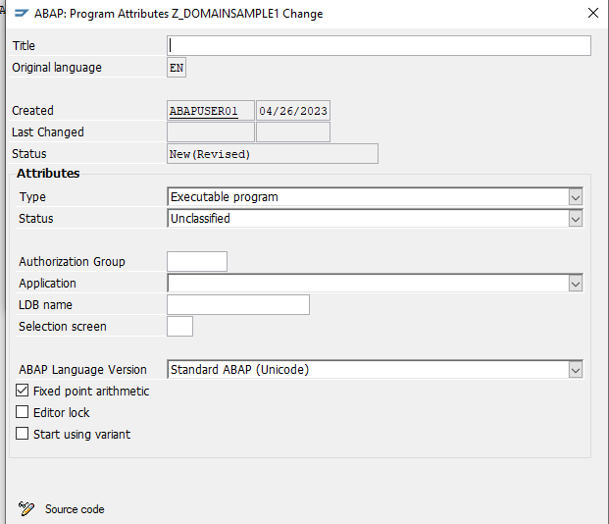
PROCESS
x
Introduction
Put a title on the program.
Click the “Source code”
Requirements
Cases
Process
Insert Topic Title
11:00 AM
6/17/2023

Slide 42
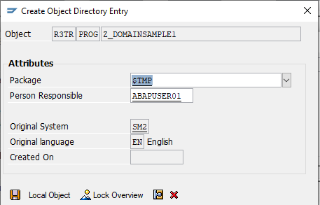
PROCESS
x
Introduction
Click on save
Requirements
Cases
Process
Insert Topic Title
11:00 AM
6/17/2023

Slide 43
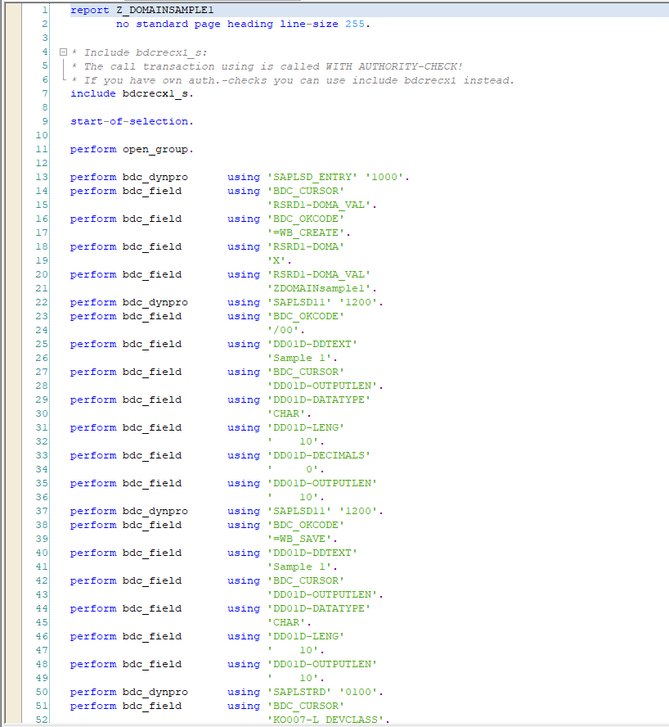
PROCESS
x
Introduction
It will redirect to the ABAP Editor with the code generated from the BDC Recording
Requirements
Cases
Process
Insert Topic Title
11:00 AM
6/17/2023

Slide 44
PROCESS
x
Introduction
DECLARATIONS
Requirements
Cases
Process
Insert Topic Title
11:00 AM
6/17/2023

Slide 45
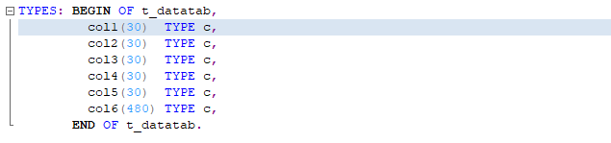
PROCESS
x
Introduction
Declare the Data for our table that will be populated by excel that we will upload
Requirements
Cases
Process
Insert Topic Title
11:00 AM
6/17/2023

Slide 46

PROCESS
x
Introduction
Declare the internal table where data from excel will be saved
Requirements
Data for the Batch Input Data of single transaction
Cases
Process
Insert Topic Title
11:00 AM
6/17/2023

Slide 47

PROCESS
x
Introduction
table for the Messages(Error) of call transaction
Requirements
Data for Display structure
Cases
Process
Insert Topic Title
11:00 AM
6/17/2023

Slide 48

PROCESS
x
Introduction
Next is the declaration of SELECTION-SCREEN for our File Parameter.
Requirements
Cases
Process
Insert Topic Title
11:00 AM
6/17/2023

Slide 49
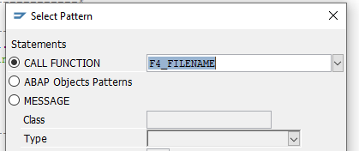
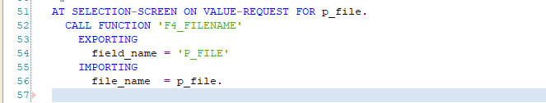
PROCESS
x
Introduction
AT-SELECTION SCREEN VALUE REQUEST FOR file, you will go to PATTERN and call F4_FILENAME
Requirements
Cases
Process
Insert Topic Title
11:00 AM
6/17/2023

Slide 50
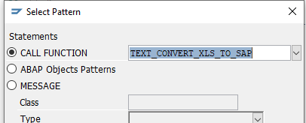
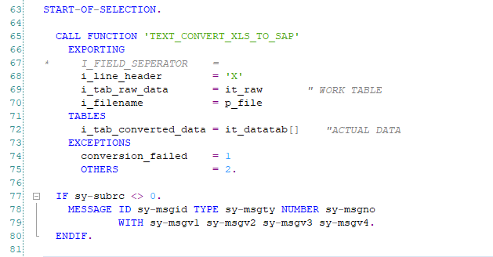
PROCESS
x
Introduction
On our START-OF-SELECTION FUNCTION go to Pattern and Call ‘TEXT_CONVERT_XLS_TO_SAP’
Requirements
Cases
Process
Insert Topic Title
11:00 AM
6/17/2023

Slide 51
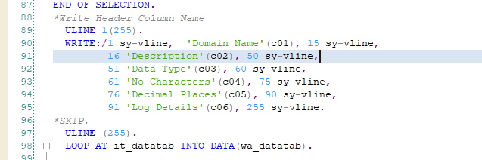
PROCESS
x
Introduction
At the END-OF-SELECTION
We will be using WRITE and vline for vertical lines and data from the it_datatab
Requirements
Cases
_____________________________________________________________________________________ |Domain Name | Description| Data Type | No Characters | Decimal Places | Log Details|
_____________________________________________________________________________________
Process
Insert Topic Title
11:00 AM
6/17/2023

Slide 52
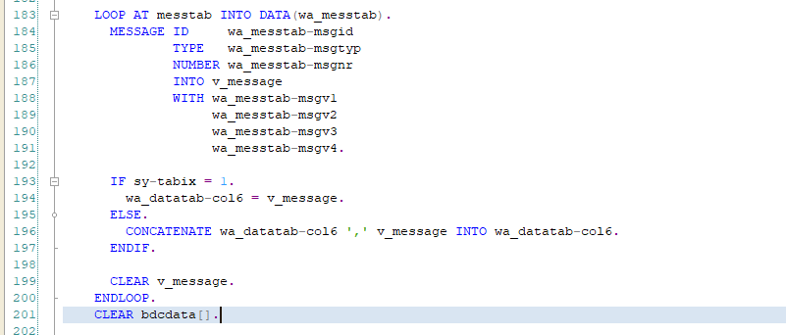
PROCESS
x
Introduction
We will display message from wa_messtab and save it in v_message, Which is the logs
Requirements
Cases
Process
Insert Topic Title
11:00 AM
6/17/2023

Slide 53
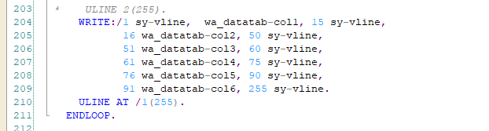
PROCESS
x
Introduction
To display the output of the program we use write and get the data from our work area data table
Requirements
Cases
Process
Insert Topic Title
11:00 AM
6/17/2023

Slide 54
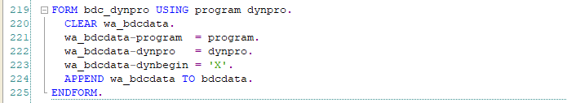
PROCESS
x
Introduction
We are using this subroutine for starting new screen
Requirements
Cases
Process
Insert Topic Title
11:00 AM
6/17/2023

Slide 55
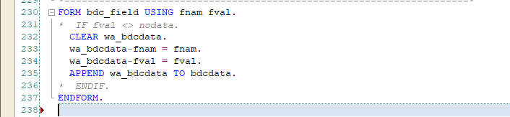
PROCESS
x
Introduction
This subroutine is used for appending a new line of data
Requirements
Cases
Process
Insert Topic Title
11:00 AM
6/17/2023

Slide 56
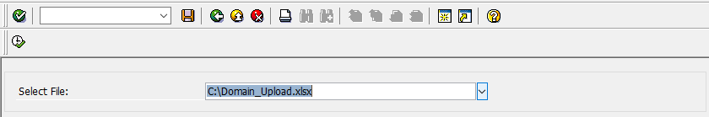
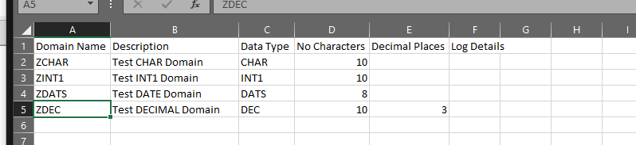
PROCESS
x
Introduction
Output:
File Selection:
Requirements
XLS File:
Cases
Process
Insert Topic Title
11:00 AM
6/17/2023

Slide 57
PROCESS
x
Introduction
Result:
Requirements
Cases
Process
Insert Topic Title
11:00 AM
6/17/2023

Slide 58
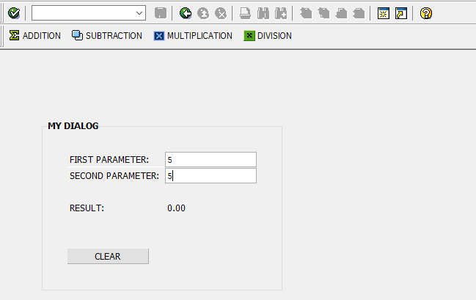
CASES
x
Introduction
CASE 1
CASE 2
CASE 3
CASE 4
Requirements
x
CASE 4
Create an ABAP program that will let you perform simple dialog programming.
Cases
Process
Insert Topic Title
11:00 AM
6/17/2023

Slide 59
Requirements
x
Introduction
Process:
Create a dialog Program
Create PF-STATUS for the ADDITION, SUBSTRACTION, MULTIPLICATION, DIVISION
Create input field for the First and Second Parameter
Create button for execute computation and clear results
Notes:
the input parameter should only contain numeric
Requirements
Cases
Process
Insert Topic Title
11:00 AM
6/17/2023

Slide 60
PROCESS
x
Introduction
creating Screen for our dialog
Requirements
Cases
Process
Insert Topic Title
11:00 AM
6/17/2023

Slide 61
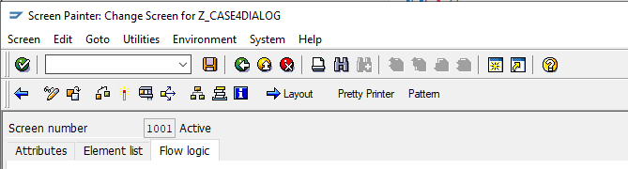
PROCESS
x
Introduction
On the screen painter, on the toolbar,
click the ‘-> Layout’
Requirements
Cases
Process
Insert Topic Title
11:00 AM
6/17/2023

Slide 62
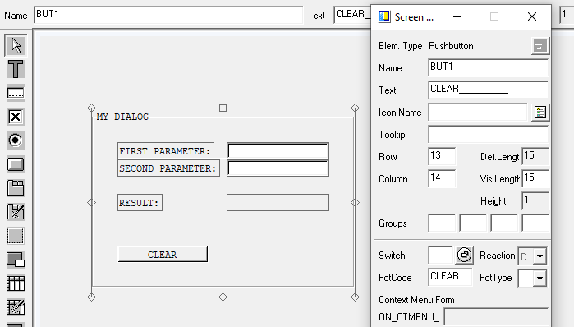
PROCESS
x
Introduction
Put the attributes and names for the button and textfields:
Requirements
Cases
Process
Insert Topic Title
11:00 AM
6/17/2023

Slide 63
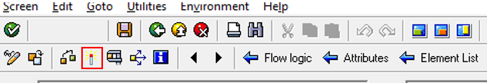
PROCESS
x
Introduction
To save click the activate icon on the toolbar:
Requirements
Cases
Process
Insert Topic Title
11:00 AM
6/17/2023

Slide 64

PROCESS
x
Introduction
Go back to the Screen Painter Main Screen, and write the PBO, and PAI for the Dialog
Requirements
Double click on the STATUS_1001 to view the module
Cases
Process
Insert Topic Title
11:00 AM
6/17/2023

Slide 65

PROCESS
x
Introduction
Requirements
declare the PF-STATUS
Cases
Double click on Z_MENU11 the pf-status we declare to go to edit the Status of Z_MENU11
Process
Insert Topic Title
11:00 AM
6/17/2023

Slide 66

PROCESS
x
Introduction
Click on the Application Toolbar [+]
Requirements
Cases
Process
Insert Topic Title
11:00 AM
6/17/2023

Slide 67

PROCESS
x
Introduction
Click on the empty field to populate the item
Requirements
Cases
Process
Insert Topic Title
11:00 AM
6/17/2023

Slide 68

PROCESS
x
Introduction
Put the appropriate attributes
Requirements
Cases
Process
Insert Topic Title
11:00 AM
6/17/2023

Slide 69

PROCESS
x
Introduction
Do the same for other STATUS
Requirements
Cases
Process
Insert Topic Title
11:00 AM
6/17/2023

Slide 70

PROCESS
x
Introduction
Back on the PBO Module, we will write the function of the PF-STATUS
Requirements
Cases
Process
Insert Topic Title
11:00 AM
6/17/2023

Slide 71

PROCESS
x
Introduction
Next is the PAI Module
Requirements
Cases
Double click on USER_COMMAND_1001 to view the module
Process
Insert Topic Title
11:00 AM
6/17/2023

Slide 72

PROCESS
x
Introduction
Write the ‘BACK’ function
Requirements
Cases
Process
Insert Topic Title
11:00 AM
6/17/2023

Slide 73

PROCESS
x
Introduction
declare the data for our parameters on our main program
Requirements
Cases
Process
Insert Topic Title
11:00 AM
6/17/2023

Slide 74
PROCESS
x
Introduction
To save click the activate icon on the toolbar:
Requirements
Cases
Process
Insert Topic Title
11:00 AM
6/17/2023

Slide 75

PROCESS
x
Introduction
Hit Check Icon
Requirements
Cases
Process
Insert Topic Title
11:00 AM
6/17/2023

Slide 76

PROCESS
x
Introduction
To execute click on execute icon on the toolbar:
Requirements
Cases
Process
Insert Topic Title
11:00 AM
6/17/2023

Slide 77
PROCESS
x
Introduction
Output:
Requirements
Cases
Process
Insert Topic Title
11:00 AM
6/17/2023

Slide 78


PROCESS
x
Introduction
ADDITION:
SUBTRACTION:
Requirements
Cases
Process
Insert Topic Title
11:00 AM
6/17/2023

Slide 79


PROCESS
x
Introduction
MULTIPLICATION:
DIVISION:
Requirements
Cases
Process
Insert Topic Title
11:00 AM
6/17/2023

Slide 80

PROCESS
x
Introduction
CLEAR:
Requirements
Cases
Process
Insert Topic Title
11:00 AM
6/17/2023

Slide 81



Introduction
Requirements
Topics
Personalize
Settings
Pictures
Shut down
Insert Topic Title
11:00 AM
8/1/2020

Slide 82
Introduction
Are you sure you want to end the presentation?
Requirements
Yes
No
Cases
Process
Insert Topic Title
11:00 AM
8/1/2020

Slide 83
THANK YOU FOR LISTENING!
Shutting down….

